Slide 1
Network security: The attacks
10A – 1.4 Network Security – Wed 1st March – Mr Woodley.

Slide 2
Malware
‘Malicious software’ – software that is damaging to a computer or network.

Slide 3
Malware
‘Malicious software’ – software that is damaging to a computer or network.
Viruses
Worms
Trojan
horses

Slide 4
Trojan
horses
Viruses
Worms
Designed to cause harm.
Attaches itself to programs or files on a computer.
Replicates itself in order to spread to other computers.
Exploits vulnerabilities in a computer network.
Does NOT need to attach to a program.
Designed to access a computer by misleading users of its intent.

Slide 5
*It’s in your exam
Why are we even learning this?
Why can’t we just use python?
(Or whatever your favorite language is)
In reality we don’t write programs in it very often*
But we need to know it:
Finding Bugs
Incredible Performance
System Software
Malware
And it will come up

Slide 6
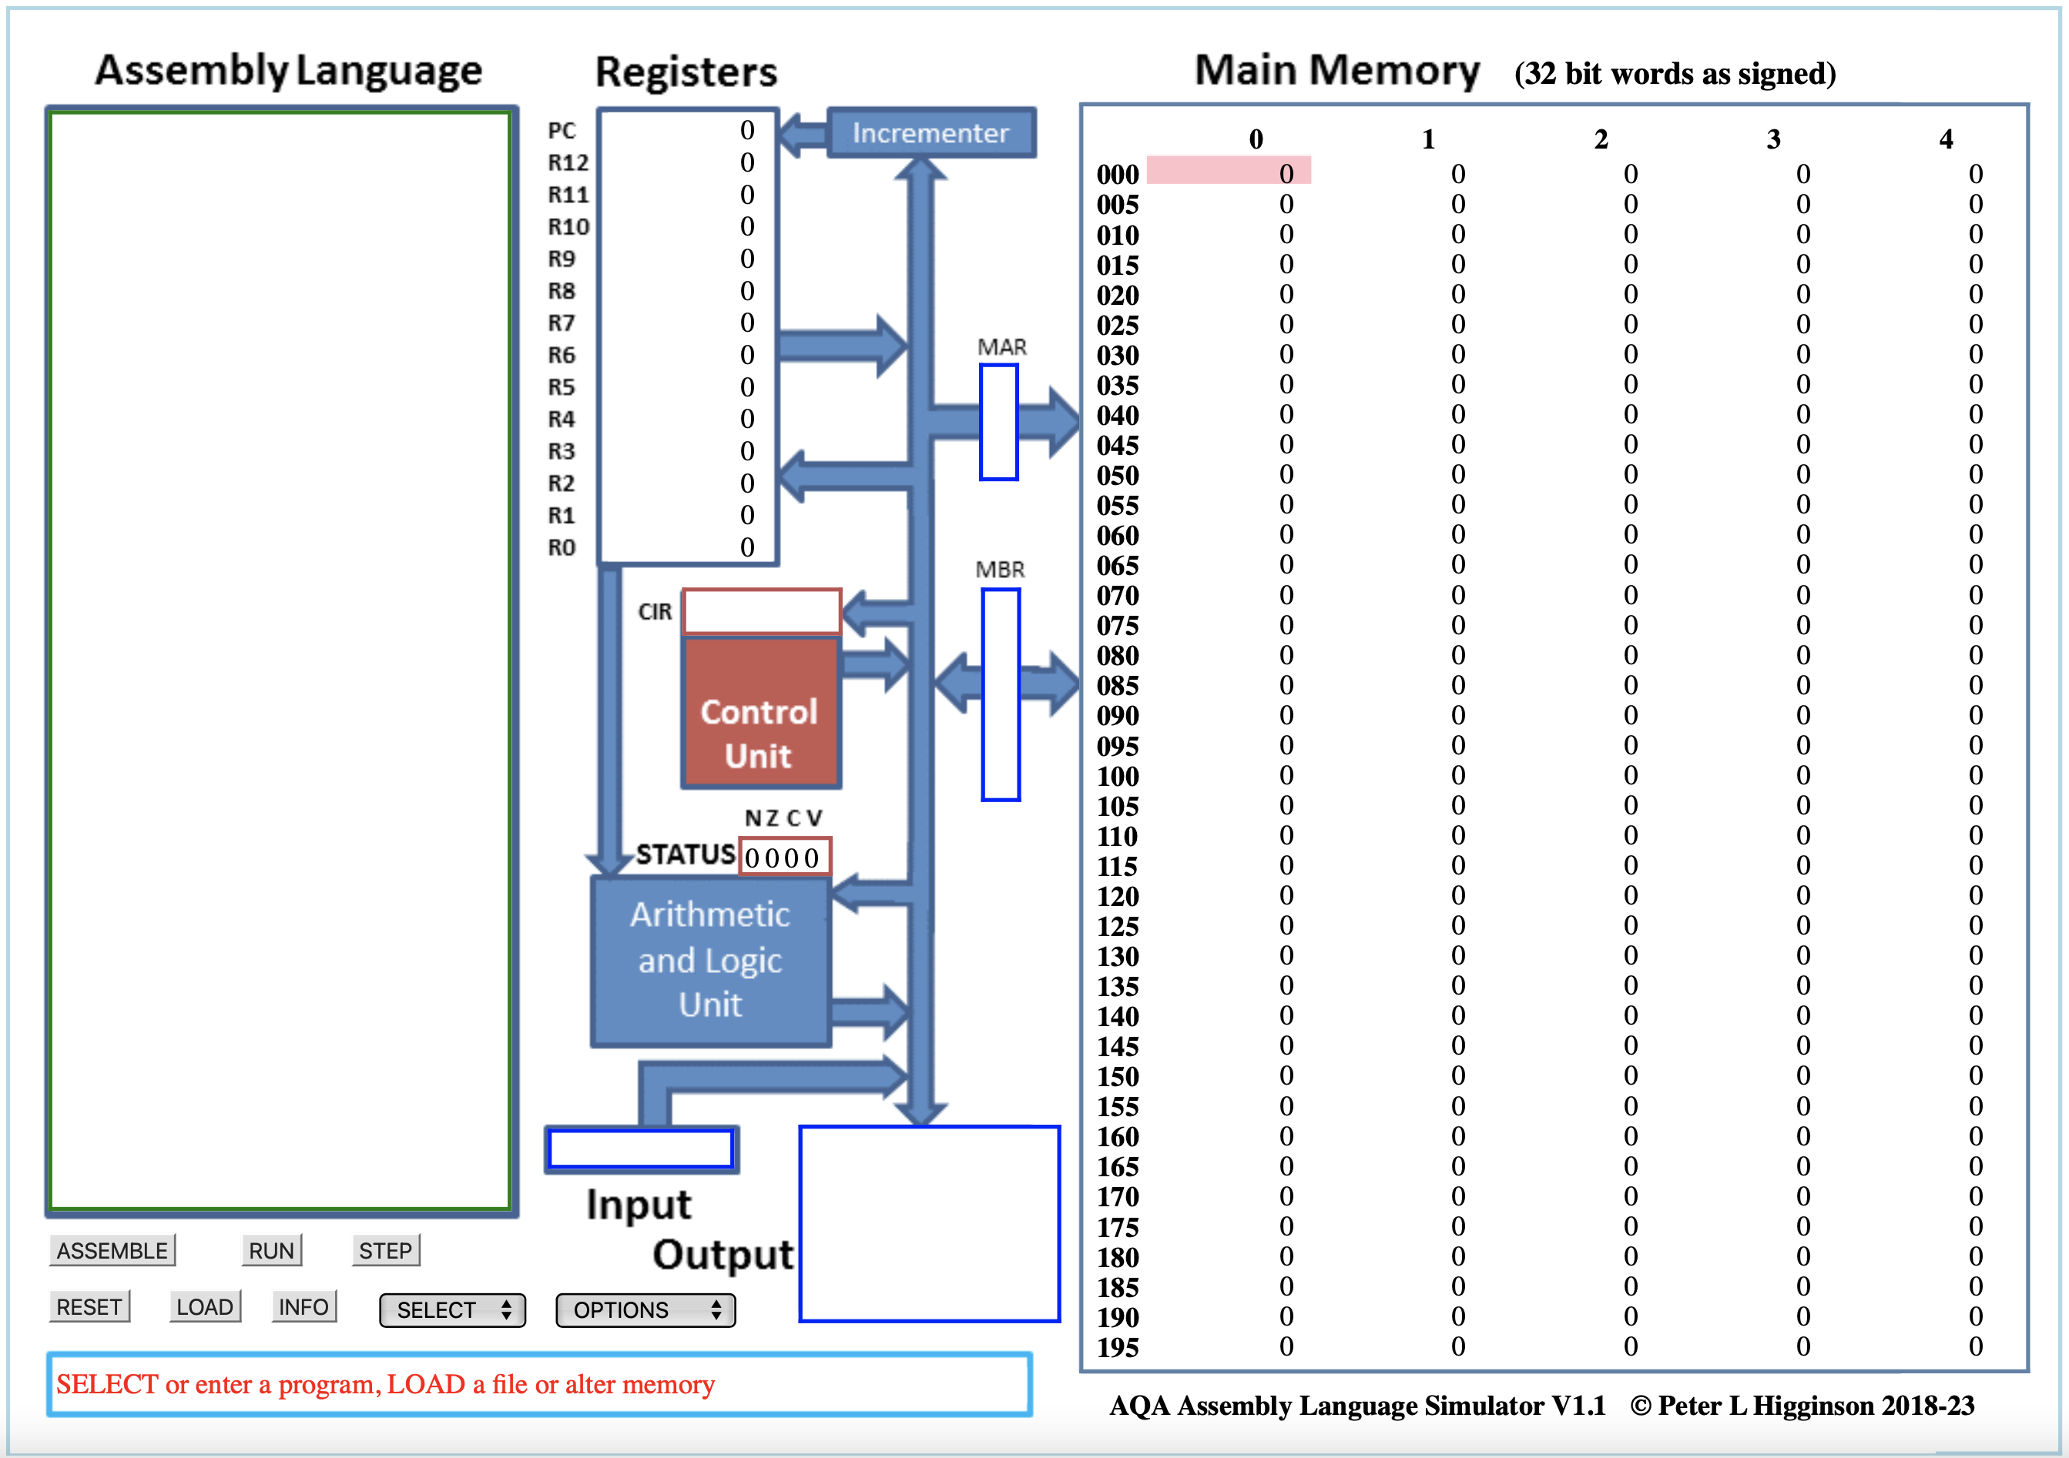

Slide 7
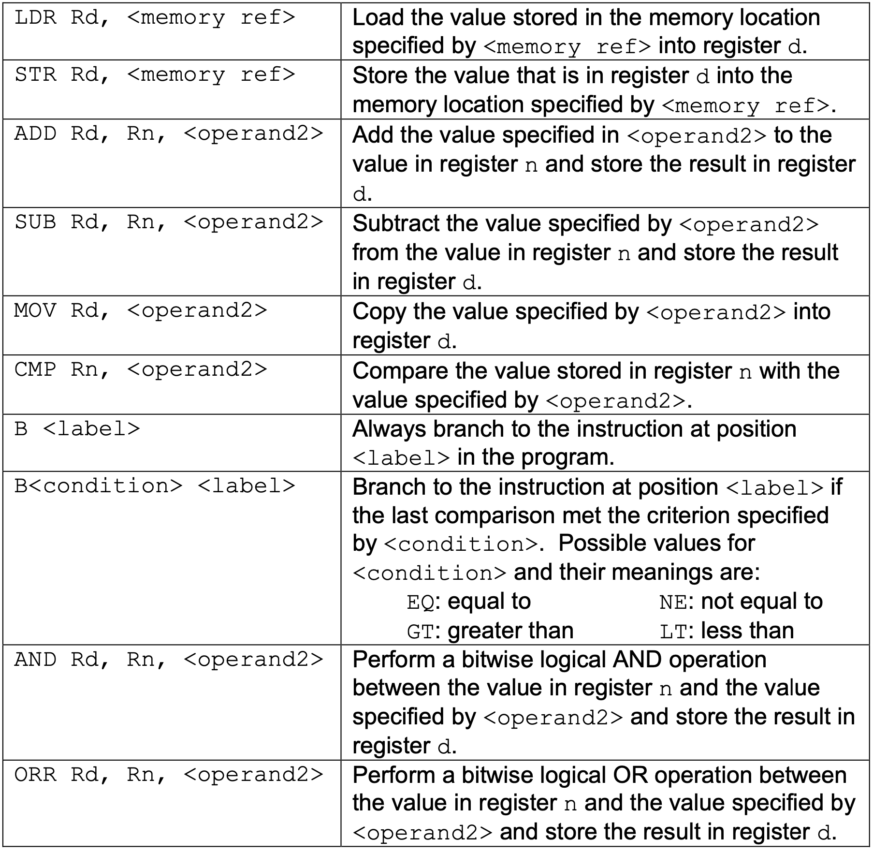
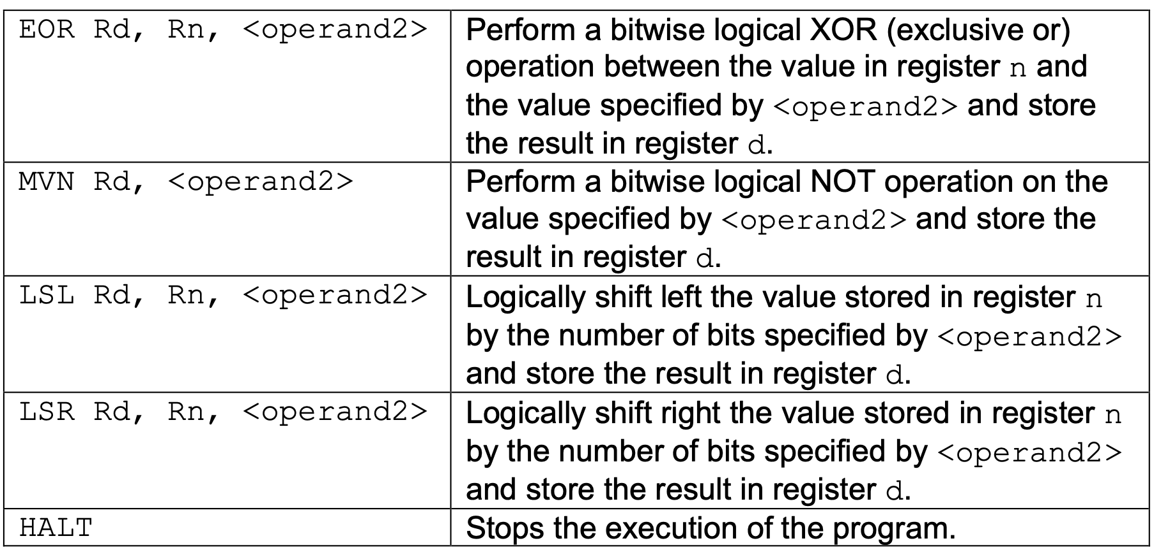
RECAP of instructions
Notes:
https://filestore.aqa.org.uk/resources/computing/AQA-75162-75172-ALI.PDF

Slide 8
If statements
If else
if ...:
#INNER CODE
# After Code
if <Condition>:
# TRUE Code
else:
# FALSE Code
# After Code
CMP ...
B<NOT Condition> label
# Inner Code
label:
# After

Slide 9
Your Turn
x = 0
if y == 7:
x = 100
else:
x = 10
Use R0 for x
Use R1 for y

Slide 10
WHILE LOOPS
while ...:
# INNER CODE
while ...:
# INNER CODE
loopStart:
CMP ...
B<NOT Condition> loopDone
# Inner Code
B loopStart
loopDone:
# After
B test
loopTop:
# Inner Code
test:
CMP …
B<Condition> loopTop
# After Code

Slide 11
Your Turn
sum = 0
while x > 1:
sum = sum + x
x = x - 1
Store the result of sum in location 42.
Assume R0 contains the value x
You may use R1 for other steps

Slide 12
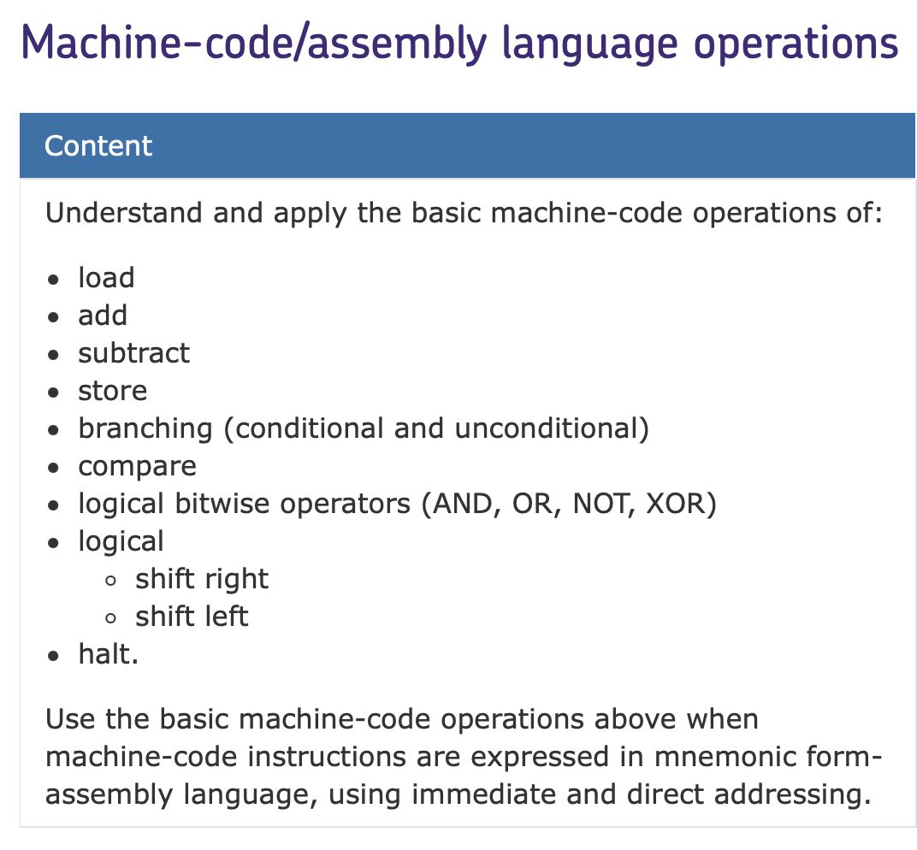
Your exam
Types of Question:
- Values in Registers + Tracing.
- Write small assembly programs.
- Operand vs Opcode.

Slide 13
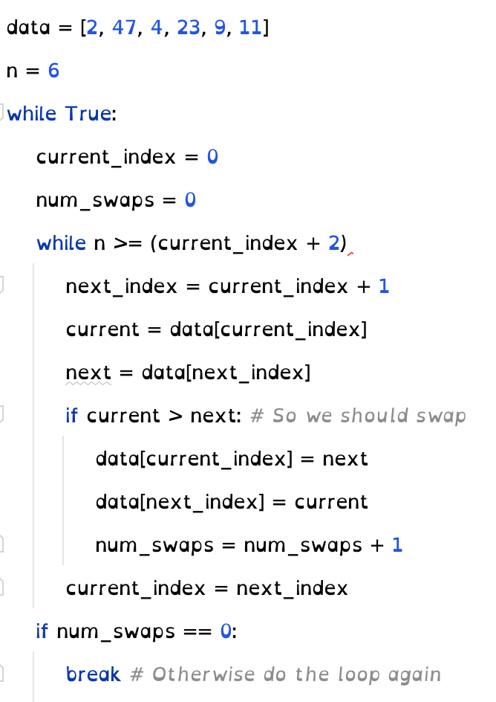
Tips for solving questions
Bubble sort
Treat each variable as a register.
Treat each register as a variable.
Draw arrows on Assembly Code.
Memorise the common If and While structure.
Think about your code in a language you’re used to.
Practice, Practice, Practice.

