Slide 1
Regular and Context Free Languages
13B – Wednesday 1st March 2023 – Mr Woodley
Notes:
10:55

Slide 2
*It’s in your exam
Why are we even learning this?
Why can’t we just use python?
(Or whatever your favorite language is)
In reality we don’t write programs in it very often*
But we need to know it:
Finding Bugs
Incredible Performance
System Software
Malware
And it will come up
Notes:
End – 11:00

Slide 3
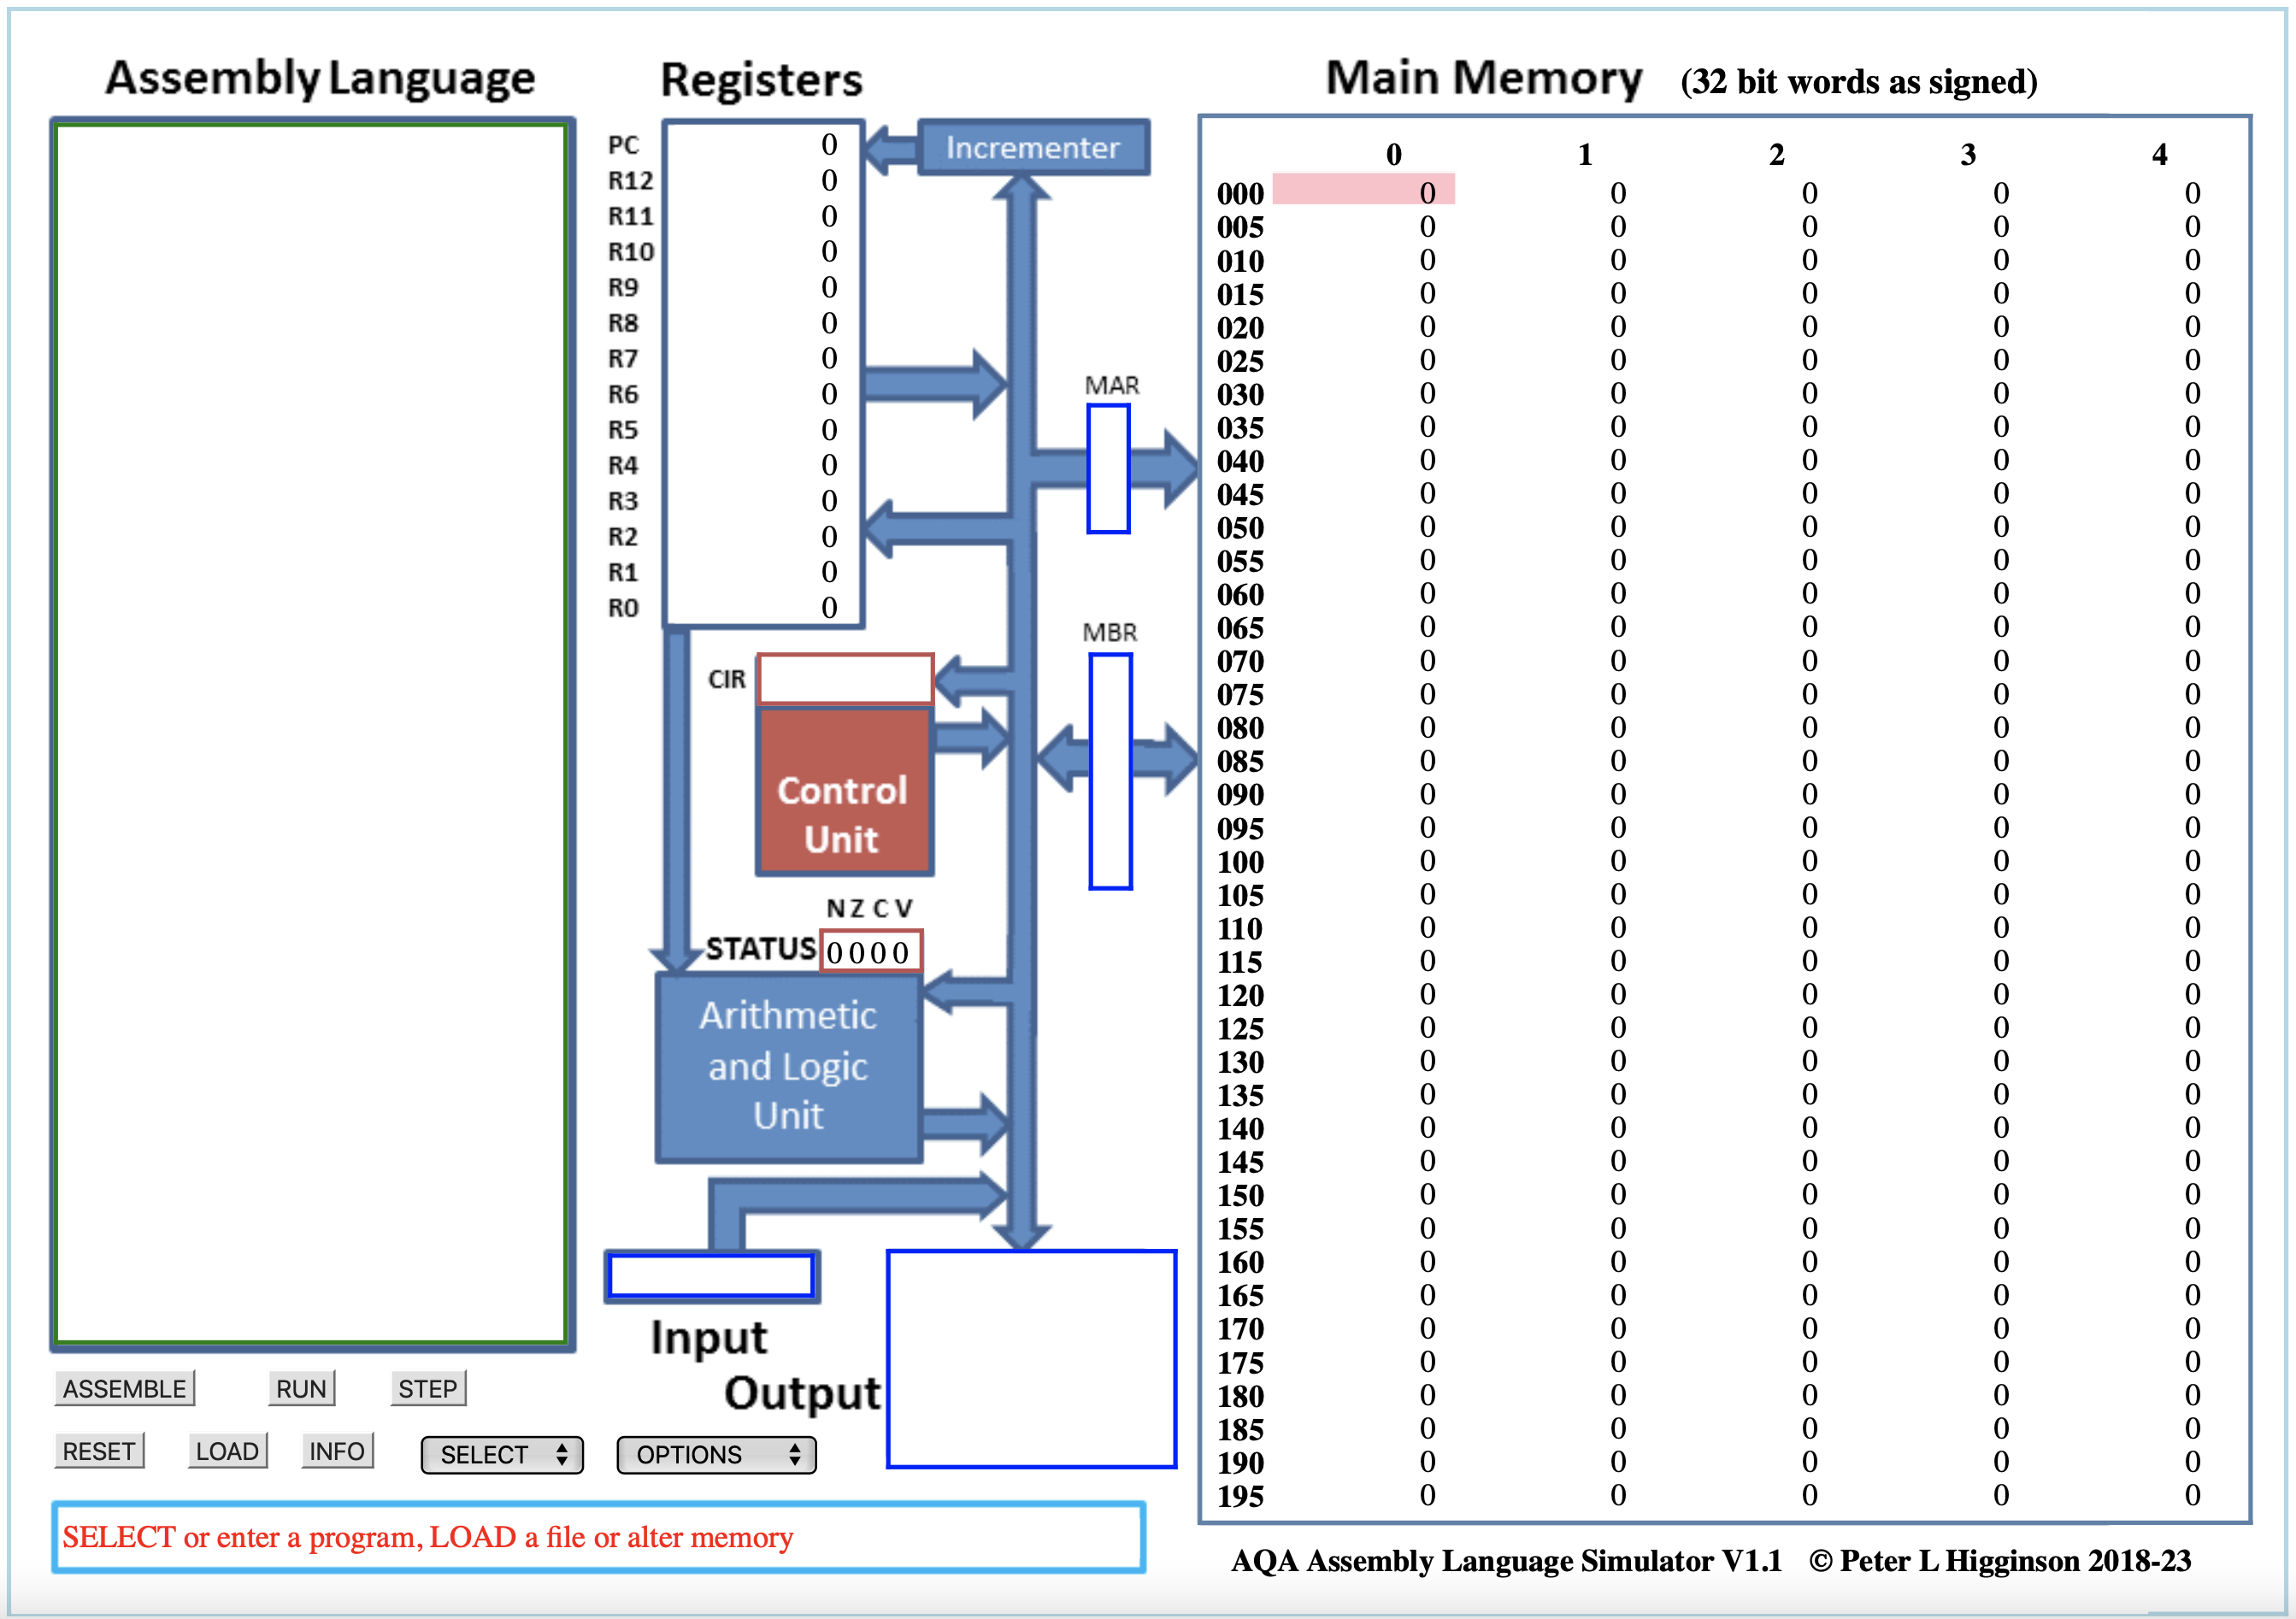
Notes:
End – 11:00

Slide 4
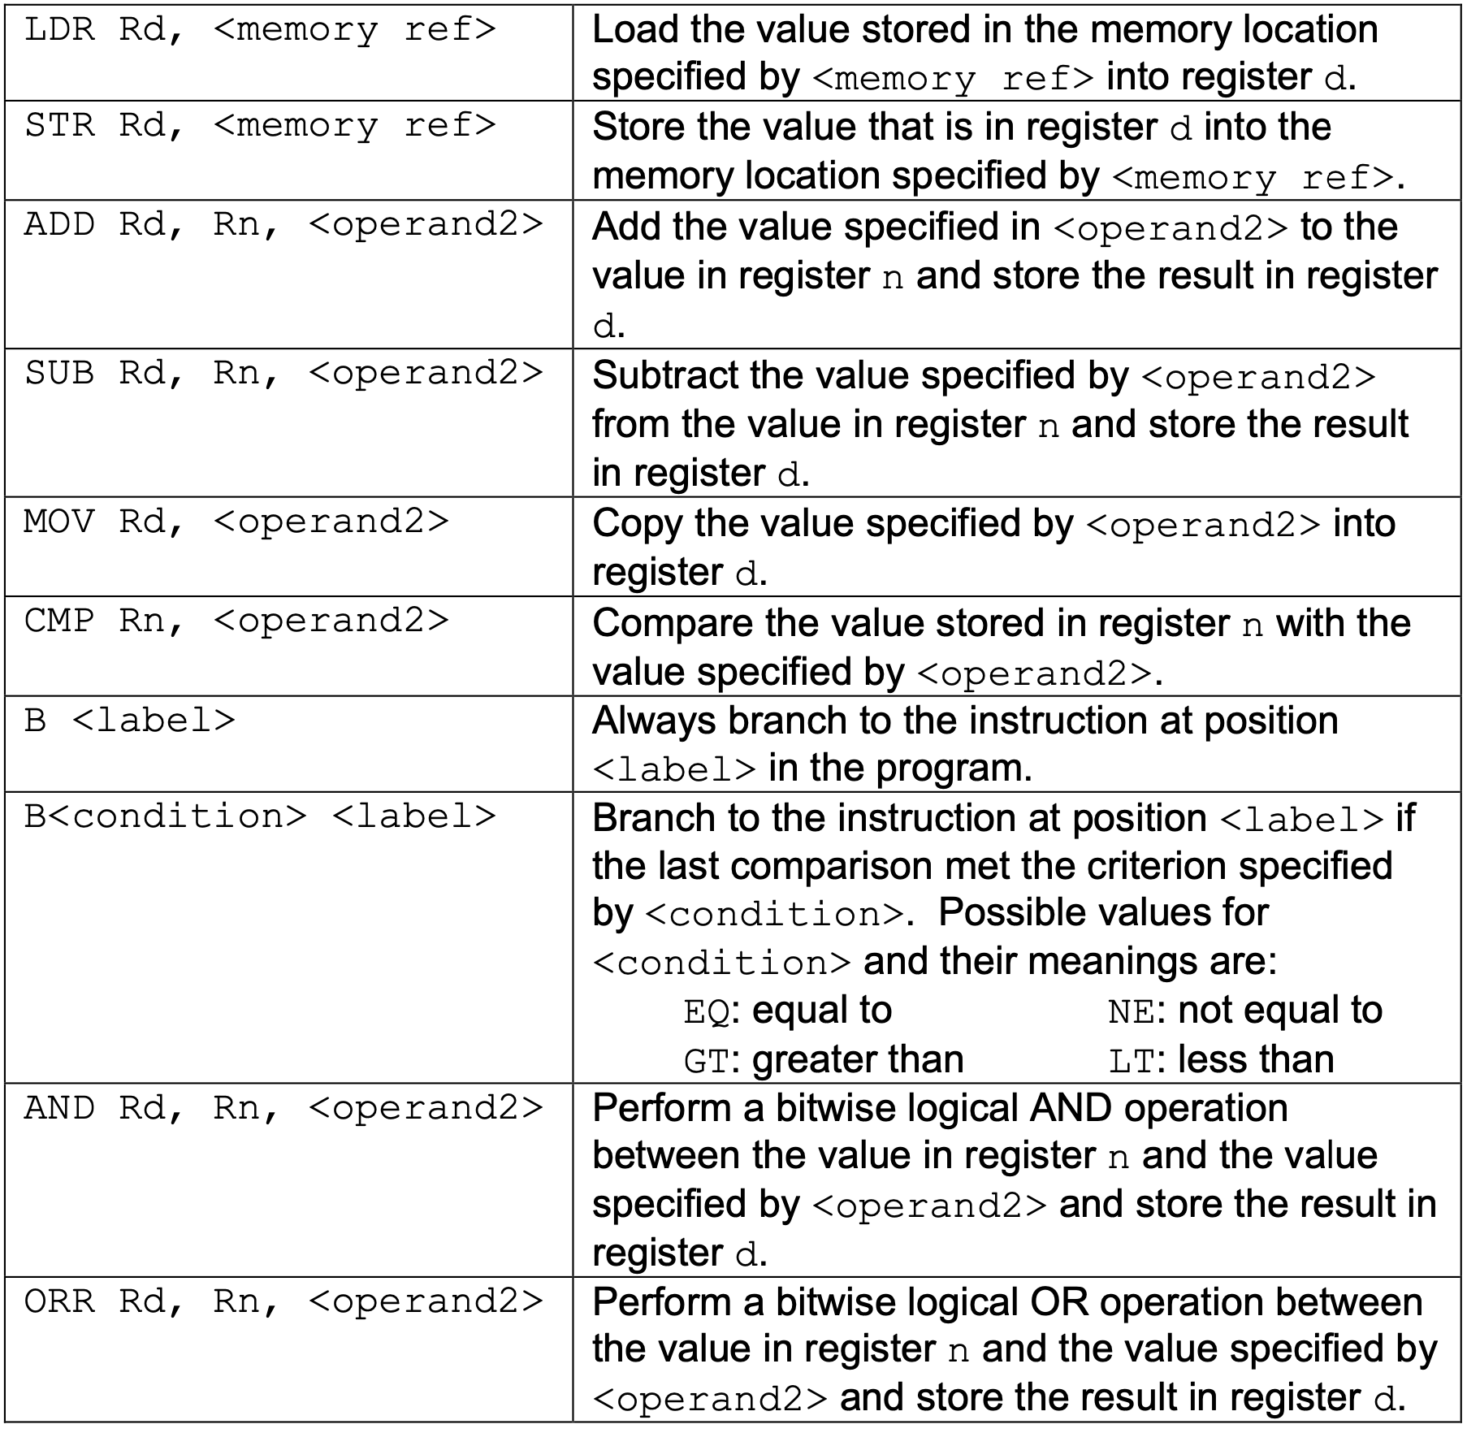
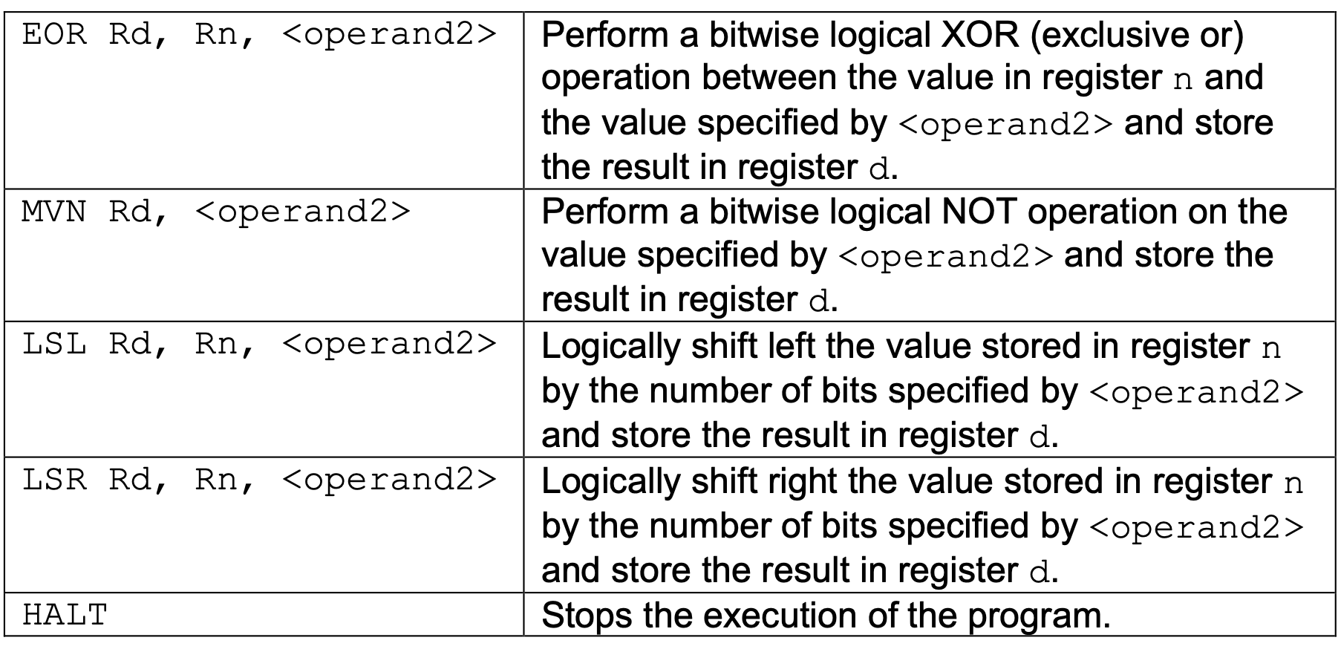
RECAP of instructions
Notes:
https://filestore.aqa.org.uk/resources/computing/AQA-75162-75172-ALI.PDF
End – 11:00

Slide 5
If statements
If else
if ...:
#INNER CODE
# After Code
if <Condition>:
# TRUE Code
else:
# FALSE Code
# After Code
CMP ...
B<NOT Condition> label
# Inner Code
label:
# After
Notes:
End - 11:05

Slide 6
Your Turn
x = 0
if y == 7:
x = 100
else:
x = 10
MOV R0, #0
CMP R1, #7
BEQ is_seven
MOV R0, #10
B after
is_seven:
MOV R0, #100
after:
HALT
Use R0 for x
Use R1 for y
Notes:
End – 11:10

Slide 7
WHILE LOOPS
while ...:
# INNER CODE
while ...:
# INNER CODE
loopStart:
CMP ...
B<NOT Condition> loopDone
# Inner Code
B loopStart
loopDone:
# After
B test
loopTop:
# Inner Code
test:
CMP …
B<Condition> loopTop
# After Code
Notes:
2 Types of While
End – 11:15

Slide 8
Your Turn
sum = 0
while x > 1:
sum = sum + x
x = x - 1
MOV R1, #0
B test
loop_top:
ADD R1, R1, R0
SUB R1, R1, #1
test:
CMP R1, #1
BLT loopTop
HALT
Store the result of sum in location 42.
Assume R0 contains the value x
You may use R1 for other steps
Notes:
End – 11:20

Slide 9
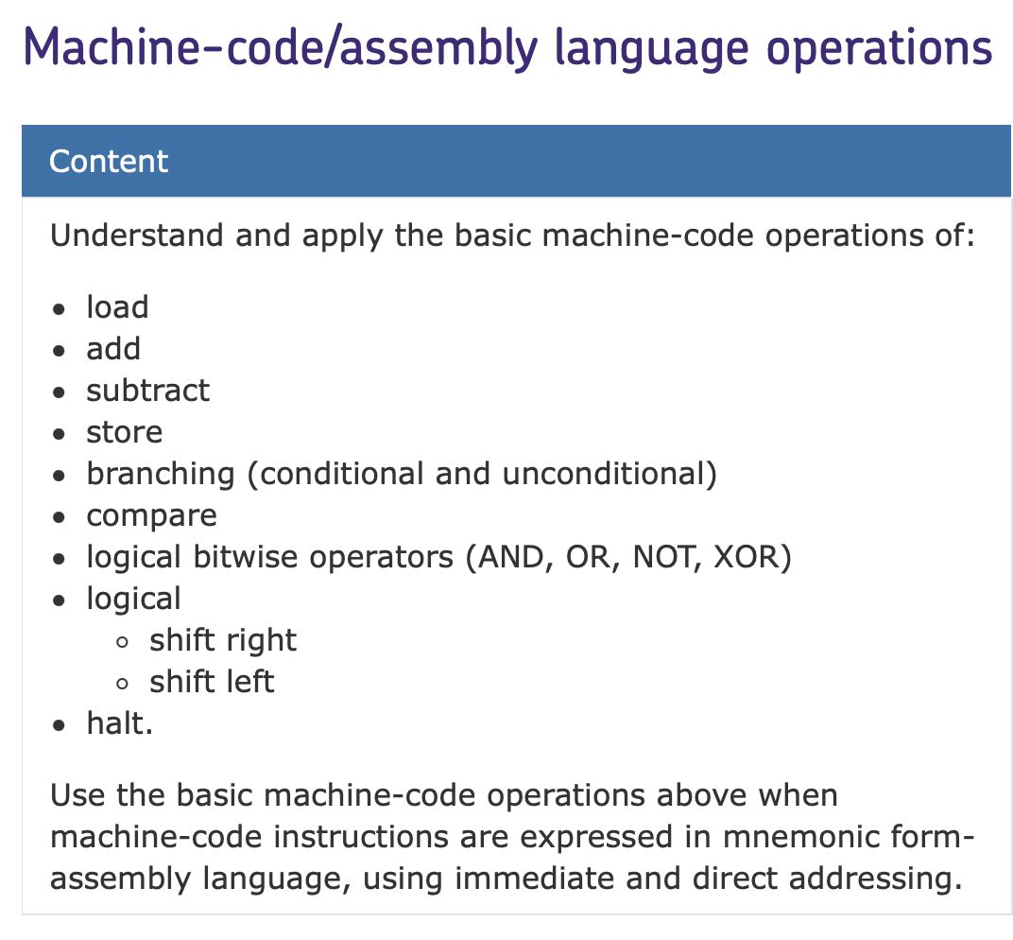
Your exam
Types of Question:
- Values in Registers + Tracing.
- Write small assembly programs.
- Operand vs Opcode.
Notes:
End – 11:25

Slide 10
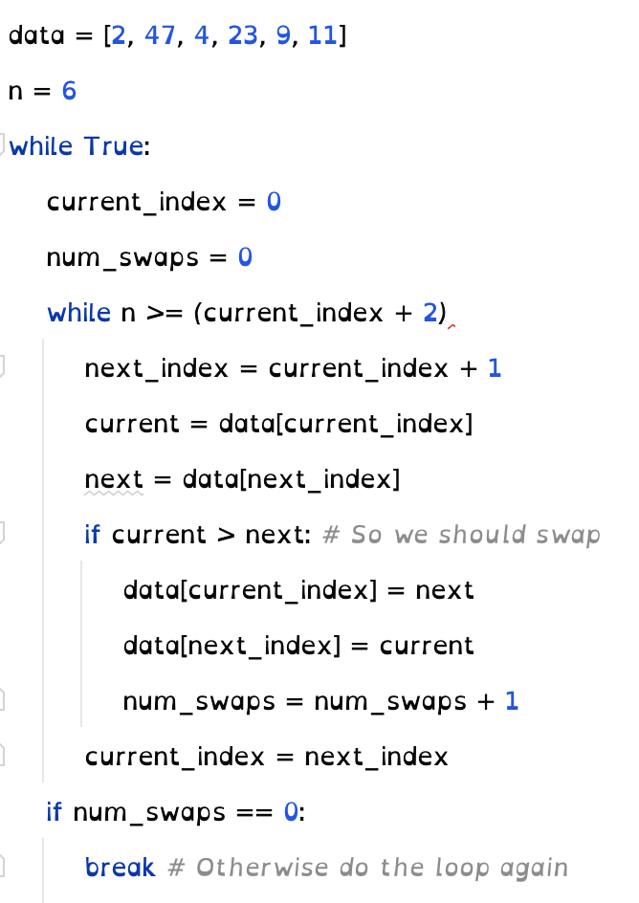
Tips for solving questions
Bubble sort
Treat each variable as a register.
Treat each register as a variable.
Draw arrows on Assembly Code.
Memorise the common If and While structure.
Think about your code in a language you’re used to.
Practice, Practice, Practice.
Notes:
End: 11:45

