Slide 1
Network security: The attacks
10A – 1.4 Network Security – Wed 1st March – Mr Woodley.

Slide 2
Malware
‘Malicious software’ – software that is damaging to a computer or network.

Slide 3
Malware
‘Malicious software’ – software that is damaging to a computer or network.
Viruses
Worms
Trojan
horses

Slide 4
Trojan
horses
Viruses
Worms
Designed to cause harm.
Attaches itself to programs or files on a computer.
Replicates itself in order to spread to other computers.
Exploits vulnerabilities in a computer network.
Does NOT need to attach to a program.
Designed to access a computer by misleading users of its intent.

Slide 5
Social engineering
“Humans are the weakest point in a system”
Gaining information to networks by influencing people.
phishing
Telephone (IVR) phishing
Commonly through email
Designed to convince people to hand over confidential information e.g. usernames, passwords, card details.
Usually sent to thousands of people.
Someone rings up pretending to be someone else to convince you to give away secrets.
E.g. Network Administrator, Manager

Slide 6
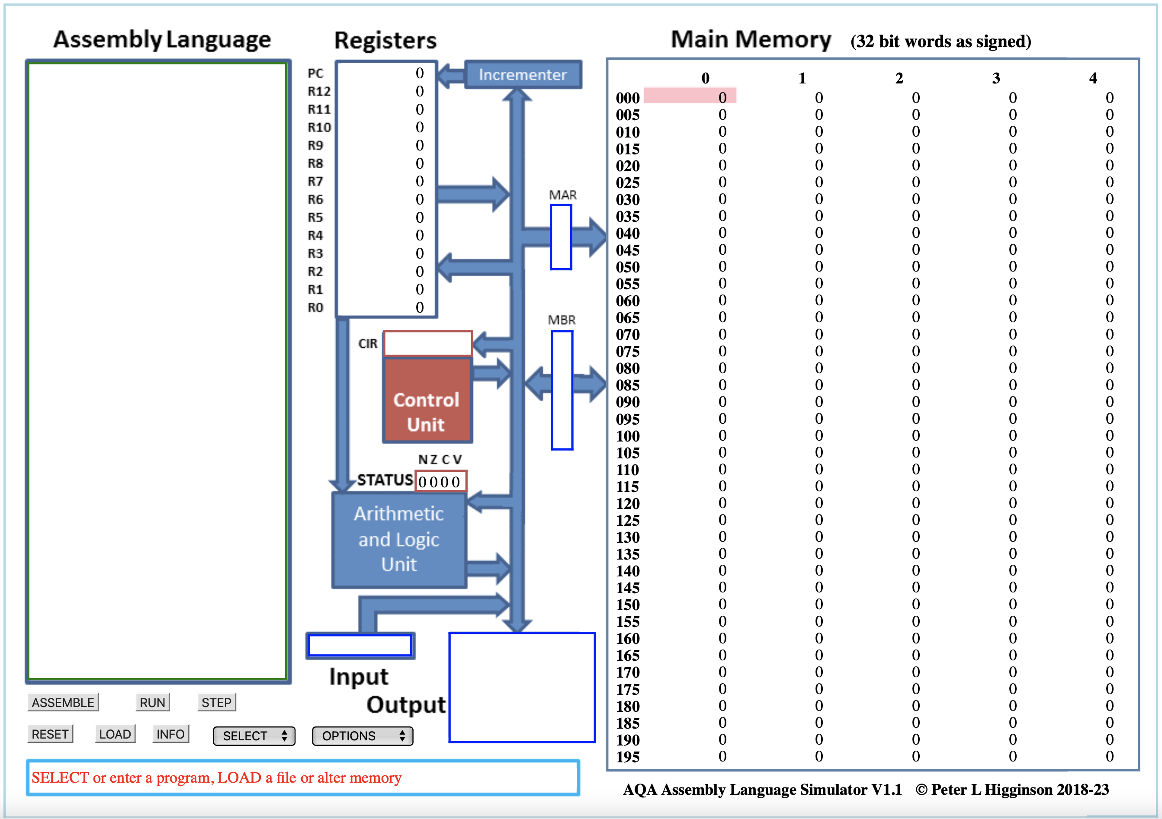

Slide 7
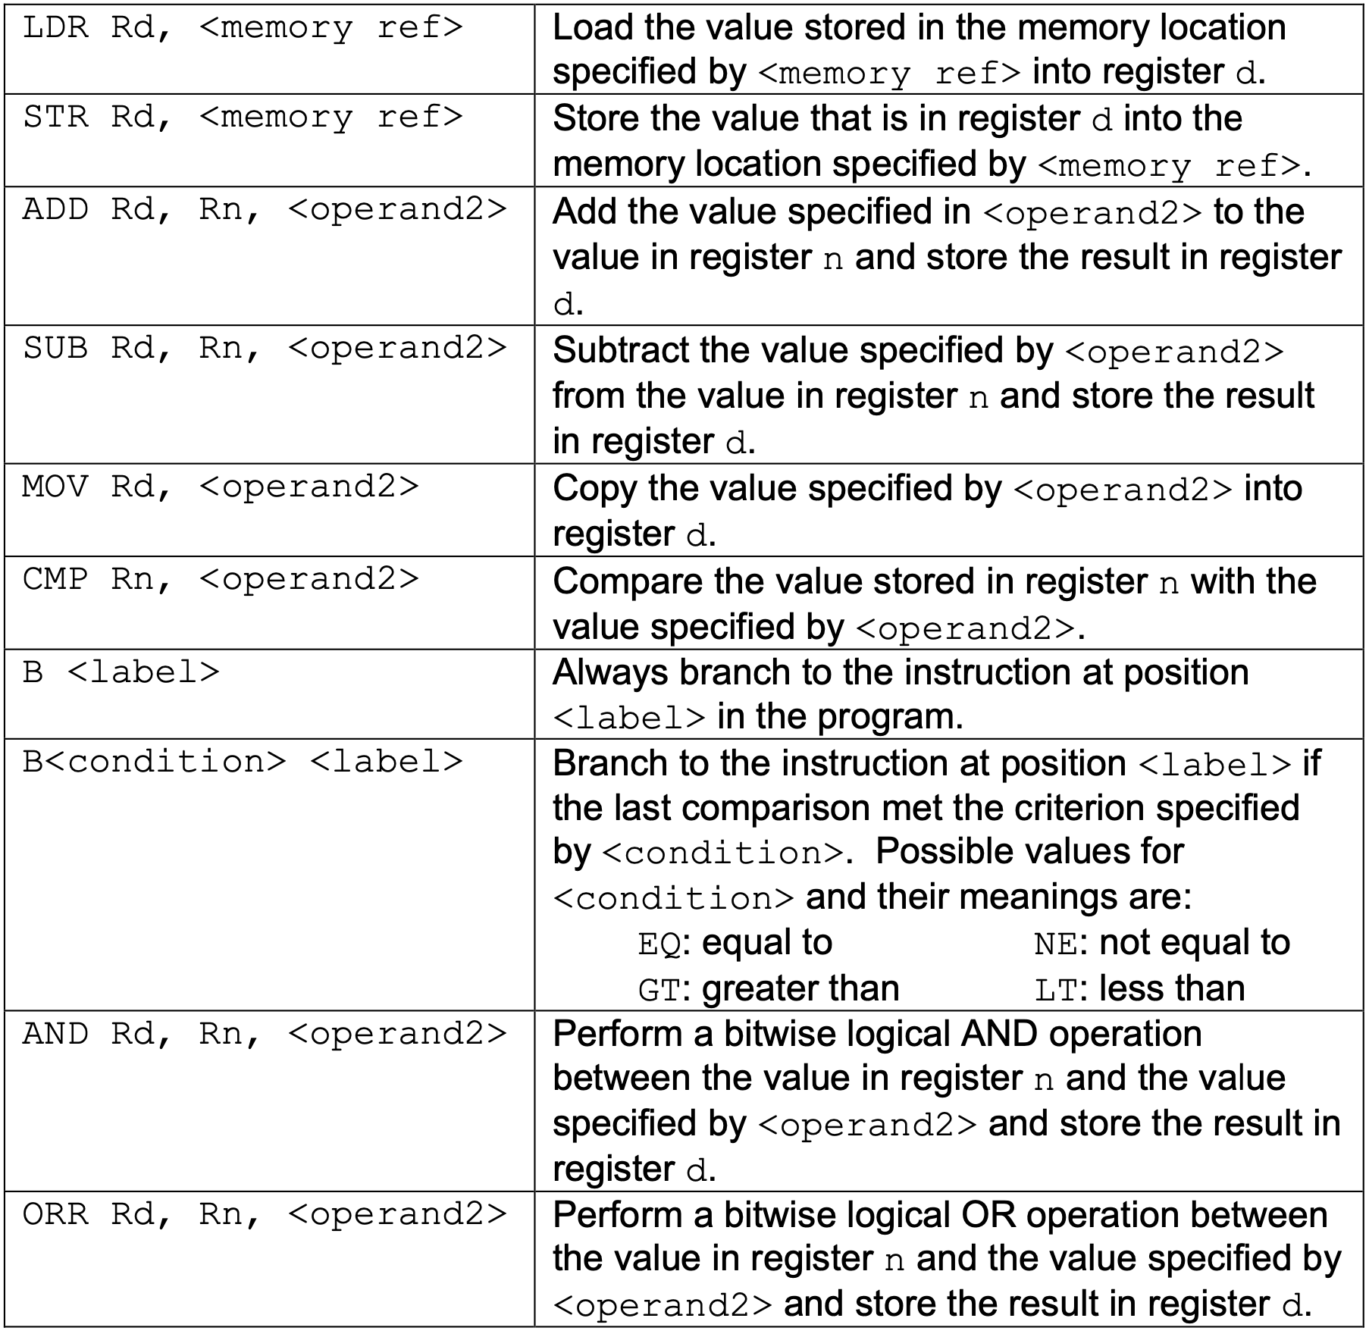
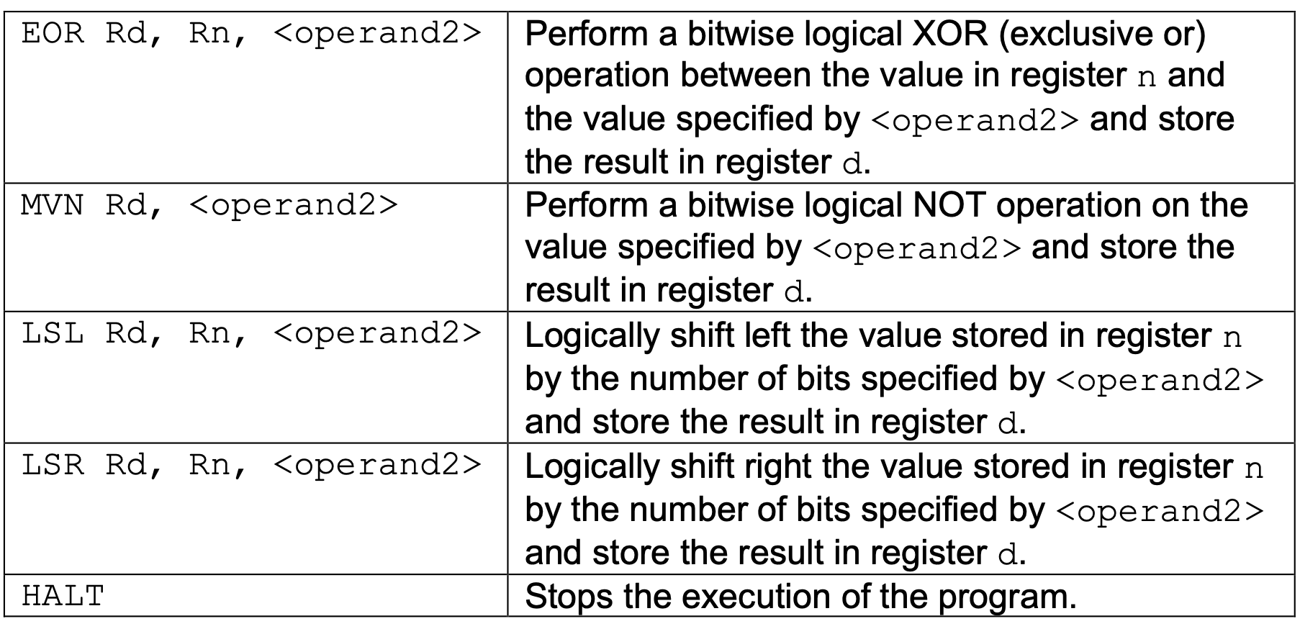
RECAP of instructions
Notes:
https://filestore.aqa.org.uk/resources/computing/AQA-75162-75172-ALI.PDF

Slide 8
If statements
If else
if ...:
#INNER CODE
# After Code
if <Condition>:
# TRUE Code
else:
# FALSE Code
# After Code
CMP ...
B<NOT Condition> label
# Inner Code
label:
# After

Slide 9
Your Turn
x = 0
if y == 7:
x = 100
else:
x = 10
Use R0 for x
Use R1 for y

Slide 10
WHILE LOOPS
while ...:
# INNER CODE
while ...:
# INNER CODE
loopStart:
CMP ...
B<NOT Condition> loopDone
# Inner Code
B loopStart
loopDone:
# After
B test
loopTop:
# Inner Code
test:
CMP …
B<Condition> loopTop
# After Code

Slide 11
Your Turn
sum = 0
while x > 1:
sum = sum + x
x = x - 1
Store the result of sum in location 42.
Assume R0 contains the value x
You may use R1 for other steps

Slide 12
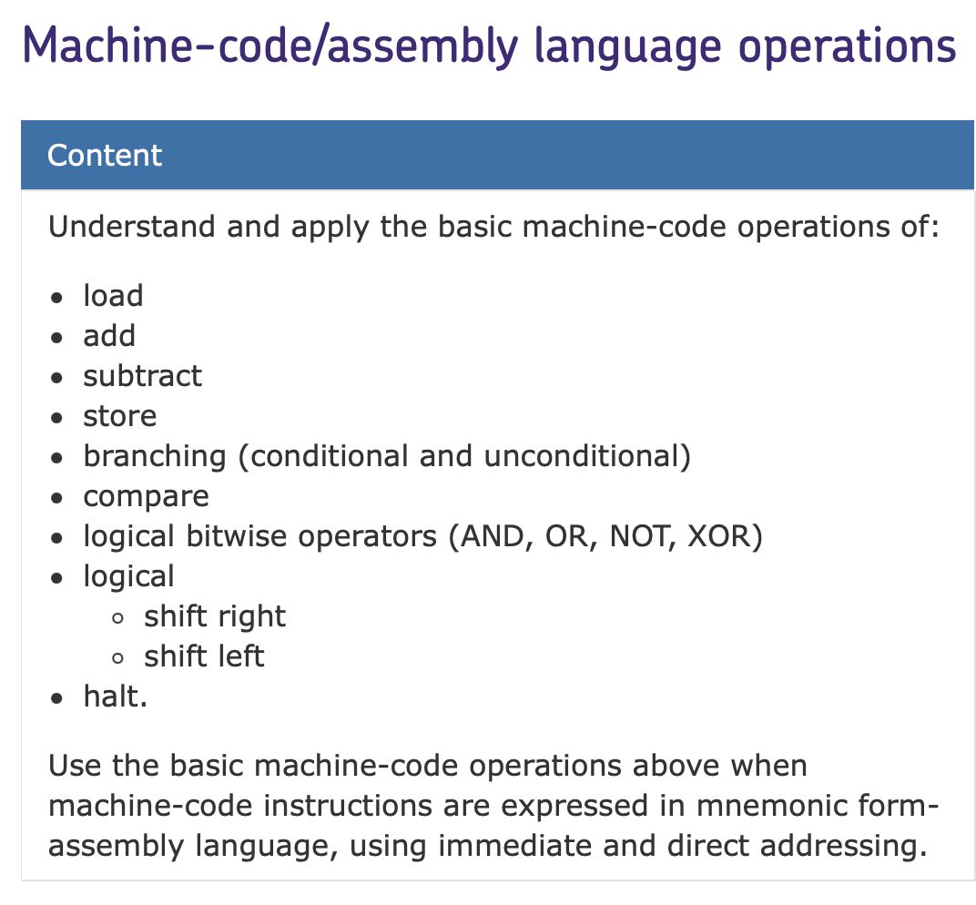
Your exam
Types of Question:
- Values in Registers + Tracing.
- Write small assembly programs.
- Operand vs Opcode.

Slide 13
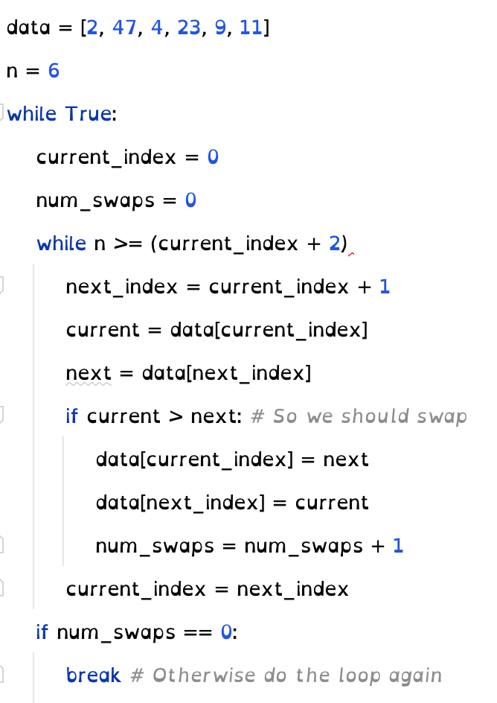
Tips for solving questions
Bubble sort
Treat each variable as a register.
Treat each register as a variable.
Draw arrows on Assembly Code.
Memorise the common If and While structure.
Think about your code in a language you’re used to.
Practice, Practice, Practice.

