Slide 1
Regular Expressions and Context Free Languages
13B – Wednesday 1st March 2023 – Mr Woodley
Notes:
10:55

Slide 2

Set comprehension
The name of the set
Such that
Natural Numbers
Conditions on the set
$$A=\left\{ x \right| x ε ℕ ∧x>10\}$$
From
And
Items to be added
Notes:
End – 11:25

Slide 3
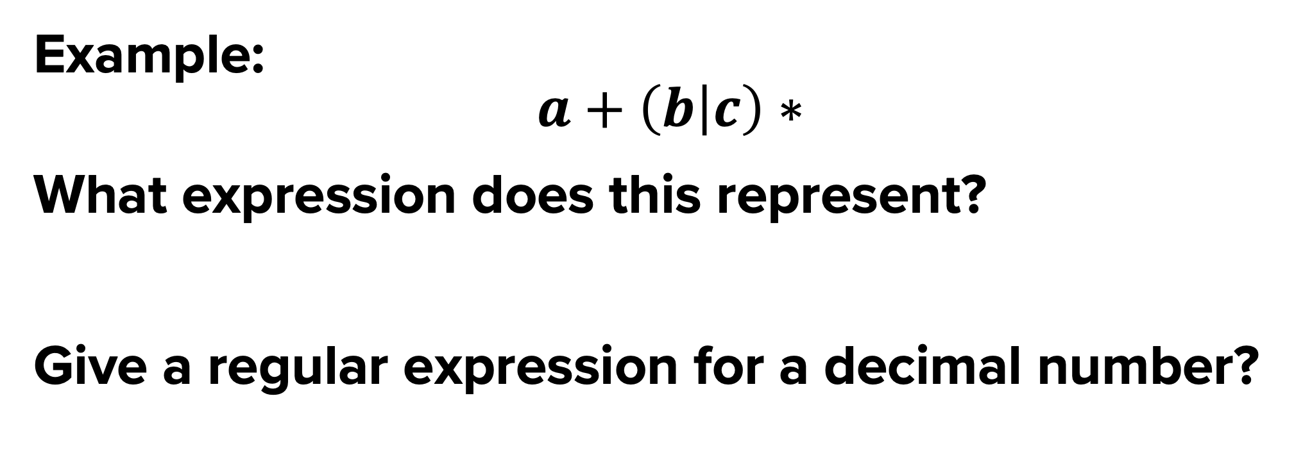




Example:
$$a+\left(b | c\right)∗$$
What expression does this represent?
Give a regular expression for a decimal number?
What is a regular expression?
A way of describing a set.
A shorthand form for a specific type of languages.
$$\left[0−9\right]$$
$$+$$
$$.$$
$$\left[0−9\right]+$$
* = Zero or more
+ = One or more
? = Optional
| = OR
() = Group
Notes:
End – 11:00

Slide 4
REGULAR EXPRESSIONS TO FSM
Single Letter e.g. a
Repeated Letter e.g. a*
a
S0
S0
S1
a
Two Letters e.g. ab
Repeated Letter e.g. a+
a
b
a
S0
S1
S3
S4
S0
S0
a
Choice e.g. a|b
b
Optional Letter e.g. a?b
a
b
S0
S1
S0
S1
S0
S3
S4
a
b
Notes:
End - 11:05

Slide 5
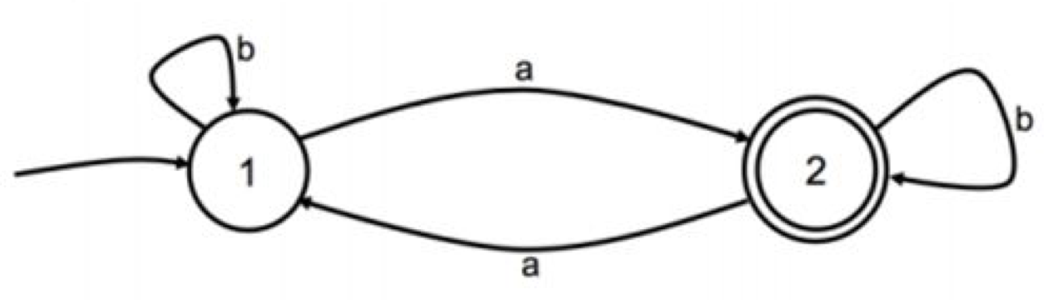
Your Turn
Write a Regular Expression for a string that:
- Starts with 10
- Has zero or more occurrences of any combination of 0 or 1 in the middle
- Ends with 01
10 (0|1)* 01
Notes:
End – 11:20

Slide 6
Example:
$$a+\left(b | c\right)∗$$
What expression does this represent?
Give a regular expression for a decimal number?
Context free languages
A way of describing a set.
A shorthand form for a specific type of languages.
$$\left[0−9\right]$$
$$+$$
$$.$$
$$\left[0−9\right]+$$
* = Zero or more
+ = One or more
? = Optional
| = OR
() = Group
Notes:
End – 11:00

Slide 7
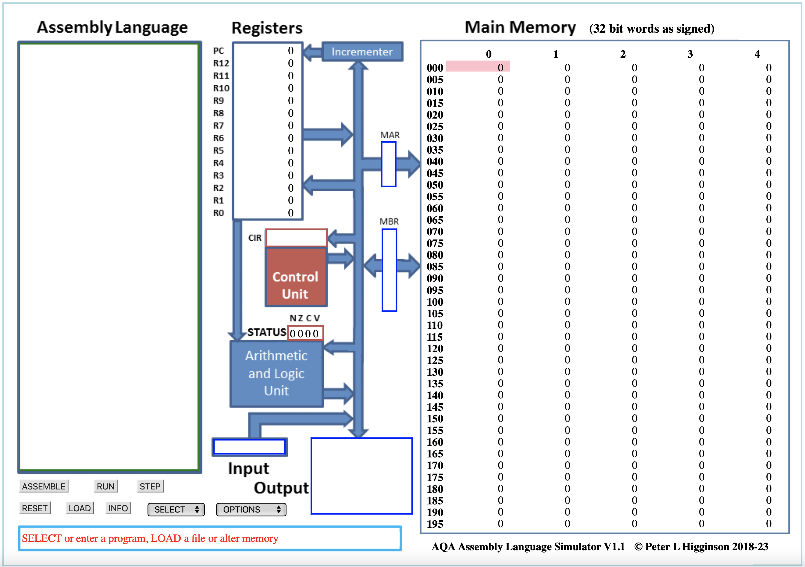
Notes:
End – 11:00

Slide 8
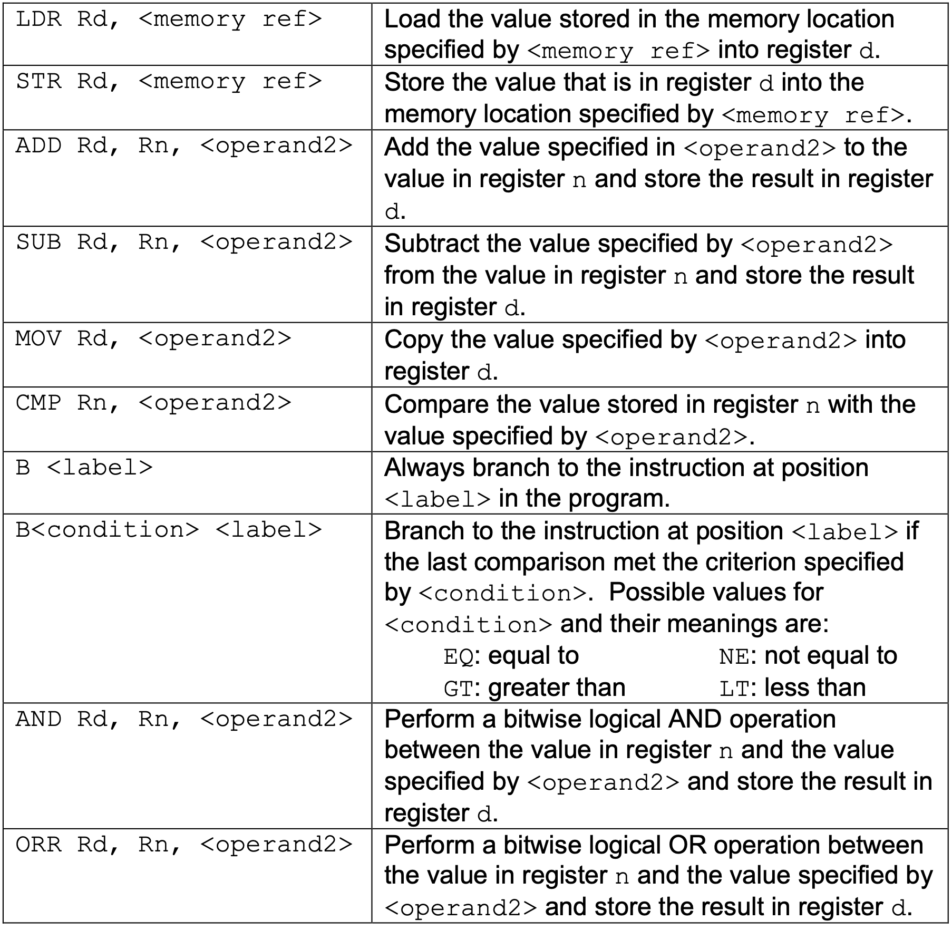
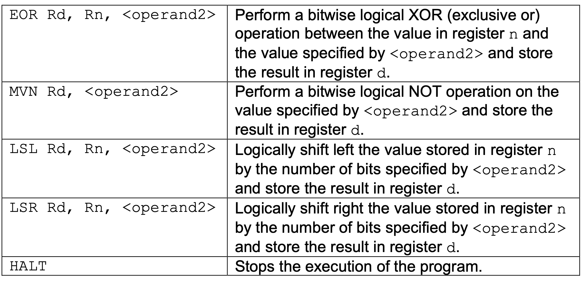
RECAP of instructions
Notes:
https://filestore.aqa.org.uk/resources/computing/AQA-75162-75172-ALI.PDF
End – 11:00

Slide 9
If statements
If else
if ...:
#INNER CODE
# After Code
if <Condition>:
# TRUE Code
else:
# FALSE Code
# After Code
CMP ...
B<NOT Condition> label
# Inner Code
label:
# After
Notes:
End - 11:05

Slide 10
Your Turn
x = 0
if y == 7:
x = 100
else:
x = 10
MOV R0, #0
CMP R1, #7
BEQ is_seven
MOV R0, #10
B after
is_seven:
MOV R0, #100
after:
HALT
Use R0 for x
Use R1 for y
Notes:
End – 11:10

Slide 11
WHILE LOOPS
while ...:
# INNER CODE
while ...:
# INNER CODE
loopStart:
CMP ...
B<NOT Condition> loopDone
# Inner Code
B loopStart
loopDone:
# After
B test
loopTop:
# Inner Code
test:
CMP …
B<Condition> loopTop
# After Code
Notes:
2 Types of While
End – 11:15

Slide 12
Your Turn
sum = 0
while x > 1:
sum = sum + x
x = x - 1
MOV R1, #0
B test
loop_top:
ADD R1, R1, R0
SUB R1, R1, #1
test:
CMP R1, #1
BLT loopTop
HALT
Store the result of sum in location 42.
Assume R0 contains the value x
You may use R1 for other steps
Notes:
End – 11:20

Slide 13
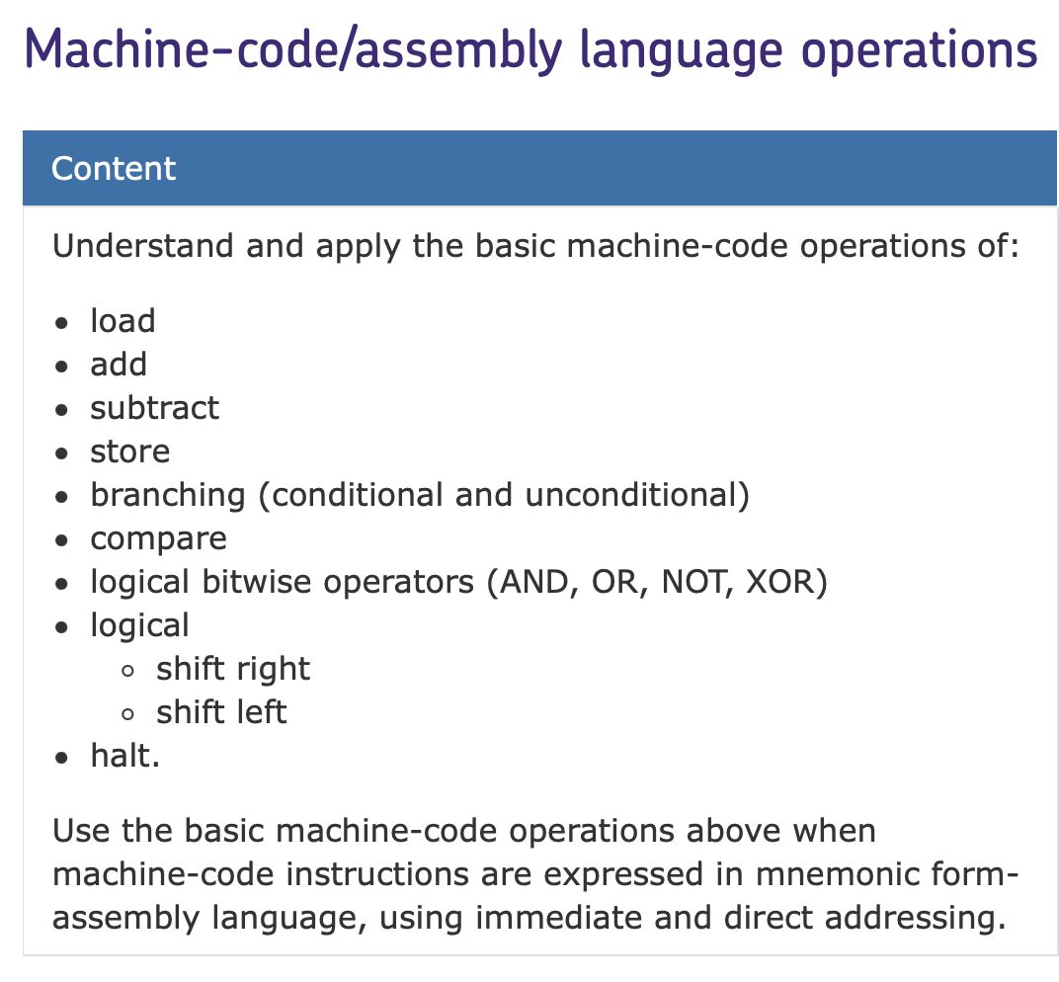
Your exam
Types of Question:
- Values in Registers + Tracing.
- Write small assembly programs.
- Operand vs Opcode.
Notes:
End – 11:25

Slide 14
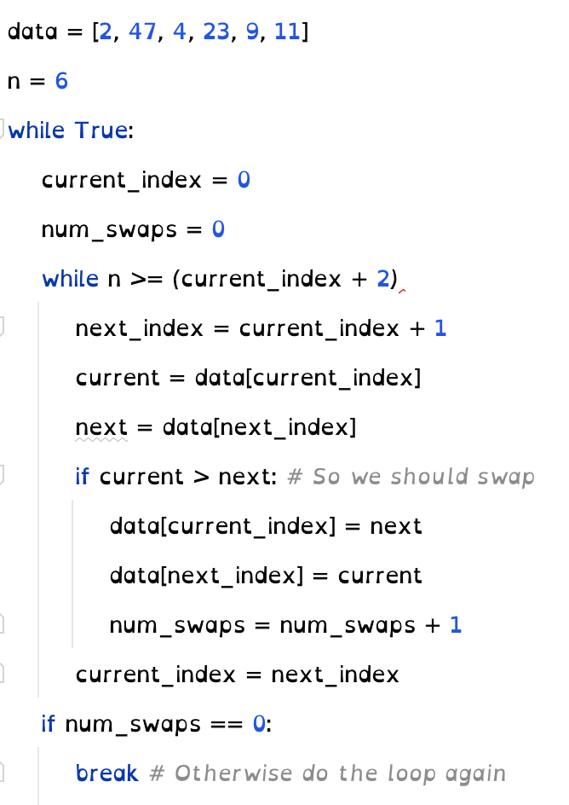
Tips for solving questions
Bubble sort
Treat each variable as a register.
Treat each register as a variable.
Draw arrows on Assembly Code.
Memorise the common If and While structure.
Think about your code in a language you’re used to.
Practice, Practice, Practice.
Notes:
End: 11:45

