Slide 1
Network security: Lesson 3
10A – 1.4 Network Security – Wed 15th March – Mr Woodley.

Slide 2





encryption
Data is translated into code.
Users need the Key in order to decrypt the coded data.

Slide 3

Movie recommendation:
The imitation game
Based on cracking the enigma code

Slide 4
Physical security
Physical security is used to prevent physical access to devices and to prevent theft.
Your turn: physical security features
Menti.com

Slide 5
Penetration testing
Searches for current vulnerabilities in order to expose weaknesses in the system so they cannot be maliciously exploited.
Trying to break in in order to find issues.

Slide 6
Your turn: white hat hacker
Grey hat hacker
Black hat hacker

Slide 7
hackers
White Hat Hacker - Have permission. Authorized to act as a Penetration Tester.
Grey Hat Hacker – Doesn’t usually have permission. But will inform the organization of any vulnerabilities. They will sometimes break the law but they’re not malicious.
Black Hat Hacker – Someone without permission and who has malicious intent. This is who we try and stop as Penetration Testers.

Slide 8

Sql injection
Companies often store their data in a database.
SQL Injection – An attacker can execute malicious SQL statements.

Slide 9
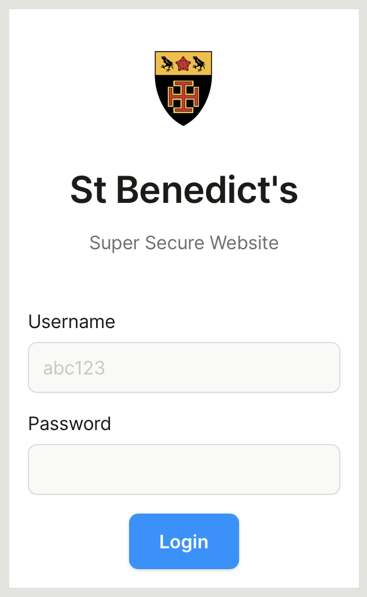
Sql injection
Bypass Authentication
Steal Data
Alter Data
Delete Data

Slide 10

Sql injection
SELECT *
FROM Users
WHERE Username = ‘ ’
AND Password = ‘ ‘

Slide 11

Sql injection
SELECT *
FROM Users
WHERE Username = ‘ ’
AND Password = ‘ ‘

Slide 12

Sql injection
SELECT *
FROM Users
WHERE Username = ‘ ’
AND Password = ‘ ‘

Slide 13
Sql injection
Information that a user has entered that is going to be run directly to get information from a database.
It could be malicious.
Any field that meets that criteria could be vunerable:
Search Fields
Login Fields

Slide 14
Your turn: sql injection
(and more)

