Slide 1
Regular Expressions and Context Free Languages
13B – Wednesday 1st March 2023 – Mr Woodley
Notes:
10:55

Slide 2
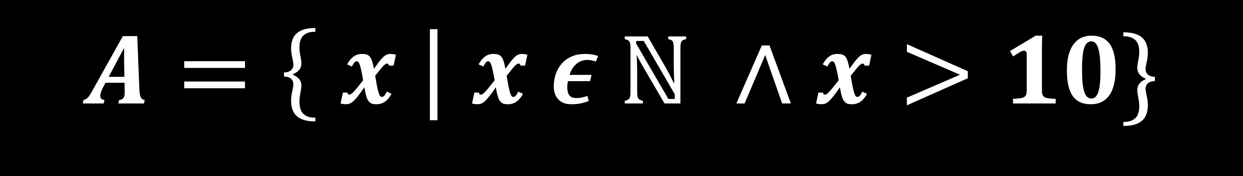
Set comprehension
The name of the set
Such that
Natural Numbers
Conditions on the set
$$A=\left\{ x \right| x ε ℕ ∧x>10\}$$
From
And
Items to be added
Notes:
End – 11:25

Slide 3
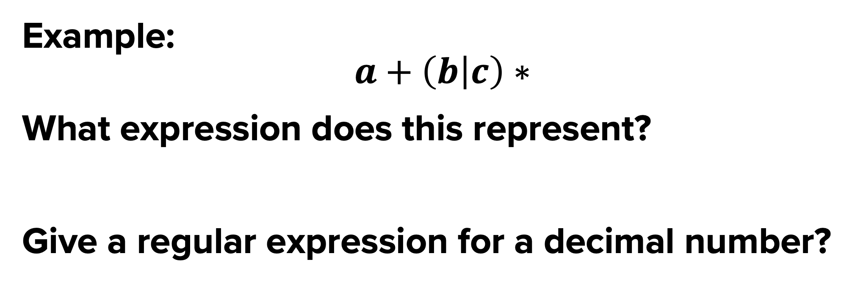
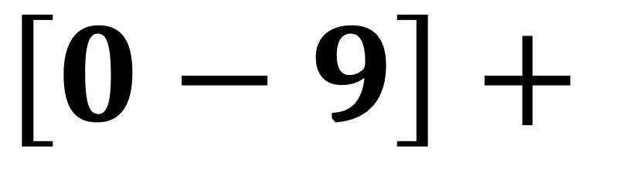

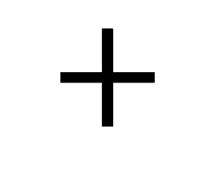
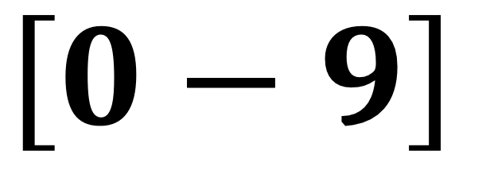
Example:
$$a+\left(b | c\right)∗$$
What expression does this represent?
Give a regular expression for a decimal number?
What is a regular expression?
A way of describing a set.
A shorthand form for a specific type of languages.
$$\left[0−9\right]$$
$$+$$
$$.$$
$$\left[0−9\right]+$$
* = Zero or more
+ = One or more
? = Optional
| = OR
() = Group
Notes:
End – 11:00

Slide 4
REGULAR EXPRESSIONS TO FSM
Single Letter e.g. a
Repeated Letter e.g. a*
a
S0
S0
S1
a
Two Letters e.g. ab
Repeated Letter e.g. a+
a
b
a
S0
S1
S3
S4
S0
S0
a
Choice e.g. a|b
b
Optional Letter e.g. a?b
a
b
S0
S1
S0
S1
S0
S3
S4
a
b
Notes:
End - 11:05

Slide 5
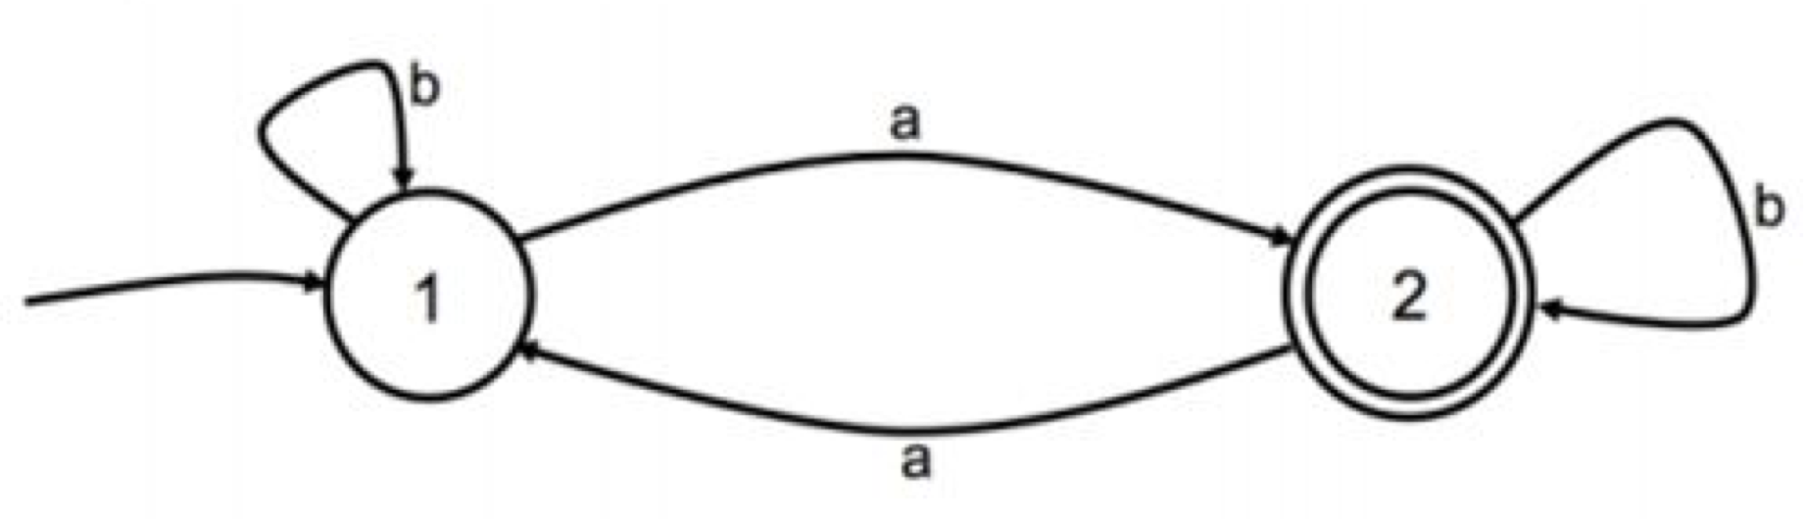
Your Turn
Write a Regular Expression for a string that:
- Starts with 10
- Has zero or more occurrences of any combination of 0 or 1 in the middle
- Ends with 01
What is a regular Language?
Regular Language = Language that can be represented by a Regular Expression
10 (0|1)* 01
Notes:
End – 11:20

Slide 6
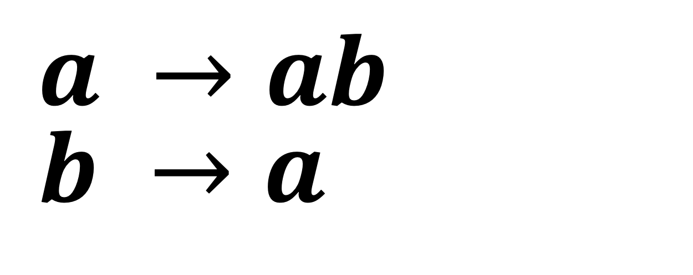
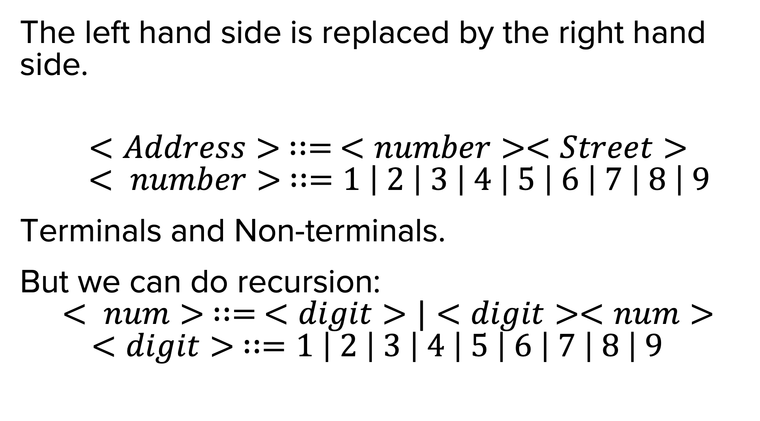
Context free languages
Backus-naur form
A set of strings and symbols that follow the rules of a context-free grammar.
Context-free grammars describe which strings are and are not possible through production rules.
What does context-free mean?
What is a production rule?
The left hand side is replaced by the right hand side.
$$<Address> ∷= <number><Street>$$
$$< number> ∷=1 \left| 2 \right| 3 \left| 4 \right| 5 \left| 6 \right| 7 \left| 8 \right| 9$$
Terminals and Non-terminals.
But we can do recursion:
$$< num> ∷= <digit>|<digit><num>$$
$$<digit> ∷=1 \left| 2 \right| 3 \left| 4 \right| 5 \left| 6 \right| 7 \left| 8 \right| 9$$
$$a →ab$$
$$b →a$$
Notes:
End – 11:00

Slide 7
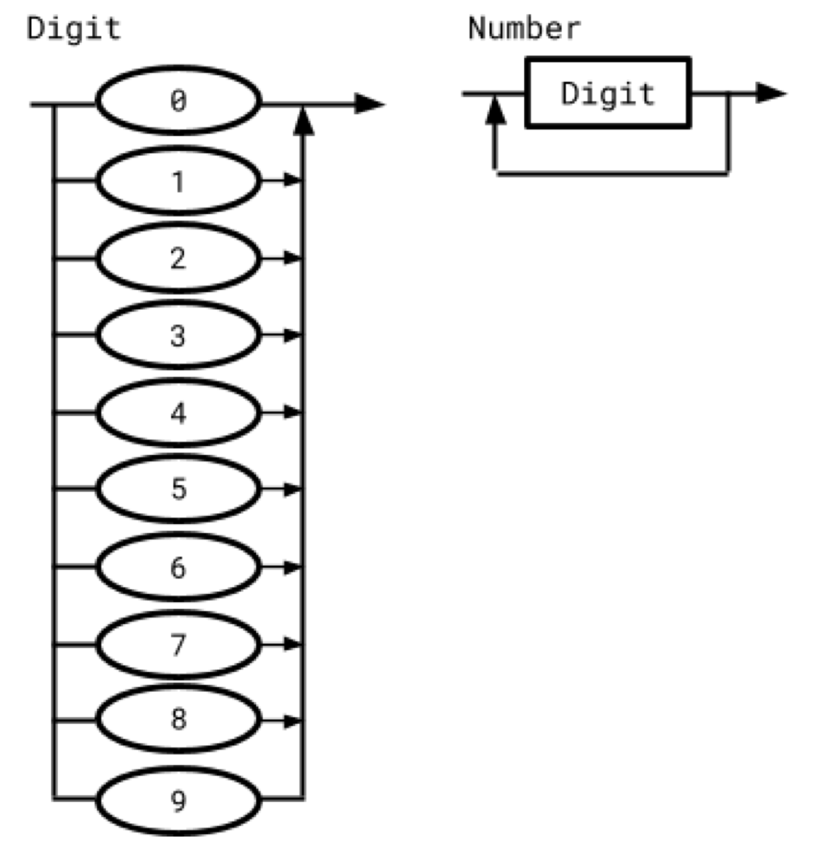
Context free languages
Backus-naur form
A set of strings and symbols that follow the rules of a context-free grammar.
Context-free grammars describe which strings are and are not possible through production rules.
What does context-free mean?
What is a production rule?
The left hand side is replaced by the right hand side.
$$<Address> ∷= <number><Street>$$
$$< number> ∷=1 \left| 2 \right| 3 \left| 4 \right| 5 \left| 6 \right| 7 \left| 8 \right| 9$$
Terminals and Non-terminals.
But we can do recursion:
$$< num> ∷= <digit>|<digit><num>$$
$$<digit> ∷=1 \left| 2 \right| 3 \left| 4 \right| 5 \left| 6 \right| 7 \left| 8 \right| 9$$
Notes:
End – 11:00

Slide 8
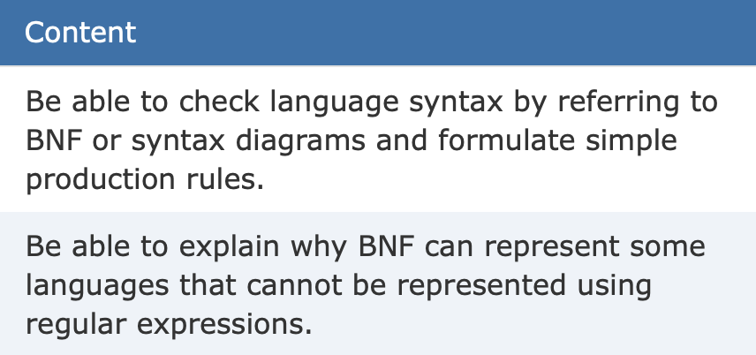
Your exam
Types of Question:
- Is this valid or not?
- Convert Syntax Diagrams to BNF
- Convert BNF to Syntax Diagrams
- Use of Recursion
Notes:
End – 11:25

