Slide 1
Big O Notation & classification of algorithms
13B – Theory of Computation – Wed 8th March – Mr Woodley.

Slide 2
Aside: logic
All computing students drink coffee
No coffee drinkers go outside
Computing Student
Coffee Drinker
Coffee Drinkers
Don’t go outside

Slide 3
Aside: logic
C1: A computing student doesn’t go outside.
C2: Nobody outside drinks coffee
C3: Everyone outside drinks Tea
Computing Student
Coffee Drinker
Coffee Drinkers
Don’t go outside

Slide 4
Your turn: logic

Slide 5
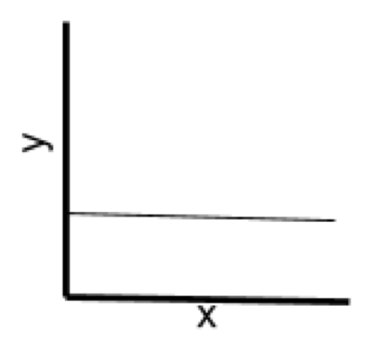
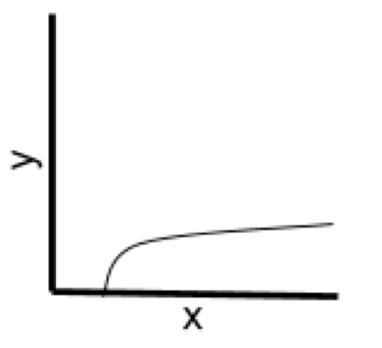
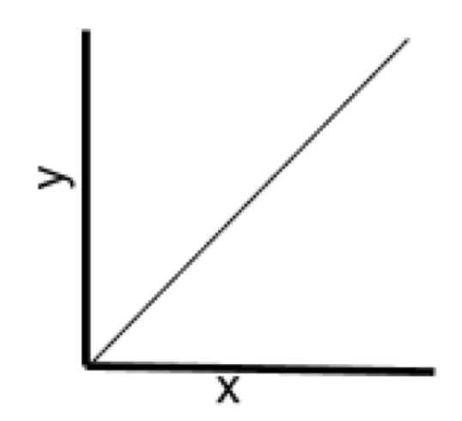
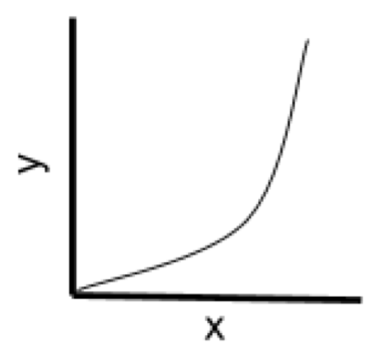
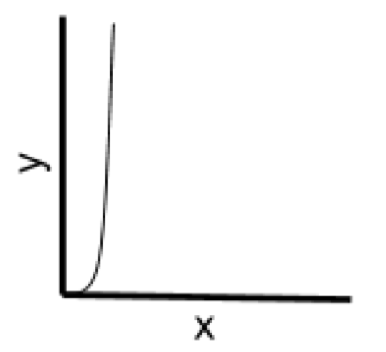
Complexity
Constant
y=1
Logarithmic
y=log(x)
Linear
y=x
Polynomial
y=x²
Exponential
y=e^{x}

Slide 6
Big o
Constant
y=1
O(n)
Logarithmic
y=log(x)
O(log₂(n))
Linear
y=x
O(n)
Linear
Logarithmic
y=log(x)
O(nlog₂(n))
Polynomial
y=x²
O(n²)
Exponential
y=e^{x}
O(e^{n})
Factorial
O(n!)

Slide 7
linear
O(n)
How do we tell?
Simple straight-line code. No loops

Slide 8
Logarithmic
O(log₂(n))
How do we tell?
Often recursive. The problem that needs to be solved halves on each iteration.
We don’t visit every node in a data structure.

Slide 9
linear
O(n)
How do we tell?
Simple loop. We go through each node exactly once

Slide 10
Linear logarithmic
O(n log₂(n))
How do we tell?
Simple loop. We go through each node exactly once
The problem that needs to be solved halves on each iteration.
Usually, a combination of the 2 above. Problem splits in half on each iteration but we still need to visit every node.

Slide 11
polynomial
O(n²)
How do we tell?
Nested loop
Number of nests = power of n
Be careful that inner loop doesn’t get shorter meaning linear log

Slide 12
exponential
O(n²)
How do we tell?
Problem gets twice as big on each iteration.

Slide 13
Your turn: BIG O

Slide 14
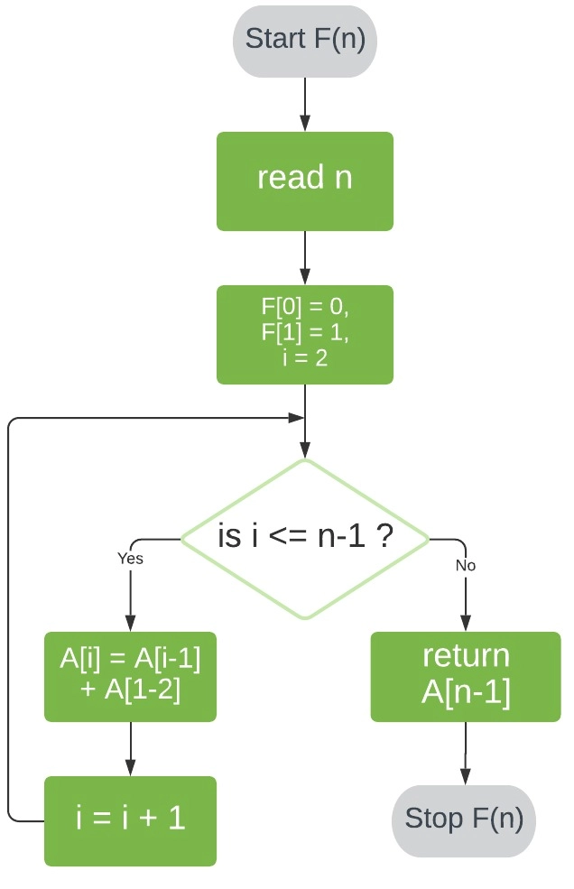

Slide 15
Tractable vs intractable
Constant
y=1
O(n)
Logarithmic
y=log(x)
O(log₂(n))
Linear
y=x
O(n)
Linear
Logarithmic
y=log(x)
O(nlog₂(n))
Polynomial
y=x²
O(n²)
Exponential
y=e^{x}
O(e^{n})
Factorial
O(n!)
Tractable:
Polynomial or
Less Solution
Intractable:
NO Polynomial or
Less Solution

Slide 16
Computational problems
Not every problem can be solved with an algorithm.
These problems we call non-computable.

Slide 17
Your turn: halting problem

