Slide 1
Boolean algebra
Year 12 & Year 13 - Wednesday 1st February 2023

Slide 2
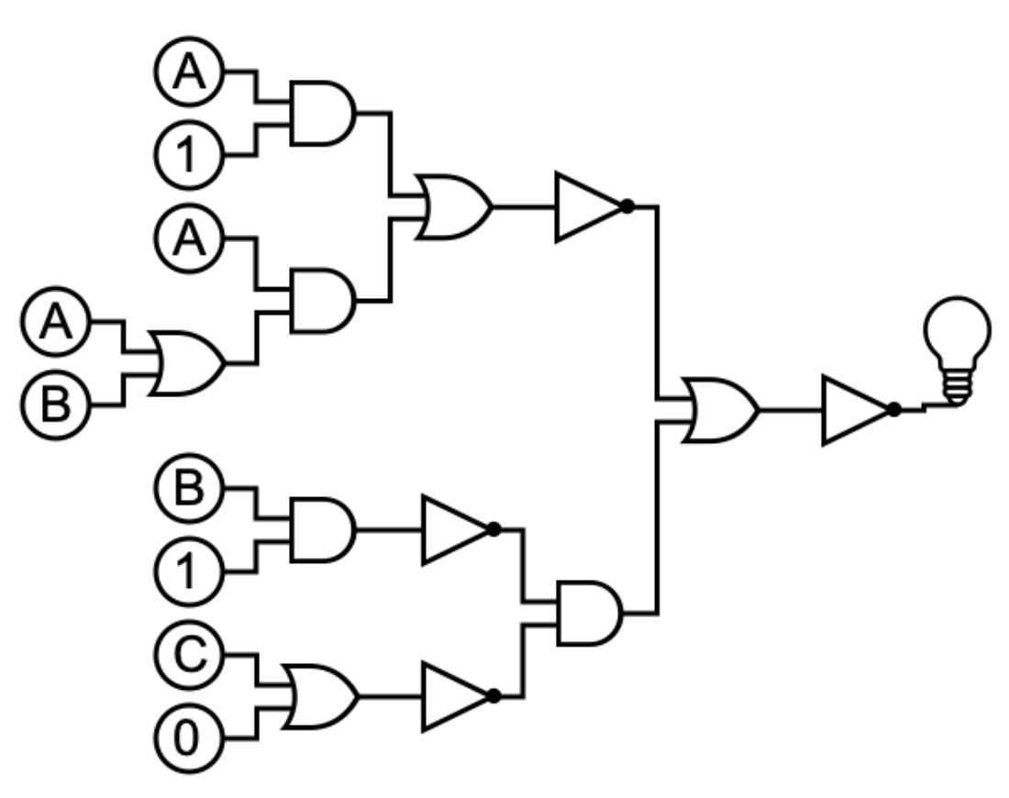

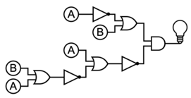
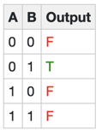

Slide 3
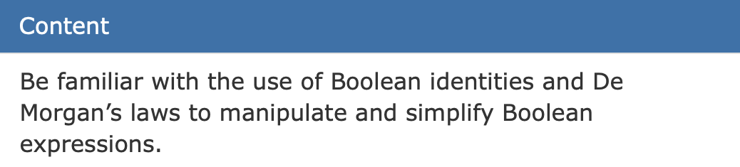



What is Boolean algebra?
Your exam
Manipulating Boolean expressions.
The same as mathematical algebra just with Boolean operators like OR, AND, NOT etc.
$$\overline{A}$$
$$A.B$$
$$A+B$$

Slide 4
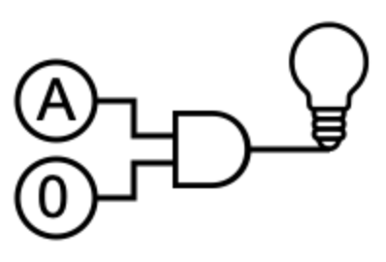
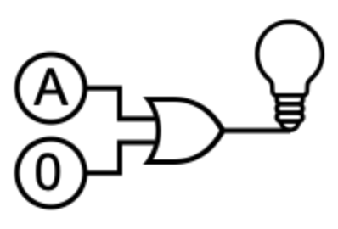
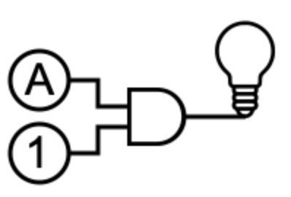
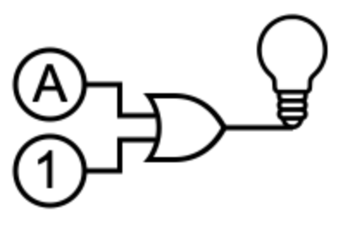
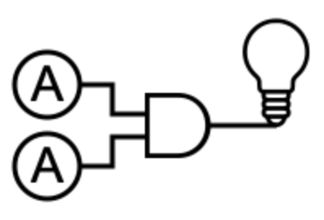












IDENTITIES
$$A.0=$$
$$0$$
$$A+0=$$
$$A$$
$$A.1=$$
$$A$$
$$A+1=$$
$$1$$
$$A.A=$$
$$A$$
$$A+A=$$
$$A$$

Slide 5



distribution
$$x×\left(y+z\right)=x×y+x×z$$
$$A.\left(B+C\right)=A.B+A.C$$
$$A+\left(B.C\right)=(A+B).(A+C)$$

Slide 6



De Morgan's law
$$\overline{A+B}=\overline{A}.\overline{B}$$
$$“break the bar and swap the sign”$$
$$\overline{A.B}=\overline{A}+\overline{B}$$

Slide 7




Example
$$A+\overline{B.A}$$
deMorgans
$$A+\overline{A}+\overline{B}$$
Identity
$$1+\overline{B}$$
Identity
$$1$$

Slide 8




Example
$$C.B+\overline{C}.B$$
Distributivity
$$B.(C+\overline{C})$$
Identity
$$B.1$$
Identity
$$B$$

Slide 9
tinyurl.com/

