Slide 1
Finite State machines & Turing machines
Year 13 Wednesday 22nd February 2023 – Mr Woodley

Slide 2
Finite state machines
1 | a
1 | a
1 | a
S0
S1
S3
0 | b
0 | b
1 | a
0 | b
0 | b
S2

Slide 3
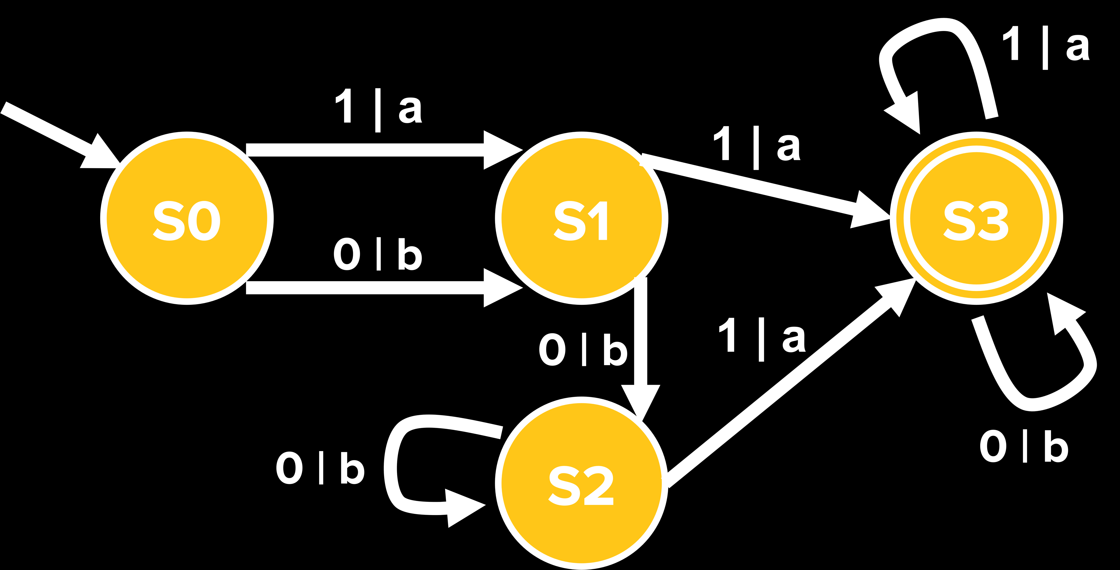
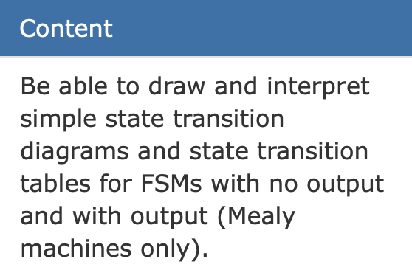
Types of exam question
State | S0
Input | 1 | 0 | 0 | 0 | 1 | 0 | 1
Output
Completing a State Transition Diagram
Accepted or Rejected Strings
Describe what the FSA will accept
Matching Events with labels

Slide 4
Types of exam question
State | S0 | S1
Input | 1 | 0 | 0 | 0 | 1 | 0 | 1
Output | a
Completing a State Transition Diagram
Accepted or Rejected Strings
Describe what the FSA will accept
Matching Events with labels

Slide 5
Types of exam question
State | S0 | S1 | S2
Input | 1 | 0 | 0 | 0 | 1 | 0 | 1
Output | a | b
Completing a State Transition Diagram
Accepted or Rejected Strings
Describe what the FSA will accept
Matching Events with labels

Slide 6
Types of exam question
State | S0 | S1 | S2 | S2
Input | 1 | 0 | 0 | 0 | 1 | 0 | 1
Output | a | b | b
Completing a State Transition Diagram
Accepted or Rejected Strings
Describe what the FSA will accept
Matching Events with labels

Slide 7
Types of exam question
State | S0 | S1 | S2 | S2 | S3
Input | 1 | 0 | 0 | 0 | 1 | 0 | 1
Output | a | b | b | a
Completing a State Transition Diagram
Accepted or Rejected Strings
Describe what the FSA will accept
Matching Events with labels

Slide 8
Types of exam question
State | S0 | S1 | S2 | S2 | S3 | S3
Input | 1 | 0 | 0 | 0 | 1 | 0 | 1
Output | a | b | b | a | a
Completing a State Transition Diagram
Accepted or Rejected Strings
Describe what the FSA will accept
Matching Events with labels

Slide 9
Types of exam question
State | S0 | S1 | S2 | S2 | S2 | S3 | S3
Input | 1 | 0 | 0 | 0 | 1 | 0 | 1
Output | a | b | b | b | a | b
Completing a State Transition Diagram
Accepted or Rejected Strings
Describe what the FSA will accept
Matching Events with labels

Slide 10
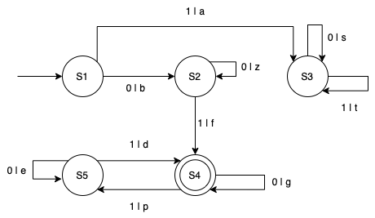
Your turn

Slide 11
Answers
State Transition Table
What does the double circle in the diagram represent?
Are the following 4 strings valid?
i. 101 -> NO
ii. 000 -> NO
iii. 001 -> YES “bzf”
iv. 010001101 -> NO
v. 0100011011 -> YES “bfgggpdgpd”
4. What kind of Strings does this FSM allow?
They must start with a 0
And then contain an odd number of 1s

Slide 12

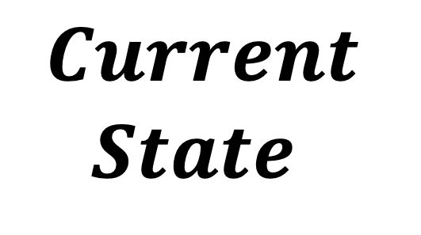
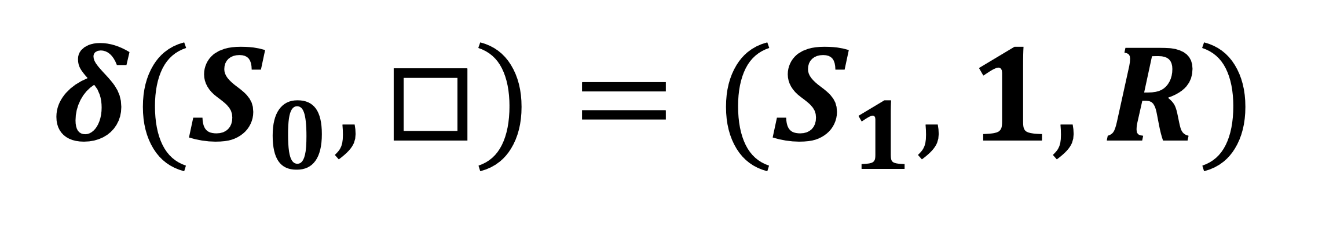
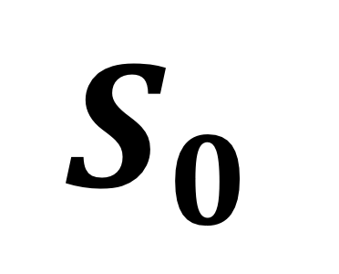


Turing machines
$$S_{0}$$
$$Current$$
$$State$$
1
1
0
0
1
0
…
$$R$$
$$δ(S_{0}, □)=(S_{1}, 1, R)$$
$$S_{1}$$
$$1$$

Slide 13
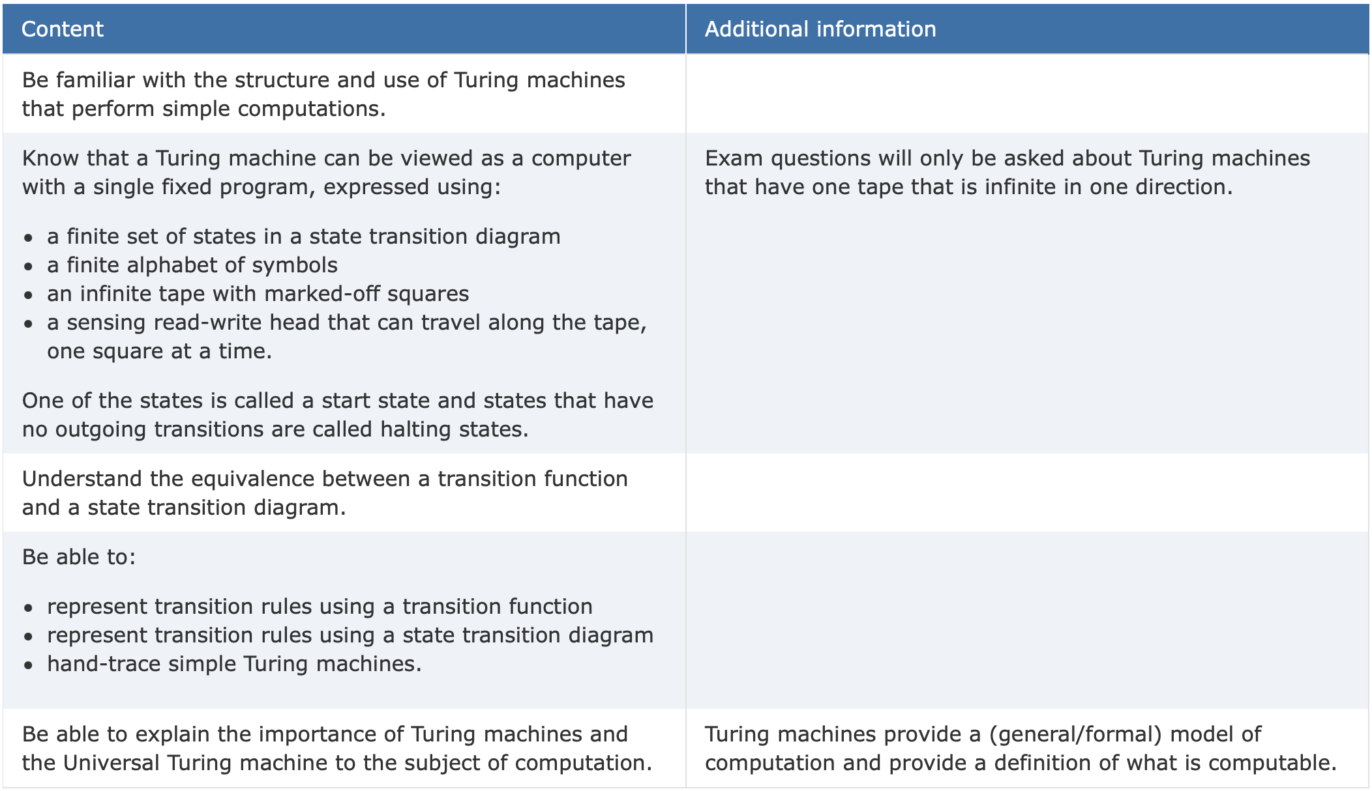
Types of exam question
Turing Machine Traces
FSM -> TM or TM -> FSM
What does the Turing Machines do?
Universal Turing Machines

Slide 14
Types of relations?
Relationship between Passengers and a Bus
Each Bus has one Passenger, and each Passenger has one Bus
One-To-One
Each Bus has many Passengers, and each Passenger is on one Bus
One-To-Many
Each Bus has many passengers, and each Passenger can ride many buses.
Many-To-Many

Slide 15
Exam style questions
A Library uses a Database Management System using the following 3 relations:
Book(BookID, Title, Author, Publisher)
Member(MemberID, Surname, FirstName, EmailAddress)
Loan(MemberID, BookID, LoanDate, DueBackDate, Returned)
The library does not stock more than one copy of the same book.
Book
Loan
Member

Slide 16
How can we tell?
It’s not Easy.
We have to really think about the types of relationships and how they’re related
Physical things
People, Cars etc.
Shared Composite keys
Loan(MemberID, BookID, LoanDate, DueBackDate, Returned)
PartUsedForJob(JobID, PartID, Quantity)

Slide 17
Your turn
Customer(CustomerID, Name, PostalCode)
Employees(EmployeeID, Name, DOB)
OrderDetails(OrderID, ProductID, Quantity)
Order(OrderID, CustomerID, EmplyeeID, Date)
Products(ProductID, ProductName, CategoryID, Price)
Categories(CategoryID, CategoryName, Description)
This is a really bad shop. So, customers never come back to the shop again. They only do one order.

Slide 18
Your turn
Order
order-detail
Product
category
employee
order
customer
order
customer
products

Slide 19
SQL
What attributes do I want?
What conditions should they meet?
How should I order them?
How can I bring all these attributes together?
SELECT …
FROM …
(INNER JOIN … ON …)
WHERE …
(ORDER BY …)

Slide 20
Exam style questions
A Library uses a Database Management System using the following 3 relations:
Book(BookID, Title, Author, Publisher)
Member(MemberID, Surname, FirstName, EmailAddress)
Loan(MemberID, BookID, LoanDate, DueBackDate, Returned)
The Library is holding a literature event for Slyvia Plath and wants to invite all members that have borrowed a Book by Slyvia Plath. The library wants the names and email addresses of all such people.
What attributes do I want?
What conditions should they meet?
How should I order them?
How can I bring all these attributes together?

Slide 21
Exam style questions
A Library uses a Database Management System using the following 3 relations:
Book(BookID, Title, Author, Publisher)
Member(MemberID, Surname, FirstName, EmailAddress)
Loan(MemberID, BookID, LoanDate, DueBackDate, Returned)
The Library is holding a literature event for Slyvia Plath and wants to invite all members that have borrowed a Book by Slyvia Plath. The library wants the names and email addresses of all such people.
What attributes do I want?
What conditions should they meet?
How should I order them?
How can I bring all these attributes together?

Slide 22
Exam style questions
A Library uses a Database Management System using the following 3 relations:
Book(BookID, Title, Author, Publisher)
Member(MemberID, Surname, FirstName, EmailAddress)
Loan(MemberID, BookID, LoanDate, DueBackDate, Returned)
The Library is holding a literature event for Slyvia Plath and wants to invite all members that have borrowed a Book by Slyvia Plath. The library wants the names and email addresses of all such people.
What attributes do I want?
What conditions should they meet?
How should I order them?
How can I bring all these attributes together?

Slide 23
Exam style questions
A Library uses a Database Management System using the following 3 relations:
Book(BookID, Title, Author, Publisher)
Member(MemberID, Surname, FirstName, EmailAddress)
Loan(MemberID, BookID, LoanDate, DueBackDate, Returned)
The Library is holding a literature event for Slyvia Plath and wants to invite all members that have borrowed a Book by Slyvia Plath. The library wants the names and email addresses of all such people.
What attributes do I want?
What conditions should they meet?
How should I order them?
How can I bring all these attributes together?

Slide 24
Exam style questions
A Library uses a Database Management System using the following 3 relations:
Book(BookID, Title, Author, Publisher)
Member(MemberID, Surname, FirstName, EmailAddress)
Loan(MemberID, BookID, LoanDate, DueBackDate, Returned)
The Library is holding a literature event for Slyvia Plath and wants to invite all members that have borrowed a Book by Slyvia Plath. The library wants the names and email addresses of all such people.
What attributes do I want?
What conditions should they meet?
How should I order them?
How can I bring all these attributes together?

Slide 25
Exam style questions
A Library uses a Database Management System using the following 3 relations:
Book(BookID, Title, Author, Publisher)
Member(MemberID, Surname, FirstName, EmailAddress)
Loan(MemberID, BookID, LoanDate, DueBackDate, Returned)
The Library is holding a literature event for Slyvia Plath and wants to invite all members that have borrowed a Book by Slyvia Plath. The library wants the names and email addresses of all such people.
What attributes do I want?
What conditions should they meet?
How should I order them?
How can I bring all these attributes together?

Slide 26
Exam style questions
A Library uses a Database Management System using the following 3 relations:
Book(BookID, Title, Author, Publisher)
Member(MemberID, Surname, FirstName, EmailAddress)
Loan(MemberID, BookID, LoanDate, DueBackDate, Returned)
The Library is holding a literature event for Slyvia Plath and wants to invite all members that have borrowed a Book by Slyvia Plath. The library wants the names and email addresses of all such people.
What attributes do I want?
What conditions should they meet?
How should I order them?
How can I bring all these attributes together?

Slide 27
Exam style questions
A Library uses a Database Management System using the following 3 relations:
Book(BookID, Title, Author, Publisher)
Member(MemberID, Surname, FirstName, EmailAddress)
Loan(MemberID, BookID, LoanDate, DueBackDate, Returned)
The Library is holding a literature event for Slyvia Plath and wants to invite all members that have borrowed a Book by Slyvia Plath. The library wants the names and email addresses of all such people.
What attributes do I want?
What conditions should they meet?
How should I order them?
How can I bring all these attributes together?

Slide 28
Exam style questions
A Library uses a Database Management System using the following 3 relations:
Book(BookID, Title, Author, Publisher)
Member(MemberID, Surname, FirstName, EmailAddress)
Loan(MemberID, BookID, LoanDate, DueBackDate, Returned)
The Library is holding a literature event for Slyvia Plath and wants to invite all members that have borrowed a Book by Slyvia Plath. The library wants the names and email addresses of all such people.

Slide 29
Exam style questions
A Library uses a Database Management System using the following 3 relations:
Book(BookID, Title, Author, Publisher)
Member(MemberID, Surname, FirstName, EmailAddress)
Loan(MemberID, BookID, LoanDate, DueBackDate, Returned)
The Library is holding a literature event for Slyvia Plath and wants to invite all members that have borrowed a Book by Slyvia Plath. The library wants the names and email addresses of all such people.
SELECT FirstName, Surname, Email
FROM Member, Loan, Book
WHERE Member.MemberID = Loan.MemberID
AND Loan.BookID = Book.BookID
AND Book.Author = “Sylvia Plath”

Slide 30
SQL
What attributes do I want?
FirstName, Surname, Email
How can I bring these attributes together?
From Member to Loan to Book
What conditions should they meet?
Author is Sylvia Plath
How should I order them?
We don’t mind
SELECT FirstName, Surname, Email
FROM Member, Loan, Book
WHERE Member.MemberID = Loan.MemberID
AND Loan.BookID = Book.BookID
AND Book.Author = “Sylvia Plath”
SELECT FirstName, Surname, Email
FROM Member
INNER JOIN Loan ON Member.MemberID = Loan.MemberID
INNER JOIN Book ON Loan.BookID = Book.BookID
WHERE Book.Author = “Sylvia Plath”

Slide 31
Let’s write some SQL queries
Which
Attributes?
What
Conditions?
How do we
bring the
Attributes
together?
What
Ordering?

