Slide 1
Abstraction, Automation, Finite State machines & Turing machines
Year 13 Wednesday 22nd February 2023 – Mr Woodley

Slide 2
Finite state machines
1 | a
1 | a
1 | a
S0
S1
S3
0 | b
0 | b
1 | a
0 | b
0 | b
S2

Slide 3
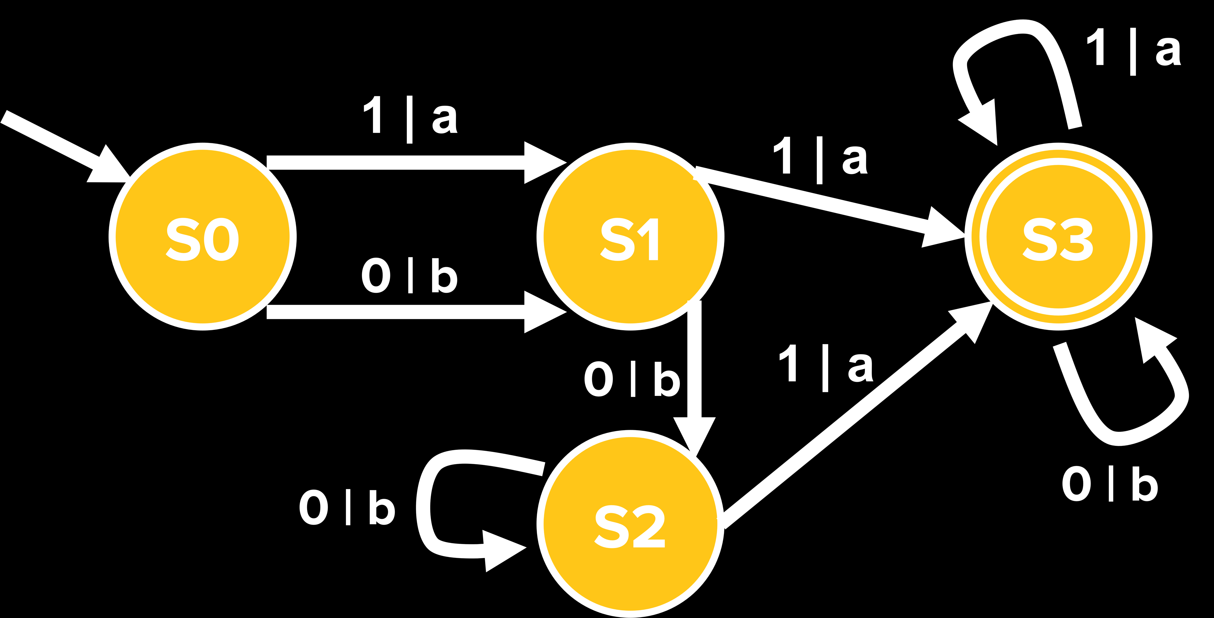
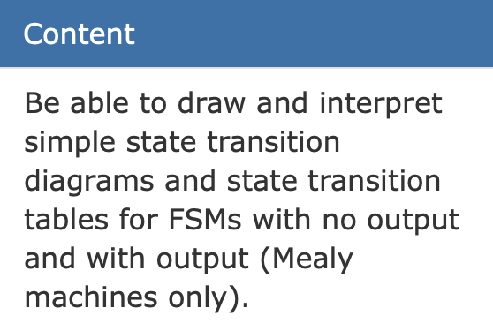
Types of exam question
State | S0
Input | 1 | 0 | 0 | 0 | 1 | 0 | 1
Output
Completing a State Transition Diagram
Accepted or Rejected Strings
Describe what the FSA will accept
Matching Events with labels

Slide 4
Types of exam question
State | S0 | S1
Input | 1 | 0 | 0 | 0 | 1 | 0 | 1
Output | a
Completing a State Transition Diagram
Accepted or Rejected Strings
Describe what the FSA will accept
Matching Events with labels

Slide 5
Types of exam question
State | S0 | S1 | S2
Input | 1 | 0 | 0 | 0 | 1 | 0 | 1
Output | a | b
Completing a State Transition Diagram
Accepted or Rejected Strings
Describe what the FSA will accept
Matching Events with labels

Slide 6
Types of exam question
State | S0 | S1 | S2 | S2
Input | 1 | 0 | 0 | 0 | 1 | 0 | 1
Output | a | b | b
Completing a State Transition Diagram
Accepted or Rejected Strings
Describe what the FSA will accept
Matching Events with labels

Slide 7
Types of exam question
State | S0 | S1 | S2 | S2 | S3
Input | 1 | 0 | 0 | 0 | 1 | 0 | 1
Output | a | b | b | a
Completing a State Transition Diagram
Accepted or Rejected Strings
Describe what the FSA will accept
Matching Events with labels

Slide 8
Types of exam question
State | S0 | S1 | S2 | S2 | S3 | S3
Input | 1 | 0 | 0 | 0 | 1 | 0 | 1
Output | a | b | b | a | a
Completing a State Transition Diagram
Accepted or Rejected Strings
Describe what the FSA will accept
Matching Events with labels

Slide 9
Types of exam question
State | S0 | S1 | S2 | S2 | S2 | S3 | S3
Input | 1 | 0 | 0 | 0 | 1 | 0 | 1
Output | a | b | b | b | a | b
Completing a State Transition Diagram
Accepted or Rejected Strings
Describe what the FSA will accept
Matching Events with labels

Slide 10
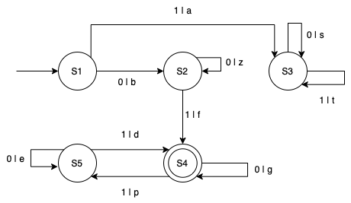
Your turn

Slide 11
Answers
State Transition Table
What does the double circle in the diagram represent?
Are the following 4 strings valid?
i. 101 ->
ii. 000 ->
iii. 001 ->
iv. 010001101 ->
v. 0100011011 ->
4. What kind of Strings does this FSM allow?
They must start with a 0
And then contain an odd number of 1s
NO
NO
YES “bzf”
NO
YES “bfgggpdgpd”

Slide 12


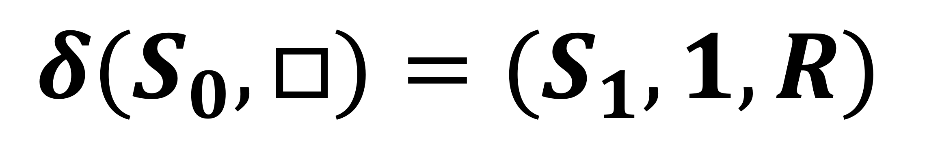



Turing machines
$$S_{0}$$
$$Current$$
$$State$$
1
1
0
0
1
0
…
$$R$$
$$δ(S_{0}, □)=(S_{1}, 1, R)$$
$$S_{1}$$
$$1$$

Slide 13
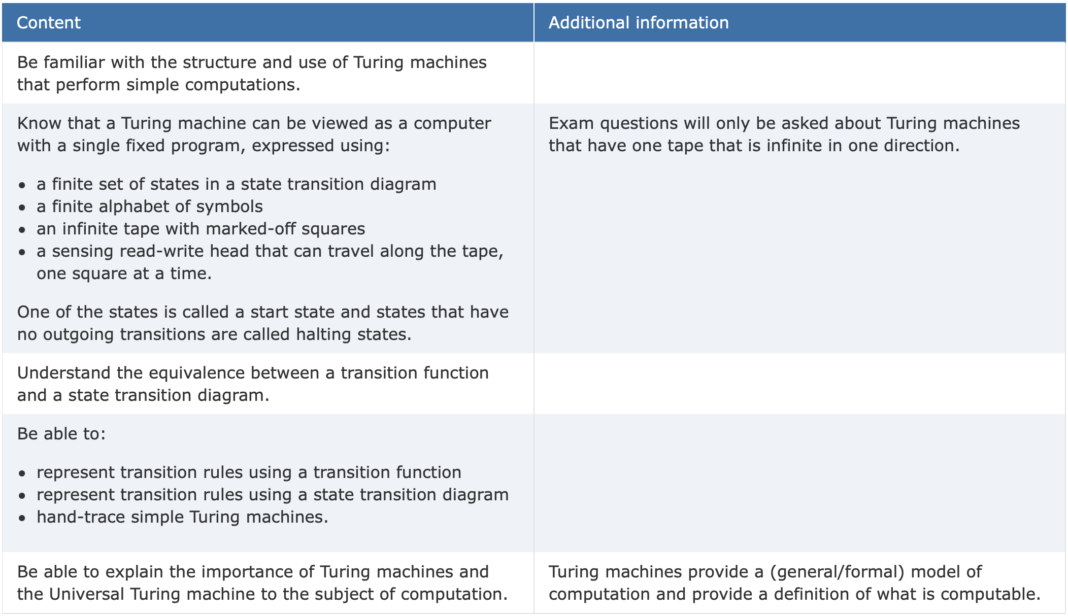
Types of exam question
Turing Machine Traces
FSM -> TM or TM -> FSM
What does the Turing Machines do?
Universal Turing Machines

Slide 14
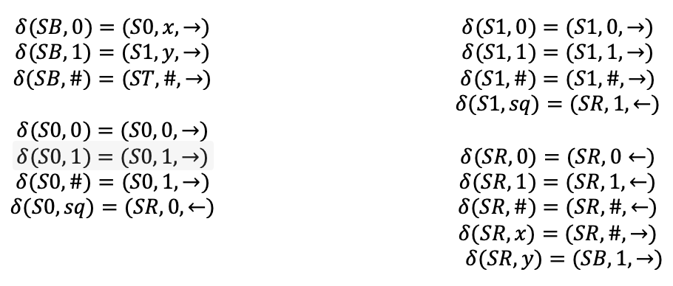
Your turn

