Slide 1
Device Tree: Hardware Description
Jun, 2022
Rev. 1.00 by Dy Le – Hung Bui

Slide 2
AGENDA
What - Why the Device Tree ?
Basic Device Tree syntax.
Device Tree inheritance.
Device Tree specifications and bindings.
Building and validating Device Trees.
Common properties.

Slide 3
What - Why the Device Tree ?

Slide 4
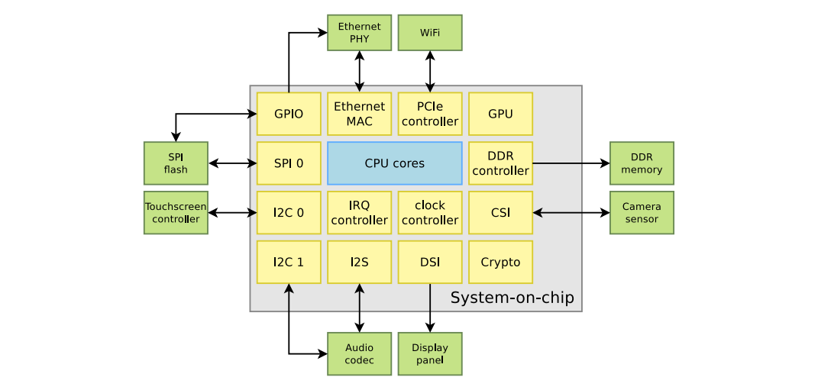
Typical embedded platform.

Slide 5
Discoverable vs. non-discoverable hardware.
Some hardware busses provide discoverability mechanisms
E.g: PCI(e), USB
One does not need to know ahead of time what will be connected on these busses
Devices can be enumerated and identified at runtime
But many hardware busses do not provide discoverability mechanisms
E.g: I2C, SPI, 1-wire, memory-mapped, etc.
One needs to know what is connected on those busses, and how they are connected to the rest of the system
Embedded systems typically make extensive use of such busses

Slide 6
Hardware description for non-discoverable hardware.
Allows the operating system or bootloader to know things like:
This system-on-chip has:
2 Cortex-A9 CPU cores
2 memory-mapped UART controllers of this variant, one with registers at 0xF1000000 and IRQ 23, and another with registers at 0xF1001000 and IRQ 24
3 I2C controllers of that variant, with registers at those memory-mapped addresses, those IRQs and taking their input clock from this source
This board has an CS4234 audio codec
Connected on the I2C bus 0 of the SoC, at slave address 0x45
Connected to the I2S interface 2 of the SoC, with the codec providing the clocks
With its reset signal connected to GPIO 67 of the SoC
These details cannot be guessed by the operating system/bootloader.

Slide 7
Describing non-discoverable hardware.
Directly in the OS/bootloader code, using compiled data structures, typically in C.
How it was done on most embedded platforms in Linux, U-Boot.
Considered not maintainable/sustainable on ARM32, which motivated the move to another solution.
Using ACPI tables
On x86 systems, but also on a subset of ARM64 platforms.
Tables provided by the firmware.
Using a Device Tree
On most embedded-oriented CPU architectures that run Linux: ARC, ARM64,RISC-V, ARM32, PowerPC, Xtensa, MIPS, etc.
Originates from the PowerPC world, not Linux specific
Now used by Linux, U-Boot, etc.
Writing/tweaking a DT is now always necessary when porting Linux to a new board.
The topic of this talk !

Slide 8
Basic Device Tree syntax

Slide 9
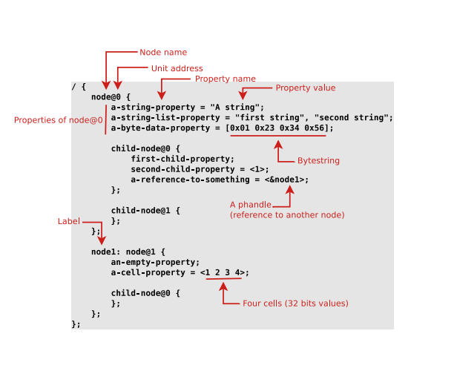

Base syntax
▶ Tree of nodes
▶ Nodes with properties
▶ A node ≈ a device
▶ Properties ≈ device characteristics
▶ dtc only does syntax checking, no semantic validation

Slide 10
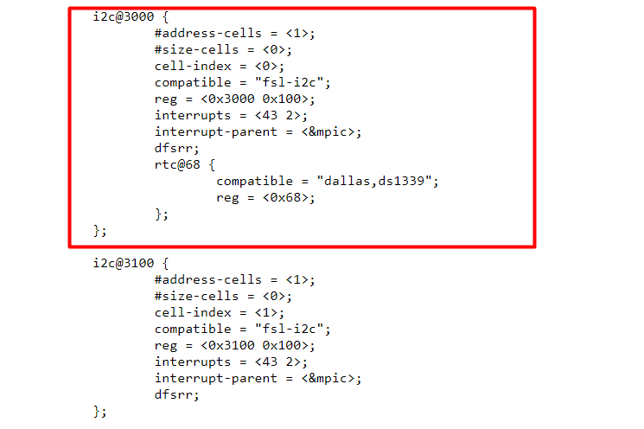

Simplified example

Slide 11
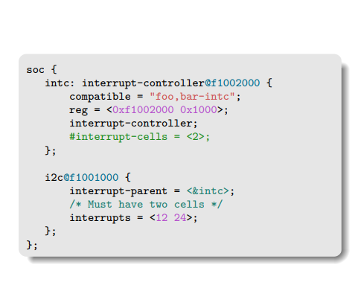
Cells concept
▶Integer values represented as 32-bit integers called cells
▶ Encoding a 64-bit value requires two cells
Ex - #interrupts-cells: how many cells are used to encode interrupt specifiers for this interrupt controller

Slide 12
Device Tree inheritance

Slide 13
Device Tree inheritance.
Device Tree files are not monolithic, they can be split in several files, including each other.
.dtsi files are included files, while .dts files are final Device Trees
Only .dts files are accepted as input to dtc
Typically, .dtsi will contain definition of SoC-level information (or sometimes definitions common to several almost identical boards)
The .dts file contains the board-level information
Uses the C pre-processor #include directive
Using the C pre-processor also allows to use #define to replace hardcoded values by human readable definitions

Slide 14
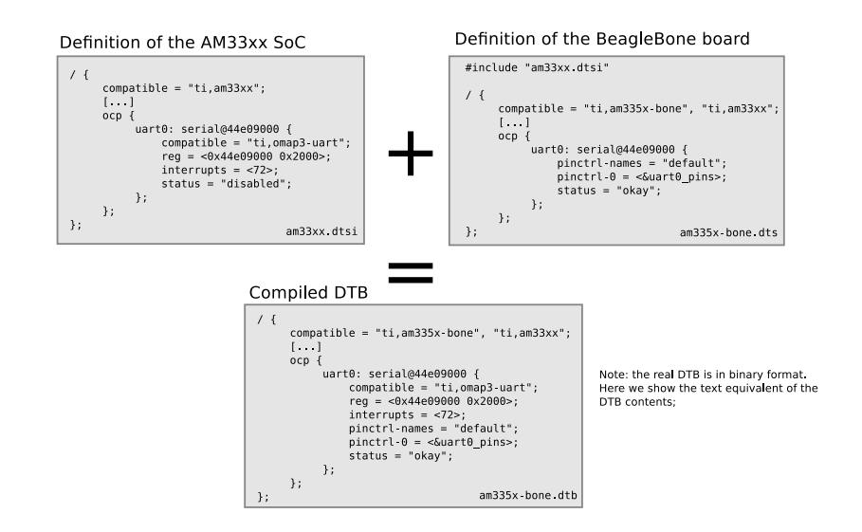
Device Tree inheritance example

Slide 15
Device Tree specifications and bindings

Slide 16
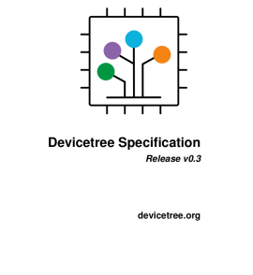
Device Tree specifications
How does one know how to write the correct nodes/properties to describe a given hardware platform ?
▶ The Device Tree Specifications at https://www.devicetree.org/specifications/ gives the base Device Tree syntax and specifies a number of standard properties.
Far from being sufficient, though.
▶ The Device Tree Bindings are documents that each describe how a particular piece of hardware.
Documentation/devicetree/bindings/ in Linux kernel sources
Reviewed by DT bindings maintainer team
Legacy: human readable documents
New norm: YAML-written specifications

Slide 17
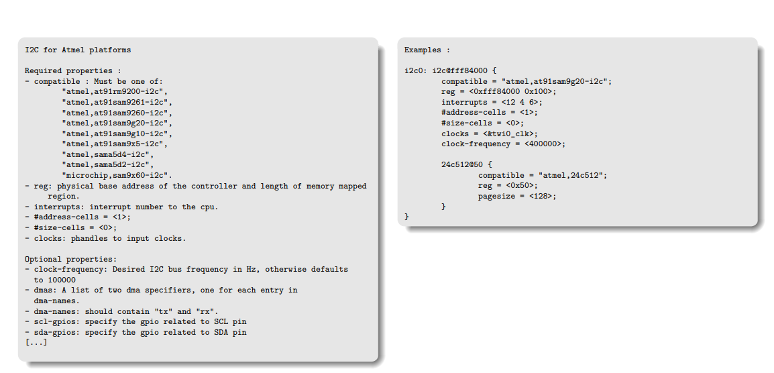
Device Tree binding: old style

Slide 18
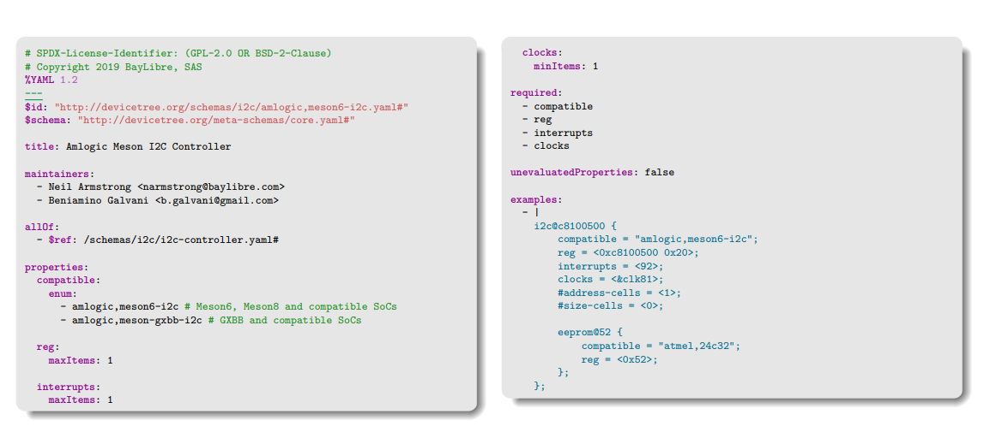
Device Tree binding: YAML style

Slide 19
Building and validating Device Trees

Slide 20
Device tree compiler.
The Device Tree Compiler (DTC) is the tool that is used to compile the source into a binary form. Source code for the DTC is located in scripts/dtc.
The output of the device tree compiler is a device tree blob (DTB).
The basic syntax of the DTC command line is: dtc [options] <input filename>
The most common options include:
-I <input format>
-O <output format>
-b <boot CPU>
set the physical boot cpu
The input format could be .dts, .dtb, or .fs (.fs would read from the current file systems /proc/device-tree). The output format could be .dts, .dtb, or .asm.
As an example, to compile the abc.dts file: dtc –I dts –O dtb abc.dts > abc.dtb
The DTC can also be used to reverse compile DTBs and make them human-readable again: dtc –I dtb –O dts abc.dtb > abc.dts

Slide 21
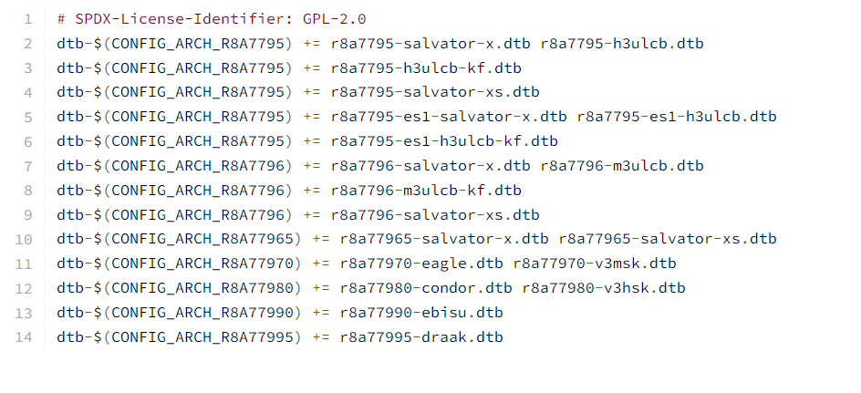
Building Device Trees in Linux.
On ARM/ARM64, arch/<ARCH>/boot/dts/Makefile or arch/<ARCH>/boot/dts/<vendor>/Makefile indicates which DT to build depending on the platform.
arch/arm64/boot/dts/renesas/Makefile
Building the kernel with make will also build the Device Trees on most architectures
Explicit make dtbs target also available

Slide 22
Validating Device Tree in Linux.
dtc only does syntaxic validation.
YAML bindings allow to do semantic validation
make dt_bindings_check → verify that YAML bindings are valid
make dtbs_check → validate DTs currently enabled against YAML bindings

Slide 23
Common properties

Slide 24
Common properties
reg
Memory-mapped devices: base address and size of the registers. Can have several entries.
I2C devices: address on the I2C bus
SPI devices: chip select number
interrupts, interrupt-parent, interrupts-extended: interrupts lines used by the device, and which interrupt controller they are connected to.
clocks: which clock(s) are used by the device, from which clock controller
dmas: which DMA controller and channels are used by the device
status: okay means the device is present and should be enabled, otherwise, the device is left unused
pinctrl-*: indicates the pin-muxing configuration requested by the device

Slide 25
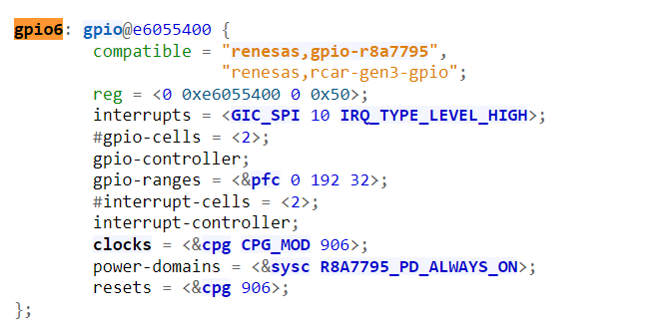
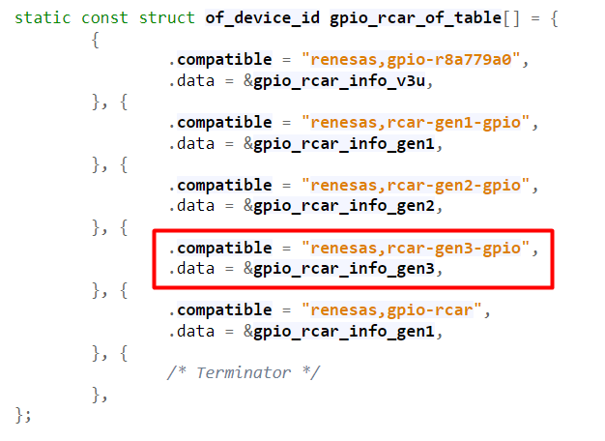

Matching with drivers in Linux: platform driver

Slide 26
REFERENCE
http://web.mit.edu/freebsd/head/sys/boot/fdt/dts/powerpc/p1020rdb.dts
https://lwn.net/Articles/771621/
https://devicetree-specification.readthedocs.io/en/v0.1/source-language.html
https://bootlin.com/

Slide 27
REVISION
Version | Modified points | Approver | Checker | Author
1.00 | Add new document device tree sharing |  | Hung Bui Jun-08-2022 | Dy Le Jun-06-2022

Slide 28
Thank You!!

