Slide 1
Embedded
Nov, 2021

Slide 2
The four elements of embedded
Toolchain
Root filesystem
Bootloader
Kernel
Notes:
The microkernel differs from an executive in how the IPC services are used to extend the functionality of the kernel with additional, service-providing processes. Since the OS is implemented as a team of cooperating processes managed by the microkernel, user-written processes can serve both as applications and as processes that extend the underlying OS functionality for industry-specific applications. The OS itself becomes "open" and easily extensible. Moreover, user-written extensions to the OS won't affect the fundamental reliability of the core OS.

Slide 3
The four elements of embedded
Toolchain: The compiler and other tools needed to create code for your target device. Everything else depends on the toolchain.
Bootloader: The program that initializes the board and loads the Linux kernel.
Kernel: This is the heart of the system, managing system resources and interfacing with hardware.
Root filesystem: Contains the libraries and programs that are run once the kernel has completed its initialization.

Slide 4
Hardware for embedded Linux
Currently Linux supports 31 architectures listed inside of arch/ directory. The ones most often found in embedded devices are ARM, MIPS PowerPC, and X86.
ARM.
MIPS PowerPC.
X86

Slide 5
QEMU
QEMU is a machine emulator. It comes in a number of different flavors, each of which can emulate a processor architecture and a number of boards built using that architecture.
Qemu-system-arm: ARM.
Qemu-system-mips: MIPS
Qemu-system-ppc: PowerPC
Qemu-system-x86: x86 and x86_64

Slide 6
Toolchains
A toolchain is the set of tools that compiles source code into executables that can run on your target device, and includes a compiler, a linker, and run-time libraries.
Initially you will use a toolchain to build the other three elements of an embedded Linux system: the bootloader, the kernel and the root filesystem

Slide 7
Toolchain – main components
Binutils: A set of binary utilities including the assembler and the linker.
GNU Compiler Collection (GCC): These are the compilers for C and other languages which, depending on the version of GCC, include C++, Objective-C, Objective-C++, Java, Fortran, Ada, and Go. They all use a common backend which produces assembler code, which is fed to the GNU assembler.
C Library: A standardized application program interface (API) based on the POSIX specification, which is the main interface to the operating system kernel for applications.

Slide 8
Toolchain – types of toolchains
Native: This toolchain runs on the same type of system (sometimes the same actual system) as the programs it generates. This is the usual case for desktops and servers, and it is becoming popular on certain classes of embedded devices. The Raspberry Pi running Debian for ARM, for example, has self-hosted native compilers.
Cross: This toolchain runs on a different type of system than the target, allowing the development to be done on a fast desktop PC and then loaded onto the embedded target for testing.

Slide 9
Toolchain – CPU architectures
The toolchain has to be built according to the capabilities of the target CPU, which includes:
CPU architecture: ARM, MIPS, x86_64 and so on.
Big- or little-endian operation: Some CPUs can operate in both modes, but the machine code is different for each.
Floating point support: Not all versions of embedded processors implement a hardware floating point unit, in which case the toolchain has to be configured to call a software floating point library instead.

Slide 10
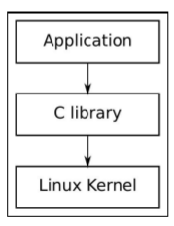
Toolchain – C library
The programming interface to the Unix operating system is defined in the C language, which is now defined by the POSIX standards. The C library is the implementation of that interface; it is the gateway to the kernel for Linux program.

Slide 11
Toolchain – c library
Glibc: This is the standard GNU C library.
Musl libc: This is the small and standards-compliant alternative to GNU libc. It is a good choice for systems with a limited amount of RAM and storage.
uClibc-ng: It was first developed to work with uClinux (Linux for CPUs without memory management units), but has since been adapted to be used with full Linux.
Eglibc: Now obsolete, eglibc was a fork of glibc with changes to make it more suitable for embedded usage.

Slide 12
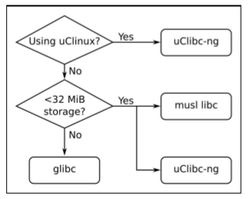
Toolchain – choose c library

Slide 13
Bootloaders
In an embedded Linux system, the bootloader has two main jobs:
To initialize the system to a basic level.
To load the kernel.

Slide 14
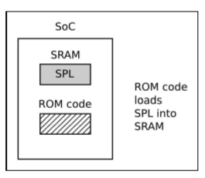
Bootloader – Phase 1 ROM Code
In the absence of reliable external memory, the code that runs immediately after a reset or power-on has to be stored on-chip in the SoC; this is known as ROM code. It is loaded into the chip when it is manufactured, and hence the ROM code is proprietary and cant be replaced by an open source equivalent. Usually, it does not include code to initialize the memory controller, since DRAM configurations are highly device-specific, and so it can only use Static Random Access Memory (SRAM), which does not require a memory controller.
Most embedded SoC designs have a small amount of SRAM on-chip, varying in size from as little as 4KB to several hundred KB:

Slide 15
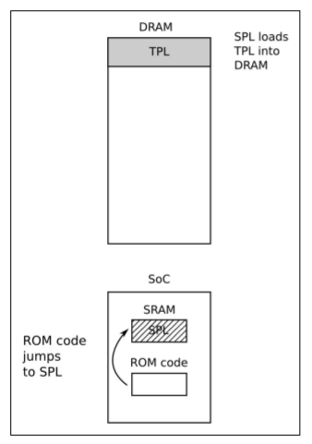
Bootloader – Phase 2 Secondary program loader
The SPL must set up the memory controller and other essential parts of the system preparatory to loading the Tertiary Program Loader (TPL) into DRAM. The functionality of the SPL is limited by the size of the SRAM. It can read a program from a list of storage devices, as can the ROM code, once again using pre-programmed offsets from the start of a flash device.

Slide 16
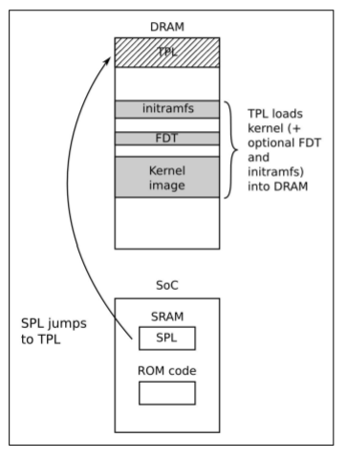
Bootloader – Phase 3 TPL
TPL is a full bootloader, such as U-Boot or BareBox. Usually, there is a simple command-line user interface that lets you perform maintenance tasks, such as loading new boot and kernel images into flash storage, and loading and booting a kernel, and there is a way to load the kernel automatically without user intervention.

Slide 17
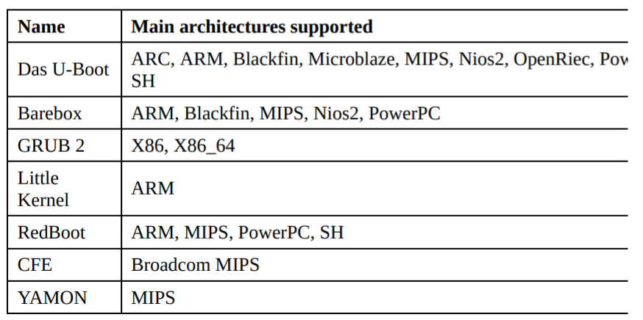
Choosing a bootloader

Slide 18
Kernel
It is the component that is responsible for managing resources and interfacing with hardware, and so affects almost every aspect of your final software build.

Slide 19
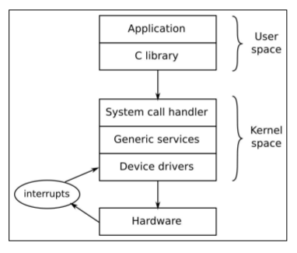
Kernel – What does the kernel do?
To manage resources.
To interface with hardware.
To provide an API that offers a useful level of abstraction to user space program.

Slide 20
Root filesystem
The kernel will get a root filesystem, either an initramfs, passed as a pointer from the bootloader, or by mounting the block device given on the kernel command line by the root= parameter.
Once it has a root filesystem, the kernel will execute the first program, by default named init.

Slide 21
Root filesystem components
Init: This is the program that starts everything off, usually by running a series of scripts.
Shell: You need a shell to give you a command prompt.
Daemons: A daemon is a background program that provides a service to others.
Shared libraries: Most programs are linked with shared libraries, and so they must be present in the root filesystem.
Configuration files: The configuration for init and other daemons is stored in a series of text files, usually in the /etc directory.
Device nodes: These are the special files that give access to various device drivers.
/proc and /sys: These two pseudo filesystems represent kernel data structures as a hierarchy of directories and files.
Kernel modules: If you have configured some parts of your kernel to be modules, they need to be installed in the root filesystem, usually in /lib/modules/[kernel version]

Slide 22
Root filesystem – Directory layout
/bin: Programs essential for all users
/dev: Device nodes and other special files
/etc: System configuration files
/lib: Essential shared libraries, for example, those that make up the Clibrary
/proc: The proc filesystem
/sbin: Programs essential to the system administrator
/sys: The sysfs filesystem
/tmp: A place to put temporary or volatile files
/usr: Additional programs, libraries, and system administrator utilities, in the directories /usr/bin, /usr/lib and /usr/sbin, respectively
/var: A hierarchy of files and directories that may be modified at runtime, for example, log messages, some of which must be retained after boot

Slide 23
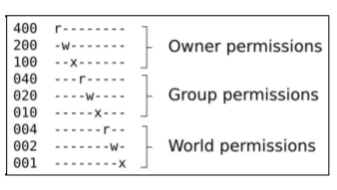
Root filesystem – POSIX file access permission
Every process, which in the context of this discussion means every running program, belongs to a user and one or more groups. The user is represented by a 32-bit number called the user ID or UID. Information about users, including the mapping from a UID to a name, is kept in /etc/passwd. Likewise, groups are represented by a group ID or GID with information kept in /etc/group. There is always a root user with a UID of 0 and a root group with a GID of 0. The root user is also called the superuser because; in a default configuration, it bypasses most permission checks and can access all the resources in the system. Security in Linux-based systems is mainly about restricting access to the root account.

Slide 24
Thank You!!

