Slide 1
IMP module
Nov, 2021

Slide 2
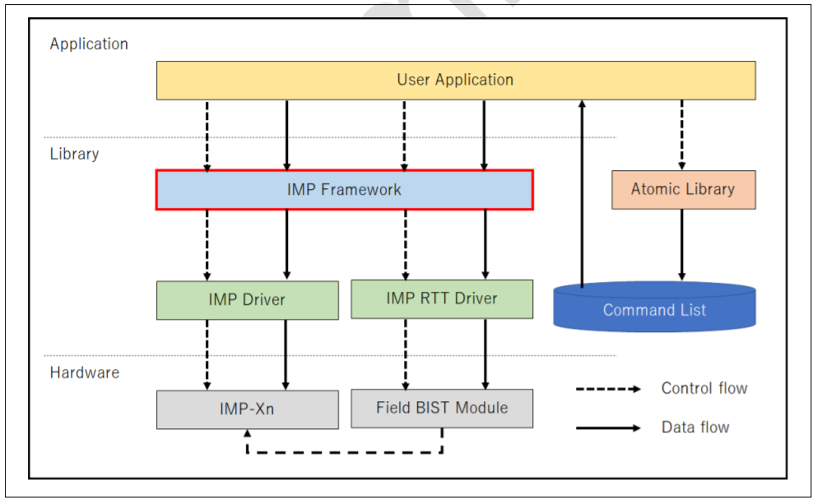
IMP
IMP module is used to process pictures using a variety of methods and algorithms.
These methods and algorithms provided by Atomic Library.
Notes:
The microkernel differs from an executive in how the IPC services are used to extend the functionality of the kernel with additional, service-providing processes. Since the OS is implemented as a team of cooperating processes managed by the microkernel, user-written processes can serve both as applications and as processes that extend the underlying OS functionality for industry-specific applications. The OS itself becomes "open" and easily extensible. Moreover, user-written extensions to the OS won't affect the fundamental reliability of the core OS.

Slide 3
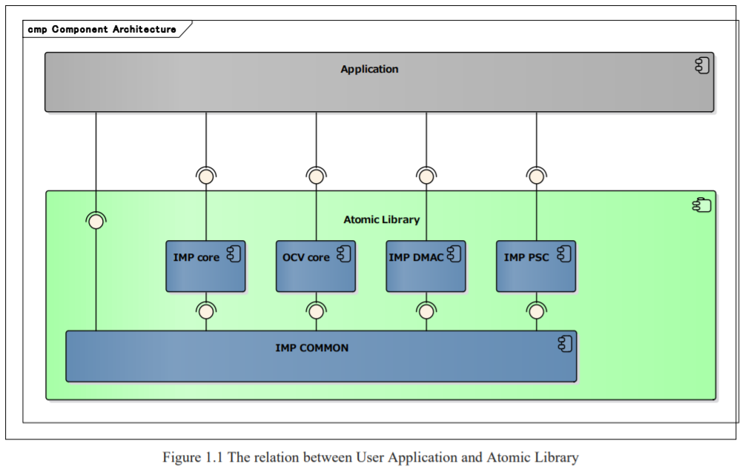
Atomic Lib includes four cores

Slide 4
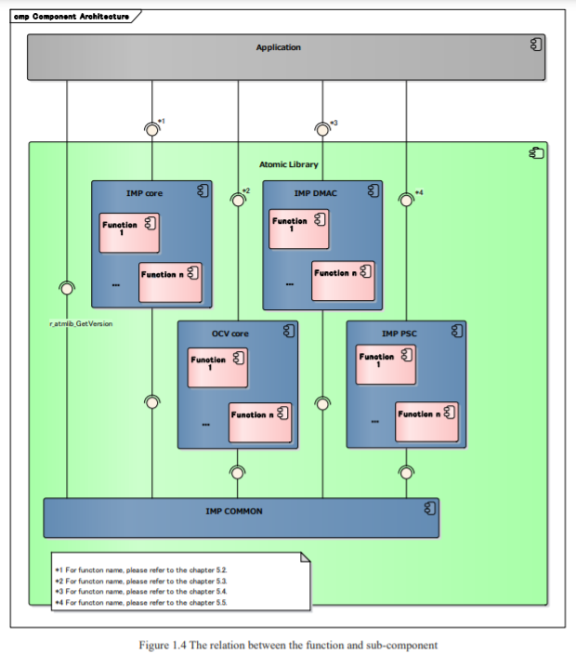
Each core has a list of functions

Slide 5
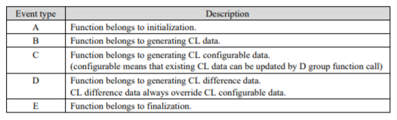
These function can be classified

Slide 6
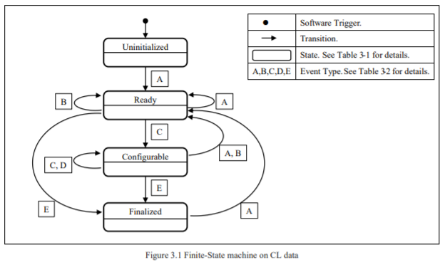
Finite-state machine
These types of function decide the way it change the state.

Slide 7
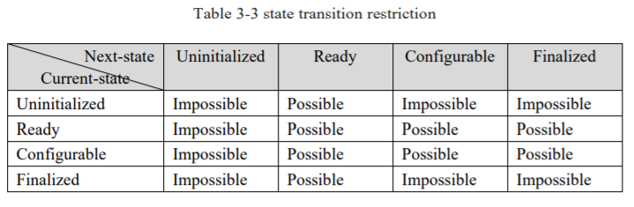
Transition state restriction

Slide 8
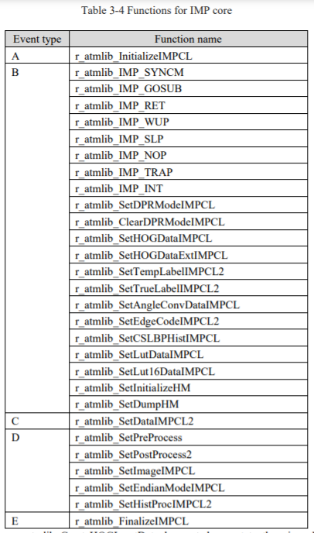
IMP core function list

Slide 9
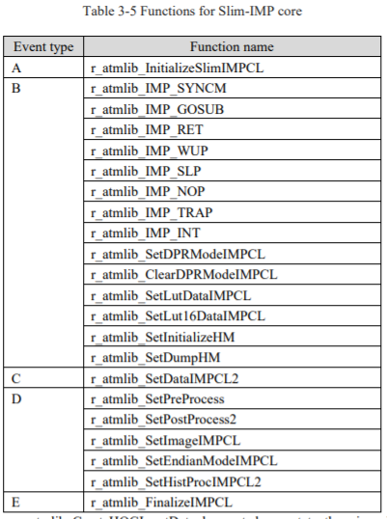
Slim-IMP core function list

Slide 10
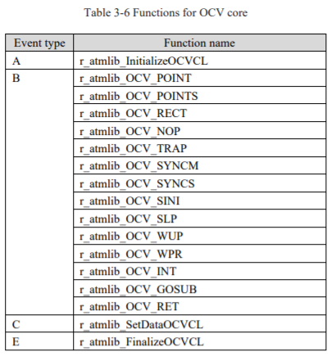
OCV core

Slide 11
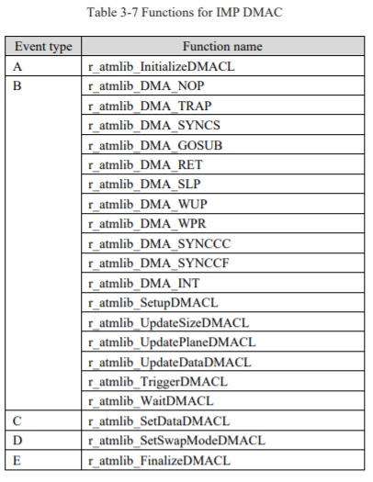
IMP DMAC

Slide 12
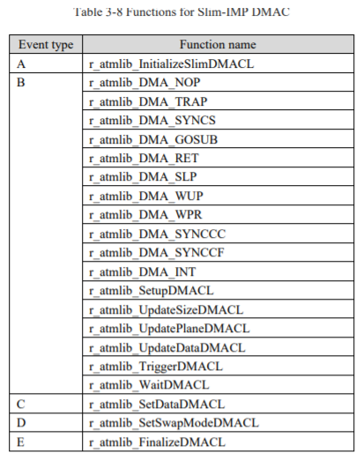
Slim-IMP DMAC

Slide 13
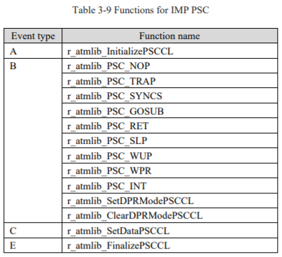
IMP PSC

Slide 14
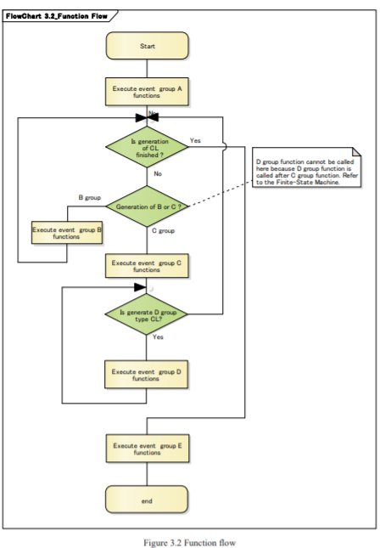
General function flow

Slide 15
Command list
Command list is the list of all the algorithms to change picture.
Change picture color by adding, subtracting, multiplying, dividing, shifting …
Convert lut using lut table.
Smoothing.
Filtering.
Interpolating.
Zooming in/out
….

Slide 16
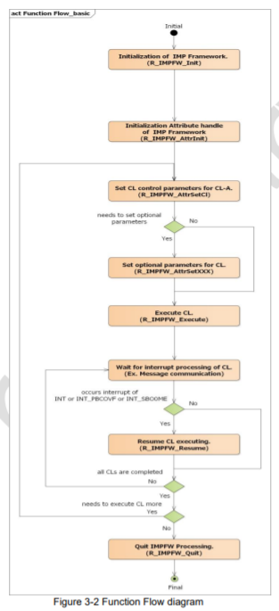
IMP basic function flow

Slide 17
Thank You!!

