Slide 1
IMR module
Nov, 2021

Slide 2
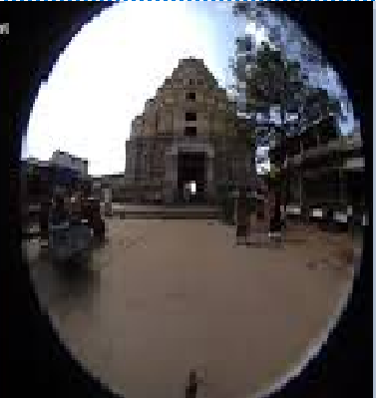
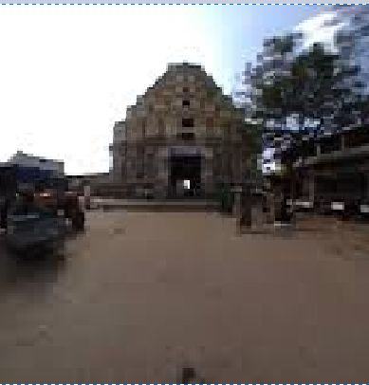
IMR
IMR module is a module to flatten distorted images recorded using an fish-eyed camera.
Notes:
The microkernel differs from an executive in how the IPC services are used to extend the functionality of the kernel with additional, service-providing processes. Since the OS is implemented as a team of cooperating processes managed by the microkernel, user-written processes can serve both as applications and as processes that extend the underlying OS functionality for industry-specific applications. The OS itself becomes "open" and easily extensible. Moreover, user-written extensions to the OS won't affect the fundamental reliability of the core OS.

Slide 3
IMR
And to rotate it too.

Slide 4
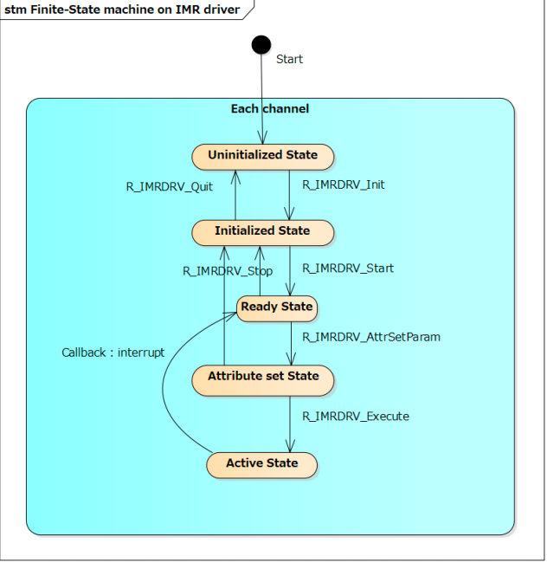
IMR – finite state machine
3.1.1Uninitialized State This is the initial state of the driver immediately after booting the system. When R_IMRDRV_Init is called, the driver state is changed to the Initialized State.
3.1.2 Initialized State This state indicates that the IMR Driver has been initialized. When R_IMRDRV_Start is called, the driver state is changed to the Ready State. When R_IMRDRV_Quit is called, the driver state is changed to the Uninitialized State. Note that this state is managed for each channel.
3.1.3 Ready State This state indicates that the channel is ready to execute DL. When R_IMRDRV_AttrSetParam is called, the driver state is changed to the Attribute set State. When R_IMRDRV_Stop is called, the driver state is changed to Initialized State.
3.1.4 Attribute set State This state indicates that the channel is set attribute parameter for executing DL. When R_IMRDRV_Execute is called, the driver state is changed to the Active State. When R_IMRDRV_Stop is called, the driver state is changed to Initialized State.
3.1.5 Active State This state indicates that the channel is executing DL which is provided by R_IMRDRV_Execute. When the execution is completed, the driver state is changed to the Ready State. When the execution is interrupted by the TRAP, IER, WUPOVF and WUPERR interrupt, the driver state is changed to
Notes:
The microkernel differs from an executive in how the IPC services are used to extend the functionality of the kernel with additional, service-providing processes. Since the OS is implemented as a team of cooperating processes managed by the microkernel, user-written processes can serve both as applications and as processes that extend the underlying OS functionality for industry-specific applications. The OS itself becomes "open" and easily extensible. Moreover, user-written extensions to the OS won't affect the fundamental reliability of the core OS.

Slide 5
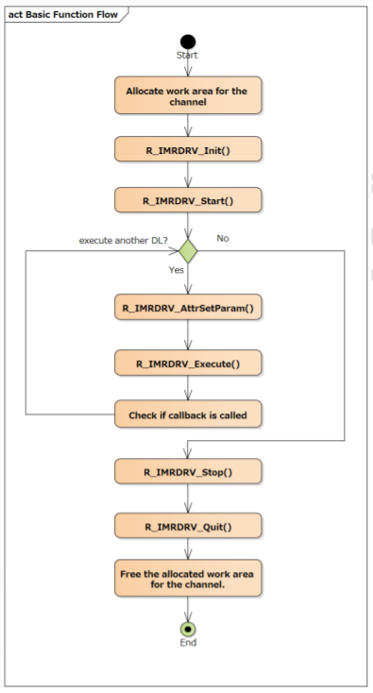
IMR - Basic Function Flow

Slide 6
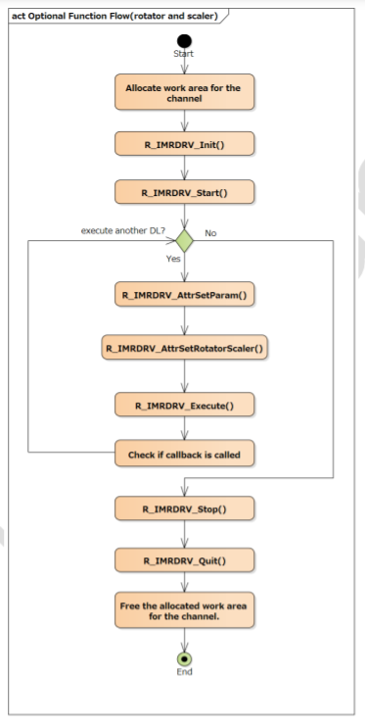
IMR - Basic Function Flow

Slide 7
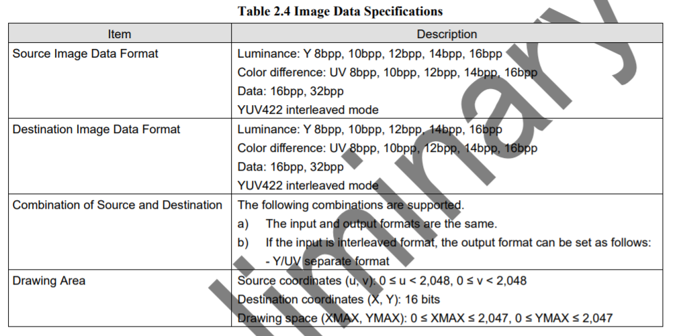
Specification for input and output

Slide 8
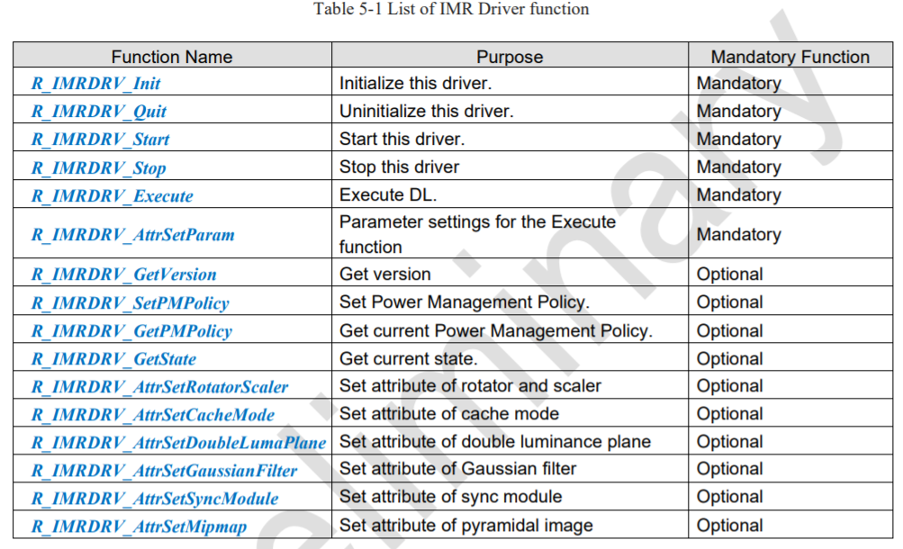
Some main API

Slide 9
Implement in source - init
To init IMR for each channel.
R_IMRDRV_Init( &initdata[channel], &os_config[channel], callback_func, (void*)&IMR_cond_handle[channel], &ctrhandle[channel] );
To get DL for Y and UV part
p_dl_top = get_DL_addr(dl_sel_t[channel][i], &dl_num);
Setup IMR device driver.
ret_imr = R_IMRDRV_Start( ctrhandle[channel]);
Config color format for input and output.
imr_mem_info[channel].attr_param[0].src_data.bpp = IMRDRV_BPP_8;
imr_mem_info[channel].attr_param[0].src_data.stride = IMRSMP_SRC_WIDTH; imr_mem_info[channel].attr_param[0].dst_data.bpp = IMRDRV_BPP_8;
imr_mem_info[channel].attr_param[0].dst_data.stride = IMRSMP_DST_WIDTH; imr_mem_info[channel].attr_param[0].src_data.color_format = IMRDRV_COLOR_FORM_SEP_Y; imr_mem_info[channel].attr_param[0].dst_data.color_format = IMRDRV_COLOR_FORM_SEP_Y;

Slide 10
Implement in source - main
Receive message from Vin
ret_osal = T_APP_mq_recv_data("IMR", IMR_mq_hndl[channel], OSAL_MQ_TIMEOUT, (const void *)&msg_receive, sizeof(st_msg_image_t));
Set data and process and then wait for callback
set_data_imr(my_mem_info);
execute_imr(my_mem_info, channel, msg_receive.frame_id);

Slide 11
Implement in source - deinit
Stop IMR
R_IMRDRV_Stop(ctrhandle[channel] );
Quit IMR
ret_imr = R_IMRDRV_Quit(ctrhandle[channel]);

Slide 12
Thank You!!

