Slide 1
LDE module
Nov, 2021

Slide 2
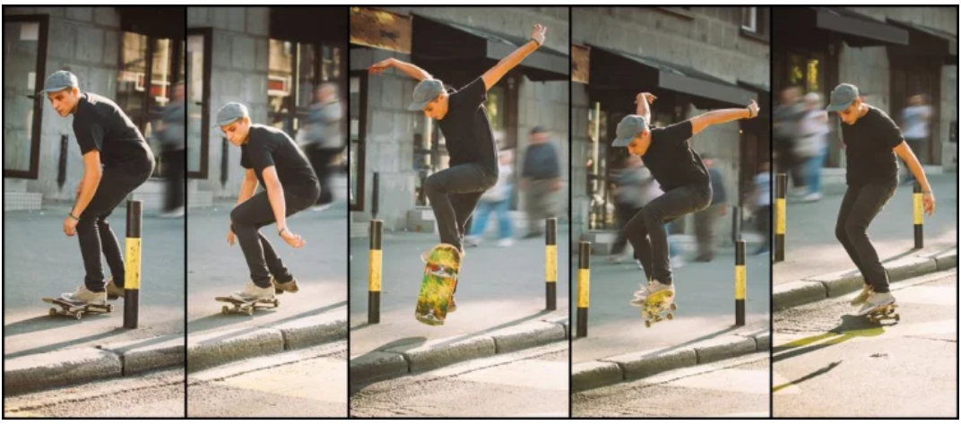

LDE
LDE is a module to turn a series of pictures into a movie in h264 format.
A movie in h264 format
Notes:
The microkernel differs from an executive in how the IPC services are used to extend the functionality of the kernel with additional, service-providing processes. Since the OS is implemented as a team of cooperating processes managed by the microkernel, user-written processes can serve both as applications and as processes that extend the underlying OS functionality for industry-specific applications. The OS itself becomes "open" and easily extensible. Moreover, user-written extensions to the OS won't affect the fundamental reliability of the core OS.

Slide 3
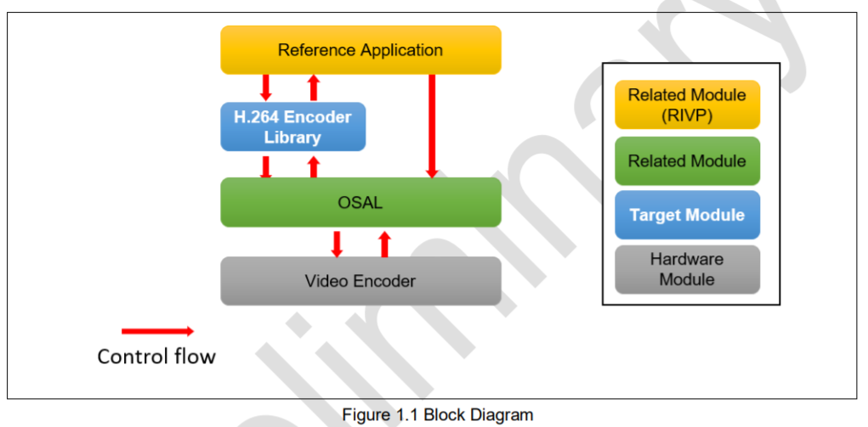
Block diagram

Slide 4
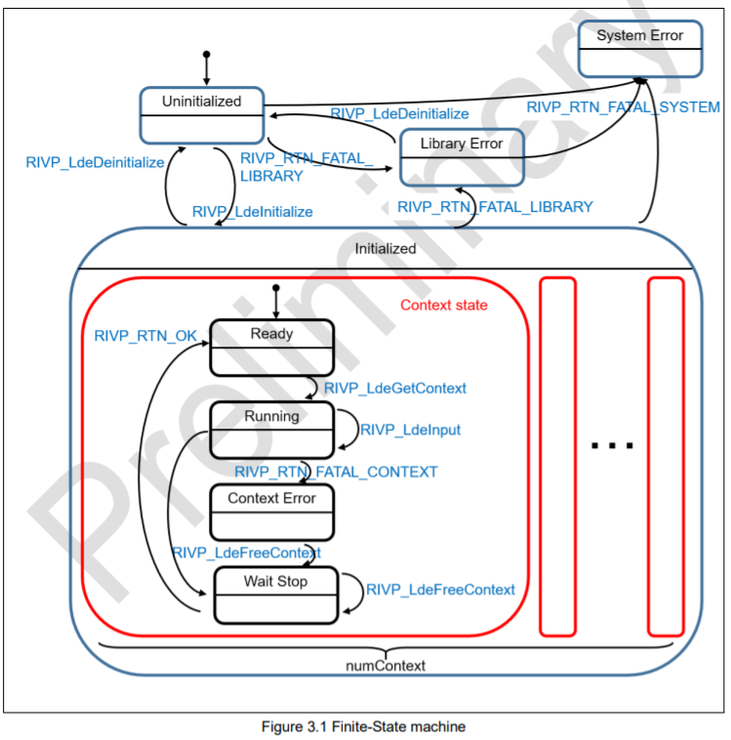
State machine of LDE

Slide 5
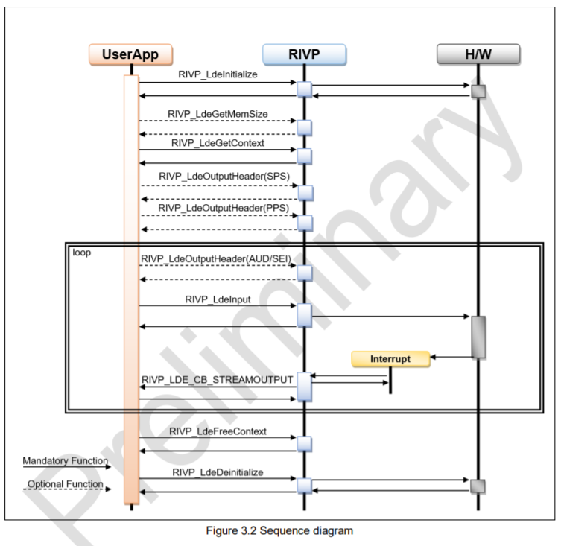
Function flow

Slide 6
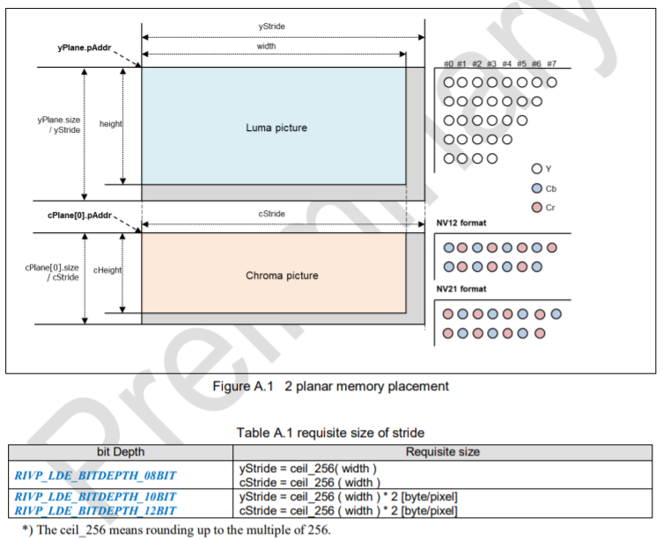
LDE support NV12/NV21 and three planar format

Slide 7
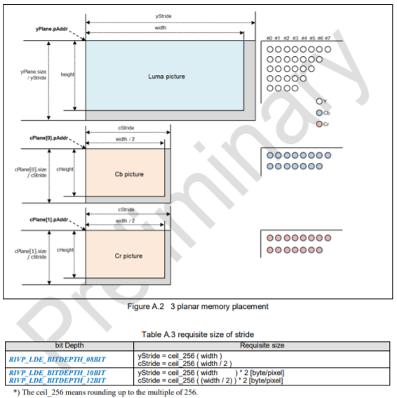
LDE support NV12/NV21 and three planar format

Slide 8
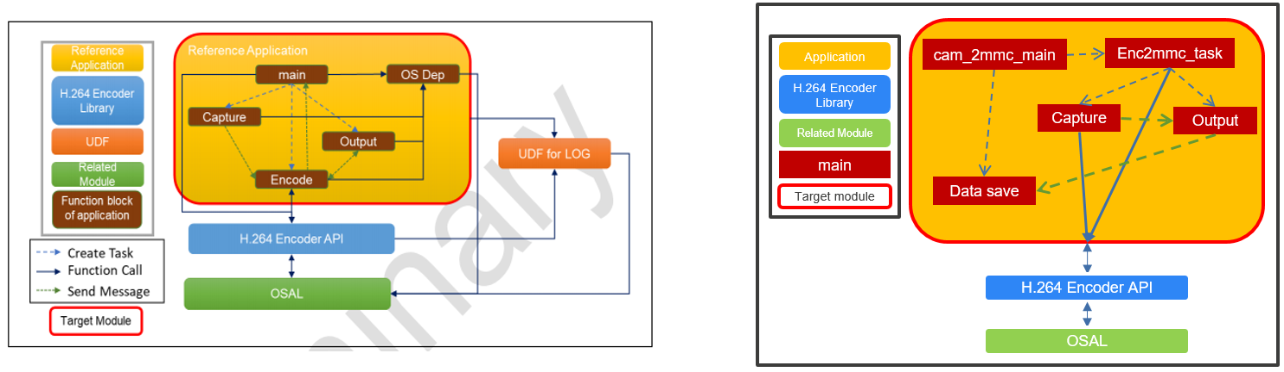
Sample LDE vs. LDE implementation on Linux
Capture: get pictures from sources.
Encode: Encode pictures into h264 video.
Output: Handle output video and write to file or mem by calling data save.

Slide 9
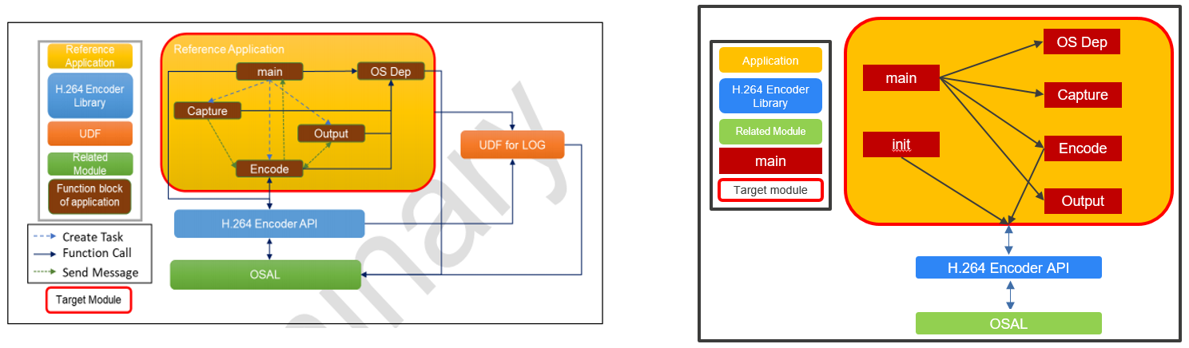
Sample LDE vs. LDE implementation on QNX
Capture: get pictures from sources.
Encode: Encode pictures into h264 video.
Output: Handle output video and write to file or mem.

Slide 10
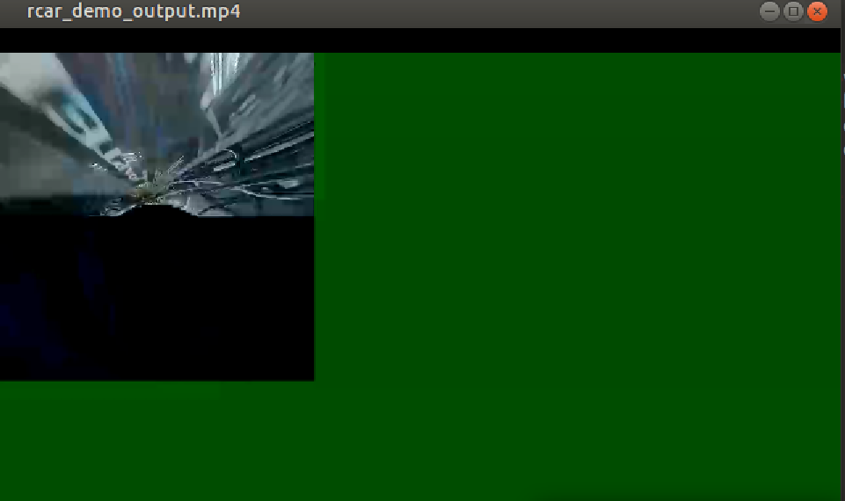
How to play h264

Slide 11
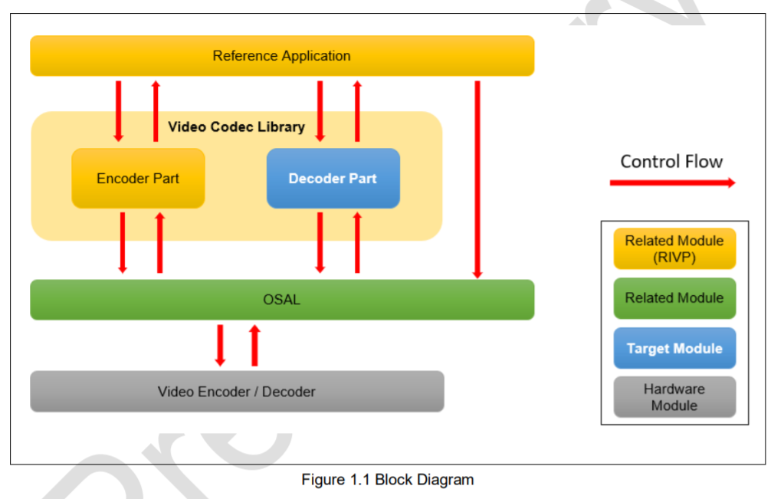
Decode

Slide 12
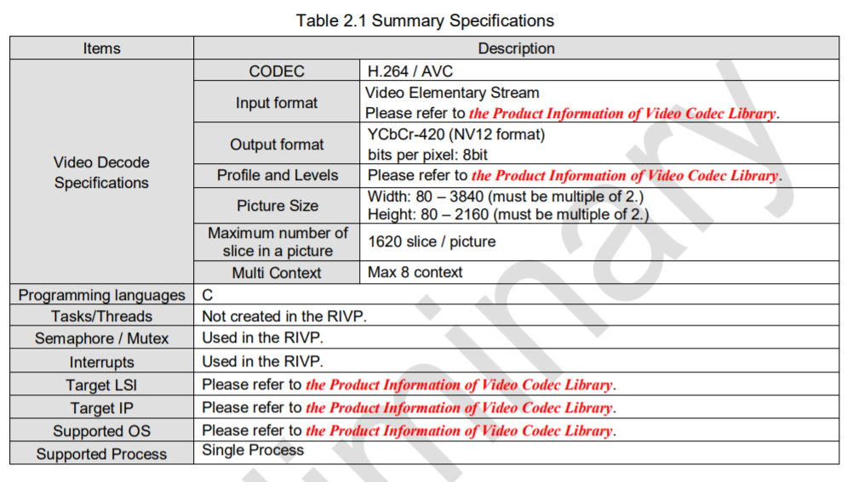
Summary of Specifications

Slide 13
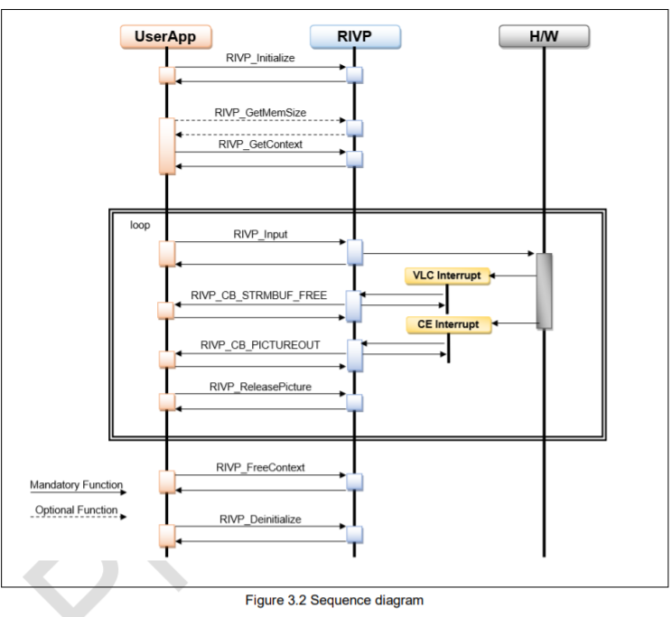
Sequence diagram

Slide 14
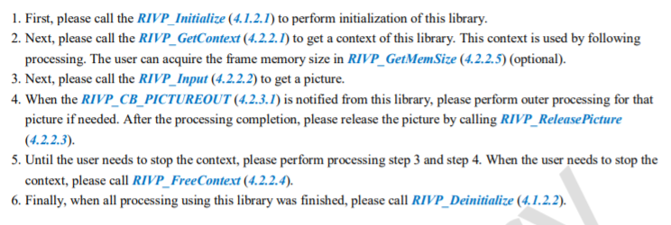
Sequence diagram

Slide 15
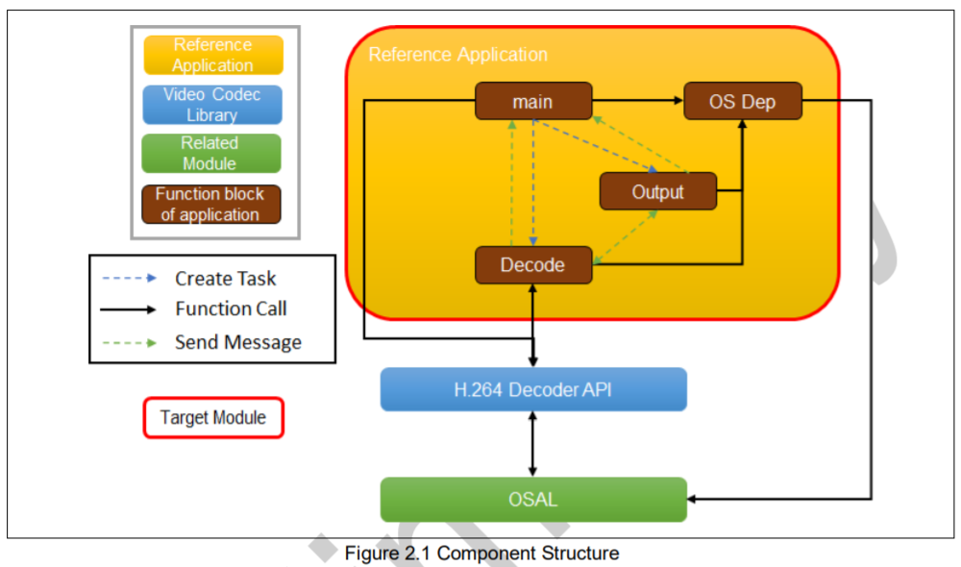
App structure

Slide 16
main
RIVP_AppOsalInit: Init osal, create one mutex, open MMGR handle
RIVP_AppOsalInit
main
RIVP_AppAvcMain:
+ Init App info: allocate mem for app, file, codecConfig, set default value for config, set info of file and size.
+ RIVP_AppAvcInitLibProc -> RIVP_Intialize
+ RIVP_GetVersion: check version of RIVP
+ RIVP_AppCmnCreateResource: create queue for main, dec, strmfree, picout, create thread dec and out
+ RIVP_AppOsalQueuereceive: Wait for messages.
+ RIVP_Deinitialize: Deinit for RIVP.
+ RIVP_AppCmnPerformanceResult: Show app performance.
+ RIVP_AppCmnDestroyResource
RIVP_AppOsalDeinit: close MMGR driver, destroy mutexes.

Slide 17
RIVP_AppOsalInit
R_OSAL_Initialize: Initialize Osal.
RIVP_AppOsalInit
RIVP_AppOsalSemInit
+ Initialize sem array s_rivpAppOsalSemData[lCnt].handle = RIVP_NULL;
+ Create on mutex s_rivpAppOsalSemSem R_OSAL_ThsyncMutexCreate(RIVP_APP_OSAL_MUTEX_ID_00, (osal_mutex_handle_t *)&s_rivpAppOsalSemSem);
+ Set s_rivpAppOsalSemInit = RIVP_TRUE;
RIVP_AppMmgrOpen
+ Create one mutex RIVP_AppOsalSemCreate(&s_rivpAppMmgrSem)
+ Lock using mutex RIVP_AppOsalSemLock(s_rivpAppMmgrSem);
+ Set config lMmgrCfg
+ Open memory handler R_OSAL_MmngrOpen(&lMmgrCfg, &s_rivpAppMmgrHandle);
+ Register callback functions for allocation and deallocation.
+ Memset for s_rivpAppMmgrMemBlock
and s_rivpAppMemAddr

Slide 18
RIVP_AppAvcMain
RIVP_AppAvcInitAppInfo
+ app, file, codecConfig RIVP_AppCmnMemAlloc(&lAppPtr, &lFilePtr, (RIVP_U32**)&lAvcConfigPtr);
+ Set default parameters RIVP_AppCmnSetDefaultXy(lAppPtr);
+ initialize application control information: file, file size, buffer
RIVP_AppAvcMain
RIVP_AppAvcInitLibProc: call RIVP_Intialize to initialize RIVP.
RIVP_GetVersion: Get version of RIVP
RIVP_AppCmnCreateResource: create queue for main, dec, strmfree, picout, create thread dec and out
RIVP_AppOsalQueuereceive: Wait for messages.
RIVP_Deinitialize: Deinit for RIVP.
RIVP_AppCmnPerformanceResult: Show app performance.

Slide 19
RIVP_AppOsalDeinit
RIVP_AppOsalDeinit
RIVP_AppMmgrClose
+ lock semaphore for memory driver RIVP_AppOsalSemLock(s_rivpAppMmgrSem);
+ Check lock and close resource R_OSAL_MmngrClose(s_rivpAppMmgrHandle);
+ set resource management handler to null s_rivpAppMmgrHandle = RIVP_NULL;
RIVP_AppOsalSemDeinit
+ Destroy array of mutexes RIVP_AppOsalSemDestroy(s_rivpAppOsalSemData[lCnt].handle);
+ Destroy one mutex
R_OSAL_ThsyncMutexDestroy(s_rivpAppOsalSemSem);

Slide 20
RIVP_AppDecTask
lAppPtr = (RIVP_APP_CMN_PARAM_T*)arg;
Get context RIVP_AppDecAvcGetCtxProc(lAppPtr)
+ initialize for AVC RIVP_AppDecAvcInitCtxParam(app);
+ get memory size RIVP_GetMemSize(&app->ctxParam, &app->ctxParam.fmemSize, &app->ctxParam.hwWork.size);
+ allocate RIVP resource(stream/frame memory) from mmngr. RIVP_AppCmnMemAllocOsal(app, app->file);
+ create context RIVP_GetContext(&app->ctxParam, &app->ctx);
input stream RIVP_AppDecAvcInput(lAppPtr);
Wait output RIVP_AppOsalQReceive(&lAppPtr->msgInf[DEC_MSG_QUEUE], (RIVP_PTR)&lDecMsg)
free context RIVP_AppDecAvcFreeCtxProc(lAppPtr);
send message main message queue RIVP_AppOsalQueueSend(&lAppPtr->msgInf[RIVP_APP_MAIN_MSG_QUEUE], (RIVP_PTR)&lMainMsg);

Slide 21
RIVP_AppDecAvcInput
create RIVP_INPUTPARAM_T for RIVP_Input, update stream information
RIVP_AppCmnUpdateInputParam(app, app->file);

Slide 22
Pic out callback
RIVP_STATIC void RIVP_AppDecAvcCbPicOut(RIVP_PTR const ctx, RIVP_PTR const udptr, const RIVP_PICPARAM_T *const pic)
{
RIVP_APP_CMN_PARAM_T *lAppPtr;
RIVP_BOOL lBoolRet;
RIVP_APP_MSG_PICOUT_T lPicMsg;
/* avoid compile warning */
(void)ctx;
if ((udptr != RIVP_NULL) && (pic != RIVP_NULL)) {
lAppPtr = (RIVP_APP_CMN_PARAM_T*)udptr;
/* set performance information(from RIVP_Input to CbPicOut) */
RIVP_AppCmnGetProcTime(lAppPtr, RIVP_APP_FUNC_PICOUT);
if (lAppPtr->perf.funcCnt[RIVP_APP_FUNC_FIRST_PIC] == 0u) {
RIVP_AppCmnGetProcTime(lAppPtr, RIVP_APP_FUNC_FIRST_PIC);
}
/* send message */
lPicMsg.picParam = *pic;
lBoolRet = RIVP_AppOsalQueueSend(&lAppPtr->msgInf[RIVP_APP_PICOUT_MSG_QUEUE], (RIVP_PTR)&lPicMsg);
if (lBoolRet != RIVP_TRUE) {
printf("[APP][ERROR] :Failed to RIVP_AppDecAvcCbPicOut. Send message error.\n");
}
} else {
printf("[APP][ERROR] :Failed to RIVP_AppDecAvcCbPicOut. Argument is NULL.\n");
}
}

Slide 23
Thank You!!

