Slide 1
QNX OS
Jan, 2021

Slide 2
QNX architecture
The guide describes the philosophy of QNX Neutrino and the architecture used to robustly implement the OS. It covers message-passing services, followed by the details of the microkernel, the process manager, resource managers, the Photon microGUI, and other aspects of QNX Neutrino.
Some advantages of QNX OS:
+ portable application code (between product-line members)
+ common tools used to develop the entire product line
+ portable skill sets of development staff
+ reduced time-to-market.
Source documentation: http://www.qnx.com/developers/docs/6.5.0/index.jsp?topic=%2Fcom.qnx.doc.neutrino_sys_arch%2Fabout.html
Notes:
When we create a new thread in a process, the new thread of execution gets its own stack (and hence local variables) but shares global variables, file descriptors, signal handlers, and its current directory state with the process that created it.
Fork duplicates the current process, creating a new entry in the process table with many of the same attributes as the current process.
The new process is almost identical to the original, executing the same code but with its own data space, environment, and file descriptors. This new process is scheduled independently, and (in general) executes almost independently of the process that created it.

Slide 3
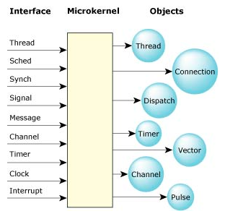
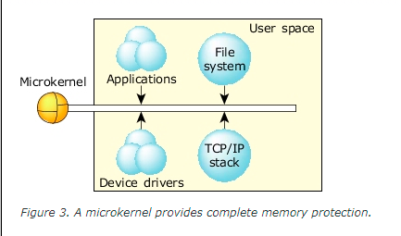
QNX architecture
The microkernel contains a few fundamental objects and the highly tuned routines that manipulate them. The OS is built from this foundation.
Notes:
The microkernel differs from an executive in how the IPC services are used to extend the functionality of the kernel with additional, service-providing processes. Since the OS is implemented as a team of cooperating processes managed by the microkernel, user-written processes can serve both as applications and as processes that extend the underlying OS functionality for industry-specific applications. The OS itself becomes "open" and easily extensible. Moreover, user-written extensions to the OS won't affect the fundamental reliability of the core OS.

Slide 4
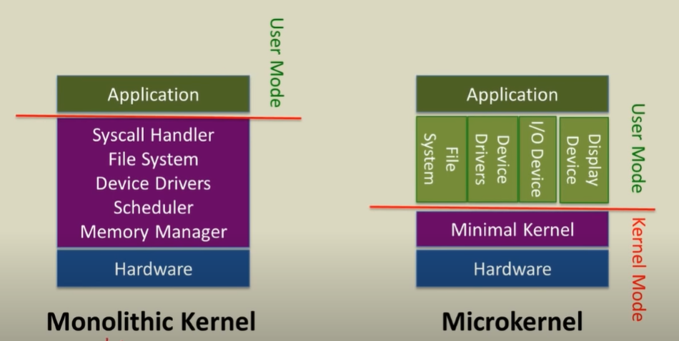
QNX architecture
Thread and process(IPC)
A thread can be thought of as the minimum “unit of execution,” the unit of scheduling and execution in the microkernel. A process, on the other hand, can be thought of as a “container” for threads, defining the “address space” within which threads will execute. A process will always contain at least one thread.
Notes:
The microkernel differs from an executive in how the IPC services are used to extend the functionality of the kernel with additional, service-providing processes. Since the OS is implemented as a team of cooperating processes managed by the microkernel, user-written processes can serve both as applications and as processes that extend the underlying OS functionality for industry-specific applications. The OS itself becomes "open" and easily extensible. Moreover, user-written extensions to the OS won't affect the fundamental reliability of the core OS.

Slide 5
QNX architecture
POSIX call | Microkernel call | Description
pthread_create() | ThreadCreate() | Create a new thread of execution.
pthread_exit() | ThreadDestroy() | Destroy a thread.
pthread_detach() | ThreadDetach() | Detach a thread so it doesn't need to be joined.
pthread_join() | ThreadJoin() | Join a thread waiting for its exit status.
pthread_cancel() | ThreadCancel() | Cancel a thread at the next cancellation point.
N/A | ThreadCtl() | Change a thread's Neutrino-specific thread characteristics.
pthread_mutex_init() | SyncTypeCreate() | Create a mutex.
pthread_mutex_destroy() | SyncDestroy() | Destroy a mutex.
pthread_mutex_lock() | SyncMutexLock() | Lock a mutex.
pthread_mutex_trylock() | SyncMutexLock() | Conditionally lock a mutex.
pthread_mutex_unlock() | SyncMutexUnlock() | Unlock a mutex.
pthread_cond_init() | SyncTypeCreate() | Create a condition variable.
pthread_cond_destroy() | SyncDestroy() | Destroy a condition variable.
pthread_cond_wait() | SyncCondvarWait() | Wait on a condition variable.
pthread_cond_signal() | SyncCondvarSignal() | Signal a condition variable.
pthread_cond_broadcast() | SyncCondvarSignal() | Broadcast a condition variable.
pthread_getschedparam() | SchedGet() | Get the scheduling parameters and policy of a thread.
pthread_setschedparam(), pthread_setschedprio() | SchedSet() | Set the scheduling parameters and policy of a thread.
pthread_sigmask() | SignalProcmask() | Examine or set a thread's signal mask.
pthread_kill() | SignalKill() | Send a signal to a specific thread.

Slide 6
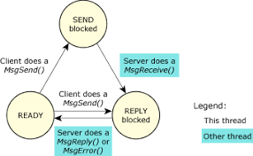
QNX architecture
Thread and process(IPC)
Synchronous message passing
Channels and connections
Events
Signals
POSIX message queues
Shared memory
Typed memory
Pipes and FIFOs
Notes:
The microkernel differs from an executive in how the IPC services are used to extend the functionality of the kernel with additional, service-providing processes. Since the OS is implemented as a team of cooperating processes managed by the microkernel, user-written processes can serve both as applications and as processes that extend the underlying OS functionality for industry-specific applications. The OS itself becomes "open" and easily extensible. Moreover, user-written extensions to the OS won't affect the fundamental reliability of the core OS.

Slide 7
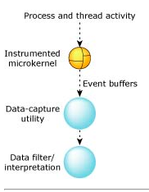
QNX architecture
The Instrumented Microkernel
The instrumented microkernel (procnto-instr) emits trace events as a result of various system activities. These events are automatically copied to a set of buffers grouped into a circular linked list.
As soon as the number of events inside a buffer reaches the high-water mark, the kernel notifies a data-capture utility.
The data-capture utility then writes the trace events from the buffer to an output device (e.g. a serial port, an event file, etc.).
A data-interpretation facility then interprets the events and presents this data to the user.
Notes:
The microkernel differs from an executive in how the IPC services are used to extend the functionality of the kernel with additional, service-providing processes. Since the OS is implemented as a team of cooperating processes managed by the microkernel, user-written processes can serve both as applications and as processes that extend the underlying OS functionality for industry-specific applications. The OS itself becomes "open" and easily extensible. Moreover, user-written extensions to the OS won't affect the fundamental reliability of the core OS.

Slide 8
QNX architecture
Multicore Processing
Feature | SMP | BMP | AMP
Seamless resource sharing | Yes | Yes | —
Scalable beyond dual CPU | Yes | Yes | Limited
Legacy application operation | In most cases | Yes | Yes
Mixed OS environment (e.g. Neutrino and Linux) | — | — | Yes
Dedicated processor by function | — | Yes | Yes
Intercore messaging | Fast (OS primitives) | Fast (OS primitives) | Slower (application)
Thread synchronization between CPUs | Yes | Yes | —
Load balancing | Yes | Yes | —
System-wide debugging and optimization | Yes | Yes | —
Notes:
The microkernel differs from an executive in how the IPC services are used to extend the functionality of the kernel with additional, service-providing processes. Since the OS is implemented as a team of cooperating processes managed by the microkernel, user-written processes can serve both as applications and as processes that extend the underlying OS functionality for industry-specific applications. The OS itself becomes "open" and easily extensible. Moreover, user-written extensions to the OS won't affect the fundamental reliability of the core OS.

Slide 9
QNX architecture
Process Manager
Process management
Memory management
Pathname management.
Notes:
The microkernel differs from an executive in how the IPC services are used to extend the functionality of the kernel with additional, service-providing processes. Since the OS is implemented as a team of cooperating processes managed by the microkernel, user-written processes can serve both as applications and as processes that extend the underlying OS functionality for industry-specific applications. The OS itself becomes "open" and easily extensible. Moreover, user-written extensions to the OS won't affect the fundamental reliability of the core OS.

Slide 10
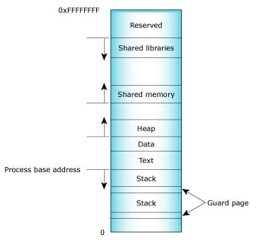
QNX architecture
Dymamic linking
The term statically linked means that the program and the particular library that it's linked against are combined together by the linker at linktime
The term dynamically linked means that the program and the particular library it references are not combined together by the linker at linktime
Notes:
The microkernel differs from an executive in how the IPC services are used to extend the functionality of the kernel with additional, service-providing processes. Since the OS is implemented as a team of cooperating processes managed by the microkernel, user-written processes can serve both as applications and as processes that extend the underlying OS functionality for industry-specific applications. The OS itself becomes "open" and easily extensible. Moreover, user-written extensions to the OS won't affect the fundamental reliability of the core OS.

Slide 11
QNX architecture
Resource managers
The OS allows user-written processes to act as resource managers that can be started and stopped dynamically.
Resource managers are typically responsible for presenting an interface to various types of devices. This may involve managing actual hardware devices (like serial ports, parallel ports, network cards, and disk drives) or virtual devices (like /dev/null, a network filesystem, and pseudo-ttys).
Notes:
The microkernel differs from an executive in how the IPC services are used to extend the functionality of the kernel with additional, service-providing processes. Since the OS is implemented as a team of cooperating processes managed by the microkernel, user-written processes can serve both as applications and as processes that extend the underlying OS functionality for industry-specific applications. The OS itself becomes "open" and easily extensible. Moreover, user-written extensions to the OS won't affect the fundamental reliability of the core OS.

Slide 12
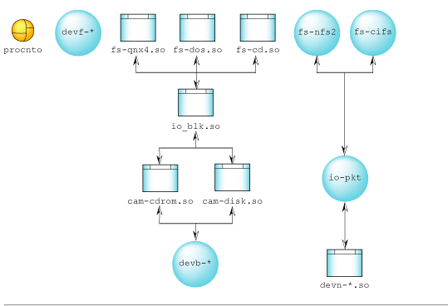
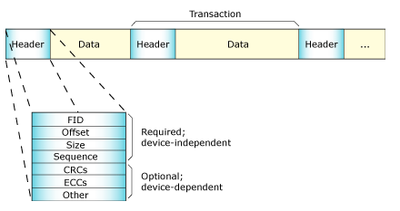
QNX architecture
Filesystems
Each filesystem adopts a portion of the pathname space (called a mountpoint) and provides filesystem services through the standard POSIX API (open(), close(), read(), write(), lseek(), etc.). Filesystem resource managers take over a mountpoint and manage the directory structure below it. They also check the individual pathname components for permissions and for access authorizations.
Notes:
The microkernel differs from an executive in how the IPC services are used to extend the functionality of the kernel with additional, service-providing processes. Since the OS is implemented as a team of cooperating processes managed by the microkernel, user-written processes can serve both as applications and as processes that extend the underlying OS functionality for industry-specific applications. The OS itself becomes "open" and easily extensible. Moreover, user-written extensions to the OS won't affect the fundamental reliability of the core OS.

Slide 13
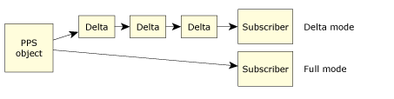
QNX architecture
PPS
A thread can be thought of as the minimum “unit of execution,” the unit of scheduling and execution in the microkernel. A process, on the other hand, can be thought of as a “container” for threads, defining the “address space” within which threads will execute. A process will always contain at least one thread.
Notes:
The microkernel differs from an executive in how the IPC services are used to extend the functionality of the kernel with additional, service-providing processes. Since the OS is implemented as a team of cooperating processes managed by the microkernel, user-written processes can serve both as applications and as processes that extend the underlying OS functionality for industry-specific applications. The OS itself becomes "open" and easily extensible. Moreover, user-written extensions to the OS won't affect the fundamental reliability of the core OS.

Slide 14
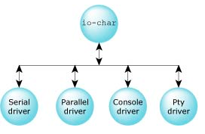
QNX architecture
Character I/O
Programs access character devices using the standard open(), close(), read(), and write() API functions. Additional functions are available for manipulating other aspects of the character device, such as baud rate, parity, flow control, etc.
Notes:
The microkernel differs from an executive in how the IPC services are used to extend the functionality of the kernel with additional, service-providing processes. Since the OS is implemented as a team of cooperating processes managed by the microkernel, user-written processes can serve both as applications and as processes that extend the underlying OS functionality for industry-specific applications. The OS itself becomes "open" and easily extensible. Moreover, user-written extensions to the OS won't affect the fundamental reliability of the core OS.

Slide 15
QNX architecture
Networking architecture
To unload a legacy io-net driver, you can use the umount command. For example:
umount /dev/io-net/en0
To unload a new-style driver or a legacy io-net driver, use the ifconfig destroy command:
ifconfig bge0 destroy
Notes:
The microkernel differs from an executive in how the IPC services are used to extend the functionality of the kernel with additional, service-providing processes. Since the OS is implemented as a team of cooperating processes managed by the microkernel, user-written processes can serve both as applications and as processes that extend the underlying OS functionality for industry-specific applications. The OS itself becomes "open" and easily extensible. Moreover, user-written extensions to the OS won't affect the fundamental reliability of the core OS.

Slide 16
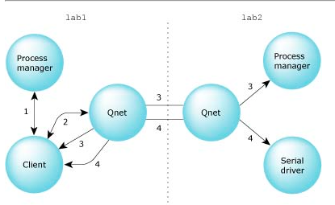
QNX architecture
Native Networking(Qnet)
Access your remote filesystem.
Scale your application with unprecedented ease.
Write applications using a collection of cooperating processes that communicate transparently with each other using Neutrino message-passing.
Extend your application easily beyond a single processor or SMP machine to several single-processor machines and distribute your processes among those CPUs.
Divide your large application into several processes, where each process can perform different functions. These processes coordinate their work using message passing.
Take advantage of Qnet's inherent remote procedure call functionality.
Notes:
The microkernel differs from an executive in how the IPC services are used to extend the functionality of the kernel with additional, service-providing processes. Since the OS is implemented as a team of cooperating processes managed by the microkernel, user-written processes can serve both as applications and as processes that extend the underlying OS functionality for industry-specific applications. The OS itself becomes "open" and easily extensible. Moreover, user-written extensions to the OS won't affect the fundamental reliability of the core OS.

Slide 17
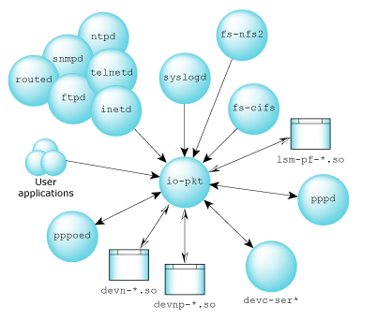
QNX architecture
TCP/IP Networking
Structure of the TCP/IP manager:
As a resource manager, io-pkt* benefits from the code savings and standard interface that all native resource managers enjoy. Due to the natural priority inheritance of QNX Neutrino IPC, clients will be dealt with in priority and time order, which leads to a more natural allocation of CPU resources.
Notes:
The microkernel differs from an executive in how the IPC services are used to extend the functionality of the kernel with additional, service-providing processes. Since the OS is implemented as a team of cooperating processes managed by the microkernel, user-written processes can serve both as applications and as processes that extend the underlying OS functionality for industry-specific applications. The OS itself becomes "open" and easily extensible. Moreover, user-written extensions to the OS won't affect the fundamental reliability of the core OS.

Slide 18
QNX architecture
High Availability
The ha_attach functions allow the client to provide a custom recovery function that's automatically invoked by the cover-function library
int recover_conn(int oldfd, void *hdl) { int newfd; Handle *thdl; thdl = (Handle *)hdl; newfd = ha_reopen(oldfd, TESTFILE, O_RDONLY); if (newfd >= 0) { // adjust file offset to previously known point lseek(newfd, thdl->curr_offset, SEEK_SET); // increment our count of successful recoveries (thdl->nr)++; } return(newfd); }
Notes:
The microkernel differs from an executive in how the IPC services are used to extend the functionality of the kernel with additional, service-providing processes. Since the OS is implemented as a team of cooperating processes managed by the microkernel, user-written processes can serve both as applications and as processes that extend the underlying OS functionality for industry-specific applications. The OS itself becomes "open" and easily extensible. Moreover, user-written extensions to the OS won't affect the fundamental reliability of the core OS.

Slide 19
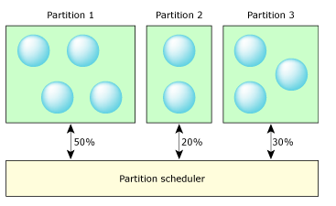
QNX architecture
Adaptive Partitioning
Some systems use virtual walls, called partitions, around a set of applications to ensure that each partition is given an engineered set of resources. The primary resource considered is CPU time, but can also include any shared resource, such as memory and file space (disk or flash).
Notes:
The microkernel differs from an executive in how the IPC services are used to extend the functionality of the kernel with additional, service-providing processes. Since the OS is implemented as a team of cooperating processes managed by the microkernel, user-written processes can serve both as applications and as processes that extend the underlying OS functionality for industry-specific applications. The OS itself becomes "open" and easily extensible. Moreover, user-written extensions to the OS won't affect the fundamental reliability of the core OS.

Slide 20
QNX architecture
The Photon microGUI
The ha_attach functions allow the client to provide a custom recovery function that's automatically invoked by the cover-function library
int recover_conn(int oldfd, void *hdl) { int newfd; Handle *thdl; thdl = (Handle *)hdl; newfd = ha_reopen(oldfd, TESTFILE, O_RDONLY); if (newfd >= 0) { // adjust file offset to previously known point lseek(newfd, thdl->curr_offset, SEEK_SET); // increment our count of successful recoveries (thdl->nr)++; } return(newfd); }
Notes:
The microkernel differs from an executive in how the IPC services are used to extend the functionality of the kernel with additional, service-providing processes. Since the OS is implemented as a team of cooperating processes managed by the microkernel, user-written processes can serve both as applications and as processes that extend the underlying OS functionality for industry-specific applications. The OS itself becomes "open" and easily extensible. Moreover, user-written extensions to the OS won't affect the fundamental reliability of the core OS.

Slide 21
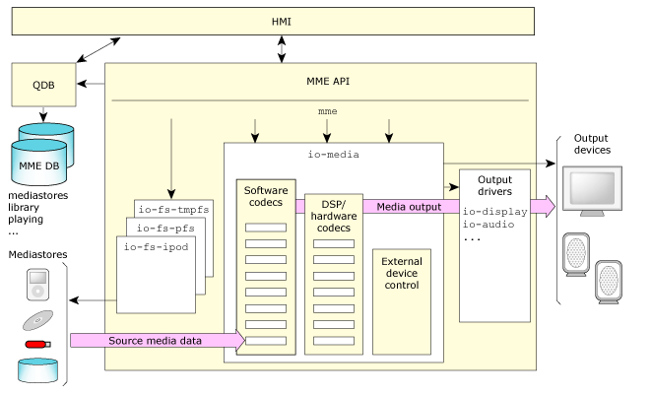
QNX architecture
Multimedia
The major component of the multimedia core package is the MultiMedia Engine (MME). The MME provides the main interfaces for configuring and controlling your multimedia applications. The MME provides consumer-product developers a component-based solution that reduces the work required to develop and deliver multimedia products to their end customers.
Notes:
The microkernel differs from an executive in how the IPC services are used to extend the functionality of the kernel with additional, service-providing processes. Since the OS is implemented as a team of cooperating processes managed by the microkernel, user-written processes can serve both as applications and as processes that extend the underlying OS functionality for industry-specific applications. The OS itself becomes "open" and easily extensible. Moreover, user-written extensions to the OS won't affect the fundamental reliability of the core OS.

Slide 22
QNX getting stated
Jan, 2021

Slide 23
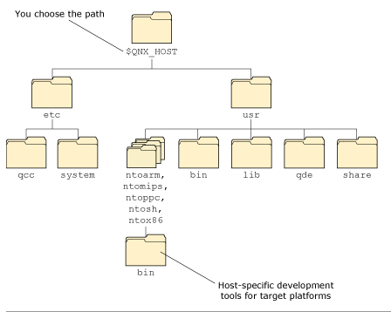
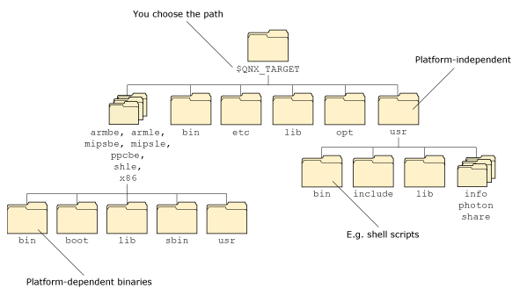
QNX GETTING STARTED
How QNX momentics is organized
The QNX Momentics Tool Suite is organized around these two main areas: Host-related and Target-related
Host-related Target-related
Notes:
The microkernel differs from an executive in how the IPC services are used to extend the functionality of the kernel with additional, service-providing processes. Since the OS is implemented as a team of cooperating processes managed by the microkernel, user-written processes can serve both as applications and as processes that extend the underlying OS functionality for industry-specific applications. The OS itself becomes "open" and easily extensible. Moreover, user-written extensions to the OS won't affect the fundamental reliability of the core OS.

Slide 24
QNX GETTING STARTED
How QNX momentics is organized
Component | Location
Buildfiles | $QNX_TARGET/platform/boot/build/boardname.build
Command-line utilities | For the host: $QNX_HOST/usr/bin and $QNX_HOST/platform/binFor the target: $QNX_TARGET/bin and $QNX_TARGET/platform/bin and $QNX_TARGET/platform/sbin
Device drivers (binaries) | $QNX_TARGET/platform/sbin
Device drivers (DLLs) | $QNX_TARGET/platform/lib/dll
Filesystems | $QNX_TARGET/platform/sbin
GUI-related | $QNX_TARGET/usr/photon
Shared libraries | $QNX_TARGET/platform/lib
System header files | $QNX_TARGET/usr/include
Documentation | Eclipse plugin directory, also in $QNX_TARGET/usr/help/product on self-hosted Neutrino systems
Notes:
The microkernel differs from an executive in how the IPC services are used to extend the functionality of the kernel with additional, service-providing processes. Since the OS is implemented as a team of cooperating processes managed by the microkernel, user-written processes can serve both as applications and as processes that extend the underlying OS functionality for industry-specific applications. The OS itself becomes "open" and easily extensible. Moreover, user-written extensions to the OS won't affect the fundamental reliability of the core OS.

Slide 25
QNX GETTING STARTED
What's on my desktop?
Windows
You can start the IDE by clicking its icon on the desktop:
IDE icon or by choosing QNX Momentics IDE from the Start-->All Programs-->QNX Software Development Platform menu. This menu also lets you add or activate licenses, configure your machine to build for a specific version of QNX Neutrino, run Phindows, and start the IDE.
Linux
The Start-->Programming menu lets you add or activate licenses, and start the IDE. You can also start the IDE by running the qde command.
Neutrino
The Launch-->Configure menu lets you add and activate licenses. The Help item in the Launch menu and on the shelf starts the Helpviewer, where you'll find the documentation.
Notes:
The microkernel differs from an executive in how the IPC services are used to extend the functionality of the kernel with additional, service-providing processes. Since the OS is implemented as a team of cooperating processes managed by the microkernel, user-written processes can serve both as applications and as processes that extend the underlying OS functionality for industry-specific applications. The OS itself becomes "open" and easily extensible. Moreover, user-written extensions to the OS won't affect the fundamental reliability of the core OS.

Slide 26
QNX GETTING STARTED
Upgrading software
Go to the QNX Software Systems website (http://www.qnx.com) and log into your myQNX account. If you don't already have a myQNX account, please register now.
Follow the instructions for registering your product. You'll need the Product Registration serial number and password, which you'll find in the box that contains the installation disks.
For more information about setting up your myQNX account, see Accessing Online Technical Support. There's a printed copy in the QNX Software Development Platform box, and a PDF version on the DVD and on our website.
Go to the Download area.
Select the product (e.g. “QNX Software Development Platform”) or search by keywords
Notes:
The microkernel differs from an executive in how the IPC services are used to extend the functionality of the kernel with additional, service-providing processes. Since the OS is implemented as a team of cooperating processes managed by the microkernel, user-written processes can serve both as applications and as processes that extend the underlying OS functionality for industry-specific applications. The OS itself becomes "open" and easily extensible. Moreover, user-written extensions to the OS won't affect the fundamental reliability of the core OS.

Slide 27
QNX GETTING STARTED
Managing source code
For information about: | See:
CVS (Concurrent Versions System) | Using CVS in the Neutrino User's Guide, and Managing Source Code in the IDE User's Guide.
Subversion (svn) | Collins-Sussman, Ben, Fitzpatrick, Brian W., Pilato, C. Michael. 2004. Version Control with Subversion. Sebastopol, CA: O'Reilly & Associates. ISBN: 9780596004484
Notes:
The microkernel differs from an executive in how the IPC services are used to extend the functionality of the kernel with additional, service-providing processes. Since the OS is implemented as a team of cooperating processes managed by the microkernel, user-written processes can serve both as applications and as processes that extend the underlying OS functionality for industry-specific applications. The OS itself becomes "open" and easily extensible. Moreover, user-written extensions to the OS won't affect the fundamental reliability of the core OS.

Slide 28
QNX GETTING STARTED
Mixing a self-hosted machine with other hosts
You can access resources — such as files, directories, and processes — on other Neutrino machines as if the resources were on your own computer; see Using Qnet for Transparent Distributed Processing in the Neutrino User's Guide.
You can use TCP/IP; see TCP/IP Networking in the Neutrino User's Guide.
You can mount DOS and Linux filesystems right on your Neutrino box, or use CIFS or NFS to mount filesystems across a network; see Working with Filesystems in the Neutrino User's Guide.
Notes:
The microkernel differs from an executive in how the IPC services are used to extend the functionality of the kernel with additional, service-providing processes. Since the OS is implemented as a team of cooperating processes managed by the microkernel, user-written processes can serve both as applications and as processes that extend the underlying OS functionality for industry-specific applications. The OS itself becomes "open" and easily extensible. Moreover, user-written extensions to the OS won't affect the fundamental reliability of the core OS.

Slide 29
QNX GETTING STARTED
Running QNX Neutrino self-hosted
You can develop software on a self-hosted QNX Neutrino system. For more information on working with Neutrino, see the Neutrino User's Guide; for information on developing software on Neutrino, see the Neutrino Programmer's Guide and the IDE User's Guide.
Notes:
The microkernel differs from an executive in how the IPC services are used to extend the functionality of the kernel with additional, service-providing processes. Since the OS is implemented as a team of cooperating processes managed by the microkernel, user-written processes can serve both as applications and as processes that extend the underlying OS functionality for industry-specific applications. The OS itself becomes "open" and easily extensible. Moreover, user-written extensions to the OS won't affect the fundamental reliability of the core OS.

Slide 30
QNX GETTING STARTED
Can different versions of QNX Momentics coexist?
When you install QNX Momentics, you get a set of configuration files that indicate where you've installed the software. The QNX_CONFIGURATION environment variable stores the location of the configuration files for the installed versions of Neutrino; on a self-hosted Neutrino machine, the default is /etc/qnx.
QWinCfg for Windows hosts
On Windows hosts, you'll find a configuration program called QWinCfg for switching between versions of QNX Momentics. You launch QWinCfg via the start menu (e.g. All Programs-->QNX Software Development Platform 6.5.0-->Configuration).
For details on using QWinCfg, see its entry in the Utilities Reference.
qconfig utility for non-Windows hosts
If you're using the command-line tools, use the qconfig utility to configure your machine to use a specific version of Neutrino:
If you run it without any options, qconfig lists the versions that are installed on your machine.
If you specify the -e option, you can set up the environment for building software for a specific version of the OS. For example, if you're using the Korn shell (ksh), you can configure your machine like this:
eval `qconfig -n "QNX Software Development Platform 6.5.0" -e`
Notes:
The microkernel differs from an executive in how the IPC services are used to extend the functionality of the kernel with additional, service-providing processes. Since the OS is implemented as a team of cooperating processes managed by the microkernel, user-written processes can serve both as applications and as processes that extend the underlying OS functionality for industry-specific applications. The OS itself becomes "open" and easily extensible. Moreover, user-written extensions to the OS won't affect the fundamental reliability of the core OS.

Slide 31
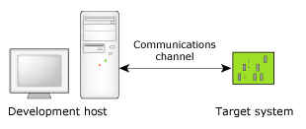
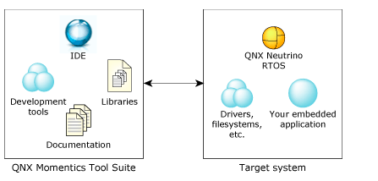
QNX QUICK START GUIDE
Requirements
First thing you need is the QNX Software Development Platform (SDP). This includes the QNX Momentics Tool Suite, which contains everything you need to develop programs that run under the QNX Neutrino RTOS: compiler, linker, libraries and other QNX Neutrino components, precompiled for all CPU architectures that QNX Neutrino supports. On Microsoft Windows and Linux, the tool suite features an extensive Integrated Development Environment (IDE).
Notes:
The microkernel differs from an executive in how the IPC services are used to extend the functionality of the kernel with additional, service-providing processes. Since the OS is implemented as a team of cooperating processes managed by the microkernel, user-written processes can serve both as applications and as processes that extend the underlying OS functionality for industry-specific applications. The OS itself becomes "open" and easily extensible. Moreover, user-written extensions to the OS won't affect the fundamental reliability of the core OS.

Slide 32
QNX GETTING STATED
Target system that will run the QNX Neutrino RTOS:
PC target: You can install the QNX Neutrino-hosted version of the development platform on a normal PC that has a free partition of about 3.0 GB.
Other hardware: You can run QNX Neutrino on a reference platform, a reference design made by a CPU vendor (with a PPC, ARM, MIPS, or SH CPU). You'll need a QNX Board Support Package for your platform. Virtual machine: You can install and run QNX Neutrino as a virtual machine in a VMware session.
Notes:
The microkernel differs from an executive in how the IPC services are used to extend the functionality of the kernel with additional, service-providing processes. Since the OS is implemented as a team of cooperating processes managed by the microkernel, user-written processes can serve both as applications and as processes that extend the underlying OS functionality for industry-specific applications. The OS itself becomes "open" and easily extensible. Moreover, user-written extensions to the OS won't affect the fundamental reliability of the core OS.

Slide 33
QNX GETTING STATED
Target system that will run the QNX Neutrino RTOS:
PC target: You can install the QNX Neutrino-hosted version of the development platform on a normal PC that has a free partition of about 3.0 GB.
Other hardware: You can run QNX Neutrino on a reference platform, a reference design made by a CPU vendor (with a PPC, ARM, MIPS, or SH CPU). You'll need a QNX Board Support Package for your platform. Virtual machine: You can install and run QNX Neutrino as a virtual machine in a VMware session.
Following steps at:
http://www.qnx.com/developers/docs/6.5.0/index.jsp?topic=%2Fcom.qnx.doc.momentics_welcome%2Fstart.html
(develoment platform)
http://www.qnx.com/developers/docs/6.5.0/topic/com.qnx.doc.neutrino_getting_started/about.html
(QNX neutrino for RT Programmer)
Notes:
The microkernel differs from an executive in how the IPC services are used to extend the functionality of the kernel with additional, service-providing processes. Since the OS is implemented as a team of cooperating processes managed by the microkernel, user-written processes can serve both as applications and as processes that extend the underlying OS functionality for industry-specific applications. The OS itself becomes "open" and easily extensible. Moreover, user-written extensions to the OS won't affect the fundamental reliability of the core OS.

Slide 34
QNX GETTING STATED
Process and thread concept
Process: have all resource for thread contain memory, io...
Multithread: many thread run on a process and shared resource. If the process allocates memory, this new memory is available to all the threads as well.
Mutual exclution: a number of threads are mutually exclusive when it comes to a particular resource.
Mutex: A thread uses an object called a mutex (an acronym for MUTual EXclusion). This object is like the lock on a door — once a thread has the mutex locked, no other thread can get the mutex, until the owning thread releases (unlocks).
Priorities: If have multiple thread want to get resource a same time, thread with higher priority will get resource first.
Sermaphore: With threads, this is accomplished via a semaphore. A “plain” semaphore works just like a mutex — you either own the mutex, in which case you have access to the resource, or you don't, in which case you don't have access. counting semaphore — it keeps track of the count (by the number of keys available to the threads).
Notes:
The microkernel differs from an executive in how the IPC services are used to extend the functionality of the kernel with additional, service-providing processes. Since the OS is implemented as a team of cooperating processes managed by the microkernel, user-written processes can serve both as applications and as processes that extend the underlying OS functionality for industry-specific applications. The OS itself becomes "open" and easily extensible. Moreover, user-written extensions to the OS won't affect the fundamental reliability of the core OS.

Slide 35
QNX GETTING STATED
Process and thread concept
Scheduling: For a multiple-CPU system, the rules are the same, except that multiple CPUs can run multiple threads concurrently. The order that the threads run (i.e., which threads get to run on the multiple CPUs) is determined in the exact same way as with a single CPU — the highest-priority READY thread will run on a CPU. For lower-priority or longer-waiting threads, the kernel has some flexibility as to when to schedule them to avoid inefficiency in the use of the cache. For more information about SMP, see the Multicore Processing User's Guide.
The important thing to keep in mind is that when a thread is blocked, regardless of which state it's blocked in, it consumes no CPU. Conversely, the only state in which a thread consumes CPU is in the RUNNING state.
Notes:
The microkernel differs from an executive in how the IPC services are used to extend the functionality of the kernel with additional, service-providing processes. Since the OS is implemented as a team of cooperating processes managed by the microkernel, user-written processes can serve both as applications and as processes that extend the underlying OS functionality for industry-specific applications. The OS itself becomes "open" and easily extensible. Moreover, user-written extensions to the OS won't affect the fundamental reliability of the core OS.

Slide 36
QNX GETTING STATED
Starting a process
Let's take a look at the functions that Neutrino provides for starting up other processes (or transforming into a different program):
system()
exec() family of functions
spawn() family of functions
fork()
vfork()
Which function you use depends on two requirements: portability and functionality. As usual, there's a trade-off between the two.
The common thing that happens in all the calls that create a new process is the following. A thread in the original process calls one of the above functions. Eventually, the function gets the process manager to create an address space for a new process. Then, the kernel starts a thread in the new process. This thread executes a few instructions, and calls main(). (In the case of fork() and vfork(), of course, the new thread begins execution in the new process by returning from the fork() or vfork(); we'll see how to deal with this shortly.)
Notes:
The microkernel differs from an executive in how the IPC services are used to extend the functionality of the kernel with additional, service-providing processes. Since the OS is implemented as a team of cooperating processes managed by the microkernel, user-written processes can serve both as applications and as processes that extend the underlying OS functionality for industry-specific applications. The OS itself becomes "open" and easily extensible. Moreover, user-written extensions to the OS won't affect the fundamental reliability of the core OS.

Slide 37
QNX GETTING STATED
Starting a process with the system() call
In fact, system() actually starts up a shell to handle the command that you want to perform.
Beside system() we have exec() and spawn():
The exec() family transforms the current process into another one. What I mean by that is that when a process issues an exec() function call, that process ceases to run the current program and begins to run another program. The process ID doesn't change — that process changed into another program. What happened to all the threads in the process? We'll come back to that when we look at fork().
The spawn() family, on the other hand, doesn't do that. Calling a member of the spawn() family creates another process (with a new process ID) that corresponds to the program specified in the function's arguments.
Notes:
The microkernel differs from an executive in how the IPC services are used to extend the functionality of the kernel with additional, service-providing processes. Since the OS is implemented as a team of cooperating processes managed by the microkernel, user-written processes can serve both as applications and as processes that extend the underlying OS functionality for industry-specific applications. The OS itself becomes "open" and easily extensible. Moreover, user-written extensions to the OS won't affect the fundamental reliability of the core OS.

Slide 38
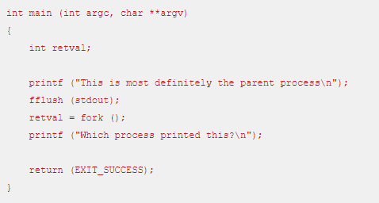

QNX GETTING STATED
Starting a process with the fork() call
The fork() function, which duplicates the current process. All the code is the same, and the data is the same as the creating (or parent) process's data.
Startting a xample code with fork():
Notes:
The microkernel differs from an executive in how the IPC services are used to extend the functionality of the kernel with additional, service-providing processes. Since the OS is implemented as a team of cooperating processes managed by the microkernel, user-written processes can serve both as applications and as processes that extend the underlying OS functionality for industry-specific applications. The OS itself becomes "open" and easily extensible. Moreover, user-written extensions to the OS won't affect the fundamental reliability of the core OS.

Slide 39
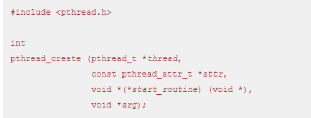
QNX GETTING STATED
Starting a thread
Any thread can create another thread in the same process; there are no restrictions (short of memory space, of course!). The most common way of doing this is via the POSIX pthread_create() call:
Notes:
The microkernel differs from an executive in how the IPC services are used to extend the functionality of the kernel with additional, service-providing processes. Since the OS is implemented as a team of cooperating processes managed by the microkernel, user-written processes can serve both as applications and as processes that extend the underlying OS functionality for industry-specific applications. The OS itself becomes "open" and easily extensible. Moreover, user-written extensions to the OS won't affect the fundamental reliability of the core OS.

Slide 40
QNX GETTING STATED
The thread attributes structure
Stack related
pthread_attr_getguardsize() pthread_attr_setguardsize() pthread_attr_getstackaddr() pthread_attr_setstackaddr() pthread_attr_getstacksize() pthread_attr_setstacksize() pthread_attr_getstacklazy() pthread_attr_setstacklazy()
Scheduling related
pthread_attr_getschedparam() pthread_attr_setschedparam() pthread_attr_getschedpolicy() pthread_attr_setschedpolicy()
Attribute administration
pthread_attr_destroy() pthread_attr_init()
Flags (Boolean characteristics)
pthread_attr_getdetachstate() pthread_attr_setdetachstate() pthread_attr_getinheritsched() pthread_attr_setinheritsched() pthread_attr_getscope() pthread_attr_setscope()
Notes:
The microkernel differs from an executive in how the IPC services are used to extend the functionality of the kernel with additional, service-providing processes. Since the OS is implemented as a team of cooperating processes managed by the microkernel, user-written processes can serve both as applications and as processes that extend the underlying OS functionality for industry-specific applications. The OS itself becomes "open" and easily extensible. Moreover, user-written extensions to the OS won't affect the fundamental reliability of the core OS.

Slide 41
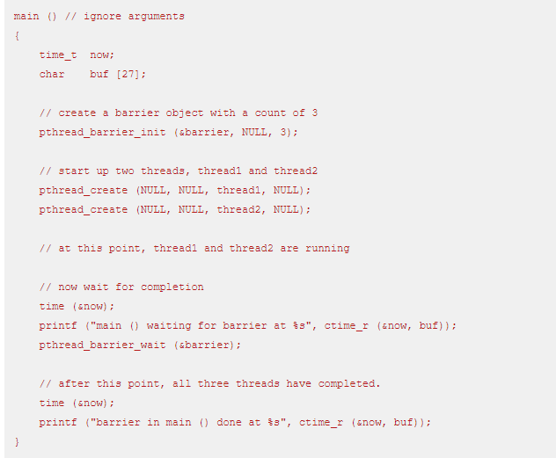
QNX GETTING STATED
Coding for SMP or single processor
Synchronizing to the termination of a thread
The simplest method of synchronization is to join the threads as they terminate. Joining really means waiting for termination.
+Joining is accomplished by one thread waiting for the termination of another thread. The waiting thread calls pthread_join():
+With the barrier, we're waiting for a certain number of threads to rendezvous at the barrier. Then, when the requisite number are present, we unblock all of them. (Note that the threads continue to run.).The main thread needs to wait until all the worker threads have completed, and only then can the next part of the program begin.
Example:
Notes:
The microkernel differs from an executive in how the IPC services are used to extend the functionality of the kernel with additional, service-providing processes. Since the OS is implemented as a team of cooperating processes managed by the microkernel, user-written processes can serve both as applications and as processes that extend the underlying OS functionality for industry-specific applications. The OS itself becomes "open" and easily extensible. Moreover, user-written extensions to the OS won't affect the fundamental reliability of the core OS.

Slide 42
QNX GETTING STATED
More on synchronization
Readers/writer locks
Readers and writer locks are used for exactly what their name implies: multiple readers can be using a resource, with no writers, or one writer can be using a resource with no other writers or readers.
The pthread_rwlock_init() function takes the lock argument (of type pthread_rwlock_t) and initializes it based on the attributes specified by attr. We're just going to use an attribute of NULL in our examples, which means, “Use the defaults.” For detailed information about the attributes, see the library reference pages for pthread_rwlockattr_init(), pthread_rwlockattr_destroy(), pthread_rwlockattr_getpshared(), and pthread_rwlockattr_setpshared().
Notes:
The microkernel differs from an executive in how the IPC services are used to extend the functionality of the kernel with additional, service-providing processes. Since the OS is implemented as a team of cooperating processes managed by the microkernel, user-written processes can serve both as applications and as processes that extend the underlying OS functionality for industry-specific applications. The OS itself becomes "open" and easily extensible. Moreover, user-written extensions to the OS won't affect the fundamental reliability of the core OS.

Slide 43
QNX GETTING STATED
More on synchronization
Readers and writer locks are used for exactly what their name implies: multiple readers can be using a resource, with no writers, or one writer can be using a resource with no other writers or readers.
The pthread_rwlock_init() function takes the lock argument (of type pthread_rwlock_t) and initializes it based on the attributes specified by attr. We're just going to use an attribute of NULL in our examples, which means, “Use the defaults.” For detailed information about the attributes, see the library reference pages for pthread_rwlockattr_init(), pthread_rwlockattr_destroy(), pthread_rwlockattr_getpshared(), and pthread_rwlockattr_setpshared().
Notes:
The microkernel differs from an executive in how the IPC services are used to extend the functionality of the kernel with additional, service-providing processes. Since the OS is implemented as a team of cooperating processes managed by the microkernel, user-written processes can serve both as applications and as processes that extend the underlying OS functionality for industry-specific applications. The OS itself becomes "open" and easily extensible. Moreover, user-written extensions to the OS won't affect the fundamental reliability of the core OS.

Slide 44
QNX GETTING STATED
More on synchronization
Sleepon locks
Readers and writer locks are used for exactly what their name implies: multiple readers can be using a resource, with no writers, or one writer can be using a resource with no other writers or readers.
The pthread_rwlock_init() function takes the lock argument (of type pthread_rwlock_t) and initializes it based on the attributes specified by attr. We're just going to use an attribute of NULL in our examples, which means, “Use the defaults.” For detailed information about the attributes, see the library reference pages for pthread_rwlockattr_init(), pthread_rwlockattr_destroy(), pthread_rwlockattr_getpshared(), and pthread_rwlockattr_setpshared().
The pthread_sleepon_wait() actually does three distinct steps!
Unlock the sleepon library mutex.
Perform the waiting operation.
Re-lock the sleepon library mutex.
Notes:
The microkernel differs from an executive in how the IPC services are used to extend the functionality of the kernel with additional, service-providing processes. Since the OS is implemented as a team of cooperating processes managed by the microkernel, user-written processes can serve both as applications and as processes that extend the underlying OS functionality for industry-specific applications. The OS itself becomes "open" and easily extensible. Moreover, user-written extensions to the OS won't affect the fundamental reliability of the core OS.

Slide 45
QNX GETTING STATED
Condition variable
Condition variables (or “condvars”) are remarkably similar to the sleepon locks we just saw above. In fact, sleepon locks are built on top of condvars, which is why we had a state of CONDVAR in the explanation table for the sleepon example. It bears repeating that the pthread_cond_wait() function releases the mutex, waits, and then reacquires the mutex, just like the pthread_sleepon_wait() function did.
Notes:
The microkernel differs from an executive in how the IPC services are used to extend the functionality of the kernel with additional, service-providing processes. Since the OS is implemented as a team of cooperating processes managed by the microkernel, user-written processes can serve both as applications and as processes that extend the underlying OS functionality for industry-specific applications. The OS itself becomes "open" and easily extensible. Moreover, user-written extensions to the OS won't affect the fundamental reliability of the core OS.

Slide 46
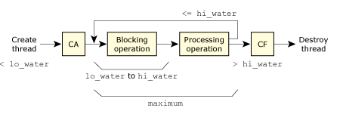
QNX GETTING STATED
Controlling the number of threads
The following diagram illustrates the relationship of the lo_water, hi_water, and maximum parameters:
Notes:
attr
This is the attributes structure that's used during thread creation. We've already discussed this structure above (in “The thread attributes structure”). You'll recall that this is the structure that controls things about the newly created thread like priority, stack size, and so on.
lo_water
There should always be at least lo_water threads sitting in the blocking operation. In a typical server, this would be the number of threads waiting to receive a message, for example. If there are less than lo_water threads sitting in the blocking operation (because, for example, we just received a message and have started the processing operation on that message), then more threads are created, according to the increment parameter. This is represented in the diagram by the first step labeled “create thread.”
increment
Indicates how many threads should be created at once if the count of blocking operation threads ever drops under lo_water. In deciding how to choose a value for this, you'd most likely start with 1. This means that if the number of threads in the blocking operation drops under lo_water, exactly one more thread would be created by the thread pool. To fine-tune the number that you've selected for increment, you could observe the behavior of the process and determine whether this number needs to be anything other than one. If, for example, you notice that your process gets “bursts” of requests, then you might decide that once you've dropped below lo_water blocking operation threads, you're probably going to encounter this “burst” of requests, so you might decide to request the creation of more than one thread at a time.
hi_water
Indicates the upper limit on the number of threads that should be in the blocking operation. As threads complete their processing operations, they will normally return to the blocking operation. However, the thread pool library keeps count of how many threads are currently in the blocking operation, and if that number ever exceeds hi_water, the thread pool library will kill the thread that caused the overflow (i.e., the thread that had just finished and was about to go back to the blocking operation). This is shown in the diagram as the “split” out of the “processing operation” block, with one path going to the “blocking operation” and the other path going to “CF” to destroy the thread. The combination of lo_water and hi_water, therefore, allows you to specify a range indicating how many threads should be in the blocking operation.
maximum
Indicates the absolute maximum number of threads that will ever run concurrently as a result of the thread pool library. For example, if threads were being created as a result of an underflow of the lo_water mark, the maximum parameter would limit the total number of threads.
One other key parameter to controlling the threads is the flags parameter passed to the thread_pool_create() function. It can have one of the following values:
POOL_FLAG_EXIT_SELF
The thread_pool_start() function will not return, nor will the calling thread be incorporated into the pool of threads.
POOL_FLAG_USE_SELF
The thread_pool_start() function will not return, but the calling thread will be incorporated into the pool of threads.
0
The thread_pool_start() function will return, with new threads being created as required.

Slide 47
QNX GETTING STATED
Scheduling and the real world
The following diagram illustrates the relationship of the lo_water, hi_water, and maximum parameters:
Threads can use any of the following synchronization methods:
mutexes — allow only one thread to own the mutex at a given point in time.
semaphores — allow a fixed number of threads to “own” the semaphore.
sleepons — allow a number of threads to block on a number of objects, while allocating the underlying condvars dynamically to the blocked threads.
condvars — similar to sleepons except that the allocation of the condvars is controlled by the programmer.
joining — allows a thread to synchronize to the termination of another thread.
barriers — allows threads to wait until a number of threads have reached the synchronization point.

Slide 48
QNX GETTING STATED
MESSAGE PASSING

Slide 49
QNX GETTING STATED
CLOCKS, TIMERS

Slide 50
QNX GETTING STATED
INTERRUPT

Slide 51
QNX GETTING STATED
RESOURCE MANAGER

Slide 52
QNX GETTING STATED
SAMPLE PROGRAMS

Slide 53
QNX TECHNICAL ARTICLES
Jan, 2021

Slide 54
QNX TECHNICAL ARTICLES
QNX® Software Center 1.7: Installation Note
QNX Software Center on the following development hosts:
+Microsoft Windows 10 Pro 64-bit or Windows 8.1 Pro 64-bit
+Ubuntu 18 LTS 64-bit or Ubuntu 20 LTS 64-bit or Linux Red Hat Enterprise Linux 7.7 64-bit, on x86_64 processors (The QNX Software Center doesn't run on ARM-based Linux hosts.)
+MacOS 10.14 or macOS 10.15
Notes:
The microkernel differs from an executive in how the IPC services are used to extend the functionality of the kernel with additional, service-providing processes. Since the OS is implemented as a team of cooperating processes managed by the microkernel, user-written processes can serve both as applications and as processes that extend the underlying OS functionality for industry-specific applications. The OS itself becomes "open" and easily extensible. Moreover, user-written extensions to the OS won't affect the fundamental reliability of the core OS.

Slide 55
QNX TECHNICAL ARTICLES
Installing the QNX Software Center
In previous releases, the installer for the QNX Software Center also installed the following components:
QNX Momentics IDE
Floating license tools
These components are available as packages from the QNX Software Center; they're no longer included in the installer. To install the QNX Momentics IDE, see the QNX Software Center User's Guide. To install the Floating license tools, see the Floating License Management Guide.
Notes:
The microkernel differs from an executive in how the IPC services are used to extend the functionality of the kernel with additional, service-providing processes. Since the OS is implemented as a team of cooperating processes managed by the microkernel, user-written processes can serve both as applications and as processes that extend the underlying OS functionality for industry-specific applications. The OS itself becomes "open" and easily extensible. Moreover, user-written extensions to the OS won't affect the fundamental reliability of the core OS.

Slide 56
QNX TECHNICAL ARTICLES
Window Host
To install the QNX Software Center on a Windows development host:
+Log in to your myQNX account on the QNX website, select the Developers tab at the top of the page, then click the QNX Software Center link.
+Click the link for Windows hosts and download the QNX Software Center installer, qnx-setup-nnnnnnnnnnnn-win.exe, where nnnnnnnnnnnn is a build number.
+Run the installer and follow the instructions on your screen. We recommend you accept the default installation directory: C:QNX
Notes:
The microkernel differs from an executive in how the IPC services are used to extend the functionality of the kernel with additional, service-providing processes. Since the OS is implemented as a team of cooperating processes managed by the microkernel, user-written processes can serve both as applications and as processes that extend the underlying OS functionality for industry-specific applications. The OS itself becomes "open" and easily extensible. Moreover, user-written extensions to the OS won't affect the fundamental reliability of the core OS.

Slide 57
QNX TECHNICAL ARTICLES
Uninstalling the QNX Software Center
If you also intend to uninstall QNX SDP 7.* and any products that depend on it, perform these steps before uninstalling the QNX Software Center:
Use the QNX Software Center to deactivate any products governed by a named user license. This will enable you to transfer the licenses to another workstation or user. (The QNX Software Center User's Guide describes how to deactivate and transfer licenses.)
Use the QNX Software Center to uninstall the products.
Notes:
The microkernel differs from an executive in how the IPC services are used to extend the functionality of the kernel with additional, service-providing processes. Since the OS is implemented as a team of cooperating processes managed by the microkernel, user-written processes can serve both as applications and as processes that extend the underlying OS functionality for industry-specific applications. The OS itself becomes "open" and easily extensible. Moreover, user-written extensions to the OS won't affect the fundamental reliability of the core OS.

