Slide 1

FSP – RA project
for iar
Date: 13/10/2022
Name: Khoa vo
Position, Department,
r-car middleware 2
Renesas Electronics Corporation

Slide 2
Agenda
Preparation Page 03
Create new project Page 08
Migrating e2 Studio to IAR Page 16
Ep automation Page 23

Slide 3
preparation

Slide 4
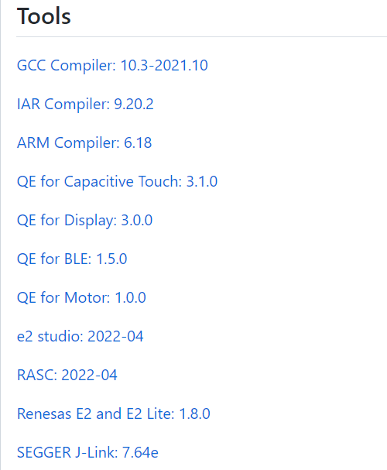
RA Smart Configurator
The Renesas RA Smart Configurator (RA SC) is a desktop application designed to configure device hardware such as clock set up and pin assignment as well as initialization of FSP software components for a Renesas RA microcontroller project when using a 3rd-party IDE and toolchain.
The RA Smart Configurator can currently be used with:
Keil MDK and the Arm compiler toolchain
IAR EWARM with IAR toolchain for Arm
Download and Install (RASC) from https://github.com/renesas/fsp/releases

Slide 5

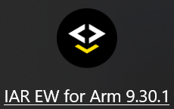
Prerequisites
RA Smart Configurator (RASC)
IAR:
IAR Embedded Workbench for Arm (IAR EWARM) installed

Slide 6
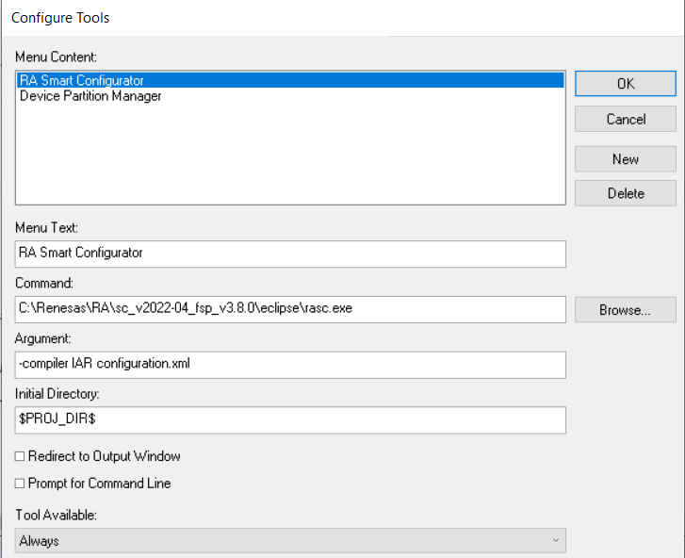
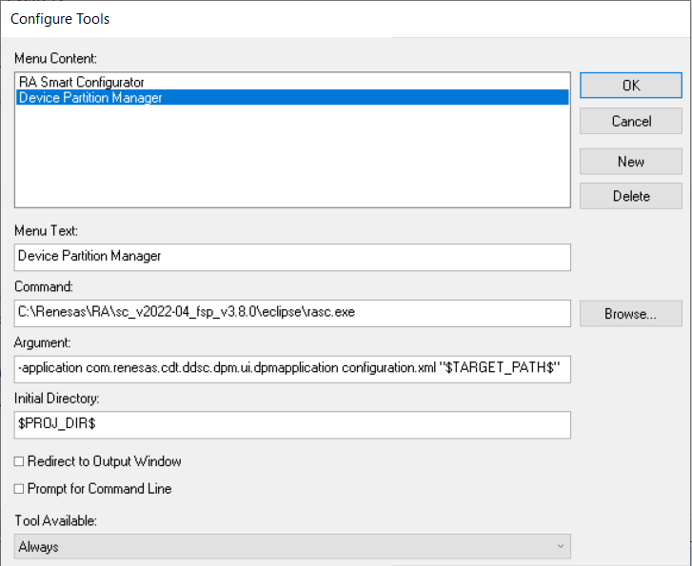
Link to rasc
In IAR select Tools → Configurate Tools
Select the new icon and fill in the fields
Argument: -compiler IAR configuration.xml
Argument: -application com.renesas.cdt.ddsc.dpm.ui.dpmapplication configuration.xml "$TARGET_PATH$"

Slide 7
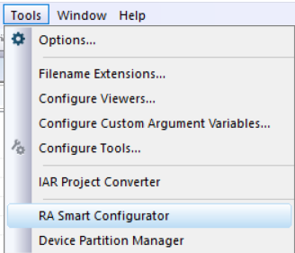
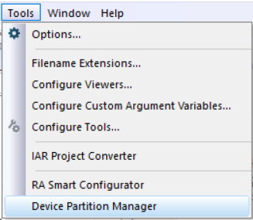
Link to Rasc
To reconfigure an existing project select
Tools > RA Smart Configurator
To reconfigure the TrustZone partitions select
Tools > Device Partition Manager

Slide 8
Create new project

Slide 9
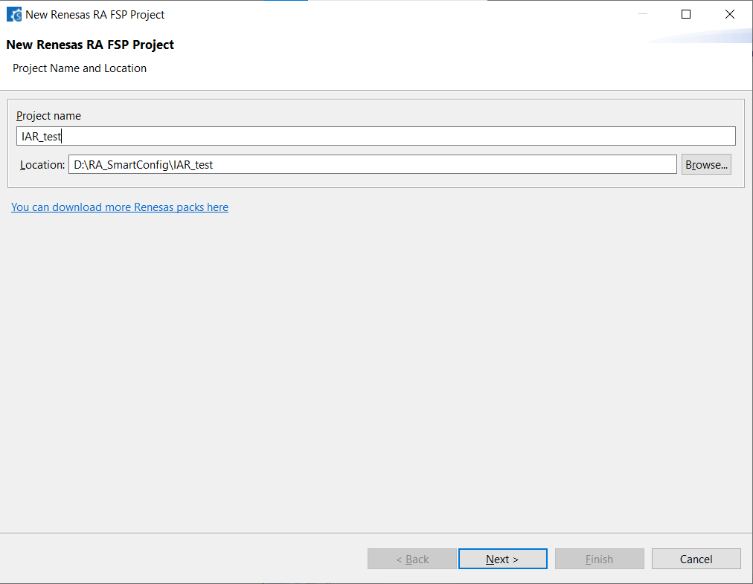
Create new project
1. Open RA Smart Configurator (RASC)
2. Chose Project Location and Project Name → Click Next

Slide 10
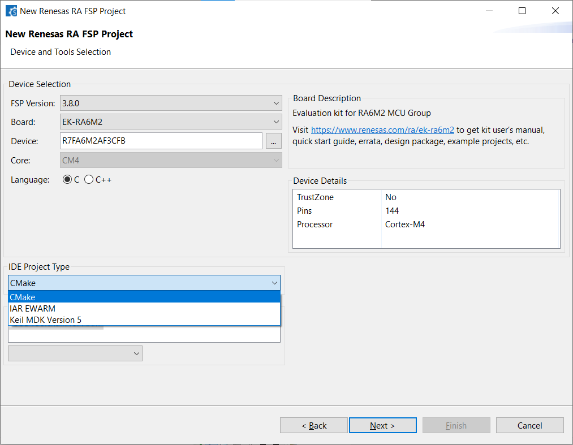
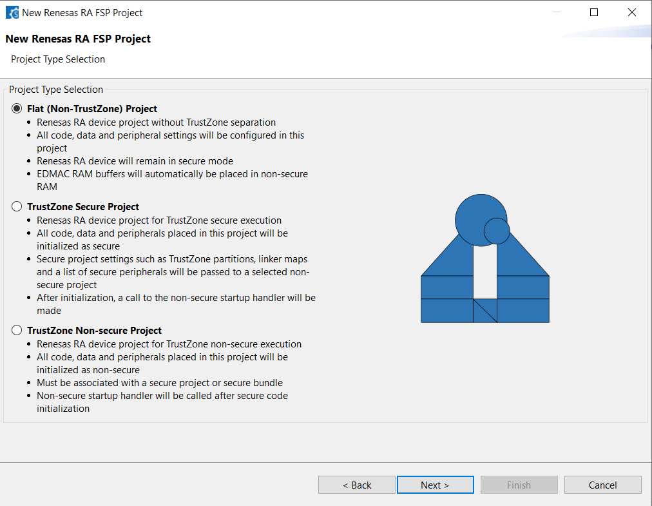
Create new project
3. Select FSP version,
Board or Device
and IDE Project type (IAR EWARM)
→ Click Next
4. Select Project Type → Click Next

Slide 11
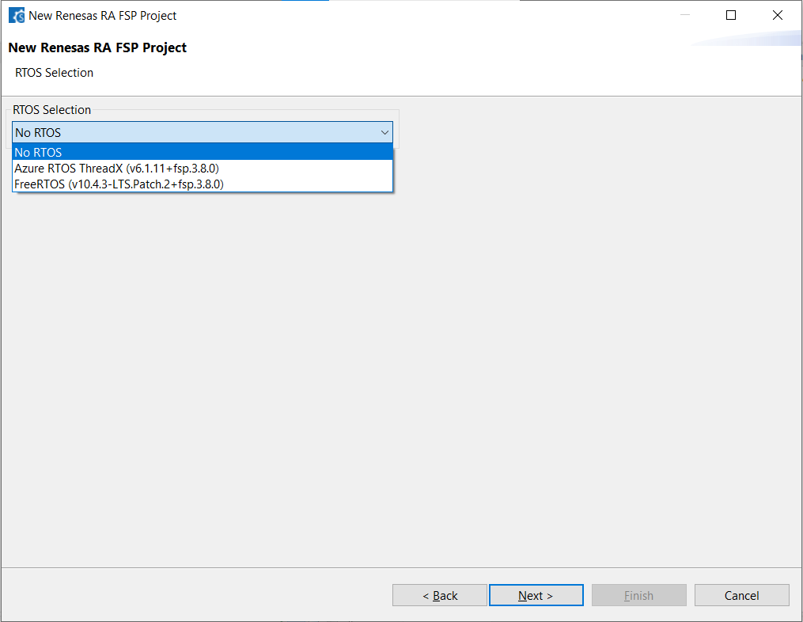
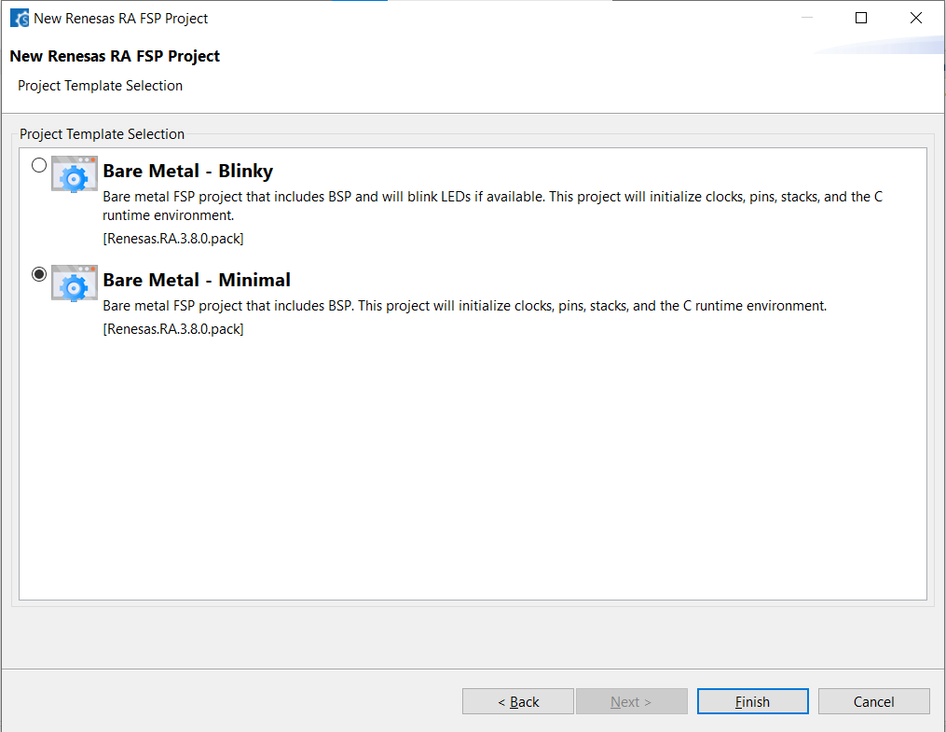
Create new project
5. Select RTOS (No RTOS, FreeRTOS or Azure RTOS) → Click Next
6. Select Project Template → Click Finish and wait to Generating Project

Slide 12
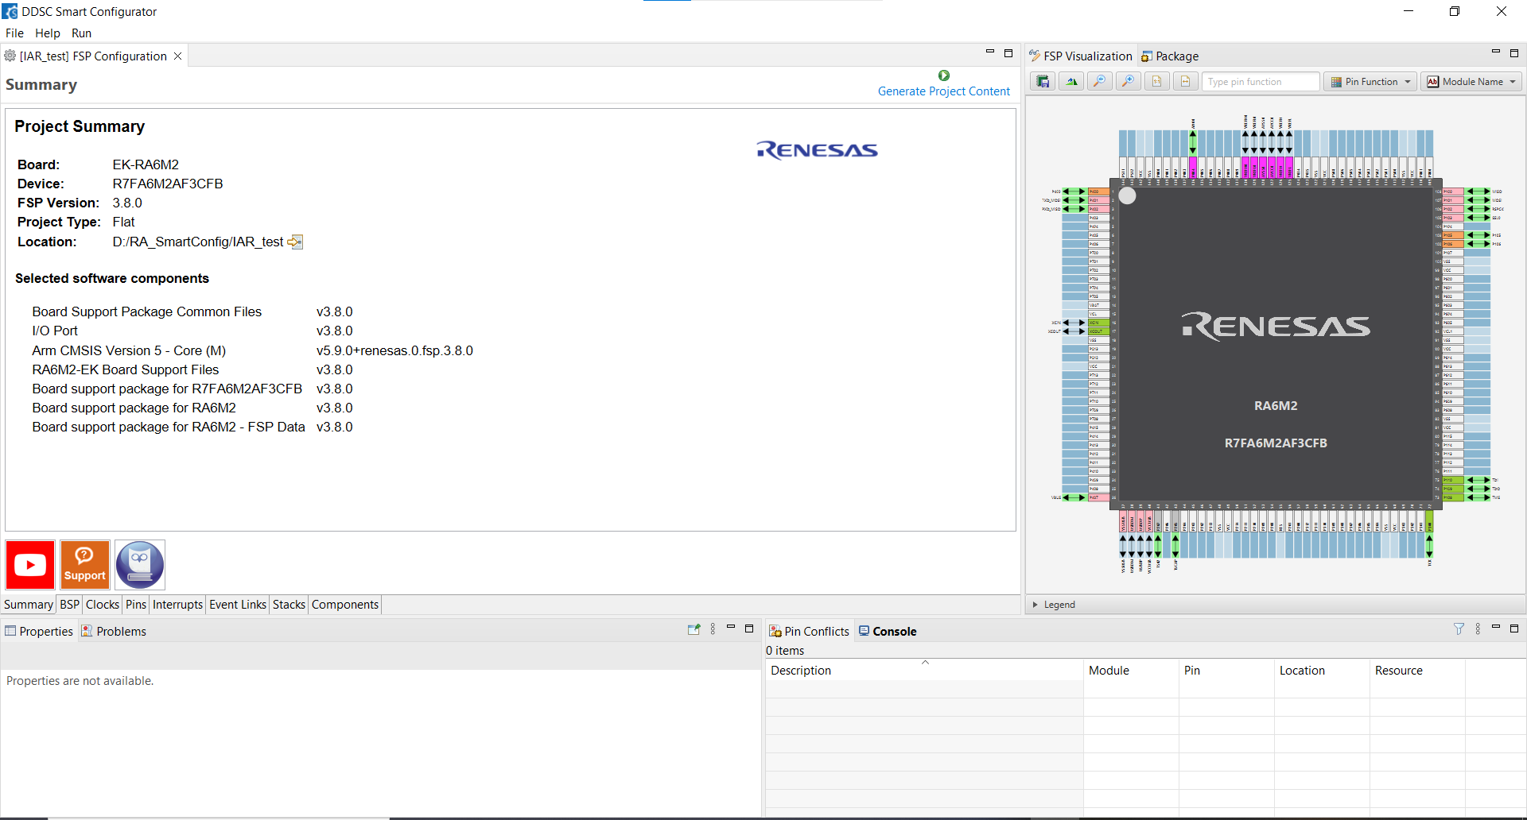
Create new project
7. Config Project similar file configuration.xml in E2 Studio → Click Generate Project Content and wait to Generate Code

Slide 13
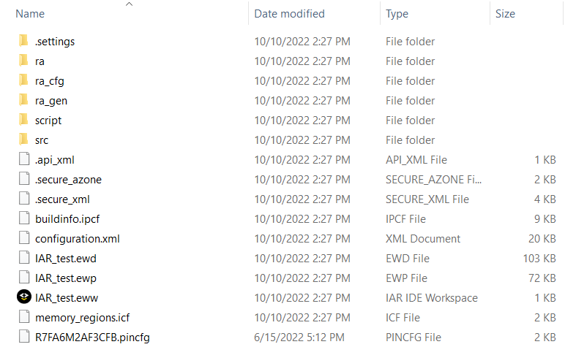
Ra project in Iar
Open Project in Folder (Location Project)

Slide 14
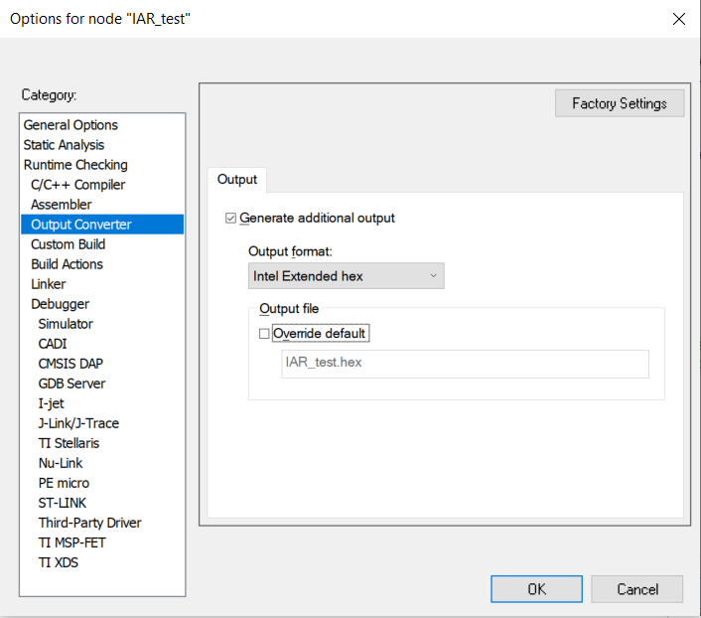
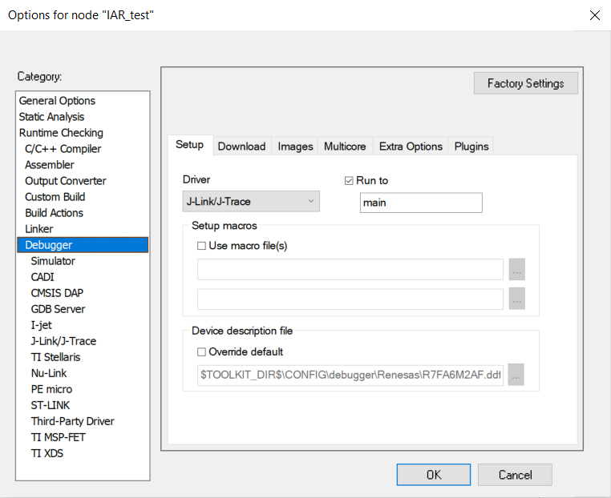
Ra project in Iar
Right click Project name → Options

Slide 15
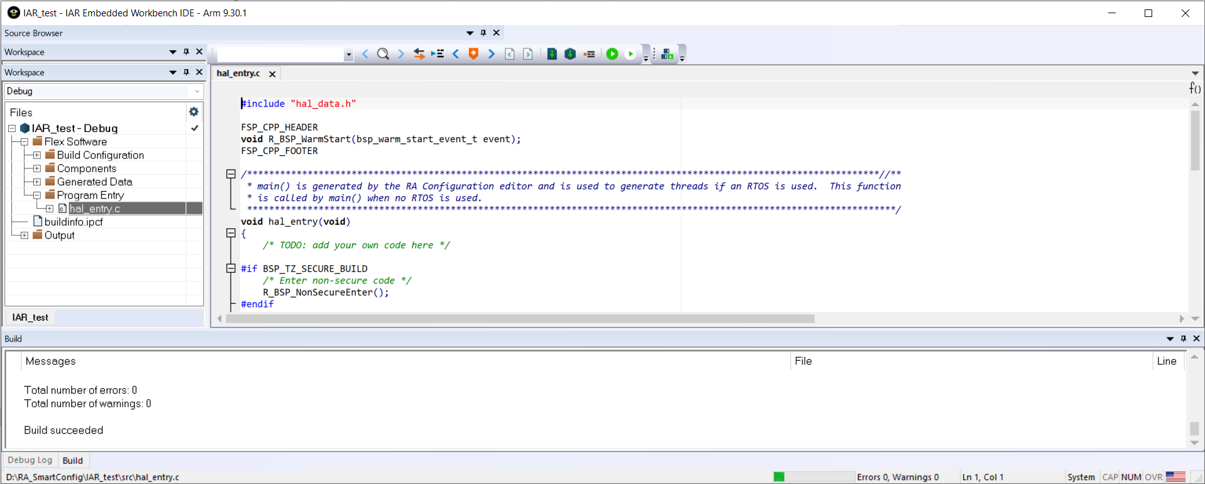
Ra project in Iar
Compile / Make
Download / Debbug

Slide 16
Migrating e2 Studio to IAR

Slide 17
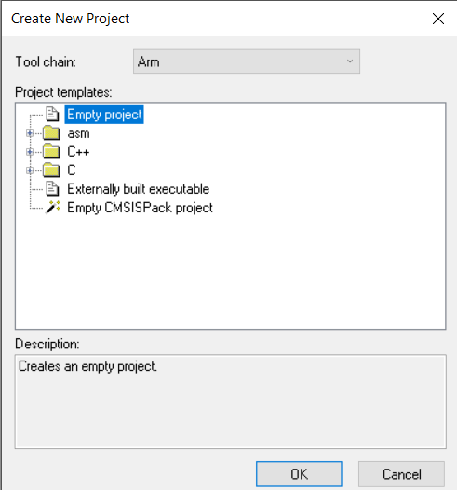
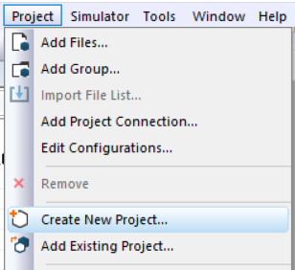
Migrating e2 Studio to IAR
1. Create empty project: Project → Create New Project → Empty Project → Choose location and wait to project created

Slide 18
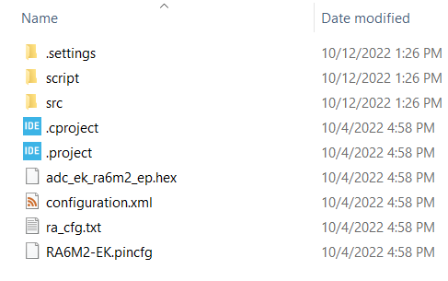
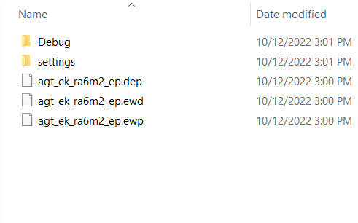
Migrating e2 Studio to IAR
2. Copy file configuration (file .xml) and file pinconfig (file .pincfg) from folder project e2 Studio to folder project IAR

Slide 19

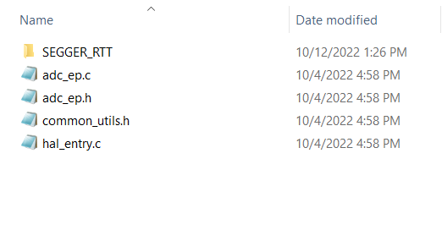
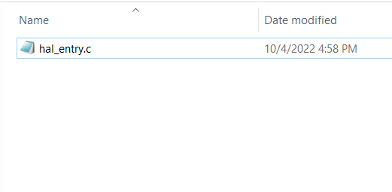
Migrating e2 Studio to IAR
3. Open RASC (Tools → RA Smart Configurator) → Click Generate Project Content
4. Copy folder src from e2 Studio folder project to IAR folder Project → Open RASC and Click Generate Project Content again

Slide 20
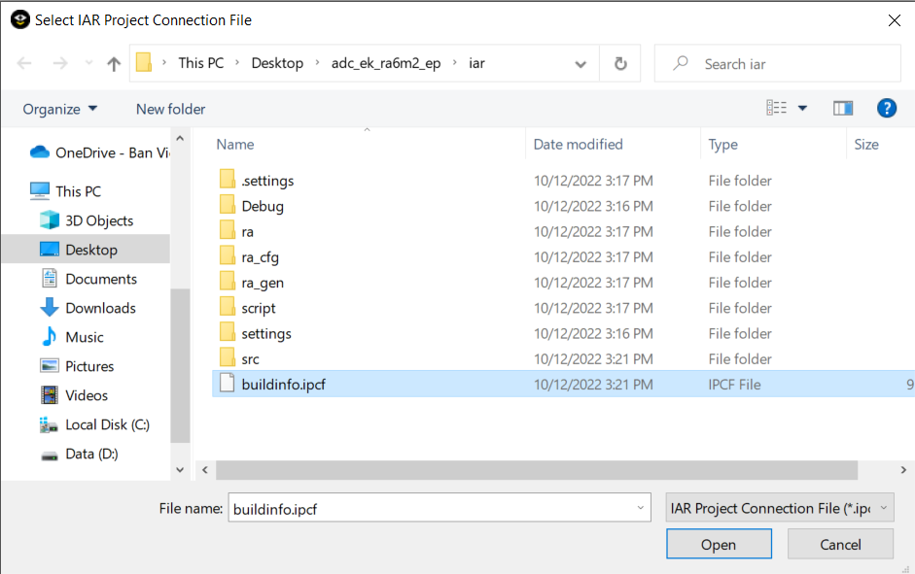
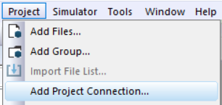
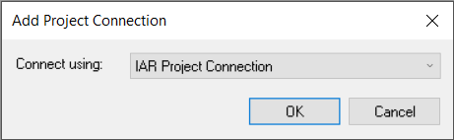
Migrating e2 Studio to IAR
5. Project → Add Project Connection → IAR Project Connection → OK → Choose file buildinfo.ipcf → Open

Slide 21

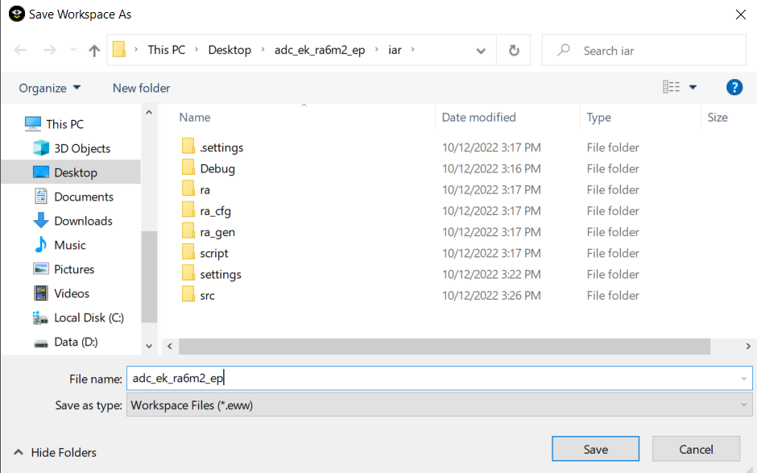
Migrating e2 Studio to IAR
6. Click Make → Create name for Project → Click Save

Slide 22
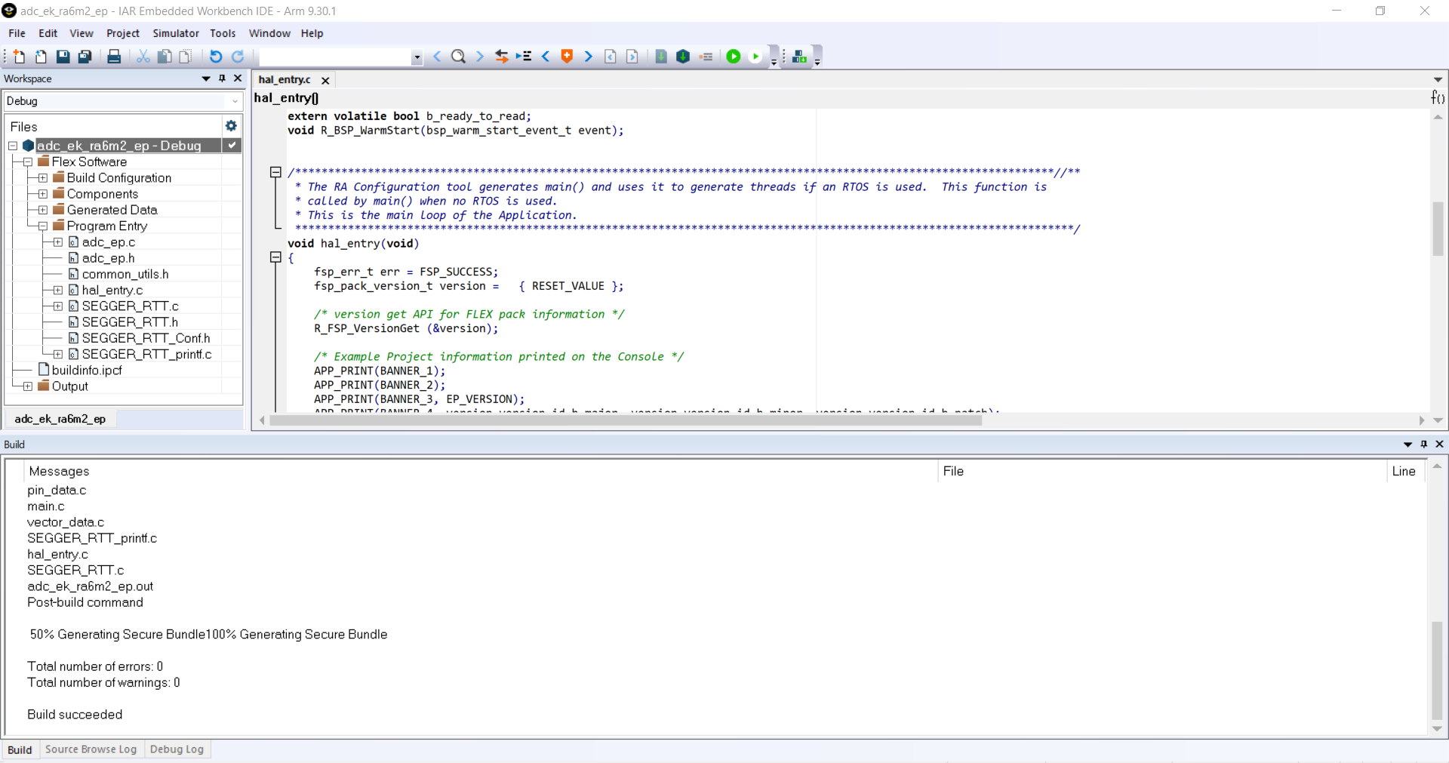
Migrating e2 Studio to IAR
7. Result

Slide 23
Ep automation

Slide 24
Build
Pre-requisite
Property name | Purpose | Example of writing
Jlink_path | Windows PC J-Link installation path required for updating SEGGER_RTT sources files in src folder of EP | C:\Program Files (x86) \SEGGER\JLink_V686e
e2_path | Required for updating configuration.xml of e2studio EPs and calling CLI tool of e2studio for building. | C:\Renesas\RA\e2studio_v2020-10_fsp_v2.0.0
rasc_path | Required for updating configuration.xml of Keil and IAR supported EPs and their project content generation. | C:\Renesas\RA\sc_v2020-10_fsp_v2.0.0
keil_path | Required for calling CLI tools of Keil MDK for building Keil supported EPs. | C:\Keil_v5
iar_path | Required for calling CLI tools of IAR EW for building IAR supported EPs. | C:\Program Files (x86)\IAR Systems\Embedded Workbench 8.4
fsp_version | EP’s migration target FSP version | 2.0.0
build_logfileformat | Configurable naming convention for auto-generated build logs | ide_module_board_build_log.txt
Clone repo from: http://pbgitap01.sc.renesasam.com/systems_tataelxsi/ra_solutions.git
Checkout user’s respective branch, which contains the previous FSP version projects/EPs and pull the latest changes to local repo
Modify app_config.csv in ra_solutions/ep_automation before running the apps.
associated parameters in app_config.csv

Slide 25
Build
Build Process
Board specific EPs:
Command> python runner_application.py -o build -i e2studio -b ek_ra2a1
Building all the EPs of that board.
Where -o is for selecting operation (build/rtt/review), -i for selecting IDE (e2studio, iar, keil) and -b for selecting board (ek_ra2a1, ek_ra4m1, etc.)
EP specific boards:
Command> python runner_application.py -o build -i e2studio -e gpt
Building that EP on all supported boards.
Where –e is for selecting EP (gpt, adc, ethernet, etc.)

Slide 26
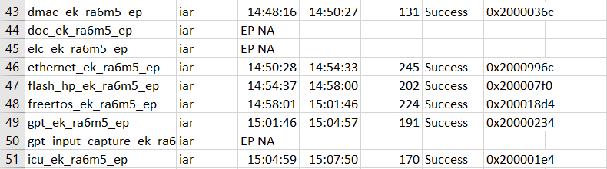
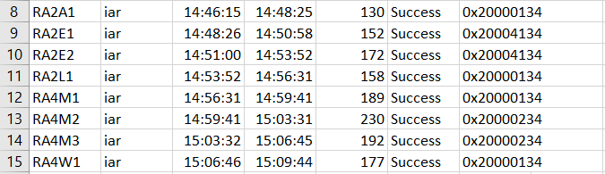
Build
IAR
python runner_application.py -o build -i iar -b ek_ra6m5
Result in Report file:
python runner_application.py -o build -i iar -e gpt
Result in Report file:

Slide 27
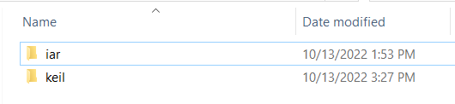
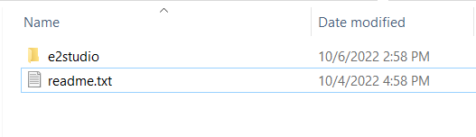
Adding Project to folder example
Modify name and copy IAR and Keil C Project (migrating from e2 Studio) in Previous path to Example folder

Slide 28
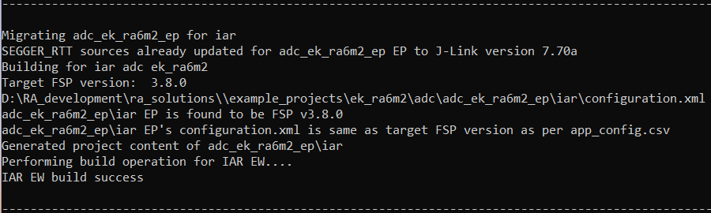

Adding Project to folder example
Run script automation build to check IAR
Log file:
In report file:

Slide 29
Renesas.com

