Slide 1
Remote debugging with e2 studio

Slide 2
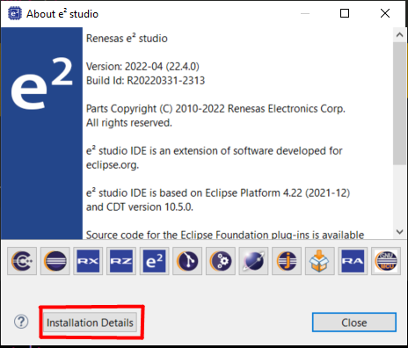
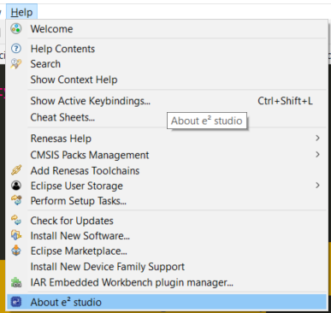
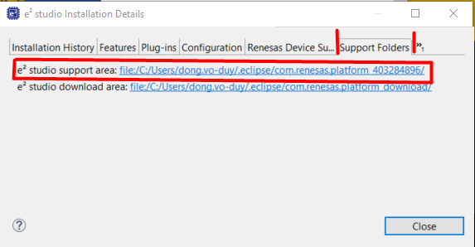
Starting GDB server on the remote PC
To confirm the location where GDB server for e 2 studio is stored:
Open e2 studio => tab Help => Installation Details => Support Folders => e 2 studio support area

Slide 3
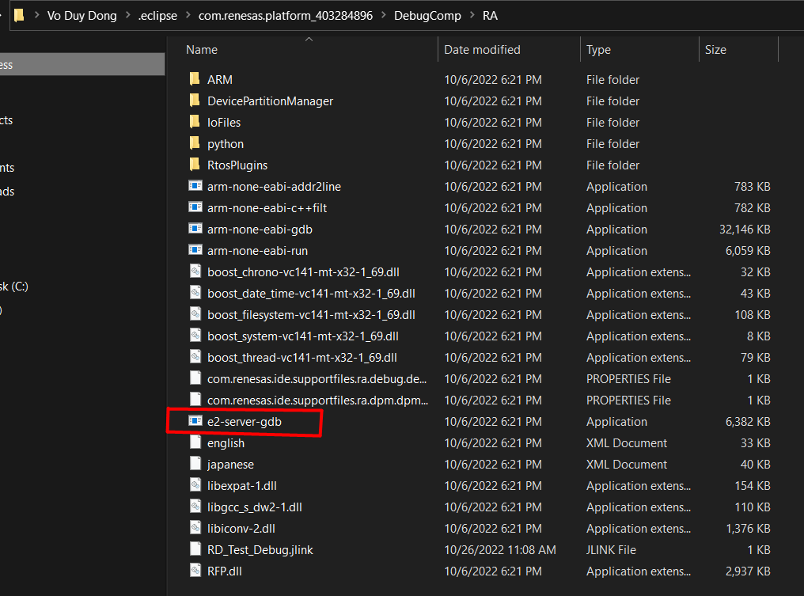
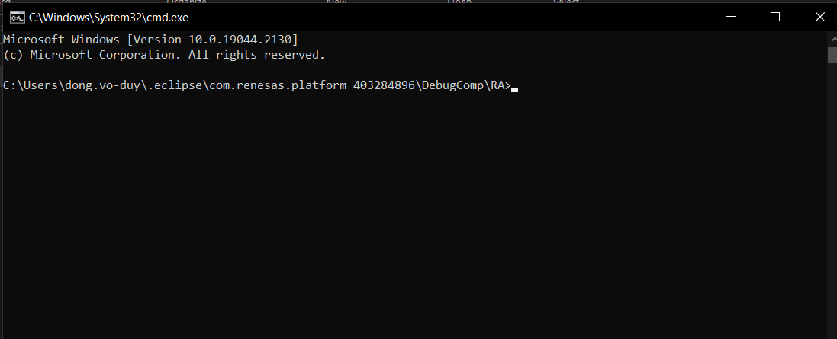
Check in folder “<support folder>\DebugComp\device_family_name\” file e2-server-gdb.exe exists?
At folder => Open cmd

Slide 4
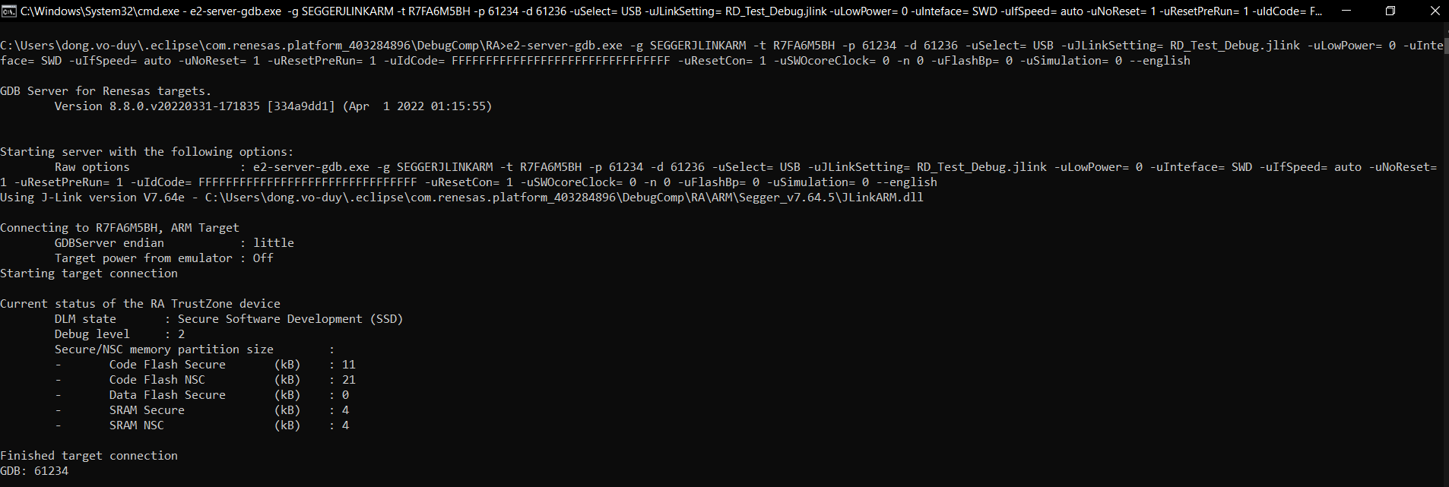
Run command: e2-server-gdb.exe -g SEGGERJLINKARM -t Name_MCU -p 61234 -d 61236 -uSelect= USB -uJLinkSetting= RD_Test_Debug.jlink -uLowPower= 0 -uInteface= SWD -uIfSpeed= auto -uNoReset= 1 -uResetPreRun= 1 -uIdCode= FFFFFFFFFFFFFFFFFFFFFFFFFFFFFFFF -uResetCon= 1 -uSWOcoreClock= 0 -n 0 -uFlashBp= 0 -uSimulation= 0 --english
Note: must connect the board with remote PC before running this command.

Slide 5
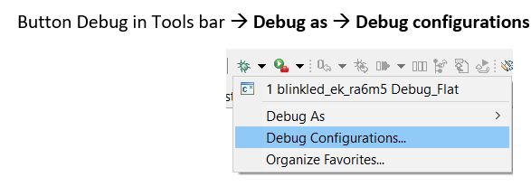
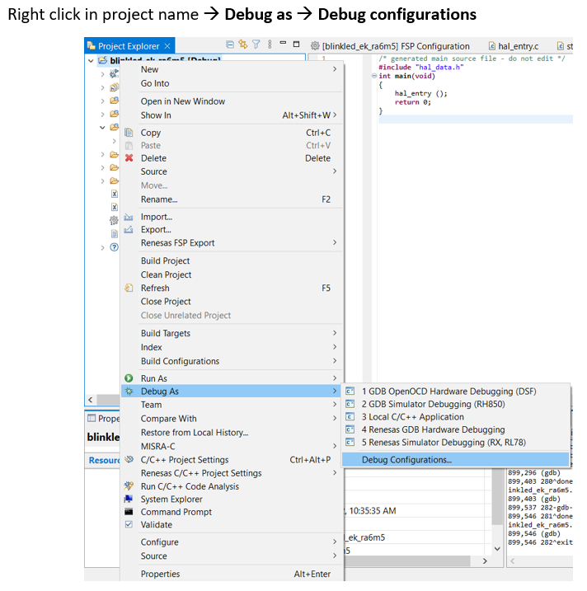
Starting e2 studio on the host PC
Open e2 studio on host PC => Open Debug configurations
OR

Slide 6
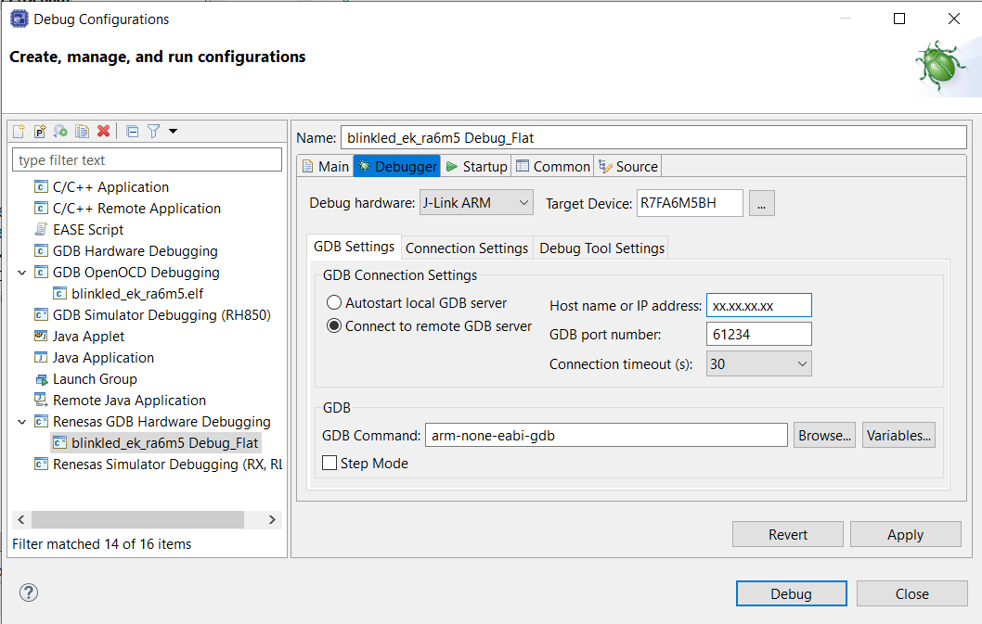
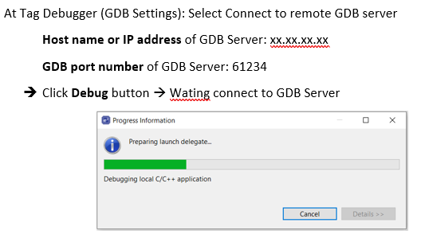
Configure remote Debug: In Debug configuration → Select Project need debug in Renesas GDB Hardware Debugging → Select Tag Debugger

Slide 7
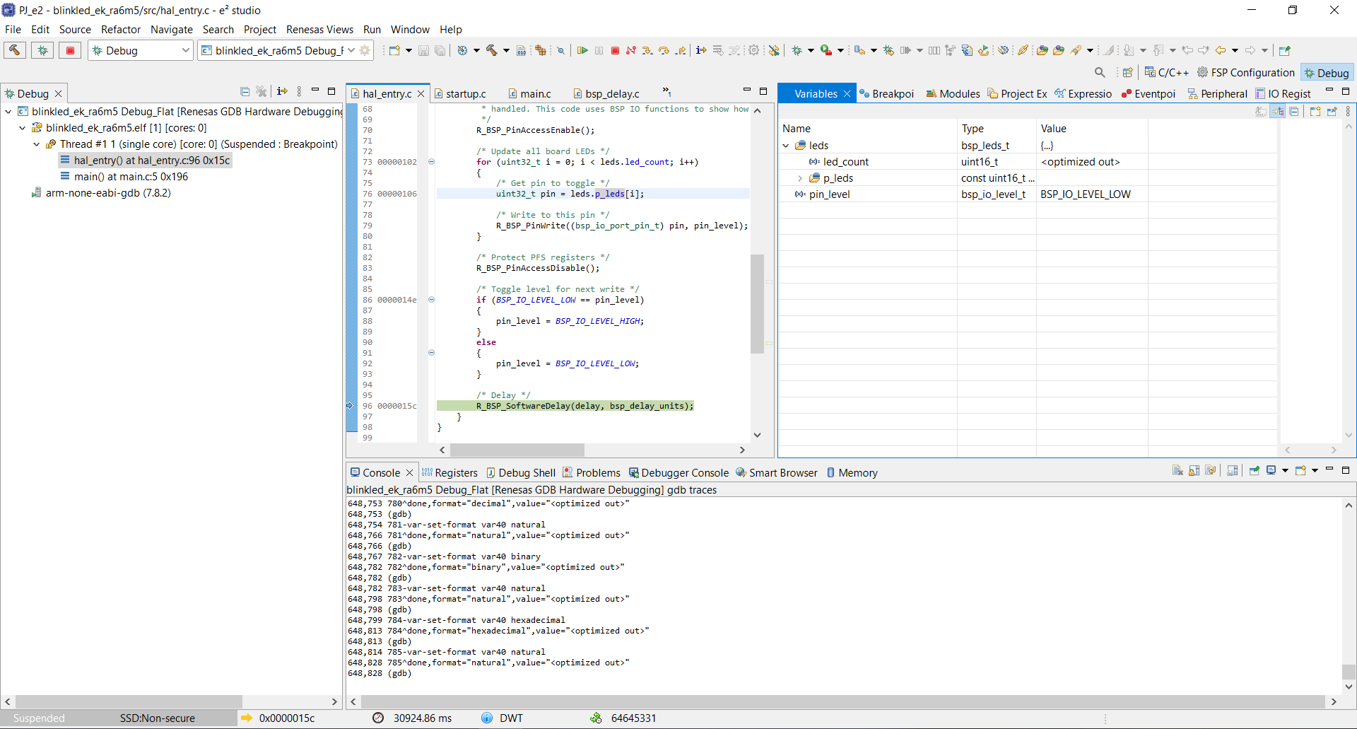
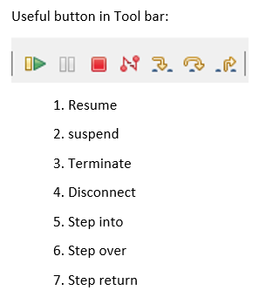
Debug project: After successful connecting to GDB Server → Debug project similar Debug in local

Slide 8
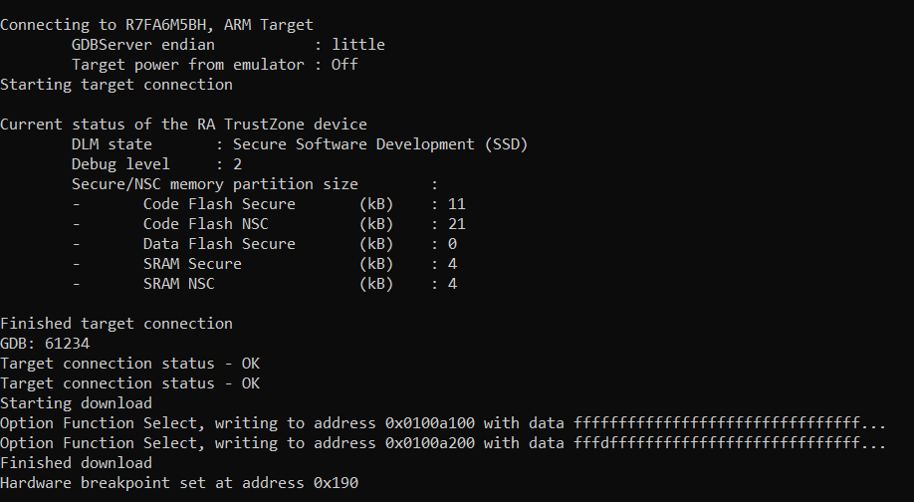
The result remote PC

