Slide 1

INVESTIGATE AZURE RTOS
SEP 2022
KHOA VO NGOC
EMBEDDED SOFTWARE ENGINEER
SOC SW TEAM
Renesas Electronics Corporation

Slide 2
Agenda
Azure RTOS Page 03
ThreadX Page 06
FileX Page 34
GUIX Page 57
NetX & NetX Duo Page 69
USBX Page 118
Reference Page 155

Slide 3
azure rtos

Slide 4
Overview azure rtos
Azure RTOS is a real time operating system (RTOS) for Internet of Things (IoT) and edge devices powered by microcontroller units (MCUs). Azure RTOS is designed to support most highly constrained devices (battery powered and having less than 64 KB of flash memory).
Azure RTOS is pre-certified for a variety of safety standards:
IEC 61508 SIL 4
IEC 62304 Class C
ISO 26262 ASIL D
EN 50128 SW-SIL 4

Slide 5
azure rtos components
The Azure RTOS platform is the collection of run-time solutions including:
Azure RTOS ThreadX: is an advanced Real-Time Operating System (RTOS) designed specifically for deeply embedded applications
Azure RTOS FileX: is a high-performance FAT-compatible file system
Azure RTOS GUIX: is a professional quality graphical user interface package, created to meet the needs of embedded systems developers
Azure RTOS NetX: is a high-performance implementation of TCP/IP protocol standards
Azure RTOS NetX Duo: is an advanced, Industrial Grade TCP/IP network stacks designed specifically for deeply embedded, real-time, and IoT applications
Azure RTOS USBX: is a high-performance USB host, device, and On-The-Go (OTG) embedded stack

Slide 6
threadx

Slide 7
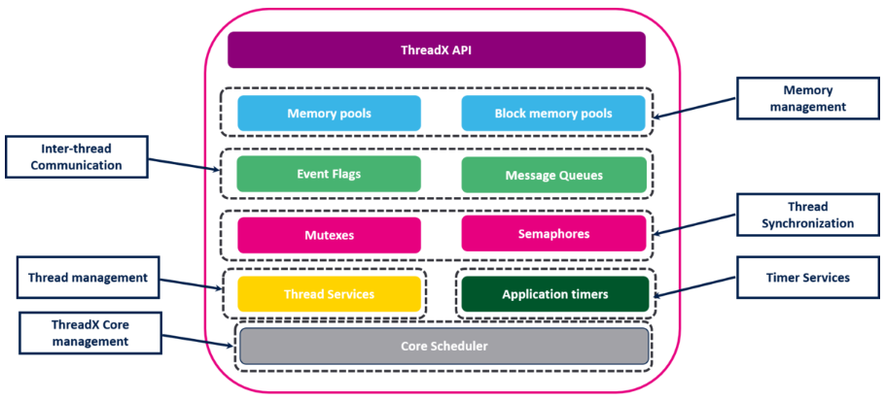
Overview threadx
The ThreadX core provides the common RTOS features, such as management of threads, semaphores, mutexes and SW timers:

Slide 8
Threadx important files
Filename | Descripttion
tx_api.h | C header file containing all system equates, data structures, and service prototypes.
tx_port.h | C header file containing all development-tool and target specific data definitions and structures.
demo_threadx.c | C file containing a small demo application.
tx.a (tx.lib) | Binary version of the ThreadX C library that is distributed with the standard package.

Slide 9
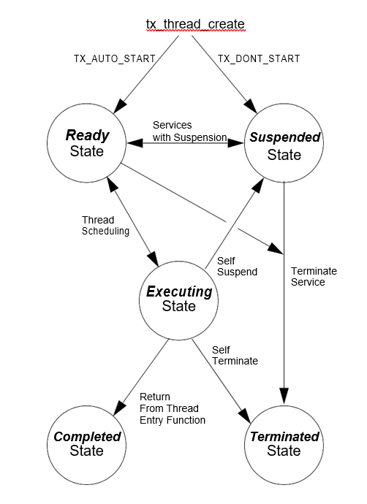
Threadx execute state
Executing State: Task is executed by CPU
Ready State: ready for execution
Suspended State: not eligible for execution
Completed State: thread that has completed its processing and returned from its entry function
Terminated State: A thread in a terminated state cannot execute again because another thread or the thread itself called the tx_thread_terminate service

Slide 10
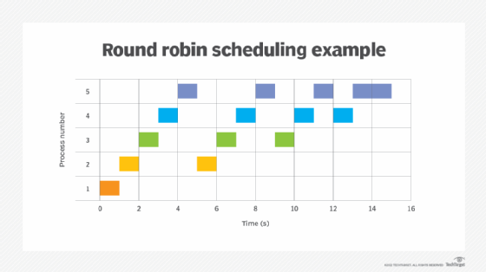
Threadx scheduling
ThreadX schedules threads based on their priority.
The ready thread with the highest priority is executed first. If multiple threads of the same priority are ready, they are executed in a first-in-first-out (FIFO) manner.
Round-robin : Each thread is executed until the end of the process, then the next task is executed.

Slide 11
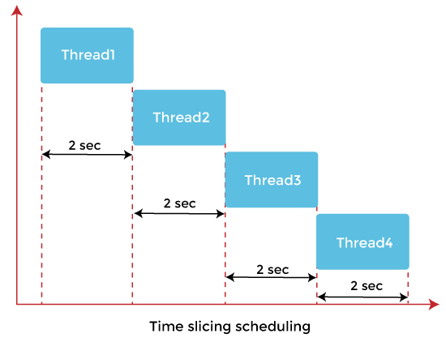
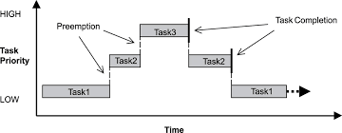
Threadx scheduling
Time slcing: Each thread is divided into a fixed time slot, if within that divided time the thread has not been completed, it will be paused, waiting for the next turn to continue working after the system finishes processing series of threads.
Preemtion: Prioritize allocating time to thread with higher priority.

Slide 12
Threadx init
The entry function (tx_kernel_enter) coordinates initialization of various internal ThreadX data structures and then calls the application's definition function tx_application_define.
When tx_application_define returns, control is transferred to the thread scheduling loop. This marks the end of initialization.
Application
tx_kernel_enter
AzureRTOS ThreadX
tx_application_define

Slide 13
Threadx creation
Creates an application thread that starts execution at the specified task entry function
UINT tx_thread_create( TX_THREAD *thread_ptr, CHAR *name_ptr,
VOID (*entry_function)(ULONG), ULONG entry_input,
VOID *stack_start, ULONG stack_size,
UINT priority, UINT preempt_threshold,
ULONG time_slice, UINT auto_start);
Deletes the specified application thread:
UINT tx_thread_delete(TX_THREAD *thread_ptr);

Slide 14
Threadx creation
Paramater:
thread_ptr: Pointer to a thread control block
name_ptr: Pointer to the name of the thread
entry_function: Specifies the initial C function for thread execution
entry_input: A 32-bit value that is passed to the thread's entry function when it first executes. The use for this input is determined exclusively by the application
stack_start: Starting address of the stack's memory area
stack_size: Number bytes in the stack memory area
priority: Numerical priority of thread (0 represents the highest priority)
preempt_threshold: Only priorities higher than this level are allowed to preempt this thread
time_slice: Number of timer-ticks this thread is allowed to run before other ready threads of the same priority are given a chance to run
auto_start: TX_AUTO_START (0x01)
TX_DONT_START (0x00) must call tx_thread_resume to run the thread

Slide 15
Threadx control
Relinquish control to other application threads (return task to ready state):
VOID tx_thread_relinquish (VOID);
Suspend current thread for specified time
UINT tx_thread_sleep (ULONG timer_ticks);
Reset thread:
UINT tx_thread_reset (TX_THREAD *thread_ptr);
Suspend application thread
UINT tx_thread_suspend (TX_THREAD *thread_ptr);
Resume suspended application thread (suspended by a tx_thread_suspend)
UINT tx_thread_resume (TX_THREAD *thread_ptr);
Terminates application thread
UINT tx_thread_terminate (TX_THREAD *thread_ptr);

Slide 16
semaphore
Create counting semaphore
UINT tx_semaphore_create ( TX_SEMAPHORE *semaphore_ptr, CHAR *name_ptr, ULONG initial_count);
Delete counting semaphore
UINT tx_semaphore_delete (TX_SEMAPHORE *semaphore_ptr);
Place an instance in counting semaphore
UINT tx_semaphore_put (TX_SEMAPHORE *semaphore_ptr);
Get instance from counting semaphore
UINT tx_semaphore_get ( TX_SEMAPHORE *semaphore_ptr, ULONG wait_option);
Notify application when semaphore is put:
UINT tx_semaphore_put_notify( TX_SEMAPHORE *semaphore_ptr, VOID (*semaphore_put_notify)(TX_SEMAPHORE *));

Slide 17
semaphore
Paramater:
semaphore_ptr: Pointer to a semaphore control block
name_ptr: Pointer to the name of the semaphore
initial_count: Specifies the initial count for this semaphore (0x00000000 to 0xFFFFFFFF)
wait_option: Defines how the service behaves if there are no instances of the semaphore available
TX_NO_WAIT (0x00000000)
TX_WAIT_FOREVER (0xFFFFFFFF)
semaphore_put_notify: Pointer to application's semaphore put notification function

Slide 18
queue
Create message queue:
UINT tx_queue_create (TX_QUEUE *queue_ptr, CHAR *name_ptr, UINT message_size, VOID *queue_start, ULONG queue_size);
Delete message queue:
UINT tx_queue_delete (TX_QUEUE *queue_ptr);
Send message to message queue:
UINT tx_queue_send ( TX_QUEUE *queue_ptr, VOID *source_ptr, ULONG wait_option);
Get message from message queue:
UINT tx_queue_receive ( TX_QUEUE *queue_ptr, VOID *destination_ptr, ULONG wait_option);
Notify application when message is sent to queue:
UINT tx_queue_send_notify ( TX_QUEUE *queue_ptr, VOID (*queue_send_notify)(TX_QUEUE *));

Slide 19
Queue
Paramater:
queue_ptr: Pointer to a message queue control block
name_ptr: Pointer to the name of the message queue
message_size: Specifies the size of each message in the queue (1 (32-bit word) to 16 (32-bit words))
queue_start: Starting address of the message queue
queue_size: Total number of bytes available for the message queue
source_ptr: Pointer to the message sending
destination_ptr: Location of where to copy the message
wait_option: Defines how the service behaves if the message queue is full(send)/empty(receive)
queue_send_notify: Pointer to application's queue send notification function

Slide 20
mutex
Create mutual exclusion mutex:
UINT tx_mutex_create (TX_MUTEX *mutex_ptr, CHAR *name_ptr, UINT priority_inherit);
Delete mutual exclusion mutex:
UINT tx_mutex_delete (TX_MUTEX *mutex_ptr);
Obtain ownership of mutex:
UINT tx_mutex_get (TX_MUTEX *mutex_ptr, ULONG wait_option);
Release ownership of mutex:
UINT tx_mutex_put (TX_MUTEX *mutex_ptr);

Slide 21
mutex
Paramater:
mutex_ptr: Pointer to a mutex control block.
name_ptr: Pointer to the name of the mutex.
priority_inherit: Specifies whether or not this mutex supports priority inheritance:
TX_INHERIT: priority inheritance is supported
TX_NO_INHERIT: priority inheritance is not supported
wait_option: Defines how the service behaves if the mutex is already owned by another thread

Slide 22
timer
Create application timer:
UINT tx_timer_create ( TX_TIMER *timer_ptr, CHAR *name_ptr, VOID (*expiration_function)(ULONG),
ULONG expiration_input, ULONG initial_ticks, ULONG reschedule_ticks, UINT auto_activate);
Delete application timer:
UINT tx_timer_delete (TX_TIMER *timer_ptr);
Activate application timer:
UINT tx_timer_activate (TX_TIMER *timer_ptr);
Deactivate application timer:
UINT tx_timer_deactivate (TX_TIMER *timer_ptr);

Slide 23
Timer
Paramater:
timer_ptr: Pointer to a timer control block
name_ptr: Pointer to the name of the timer.
expiration_function: Application function to call when the timer expires.
expiration_input: Input to pass to expiration function when timer expires.
initial_ticks: Specifies the initial number of ticks for timer expiration
reschedule_ticks: Specifies the number of ticks for all timer expirations after the first.
auto_activate: TX_AUTO_ACTIVATE (0x01) auto reload, TX_NO_ACTIVATE (0x00) one shot

Slide 24
Event flags
Create event flags group:
UINT tx_event_flags_create ( TX_EVENT_FLAGS_GROUP *group_ptr, CHAR *name_ptr);
Delete event flags group:
UINT tx_event_flags_delete (TX_EVENT_FLAGS_GROUP *group_ptr);
Get event flags from event flags group:
UINT tx_event_flags_get ( TX_EVENT_FLAGS_GROUP *group_ptr, ULONG requested_flags,
UINT get_option, ULONG *actual_flags_ptr, ULONG wait_option);
Set event flags in an event flags group:
UINT tx_event_flags_set ( TX_EVENT_FLAGS_GROUP *group_ptr, ULONG flags_to_set, UINT set_option);

Slide 25
Event flags
Paramater:
group_ptr: Pointer to an event flags group control block
name_ptr: Pointer to the name of the event flags group
requested_flags: 32-bit unsigned variable that represents the requested event flags
get_option: Specifies whether all or any of the requested event flags are required:
TX_AND (0x02)
TX_AND_CLEAR (0x03)
TX_OR (0x00)
TX_OR_CLEAR (0x01)
actual_flags_ptr: Pointer to destination of where the retrieved event flags are placed
wait_option: Defines how the service behaves if the selected event flags are not set
flags_to_set: Specifies the event flags to set or clear based upon the set option selected.

Slide 26
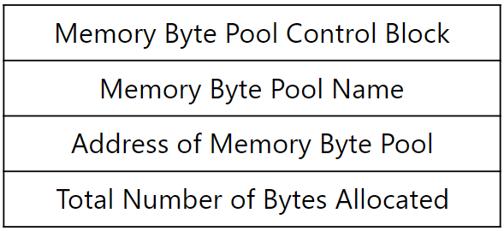
Memory byte pool
Similar to a standard C heap, but no limit to the number of memory byte pools that can be created.
ThreadX merges adjacent free memory blocks together during a subsequent allocation search for a large enough block of free memory → memory defragmentation
Memory byte pool attributes:
Control Block: contains essential system information
Name: be used primarily for user identification purposes
Address: The starting address of the byte pool
Total number: total number of bytes to be allocated to the memory byte pool

Slide 27
Memory byte pool
Create memory pool of bytes:
UINT tx_byte_pool_create (TX_BYTE_POOL *pool_ptr, CHAR *name_ptr, VOID *pool_start, ULONG pool_size);
Allocate bytes of memory:
UINT tx_byte_allocate (TX_BYTE_POOL *pool_ptr, VOID **memory_ptr, ULONG memory_size, ULONG wait_option);
Delete memory byte pool:
UINT tx_byte_pool_delete(TX_BYTE_POOL *pool_ptr);
Release bytes back to memory pool:
UINT tx_byte_release (VOID *memory_ptr);

Slide 28
Memory byte pool
Paramater:
pool_ptr: Pointer to a memory pool control block
name_ptr: Pointer to the name of the memory pool
pool_start: Starting address of the memory pool
pool_size: Total number of bytes available for the memory pool.
memory_ptr: Pointer to a destination memory pointer
memory_size: Number of bytes requested
wait_option: Defines how the service behaves if there is not enough memory available

Slide 29
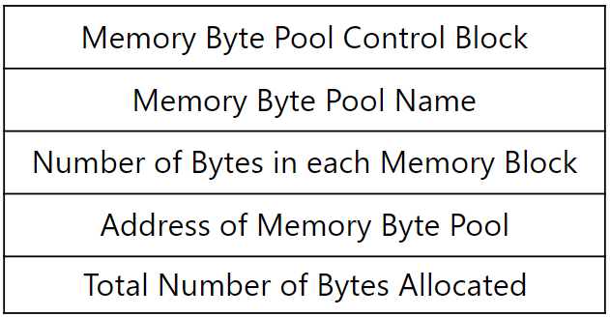
Memory block pool
Consists of fixed-size memory blocks → there is never a fragmentation problem
Same amount of memory is allocated each time → lack of flexibility in 1 block
Memory block pool attributes:
Control block: contains important system information
Name: be used primarily for identification purposes
Number of byte in each memory Block: The number of bytes in each fixed-size memory block must be specified
Address: where the memory block pool is located must be provided
Total number of byte: the total number of bytes available to the entire memory block pool must be specified.

Slide 30
Memory block pool
Create pool of fixed-size memory blocks:
UINT tx_block_pool_create (TX_BLOCK_POOL pool_ptr, CHAR name_ptr, ULONG block_size,
VOID pool_start, ULONG pool_size);
Allocate fixed-size block of memory:
UINT tx_block_allocate (TX_BLOCK_POOL *pool_ptr, VOID **block_ptr, ULONG wait_option);
Delete memory block pool:
UINT tx_block_pool_delete (TX_BLOCK_POOL *pool_ptr);
Release fixed-size block of memory:
UINT tx_block_release (VOID *block_ptr);

Slide 31
Memory block pool
Paramater:
pool_ptr*: Pointer to a memory block pool control block
name_ptr*: Pointer to the name of the memory block pool
block_size*: Number of bytes in each memory block
pool_start*: Starting address of the memory block pool
pool_size*: Total number of bytes available for the memory block pool
block_ptr: Pointer to a destination block pointer.
wait_option: Defines how the service behaves if there are no memory blocks available

Slide 32
Migration from freertos to threadx
Feature | ThreadX | FreeRTOS | ThreadX API | FreeRTOS API
Thread management | Supported | Supported | tx_thread_create tx_thread_sleep tx_thread_suspend | xTaskCreate vTaskDelay vTaskSuspend
Message queue | Supported | Supported | tx_queue_create tx_queue_send tx_queue_receive | xQueueCreate xQueueSend xQueueReceive
Event Flags | Supported | Supported | tx_event_flags_create tx_event_flags_get tx_event_flags_set | xEventGroupCreate xEventGroupGetBits xEventGroupSetBits
Mutex | Supported | Supported | tx_mutex_create tx_mutex_put tx_mutex_get | xSemaphoreCreateMutex
Semaphore | Supported | Supported | tx_semaphore_create tx_semaphore_put tx_semaphore_get | xSemaphoreCreate xSemaphoreGive xSemaphoreTake
Software Timer | Supported | Supported | tx_timer_create tx_timer_delete | xTimerCreate xTimerDelete
Memory Mangement | Advanced (Byte Pools and Block Pools) | Simple

Slide 33
Migration from freertos to threadx
ThreadX does not have an idle task
Unlike ThreadX, FreeRTOS fixes the total heap size in FreeRTOSConfig.h file (configTOTAL_HEAP_SIZE)
The default value of ticks number per second is fixed to 1000 for FreeRTOS and 100 for ThreadX
Priority:
Low priority numbers denote low priority tasks (0 is lowest priority)
Low priority numbers denote high priority tasks (0 is highest priority)
Preemption threshold: assign one or more threads a second priority, called its “Preemption-Threshold,” that must be exceeded by a preempting thread

Slide 34
filex

Slide 35
Overview filex
Azure RTOS FileX is a fully compliant FAT library for media storage and file system management
Storage media management
Multi partition support
File/Directory Access
Fault tolerance
Support 12-, 16-, 32- bit File Allocation Table (FAT)
Format and Extended FAT (exFAT)

Slide 36
Overview filex
ThreadX is typically required to run FileX
Using FX_STANDALONE_ENABLE flag to enable Standalone mode:
FX_STANDALONE_ENABLE flag is activated, local path logic and ThreadX timer setup are disabled
Using FileX in Standalone mode allows the reduction of code footprint by removing ThreadX files and libraries from the project

Slide 37
Filex important files
Filename | Descripttion
fx_api.h | This C header file contains all system equates, data structures, and service prototypes
fx_port.h | This C header file contains all development-tool-specific data definitions and structures
demo_filex.c | This C file contains a small demo application.
fx.a (fx.lib) | This is the binary version of the FileX C library. It is distributed with the standard package.

Slide 38
Media services
Opens the specified media for file access:
UINT fx_media_open ( FX_MEDIA *media_ptr, CHAR *media_name, VOID(*media_driver)(FX_MEDIA *),
VOID *driver_info_ptr, VOID *memory_ptr, ULONG memory_size);
Closes the specified media:
UINT fx_media_close (FX_MEDIA *media_ptr);
Parameter:
media_ptr: Pointer to media control block
media_name: Pointer to media's name
media_driver: Pointer to I/O driver for this media
driver_info_ptr: Pointer to optional information that the supplied I/O driver may utilize
memory_ptr: Pointer to the working memory for the media
memory_size: Specifies the size of the working media memory

Slide 39
Media services
Formats the specified media:
UINT fx_media_format (FX_MEDIA *media_ptr, VOID (*driver)(FX_MEDIA *media), VOID *driver_info_ptr, UCHAR *memory_ptr, UINT memory_size, CHAR *volume_name, UINT number_of_fats, UINT directory_entries, UINT hidden_sectors,
ULONG total_sectors, UINT bytes_per_sector, UINT sectors_per_cluster, UINT heads, UINT sectors_per_track);
Parameter:
driver: Pointer to the I/O driver for this media
driver_info_ptr: Pointer to the optional information that the I/O driver may utilize.
memory_ptr: Pointer to the working memory for the media.
memory_size: Specifies the size of the working media memory. The size must be at least as large as the media's sector size.
volume_name: Pointer to the volume name string, which is a maximum of 11 characters.
number_of_fats: Number of FATs in the media
directory_entries: Number of directory entries in the root directory
hidden_sectors: Number of sectors hidden before this media's boot sector. This is typical when multiple partitions are present.
total_sectors: Total number of sectors in the media.
bytes_per_sector: Number of bytes per sector, which is typically 512. FileX requires this to be a multiple of 32.
sectors_per_cluster: Number of sectors in each cluster. The cluster is the minimum allocation unit in a FAT file system.
heads: Number of physical heads
sectors_per_track: Number of sectors per track

Slide 40
Media services
Reads a logical sector from the media:
UINT fx_media_read (FX_MEDIA *media_ptr, ULONG logical_sector, VOID *buffer_ptr);
Writes a logical sector to the media:
UINT fx_media_write (FX_MEDIA *media_ptr, ULONG logical_sector, VOID *buffer_ptr);
Returns the available media space in bytes:
UINT fx_media_space_available (FX_MEDIA *media_ptr, ULONG *available_bytes_ptr);
Parameter:
media_ptr: Pointer to a previously-opened media
logical_sector: Logical sector to read/write
buffer_ptr: Pointer to the source for the logical sector read/write
available_bytes_ptr: Available bytes left in the media

Slide 41
directory services
Creates a subdirectory:
UINT fx_directory_create (FX_MEDIA *media_ptr, CHAR *directory_name);
Deletes the specified subdirectory:
UINT fx_directory_delete (FX_MEDIA *media_ptr, CHAR *directory_name);
Tests for the specified directory:
UINT fx_directory_name_test (FX_MEDIA *media_ptr, CHAR *directory_name);
Parameter:
media_ptr: Pointer to a media control block
directory_name: Pointer to the name of the directory

Slide 42
directory services
Sets a specified directory's attributes:
UINT fx_directory_attributes_set (FX_MEDIA *media_ptr, CHAR *directory_name, UINT *attributes);
Reads a specified directory's attributes:
UINT fx_directory_attributes_read (FX_MEDIA *media_ptr, CHAR *directory_name, UINT *attributes_ptr);
Parameter:
media_ptr: Pointer to a media control block
directory_name: Pointer to the name of the directory
attributes_ptr: Pointer to the destination for the directory's attributes:
FX_READ_ONLY (0x01) FX_HIDDEN (0x02)
FX_SYSTEM (0x04) FX_VOLUME (0x08)
FX_DIRECTORY (0x10) FX_ARCHIVE (0x20)

Slide 43
directory services
Gets the first directory entry:
UINT fx_directory_first_entry_find (FX_MEDIA *media_ptr, CHAR *return_entry_name);
Finds the next directory entry:
UINT fx_directory_next_entry_find (FX_MEDIA *media_ptr, CHAR *return_entry_name);
Parameter:
media_ptr: Pointer to a media control block
return_entry_name: Pointer to destination for the entry name in the default directory

Slide 44
file services
Creates a file:
UINT fx_file_create (FX_MEDIA *media_ptr, CHAR *file_name);
Deletes a file:
UINT fx_file_delete (FX_MEDIA *media_ptr, CHAR *file_name);
Opens a file:
UINT fx_file_open (FX_MEDIA *media_ptr, FX_FILE *file_ptr, CHAR *file_name, UINT open_type);
Closes a file:
UINT fx_file_close (FX_FILE *file_ptr);
Parameter:
media_ptr: Pointer to a media control block
file_name: Pointer to the name of the file to create/delete
file_ptr: Pointer to the file control block
open_type: Type of file:
FX_OPEN_FOR_READ (0x00)
FX_OPEN_FOR_WRITE (0x01)
FX_OPEN_FOR_READ_FAST (0x02)

Slide 45
file services
Reads bytes from the specified file:
UINT fx_file_read (FX_FILE *file_ptr, VOID *buffer_ptr, ULONG request_size, ULONG *actual_size);
Writes bytes to a file:
UINT fx_file_write (FX_FILE *file_ptr, VOID *buffer_ptr, ULONG size);
Positions the internal read/write pointer to a byte offset:
UINT fx_file_seek (FX_FILE *file_ptr, ULONG byte_offset);
Parameter:
file_ptr: Pointer to the file control block
buffer_ptr: Pointer to the destination buffer for the read/write
request_size: Maximum number of bytes to read
size: Number of bytes to write
actual_size: Pointer to the variable to hold the actual number of bytes read into the supplied buffer
byte_offset: Desired byte offset in file

Slide 46
Migration from fatfs to filex
Main features:
Feature | FileX | FATFS
FAT 12/16/32 and exFAT support | Yes | Yes
Platform independent | Yes | Yes
Multiple partition support | Yes | Yes
Long file name in ANSI/OEM or Unicode | Yes | Yes
Fault tolerance: Power failure recovery capability | Yes | No
Wear levelling support | Yes | No

Slide 47
Migration from fatfs to filex
Main API:
Description of the Media API | FileX | FATFS
Create a FAT volume on the logical drive | fx_media_format | f_mkfs
Register/Unregister the work area of the volume | fx_media_open / fx_media_close | f_mount
Read data | fx_media_read | disk_read
Write data | fx_media_write | disk_wirte
Get free space on the volume | fx_media_space_available | f_getfree

Slide 48
Migration from fatfs to filex
Main API:
Description of the Files API | FileX | FATFS
Open/Create a file | fx_file_open | f_open
Close a file | fx_file_close | f_close
Read data from a file | fx_file_read | f_read
Get the current read/write pointer | fx_file_seek | f_tell
Read a string | N/A | f_gets
Description of the Files API | FileX | FATFS
Write a character | N/A | f_putc
Write a string | N/A | f_puts
Write a formatted string | N/A | f_printf
Test for end of file | N/A | f_eof
Get object size | N/A | f_size
Check for errors | N/A | f_error

Slide 49
Levelx

Slide 50
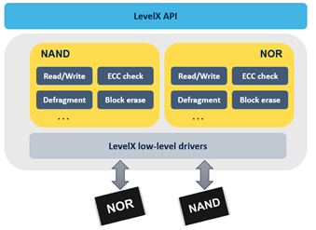
Levelx overview
LevelX: library providing API to deal with NAND and NOR flash memories
Main features:
Data read/write
Flash erase
Flash defragmentation
Wear levelling
Error checks

Slide 51
Levelx nand memory API
Initialize NAND flash support:
UINT lx_nand_flash_initialize (void);
Open NAND flash instance:
UINT lx_nand_flash_open ( LX_NAND_FLASH *nand_flash, CHAR *name, UINT (*nand_driver_initialize) (LX_NAND_FLASH *));
Close NAND flash instance:
UINT lx_nand_flash_close (LX_NAND_FLASH *nand_flash);
Paramater:
nand_flash: NAND flash instance pointer.
nand_flash: NAND flash instance pointer.
nand_driver_initialize: Function pointer to NAND flash driver initialization function.

Slide 52
Levelx nand memory API
Read NAND flash sector:
UINT lx_nand_flash_sector_read (LX_NAND_FLASH *nand_flash, ULONG logical_sector, VOID *buffer);
Write NAND flash sector:
UINT lx_nand_flash_sector_write (LX_NAND_FLASH *nand_flash, ULONG logical_sector, VOID *buffer);
Release NAND flash sector:
UINT lx_nand_flash_sector_release (LX_NAND_FLASH *nand_flash, ULONG logical_sector);
Paramater:
nand_flash: NAND flash instance pointer.
logical_sector: Logical sector to read/write/release
buffer: Pointer to destination for contents of the logical sector

Slide 53
Levelx nand memory API
Check page for ECC errors with correction:
UINT lx_nand_flash_page_ecc_check (LX_NAND_FLASH *nand_flash, UCHAR *page_buffer, UCHAR *ecc_buffer);
Compute ECC for page:
UINT lx_nand_flash_page_ecc_compute (LX_NAND_FLASH *nand_flash, UCHAR *page_buffer, UCHAR *ecc_buffer);
Paramater:
nand_flash: NAND flash instance pointer.
page_buffer: Pointer to NAND flash page buffer.
ecc_buffer: Pointer to destination for ECC of the NAND flash page.

Slide 54
Levelx nor memory API
Initialize NOR flash support:
UINT lx_nor_flash_initialize (void);
Open NOR flash instance:
UINT lx_nor_flash_open (LX_NOR_FLASH *nor_flash, CHAR *name, UINT (*nor_driver_initialize) (LX_NOR_FLASH *));
Close NOR flash instance:
UINT lx_nor_flash_close (LX_NOR_FLASH *nor_flash);
Paramater:
nor_flash: NOR flash instance pointer.
name: Name of NOR flash instance.
nor_driver_initialize: Function pointer to NOR flash driver Initialization function.

Slide 55
Levelx nand memory API
Read NOR flash sector:
UINT lx_nor_flash_sector_read (LX_NOR_FLASH *nor_flash, ULONG logical_sector, VOID *buffer);
Write NOR flash sector:
UINT lx_nor_flash_sector_write (LX_nor_FLASH *NOR_flash, ULONG logical_sector, VOID *buffer);
Release NOR flash sector:
UINT lx_nor_flash_sector_release (LX_NOR_FLASH *nor_flash, ULONG logical_sector);
Paramater:
nor_flash: NOR flash instance pointer.
logical_sector: Logical sector to read/write/release.
buffer: Pointer to destination for contents of the logical sector.

Slide 56
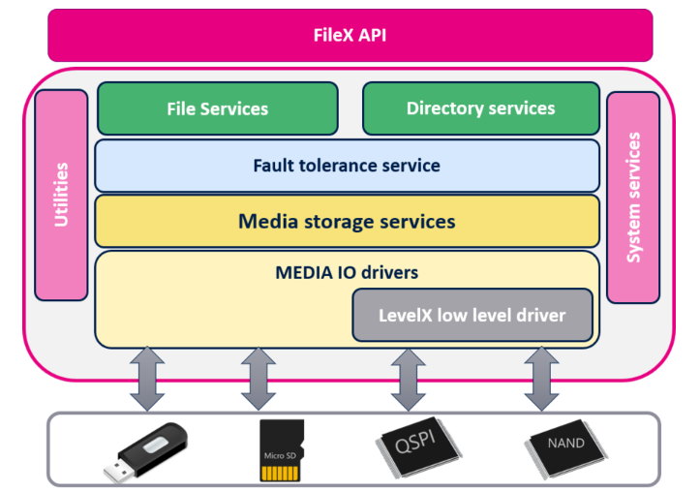
Filex and levelx intergration
Application
FileX
Media API
LevelX
Flash API
Flash Device

Slide 57
GUIx

Slide 58
Overview GUIX
Azure GUIX embedded GUI is Microsoft’s advanced, industrial grade GUI solution designed specifically for deeply embedded, real-time, and IoT applications
Azure RTOS GUIX is fully integrated with Azure RTOS ThreadX RTOS and is available for many of the same processors supported by Azure RTOS ThreadX
Support Azure RTOS GUIX Studio which includes everything to create, build, and run graphical interface design:
The GUIX Studio application
Several GUIX example projects
All graphics resources and fonts used in the example projects
Solution files and project files for building in a Windows desktop environment using the Microsoft Visual Studio IDE
Pre-built GUIX and ThreadX libraries for Win32, allowing you to build and run your own applications on your PC
GUIX and ThreadX API header files

Slide 59
GUIX important files
Filename | Descripttion
gx_api.h | This C header file contains all system equates, data structures, and service prototypes.
gx_port.h | This C header file contains all target-specific and development tool-specific data definitions and structures.
gx.a (gx.lib) | This is the binary version of the GUIX C library.

Slide 60
GUIX Thread
GUIX has an internal thread created by:
gx_system_initialize: Initialize GUIX
gx_system_start: Start GUIX processing
#define GX_SYSTEM_THREAD_PRIORITY: define the priority of Internal GUIX ThreadX (gx_port.h or gx_user.h header file)
#define GX_SYSTEM_THREAD_TIMESLICE: define GUIX ThreadX time slide (default 10ms)
#define GX_THREAD_STACK_SIZE: define the stack size of system thread (gx_port.h header file)
Thread Execution loop:
Dispatch events
Needing refresh screen ?
Retrieves events from the GUIX event queue
Processing by the GUIX windows and widgets.
Processing by the GUIX windows and widgets.

Slide 61
GUIX Event processing
Input event
Current window or widget
Understand event ?
No
Window’s or widget’s parent
Yes
Yes
Process the event
Yes
Understand event ?
Root window
No
Understand event ?
……
No
Discarde the event

Slide 62
GUIX components API
The GUIX APIs are divided and organized into several basic groups which correspond to fundamental components of the GUIX system:
GX_SYSTEM (System component): responsible for initialization, events, timers, string tables, and visible widget hierarchy management.
GX_CANVAS (Canvas component): A drawing area. The canvas type is determined by parameters passed to the gx_canvas_create API function.
GX_CONTEXT (Drawing context component): The drawing context contains information about the screen, canvas, and brush, and clipping area for the current drawing operations.
GX_DISPLAY (Display component): Provides the APIs and driver-level implementations to allow your application and the GUIX widgets to perform drawing on a canvas.
GX_WIDGET (Widget component): The basic visible widget object and associated APIs. All GUIX widget types are based on or derived from the basic GX_WIDGET type
GX_UTILITY (Utility component): is responsible for all common utility functions in GUIX.

Slide 63

GUIX studio
Azure RTOS GUIX Studio (GUIX Studio) is a Microsoft Windows-based rapid UI development environment specifically designed for the GUIX runtime library from Microsoft
Azure RTOS GUIX Studio includes everything need to create, build, and run graphical interface design

Slide 64
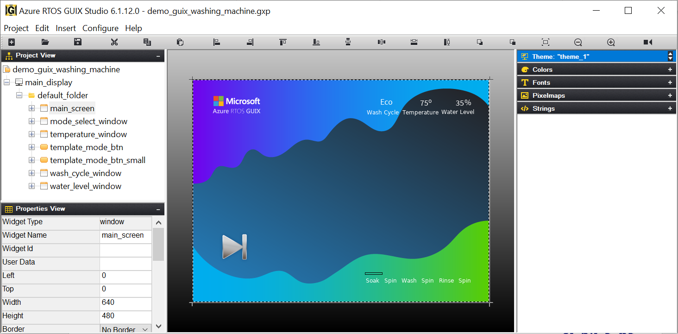
GUIX studio views
Toolbar
Project View
Properties View
Resource View
Target View

Slide 65
GUIX studio view
Toolbar: shows the buttons available to the GUIX Studio developer.
Project View: shows the hierarchical list GUIX objects that comprise the embedded UI.
Properties View: shows detailed property information of the currently selected GUIX object
Target View: is the WYSIWYG screen design and layout area. This view represent the physical display or displays available on target hardware.
Resource View: is used to manage the resources (colors, fonts, pixelmaps, and strings) available to applications screens defined for each display.

Slide 66
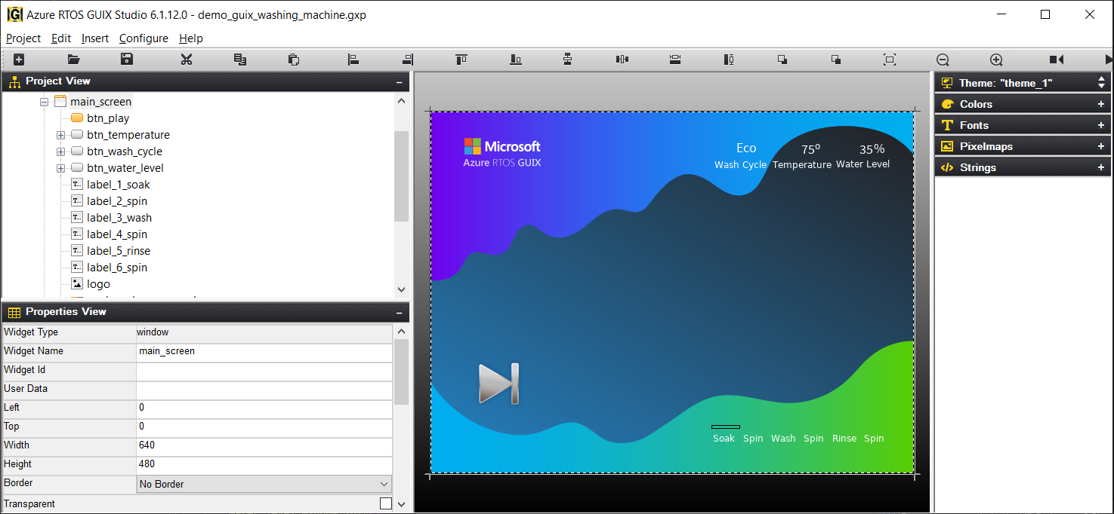
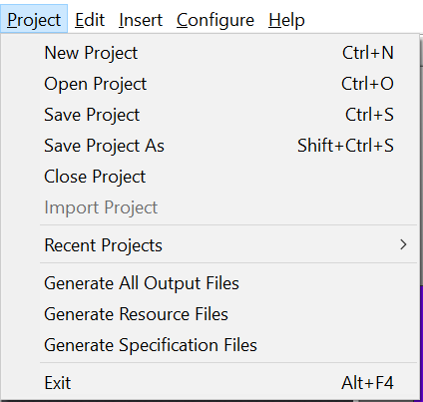
GUIX execution
Create project GUI
in GUIX Studio
Generating output file
resource file
specification file
Resource Files: contain preset data structures that define all of the GUIX Studio resources (colors, fonts, pixelmaps, and strings)
{project-name}_resources.h
{project-name}_resources.c
Specification Files: contain all the C code to create the UI designed in GUIX Studio
{project-name}_specifications.h
{project-name}_specifications.c
Add file
Embedded IDE project

Slide 67
GUIX execution
Embedded IDE project
Initialize GUIX
gx_system_initialize
Custom draw funtions
Custom event process functions
Configure display defined in GUIX Studio
gx_studio_display_configure
Call Init and Create functions
define in specification file
Show widget
gx_widget_show
Start GUIX
gx_system_start

Slide 68
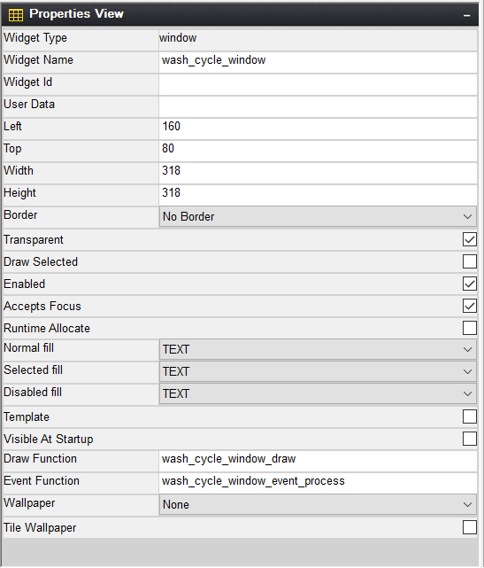
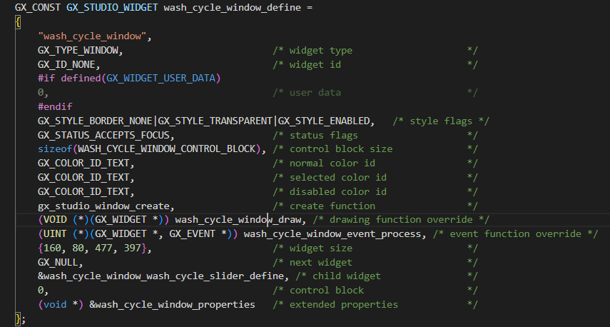
GUIX execution
Properties View of Widget in GUIX Studio
Define of Widget in Specification file
Draw function of widget
Function process when having event

Slide 69
Netx & NetX duo

Slide 70
Agenda
Overview Page 70
Execution overview Page 76
Packet Pool Page 78
IP Protocol Page 82
ARP & RARP Page 90
ICMP Page 93
IGMP Page 95
UDP Page 96
TCP Page 99
ADDONS Page 100

Slide 71
overview
Azure RTOS NetX is an industrial grade TCP/IP (only IPv4) embedded network stack, designed specifically for deeply embedded, real-time, and IoT applications.
Provides embedded applications with core network protocols such as IPv4, TCP, and UDP as well as a complete suite of additional, higher-level add-on protocols.
Azure RTOS NetX Duo is an upgraded TCP/IP network by integrating dual IPv4 and IPv6
Provides embedded applications with core network protocols such as IPv4, IPv6, TCP, and UDP as well as a complete suite of additional, higher-level add-on protocols.
Offers security via additional add-on security products, including Azure RTOS NetX Secure IPsec and Azure RTOS NetX Secure SSL/TLS/DTLS.

Slide 72
Modularity in protocol
Protocol for NetX
Protocol | Use | ROM | RAM | Protocol | Use | ROM | RAM
TELNET | Client/Server | 0.5 kB | 0.3 kB | ARP/RARP | IP to MAC
AutoIP | IPv4 addressing | 1.2 kB | 300 bytes | PPP | Comunication | 7.1 kB | 3.8 kB
HTTP | Client/Server | 2.8-4.8 kB | 0.4-1 kB | SNTP | Time management | 4 kB | 0.5 kB
SMTP | E-mail client | 4.1 kB | 0.6 kB | IGMP | Group IP | 2.5 kB
DHCP | Client/Server | 3.6-4.6 kB | 2.7 kB | ICMP | Ping | 2.5 kB
POP3 | E-mail client | 8.1 kB | 1.4 kB | UDP | Transmission | 2.5 kB | 124 bytes/socket
SNMP | Management | 10.9 kB | 2.6 kB | TCP | Transmission | 10.5 -12.5 kB | 280 bytes/socket
FTP | File Tranfer | 1.8-7.2 kB | 0.6-2.1 kB | IPv4 | Transport | 3.5-8.5 kB | 2-3 kB
TFTP | File Tranfer | 1.7-2.4 kB | 0.3-1.8 kB

Slide 73
Modularity in protocol
NetX Duo supports all of NetX's protocols and following additional protocols:
Protocol | Use | ROM | RAM
MQTT | IoT/Telemetry | 2.7 kB
HTTPs | Client/Server, TLS | 3-9.5 kB | 0.5-2 kB
NAT | Bridging | 3.5 kB | 0.6 kB
DNS, mDNS, DNS-SD | Name resolution | 2.4-3 kB | 1 kB
PPPoE | Comunication | 7.1 kB | 3.8 kB
TLS/DTLS | HW crypto support | 8.8/11 kB
IPv6 | Transport | 3.5-8.5 kB | 2-3 kB

Slide 74
Configuration
The configuration options can be defined in the application source, on the command line, or within the nx_user.h include file, unless otherwise specified.
System Configuration Options
ARP Configuration Options
ICMP Configuration Options
IGMP Configuration Options
IP Configuration Options
Packet Configuration Options
RARP Configuration Options
TCP Configuration Options
UDP Configuration Options
IPv6 Options
Neighbor Cache Configuration Options
Miscellaneous ICMPv6 Configuration Options

Slide 75
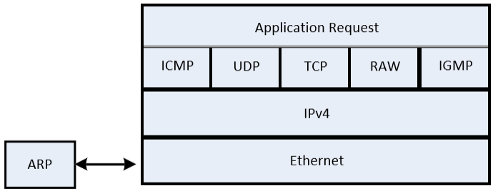
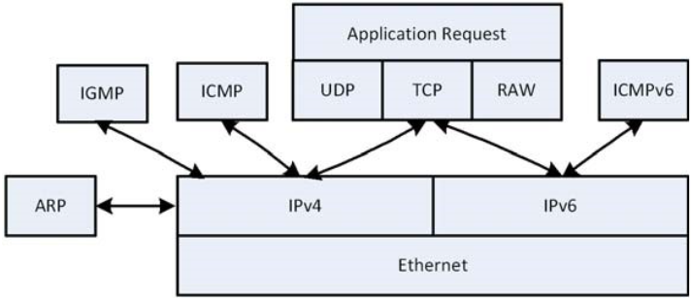
Protocol layering
Link Layer: is handled by the network driver.
Network Layer: is basically responsible for sending and receiving simple packets across the network.
Transport Layer: is responsible for managing the flow of data between hosts on the network.
TCP: to to transport ordered and error-checked packets over the network.
UDP: to transport data faster by bypassing error checking.
Application Layer: communicate directly with application processes and perform their usual services.
Application Layer
Transport Layer
Network Layer
Link layer
NetX Layer Protocol
NetX Duo Layer Protocol

Slide 76
Execution overview
nx_system_initialize
Call from tx_application_define
or user threads
nx_packet_pool_create
nx_ip_create
Network Driver
IP Thread
User Threads
1000ms
(ARP, IGMP, TCP) timeout
IP Periodic Timers
100ms
(TCP retransmit timeout)

Slide 77
Execution overview
Multihome support: supports systems connected to multiple physical devices using a single IP instance.
NX_MAX_PHSYCIAL_INTERFACES: define number of physical devices attached to the system
Primary device: using the nx_ip_create to creates a single IP instance for the primary device (has zero index in IP instance list)
Additional network devices using the nx_ip_interface_attach: attaches the device to the IP instance (assigned next index)
Loopback Interface: is a special network interface without an physical link attached to
allows applications to communicate using the IP loopback address 127.0.0.1
Set NX_DISABLE_LOOPBACK_INTERFACE to enable Loopback interface

Slide 78
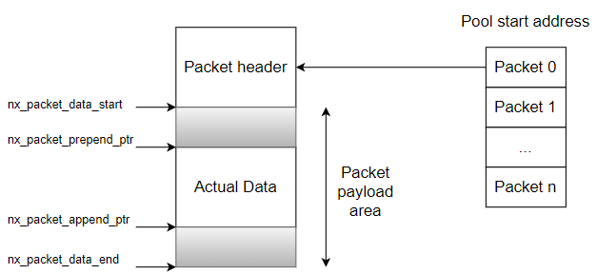
Packet pools
NetX provides the ability to create and manage multiple pools of fixed-size network packets:
NetX Duo provides packet pools with more Packet header offsets for IPv6 and Dual Packet Pool

Slide 79
Packet pools
Create packet pool in specified memory area:
UINT nx_packet_pool_create (NX_PACKET_POOL *pool_ptr, CHAR *name,
ULONG payload_size, VOID *memory_ptr, ULONG memory_size);
Allocate packet from specified pool:
UINT nx_packet_allocate (NX_PACKET_POOL *pool_ptr, NX_PACKET **packet_ptr,
ULONG packet_type, ULONG wait_option);
Release previously allocated packet:
UINT nx_packet_release (NX_PACKET *packet_ptr);
Release a transmitted packet:
UINT nx_packet_transmit_release (NX_PACKET *packet_ptr);
Delete previously created packet pool:
UINT nx_packet_pool_delete (NX_PACKET_POOL *pool_ptr);

Slide 80
Packet pools
Paramater:
pool_ptr: Pointer to packet pool control block.
name: Pointer to application’s name for the packet pool.
payload_size: Number of bytes in each packet in the pool.
memory_ptr: Pointer to the memory area to place the packet pool in.
memory_size: Size of the pool memory area.
packet_ptr: Pointer to the pointer of the allocated packet pointer.
packet_type: Defines the type of packet requested.
wait_option: Defines the wait time in ticks if there are no packets available in the packet pool.

Slide 81
Packet pools
Dual Packet Pool: NetX Duo allows application to install an auxiliary packet pool, where the payload size is smaller. Once the auxiliary packet pool is installed, the IP helper thread would allocate packets from either the default packet pool or the auxiliary pool, depending on the size of the message it transmits.
Set NX_DUAL_PACKET_POOL_ENABLE to enable dual packet pool
Configure an auxiliary packet pool:
UINT nx_ip_auxiliary_packet_pool_set (NX_IP *ip_ptr, NX_PACKET_POOL *aux_pool);
ip_ptr: Pointer to previously created IP instance.
aux_pool: The auxiliary packet pool to be configured for the IP instance.

Slide 82
Ip protocol
Create an IP instance:
UINT nx_ip_create (NX_IP *ip_ptr, CHAR *name, ULONG ip_address, ULONG network_mask,
NX_PACKET_POOL *default_pool, VOID (*ip_network_driver)(NX_IP_DRIVER *),
VOID *memory_ptr, ULONG memory_size, UINT priority);
Delete previously created IP instance:
UINT nx_ip_delete(NX_IP *ip_ptr);

Slide 83
Ip protocol
Paramater:
ip_ptr: Pointer to control block to create a new IP instance.
name: Name of this new IP instance.
ip_address: IP address for this IP instance.
network_mask: Mask to delineate the network portion of the IP address for sub-netting and super-netting uses.
default_pool: Pointer to control block of previously created NetX packet pool.
ip_network_driver: User-supplied network driver used to send and receive IP packets.
memory_ptr: Pointer to memory area for the IP helper thread’s stack area.
memory_size: Number of bytes in the memory area for the IP helper thread’s stack.
priority: Priority of IP helper thread.

Slide 84
Ip protocol
Attach network interface to IP instance:
UINT nx_ip_interface_attach (NX_IP *ip_ptr, CHAR *interface_name, ULONG ip_address,
ULONG network_mask, VOID(*ip_link_driver) (struct NX_IP_DRIVER_STRUCT *));
Paramater:
ip_ptr: Pointer to previously created IP instance.
interface_index: Interface index, the same value as the index to the network interface attached to the IP instance.
ip_address: Pointer to destination for the device interface IP address.
network_mask: Pointer to destination for the device interface network mask.

Slide 85
Ip protocol
Raw IP: The Raw IP interface lets a client program send and receive arbitrary IP packets on any IP protocol except TCP and UDP. Only one client can use any given protocol at one time.
Enable raw packet processing:
UINT nx_ip_raw_packet_enable (NX_IP *ip_ptr);
Disable raw packet sending/receiving:
UINT nx_ip_raw_packet_disable (NX_IP *ip_ptr);
Parameters:
ip_ptr: Pointer to previously created IP instance.

Slide 86
Ip protocol
Send raw IP packet through specified network interface:
UINT nx_ip_raw_packet_interface_send (NX_IP *ip_ptr, NX_PACKET *packet_ptr, ULONG destination_ip,
UINT address_index, ULONG type_of_service);
Send raw IP packet:
UINT nx_ip_raw_packet_send (NX_IP *ip_ptr, NX_PACKET *packet_ptr,
ULONG destination_ip, ULONG type_of_service);
Receive raw IP packet:
UINT nx_ip_raw_packet_receive (NX_IP *ip_ptr, NX_PACKET **packet_ptr, ULONG wait_option);
Parameters:
ip_ptr: Pointer to previously created IP instance
packet_ptr: Pointer to packet to transmit.
destination_ip: IP address to send packet.
address_index: Index of the address of the interface to send packet out on.
wait_option: Defines how the service behaves if there are no raw IP packets available.
type_of_service: Type of service for packet:
NX_IP_NORMAL (0x00000000)
NX_IP_MIN_DELAY (0x00100000)
NX_IP_MAX_DATA (0x00080000)
NX_IP_MAX_RELIABLE (0x00040000)
NX_IP_MIN_COST (0x00020000)

Slide 87
IPv6 protocol
NetX Duo support both IPv4 and IPv6:
IPv4 similar NetX
IPv6: only support Unicast and Multicast (Anycast not support)
To accommodate both IPv4 and IPv6 formats, NetX Duo provides a new data type, NXD_ADDRESS, for holding IPv4 and IPv6 addresses:
typedef struct NXD_ADDRESS_STRUCT {
ULONG nxd_ip_version;
union {
ULONG v4;
ULONG v6[4];
} nxd_ip_address;
} NXD_ADDRESS;
nxd_ip_version: indicates IPv4 or IPv6 version (NX_IP_VERSION_V4 or NX_IP_VERSION_V6)

Slide 88
IPv6 protocol
Enabling IPv6 in NetX Duo
Enable IPv6 Services:
UINT nxd_ipv6_enable (NX_IP *ip_ptr);
Disable the IPv6 feature:
UINT nxd_ipv6_disable (NX_IP *ip_ptr);
Set IPv6 Address and Prefix:
UINT nxd_ipv6_address_set ( NX_IP *ip_ptr, UINT interface_index, NXD_ADDRESS *ip_address,
ULONG prefix_length, UINT *address_index);
Parameters:
ip_ptr: Pointer to the previously created IP instance
nterface_index: Index to the interface the IPv6 address is associated with
ip_address: Pointer to the address to set
prefix_length: Length of the address prefix (subnet mask)
address_index: Pointer to the index into the address table where the address is inserted

Slide 89
IPv6 protocol
IPv6 Multicast:
Join IP instance to specified multicast group:
UINT nx_igmp_multicast_join (NX_IP *ip_ptr, ULONG group_address);
Cause IP instance to leave specified multicast group:
UINT nx_igmp_multicast_leave (NX_IP *ip_ptr, ULONG group_address);
Parameters:
ip_ptr: Pointer to previously created IP instance.
group_address: Multicast group to leave.

Slide 90
Address Resolution Protocol (ARP) in IP
ARP (Address Resolution Protocol) is a network protocol used to find out the hardware address (MAC address) of a device from a source IP address.
Enables Address Resolution Protocol (ARP):
UINT nx_arp_enable (NX_IP *ip_ptr, VOID *arp_cache_memory, ULONG arp_cache_size);
Locate IP address given a physical address:
UINT nx_arp_ip_address_find (NX_IP *ip_ptr, ULONG *ip_address, ULONG physical_msw, ULONG physical_lsw);
Parameters:
ip_ptr: Pointer to previously created IP instance.
arp_cache_memory: Pointer to memory area to place ARP cache.
arp_cache_size: Each ARP entry is 52 bytes, the total number of ARP entries is, therefore, the size divided by 52.
ip_address: Pointer to return IP address, if one is found that has been mapped.
physical_msw: Top 16 bits (47-32) of the physical address to search for.
physical_lsw: Lower 32 bits (31-0) of the physical address to search for. Return Values

Slide 91
Address Resolution Protocol (ARP) in IP
ARP (Address Resolution Protocol) is a network protocol used to find out the hardware address (MAC address) of a device from a source IP address.
Locate physical hardware address given an IP address:
UINT nx_arp_hardware_address_find (NX_IP *ip_ptr, ULONG ip_address, ULONG *physical_msw, ULONG *physical_lsw);
Parameters:
ip_ptr: Pointer to previously created IP instance.
ip_address: IP address to search for.
physical_msw: Pointer to the variable for returning the top 16 bits (47-32) of the physical address.
physical_lsw: Pointer to the variable for returning the lower 32 bits (31-0) of the physical address.

Slide 92
Reverse Address Resolution Protocol (rARP) in IP
RARP (Reverse Address Resolution Protocol) is the protocol for requesting network assignment of the host's 32-bit IP addresses
Enable Reverse Address Resolution Protocol (RARP)
UINT nx_rarp_enable (NX_IP *ip_ptr);
Disable Reverse Address Resolution Protocol (RARP):
UINT nx_rarp_disable (NX_IP *ip_ptr);
Retrieve information about RARP activities
UINT nx_rarp_info_get (NX_IP *ip_ptr, ULONG *rarp_requests_sent,
ULONG *rarp_responses_received, ULONG *rarp_invalid_messages);
Parameters:
ip_ptr: Pointer to previously created IP instance.
rarp_requests_sent: Pointer to destination for the total number of RARP requests sent.
rarp_responses_received: Pointer to destination for the total number of RARP responses received.
rarp_invalid_messages: Pointer to destination of the total number of invalid messages.

Slide 93
Internet Control Message Protocol (ICMP)
ICMP: is limited to passing error and control information between IP network members.
Enable Internet Control Message Protocol (ICMP):
UINT nx_icmp_enable (NX_IP *ip_ptr);
Send ping request to specified IP address:
UINT nx_icmp_ping (NX_IP *ip_ptr, ULONG ip_address, CHAR *data,
ULONG data_size, NX_PACKET **response_ptr, ULONG wait_option);
Parameters:
ip_ptr: Pointer to previously created IP instance.
ip_address: IP address, in host byte order, to ping. data Pointer to data area for ping message.
data_size: Number of bytes in the ping data.
response_ptr: Pointer to packet pointer to return the ping response message in.
wait_option: Defines how long to wait for a ping response.

Slide 94
Internet Control Message Protocol in IPv6 (ICMPv6)
Enable ICMPv4 and ICMPv6 Services:
UINT nxd_icmp_enable (NX_IP *ip_ptr);
Perform ICMPv4 or ICMPv6 Echo Requests:
UINT nxd_icmp_ping (NX_IP *ip_ptr, NXD_ADDRESS *ip_address, CHAR *data_ptr,
ULONG data_size, NX_PACKET **response_ptr, ULONG wait_option);
Parameters:
ip_ptr: Pointer to IP instance
ip_address: Destination IP address to ping, in host byte order
data_ptr: Pointer to ping packet data area
data_size: Number of bytes of ping data
response_ptr: Pointer to response packet Pointer
wait_option: Time to wait for a reply.

Slide 95
Internet group Management Protocol (IGMP)
IGMP: provides a device to communicate with its neighbors and its routers that it intends to receive, or join, an IP multicast
Enable Internet Group Management Protocol (IGMP):
UINT nx_igmp_enable (NX_IP *ip_ptr);
Join IP instance to specified multicast group:
UINT nx_igmp_multicast_join (NX_IP *ip_ptr, ULONG group_address);
Cause IP instance to leave specified multicast group:
UINT nx_igmp_multicast_leave (NX_IP *ip_ptr, ULONG group_address);
Parameters:
ip_ptr: Pointer to previously created IP instance.
group_address: Multicast group to join/leave.

Slide 96
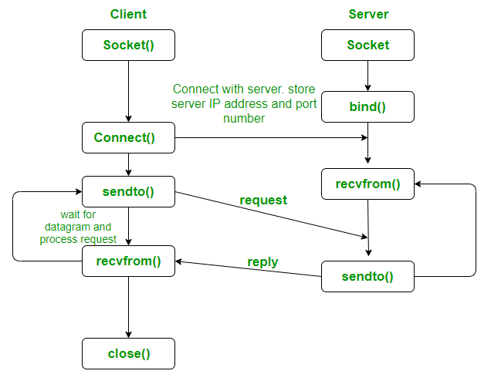
User datagram protocol (udp)
UDP: provides the simplest form of data transfer between network members (transport data faster by bypassing error checking)
Enable UDP component of NetX:
UINT nx_udp_enable (NX_IP *ip_ptr);

Slide 97
User datagram protocol (udp)
UDP Server
UDP Client
Create UDP socket
nx_udp_socket_create
Create UDP socket
nx_udp_socket_create
Bind UDP socket to UDP port nx_udp_socket_bind
Bind UDP socket to UDP port nx_udp_socket_bind
Receive a UDP Datagram nx_udp_socket_receive
Send a UDP Datagram
nx_udp_socket_send
Send a UDP Datagram
nx_udp_socket_send
Receive a UDP Datagram nx_udp_socket_receive

Slide 98
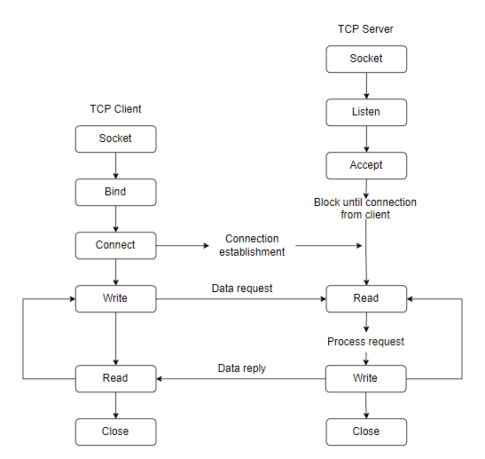
Transmission Control Protocol (TCP)
TCP: provides reliable stream data transfer between two network members (transport ordered and error-checked packets over the network)
Enable TCP component of NetX:
UINT nx_tcp_enable (NX_IP *ip_ptr);

Slide 99
Transmission Control Protocol (TCP)
TCP Server
TCP Server
Create server socket
nx_tcp_socket_create
Create TCP client
nx_tcp_socket_create
Enable listen for connection on TCP port
nx_tcp_server_socket_listen
Bind client TCP socket to TCP port
nx_tcp_client_socket_bind
Connect client TCP socket
nx_tcp_client_socket_connect
Accept TCP connection
nx_tcp_server_socket_accept
Wait to client connect
Send data from TCP socket
nx_tcp_socket_send
Receive data from TCP socket
nx_tcp_socket_receive
Receive data from TCP socket
nx_tcp_socket_receive
Send data from TCP socket
nx_tcp_socket_send
Disconnect client and server socket nx_tcp_socket_disconnect

Slide 100
Netx and netx duo addons

Slide 101
Auto ip
Auto IP:
The Azure RTOS NetX AutoIP Protocol is a protocol designed for dynamically configuring IPv4 addresses on a local network.
AutoIP allocates addresses in the range of 169.254.1.0 through 169.254.254.255.
Create AutoIP instance:
UINT nx_auto_ip_create ( NX_AUTO_IP *auto_ip_ptr, CHAR *name, NX_IP *ip_ptr,
VOID *stack_ptr, ULONG stack_size, UINT priority);
Start AutoIP processing:
UINT nx_auto_ip_start ( NX_AUTO_IP *auto_ip_ptr, ULONG starting_local_address);
Stop AutoIP processing:
UINT nx_auto_ip_stop (NX_AUTO_IP *auto_ip_ptr);
Get current AutoIP address:
UINT nx_auto_ip_get_address (NX_AUTO_IP *auto_ip_ptr, ULONG *local_ip_address);

Slide 102
Netx addons
DHCP (Dynamic Host Configuration Protocol):
DHCP: as the ability to dynamically allocate an IP address and also provide additional important network information.
DHCP Server
DHCP Client
Create a DHCP Server
nx_dhcp_server_create
Create a DHCP instance
nx_dhcp_create
Create an IP Address Pool
nx_dhcp_server_ip_address_list
Set requested IP address for DHCP instance
nx_dhcp_request_client_ip
Set network parameters for DHCP options
nx_dhcp_set_interface_network_parameters
Set DHCP state change callback function
nx_dhcp_state_change_notify
Call back function execute when DHCP has a change
Start DHCP Server processing
nx_dhcp_server_start
Start DHCP processing
nx_dhcp_start

Slide 103
dns
Create a DNS Client instance
nx_dns_create
DNS (Domain Name System) Server:
Provides a distributed database that contains mapping between domain names and physical IP addresses.
The DNS Client protocol for NetX provides the application with services to request mapping information from one or more DNS Servers.
Initialize the DNS Cache
nx_dns_cache_initialize
Set the DNS Client packet pool
nx_dns_packet_pool_set
Add DNS Server IP Address
nx_dns_server_add (IPv4)
nxd_dns_server_add (IPv6)
Look up an IP address from the host name
nx_dns_host_by_name_get (IPv4)
nxd_dns_host_by_name_get (IPv6)
Look up a host name from an IP address
nx_dns_host_by_address_get (IPv4)
nxd_dns_host_by_address_get (IPv6)
Look up the IPv4 address for the input host name
nx_dns_ipv4_address_by_name_get (IPv4)
nxd_dns_ipv6_address_by_name_get (IPv6)

Slide 104
http/https
HTTP (Hypertext Transfer Protocol): (using TCP)
A protocol designed for transferring content on the Web
Is a simple protocol that utilizes reliable Transmission Control Protocol (TCP) services to perform its content transfer function
HTTP Server
HTTP Client
Create an HTTP Server instance
nx_http_server_create
Create a HTTP Client instance
nx_http_client_create
Start the HTTP Server
nx_http_server_start
Start an HTTP GET request
nx_http_client_get_start (IPv4)
nxd_http_client_get_start (IPv6)
Start an HTTP GET request
nx_http_client_get_start (IPv4)
nxd_http_client_get_start (IPv6)
Get next resource data packet
nx_http_client_get_packet
Send next resource data packet
nx_http_client_put_packet
HTTPs:
is the secure version of the HTTP protocol, which implements HTTP using Transport Layer Security (TLS) to secure the underlying TCP connection

Slide 105
ftp/tftp
FTP (File Transfer Protocol): (using TCP)
A protocol designed for file transfers
FTP utilizes reliable Transmission Control Protocol (TCP) services to perform its file transfer function.
FTP Server
FTP Client
Create FTP Server
nx_ftp_server_create
Create FTP Client
nx_ftp_client_create
Start FTP Server
nx_ftp_server_start
Connect to an FTP Server over IP
nx_ftp_client_connect (IPv4)
nxd_ftp_client_connect (IPv6)
Opens file on FTP Server
nx_ftp_client_file_open
Rename/Delete file on FTP Server
nx_ftp_client_file_rename
nx_ftp_client_file_delete
Read/Wite file
nx_ftp_client_file_read
nx_ftp_client_file_write
Close file
nx_ftp_client_file_close

Slide 106
ftp/tftp
TFTP (Trivial File Transfer Protocol): (using TCP)
is a lightweight protocol designed for file transfers
TFTP Server
TFTP Client
Create TFTP Server
nxd_tftp_server_create
Create TFTP client
nx_ftp_client_create
Start TFTP Server
nxd_tftp_server_start
Opens file on TFTP Server
nxd_tftp_client_file_open
Read/Wite file
nxd_tftp_client_file_read
nxd_tftp_client_file_write
Close file
nxd_tftp_client_file_close

Slide 107
POP3
POP3 (Post Office Protocol version 3): (using TCP)
is an application layer protocol, used to retrieve email messages from the mail server, over a TCP/IP connection.
Create a POP3 Client instance:
nx_pop3_client_create: for IPv4
nxd_pop3_client_create: for IPv6
Retrieve a specified mail item:
nx_pop3_client_mail_item_get
Retrieve the number of mail items in maildrop:
nx_pop3_client_mail_items_get
Retrieve the specified mail item message:
nx_pop3_client_mail_item_message_get
Retrieve the size of the specified mail item:
nx_pop3_client_mail_item_size_get

Slide 108
MQTT
MQTT Client (Message Queue Telemetry Transport):
Is a message transmission protocol according to the publish/subscribe (provide/subscribe) model
MQTT Client
Create MQTT Client Instance
nxd_mqtt_client_create
Callback function when client receive
Connect MQTT Client to the broker
nxd_mqtt_client_connect
Subscribe to a topic
nxd_mqtt_client_subscribe
Publish a message through the broker
nxd_mqtt_client_publish
Set MQTT message receive notify callback function
nxd_mqtt_client_receive_notify_set
Receive queue in MQTT client
Retrieve a message from the broker
nxd_mqtt_client_message_get

Slide 109
SMTP
SMTP (Simple Mail Transfer Protocol): (using TCP)
is an Internet standard communication protocol for electronic mail transmission.
Create an SMTP Client Instance
nxd_smtp_client_create
Create and send an SMTP mail item
nx_smtp_mail_send
Delete an SMTP Client Instance
nx_smtp_client_delete

Slide 110
Telnet
Telnet: (using TCP)
designed for transferring commands and responses between two nodes on the Internet
new_connection: called whenever a new Telnet Client connection request is detected by the Server.
receive_data: called whenever a new Telnet Client data is present on the connection.
end_connection: is called whenever a Telnet Client connection is disconnected
Create a Telnet Server
nx_telnet_server_create
Create a Telnet Client
nx_telnet_client_create
Connect a Telnet Client with IP address
nx_telnet_client_connect (IPv4)
nxd_telnet_client_connect (IPv6)
Start a Telnet Server
nx_telnet_server_start
Receive packet via Telnet Client
nx_telnet_client_packet_receive
Send packet through Client connection
nx_telnet_server_packet_send

Slide 111
PPP/PPPoe
PPP (Point-to-Point Protocol):
A communication protocol of the data link layer that is used to transmit multiprotocol data between two directly connected
Create a PPP instance:
nx_ppp_create
Start PPP processing:
nx_ppp_start
Receive a byte from serial ISR
nx_ppp_byte_receive
Receive PPP packet
nx_ppp_packet_receive

Slide 112
PPP/PPPoe
PPPoE (Point-to-Point Protocol over Ethernet):
Allows hosts to connect to PPP server via Ethernet instead of the traditional character-based serial line communication.
PPPoE Client:
Create a PPPoE Client instance:
nx_pppoe_client_create
Connect PPPoE Client session
nx_pppoe_client_session_connect
Send PPPoE Client packet to specified session
nx_pppoe_client_session_packet_send

Slide 113
PPP/PPPoe
PPPoE (Point-to-Point Protocol over Ethernet):
Allows hosts to connect to PPP server via Ethernet instead of the traditional character-based serial line communication.
PPPoE Server:
Enable PPPoE Server service
nx_pppoe_server_enable
Create a PPPoE Server instance
nx_pppoe_server_create
Send PPPoE Server data to specified session
nx_pppoe_server_session_send
Send PPPoE Server packet to specified session
nx_pppoe_server_session_packet_send

Slide 114
Smtp/sntp
SNMP (Simple Network Management Protocol): (using UDP)
is a protocol designed for managing devices on the internet.
Create SNMP agent: nx_snmp_agent_create
Start SNMP agent: nx_snmp_agent_start
More API:
get: The SNMPGET retrieves one or more values from the MIB (management information base).
set: The SNMPSET is used by the SNMP manager to tell an agent to take action.

Slide 115
Smtp/sntp
SNTP (Simple Network Time Protocol): (using UDP)
is a protocol designed for synchronizing clocks over the Internet
Create an SNTP Client: nx_sntp_client_create
Set the SNTP update callback: nx_sntp_client_set_time_update_notify
Set up the SNTP Client to run in unicast: nx_sntp_client_initialize_unicast
Run the Client in unicast mode: nx_sntp_client_run_unicast
Initialize the Client for broadcast operation: nx_sntp_client_initialize_broadcast
Run the Client in broadcast mode: nx_sntp_client_run_broadcast

Slide 116
DTLS/TLS
DTLS (Datagram Transport Layer Security):
is a communications protocol providing security to datagram-based applications by allowing them to communicate in a way designed to prevent eavesdropping, tampering, or message forgery.
Create a NetX Secure DTLS:
nx_secure_dtls_server_create
nx_secure_dtls_session_create
Start a NetX Secure DTLS:
nx_secure_dtls_server_start
nx_secure_dtls_client_session_start
DTLS package allocate
nx_secure_dtls_packet_allocate
DTLS Session Send/Receive:
nx_secure_dtls_session_send
nx_secure_dtls_session_receive

Slide 117
DTLS/TLS
TLS (Transport Layer Security):
provides privacy and data integrity for Internet communications
Create a NetX Secure TLS Session for secure communications
nx_secure_tls_session_create
Start a NetX Secure TLS Session:
nx_secure_tls_session_start
TLS Packet Allocation:
nx_secure_tls_packet_allocate
Send/Receive TLS Session:
nx_secure_tls_session_send
nx_secure_tls_session_receive

Slide 118
USBX

Slide 119
Agenda
Overview Page 120
USBX Host Page 127
Host Classes API Page 130
USBX Device Page 142
Device Classes API Page 145

Slide 120
Overview
Azure RTOS USBX is a high-performance USB host, device, and on-the-go (OTG) embedded stack.
Azure RTOS USBX is fully integrated with Azure RTOS ThreadX and available for all ThreadX–supported processors.
Source Code tree:
USBX Core
USBX Device
Stack
USBX Host Stack
USBX Network
USBX
Examples
Windows
host file
USBX Device
Controllers
USBX Host Controller
USBX OTG
USBX Device
Classes
USBX Host
Classes

Slide 121
USB Device Framework
A USB device is represented by a tree of descriptors. There are main types of descriptors:
Device Descriptor
String Descriptor
Configuration Descriptor
Configuration Descriptor
Interface Descriptor
Interface Descriptor
Interface Descriptor
Endpoint Descriptor
Endpoint Descriptor
Endpoint Descriptor
Endpoint Descriptor
Endpoint Descriptor

Slide 122
Device Descriptors
USBX defines a USB device descriptor :
typedef struct UX_DEVICE_DESCRIPTOR_STRUCT {
UINT bLength; Length of this descriptor = 18 bytes
UINT bDescriptorType; Descriptor type = DEVICE (01h)
USHORT bcdUSB; USB specification version (BCD)
UINT bDeviceClass; Device class
UINT bDeviceSubClass; Device subclass
UINT bDeviceProtocol; Device Protocol
UINT bMaxPacketSize0; Max Packet size for endpoint 0
USHORT idVendor; Vendor ID (or VID, assigned by USB-IF)
USHORT idProduct; Product ID (or PID, assigned by the manufacturer)
USHORT bcdDevice; Device release number (BCD)
UINT iManufacturer; Index of manufacturer string
UINT iProduct; Index of product string
UINT iSerialNumber; Index of serial number string
UINT bNumConfigurations; Number of configurations supported
} UX_DEVICE_DESCRIPTOR;

Slide 123
configuration descriptor
USBX defines a USB configuration descriptor :
typedef struct UX_CONFIGURATION_DESCRIPTOR_STRUCT
{
UINT bLength; Length of this descriptor = 9 bytes
UINT bDescriptorType; Descriptor type = CONFIGURATION (02h)
USHORT wTotalLength; Number of interfaces in this configuration
UINT bNumInterfaces; Number of interfaces in this configurationConfiguration value used by SET_CONFIGURATION to select this configuration
UINT bConfigurationValue; Configuration value used by SET_CONFIGURATION to select this configuration
UINT iConfiguration; Index of string that describes this configuration
UINT bmAttributes; Bitmap (Bit 7: Reserved (set to 1), Bit 6: Self-powered, Bit 5: Remote wakeup)
UINT MaxPower; Maximum power required for this configuration
} UX_CONFIGURATION_DESCRIPTOR;

Slide 124
Interface Descriptor
USBX defines a USB interface descriptor:
typedef struct UX_INTERFACE_DESCRIPTOR_STRUCT {
UINT bLength; Length of this descriptor = 9 bytes
UINT bDescriptorType; Descriptor type = INTERFACE (04h)
UINT bInterfaceNumber; Zero based index of this interface
UINT bAlternateSetting; Alternate setting value
UINT bNumEndpoints; Number of endpoints used by this interface (not including EP0)
UINT bInterfaceClass Interface class
UINT bInterfaceSubClass; Interface subclass
UINT bInterfaceProtocol; Interface protocol
UINT iInterface; Index to string describing this interface
} UX_INTERFACE_DESCRIPTOR;

Slide 125
Endpoint Descriptor
USBX defines a USB endpoint descriptor:
typedef struct UX_ENDPOINT_DESCRIPTOR_STRUCT {
UINT bLength; Length of this descriptor = 7 bytes
UINT bDescriptorType; Descriptor type = ENDPOINT (05h)
UINT bEndpointAddress; Bit 3...0: The endpoint number
Bit 6...4: Reserved, reset to zero
Bit 7: Direction. Ignored for Control (0 = OUT endpoint 1 = IN endpoint)
UINT bmAttributes; Bits 1..0: Transfer Type
Bits 3..2: Synchronization Type
Bits 5..4: Usage Type
USHORT wMaxPacketSize; Maximum packet size for this endpoint
UINT bInterval; Polling interval in milliseconds for interrupt endpoints
(1 for isochronous endpoints, ignored for control or bulk)
} UX_ENDPOINT_DESCRIPTOR;

Slide 126
String descriptor
USBX defines a non-zero length USB string descriptor:
typedef struct UX_STRING_DESCRIPTOR_STRUCT
{
UINT bLength; Size of this descriptor in bytes
UINT bDescriptorType; STRING Descriptor Type
USHORT bString[1]; UNICODE encoded string
} UX_STRING_DESCRIPTOR;

Slide 127
USBX HOST

Slide 128
Configuration
Config the USBX build options by modifying the status of the different conditional compilation defines in ux_user.h
USBX thread stack size: UX_THREAD_STACK_SIZE
The maximum class number that can be loaded by USBX: UX_MAX_CLASS_DRIVER
The maximum number of devices that can be attached into one USB system: UX_MAX_DEVICES
Number of different host controllers that are available in the system: UX_MAX_HCD

Slide 129
Execute Overview
1. ux_system_initialize
Initialize USBX’ different data structures to be used by the USB system
2. _ux_utility_error_callback_register
Register an error callback function to be able to get the error events at application level (optional)
3. ux_host_stack_initialize
Initialize the USB Host stack
4. ux_host_stack_class_register
Register the class
5. Initialize the USB hardware peripheral
6. ux_host_stack_hcd_register
Register all the available USB Host controllers with the USBX stack.
7. Define and create the application required Threads → Start USB Host controller

Slide 130
Host classes api

Slide 131
Hid class
HID class: allows for a USB host system to connect to a HID device with specific HID client capabilities
Initialize the usb system
ux_system_initialize
Callback function when USB change state
Initialize usb stack
ux_host_stack_initialize
Device insert ?
Get current Hid Class
ux_host_stack_class_get
Check the HID_client
ux_utility_memory_compare
Register stack class
ux_host_stack_class_register
Register hid client
ux_host_class_hid_client_register
Enable USB Driver
Register USB Host controllers
ux_host_stack_hcd_register
Device inserted
USBX HID operation

Slide 132
Hid class
USBX HID operation:
Device connected
Device = Mouse
Device = Keyboard
Send a report to HID device:
ux_host_class_hid_report_set
get Mouse position:
ux_host_class_hid_mouse_position_get
get Mouse buttons value:
ux_host_class_hid_mouse_button_get
Get keyboard key and state:
ux_host_class_hid_keyboard_key_get
Get a report from HID device:
ux_host_class_hid_report_get

Slide 133
Cdc class
ACM (Abstract Control Model): CDC-ACM class allows for a USB host system to communicate with the device as a serial device.
Initialize the usb system
ux_system_initialize
Callback function when USB change state
Initialize usb stack
ux_host_stack_initialize
Device insert ?
Get current CDC-ACM Class
ux_host_stack_class_get
Register stack class
ux_host_stack_class_register
Register hid client
ux_host_class_hid_client_register
Enable USB Driver
Register USB Host controllers
ux_host_stack_hcd_register
Device inserted
USBX CDC-ACM operation

Slide 134
Cdc class
USBX CDC-ACM operation:
Device connected
Sending data
ux_host_class_cdc_acm_write
Receive data
Callback function when receive data
Start background reception
ux_host_class_cdc_acm_reception_start
New data
Get data in buffer:
app_cdc_acm_reception.ux_host_class_cdc_acm_reception_data_buffer

Slide 135
Cdc class
ECM (Ethernet Control Model):
CDC-ECM class allows for a USB host system to communicate with the device as a ethernet device
is designed to be used with NetX, specifically, the USBX CDC-ECM class acts as the driver for NetX.
Initial USBX and register (stack, class, hcd)
Find the CDC-ECM class
class_cdc_ecm_get();
wait for the link to be up
Using NetX to communicate with the device

Slide 136
printer class
Get the printer status:
ux_host_class_printer_status_get
Get the printer device id:
ux_host_class_printer_device_id_get
Perform a soft reset to the printer:
ux_host_class_cdc_acm_write
Read from the printer interface:
ux_host_class_printer_read
Write to the printer interface:
ux_host_class_printer_write

Slide 137
Audio class
Get a specific control from the audio control interface:
ux_host_class_audio_control_get
Set a specific control to the audio control interface:
ux_host_class_audio_control_value_set
Set/Get an alternate setting interface of the audio streaming interface:
ux_host_class_audio_streaming_sampling_set
ux_host_class_audio_streaming_sampling_get
Read from the audio interface:
ux_host_class_audio_read
Write to the audio interface:
ux_host_class_audio_write

Slide 138
asix class
Read from the asix interface:
ux_host_class_asix_read
ux_host_class_asix_write:
ux_host_class_asix_write

Slide 139
Pima/PTP class
Open/Close a session between Initiator and Responder:
ux_host_class_pima_session_open
ux_host_class_pima_session_close
Obtain the storage ID array from Responder:
ux_host_class_pima_storage_ids_get
Obtain the storage information from Responder:
ux_host_class_pima_storage_info_get
Get a thumb object stored in the Responder:
ux_host_class_pima_thumb_get

Slide 140
Pima/PTP class
Open/Close an object stored in the Responder:
ux_host_class_pima_object_open
ux_host_class_pima_object_close
Delete an object stored in the Responder:
ux_host_class_pima_object_delete
Send an object stored in the Responder:
ux_host_class_pima_object_send
Get an object stored in the Responder:
ux_host_class_pima_object_get

Slide 141
Generic Serial class
Start/Stop reception on the generic serial interface:
ux_host_class_gser_reception_start
ux_host_class_gser_reception_stop
Perform an IOCTL function to the generic serial interface:
ux_host_class_gser_ioctl
Read from the generic serial interface:
ux_host_class_gser_read
Write to the generic serial interface:
ux_host_class_gser_write

Slide 142
USBX device

Slide 143
Customize
Add the convenient Descriptors:
The device descriptor
Configuration descriptor
Interface descriptor
Endpoint descriptor
The Strings (Language ID, Product ID, and Vendor ID, manufacturer, and so on).
2. Add the Class parameters

Slide 144
Execute Overview
1. ux_system_initialize
Initialize the USBX controller data structures and allocate the required memory
2. Prepare the Device, string and LangID frameworks
3. ux_device_stack_initialize
Initialize the USBX device stack with the prepared frameworks
4. ux_device_stack_class_register
Initialize the device class parameters and register the class.
5. Initialize the USB hardware peripheral and start the controller
6. Define and create the application required Threads → Start USB Host controller

Slide 145
device classes api

Slide 146
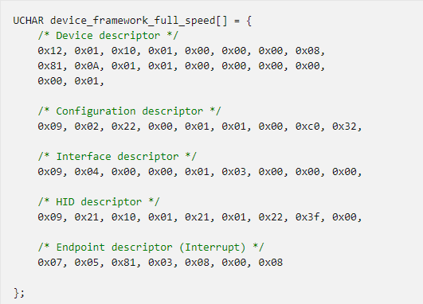
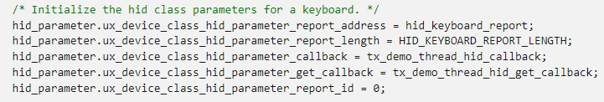
hid class
HID class: allows for a USB host system to connect to a HID device with specific HID client capabilities
Initialize the usb system
ux_system_initialize
Prepare frameworks
Initialize usb stack
ux_device_stack_initialize
Callback function when USB change state
Prepare parameter for HID Class
Register stack class
ux_device_stack_class_register
Enable USB Driver
Wait to enumeration event
USBX HID operation

Slide 147
hid class
USBX HID operation:
Wait for usb connect
hid_callback
called when the host sends a HID SET_REPORT
Check user input
hid_get_callback
called when the host sends a HID GET_REPORT
Prepare hid_event
send a HID event back to the host
ux_device_class_hid_event_set

Slide 148
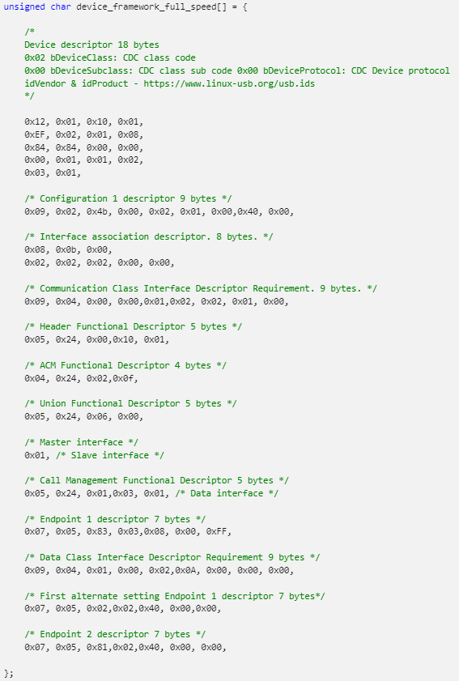
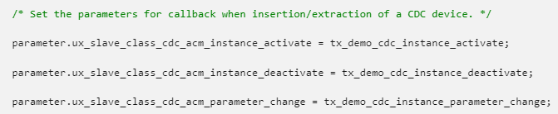
CDC class
ACM (Abstract Control Model): CDC-ACM class allows for a USB host system to communicate with the device as a serial device.
Initialize the usb system
ux_system_initialize
Prepare frameworks
Callback function when USB change state
Initialize usb stack
ux_device_stack_initialize
Prepare parameter for CDC-ACM Class
Register stack class
ux_device_stack_class_register
Enable USB Driver
Wait to enumeration event
USBX CDC-ACM operation

Slide 149
CDC class
USBX CDC-ACM operation:
Wait for usb connect
Perform IOCTL on the CDC-ACM interface
ux_device_class_cdc_acm_ioctl
Write to a CDC-ACM pipe
ux_device_class_cdc_acm_write
Read from CDC-ACM pipe
ux_device_class_cdc_acm_read
IOCTL Function:
UX_SLAVE_CLASS_CDC_ACM_IOCTL_SET_LINE_CODING 1
UX_SLAVE_CLASS_CDC_ACM_IOCTL_GET_LINE_CODING 2
UX_SLAVE_CLASS_CDC_ACM_IOCTL_GET_LINE_STATE 3
UX_SLAVE_CLASS_CDC_ACM_IOCTL_ABORT_PIPE 4
UX_SLAVE_CLASS_CDC_ACM_IOCTL_SET_LINE_STATE 5
UX_SLAVE_CLASS_CDC_ACM_IOCTL_TRANSMISSION_START 6
UX_SLAVE_CLASS_CDC_ACM_IOCTL_TRANSMISSION_STOP 7

Slide 150
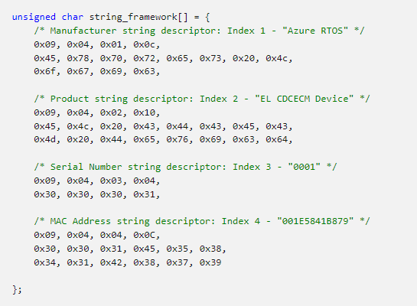
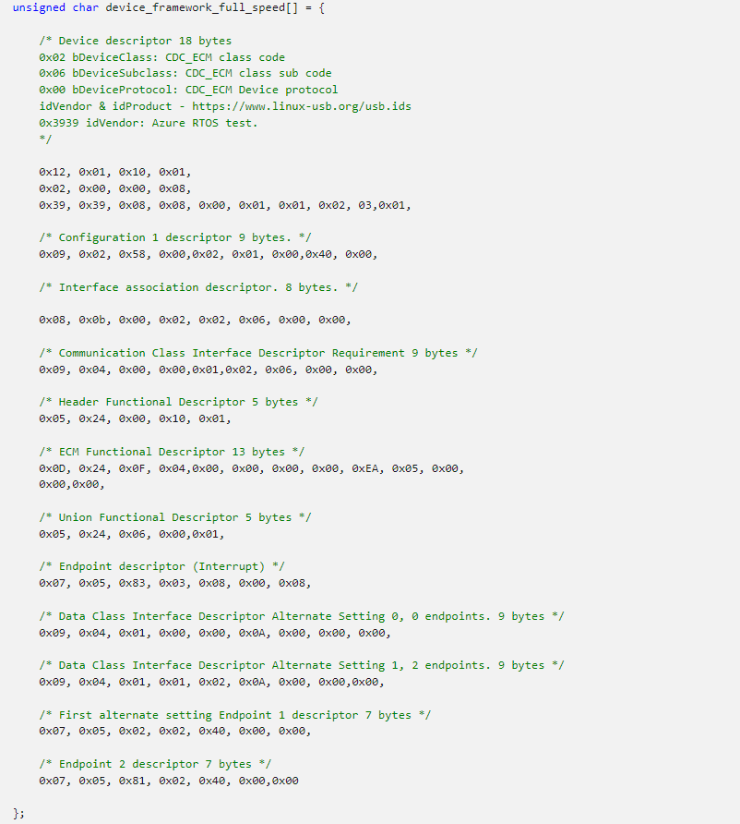
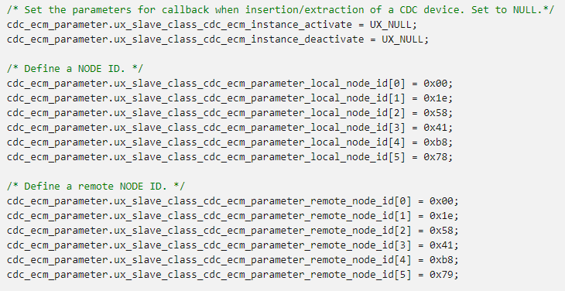
CDC class
ECM (Abstract Control Model): CDC-ECM class allows for a USB host system to communicate with the device as a ethernet device
Initialize the usb system
ux_system_initialize
Prepare frameworks
Initialize usb stack
ux_device_stack_initialize
Prepare parameter for CDC-ECM Class
Register stack class
ux_device_stack_class_register
Initialize the NetX system
nx_system_initialize()
Using NetX to communicate

Slide 151
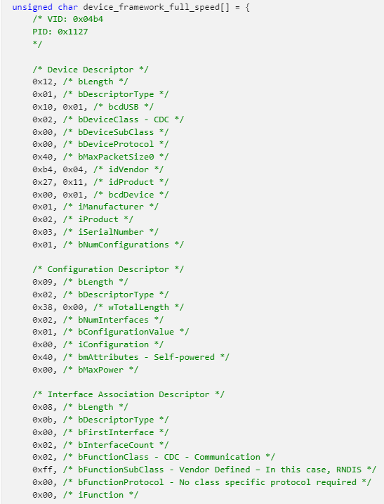
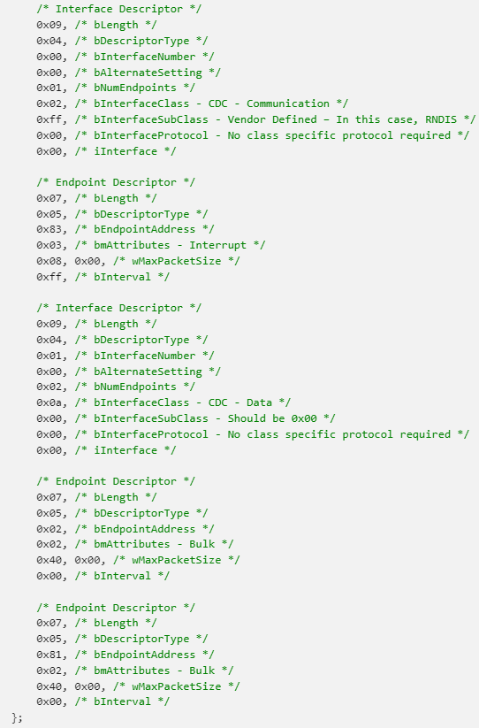
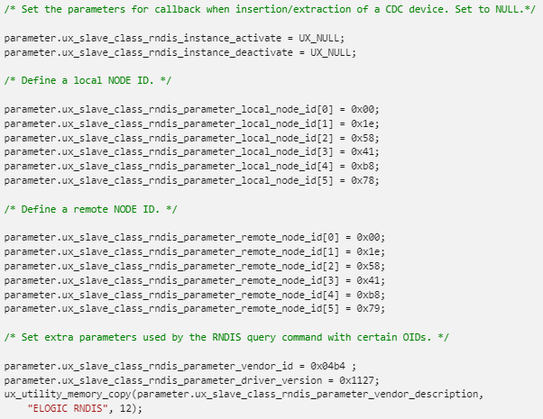
RNDIS Class
RNDIS (Remote Network Driver Interface Specification) class: allows for a USB host system to communicate with the device as a ethernet device.
Initialize the usb system
ux_system_initialize
Prepare frameworks
Initialize usb stack
ux_device_stack_initialize
Prepare parameter for RNDIS Class
Register stack class
ux_device_stack_class_register
Initialize the NetX system
nx_system_initialize()
Using NetX to communicate

Slide 152
PIMA Class (PTP Responder)
PIMA class: allows for a USB host system (Initiator) to connect to a PIMA device (Resonder) to transfer media files.
Adding an object and sending the event to the host (add an object and inform the host):
ux_device_class_pima_object_add
Delete a local object:
ux_device_class_pima_object_delete
Return the object data:
ux_device_class_pima_object_info_get
Host sends the object information (PIMA class needs to receive the object information in the local system):
ux_device_class_pima_object_info_send
Host sends the object data (PIMA class needs to receive the object data in the local system)
ux_device_class_pima_object_data_send

Slide 153
Audio Class
Get specific stream instance for the Audio function:
ux_device_class_audio_stream_get
Start audio data reception for the Audio stream:
ux_device_class_audio_reception_start
Read 8(16,24,32)-bit sample from the Audio stream:
ux_device_class_audio_sample_read8 ux_device_class_audio_sample_read16
ux_device_class_audio_sample_read24 ux_device_class_audio_sample_read32
Start audio data transmission for the Audio stream:
ux_device_class_audio_transmission_start
Write an audio frame into the Audio stream:
ux_device_class_audio_frame_write

Slide 154
printer Class
Read from printer pipe:
_ux_device_class_printer_read
Write to a printer pipe:
_ux_device_class_printer_write
Perform IOCTL on the printer interface:
ux_device_class_printer_ioctl
Ioctl functions:
UX_DEVICE_CLASS_PRINTER_IOCTL_PORT_STATUS_SET
UX_DEVICE_CLASS_PRINTER_IOCTL_READ_TIMEOUT_SET
UX_DEVICE_CLASS_PRINTER_IOCTL_WRITE_TIMEOUT_SET

Slide 155
reference
Microsoft Azure RTOS:
https://azure.microsoft.com/en-us/products/rtos/
Github Azure RTOS:
https://github.com/azure-rtos
Github Renesas – Azure RTOS:
https://github.com/renesas/azure-rtos
Azure RTOS with STM32:
https://wiki.stmicroelectronics.cn/stm32mcu/wiki/Introduction_to_Azure_RTOS_with_STM32

Slide 156
Renesas.com

