Slide 1
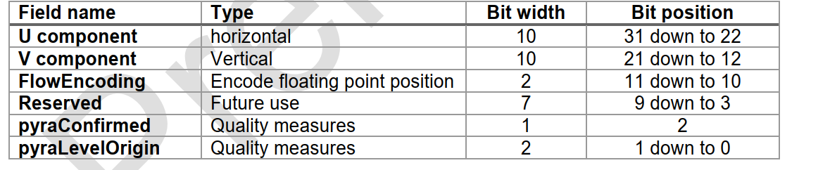
SPS input format
Example:
u = 5
v = 6
flow_encode = 3
3_bits_quality = 5
=> Flow vector value: 0x01406c05

Slide 2
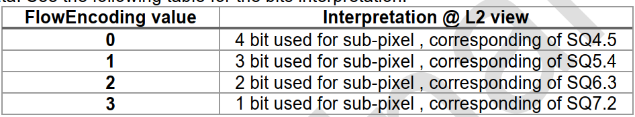
SPS Internal data format
Example:
flow_enclode = 3
u(10 bits signed number) = 5 = 0_0000001_01 => u_real = 1.25

Slide 3
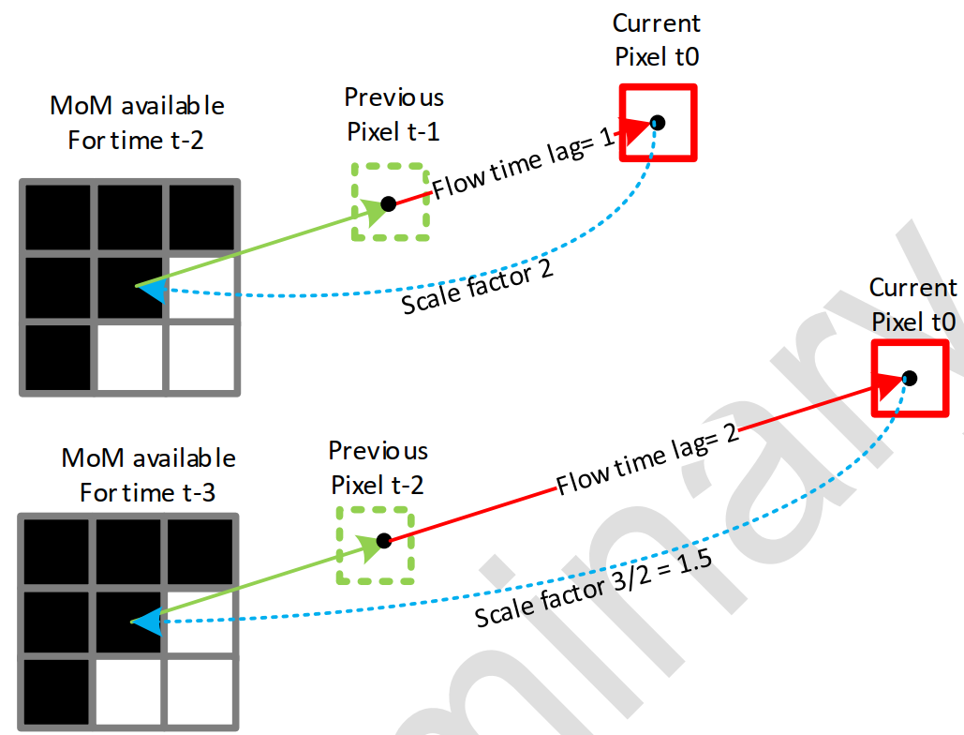
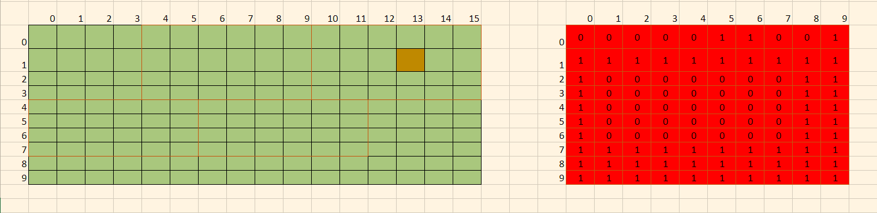
SPS MOM Warping

Slide 4
Calculate MOM lookup position
Example with flow_encode = 3; int16_t age_scale = 1025; int10_t u = 5; x = 30
1. Convert 16-bit age_scale to sQ5.10 real number value = 1025 * 2^(-10) = 1 + 2^(-10)
2.
- Convert 10-bit u value to sQ7.2 real number value = 5 * 2^(-2) = 1.25
- Then convert sQ7.2 real number value to sQ7.5 real number value = same value = 1.25

Slide 5




Calculate MOM lookup position
Example with flow_encode = 3; int16_t age_scale = 1025; int10_t u = 5; x = 30
3. Convert the product of 1, 2 to floor of sQ13.5 real number value
=
4. Round the result in 3 to the closest sQ13.4 real number value

Slide 6
Calculate MOM lookup position
Example with flow_encode = 3; int16_t age_scale = 1025; int10_t u = 5; x = 30
5. Convert 10-bit x to sQ13.4 real number value = same value = 30
6. Convert the subtraction result of 5, 4 to floor of sQ14.4 real number value = same value of (5 - 4)
= 30 - 1.25 = 28.75

Slide 7
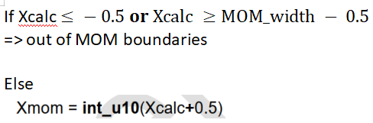
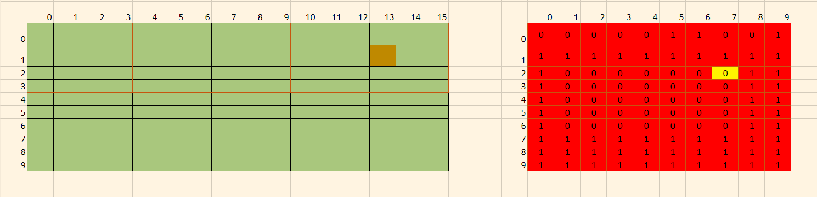
Calculate MOM lookup position

