Slide 1
REL-B2B Basic
Software update manual (Simplified Version)
REL/DO/ISD/NWOP

Slide 2
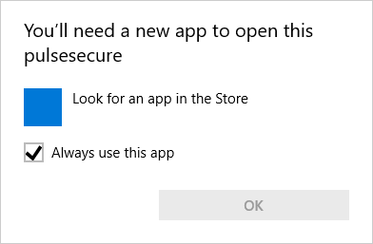
REL-B2B Basic login and module installation(Simplified Version)
*This work needs to be performed by a user account with admin rights.
Login to REL-B2B Basic Please log in to REL-B2B Basic from the URL below after the update date. Login page :https://b2b-gateway.renesas.com/login/ssl
Client software update When you log in to REL-B2B Basic, the download and installation of the new module will begin automatically. At that time, a screen for selecting [Yes] and [No] appears several times, so please select [Yes] for all. *If the following screen is displayed, please wait for about 1 minute.

Slide 3
REL-B2B Basic login and module installation(Simplified Version)
*This work needs to be performed by a user account with admin rights.
Inactivation of the popup of Pulse Secure Client App When starting PC, a login app attached to the new module will automatically start. However, this app is not available for REL-B2B service, so please set it to be invisible following the procedure below. 【Inactivation of the popup of Pulse Secure Client App】 １．Start Task Manager by right-clicking at the void of Taskbar. ２．From Startup tab, right-click “Pulse Secure User Interface” or ”Pulse Secure Desktop Client” and select “Disable”. or １．Select “Settings” from Menu and click “Apps” > “Startup”. ２．From Startup menu, turn off “Pulse Secure User Interface” or ”Pulse Secure Desktop Client”.

Slide 4

New Module Pulse Secure Client Troubleshooting
Q. When logging in to Basic, Pulse Secure Client app pops up and cannot connect. A. There is a case that a trouble occurs by Pulse Secure Client app popping up. Please log in again by following the procedure written in 【Inactivation of the popup of Pulse Secure Client app】 in the section “REL-B2B BASIC Login and module installation(Simplified Version)” in this manual.
Q. Could not log in by accidentally selected “No” at the installation confirmation display of the new module. A. By logging in again, the installation confirmation display will reappear. Please select “Yes” and install the new module.
Q. Tried to log in again after successfully installing and logging in, but could not do it. A. There is a possibility that you are trying to log in again without Pulse Secure Client app not being closed. Please check the status of the app from the icon at Taskbar, and if it is still connected, close the app and log in again

Slide 5
Contact Details for Inquiries Regarding Pules Secure Client(PSC) Switching Trouble of REL-B2B
About the troubles which do not fall into this manual’s “New Module Pulse Secure Client Troubleshooting”, or if you cannot solve the problem by the method as written in the section, please contact the email address below. Contact the address below with the subject “【REL-B2B】 PSC Switching Trouble” by email. In the body, please write your user ID, login date and time in addition to situation of the trouble. Address：rel-madoguchi@ml.nesic.com Subject： 【REL-B2B】 PSC Switching Trouble Body：Situation of the trouble User ID, Login date and time Detailed version of Windows OS Screenshot of the condition of installed module of PC Screenshot of the connection information of Pulse Secure Client app

Slide 6
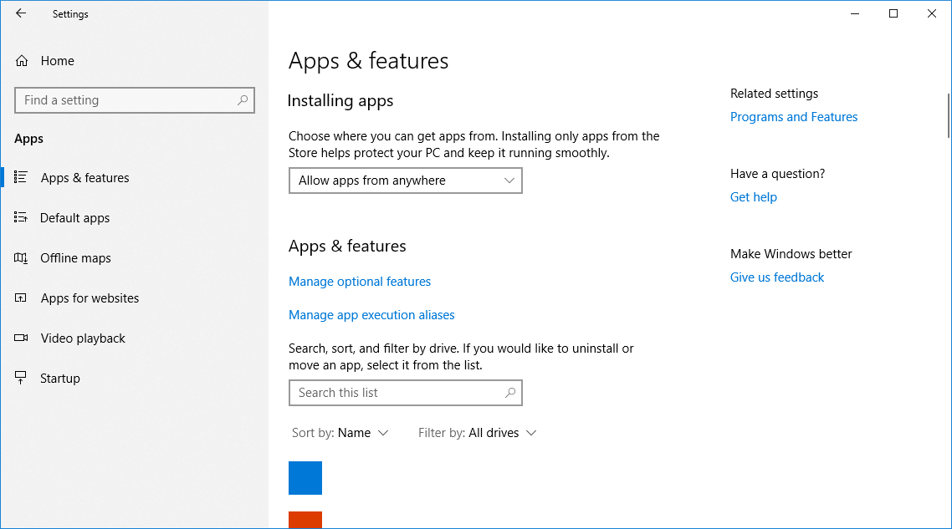
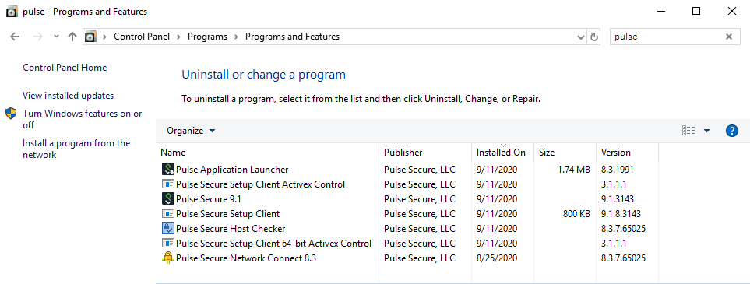
How to Confirm the Information for Inquiry
How to Confirm the detailed version of Windows OS Please provide the version of Windows which can be obtained from; Start > Settings > System > About E.g.)Windows10 1809,Windows10 1903…etc.
How to Confirm the condition of installed module of PC Please provide a screenshot of modules searched by Juniper or Pulse Secure at; Start > Settings > Apps > Related settings“Programs and Features” Please extend the screenshot so that the version information is legible.

Slide 7
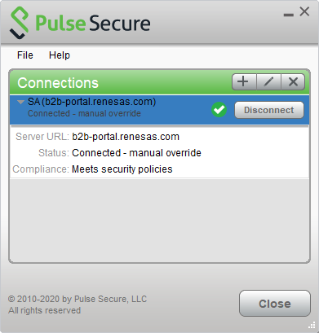
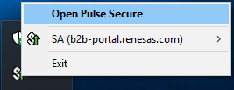
How to Confirm the Information for Inquiry
How to confirm the connection information of Pulse Secure Client app Right-click the icon in the task tray. Click “Open Pulse Secure”. Connection information will pop up. Please select Click “▶” and provide a screenshot of it with information such as server URL is legible. E.g.)▽SA(b2b-portal.renesas.com) Server URL：b2b-portal.renesas.com

Slide 8
Reference information

Slide 9
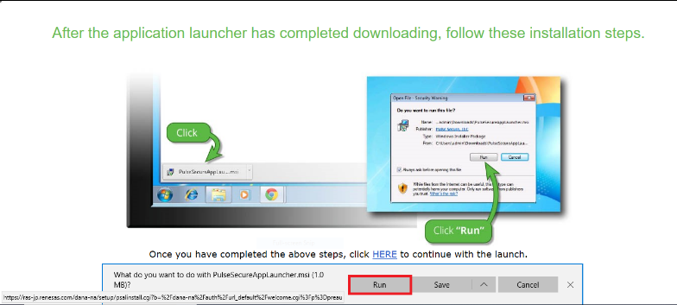
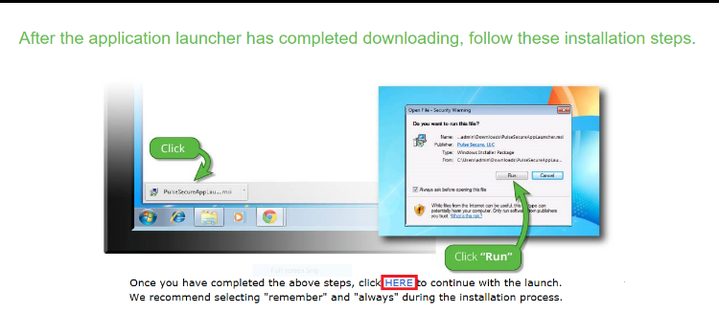
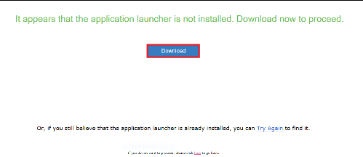
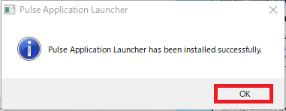
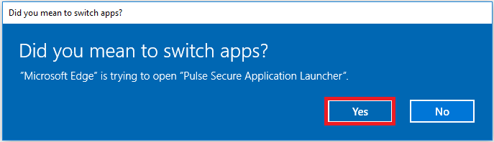
When connecting to REL-B2B BASIC using MS Edge
When connecting to REL-B2B BASIC using MS Edge Enter your ID / password and the screen below will be displayed. Follow the instructions on the screen below.
① If the following screen is displayed, please wait for about 1 minute.
③
When the download is complete, the screen below will change. Click the [Run] button to install.
⑤
Click "here" at the bottom of the screen
② After a while, the Pulse Application Launcher download screen will be displayed. Click Download.
④ When the installation is complete, the following screen will be displayed. Click the “OK” button.
⑥
After that, the following screens will be displayed multiple times, but click "Yes" for all of them.

Slide 10
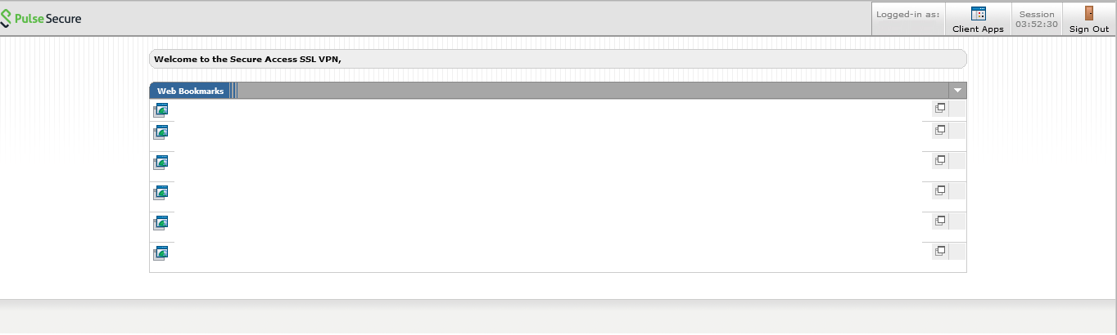
CONFIRMATION of REL-B2B BASIC Login
Confirmation of REL-B2B BASIC Login. When the screen below is displayed, you are singed in to REL-B2B(SSL-VPN),and if the icon is displayed on the taskbar, you can access the registered Renesas internal system.

Slide 11
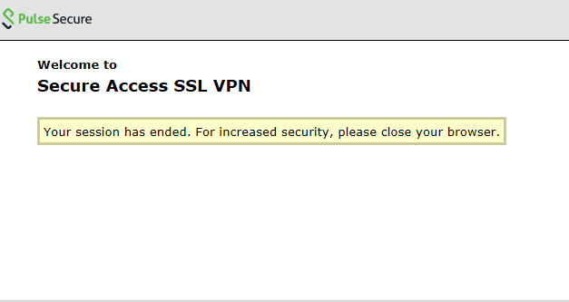
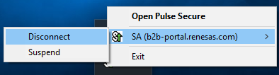
How to Logout of the REL-B2B BASIC
How to logout from Portal site(Login Page) You can log out from the REL-B2B Basic by clicking the “Sign Out” button below.
How to logout from the portal site(Task tray) Right-click the icon in the task tray. You can logout of Service REL-B2B Basic by clicking the Disconnect button.

Slide 12
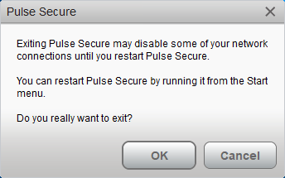
How to Exit Pulse Secure Client
How to exit Pulse Secure Client Right-click the icon in the task tray. Click the “Exit”. Click the OK button to exit the Pulse Secure Client app.

Slide 13
Renesas.com

