Slide 1
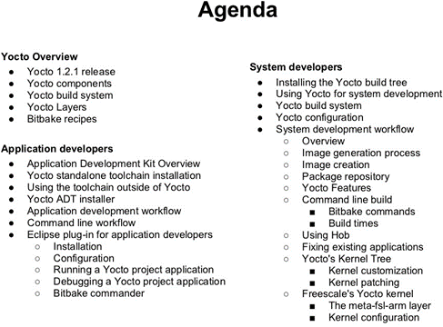

Slide 2

Introduction to Embedded Linux
Introduction to Embedded Linux

Slide 3


Simplified Linux system architecture

Slide 4

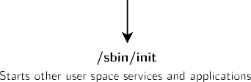
Overall Linux boot sequence

Slide 5
Embedded Linux work
BSP work: porting the bootloader and Linux kernel, developing Linux device drivers.
system integration work: assembling all the user space components needed for the system, configure them, develop the upgrade and recovery mechanisms, etc.
application development: write the company-specific applications and libraries.

Slide 6
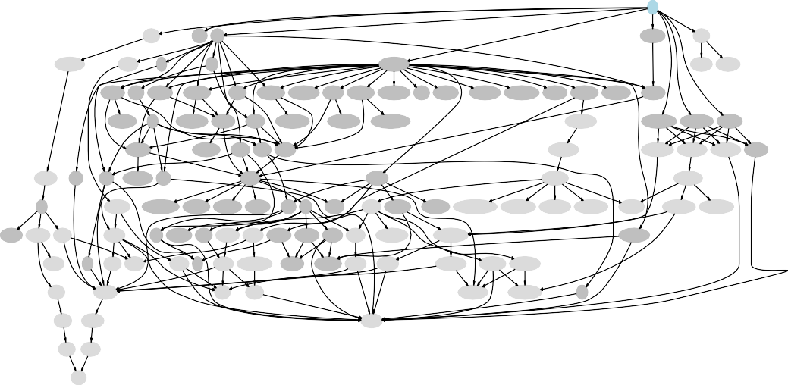
Complexity of user space integration
ALL
toolchain
busybox libgtk3
xapp_xkbcomp
rootfs-tar
toolchain-buildroot
host-libgtk3
atk
pango
xserver_xorg-server
host-fakeroot host-makedevs
xlib_libXrandr harfbuzz xlib_libXcursor
xlib_libXdamage
xlib_libXi xlib_libXinerama xproto_xcmiscproto xlib_libXres xlib_libXxf86vm xproto_xf86dgaproto mcookie xdata_xbitmaps
xproto_bigreqsproto
xproto_compositeproto xproto_glproto xkeyboard-config xproto_videoproto
xlib_libxkbfile
xproto_randrproto cairo
xproto_damageproto xlib_libXfixes xlib_libXft xproto_xineramaproto
xproto_resourceproto
xproto_xf86vidmodeproto
host-xapp_xkbcomp
xfont_font-cursor-misc
xfont_font-misc-misc xfont_font-alias
xlib_libXrender
xproto_fixesproto gdk-pixbuf fontconfig xlib_libXext
host-xlib_libxkbfile
host-xapp_mkfontdir host-xapp_bdftopcf host-xfont_font-util xfont_font-util
host-gcc-final libsha1
libglib2 xproto_renderproto pixman
xlib_libX11
xlib_libXfont
host-xlib_libX11
host-xlib_libXfont
glibc
host-gdk-pixbuf xproto_xf86bigfontproto xproto_xextproto xproto_inputproto xproto_kbproto freetype libxcb
xlib_xtrans
host-libxcb xfont_encodings
xproto_fontsproto host-xproto_xf86bigfontproto
host-xproto_inputproto host-xproto_kbproto host-xproto_xextproto
host-xlib_xtrans
host-xfont_encodings
host-xproto_fontsproto
linux-headers host-gcc-initial host-gawk
host-libglib2
libpng libpthread-stubs xcb-proto host-xcb-proto host-intltool xlib_libfontenc xlib_libXdmcp xlib_libXau host-libxslt
host-libpthread-stubs
host-xapp_mkfontscale
xproto_presentproto
host-binutils
libffi
host-libffi host-gettext
host-libpng zlib
host-python host-libxml-parser-perl
xproto_xproto
xutil_util-macros host-libxml2
host-freetype
host-xlib_libfontenc host-xlib_libXau host-xlib_libXdmcp
host-mpc
host-automake
host-zlib host-expat
host-xproto_xproto
host-xutil_util-macros
expat
host-mpfr
host-autoconf
host-pkgconf
host-gmp host-libtool
host-m4

Slide 7
System integration: several possibilities
 | Pros | Cons
Building everything manually | Full flexibility Learning experience | Dependency hell Need to understand a lot of details Version compatibility Lack of reproducibility
Binary distribution Debian, Ubuntu, Fedora, etc. | Easy to create and extend | Hard to customize Hard to optimize (boot time, size) Hard to rebuild the full system from source Large system Uses native compilation (slow) No well-defined mechanism to generate an image Lots of mandatory dependencies Not available for all architectures
Build systems Buildroot, Yocto, PTXdist, etc. | Nearly full flexibility Built from source: customization and op- timization are easy Fully reproducible Uses cross-compilation Have embedded specific packages not nec- essarily in desktop distros Make more features optional | Not as easy as a binary distribution Build time

Slide 8
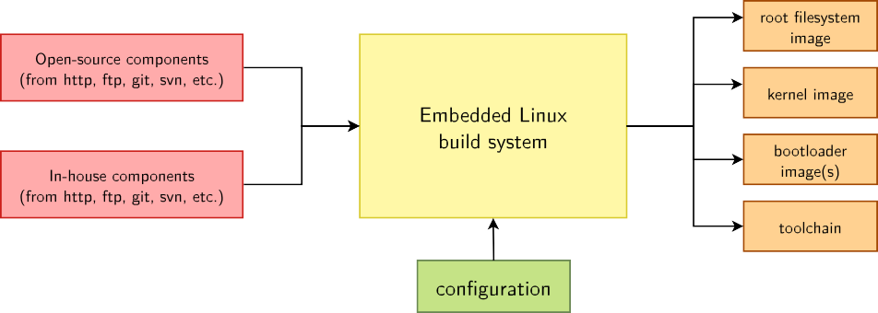
Embedded Linux build system: principle
Building from source → lot of flexibility
Cross-compilation → leveraging fast build machines
Recipes for building components → easy

Slide 9
Embedded Linux build system: tools
A wide range of solutions: Yocto/OpenEmbedded, PTXdist, Buildroot, OpenWRT, and more.
Today, two solutions are emerging as the most popular ones
Builds a complete Linux distribution with binary packages. Powerful, but somewhat complex, and quite steep learning curve.
Builds a root filesystem image, no binary packages. Much simpler to use, understand and modify.
Yocto/OpenEmbedded
Buildroot

Slide 10
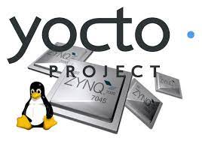
Yocto Project and Poky reference system overview
Yocto Project and Poky reference system overview
© Copyright, Bootlin. Creative Commons BY-S2004-2022A 3.0 license.
Corrections, suggestions, contributions and translations are welcome!

Slide 11
About
The Yocto Project is a set of templates, tools and methods that allow to build custom embedded Linux-based systems.
It is an open source project initiated by the Linux Foundation in 2010 and is still managed by one of its fellows: Richard Purdie.

Slide 12
The Yocto Project lexicon
The core components of the Yocto Project are:
BitBake, the build engine. It is a task scheduler, like make. It interprets configuration files and recipes (also called metadata) to perform a set of tasks, to download, configure and build specified applications and filesystem images.
OpenEmbedded-Core, a set of base layers. It is a set of recipes, layers and classes which are shared between all OpenEmbedded based systems.
Poky, the reference system. It is a collection of projects and tools, used to bootstrap
a new distribution based on the Yocto Project.

Slide 13
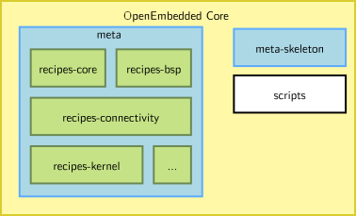
The Yocto Project lexicon

Slide 14
The Yocto Project lexicon
Organization of OpenEmbedded-Core:
Recipes describe how to fetch, configure, compile and package applications and images. They have a specific syntax.
Layers are sets of recipes, matching a common purpose. For Texas Instruments board support, the meta-ti layer is used.
Multiple layers are used within a same distribution, depending on the requirements.
It supports the ARM, MIPS (32 and 64 bits), PowerPC, RISC-V and x86 (32 and 64 bits) architectures.
It supports QEMU emulated machines for these architectures.

Slide 15
The Yocto Project lexicon
The Yocto Project is not used as a finite set of layers and tools.
Instead, it provides a common base of tools and layers on top of which custom and specific layers are added, depending on your target.
The main required element is Poky, the reference system which includes OpenEmbedded-Core. Other available tools are optional, but may be useful in some cases.

Slide 16
Example of a Yocto Project based BSP
To build images for a Rasberrypi 3B we need:
The Poky reference system, containing all common recipes and tools.
The meta-raspberrypi layer, a set of ARM specific recipes.
All modifications are made in the meta- raspberrypi layer. Editing Poky !
We will set up this environment in the lab.
To build images for a Beagle bone we need:
The Poky reference system, containing all common recipes and tools.
The meta-ti layer, a set of Texas Instruments specific recipes.
All modifications are made in the meta-ti layer. Editing Poky !
We will set up this environment in the lab.

Slide 17
Getting the Poky reference system
All official projects part of the Yocto Project are available at
Source Repositories (yoctoproject.org)
To download the Poky reference system:
git clone -b dunfell https://git.yoctoproject.org/git/poky
Each release has a codename such as dunfell or hardknott, corresponding to a release number.
A summary can be found at https://wiki.yoctoproject.org/wiki/Releases
A new version is released every 6 months, and maintained for 7 months
LTS versions are maintained for 2 years, and announced before their release.

Slide 18
Poky

Slide 19
Poky source tree 1/2
bitbake/ Holds all scripts used by the BitBake command. Usually matches the stable release of the BitBake project.
documentation/ All documentation sources for the Yocto Project documentation. Can be used to generate nice PDFs.
meta/ Contains the OpenEmbedded-Core metadata.
meta-skeleton/ Contains template recipes for BSP and kernel development.

Slide 20
Poky source tree 2/2
meta-poky/ Holds the configuration for the Poky reference distribution. meta-yocto-bsp/ Configuration for the Yocto Project reference hardware board
support package.
LICENSE The license under which Poky is distributed (a mix of GPLv2 and MIT). oe-init-build-env Script to set up the OpenEmbedded build environment. It will create
the build directory. It takes an optional parameter which is the build directory name. By default, this is build. This script has to be sourced because it changes environment variables.
scripts Contains scripts used to set up the environment, development tools, and tools to flash the generated images on the target.

Slide 21
Documentation
Documentation for the current sources, compiled as a ”mega manual”, is available at: https://docs.yoctoproject.org/singleindex.html
Variables in particular are described in the variable glossary:
https://docs.yoctoproject.org/genindex.html

Slide 22
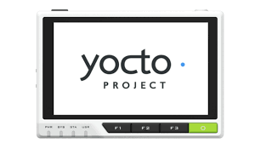
Using Yocto Project - basics
Using Yocto Project - basics
© Copyright 2004-2022, Bootlin. Creative Commons BY-SA 3.0 license.
Corrections, suggestions, contributions and translations are welcome!

Slide 23
Environment setup Yocto Project Quick Start
Using Yocto Project - basics

Slide 24
Environment setup
All Poky files are left unchanged when building a custom image.
Specific configuration files and build repositories are stored in a separate build directory.
A script, oe-init-build-env, is provided to set up the build directory and the environment variables (needed to be able to use the bitbake command for example).

Slide 25
oe-init-build-env
Modifies the environment: has to be sourced!
Adds environment variables, used by the build engine.
Allows you to use commands provided in Poky.
source ./oe-init-build-env [builddir]
Sets up a basic build directory, named builddir if it is not found. If not provided, the default name is build.
25/300

Slide 26
Common targets
▶ Common targets are listed when sourcing the script:
core-image-minimal A small image to boot a device and have access to core command line commands and services.
core-image-sato Image with Sato support. Sato is a GNOME mobile-based user interface.
meta-toolchain Generates the cross-toolchain in an installable format.
meta-ide-support Generates the cross-toolchain and additional tools (gdb, qemu,
...) for IDE integration.

Slide 27
Exported environment variables
BUILDDIR Absolute path of the build directory.
PATH Contains the directories where executable programs are located. Absolute paths to scripts/ and bitbake/bin/ are prepended.

Slide 28
Available commands
bitbake The main build engine command. Used to perform tasks on available recipes (download, configure, compile…).
bitbake-* Various specific commands related to the BitBake build engine.

Slide 29
The build/ directory 1/2
conf/ Configuration files. Image specific and layer configuration. downloads/ Downloaded upstream tarballs of the recipes used in the builds.
sstate-cache/ Shared state cache. Used by all builds. tmp/ Holds all the build system outputs.

Slide 30
The build/ directory 2/2
tmp/buildstats/ Build statistics for all packages built (CPU usage, elapsed time, host, timestamps…).
tmp/deploy/ Final output of the build.
tmp/deploy/images/ Contains the complete images built by the OpenEmbedded build system. These images are used to flash the target.
tmp/work/ Set of specific work directories, split by architecture. They are used to unpack, configure and build the packages. Contains the patched sources, generated objects and logs.
tmp/sysroots/ Shared libraries and headers used to compile applications for the target but also for the host.

Slide 31
Configuring the build system
Using Yocto Project - basics

Slide 32
The build/conf/ directory
▶ The conf/ directory in the build one holds build specific configuration. bblayers.conf Explicitly list the available layers.
local.conf Set up the configuration variables relative to the current user for the build. Configuration variables can be overridden there.

Slide 33
Configuring the build
▶ The conf/local.conf configuration file holds local user configuration variables: BB_NUMBER_THREADS How many tasks BitBake should perform in parallel.
Defaults to the number of CPUs on the system.
PARALLEL_MAKE How many processes should be used when compiling.
Defaults to the number of CPUs on the system.
MACHINE The machine the target is built for, e.g. beaglebone.

Slide 34
Building an image
Using Yocto Project - basics

Slide 35
Compilation
The compilation is handled by the BitBake build engine.
Usage: bitbake [options] [recipename/target ...]
To build a target: bitbake [target]
Building a minimal image: bitbake core-image-minimal
This will run a full build for the selected target.

Slide 36
Practical lab - First Yocto build
Download the sources
Set up the environment
Configure the build
Build an image

Slide 37
Using Yocto Project - advanced usage
Using Yocto Project - advanced usage
© Copyright 2004-2022, Bootlin. Creative Commons BY-SA 3.0 license.
Corrections, suggestions, contributions and translations are welcome!

Slide 38
Advanced build usage and configuration
Select package variants.
Manually add packages to the generated image.
Run specific tasks with BitBake.

Slide 39
A little reminder
Recipes describe how to fetch, configure, compile and install applications.
These tasks can be run independently (if their dependencies are met).
All available packages in Poky are not selected by default in the images.
Some packages may provide the same functionality, e.g. OpenSSH and Dropbear.

Slide 40
Advanced configuration
Using Yocto Project - advanced usage

Slide 41
Overview
The OpenEmbedded build system uses configuration variables to hold information.
Configuration settings are in upper-case by convention, e.g. CONF_VERSION
To make configuration easier, it is possible to prepend, append or define these variables in a conditional way.
Variables defined in Configuration Files have a global scope
Variables defined in Recipes have a local scope
Files ending in .bb, .bbappend and .bbclass
Recipes can also access the global scope
All variables can be overridden or modified in $BUILDDIR/conf/local.conf
Files ending in .conf

Slide 42
Operators and Overrides
BitBake uses a dedicated set of operators to assign values to variables
The operators apply their effect immediately when executed
The parsing order is difficult to predict, no assumption should be made about it.
Variables in the global scope therefore have a value difficult to predict
Bitbake supports overrides, to allow appending, prepending or modifying a variable at expansion time, when the variable’s value is read
Overrides are written as VARIABLE_override = "some_value"
A new syntax was introduced in bitbake : VARIABLE:override = "some_value"
It will be the new syntax to be used starting with Honister, with no retrocompatibility

Slide 43
Methods and conditions 1/4
Append the keyword _append to a configuration variable to add values after the ones previously defined (without space).
IMAGE_INSTALL_append = " dropbear" adds dropbear to the packages installed on the image.
Append the keyword _prepend to add values before the ones previously defined (without space).
FILESEXTRAPATHS_prepend := "${THISDIR}/${PN}:" adds the folder to the set of paths where files are located (in a recipe).

Slide 44
Methods and conditions 2/4
Append the keyword _remove to a configuration variable to remove all occurrences of a value within a configuration variable.
Append the machine name to only define a configuration variable for a given machine. It tries to match with values from MACHINEOVERRIDES which include MACHINE and SOC_FAMILY.
IMAGE_INSTALL_remove = "i2c-tools"
KERNEL_DEVICETREE_beaglebone = "am335x-bone.dtb" tells to use the kernel device tree am335x-bone.dtb only when the machine is beaglebone.

Slide 45
Methods and conditions 3/4
The previous methods can be combined.
If we define:
IMAGE_INSTALL = "busybox mtd-utils"
IMAGE_INSTALL_append = " dropbear"
IMAGE_INSTALL_append_beaglebone = " i2c-tools"
The resulting configuration variable will be:
IMAGE_INSTALL = "busybox mtd-utils dropbear i2c-tools" if the machine being built is beaglebone.
IMAGE_INSTALL = "busybox mtd-utils dropbear" otherwise.

Slide 46
Methods and conditions 4/4
The most specific variable takes precedence.
Example:
IMAGE_INSTALL_beaglebone = "busybox mtd-utils i2c-tools" IMAGE_INSTALL = "busybox mtd-utils"
If the machine is beaglebone:
IMAGE_INSTALL = "busybox mtd-utils i2c-tools"
Otherwise:
IMAGE_INSTALL = "busybox mtd-utils"

Slide 47
Operators 1/2
▶ Various operators can be used to assign values to configuration variables:
= expand the value when using the variable
:= immediately expand the value
+= append (with space)
=+ prepend (with space)
.= append (without space)
=. prepend (without space)
?= assign if no other value was previously assigned
??= same as previous, with a lower precedence

Slide 48
Operators 2/2
Avoid using +=, =+, .= and =. in $BUILDDIR/conf/local.conf due to ordering issues.
If += is parsed before ?=, the latter will be discarded.
Using _append unconditionally appends the value.

Slide 49
Packages variants
Using Yocto Project - advanced usage

Slide 50
Introduction to package variants
Some packages have the same purpose, and only one can be used at a time.
The build system uses virtual packages to reflect this. A virtual package describes functionalities and several packages may provide it.
Only one of the packages that provide the functionality will be compiled and integrated into the resulting image.

Slide 51
Variant examples
The virtual packages are often in the form virtual/<name>
Example of available virtual packages with some of their variants:
virtual/bootloader: u-boot, u-boot-ti-staging…
virtual/kernel: linux-yocto, linux-yocto-tiny, linux-yocto-rt, linux-ti-staging…
virtual/libc: glibc, musl, newlib
virtual/xserver: xserver-xorg

Slide 52
Package selection
Variants are selected thanks to the PREFERRED_PROVIDER configuration variable.
The package names have to suffix this variable.
Examples:
PREFERRED_PROVIDER_virtual/kernel ?= "linux-ti-staging"
PREFERRED_PROVIDER_virtual/libgl = "mesa"

Slide 53
Version selection
By default, Bitbake will try to build the provider with the highest version number, from the highest priority layer, unless the recipe defines
DEFAULT_PREFERENCE = "-1"
When multiple package versions are available, it is also possible to explicitly pick a given version with PREFERRED_VERSION.
The package names have to suffix this variable.
% can be used as a wildcard.
Example:
PREFERRED_VERSION_linux-yocto = "5.14%"
PREFERRED_VERSION_python = "2.7.3"

Slide 54
Packages
Using Yocto Project - advanced usage

Slide 55
Selection
The set of packages installed into the image is defined by the target you choose (e.g. core-image-minimal, core-image-fullcmd, core-image-qt5).
It is possible to have a custom set by defining our own target, and we will see this later.
When developing or debugging, adding packages can be useful, without modifying the recipes.
Packages are controlled by the IMAGE_INSTALL configuration variable.
(e.g. IMAGE_INSTALL = WET, IMAGE_INSTALL = net-tool,…

Slide 56
Exclusion
The list of packages to install is also filtered using the PACKAGE_EXCLUDE variable.
If you choose to not install a package using this variable and some other package is dependent on it (i.e. listed in a recipe’s RDEPENDS variable), the OpenEmbedded build system generates a fatal installation error.
This only works with RPM and IPK packages.

Slide 57
The power of BitBake
Using Yocto Project - advanced usage

Slide 58
Common BitBake options
BitBake can be used to run a full build for a given target with bitbake [target].
But it can be more precise, with optional options:
-c <task> execute the given task
-s list all locally available packages and their versions
-f force the given task to be run by removing its stamp file
world keyword for all recipes
-b <recipe> execute tasks from the given recipe (without resolving dependencies).

Slide 59
BitBake examples
bitbake -c listtasks virtual/kernel
Gives a list of the available tasks for the recipe providing the package
virtual/kernel. Tasks are prefixed with do_.
bitbake -c menuconfig virtual/kernel
Execute the task menuconfig on the recipe providing the virtual/kernel package.
bitbake -f dropbear
Force the dropbear recipe to run all tasks.
bitbake world --runall=fetch
Download all recipe sources and their dependencies.
For a full description: bitbake --help

Slide 60
Shared state cache
BitBake stores the output of each task in a directory, the shared state cache. Its location is controlled by the SSTATE_DIR variable.
This cache is use to speed up compilation.
Over time, as you compile more recipes, it can grow quite big. It is possible to clean old data with:
$ ./scripts/sstate-cache-management.sh -y -d \
--cache-dir=$SSTATE_DIR

Slide 61
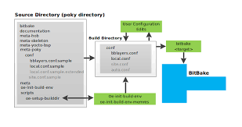
Practical lab - Advanced Yocto configuration
Modify the build configuration
Customize the package selection
Experiment with BitBake
Mount the root file system over NFS

Slide 62
Writing recipes - basics
Writing recipes - basics
© Copyright 2004-2022, Bootlin. Creative Commons BY-SA 3.0 license.
Corrections, suggestions, contributions and translations are welcome!

Slide 63
Recipes: overview
Writing recipes - basics

Slide 64
Recipes

Slide 65
Basics
Recipes describe how to handle a given application.
A recipe is a set of instructions to describe how to retrieve, patch, compile, install and generate binary packages for a given application.
It also defines what build or runtime dependencies are required.
The recipes are parsed by the BitBake build engine.
The format of a recipe file name is <application-name>_<version>.bb

Slide 66
Content of a recipe
A recipe contains configuration variables: name, license, dependencies, path to retrieve the source code…
It also contains functions that can be run (fetch, configure, compile…) which are called tasks.
Tasks provide a set of actions to perform.
Remember the bitbake -c <task> <target> command?

Slide 67
Common variables
▶ To make it easier to write a recipe, some variables are automatically available: PN package name, as specified in the recipe file name
BPN PN with prefixes and suffixes removed such as nativesdk-, or
-native
PV package version, as specified in the recipe file name PR package revision, defaults to r0
BP defined as ${BPN}-${PV}
The recipe name and version usually match the upstream ones.
When using the recipe bash_4.2.bb:
${PN} = "bash"
${PV} = "4.2"

Slide 68
Organization of a recipe
Writing recipes - basics

Slide 69
Organization of a recipe

Slide 70
Organization of a recipe
Many applications have more than one recipe, to support different versions. In that case the common metadata is included in each version specific recipe and is in a .inc file:
<application>.inc: version agnostic metadata.
<application>_<version>.bb: require <application>.inc and version specific metadata.
We can divide a recipe into three main parts:
The header: what/who
The sources: where
The tasks: how

Slide 71
The header
▶ Configuration variables to describe the application: DESCRIPTION describes what the software is about HOMEPAGE URL to the project’s homepage
PRIORITY defaults to optional
SECTION package category (e.g. console/utils) LICENSE the application’s license

Slide 72
The source locations: overview
We need to retrieve both the raw sources from an official location and the resources needed to configure, patch or install the application.
SRC_URI defines where and how to retrieve the needed elements. It is a set of URI schemes pointing to the resource locations (local or remote).
URI scheme syntax: scheme://url;param1;param2
scheme can describe a local file using file:// or remote locations with https://, git://, svn://, hg://, ftp://…
By default, sources are fetched in $BUILDDIR/downloads. Change it with the
DL_DIR variable in conf/local.conf

Slide 73
The source locations: remote files 1/2
The git scheme:
git://<url>;protocol=<protocol>;branch=<branch>
When using git, it is necessary to also define SRCREV. If SRCREV is a hash or a tag not present in master, the branch parameter is mandatory. When the tag is not in any branch, it is possible to use nobranch=1
The http, https and ftp schemes:
https://example.com/application-1.0.tar.bz2
A few variables are available to help pointing to remote locations:
${SOURCEFORGE_MIRROR}, ${GNU_MIRROR}, ${KERNELORG_MIRROR}…
Example: ${SOURCEFORGE_MIRROR}/<project-name>/${BPN}-${PV}.tar.gz
See meta/conf/bitbake.conf

Slide 74
The source locations: remote files 2/2
An md5 or an sha256 sum must be provided when the protocol used to retrieve the file(s) does not guarantee their integrity. This is the case for https, http or ftp.
SRC_URI[md5sum] = "97b2c3fb082241ab5c56ab728522622b" SRC_URI[sha256sum] = "..."
It’s possible to use checksums for more than one file, using the name parameter:
SRC_URI = "http://example.com/src.tar.bz2;name=tarball \ http://example.com/fixes.patch;name=patch"
SRC_URI[tarball.md5sum] = "97b2c3fb082241ab5c56..." SRC_URI[patch.md5sum] = "b184acf9eb39df794ffd..."

Slide 75
The source locations: local files
All local files found in SRC_URI are copied into the recipe’s working directory, in
$BUILDDIR/tmp/work/.
The searched paths are defined in the FILESPATH variable.
FILESPATH = "${@base_set_filespath(["${FILE_DIRNAME}/${BP}", "${FILE_DIRNAME}/${BPN}","${FILE_DIRNAME}/files"], d)}
FILESOVERRIDES = "${TRANSLATED_TARGET_ARCH}:
${MACHINEOVERRIDES}:${DISTROOVERRIDES}"
The base_set_filespath(path) function uses its path parameter,
FILESEXTRAPATHS and FILESOVERRIDES to fill the FILESPATH variable.
Custom paths and files can be added using FILESEXTRAPATHS and
FILESOVERRIDES.
Prepend the paths, as the order matters.

Slide 76
The source locations: tarballs
When extracting a tarball, BitBake expects to find the extracted files in a directory named <application>-<version>. This is controlled by the S variable. If the directory has another name, you must explicitly define S.
If the scheme is git, S must be set to ${WORKDIR}/git

Slide 77
The source locations: license files
License files must have their own checksum.
LIC_FILES_CHKSUM defines the URI pointing to the license file in the source code as well as its checksum.
Ex:
LIC_FILES_CHKSUM = "file://gpl.txt;md5=393a5ca..."
LIC_FILES_CHKSUM = \
"file://main.c;beginline=3;endline=21;md5=58e..."
LIC_FILES_CHKSUM = \ "file://${COMMON_LICENSE_DIR}/MIT;md5=083..."
▶ This allows to track any license update: if the license changes, the build will trigger a failure as the checksum won’t be valid anymore.

Slide 78
Dependencies 1/2
A recipe can have dependencies during the build or at runtime. To reflect these requirements in the recipe, two variables are used:
DEPENDS List of the recipe build-time dependencies.
RDEPENDS List of the package runtime dependencies. Must be package specific (e.g. with _${PN}).
DEPENDS = "recipe-b": the local do_configure task depends on the
do_populate_sysroot task of recipe-b.
RDEPENDS_${PN} = "recipe-b": the local do_build task depends on the
do_package_write_<archive-format> task of recipe b.

Slide 79
Dependencies 2/2
Sometimes a recipe have dependencies on specific versions of another recipe.
BitBake allows to reflect this by using:
DEPENDS = "recipe-b (>= 1.2)"
RDEPENDS_${PN} = "recipe-b (>= 1.2)"
The following operators are supported: =, >, <, >= and <=.
A graphical tool can be used to explore dependencies or reverse dependencies:
bitbake -g -u taskexp core-image-minimal

Slide 80
Tasks
Default tasks already exists, they are defined in classes:
do_fetch
do_unpack
do_patch
do_configure
do_compile
do_install
do_package
do_rootfs
You can get a list of existing tasks for a recipe with:
bitbake <recipe> -c listtasks

Slide 81
Writing tasks 1/2
▶ Functions use the sh shell syntax, with available OpenEmbedded variables and internal functions available.
WORKDIR the recipe’s working directory
S The directory where the source code is extracted
B The directory where bitbake places the objects generated during the build
D The destination directory (root directory of where the files are installed, before creating the image).
▶ Syntax of a task:
do_task() {
action0 action1
...
}

Slide 82
Writing tasks 2/2
▶ Example:
do_compile() { oe_runmake
}
do_install() {
install -d ${D}${bindir}
install -m 0755 hello ${D}${bindir}
}

Slide 83
Modifying existing tasks
Tasks can be extended with _prepend or _append
do_install_append() {
install -d ${D}${sysconfdir}
install -m 0644 hello.conf ${D}${sysconfdir}
}

Slide 84
Adding new tasks
Tasks can be added with addtask
do_mkimage () { uboot-mkimage ...
}
addtask do_mkimage after do_compile before do_install

Slide 85
Applying patches
Writing recipes - basics

Slide 86
Patches use cases
Patches can be applied to resolve build-system problematics:
To support old versions of a software: bug and security fixes.
To fix cross-compilation issues.
In certain simple cases the -e option of make can be used.
The -e option gives variables taken from the environment precedence over variables from Makefiles.
Helps when an upstream Makefile uses hardcoded CC and/or CFLAGS.
To apply patches before they get their way into the upstream version.

Slide 87
The source locations: patches
Files ending in .patch, .diff or having the apply=yes parameter will be applied after the sources are retrieved and extracted, during the do_patch task.
SRC_URI += "file://joystick-support.patch \ file://smp-fixes.diff \
"
Patches are applied in the order they are listed in SRC_URI.
It is possible to select which tool will be used to apply the patches listed in
SRC_URI variable with PATCHTOOL.
By default, PATCHTOOL = 'quilt' in Poky.
Possible values: git, patch and quilt.

Slide 88
Resolving conflicts
The PATCHRESOLVE variable defines how to handle conflicts when applying patches.
It has two valid values:
noop: the build fails if a patch cannot be successfully applied.
user: a shell is launched to resolve manually the conflicts.
By default, PATCHRESOLVE = "noop" in meta-poky.

Slide 89
Example of a recipe
Writing recipes - basics

Slide 90
Hello world recipe
DESCRIPTION = "Hello world program" HOMEPAGE = "http://example.net/hello/" PRIORITY = "optional"
SECTION = "examples"
LICENSE = "GPLv2"
do_compile() { oe_runmake
}
do_install() {
install -d ${D}${bindir}
install -m 0755 hello ${D}${bindir}
}
SRC_URI = "git://git.example.com/hello;protocol=https" SRCREV = "2d47b4eb66e705458a17622c2e09367300a7b118"
S = "${WORKDIR}/git"
LIC_FILES_CHKSUM = \
"file://hello.c;beginline=3;endline=21;md5=58e..."

Slide 91
Example of a recipe with a version agnostic part
Writing recipes - basics

Slide 92
tar.inc
SUMMARY = "GNU file archiving program" HOMEPAGE = "https://www.gnu.org/software/tar/" SECTION = "base"
SRC_URI = "${GNU_MIRROR}/tar/tar-${PV}.tar.bz2" do_configure() { ... }
do_compile() { ... }
do_install() { ... }

Slide 93
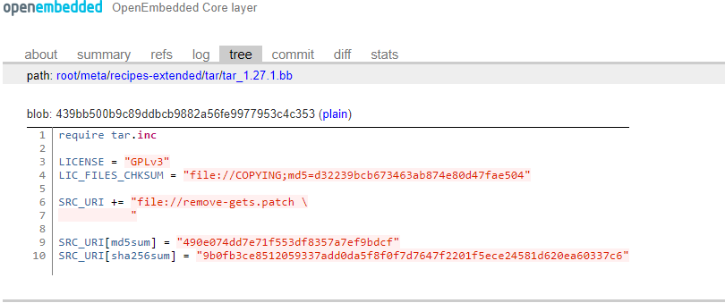
tar_1.27..1bb

Slide 94
Practical lab - Add a custom application
Write a recipe for a custom application
Integrate it in the image

Slide 95
Extending a recipe
Writing recipes - advanced

Slide 96
Introduction to recipe extensions
It is a good practice not to modify recipes available in Poky.
But it is sometimes useful to modify an existing recipe, to apply a custom patch for example.
The BitBake build engine allows to modify a recipe by extending it.
Multiple extensions can be applied to a recipe.

Slide 97
Introduction to recipe extensions
Metadata can be changed, added or appended.
Tasks can be added or appended.
Operators are used extensively, to add, append, prepend or assign values.

Slide 98
Extend a recipe
The recipe extensions end in .bbappend
Append files must have the same root name as the recipe they extend.
example_0.1.bbappend applies to example_0.1.bb
Append files are version specific. If the recipe is updated to a newer version, the append files must also be updated.
If adding new files, the path to their directory must be prepended to the
FILESEXTRAPATHS variable.
Files are looked up in paths referenced in FILESEXTRAPATHS, from left to right.
Prepending a path makes sure it has priority over the recipe’s one. This allows to override recipes’ files.

Slide 99
Append file example
Writing recipes - advanced

Slide 100
Hello world append file
FILESEXTRAPATHS_prepend := "${THISDIR}/files:"
SRC_URI += "file://custom-modification-0.patch \ file://custom-modification-1.patch \ "

Slide 101
Advanced recipe configuration
Writing recipes - advanced

Slide 102
Advanced configuration
In the real word, more complex configurations are often needed because recipes may:
Provide virtual packages
Inherit generic functions from classes

Slide 103
Providing virtual packages
BitBake allows to use virtual names instead of the actual package name. We saw a use case with package variants.
The virtual name is specified through the PROVIDES variable.
Several recipes can provide the same virtual name. Only one will be built and installed into the generated image.
PROVIDES = "virtual/kernel"

Slide 104
Classes
Writing recipes - advanced

Slide 105
Introduction to classes
Classes provide an abstraction to common code, which can be re-used in multiple recipes.
Common tasks do not have to be re-developed!
Any metadata and task which can be put in a recipe can be used in a class.
Classes extension is .bbclass
Classes are located in the classes folder of a layer.
Recipes can use this common code by inheriting a class:
inherit <class>

Slide 106
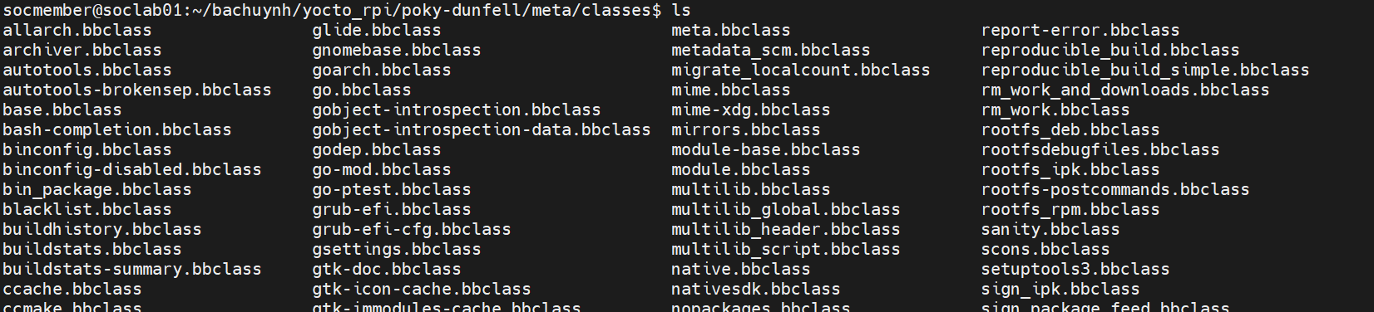
Common classes
Common classes can be found in meta/classes/
base.bbclass
kernel.bbclass
autotools.bbclass
autotools-brokensep.bbclass
cmake.bbclass
native.bbclass
systemd.bbclass
update-rc.d.bbclass
useradd.bbclass
…

Slide 107
The base class
Every recipe inherits the base class automatically.
Contains a set of basic common tasks to fetch, unpack or compile applications.
Inherits other common classes, providing:
Mirrors definitions: DEBIAN_MIRROR, GNU_MIRROR, KERNELORG_MIRROR…
The ability to filter patches by SRC_URI
Some tasks: clean, listtasks or fetch.
Defines oe_runmake, using EXTRA_OEMAKE to use custom arguments.

Slide 108
The kernel class
Used to build Linux kernels.
Defines tasks to configure, compile and install a kernel and its modules.
The kernel is divided into several packages: kernel, kernel-base, kernel-dev, kernel-modules…
Automatically provides the virtual package virtual/kernel.
Configuration variables are available:
KERNEL_IMAGETYPE, defaults to zImage
KERNEL_EXTRA_ARGS
INITRAMFS_IMAGE

Slide 109
The autotools class
Defines tasks and metadata to handle applications using the autotools build system (autoconf, automake and libtool):
do_configure: generates the configure script using autoreconf and loads it with standard arguments or cross-compilation.
do_compile: runs make
do_install: runs make install
Extra configuration parameters can be passed with EXTRA_OECONF.
Compilation flags can be added thanks to the EXTRA_OEMAKE variable.

Slide 110
Example: use the autotools class
DESCRIPTION = "Print a friendly, customizable greeting" HOMEPAGE = "https://www.gnu.org/software/hello/" PRIORITY = "optional"
SECTION = "examples"
LICENSE = "GPLv3"
SRC_URI = "${GNU_MIRROR}/hello/hello-${PV}.tar.gz" SRC_URI[md5sum] = "67607d2616a0faaf5bc94c59dca7c3cb"
SRC_URI[sha256sum] = "ecbb7a2214196c57ff9340aa71458e1559abd38f6d8d169666846935df191ea7"
LIC_FILES_CHKSUM = "file://COPYING;md5=d32239bcb673463ab874e80d47fae504"
inherit autotools

Slide 111
The useradd class
This class helps to add users to the resulting image.
Adding custom users is required by many services to avoid running them as root.
USERADD_PACKAGES must be defined when the useradd class is inherited. Defines the list of packages which needs the user.
Users and groups will be created before the packages using it perform their
do_install.
At least one of the two following variables must be set:
USERADD_PARAM: parameters to pass to useradd.
GROUPADD_PARAM: parameters to pass to groupadd.

Slide 112
Example: use the useradd class
DESCRIPTION = "useradd class usage example" PRIORITY = "optional"
SECTION = "examples"
LICENSE = "MIT"
SRC_URI = "file://file0"
LIC_FILES_CHKSUM = "file://${COREBASE}/meta/files/common-licenses/MIT;md5=0835ade698e0bc..."
inherit useradd USERADD_PACKAGES = "${PN}"
USERADD_PARAM = "-u 1000 -d /home/user0 -s /bin/bash user0"
do_install() {
install -m 644 file0 ${D}/home/user0/ chown user0:user0 ${D}/home/user0/file0
}

Slide 113
Binary packages
Writing recipes - advanced

Slide 114
Specifics for binary packages
It is possible to install binaries into the generated root filesystem.
Set the LICENSE to CLOSED.
Use the do_install task to copy the binaries into the root file system.

Slide 115
BitBake file inclusions
Writing recipes - advanced

Slide 116
Locate files in the build system
Metadata can be shared using included files.
BitBake uses the BBPATH to find the files to be included. It also looks into the current directory.
Three keywords can be used to include files from recipes, classes or other configuration files:
inherit
include
require

Slide 117
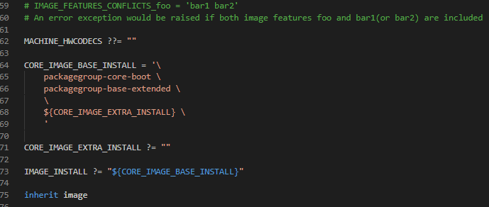
The inherit keyword
inherit can be used in recipes or classes, to inherit the functionalities of a class.
To inherit the functionalities of the kernel class, use: inherit kernel
inherit looks for files ending in .bbclass, in classes directories found in
BBPATH.
It is possible to include a class conditionally using a variable: inherit ${FOO}

Slide 118
The include and require keywords
include and require can be used in all files, to insert the content of another file at that location.
If the path specified on the include (or require) path is relative, BitBake will insert the first file found in BBPATH.
include does not produce an error when a file cannot be found, whereas require
raises a parsing error.
To include a local file: include ninvaders.inc
To include a file from another location (which could be in another layer):
include path/to/file.inc

Slide 119
Debugging recipes
Writing recipes - advanced

Slide 120
Debugging recipes
For each task, logs are available in the temp directory in the work folder of a recipe. This includes both the actual tasks code that ran and the output of the task.
bitbake can dump the whole environment, including the variable values and how they were set:
$ bitbake -e ninvaders
# $DEPENDS [4 operations]
# set /yocto-labs/poky/meta/conf/bitbake.conf:268 # ""
# set /yocto-labs/poky/meta/conf/documentation.conf:130
# [doc] "Lists a recipe's build-time dependencies (i.e. other recipe files)." # _prepend /yocto-training/yocto-labs/poky/meta/classes/base.bbclass:74
# "${BASEDEPENDS} "
# set /yocto-labs/meta-bootlinlabs/recipes-games/ninvaders/ninvaders.inc:11 # "ncurses"
# pre-expansion value:
# "${BASEDEPENDS} ncurses"
DEPENDS="virtual/arm-poky-linux-gnueabi-gcc virtual/arm-poky-linux-gnueabi-compilerlibs virtual/libc ncurses"

Slide 121
Debugging recipes
A development shell, exporting the full environment can be used to debug build failures:
$ bitbake -c devshell <recipe>
To understand what a change in a recipe implies, you can activate build history in
local.conf:
INHERIT += "buildhistory" BUILDHISTORY_COMMIT = "1"
Then use the buildhistory-diff tool to examine differences between two builds.
./scripts/buildhistory-diff

Slide 122
Network usage
Writing recipes - advanced

Slide 123
Source fetching
BitBake will look for files to retrieve at the following locations, in order:
DL_DIR (the local download directory).
The PREMIRRORS locations.
The upstream source, as defined in SRC_URI.
The MIRRORS locations.
If all the mirrors fail, the build will fail.

Slide 124
Mirror configuration in Poky
PREMIRRORS ??= "\
bzr://.*/.* cvs://.*/.* git://.*/.* hg://.*/.* osc://.*/.* p4://.*/.* svk://.*/.* svn://.*/.*
http://downloads.yoctoproject.org/mirror/sources/ \n \ http://downloads.yoctoproject.org/mirror/sources/ \n \ http://downloads.yoctoproject.org/mirror/sources/ \n \ http://downloads.yoctoproject.org/mirror/sources/ \n \ http://downloads.yoctoproject.org/mirror/sources/ \n \ http://downloads.yoctoproject.org/mirror/sources/ \n \ http://downloads.yoctoproject.org/mirror/sources/ \n \ http://downloads.yoctoproject.org/mirror/sources/ \n"
MIRRORS =+ "\
ftp://.*/.* http://.*/.*
http://downloads.yoctoproject.org/mirror/sources/ \n \ http://downloads.yoctoproject.org/mirror/sources/ \n \
https://.*/.* http://downloads.yoctoproject.org/mirror/sources/ \n"

Slide 125
Configuring the mirrors
It’s possible to prepend custom mirrors, using the PREMIRRORS variable:
PREMIRRORS_prepend = "\
git://.*/.* http://www.yoctoproject.org/sources/ \n \ ftp://.*/.* http://www.yoctoproject.org/sources/ \n \ http://.*/.* http://www.yoctoproject.org/sources/ \n \ https://.*/.* http://www.yoctoproject.org/sources/ \n"
Another solution is to use the own-mirrors class:
INHERIT += "own-mirrors"
SOURCE_MIRROR_URL = "http://example.com/my-source-mirror"

Slide 126
Forbidding network access
You can use BB_GENERATE_MIRROR_TARBALLS = "1" to generate tarballs of the git repositories in DL_DIR
You can also completely disable network access using BB_NO_NETWORK = "1"
Or restrict BitBake to only download files from the PREMIRRORS, using
BB_FETCH_PREMIRRORONLY = "1"

Slide 127
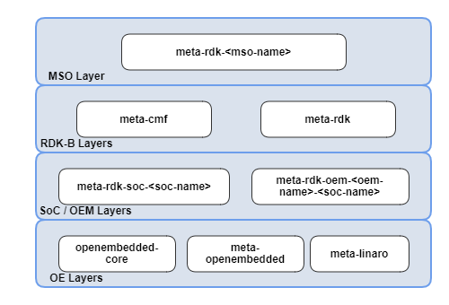
Layers
Layers
© Copyright 2004-2022, Bootlin. Creative Commons BY-SA 3.0 license.
Corrections, suggestions, contributions and translations are welcome!

Slide 128
Introduction to layers
Layers

Slide 129
Layers’ principles
The OpenEmbedded build system manipulates metadata.
Layers allow to isolate and organize the metadata.
A layer is a collection of recipes.
It is a good practice to begin a layer name with the prefix meta-.

Slide 130
Layers in Poky

Slide 131
Layers in Poky
The Poky reference system is a set of basic common layers:
meta
meta-skeleton
meta-poky
meta-yocto-bsp
Poky is not a final set of layers. It is the common base.
Layers are added when needed.
When making modifications to the existing recipes or when adding new ones, it is a good practice not to modify Poky. Instead you can create your own layers!

Slide 132
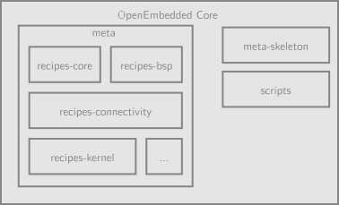
Third party layers
Meta-pi

Slide 133
Integrate and use a layer 1/3
A list of existing and maintained layers can be found at
https://layers.openembedded.org/layerindex/branch/master/layers/
Instead of redeveloping layers, always check the work hasn’t been done by others.
It takes less time to download a layer providing a package you need and to add an append file if some modifications are needed than to do it from scratch.

Slide 134
Integrate and use a layer 2/3
The location where a layer is saved on the disk doesn’t matter.
But a good practice is to save it where all others layers are stored.
The only requirement is to let BitBake know about the new layer:
The list of layers BitBake uses is defined in $BUILDDIR/conf/bblayers.conf
To include a new layer, add its absolute path to the BBLAYERS variable.
BitBake parses each layer specified in BBLAYERS and adds the recipes, configurations files and classes it contains.

Slide 135
Integrate and use a layer 3/3
The bitbake-layers tool is provided alongside bitbake.
It can be used to inspect the layers and to manage
$BUILDDIR/conf/bblayers.conf:
bitbake-layers show-layers
bitbake-layers add-layer meta-custom
bitbake-layers remove-layer meta-qt5

Slide 136
Some useful layers
Many SoC specific layers are available, providing support for the boards using these SoCs. Some examples: meta-ti, meta-freescale and meta-raspberrypi.
Other layers offer to support applications not available in the Poky reference system:
meta-browser: web browsers (Chromium, Firefox).
meta-filesystems: support for additional filesystems.
meta-gstreamer10: support for GStreamer 1.0.
meta-java and meta-oracle-java: Java support.
meta-linaro-toolchain: Linaro toolchain recipes.
meta-qt5: QT5 modules.
meta-realtime: real time tools and test programs.
meta-telephony and many more…
Notice that some of these layers do not come with all the Yocto branches. The
meta-browser did not have a krogoth branch, for example.

Slide 137
Creating a layer
Layers

Slide 138
Custom layer

Slide 139
Create a custom layer 1/2
A layer is a set of files and directories and can be created by hand.
However, the bitbake-layers create-layer command helps us create new layers and ensures this is done right.
bitbake-layers create-layer -p <PRIORITY> <layer>
The priority is used to elect which recipe to use when multiple layers contains the same recipe
The recipe priority takes precedence over the version number ordering

Slide 140
Create a custom layer 2/2
The layer created will be pre-filled with the following files: conf/layer.conf The layer’s configuration. Holds its priority and generic
information. No need to modify it in many cases.
COPYING.MIT The license under which a layer is released. By default MIT. README A basic description of the layer. Contains a contact e-mail to update.
By default, all metadata matching ./recipes-*/*/*.bb will be parsed by the BitBake build engine.

Slide 141
Use a layer: best practices
Do not copy and modify existing recipes from other layers. Instead use append files.
Avoid duplicating files. Use append files or explicitly use a path relative to other layers.
Save the layer alongside other layers, in OEROOT.
Use LAYERDEPENDS to explicitly define layer dependencies.
Use LAYERSERIES_COMPAT to define the Yocto version(s) with which the layer is compatible.

Slide 142





Practical lab - Create a custom layer and Extend a recipe
Create a layer from scratch
Add recipes to the new layer
Integrate it to the build
Apply patches to an existing recipe
Use a custom configuration file for an existing recipe
Extend a recipe to fit your needs

Slide 143
Introduction to BSP layers in the Yocto Project
BSP Layers

Slide 144
BSP layers

Slide 145
Overview
BSP layers are device specific layers. They hold metadata with the purpose of supporting specific hardware devices.
BSP layers describe the hardware features and often provide a custom kernel and bootloader with the required modules and drivers.
BSP layers can also provide additional software, designed to take advantage of the hardware features.
As a layer, it is integrated into the build system as we previously saw.
A good practice is to name it meta-<bsp_name>.

Slide 146
BSP layers Specifics
BSP layers are a subset of the layers.
In addition to package recipes and build tasks, they often provide:
Hardware configuration files (machines).
Bootloader, kernel and display support and configuration.
Pre-built user binaries.

Slide 147
Hardware configuration files
BSP Layers

Slide 148
Overview 1/2
A layer provides one machine file (hardware configuration file) per machine it supports.
These configuration files are stored under
meta-<bsp_name>/conf/machine/*.conf
The file names correspond to the values set in the MACHINE configuration variable.
meta-ti/conf/machine/beaglebone.conf
MACHINE = "beaglebone"
Each machine should be described in the README file of the BSP.

Slide 149
Overview 2/2
The hardware configuration file contains configuration variables related to the architecture and to the machine features.
Some other variables help customize the kernel image or the filesystems used.

Slide 150
Machine configuration
TARGET_ARCH The architecture of the device being built. PREFERRED_PROVIDER_virtual/kernel The default kernel. MACHINE_FEATURES List of hardware features provided by the machine, e.g.
usbgadget usbhost screen wifi
SERIAL_CONSOLES Speed and device for the serial console to attach. Used to configure getty, e.g. 115200;ttyS0
KERNEL_IMAGETYPE The type of kernel image to build, e.g. zImage, uImage,Image,…

Slide 151
MACHINE_FEATURES
Lists the hardware features provided by the machine.
These features are used by package recipes to enable or disable functionalities.
Some packages are automatically added to the resulting root filesystem depending on the feature list.
The feature bluetooth:
Asks the bluez daemon to be built and added to the image.
Enables bluetooth support in ConnMan.

Slide 152
conf/machine/include/cfa10036.inc
# Common definitions for cfa-10036 boards include conf/machine/include/imx-base.inc include conf/machine/include/tune-arm926ejs.inc
SOC_FAMILY = "mxs:mx28:cfa10036"
PREFERRED_PROVIDER_virtual/kernel ?= "linux-cfa" PREFERRED_PROVIDER_virtual/bootloader ?= "barebox" IMAGE_BOOTLOADER = "barebox"
BAREBOX_BINARY = "barebox"
IMAGE_FSTYPES_mxs = "tar.bz2 barebox.mxsboot-sdcard sdcard.gz" IMXBOOTLETS_MACHINE = "cfa10036"
KERNEL_IMAGETYPE = "zImage" KERNEL_DEVICETREE = "imx28-cfa10036.dtb"
# we need the kernel to be installed in the final image
IMAGE_INSTALL_append = " kernel-image kernel-devicetree" SDCARD_ROOTFS ?= "${DEPLOY_DIR_IMAGE}/${IMAGE_NAME}.rootfs.ext3" SERIAL_CONSOLE = "115200 ttyAMA0"
MACHINE_FEATURES = "usbgadget usbhost vfat"

Slide 153
conf/machine/cfa10057.conf
#@TYPE: Machine
#@NAME: Crystalfontz CFA-10057 #@SOC: i.MX28
#@DESCRIPTION: Machine configuration for CFA-10057, also called CFA-920
#@MAINTAINER: Alexandre Belloni <alexandre.belloni@bootlin.com>
include conf/machine/include/cfa10036.inc KERNEL_DEVICETREE += "imx28-cfa10057.dtb"
MACHINE_FEATURES += "touchscreen"

Slide 154
Bootloader
BSP Layers

Slide 155
Default bootloader 1/2
By default the bootloader used is the mainline version of U-Boot, with a fixed version (per Poky release).
All the magic is done in meta/recipes-bsp/u-boot/u-boot.inc
Some configuration variables used by the U-Boot recipe can be customized, in the machine file.

Slide 156
Default bootloader 2/2
SPL_BINARY If an SPL is built, describes the name of the output binary. Defaults to an empty string.
UBOOT_SUFFIX bin (default) or img.
UBOOT_MACHINE The target used to build the configuration. UBOOT_ENTRYPOINT The bootloader entry point.
UBOOT_LOADADDRESS The bootloader load address.
UBOOT_MAKE_TARGET Make target when building the bootloader. Defaults to
all.

Slide 157
Customize the bootloader
It is possible to support a custom U-Boot by creating an extended recipe and to append extra metadata to the original one.
This works well when using a mainline version of U-Boot.
Otherwise it is possible to create a custom recipe.
Try to still use meta/recipes-bsp/u-boot/u-boot.inc

Slide 158
Kernel
BSP Layers

Slide 159
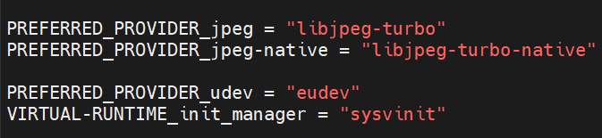
Linux kernel recipes in Yocto
There are basically two ways of compiling a kernel in the Yocto Project:
By using the linux-yocto packages, provided in Poky.
By using a fully custom kernel recipe.
The kernel used is selected in the machine file thanks to:
PREFERRED_PROVIDER_virtual/kernel
Its version is defined with: PREFERRED_VERSION_<kernel_provider>

Slide 160
Linux Yocto 1/4
linux-yocto is a generic set of recipes for building mainline Linux kernel images.
PREFERRED_PROVIDER_virtual/kernel = "linux-yocto"
PREFERRED_VERSION_linux-yocto = "5.14%"

Slide 161
Linux Yocto 2/4
Like other appended recipes, patches can be added by filling SRC_URI with .patch
and/or .diff files.
The kernel configuration must also be provided, and the file containing it must be called defconfig.
This can be generated from a Linux source tree, by using make savedefconfig
The configuration can be split in several files, by using the .cfg extension. It is the best practice when adding new features:
SRC_URI += "file://defconfig
\
file://nand-support.cfg \ file://ethernet-support.cfg"

Slide 162
Linux Yocto 3/4
Configuration fragments can be generated directly with the bitbake command:
Configure the kernel following its recipe instructions:
bitbake -c kernel_configme linux-yocto
Edit the configuration: bitbake -c menuconfig linux-yocto
Save the configuration differences: bitbake -c diffconfig linux-yocto
The differences will be saved at $WORKDIR/fragment.cfg
After integrating configuration fragments into the appended recipe, you can check everything is fine by running:
bitbake -c kernel_configcheck -f linux-yocto

Slide 163
Linux Yocto 4/4
Another way of configuring linux-yocto is by using Advanced Metadata.
It is a powerful way of splitting the configuration and the patches into several pieces.
It is designed to provide a very configurable kernel.
The full documentation can be found at https://docs.yoctoproject.org/kernel-dev/advanced.html#working-with- advanced-metadata-yocto-kernel-cache

Slide 164
Linux Yocto: Kernel Metadata 1/4
Kernel Metadata is a way to organize and to split the kernel configuration and patches in little pieces each providing support for one feature.
Two main configuration variables help taking advantage of this: LINUX_KERNEL_TYPE standard (default), tiny or preempt-rt
standard: generic Linux kernel policy.
tiny: bare minimum configuration, for small kernels.
preempt-rt: applies the PREEMPT_RT patch.
KERNEL_FEATURES List of features to enable. Features are sets of patches and configuration fragments.

Slide 165
Linux Yocto: Kernel Metadata 2/4
Kernel Metadata can be stored in the linux-yocto recipe space.
It must be under $FILESEXTRAPATHS. A best practice is to follow this directory hierarchy:
bsp/ cfg/ features/ ktypes/ patches/
Kernel Metadata are divided into 3 file types:
Description files, ending in .scc
Configuration fragments
Patches

Slide 166
Linux Yocto: Kernel Metadata 3/4
Kernel Metadata description files have their own syntax, used to describe the feature provided and which patches and configuration fragments to use.
Simple example, features/smp.scc
define KFEATURE_DESCRIPTION "Enable SMP"
kconf hardware smp.cfg patch smp-support.patch
To integrate the feature into the kernel image:
KERNEL_FEATURES += "features/smp.scc"

Slide 167
Linux Yocto: Kernel Metadata 4/4
▶ .scc syntax description:
branch <ref> Create a new branch relative to the current one.
define Defines variables.
include <scc file> Include another description file. Parsed inline.
kconf [hardware|non-hardware] <cfg file> Queues a configuration fragment, to merge it into Linux’s .config
git merge <branch> Merge branch into the current git branch.
patch <patch file> Applies patch file to the current git branch.

Slide 168
Practical lab - Create a custom machine configuration
Write a machine configuration
Understand how the target architecture is chosen

Slide 169
Distro Layers
Distro Layers

Slide 170
Distro layers

Slide 171
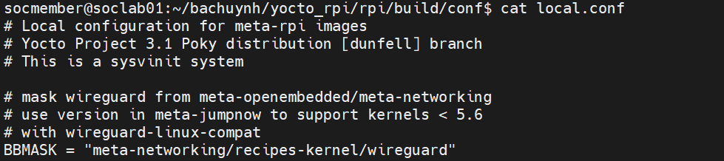
Distro layers
You can create a new distribution by using a Distro layer.
This allows to change the defaults that are used by Poky.
It is useful to distribute changes that have been made in local.conf

Slide 172
Best practice
A distro layer is used to provide policy configurations for a custom distribution.
It is a best practice to separate the distro layer from the custom layers you may create and use.
It often contains:
Configuration files.
Specific classes.
Distribution specific recipes: initialization scripts, splash screen…

Slide 173
Creating a Distro layer
The configuration file for the distro layer is conf/distro/<distro>.conf
This file must define the DISTRO variable.
It is possible to inherit configuration from an existing distro layer.
You can also use all the DISTRO_* variables.
Use DISTRO = "<distro>" in local.conf to use your distro configuration.
require conf/distro/poky.conf DISTRO = "distro"
DISTRO_NAME = "distro description" DISTRO_VERSION = "1.0"
MAINTAINER = "..."

Slide 174
DISTRO_FEATURES
Lists the features the distribution will provide.
As for MACHINE_FEATURES, this is used by package recipes to enable or disable functionalities.
COMBINED_FEATURES provides the list of features that are enabled in both
MACHINE_FEATURES and DISTRO_FEATURES.

Slide 175
Toolchain selection
The toolchain selection is controlled by the TCMODE variable.
It defaults to "default".
The conf/distro/include/tcmode-${TCMODE}.inc file is included.
This configures the toolchain to use by defining preferred providers and versions for recipes such as gcc, binutils, *libc…
The providers’ recipes define how to compile or/and install the toolchain.
Toolchains can be built by the build system or external.

Slide 176
Sample files
A distro layer often contains sample files, used as templates to build key configurations files.
Example of sample files:
bblayers.conf.sample
local.conf.sample
In Poky, they are in meta-poky/conf/.
The TEMPLATECONF variable controls where to find the samples.
It is set in ${OEROOT}/.templateconf.

Slide 177
Release management
Distro Layers

Slide 178
Release management
There are multiple tasks that OE/bitbake based projects let you do on your own to ensure build reproducibility:
Code distribution and project setup.
Release tagging
A separate tool is needed for that, usual solutions are:
combo-layer, as done by Poky:
https://wiki.yoctoproject.org/wiki/Combo-layer
git submodules + setup script. Great example in YOE:
https://github.com/YoeDistro/yoe-distro
repo and templateconf or setup script
kas

Slide 179
Distribute the distribution
A good way to distribute a distribution (Poky, custom layers, BSP,
.templateconf…) is to use Google’s repo.
Repo is used in Android to distribute its source code, which is split into many git
repositories. It’s a wrapper to handle several git repositories at once.
The only requirement is to use git.
The repo configuration is stored in manifest file, usually available in its own git
repository.
It could also be in a specific branch of your custom layer.
It only handles fetching code, handling local.conf and bblayers.conf is done separately

Slide 180
Manifest example
<?xml version="1.0" encoding="UTF-8"?>
<manifest>
<remote name="yocto-project" fetch="git.yoctoproject.org" />
<remote name="private" fetch="git.example.net" />
<default revision="dunfell" remote="private" />
<project name="poky" remote="yocto-project" />
<project name="meta-ti" remote="yocto-project" />
<project name="meta-custom" />
<project name="meta-custom-bsp" />
<project path="meta-custom-distro" name="distro">
<copyfile src="templateconf" dest="poky/.templateconf" />
</project>
</manifest>

Slide 181
Retrieve the project using repo
$ mkdir my-project; cd my-project
$ repo init -u https://git.example.net/manifest.git
$ repo sync -j4
repo init uses the default.xml manifest in the repository, unless specified otherwise.
You can see the full repo documentation at
https://source.android.com/source/using-repo.html.

Slide 182
repo: release
To tag a release, a few steps have to be taken:
Optionally tag the custom layers
For each project entry in the manifest, set the revision parameter to either a tag or a commit hash.
Commit and tag this version of the manifest.

Slide 183
Introduction to images
Images

Slide 184
Overview 1/3
An image is the top level recipe and is used alongside the machine definition.
Whereas the machine describes the hardware used and its capabilities, the image is architecture agnostic and defines how the root filesystem is built, with what packages.
By default, several images are provided in Poky:
meta*/recipes*/images/*.bb

Slide 185
Overview 2/3
▶ Common images are:
core-image-base Console-only image, with full support of the hardware. core-image-minimal Small image, capable of booting a device.
core-image-minimal-dev Small image with extra tools, suitable for development. core-image-x11 Image with basic X11 support.
core-image-rt core-image-minimal with real time tools and test suite.

Slide 186
Overview 3/3
An image is no more than a recipe.
It has a description, a license and inherits the core-image class.

Slide 187
Organization of an image recipe
▶ Some special configuration variables are used to describe an image: IMAGE_BASENAME The name of the output image files. Defaults to ${PN}.
IMAGE_INSTALL List of packages and package groups to install in the generated image.
IMAGE_ROOTFS_SIZE The final root filesystem size. IMAGE_FEATURES List of features to enable in the image.
IMAGE_FSTYPES List of formats the OpenEmbedded build system will use to create images.
IMAGE_LINGUAS List of the locales to be supported in the image. IMAGE_PKGTYPE Package type used by the build system. One of deb, rpm,
ipk and tar.
IMAGE_POSTPROCESS_COMMAND Shell commands to run at post process.

Slide 188
Example of an image
require recipes-core/images/core-image-minimal.bb
DESCRIPTION = "Example image" IMAGE_INSTALL += "ninvaders" LICENSE = "MIT"

Slide 189
IMAGE_FSTYPES
Configures the resulting root filesystem image format.
If more than one format is specified, one image per format will be generated.
Image formats instructions are delivered in Poky, thanks to
meta/classes/image_types.bbclass
Common image formats are: ext2, ext3, ext4, squashfs, squashfs-xz, cpio, jffs2, ubifs, tar.bz2, tar.gz…

Slide 190
Creating an image type
If you have a particular layout on your storage (for example bootloader location on an SD card), you may want to create your own image type.
This is done through a class that inherits from image_types.
It has to define a function named IMAGE_CMD_<type>.
Append it to IMAGE_TYPES

Slide 191
Creating an image conversion type
Common conversion types are: gz, bz2, sha256sum, bmap…
This is done through a class that inherits from image_types.
It has to define a function named CONVERSION_CMD_<type>.
Append it to CONVERSIONTYPES
Append valid combinations to IMAGE_TYPES

Slide 192
▶ wic is a tool that can create a flashable image from the compiled packages and artifacts.
wic
It can create partitions.
It can select which files are located in which partition through the use of plugins.
The final image layout is described in a .wks or .wks.in file.
It can be extended in any layer.
Usage example:
WKS_FILE = "imx-uboot-custom.wks.in" IMAGE_FSTYPES = "wic.bmap wic"

Slide 193
U-boot-custom.wks.in
part u-boot --source rawcopy --sourceparams="file=u-boot" --ondisk sda --no-table --align ${_BOOT_SEEK} part /boot --source bootimg-partition --ondisk sda --fstype=vfat --label boot --active --align 8192 --size 64
part / --source rootfs --ondisk sda --fstype=ext4 --label root --exclude-path=home/ --exclude-path=opt/ --align 8192
part /home --source rootfs --rootfs-dir=${IMAGE_ROOTFS}/home --ondisk sda --fstype=ext4 --label home --align 8192 part /opt --source rootfs --rootfs-dir=${IMAGE_ROOTFS}/opt --ondisk sda --fstype=ext4 --label opt --align 8192
bootloader --ptable msdos
Copies U-boot from $DEPLOY_DIR in the image, aligned on (and so at that offset) ${_BOOT_SEEK}.
Creates a first partition, formatted in FAT32, with the files listed in the
IMAGE_BOOT_FILES variable.
Creates an ext4 partition with the contents on the root filesystem, excluding the content of /home and /opt
Creates two ext4 partitions, one with the content of /home, the other one with the content of /opt, from the image root filesystem.

Slide 194
Package groups
Images

Slide 195
Overview
Package groups are a way to group packages by functionality or common purpose.
Package groups are used in image recipes to help building the list of packages to install.
They can be found under meta*/recipes-core/packagegroups/
A package group is yet another recipe.
The prefix packagegroup- is always used.
Be careful about the PACKAGE_ARCH value:
Must be explicitly set to ${MACHINE_ARCH} when there is a machine dependency.
Set to the value all by default,

Slide 196
Common package groups
packagegroup-core-boot
packagegroup-core-buildessential
packagegroup-core-nfs-client
packagegroup-core-nfs-server
packagegroup-core-tools-debug
packagegroup-core-tools-profile

Slide 197
Example
./meta/recipes-core/packagegroups/packagegroup-core-tools-debug.bb:
SUMMARY = "Debugging tools" LICENSE = "MIT"
inherit packagegroup RDEPENDS_${PN} = "\
gdb \ gdbserver \ strace"

Slide 198
Practical lab - Create a custom image
Write an image recipe
Choose the packages to install

Slide 199
Managing licenses
Licensing

Slide 200
Tracking license changes
The license of an external project may change at some point.
The LIC_FILES_CHKSUM tracks changes in the license files.
If the license’s checksum changes, the build will fail.
The recipe needs to be updated.
LIC_FILES_CHKSUM = "
file://COPYING;md5=...
\
\
file://src/file.c;beginline=3;endline=21;md5=..."
▶ LIC_FILES_CHKSUM is mandatory in every recipe, unless LICENSE is set to CLOSED.

Slide 201
Package exclusion
We may not want some packages due to their licenses.
To exclude a specific license, use INCOMPATIBLE_LICENSE
To exclude all GPLv3 packages:
INCOMPATIBLE_LICENSE = "GPLv3"
License names are the ones used in the LICENSE variable.
The meta-gplv2 layer provides recipes for software where upstream has moved to GPLv3 licenses.

Slide 202
Commercial licenses
By default the build system does not include commercial components.
Packages with a commercial component define:
LICENSE_FLAGS = "commercial"
To build a package with a commercial component, the package must be in the
LICENSE_FLAGS_WHITELIST variable.
Example, gst-plugins-ugly:
LICENSE_FLAGS_WHITELIST = "commercial_gst-plugins-ugly"

Slide 203
Listing licenses
OpenEmbbedded will generate a manifest of all the licenses of the software present on the target image in $BUILDDIR/tmp/deploy/licenses/<image>/license.manifest
PACKAGE NAME: busybox PACKAGE VERSION: 1.31.1
RECIPE NAME: busybox
LICENSE: GPLv2 & bzip2-1.0.6
PACKAGE NAME: dropbear PACKAGE VERSION: 2019.78
RECIPE NAME: dropbear
LICENSE: MIT & BSD-3-Clause & BSD-2-Clause & PD

Slide 204
Providing license text
To include the license text in the root filesystem either:
Use COPY_LIC_DIRS = "1" and COPY_LIC_MANIFEST = "1"
or use LICENSE_CREATE_PACKAGE = "1" to generate packages including the license and install the required license packages.

Slide 205
Providing sources
OpenEmbbedded provides the archiver class to generate tarballs of the source code:
Use INHERIT += "archiver"
Set the ARCHIVER_MODE variable, the default is to provide patched sources. To provide configured sources:
ARCHIVER_MODE[src] = "configured"

Slide 206
Packages features
Writing recipes - going further

Slide 207
Benefits
Features can be built depending on the needs.
This allows to avoid compiling all features in a software component when only a few are required.
A good example is ConnMan: Bluetooth support is built only if there is Bluetooth on the target.
The PACKAGECONFIG variable is used to configure the build on a per feature granularity, for packages.

Slide 208
PACKAGECONFIG
PACKAGECONFIG takes the list of features to enable.
PACKAGECONFIG[feature] takes up to six arguments, separated by commas:
Argument used by the configuration task if the feature is enabled (EXTRA_OECONF).
Argument added to EXTRA_OECONF if the feature is disabled.
Additional build dependency (DEPENDS), if enabled.
Additional runtime dependency (RDEPENDS), if enabled.
Additional runtime recommendations (RRECOMMENDS), if enabled.
Any conflicting PACKAGECONFIG settings for this feature.
Unused arguments can be omitted or left blank.

Slide 209
Example: from ConnMan
PACKAGECONFIG ??= "wifi openvpn"
PACKAGECONFIG[wifi] = "--enable-wifi,
--disable-wifi, wpa-supplicant, wpa-supplicant"
PACKAGECONFIG[bluez] = "--enable-bluetooth,
--disable-bluetooth, bluez5,
bluez5" PACKAGECONFIG[openvpn] = "--enable-openvpn,
--disable-openvpn,
,
openvpn"
\
\
\
\
\
\
\
\
\

Slide 210
Conditional features
Writing recipes - going further

Slide 211
Conditional features
Some values can be set dynamically, thanks to a set of functions:
bb.utils.contains(variable, checkval, trueval, falseval, d): if
checkval is found in variable, trueval is returned; otherwise falseval is used.
bb.utils.filter(variable, checkvalues, d): returns all the words in the variable that are present in the checkvalues.
Example:
PACKAGECONFIG ??= "wispr iptables client\
${@bb.utils.filter('DISTRO_FEATURES', '3g systemd wifi', d)} \
${@bb.utils.contains('DISTRO_FEATURES', 'bluetooth', 'bluez', '', d)} \
"

Slide 212
Python tasks
Writing recipes - going further

Slide 213
Tasks in Python
Tasks can be written in Python when using the keyword python.
The d variable is accessible, and represents the BitBake datastore (where variables are stored).
Two modules are automatically imported:
bb: to access BitBake’s internal functions.
os: Python’s operating system interfaces.
You can import other modules using the keyword import.
Anonymous Python functions are executed during parsing.

Slide 214
Accessing the datastore with Python
▶ The d variable is accessible within Python tasks.
d.getVar("X", expand=False) Returns the value of X. d.setVar("X", "value") Set X.
d.appendVar("X", "value") Append value to X. d.prependVar("X", "value") Prepend value to X. d.expand(expression) Expand variables in expression.

Slide 215
Python task example
# Anonymous function python anonymous() {
if d.getVar("FOO", True) == "example": d.setVar("BAR", "Hello, World.")
}
# Task
python do_settime() { import time
d.setVar("TIME", time.strftime('%Y%m%d', time.gmtime()))
}

Slide 216
Variable flags
Writing recipes - going further

Slide 217
Variable flags
Variable flags are used to store extra information on tasks and variables.
They are used to control task functionalities.
A number of these flags are already used by BitBake:
dirs: directories that should be created before the task runs. The last one becomes the work directory for the task.
noexec: disable the execution of the task.
nostamp: do not create a stamp file when running the task. The task will always be executed.
doc: task documentation displayed by listtasks.
do_settime[noexec] = "1"
do_compile[nostamp] = "1"
do_settime[doc] = "Set the current time in ${TIME}"

Slide 218
Root filesystem creation
Writing recipes - going further

Slide 219
Files and directories selection
The FILES variable controls the list of files and directories to be placed into packages.
It must be package specific (e.g. with _${PN}).
In Poky, defaults to:
FILES_${PN} = \
"${bindir}/* ${sbindir}/* ${libexecdir}/* ${libdir}/lib*${SOLIBS} \
${sysconfdir} ${sharedstatedir} ${localstatedir} \
${base_bindir}/* ${base_sbindir}/* \
${base_libdir}/*${SOLIBS} \
${base_prefix}/lib/udev/rules.d ${prefix}/lib/udev/rules.d \
${datadir}/${BPN} ${libdir}/${BPN}/* \
${datadir}/pixmaps ${datadir}/applications \
${datadir}/idl ${datadir}/omf ${datadir}/sounds \
${libdir}/bonobo/servers"
▶ To prevent configuration files to be overwritten during the Package Management System update process, use CONFFILES.

Slide 220
Root filesystem generation
Image generation overview:
The rootfs is created using packages.
One or more images files are created, depending on the IMAGE_FSTYPES value.
The rootfs creation is specific to the IMAGE_PKGTYPE value. It should be defined in the image recipe, otherwise the first valid package type defined in PACKAGE_CLASSES is used.
All the magic is done in meta/classes/rootfs_${IMAGE_PKGTYPE}.bbclass

Slide 221
Example: rootfs creation with .deb packages
rootfs_deb_do_rootfs () { [...]
export INSTALL_ROOTFS_DEB="${IMAGE_ROOTFS}" [...]
apt update
apt ${APT_ARGS} install ${package_to_install} \
--force-yes --allow-unauthenticated
[...]
}

Slide 222
Splitting packages
Writing recipes - going further

Slide 223
Benefits
Packages can be split.
Useful when a single remote repository provides multiple binaries or libraries.
The list of packages to provide is defined by the PACKAGES variable.
The FILES variable is often used to split the output into packages.
PACKAGE_BEFORE_PN allows to pick files normally included in the default package in another.
PACKAGES_DYNAMIC allows to check dependencies with optional packages are satisfied.
ALLOW_EMPTY allows to produce a package even if it is empty.

Slide 224
Example
▶ The kexec tools provides kexec and kdump:
require kexec-tools.inc
export LDFLAGS = "-L${STAGING_LIBDIR}"
EXTRA_OECONF = " --with-zlib=yes"
SRC_URI[md5sum] = \ "b9f2a3ba0ba9c78625ee7a50532500d8"
SRC_URI[sha256sum] = "..."
PACKAGES =+ "kexec kdump"
FILES_kexec = "${sbindir}/kexec" FILES_kdump = "${sbindir}/kdump"

Slide 225
Default packages
By default several packages are produced automatically:
PACKAGES = "${PN}-src ${PN}-dbg ${PN}-staticdev ${PN}-dev \
${PN}-doc ${PN}-locale ${PACKAGE_BEFORE_PN} ${PN}"
For each of these packages a FILES variable is defined in
meta/conf/bitbake.conf:
FILES_${PN}-dev = \
"${includedir} ${FILES_SOLIBSDEV} ${libdir}/*.la \
${libdir}/*.o ${libdir}/pkgconfig ${datadir}/pkgconfig \
${datadir}/aclocal ${base_libdir}/*.o \
${libdir}/${BPN}/*.la ${base_libdir}/*.la \
${libdir}/cmake ${datadir}/cmake"
FILES_${PN}-dbg = \
"/usr/lib/debug /usr/lib/debug-static \
/usr/src/debug"

Slide 226
Inspecting packages
oe-pkgdata-util is a tool that can help inspecting packages:
Which package is shipping a file:
$ oe-pkgdata-util find-path /bin/busybox busybox: /bin/busybox
Which files are shipped by a package:
$ oe-pkgdata-util list-pkg-files busybox busybox:
/bin/busybox
/bin/busybox.nosuid
/bin/busybox.suid
/bin/sh
▶ Which recipe is creating a package:
$ oe-pkgdata-util lookup-recipe kdump kexec-tools
$ oe-pkgdata-util lookup-recipe libtinfo5
ncurses

Slide 227
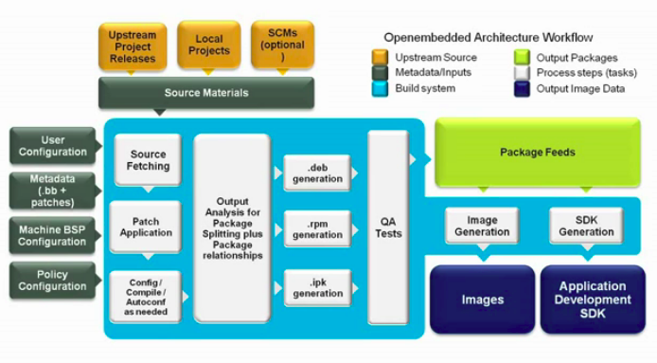
Application development workflow
Application development workflow
© Copyright 2004-2022, Bootlin. Creative Commons BY-SA 3.0 license.
Corrections, suggestions, contributions and translations are welcome!

Slide 228
Recommended workflows
Different development workflows are possible given the needs:
Low-level application development (bootloader, kernel).
Application development.
Temporary modifications on an external project (bug fixes, security fixes).
Three workflows exists for theses needs: the SDK, devtool and quilt.

Slide 229
The Yocto Project SDK
Application development workflow

Slide 230
Overview
An SDK (Software Development Kit) is a set of tools allowing the development of applications for a given target (operating system, platform, environment…).
It generally provides a set of tools including:
Compilers or cross-compilers.
Linkers.
Library headers.
Debuggers.
Custom utilities.

Slide 231
The Yocto Project SDK
The Poky reference system is used to generate images, by building many applications and doing a lot of configuration work.
When developing an application, we only care about the application itself.
We want to be able to develop, test and debug easily.
The Yocto Project SDK is an application development SDK, which can be generated to provide a full environment compatible with the target.
It includes a toolchain, libraries headers and all the needed tools.
This SDK can be installed on any computer and is self-contained. The presence of Poky is not required for the SDK to fully work.

Slide 232
Available SDKs
Two different SDKs can be generated:
A generic SDK, including:
A toolchain. Common tools.
A collection of basic libraries.
An image-based SDK, including:
The generic SDK.
The sysroot matching the target root filesystem.
Its toolchain is self-contained (linked to an SDK embedded libc).
The SDKs generated with Poky are distributed in the form of a shell script.
Executing this script extracts the tools and sets up the environment.

Slide 233
The generic SDK
Mainly used for low-level development, where only the toolchain is needed:
Bootloader development.
Kernel development.
The recipe meta-toolchain generates this SDK:
The generated script, containing all the tools for this SDK, is in:
bitbake meta-toolchain
$BUILDDIR/tmp/deploy/sdk
Example:
poky-glibc-x86_64-meta-toolchain-cortexa8hf-neon-toolchain-2.5.sh
▶
The SDK will be configured to be compatible with the specified MACHINE.

Slide 234
The image-based SDK
Used to develop applications running on the target.
Pref : 10 Images — The Yocto Project ® 4.0.1 documentation
One task is dedicated to the process. The task behavior can vary between the images.
To generate an SDK for core-image-minimal:
populate_sdk
bitbake -c populate_sdk core-image-minimal
The generated script, containing all the tools for this SDK, is in:
$BUILDDIR/tmp/deploy/sdk
Example:
poky-glibc-x86_64-core-image-minimal-cortexa8hf-neon-toolchain-2.5.sh
▶
The SDK will be configured to be compatible with the specified MACHINE.

Slide 235
SDK format
Both SDKs are distributed as bash scripts.
These scripts self extract themselves to install the toolchains and the files they provide.
To install an SDK, retrieve the generated script and execute it.
The script asks where to install the SDK. Defaults to /opt/poky/<version>
Example: /opt/poky/2.5
$ ./poky-glibc-x86_64-meta-toolchain-cortexa8hf-neon-toolchain-2.5.sh Poky (Yocto Project Reference Distro) SDK installer version 2.5
===============================================================
Enter target directory for SDK (default: /opt/poky/2.5):
You are about to install the SDK to "/opt/poky/2.5". Proceed[Y/n]? Extracting SDK.................done
Setting it up...done
SDK has been successfully set up and is ready to be used.
Each time you wish to use the SDK in a new shell session, you need to source the environment setup script e.g.
$ . /opt/poky/2.5/environment-setup-cortexa8hf-neon-poky-linux-gnueabi

Slide 236
Use the SDK
To use the SDK, a script is available to set up the environment:
$ cd /opt/poky/2.5
$ source ./environment-setup-cortexa8hf-neon-poky-linux-gnueabi
The PATH is updated to take into account the binaries installed alongside the SDK.
Environment variables are exported to help using the tools.

Slide 237
SDK installation
environment-setup-cortexa8hf-neon-poky-linux-gnueabi Exports environment variables. site-config-cortexa8hf-neon-poky-linux-gnueabi Variables used during the toolchain
creation
sysroots SDK binaries, headers and libraries. Contains one directory for the host and one for the target.
version-cortexa8hf-neon-poky-linux-gnueabi Version information.

Slide 238
SDK environment variables
CC Full path to the C compiler binary.
CFLAGS C flags, used by the C compiler.
CXX C++ compiler.
CXXFLAGS C++ flags, used by CPP
LD Linker.
LDFLAGS Link flags, used by the linker.
ARCH For kernel compilation.
CROSS_COMPILE For kernel compilation.
GDB SDK GNU Debugger.
OBJDUMP SDK objdump.
▶ To see the full list, open the environment script.

Slide 239
Examples
To build an application for the target:
$ $CC -o example example.c
The LDFLAGS variables is set to be used with the C compiler (gcc).
When building the Linux kernel, unset this variable.
$ unset LDFLAGS
$ make menuconfig
$ make

Slide 240
Devtool
Application development workflow

Slide 241
Overview
Devtool is a set of utilities to ease the integration and the development of OpenEmbedded recipes.
It can be used to:
Generate a recipe for a given upstream application.
Modify an existing recipe and its associated sources.
Upgrade an existing recipe to use a newer upstream application.
Devtool adds a new layer, automatically managed, in $BUILDDIR/workspace/.
It then adds or appends recipes to this layer so that the recipes point to a local path for their sources. In $BUILDDIR/workspace/sources/.
Local sources are managed by git.
All modifications made locally should be commited.

Slide 242
Devtool usage 1/3
There are three ways of creating a new devtool project:
To create a new recipe: devtool add <recipe> <fetchuri>
Where recipe is the recipe’s name.
fetchuri can be a local path or a remote uri.
To modify the source for an existing recipe: devtool modify <recipe>
To upgrade a given recipe: devtool upgrade -V <version> <recipe>
Where version is the new version of the upstream application.

Slide 243
Devtool usage 2/3
Once a devtool project is started, commands can be issued:
devtool edit-recipe <recipe>: edit recipe in a text editor (as defined by the
EDITOR environment variable).
devtool build <recipe>: build the given recipe.
devtool build-image <image>: build image with the additional devtool
recipes’ packages.

Slide 244
Devtool usage 3/3
devtool deploy-target <recipe> <target>: upload the recipe’s packages on target, which is a live running target with an SSH server running (user@address).
devtool update-recipe <recipe>: generate patches from git commits made locally.
devtool reset <recipe>: remove recipe from the control of devtool.
Standard layers and remote sources are used again as usual.

Slide 245
Quilt
Application development workflow

Slide 246
Overview
Quilt is a utility to manage patches which can be used without having a clean source tree.
It can be used to create patches for recipes already available in the build system.
Be careful when using this workflow: the modifications won’t persist across builds!

Slide 247
Using Quilt
Find the recipe working directory in $BUILDDIR/tmp/work/.
Create a new Quilt patch: $ quilt new topic.patch
Add files to this patch: $ quilt add file0.c file1.c
Make the modifications by editing the files.
Test the modifications: $ bitbake -c compile -f recipe
Generate the patch file: $ quilt refresh
Move the generated patch into the recipe’s directory.

Slide 248
Practical lab - Create and use a Poky SDK
Generate an SDK
Compile an application for the target in the SDK

Slide 249
Runtime Package Management
Runtime Package Management
© Copyright 2004-2022, Bootlin. Creative Commons BY-SA 3.0 license.
Corrections, suggestions, contributions and translations are welcome!

Slide 250
Introduction
BitBake always builds packages selected in IMAGE_INSTALL.
The packages are used to generate the root filesystem.
It is also possible to update the system at runtime using these packages, for many use cases:
In-field security updates.
System updates over the wire.
System, packages or configuration customization at runtime.
Remote debugging.
Using the Runtime Package Management is an optional feature.
We’ll use the IPK package format as an example in the following slides.

Slide 251
Requirements
First of all, you need a server to serve the packages to a private subnet or over the Internet. Packages are typically served over https or http.
Specific tools are also required on the target, and must be shipped on the product. They should be included into the images generated by the build system.
These tools will be specific to the package type used.
This is similar to Linux distributions: Debian is using .deb related tools (dpkg, apt…) while Fedora uses .rpm related ones (rpm, dnf).

Slide 252
Build configuration
Runtime Package Management

Slide 253
Build configuration 1/2
The PACKAGE_CLASSES variable controls which package format to use. More than one can be used.
Valid values are package_rpm, package_deb, package_ipk.
By default Poky uses the RPM format, while OpenEmbedded-Core uses the IPK one.
Example:
PACKAGE_CLASSES = "package_ipk"
PACKAGE_CLASSES = "package_rpm package_deb"

Slide 254
Build configuration 2/2
To install the required tools on the target, there are two possible solutions:
By adding package-management to the images features.
The required tool will be installed on the target.
The package database corresponding to the build will be installed as well.
Or by manually adding the required tools in IMAGE_INSTALL. For example, to use the IPK format we need opkg.

Slide 255
Build considerations
The Runtime Package Management uses package databases to store information about available packages and their version.
Whenever a build generates a new package or modifies an existing one, the package database must be updated.
$ bitbake package-index
Be careful: BitBake does not properly schedule the package-index target. You must use this target alone to have a consistent package database.
$ bitbake ninvaders package-index won’t necessarily generate an updated package database.

Slide 256
Target configuration
Runtime Package Management

Slide 257
The IPK runtime management software
The IPK runtime management software is opkg.
It can be configured using configurations files ending in .conf in /etc/opkg/.
This configuration helps opkg to find the package databases you want to use.
For example, with our previously configured package server:
src/gz all http://packages.example.net/all src/gz armv7a http://packages.example.net/armv7a
src/gz beaglebone http://packages.example.net/beaglebone
This can be automatically generated by defining the PACKAGE_FEED_URIS, PACKAGE_FEED_BASE_PATHS and PACKAGE_FEED_ARCHS variables

Slide 258
opkg usage
opkg update: fetch and update the package databases, from the remote package servers.
opkg list: list available packages.
opkg upgrade: upgrade all installed packages.
opkg upgrade <package>: upgrade one package explicitly.
opkg install <package>: install a specific package.

Slide 259
opkg upgrade over an unstable network
To avoid upgrade issues when downloading packages from a remote package server using an unstable connection, you can first download the packages and then proceed with the upgrade.
To do this we must use a cache, which can be defined in the opkg configuration with: option cache /tmp/opkg-cache.
# opkg update
# opkg --download-only upgrade # opkg upgrade

Slide 260
Yocto Project documentation
https://docs.yoctoproject.org/
Wiki: https://wiki.yoctoproject.org/wiki/Main_Page
https://layers.openembedded.org/

Slide 261
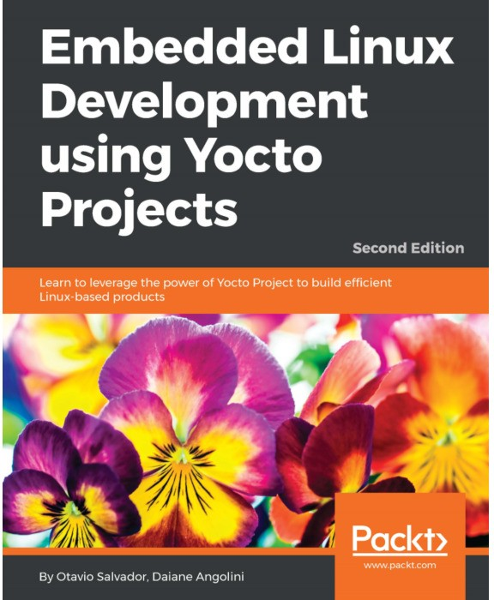
Useful Reading (1)
Embedded Linux Development with Yocto Project - Second Edition, Nov 2017
https://www.packtpub.com/virtualization-and- cloud/embedded-linux-development-using-yocto- projects-second-edition
By Otavio Salvador and Daiane Angolini
From basic to advanced usage, helps writing better, more flexible recipes. A good reference to jumpstart your Yocto Project development.

Slide 262
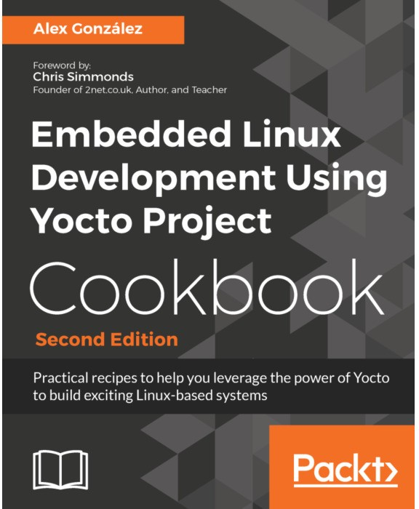
Useful Reading (2)
Embedded Linux Projects Using Yocto Project Cookbook - Second Edition, January 2018
https://www.packtpub.com/virtualization-and- cloud/embedded-linux-development-using-yocto- project-cookbook-second-edition
By Alex González
A set of recipes that you can refer to and solve your immediate problems instead of reading it from cover to cover.
See our review: https://bit.ly/1GgVmCB

Slide 263
Thank you!
And may the Source be with you
Last slide

Slide 264
Rights to copy
© Copyright 2004-2022, Bootlin
License: Creative Commons Attribution - Share Alike 3.0 https://creativecommons.org/licenses/by-sa/3.0/legalcode You are free:
to copy, distribute, display, and perform the work
to make derivative works
to make commercial use of the work Under the following conditions:
Attribution. You must give the original author credit.
Share Alike. If you alter, transform, or build upon this work, you may distribute the resulting work only under a license identical to this one.
For any reuse or distribution, you must make clear to others the license terms of this work.
Any of these conditions can be waived if you get permission from the copyright holder.
Your fair use and other rights are in no way affected by the above.
Document sources: https://github.com/bootlin/training-materials/

