Slide 1
MC/DC Testing – A Cost Effective White Box Testing Technique
Dr. Durga Prasad Mohapatra
Professor and Head
Department of Computer Science and Engineering
National Institute of Technology Rourkela, Odisha, India

Slide 2
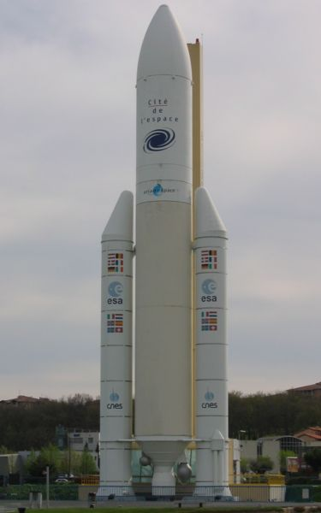
Why Test?
Ariane 5 rocket self-destructed 37 seconds after launch
Reason: A control software bug that went undetected
Conversion from 64-bit floating point to 16-bit signed integer value had caused an exception
The floating point number was larger than 32767
Efficiency considerations had led to the disabling of the exception handler.
Total Cost: over $1 billion

Slide 3
How Do You Test a Program?
Input test data to the program.
Observe the output:
Check if the program behaved as expected.

Slide 4



How Do You Test a Program? cont …

Slide 5
How Do You Test a Program? cont …
If the program does not behave as expected:
Note the conditions under which it failed.
Later debug and correct.

Slide 6
Testing Facts
Consumes largest effort among all phases
Largest manpower among all other development roles
Implies more job opportunities
About 50% development effort
But 10% of development time?
How?

Slide 7
Testing Facts cont …
Testing is getting more complex and sophisticated every year.
Larger and more complex programs
Newer programming paradigms

Slide 8
Overview of Testing Activities
Test Suite Design
Run test cases and observe results to detect failures.
Debug to locate errors
Correct errors.

Slide 9
Error, Faults and Failures
A failure is a manifestation of an error (also defect or bug).
Mere presence of an error may not lead to a failure.

Slide 10
Test Cases and Test Suites
Test a software using a set of carefully designed test cases:
The set of all test cases is called the test suite

Slide 11
Test Cases and Test Suites cont …
A test case is a triplet [I,S,O]
I is the data to be input to the system,
S is the state of the system at which the data will be input,
O is the expected output of the system.

Slide 12
Design of Test Cases
Exhaustive testing of any non-trivial system is impractical:
Input data domain is extremely large.
Design an optimal test suite:
of reasonable size and
uncovers as many errors as possible.

Slide 13
Design of Test Cases cont …
There are essentially three main approaches to design test cases:
Black-box (or functional testing) approach
White-box (or glass-box) approach
Grey-box testing

Slide 14
Black-Box Testing
Test cases are designed using only functional specification of the software:
Without any knowledge of the internal structure of the software.
For this reason, black-box testing is also known as functional testing.

Slide 15
White-Box Testing
Designing white-box test cases:
Requires knowledge about the internal structure of software.
White-box testing is also called structural testing.

Slide 16
White-Box Testing cont …
There exist several popular white-box testing methodologies:
Statement coverage
Branch coverage
Path coverage
Condition coverage
MC/DC coverage
Mutation testing
Data flow-based testing

Slide 17
Coverage-Based vs Fault-Based Testing
Idea behind coverage-based testing:
Design test cases so that certain program elements are executed (or covered).
Example: statement coverage, path coverage, etc.
Idea behind fault-based testing:
Design test cases that focus on discovering certain types of faults.
Example: Mutation testing.

Slide 18
Statement Coverage
Statement coverage methodology:
Design test cases so that every statement in the program is executed at least once.

Slide 19
Statement Coverage cont …
The principal idea:
Unless a statement is executed,
We have no way of knowing if an error exists in that statement.

Slide 20
Statement Coverage Criterion
Observing that a statement behaves properly for one input value:
No guarantee that it will behave correctly for all input values.

Slide 21
Statement Testing adequacy criterion
Adequacy criterion: Each statement (edge in the CFG) must be executed at least once
Rationale: a fault in a statement can only be revealed by executing the faulty statement
Coverage measurement:
# executed statements
# statements
Notes:
12.2 STATEMENT TESTING

Slide 22
Example
int f1(int x, int y){
1 while (x != y){
2 if (x>y) then
3 x=x-y;
4 else y=y-x;
5 }
6 return x; }
Euclid's GCD Algorithm

Slide 23
Euclid's GCD Algorithm
By choosing the test set {(x=3,y=3),(x=4,y=3), (x=3,y=4)}
All statements are executed at least once.

Slide 24
Statement Coverage
The major advantage of this measure is that it can be applied directly to object code and does not require processing source code. Performance profilers commonly implement this measure.
The major disadvantage of statement coverage is that it is insensitive to some control structures

Slide 25
Statement Coverage Examples
int* ptr = NULL;
if (B)
ptr = &variable;
*ptr = 10;
Test Case:
B=True
Statement Coverage
Achieved
Problem : if B is false the code
will fail with a null pointer
exception.
if(A) then
F1();
F2();
Test Case: A=True
Statement Coverage
achieved

Slide 26
Statement Coverage Comments
The major advantage of this measure is that it can be applied directly to object code and does not require processing source code. Performance profilers commonly implement this measure.
The major disadvantage of statement coverage is that it is insensitive to some control structures such as logical decisions.
Statement coverage does not report whether loops reach their termination condition - only whether the loop body was executed.

Slide 27
Statement Coverage Comments
Since do-while loops always execute at least once, statement coverage considers them the same rank as non-branching statements.
Statement coverage requires in most cases very few test cases to achieve. Not acceptable to release code based on statement coverage alone.

Slide 28
Branch (Decision) Coverage
Also known as Decision coverage.
Test cases are designed such that:
Different branch conditions
Given true and false values in turn.
Additionally, this measure includes coverage of switch-statement cases, exception handlers, and interrupt handlers.

Slide 29
Branch Coverage
Branch testing guarantees statement coverage:
A stronger testing compared to the statement coverage-based testing.

Slide 30
Stronger Testing
Test cases are a superset of a weaker testing:
A stronger testing covers at least all the elements of the elements covered by a weaker testing.

Slide 31
Stronger, Weaker & Complementary Testing
Complementary
Weaker

Slide 32
Example
int f1(int x,int y){
1 while (x != y){
2 if (x>y) then
3 x=x-y;
4 else y=y-x;
5 }
6 return x; }

Slide 33
Example cont …
Test cases for branch coverage can be:
{(x=3,y=3),(x=3,y=2), (x=4,y=3), (x=3,y=4)}

Slide 34
Another Example
if(A)
F1();
else
F2();
if(B)
F3()
else
F4();
Test Cases for Decision Coverage:
A=T, B=T
A=F, B=F
if (A && (B || F1()))
F2();
else
F3();
Test Cases for Decision Coverage:
A=T, B=T
A=F
Problem: F1() never gets called. This
problem occurs in languages with short circuiting boolean operators

Slide 35
Branch Coverage Comments
This measure has the advantage of simplicity and does not have the the problems of statement coverage.
A disadvantage is that it may produce gaps in tested code in programs written in languages that have short-circuit logic operators (C. C++, Java etc.)

Slide 36
Branch Testing Adequacy Criterion
Adequacy criterion: Each branch (edge in the CFG) must be executed at least once
Coverage:
# executed branches
# branches

Slide 37
Condition Coverage
Condition coverage reports the true or false outcome of each boolean sub-expression.
Condition coverage measures the sub-expressions independently of each other.
This measure is similar to decision coverage but has better sensitivity to the control flow.

Slide 38
Condition Coverage contd….
An extension of Condition Coverage is the Condition/Decision Coverage which is a hybrid measure composed by the union of condition coverage and decision coverage. It has the advantage of simplicity but without the shortcomings of its component measures.

Slide 39
Condition Coverage Examples
if(A && B)
F1();
else
F2();
if(C)
F3()
else
F4();
Test Cases for Condition Coverage:
A=T, B=T, C=F
A=F, B=F, C=T
if(A && B)
F1();
else
F2();
if(C)
F3()
else
F4();
Test Cases for Condition Coverage:
A=T, B=F, C=F
A=F, B=T, C=T
Problem: Not decision coverage achieved

Slide 40
Condition/Decision Coverage
Condition/decision coverage combines the requirements for decision coverage with those for condition coverage. That is, there must be sufficient test cases to toggle the decision outcome between true and false and to toggle each condition value between true and false.

Slide 41
Condition/Decision Coverage cont …
Hence, a minimum of two test cases are necessary for each decision. Using the example (A or B), test cases (TT) and (FF) would meet the coverage requirement.
However, these two tests do not distinguish the correct expression (A or B) from the expression A or from the expression B or from the expression (A and B).

Slide 42
Multiple Condition Coverage
Multiple condition coverage reports whether every possible combination of boolean sub-expressions occurs.
The test cases required for full multiple condition coverage of a condition are essentially given by the logical operator truth table for the condition.

Slide 43
Multiple Condition Coverage cont …
Test cases are designed such that:
Each component of a composite conditional expression
Given both true and false values.

Slide 44
Example
Consider the conditional expression
((c1.and.c2).or.c3):
Each of c1, c2, and c3 are exercised at least once,
i.e. given true and false values.

Slide 45
Multiple Condition Coverage Examples
if(A && B) // condition 1
F1();
else
F2();
if(C || D)// condition 2
F3()
else
F4();
Test Cases for MCC:
For condition 1 For condition 2
A=T, B=T C=T, D=T
A=T, B=F C=T, D=F
A=F, B=T C=F, D=T
A=F, B=F C=F, D=F

Slide 46
Multiple Condition Coverage Comments
For languages with short circuit operators multiple condition coverage is very similar to condition coverage (but with more test cases).
For languages without short circuit operators multiple condition coverage is effectively path coverage.

Slide 47
Multiple Condition Coverage Comments cont …
A disadvantage of this measure is that it can be tedious to determine the minimum set of test cases required, especially for very complex boolean expressions.
An additional disadvantage of this measure is that the number of test cases required could vary substantially among conditions that have similar complexity. Consider a && b && (c || (d && e)) and the ((a || b) && (c || d)) && e [1]

Slide 48
MCC Testing Adequacy Criterion
Adequacy criterion: each basic condition must be executed at least once
Coverage:
# truth values taken by all basic conditions
2 * # basic conditions
Notes:
the total number of truth values that the basic conditions can take is twice the number of basic conditions, since each basic condition can assume value true or false

Slide 49
Branch Testing vs MCC Testing
Multiple Condition Coverage testing:
Stronger testing than branch testing.
Branch testing:
Stronger than statement coverage testing.

Slide 50
Need of a Feasible Testing Technique
Consider a boolean expression having n components:
For condition coverage we require 2^{n} test cases.
Condition coverage-based testing technique:
Practical only if n (the number of component conditions) is small.
MCC is based on Combinatorial testing. Also, we know that combinatorial explosion is a traditional problem.

Slide 51
Need of a Feasible Testing Technique cont …
Disadvantages of Short-circuit evaluation in test cases generation tends to low MC/DC.
So, there is a need of an efficient testing technique for large size industrial programs having more number of conditions.
Solution: Modified Condition / Decision Coverage (MC/DC) Testing

Slide 52
Combinatorial Explosion: A problem!
One straight-forward test selection strategy would be to consider all possible combinations of input and or/ coverage conditions.
Yet, this often results in combinatorial explosion, where it is infeasible either for the tester to compute valid input values for each combinations or for the machine to execute all combinations.
Moreover, many combinations are neither meaningful nor interesting: for example, it may not be desirable to combine and exceptional condition with all possible normal conditions.

Slide 53
Combinatorial Explosion: A problem! cont …
Thus an important aspect of a test selection strategy is its tractability it should never require an impractical or unmanageable number of test cases.
Our hypothesis here is that SST/ADLscope does not require an excessive number of coverage conditions (and hence test data) relative to the size of the subject programs, and hence the technology is tractable.

Slide 54
What is Combinatorial Explosion?
The problem with all brute-force search algorithms is that their time complexities grow exponentially with problem size. This problem is called combinatorial explosion.
The combinatorial explosion results in limited size of problems that can be solved with brute-force search techniques.

Slide 55
What is Combinatorial Explosion? cont …
For example while eight-puzzle with 105 states is easily solved by brute-force search, the fifteen-puzzle contains over 1013 states, and hence cannot be solved with brute-force techniques on current machines. Even faster machines cannot have significant impact on this problem since the 5 * 5 twenty-four puzzle contains almost 1025 states.

Slide 56
Short-circuiting: A Problem!!
The Boolean AND and OR operators perform short-circuit evaluation, i.e. they evaluate the expression on the right of the operator only when it is necessary to determine the overall result of the expression.
In the assembly code it is treated as branch only or atomic condition only, so it may be possible to skip other unvisited atomic conditions.
The second expression of the “&&" operator is evaluated only if the first expression evaluates to true.
.

Slide 57
Short-circuiting: A Problem!! cont …
The second expression of the “||” operator is evaluated only if the first expression evaluates to false.
It means whenever any test input generator scans a Boolean expression due to short-circuit evaluation, it is not possible to invoke each atomic condition or branch at least once, which violates one of the requirements of MC/DC definition to achieve 100% MC/DC.

Slide 58
Motivation for MC/DC Testing
Limited work in the area of automated testing methods that support MC/DC.
Automated tool for MC/DC test case generation
Improves software quality
performs exhaustive testing of a software
Reduces software testing time
Safety critical systems requires the satisfaction of MC/DC for DO-178 B/C Level A certification of a software.

Slide 59
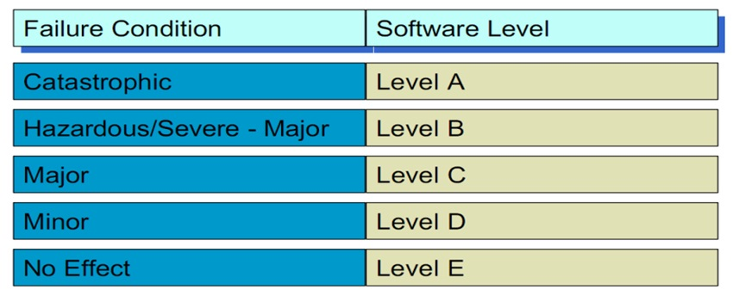
Criticality of Software
Different failure conditions require different software conditions → 5 levels

Slide 60
Modified Condition/Decision Coverage (MC/DC)
Main Objective: To effectively test important combinations of conditions, without exponential blowup in test suite size
“Important” combinations means: Each basic condition shown to independently affect the outcome of each decision
Notes:
If we don’t want to test all possible combinations, then we have to say which combinations are important.
One good choice is to choose combinations that show how each basic condition can affect the outcome,
i.e., how changing that one condition can change the value of the whole compound condition. That’s
what the “modified condition/decision” criterion requires.

Slide 61
Modified Condition/Decision Coverage (MC/DC) cont …
Requires:
For each basic condition C, two test cases,
values of all evaluated conditions except C are the same
compound condition as a whole evaluates to true for one and false for the other
Notes:
If we don’t want to test all possible combinations, then we have to say which combinations are important.
One good choice is to choose combinations that show how each basic condition can affect the outcome,
i.e., how changing that one condition can change the value of the whole compound condition. That’s
what the “modified condition/decision” criterion requires.

Slide 62
What is MC/DC?
MC/DC stands for Modified Condition/Decision Coverage
Some kind of Predicate Coverage technique MC/DC was designed for languages containing logical operators that do not short-circuit.
Some terms:
Condition: Leaf level Boolean expression.
Decision: Controls the program flow.
Main idea: Each condition must be shown to independently affect the outcome of a decision, i.e. the outcome of a decision changes as a result of changing a single condition.

Slide 63
What is MC/DC? cont …
Modified Condition/Decision Coverage
Source code metric for measuring the quality of a test suite
Condition Coverage
+
Decision
Coverage
+
Each condition must independently affect the outcome of a decision

Slide 64
MC/DC Requirements
The RTCA standard of DO-178B stands for Radio Technical Commission for Aeronautics. It is mandatory to achieve MC/DC for Level A certificate of safety critical application. MC/DC necessitates satisfaction of the following:
Every statement in the program has been invoked at least once.
Every point of entry and exit in the program has been invoked at least once.

Slide 65
MC/DC Requirements cont …
Every control statement (i.e., branch point) in the program has taken all possible outcomes (i.e., branches) at least once.
Every non-constant Boolean expression in the program has evaluated to both a true and a false result.
Every non-constant condition in a Boolean expression in the program has evaluated to both a true and a false result.
Every non-constant condition in a Boolean expression in the program has been shown to independently affect that expression’s outcome.

Slide 66
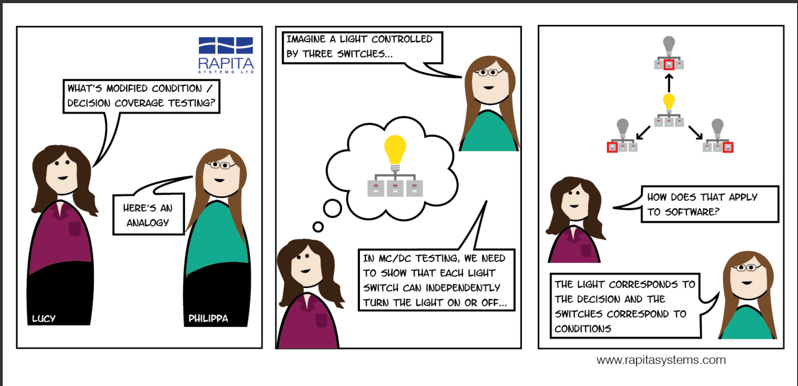
MC/DC Requirements
The RTCA standard of DO-178B stands for Radio Technical Commission for Aeronautics. It is mandatory to achieve MC/DC for Level A certificate of safety critical application. MC/DC necessitates satisfaction of the following::
Every statement in the program has been invoked at least once.
Every point of entry and exit in the program has been invoked at least once.
Every control statement (i.e., branch point) in the program has taken all possible outcomes (i.e., branches) at least once.
Every non-constant Boolean expression in the program has evaluated to both a true and a false result.
Every non-constant condition in a Boolean expression in the program has evaluated to both a true and a false result.
Every non-constant condition in a Boolean expression in the program has been shown to independently affect that expression’s outcome.
66

Slide 67
MC/DC Coverage
According to multiple condition coverage, every condition in the decision has taken all possible outcomes at least once.
if ( (a) & (b) | (c) ) then…
true
false
true
false
true
false

Slide 68
MC/DC Coverage cont …
According to MC/DC, every condition in the decision independently affects the decision’s outcome.
if ( (a) & (b) | (c) ) then…
true
false
true
false
Change the value of each condition individually while keeping all other conditions constant.

Slide 69
MC/DC vs condition/decision coverage
The MC/DC criterion enhances the condition/decision coverage criterion by requiring that each condition be shown to independently affect the outcome of the decision.
The independence requirement ensures that the effect of each condition is tested relative to the other conditions. However, achieving MC/DC requires more thoughtful selection of the test cases. In general, a minimum of n+ 1 test cases for a decision with n inputs.
For the example (A or B), test cases (TF), (FT), and (FF) provide MC/DC.

Slide 70
Examples
To test if (A or B)
A: T F F
B: F T F
To test if (A and B)
A: F T T
B: T F T
To test if (A xor B)
A: T T F
B: T F T

Slide 71
MC/DC: Linear Complexity
N+1 test cases for N basic conditions
(((a || b) && c) || d) && e
Test a b c d e outcome
Case
(1) true -- true -- true true
(2) false true true -- true true
(3) true -- false true true true
(6) true -- true -- false false
(11) true -- false false -- false
(13) false false -- false -- false
Underlined values independently affect the output of the decision
Required by the RTCA/DO-178B standard
Notes:
This is the same table as two slides ago, omitting redundant cases.
Cases 4,5, 7-10, and 12 have been omitted.
In each column we find two rows in which that column is underlined. For example, the “a” column
is underlined in rows (1) and (13). All the evaluated conditions in those two rows are the same
except for that column. For example, to show that changing “a” from true to false in case (1) would
change the outcome, we
* Fill in the “don’t care” columns in row 1 with values from row 13 (because this doesn’t change
anything
* Then see that the rows are completely identical except in column “a” and the outcome
so clearly changing the value of “a” changed the outcome.
The number of test cases needed is hardly more than for basic condition coverage, but MC/DC is
much better than basic condition coverage at exposing faults in conditional expressions, so it is
clearly superior (and therefore very widely used, and specified in some standards).

Slide 72
Comments on MC/DC
MC/DC is
basic condition coverage (C)
branch coverage (DC)
plus one additional condition (M): every condition must independently affect the decision’s output
Notes:
(This mainly restates comments on the previous slide, and can be used
or skipped depending on lecture style)

Slide 73
Comments on MC/DC cont …
It is subsumed by compound conditions and subsumes all other criteria discussed so far
stronger than statement and branch coverage
A good balance of thoroughness and test size (and therefore widely used).
Notes:
(This mainly restates comments on the previous slide, and can be used
or skipped depending on lecture style)

Slide 74
Example
If (A && B) then…
(1) create truth table for conditions.
(2) Extend truth table so that it indicated which test cases can be used to show the independence of each condition.
A B | Result
T T | T
T F | F
F T | F
F F | F
Number | A B | Result | A | B
1 | T T | T | 3 | 2
2 | T F | F |  | 1
3 | F T | F | 1
4 | F F | F
Notes:
(T,T) test is required as it is the only one that returns true
(F,T) test is required as it is the only test that changes the value of only A and also changes the decision's outcome, thereby establishing the independence of A In similar fashion
(T,T) and (T,F) tests are required to show the independence of B.
Test set {(T,T), (T,F), (F,T)} satisfies MC/DC for the expression A and B.

Slide 75
Example cont …
Show independence of A:
Take 1 + 3
Show independence of B:
Take 1 + 2
Resulting test cases are
1 + 2 + 3
(T , T) + (T , F) + (F , T)
Number | A B | Result | A | B
1 | T T | T | 3 | 2
2 | T F | F |  | 1
3 | F T | F | 1
4 | F F | F

Slide 76
More advanced example
If (A && (B || C)) then…
Number | A B C | Result | A | B | C
1 | T T T | T | 5
2 | T T F | T | 6 | 4
3 | T F T | T | 7 |  | 4
4 | T F F | F |  | 2 | 3
5 | F T T | F | 1
6 | F T F | F | 2
7 | F F T | F | 3
8 | F F F | F
Note: We want to determine the MINIMAL set of test cases
Here:
{2,3,4,6}
{2,3,4,7}
Non-minimal set is:
{1,2,3,4,5}

Slide 77
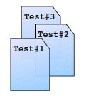
Another MC/DC Example
Implementation
Test Suite
int myFunc (bool c1, bool c2, bool c3)
{
bool d1 = c1 or c2;
bool d2 = d1 and c3;
if (d2)
return 1;
else
return 1;
}

Slide 78
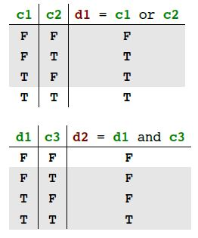
Another MC/DC Example cont …
int myFunc (bool c1, bool c2, bool c3)
{
bool d1 = c1 or c2;
bool d2 = d1 and c3;
if (d2)
return 1;
else
return 1;
}

Slide 79
Another MC/DC Example cont …
Test Suite
Subset of all possible input tuples which satisfies MC/DC criteria
For example :
TS1 = (2, 3, 4) = (FT), (TF), (TT)
{FFT , TFF, FTF,, TTT} // (c1 c2 c3)
No | d1 c3 | d2 | d1 | c3
1 | F F | F
2 | F T | F | 4
3 | T F | F |  | 4
4 | T T | T | 2 | 3

Slide 80
Problems with MC/DC
int myFunc (bool c1, bool c2, bool c3)
{
bool d2 = (c1 or c2) and c3;
if (d)
return 1;
else
return -1;
}
NO | c1 c2 c3 | d2 | c1 | c2 | c3
1 | F F F | F
2 | F F T | F | 6 | 4
3 | F T F | F |  |  | 4
4 | F T T | T |  | 2 | 3
5 | T F F | F |  |  | 6
6 | T F T | T | 2 |  | 5
7 | T T F | F |  |  | 8
8 | T T T | T |  |  | 7

Slide 81
Problems with MC/DC cont …
Test Suite
TS2 = (2,4,5,6) = {FFT , FTT,TFF,TFT}
TS3 = (2,3,4,6) = {FFT , FTF,FTT,TFT}
Problem: MC/DC coverage can be affected by program structure.

Slide 82
Where does it fit in?
The MC/DC criterion is much stronger than the condition/decision coverage criterion, but the number of test cases to achieve the MC/DC criterions still varies linearly with the number of conditions n in the decisions.
Much more complete coverage than condition/decision coverage, but
at the same time it is not terribly costly in terms of number of test cases.
Multiple-condition
all paths
Modified condition/decision
all-du-paths
Condition/Decision
all uses
Decision
reach
Statement
Condition

Slide 83
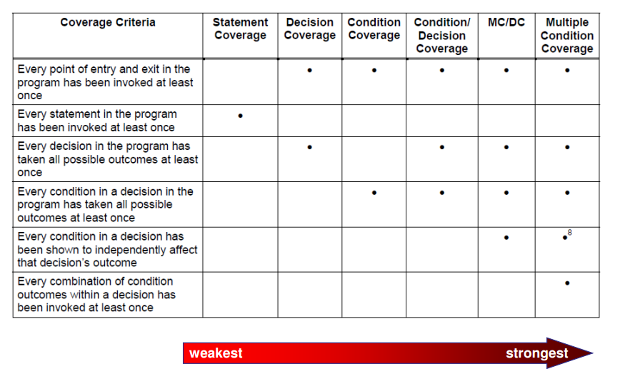
Comparison of different coverage based Testing Strategies

Slide 84
Comparison
Relative strengths when a stronger measure includes a weaker measure.
Decision coverage includes statement coverage since exercising every branch must lead to exercising every statement.
Condition/decision coverage includes decision coverage and condition coverage (by definition).

Slide 85
Comparison contd ….
Path coverage includes decision coverage.
Predicate coverage (paths as possible combinations of logical conditions) includes path coverage and multiple condition coverage, as well as most other measures.

Slide 86
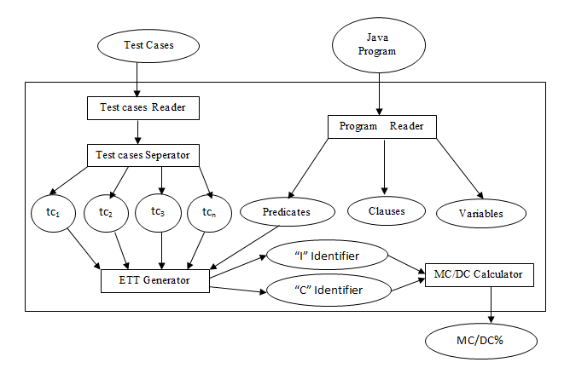
COPECA: Architecture of our Proposed Tool to measure MC/DC%

Slide 87
Results on COPECA
Table 1: Characteristics of input Programs
Sl. No. | Program Name | LOCs | Conditions | Predicates
1 | BSTree | 307 | 13 | 6
2 | BubbleSort | 142 | 14 | 7
3 | AssertTest1 | 75 | 7 | 3
4 | CAssume1 | 63 | 7 | 3
5 | Demo1 | 76 | 8 | 3
6 | Dsort_BST | 305 | 7 | 3
7 | FruitBasket | 209 | 38 | 12
8 | Comparison1 | 128 | 43 | 17
9 | Condition | 60 | 9 | 4
10 | Dsort1 | 136 | 20 | 10

Slide 88
Results on COPECA cont …
Table 2: MC/DC score for different input programs
Sl. No. | Program Name | Independently affected Conditions (I) | Simple Conditions (C) | MC/DC%
1 | BSTree | 2 | 13 | 15.3
2 | BubbleSort | 5 | 14 | 35.7
3 | AssertTest1 | 7 | 7 | 100
4 | CAssume1 | 5 | 7 | 71.4
5 | Demo1 | 2 | 8 | 25
6 | Dsort_BST | 3 | 7 | 42.8
7 | FruitBasket | 6 | 38 | 15.7
8 | Comparison1 | 40 | 43 | 93
9 | Condition | 6 | 9 | 66.6
10 | Dsort1 | 5 | 20 | 25

Slide 89
Misunderstanding the MC/DC Objective
Some misunderstandings of MC/DC testing are:
Not understanding the intent of structural coverage
Trying to meet the MC/DC objective apart from requirements-based testing; that is, using the source code to derive inputs for all test cases
Trying to achieve MC/DC before having a stable implementation

Slide 90
Misunderstanding the MC/DC Objective cont …
Using MC/DC as a testing method; that is, expecting MC/DC to find errors instead of assuring that requirements-based testing is adequate
Relying on MC/DC to find problems that should have been addressed earlier in the software life cycle (such as complex or erroneous logic)

Slide 91
Conclusion
Basics of MC/DC testing.
It is stronger than statement coverage & branch coverage and weaker than Multiple Condition Coverage (MCC).
It is good balance of thoroughness and test suite size. Hence, it is widely used in industries.
It is highly insensitive to structure of implementation.

Slide 92
Future Directions
MC/DC test cases minimization and prioritization.
Can be implemented in HPC (High Performance Computing) environment to achieve higher code coverage.
Can be implemented using Clouds.
Can combine coverage based and fault based testing criteria, by measuring mutation score for MC/DC testing.

Slide 93
Future Directions cont …
Now-a-days testing starts during the design phase. So, MC/DC test cases can be generated during the design phase by using UML diagrams, such as activity and communication diagrams containing predicates and conditions.
We can apply some heuristic search techniques such as GA and PSO to improve code coverage. We can apply some machine-learning techniques to predict the code coverage and software reliability

Slide 94
Some Recent Publications by our group in this research domain
Sl. No | Publications | Journal/Conference | Year
1. | Automated M/DC Test Data Generation | ACTA Press Software Engineering | 2016
2. | An improved distributed Concolic testing approach | Software: Practice and Experience | 2017
3. | GECOJAP: A Modern Technique to Gear Coverage Criteria | Computer Standards & Interfaces, Elsevier | 2017
4. | J3 Model: A novel framework for Improved Modified Condition/Decision Coverage Analysis | Computer Standards & Interfaces, Elsevier | 2016
5. | Making a Concolic tester achieve increased MC/DC | Innovations in System and Software Engineering, Springer | 2016
 | An Automated Analysis of the Branch Coverage and Energy Consumption Using Concolic Testing | Arabian Journal for Science and Engineering | 2016
6. | Java-HCT: An approach to increase MC/DC using Hybrid Concolic Testing for Java programs. | 36th IEEE Software Engineering Workshop | 2016
7. | Measuring MC/DC at Design Phase Using UML Sequence Diagram and Concolic Testing | INDICON | 2016

Slide 95
References
[1] Hayhurst, Kelly J., Dan S. Veerhusen, John J. Chilenski, Leanna K. Rierson, May 2001, A Practical Tutorial on Modified Condition/Decision Coverage, NASA/TM-2001-210876.
[2] P. Ammann, J. Offutt, and H. Huang. Coverage criteria for logical expression. In Proc. ISSRE, pages 99-107, 2003.
[3] K. Sen, D. Marinov, and G. Agha. CUTE: A concolic unit testing engine for C. In Proc. ESEC/FSE, pages 263–272, 2005.
[4] Z. Awedikian, K. Ayari, and G. Antoniol. MC/DC automatic test input data generation. In Proc. GECCO, pages 1657–1664, 2009
[5] Allan L. White. Programming Boolean Expressions for Testability. In Proc. IEEE Aerospace, 2004
[6] James A. Jones and Mary Jean Harrold. Test-suite Reduction and Prioritization for Modified Condition/Decision Coverage. In Proc. IEEE Software Maintenance, 2001

Slide 96
References contd ….
[7] D. Richard Kuhn. Fault classes and error detection capability of specification based testing. ACM Transactions on Software Engineering Methodology, 8(4):411-424, October 1999.
[8] Rahul Pandita, Tao Xie, N.Tillmann, and Jonathan de Halleux. Guided Test Generation for Coverage Criteria. In Proc. ICSM, pages 1-10, 2010.
[9] P. Godefroid, N. Klarlund, and K. Sen. DART: Directed automated random testing. In Proc. PLDI, pages 75-84, 2005.
[10] J. Burnim and K.Sen. Heuristics for scalable dynamic test generation. In Proc. ASE, pages 443-446, 2008.
[11] J. Chilenski and S. Miller. Applicability of Modified Condition/Decision Coverage to Software Testing. Software Engineering Journal, September, 1994, pp. 193-200
[12] R. Majumder and K. Sen. Hybrid Concolic Testing. In Proc. Of 29th ICSE, Washington, 416-426, 2007

Slide 97


Slide 98


Slide 99
Contacts:
1. Dr. Durga Prasad Mohapatra
Email: durga@nitrkl.ac.in
2. Dr. Sangharatna Godboley
Email: sanghu1790@gmail.com, sanghara@comp.nus.edu.sg

