Slide 1


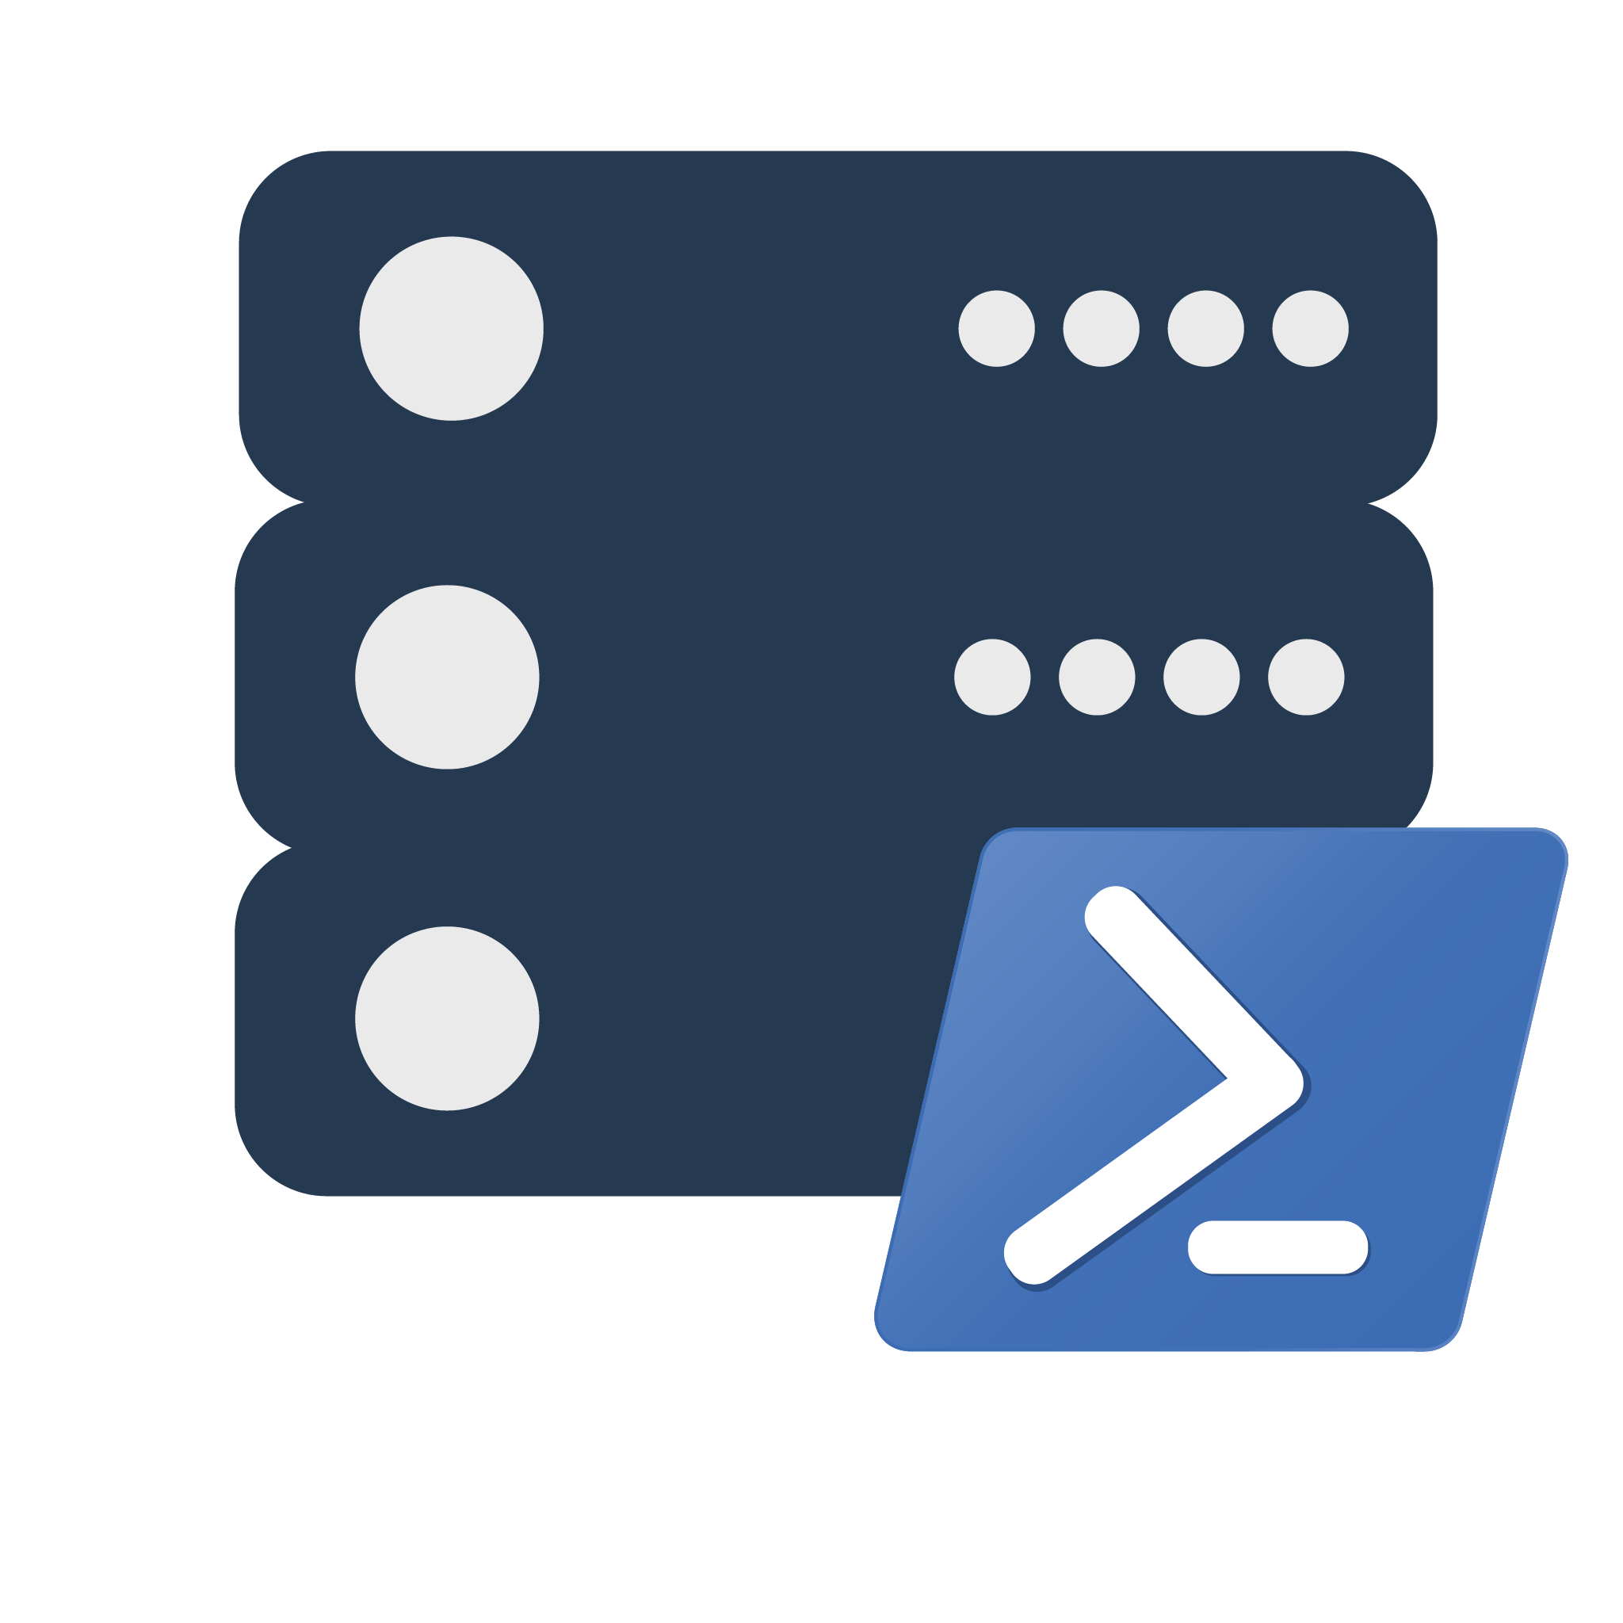







#datasatpn
Data Saturday #1
Life Hacks: dbatools Edition
Jess Pomfret (She/Her)

Slide 2
Life Hacks: dbatools Edition

Slide 3




Jess Pomfret
(She\Her)
@jpomfret
linkedin.com/in/jpomfret/

Slide 4

Jess Pomfret (She/Her)
Database Engineer
Open Source Contributor
dbatools, dbachecks, SqlServerDsc
Passionate about Automation, Proper Football & Fitness
jpomfret7@gmail.com
@jpomfret

Slide 5
Agenda
What is dbatools?
PowerShell 101
Life Hacks
Test Your Backups
Manage Logins & Access
Mask Sensitive Data
Migrate… Everything
Meet Best Practices
Documentation for everyone
Notes:
Backups are useless if they can’t be restored
https://dbatools.io/dedicated-server/

Slide 6

What is dbatools?
Open Source PowerShell Module
Command line SSMS
Great for handling multiples
MIT Licensed
“A short and simple permissive license”
Secure!
PowerShell - “Secure by Design”
Code Signed
Pester tests
Branch policies
Notes:
PowerShell Module – Command line SSMS
- makes it easier to manage multiples… multiple servers, databases, jobs, logins, etc.
Support all the ways to login to SQL Server that SSMS does (including Multi Factor Authentication)
Support SQL Server 2000 and PowerShell 3 wherever possible – goal is still to make migrations easy
Support for Azure (can migrate to Azure Managed Instances)
75% of commands run on Mac OS and Linux
MIT license - https://dbatools.io/mit/ - only requirement is to maintain copywrite and license notices.
OK for private use or commercial use, modification, distribution
Talking to your company about dbatools - https://dbatools.io/secure/
PowerShell team works hard at “Secure by Design” approach
Code signed – verifies the code you receive hasn’t been modified by a third party. Chrissy & Rob are the only people who can sign dbatools releases
Enterprise ready
Pester tests
Restricted merging to master branch
PowerShell gallery runs a virus scan against the module
DevOps Collective & PowerShell.Org announced last night that dbatools would be the 2020 recipient for the Git-Grant program.

Slide 7
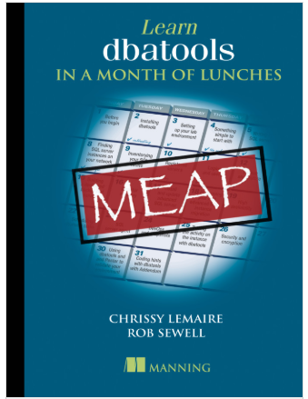
dbatools: a short history
Created by Chrissy LeMaire to migrate SharePoint instances
September 2015 – First commit to GitHub
June 2019 – 1.0 launch at DataGrillen
594 Functions (as of 26/2/2021) – v1.0.139
590 Pester tests
Learn dbatools in a Month of Lunches
Notes:
2014 – Chrissy had to do a SharePoint migration – lot of databases/logins/jobs/etc.
1.0 - Over 160 contributors and 550 commands
Standardize naming
Standardize parameters
https://dbatools.io/meap/ (12/27 chapters available)
Early days – Chrissy would troll reddit, looking for common problems, automating them and then adding them to dbatools

Slide 8
Demo Time
Demo Files available here:
https://github.com/jpomfret/demos/tree/master/LifeHacks_dbatools
Notes:
Enable Exception
Backup-DbaDatabase – default is a full backup (not copy only)
DATA_PURITY - Causes DBCC CHECKDB to check the database for column values that are not valid or out-of-range.
For example, columns with date and time values that are larger than or less than the acceptable range for the datetime data type;

Slide 9
Resources
dbatools Blog
https://dbatools.io/meap/
https://dbatools.io/secure/
Docs
https://docs.dbatools.io/
https://dbatools.io/build
Other
https://dbatools.io/github
https://dbatools.io/slack/
http://dbatools.io/twitter - @psdbatools

Slide 10
Questions?
Jess Pomfret
jpomfret7@gmail.com
@jpomfret
www.JessPomfret.com
https://github.com/jpomfret/demos/
Please fill out the feedback form, help me get better.
Jess Pomfret
jpomfret7@gmail.com
@jpomfret
www.JessPomfret.com
https://github.com/jpomfret/demos/
Please fill out the feedback form, help me get better.
Notes:
14:30 – 15:30

Slide 11

#datasatpn
Questions?
Jess Pomfret
jpomfret7@gmail.com
@jpomfret
www.JessPomfret.com
https://github.com/jpomfret/demos/

