Slide 1

Get your SQL Server estate back in shape
Notes:
Created my free logo at LogoMakr.com

Slide 2


Jess Pomfret (She/Her)
Database Engineer
Open-Source Contributor
dbatools, dbachecks, SqlServerDsc
Passionate about Automation, Proper Football & Fitness
jpomfret7@gmail.com
@jpomfret

Slide 3
Database Estate
Server Name | Instance Name | SQL Version | Databases
mssql1 | MSSQLSERVER | SQL Server 2017 - 14.0.3294 | AdventureWorks2017 DatabaseAdmin ImportantAppDb ImportantAppDb2
mssql2 | MSSQLSERVER | SQL Server 2017 - 14.0.3294 | DatabaseAdmin
mssql3 | MSSQLSERVER | SQL Server 2017 - 14.0.3294 | ImportantAppDW DatabaseAdmin
Notes:
So let’s get right into it.
Imagine we’ve been gifted this database estate.
Perhaps we’re walking into a new job, or someone discovered some new servers under a desk or in a closet somewhere – and we’re presented with this.
How do we know if it’s in a good shape?

Slide 4


Are they Fit?
Photo by Quino Al on Unsplash
Photo by Alora Griffiths on Unsplash
Notes:
Both people are fit – but in specific disciplines
We need a way of testing fitness across the board – through multiple disciplines

Slide 5
Physical Fitness Test
What’s a Fitness Test?
Category | Test
Strength | 1 Rep Max Bench Press
Endurance | 10k Run
Flexibility | Sit & Reach Test
Explosive Power | Vertical Jump Test
Notes:
To test fitness you need to test across different domains
We can use a fitness test to create a fitness score – which can be a great way to measure progress

Slide 6
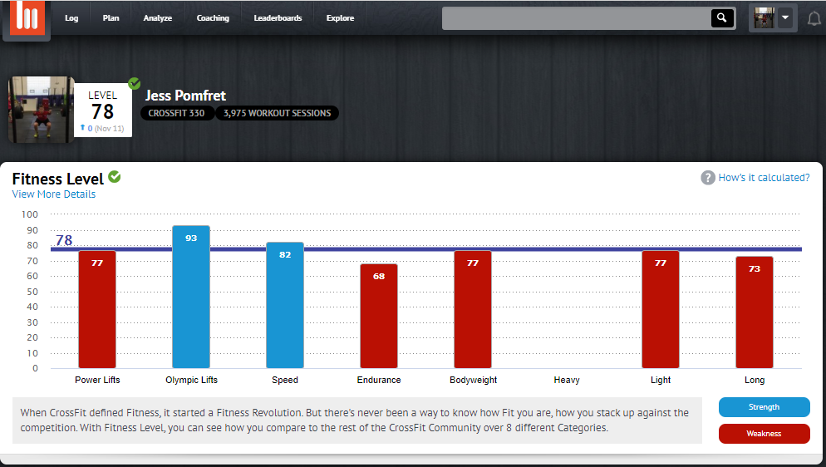
Notes:
So what if we could do something similar for our SQL Servers
Once we have this score – we can work on weaknesses and improve things that’ll bring our overall fitness scores up

Slide 7
SQL Server Fitness Test
What is an ‘In Shape’ SQL Server Estate?
Category | Test
Security | Sa Disabled, Guest access
Performance | Autoshrink, Autoclose, VLF count
Maintenance | Backups, DBCC CHECKDB
Business Specific | ?
Notes:
First we need to decide what fitness for a SQL Server looks like
We’ll start with three aspects of SQL Server fitness
We can always add more on categories and tests
Business specific
rows need to get to down stream system in X mins
Should be less than X rows in staging table

Slide 8
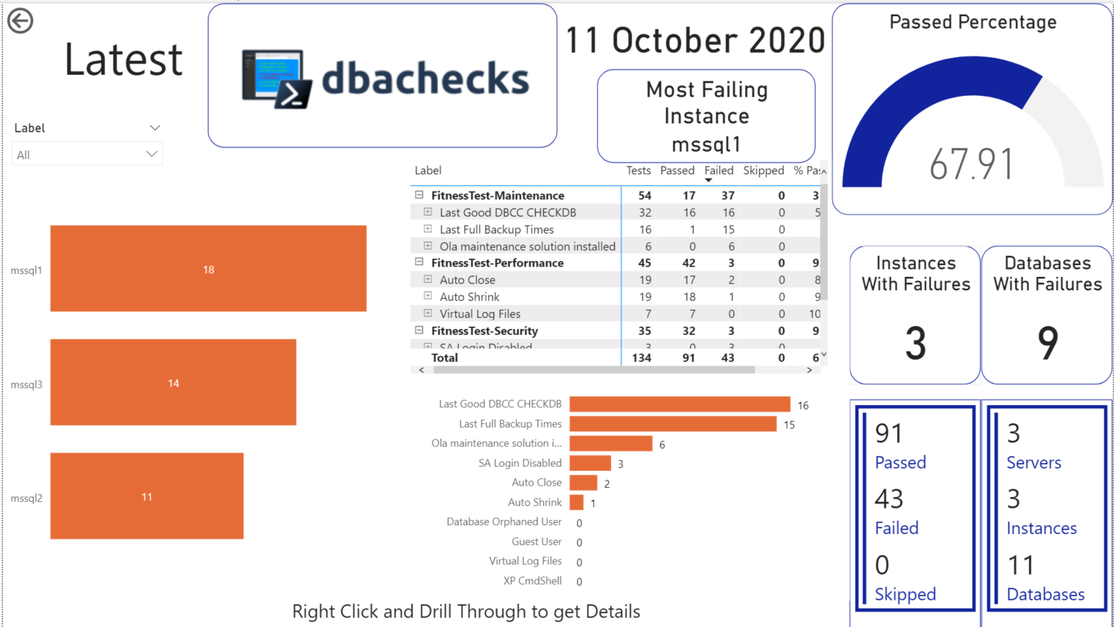
Notes:
CHANGE THIS PICTURE

Slide 9


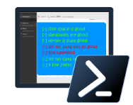
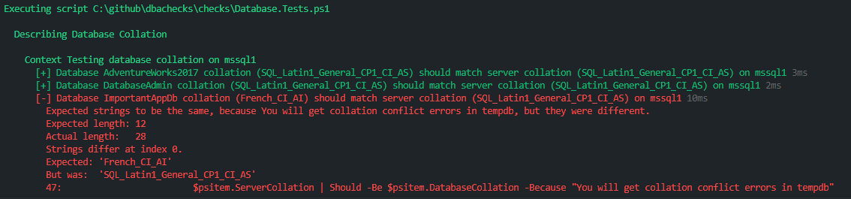
dbachecks
Combination of dbatools & Pester
Notes:
dbatools
Open-source PowerShell module for making Database Admin tasks easier
Command line SSMS
Powerful for handling multiples
Pester
Testing framework
Written in a Domain Specific Language (DSL) – like PowerShell but has it’s own terminology and patterns
Main use is Unit and Integration Testing – but can test anything
dbachecks
Also an open source PowerShell module from SqlCollaborative
Pester test your database infrastructure

Slide 10
Demo: SQL Server Fitness Test
Explore dbachecks
Run our baseline fitness test
Notes:
We’ll start with three aspects of SQL Server fitness
We can always add more on

Slide 11
SQL Server Training Plan
How we get from ‘here’ to ‘there’
Gaining Approval
Organising Downtime
Writing Scripts
Notes:
Couch to 5k
Marathon Training
If you’re ‘there’ is running a marathon – you need some kind of plan to get from being able to run 1 mile today, to 26.2 miles in 6 months time

Slide 12
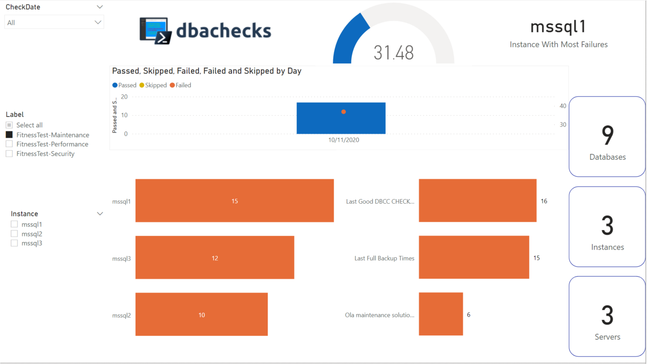
Training Plan: Maintenance
Top Issues:
Ola Not Installed
No recent Backups or CheckDb
Scope:
mssql1
mssql2
mssql3
Next Step:
Install & Configure Ola
Notes:
Identify the issues we want to resolve in this plan/sprint if you’re doing agile or something similar
Identify the scope – we can’t necessarily fix everything in one go – coordinating downtime for 300 sql instances at once sounds like a bad nightmare
Perhaps we split it into nonproduction and then production
Or split by application support tea,
Clearly define the plan
Install Ola – how will we do it?
How will we configure – when will full backups run, index maintenance, checkdb, etc

Slide 13

Demo: Fix Maintenance Issues with dbatools
Perfect for fixing issues with code
Perfect for handling multiples
Install Ola Maintenance Solution
Kick off SQL Agent Jobs
Notes:
Code Vs Gui
Documented
Repeatable
Source controlled
Multiples
Rolling out ola on 3 boxes at once

Slide 14
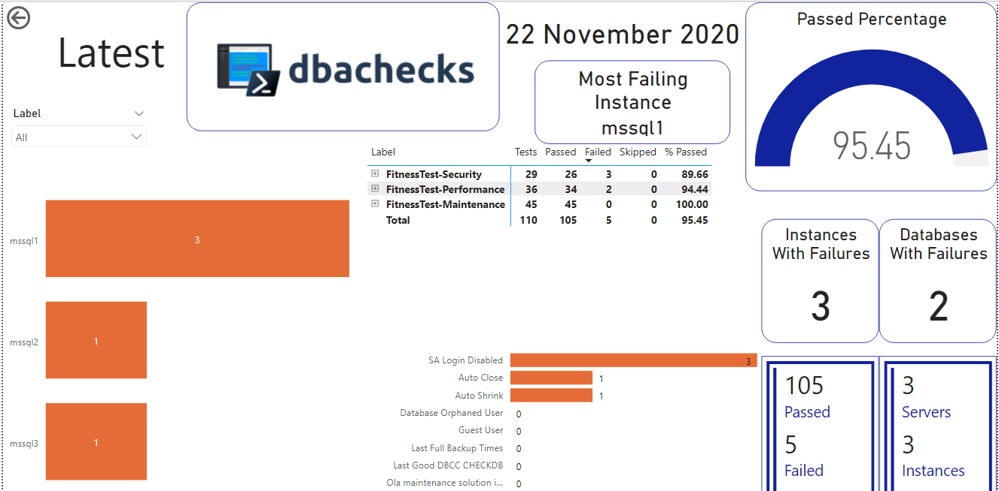

Slide 15
Summary
Decide on the metrics
dbachecks: run the test
dbatools: fix issues
Notes:
What do we care about?
What determines a healthy environment for us

Slide 16
Demo Time
Demo Files available here:
https://github.com/jpomfret/demos/tree/master/SqlEstateShape

Slide 17
Resources
Official Docs
https://dbachecks.readthedocs.io
https://github.com/sqlcollaborative/dbachecks
Blogs
https://sqldbawithabeard.com/tag/dbachecks/
https://claudioessilva.eu/tag/dbachecks
Contact
https://dbatools.io/slack/
http://dbatools.io/twitter - @psdbatools, @dbachecks

Slide 18
Questions?
Jess Pomfret
jpomfret7@gmail.com
@jpomfret
www.JessPomfret.com
https://github.com/jpomfret/demos/
Notes:
14:30 – 15:30

