Slide 1
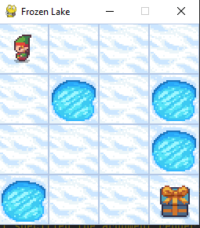
Path2
S0
S1
S2
S3
Path1
S4
S5
S6
S7
S8
S9
S10
S11
S12
S13
S14
S14

Slide 2
P=1/3
S0
P=1/3
S1
S2
S3
a=1
P=1/3
S4
S5
P=1/3
P=1/3
S7
S6
a=1
P=1/3
S8
S9
S10
S11
S12
S13
S14
S14

Slide 3
S0
S1
S2
S3
S4
S5
S6
S7
S8
S9
S10
S11
S12
S13
S14
S15

