Slide 1
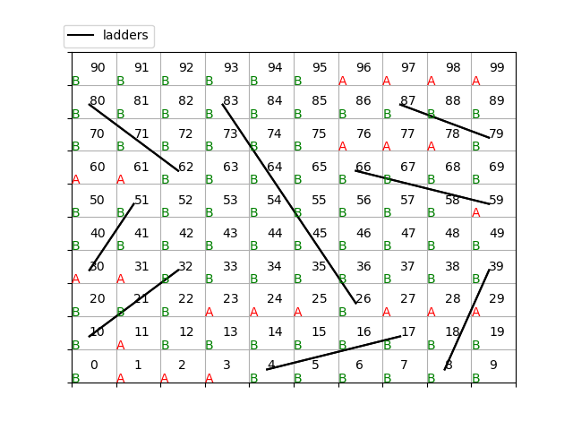
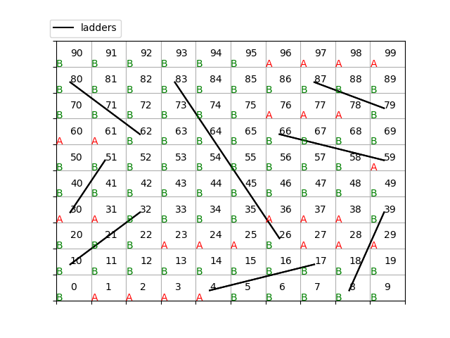
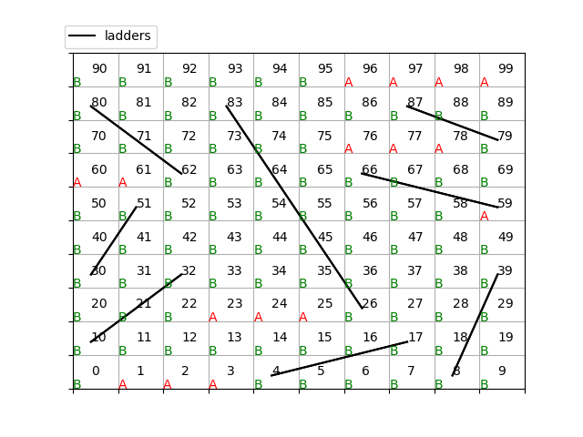
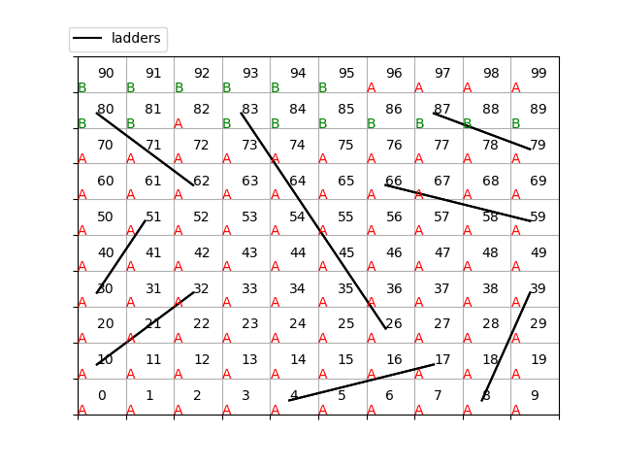
(a) max_iter=100
(b) max_iter=50
(c) max_iter=10
(d) max_iter=5
(e) max_iter=1

Slide 2
(a) max_iter=100
(b) max_iter=50
(c) max_iter=10
(d) max_iter=5
(e) max_iter=1

