Slide 1
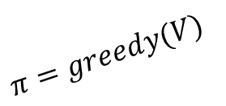







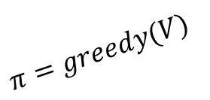

Policy Evaluation
Value Iteration
Policy Improvement
Policy Improvement
Start $V$
$$V=V_{π}$$
$$V=V_{π}$$
$$V^{∗}$$
$$V^{∗}$$
$$π^{∗}$$
$$π^{∗}$$
$$π=greedy(V)$$
$$π=greedy(V)$$
Start $π$
(a) Policy Iteration
(b) Value Iteration

Slide 2






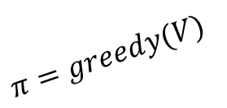
Value Iteration
Policy Evaluation
Start $V$
Policy Improvement
$$V^{′}$$
$$V=V_{π}$$
$$V^{∗}$$
$$π^{∗}$$
$$π^{′}$$
$$π=greedy(V)$$
General Iteration

