Slide 1
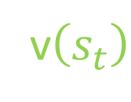
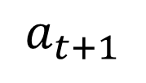






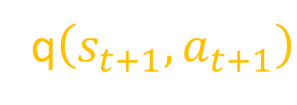


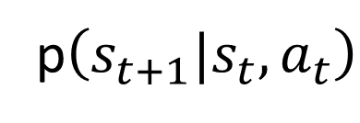

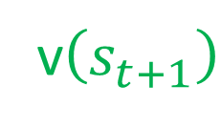
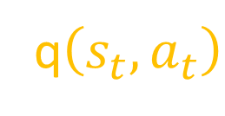
v$\left(s_{t}\right)$
q$\left(s_{t},a_{t}\right)$
v$\left(s_{t+1}\right)$
q$\left(s_{t+1},a_{t+1}\right)$
$$π\left(a_{t}|s_{t}\right)$$
p$\left(s_{t+1}|s_{t}, a_{t}\right)$
$$π\left(a_{t+1}|s_{t+1}\right)$$
$$s_{t}$$
$$a_{t}$$
$$s_{t+1 }$$
$$a_{t+1}$$
$$r_{t+1}$$
$$…$$
$$…$$
$$…$$
t policy
Env Transformation
t+1 policy

Slide 2




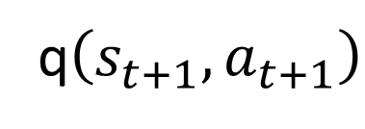

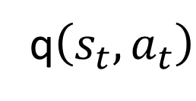

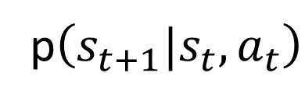


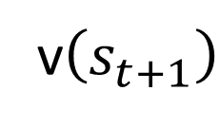

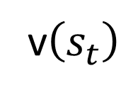
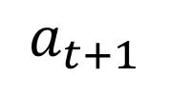
q$\left(s_{t+1},a_{t+1}\right)$
$$a_{t+1}$$
v$\left(s_{t+1}\right)$
$$π\left(a_{t+1}|s_{t+1}\right)$$
$$s_{t+1, }r_{t+1}$$
q$\left(s_{t},a_{t}\right)$
p$\left(s_{t+1}|s_{t}, a_{t}\right)$
$$a_{t+1}^{′}$$
$$a_{t}$$
$$π\left(a_{t}|s_{t}\right)$$
$${s_{t+1}^{′}}_{, }r_{t+1}^{′}$$
v$\left(s_{t}\right)$
$$s_{t}$$
$$a_{t}^{′}$$
…
$$a_{t}^{′′}$$
…

Slide 3





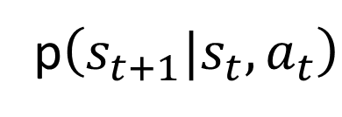

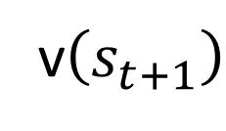

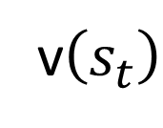
v$\left(s_{t+1}\right)$
$$s_{t+1, }r_{t+1}$$
p$\left(s_{t+1}|s_{t}, a_{t}\right)$
$$a_{t}$$
$$π\left(a_{t}|s_{t}\right)$$
$${s_{t+1}^{′}}_{, }r_{t+1}^{′}$$
v$\left(s_{t}\right)$
$$s_{t}$$
$$a_{t}^{′}$$
…
$$a_{t}^{′′}$$
…

