Slide 1
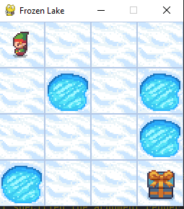
Start
Frozen
Hole
a=3
a=0
a=2
a=1
Goal

Slide 2
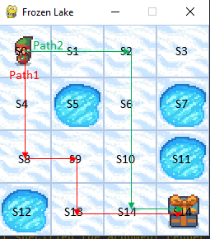
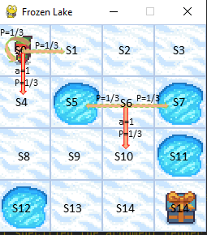
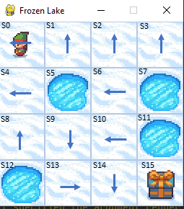
(a) 2 Paths
(b) Action and Slippery
(b) Optimized Policy

