Slide 1




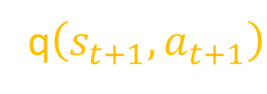



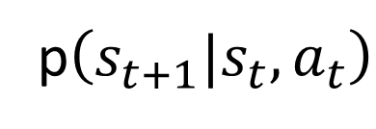

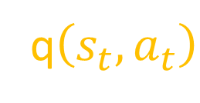
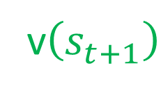

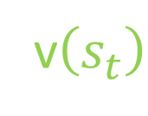
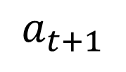
v$\left(s_{t}\right)$
q$\left(s_{t},a_{t}\right)$
v$\left(s_{t+1}\right)$
q$\left(s_{t+1},a_{t+1}\right)$
$$π\left(a_{t}|s_{t}\right)$$
p$\left(s_{t+1}|s_{t}, a_{t}\right)$
$$π\left(a_{t+1}|s_{t+1}\right)$$
$$s_{t}$$
$$a_{t}$$
$$s_{t+1 }$$
$$a_{t+1}$$
$$r_{t+1}$$
$$…$$
$$…$$
$$…$$
t policy
Env Transformation
t+1 policy
Notes:
Markov Decision Process

Slide 2

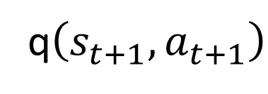


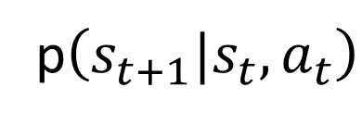
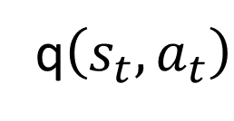


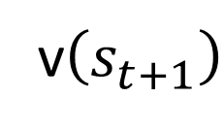

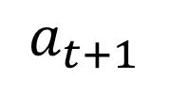
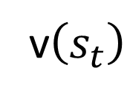



q$\left(s_{t+1},a_{t+1}\right)$
$$a_{t+1}$$
v$\left(s_{t+1}\right)$
$$π\left(a_{t+1}|s_{t+1}\right)$$
$$s_{t+1, }r_{t+1}$$
q$\left(s_{t},a_{t}\right)$
p$\left(s_{t+1}|s_{t}, a_{t}\right)$
$$a_{t+1}^{′}$$
$$a_{t}$$
$$π\left(a_{t}|s_{t}\right)$$
$${s_{t+1}^{′}}_{, }r_{t+1}^{′}$$
v$\left(s_{t}\right)$
$$s_{t}$$
$$a_{t}^{′}$$
…
$$a_{t}^{′′}$$
…
Notes:
Deprecated

Slide 3



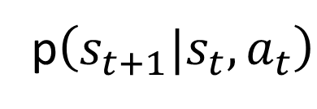

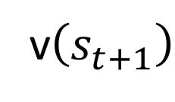

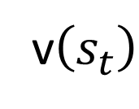


v$\left(s_{t+1}\right)$
$$s_{t+1, }r_{t+1}$$
p$\left(s_{t+1}|s_{t}, a_{t}\right)$
$$a_{t}$$
$$π\left(a_{t}|s_{t}\right)$$
$${s_{t+1}^{′}}_{, }r_{t+1}^{′}$$
v$\left(s_{t}\right)$
$$s_{t}$$
$$a_{t}^{′}$$
…
$$a_{t}^{′′}$$
…
Notes:
Deprecated

Slide 4




















$$q_{π}\left(s_{t},a_{t}\right)$$
$$π$$
$$π$$
$$s_{t}$$
$$a_{t}$$
$${\hat{q}}_{t}^{i}$$
$$s_{t+1}^{i}$$
$$a_{t+1}^{i}$$
$${\hat{q}}_{t+1}^{i}$$
$$r_{t+1}^{i}$$
$${\hat{q}}_{t}^{N−1}$$
$$π$$
$$s_{t+1}^{N−1}$$
$$a_{t+1}^{N−1}$$
$${\hat{q}}_{t+1}^{N−1}$$
$${\hat{q}}_{t}^{N}$$
$$r_{t+1}^{N−1}$$
$$π$$
$$s_{t+1}^{N}$$
$$a_{t+1}^{N}$$
$${\hat{q}}_{t+1}^{N}$$
$$r_{t+1}^{N}$$
t policy
Env Transformation
t+1 policy
Notes:
Monte Carlo

Slide 5















$$q\left(s_{t},a_{t}\right)$$
$$r_{t+1}^{N}$$
Monte
Carlo
$$π$$
$$π$$
$$s_{t}$$
$$a_{t}$$
$$s_{t+1}^{N}$$
$$a_{t+1}^{N}$$
$${\hat{q}}_{t+1}^{N}$$
$${\hat{q}}_{t}^{N}$$
$$q\left(s_{t},a_{t}\right)$$
$$r_{t+1}^{N}$$
$$q\left(s_{t+1},a_{t+1}\right)$$
Temporal
Difference
$$π$$
$$π$$
$$s_{t}$$
$$a_{t}$$
$$s_{t+1}^{N}$$
$$a_{t+1}^{N}$$
t policy
Env Transformation
t+1 policy
Notes:
Monte Carlo and TD

Slide 6

















$$q_{π}\left(s_{t},a_{t}\right)$$
$$r_{t+1}$$
$$s_{t}$$
$$π$$
$$π$$
$$a_{t}$$
$$s_{t+1 }$$
$$a_{t+1}$$
$$s_{t+M }$$
$${\hat{q}}_{t}^{i}$$
$$q_{π}\left(s_{t},a_{t}\right)$$
$$r_{t+1}$$
$$q_{π}\left(s_{t+1},a_{t+1}\right)$$
$$s_{t}$$
$$π$$
$$π$$
$$a_{t}$$
$$s_{t+1 }$$
$$a_{t+1}$$
Notes:
Deprecated

