Slide 1
Lightweight Neural S-Box Evaluation
BNNs for Fast S-Box Metric Estimation
Binyamin Alony & Tommy Levi
Bar-Ilan University — Sept 2025

Slide 2
Agenda
Motivation & Problem
Background: S-Boxes, Metrics, and BNNs
Proposed Approach & Dataset
Models, Training & Evaluation
Results & Analysis
Conclusions & Future Work
Notes:
Keep it tight: 10–12 minutes total. Focus on the acceleration angle and recall vs TN trade-offs.

Slide 3
Motivation
S-Boxes are the nonlinear core of block ciphers; stronger S-Boxes enable fewer rounds and lower cost for the same security.
Modern S-Box design is search-based over huge spaces; computing metrics (e.g., LP, nonlinearity, differential uniformity) is expensive.
Most candidates are weak, so exhaustive metric evaluation wastes time on poor options.
Idea: use a lightweight BNN to quickly predict S-Box quality, then compute exact metrics only for promising candidates.
Target behavior: high Recall for “good” S-Boxes (don’t miss them) and sufficient TN to prune many bad ones early
Goal: shrink the search space before exact computations, with a final verification step to preserve correctness.
Notes:
Set context: expensive metrics like LP/Nonlinearity; exhaustive evaluation costs dominate.

Slide 4
Why Binarized Neural Networks (BNNs)?
Binary neural networks use 1-bit weights and activations, making models extremely compact and reducing memory traffic by ~32× compared to FP32.
Computation reduces to simple XNOR and popcount operations that map efficiently to CPUs, FPGAs, and ASICs.
Small footprints keep models in cache, delivering high throughput and low latency; inference is fast and energy-efficient, ideal for embedded acceleration and large-scale screening.
Training remains practical with straight-through estimators, and the first/last layers can stay higher-precision to stabilize accuracy.
For our use case, BNNs provide a cheap, high-recall filter to prune large S-Box search spaces before exact metric evaluations.

Slide 5
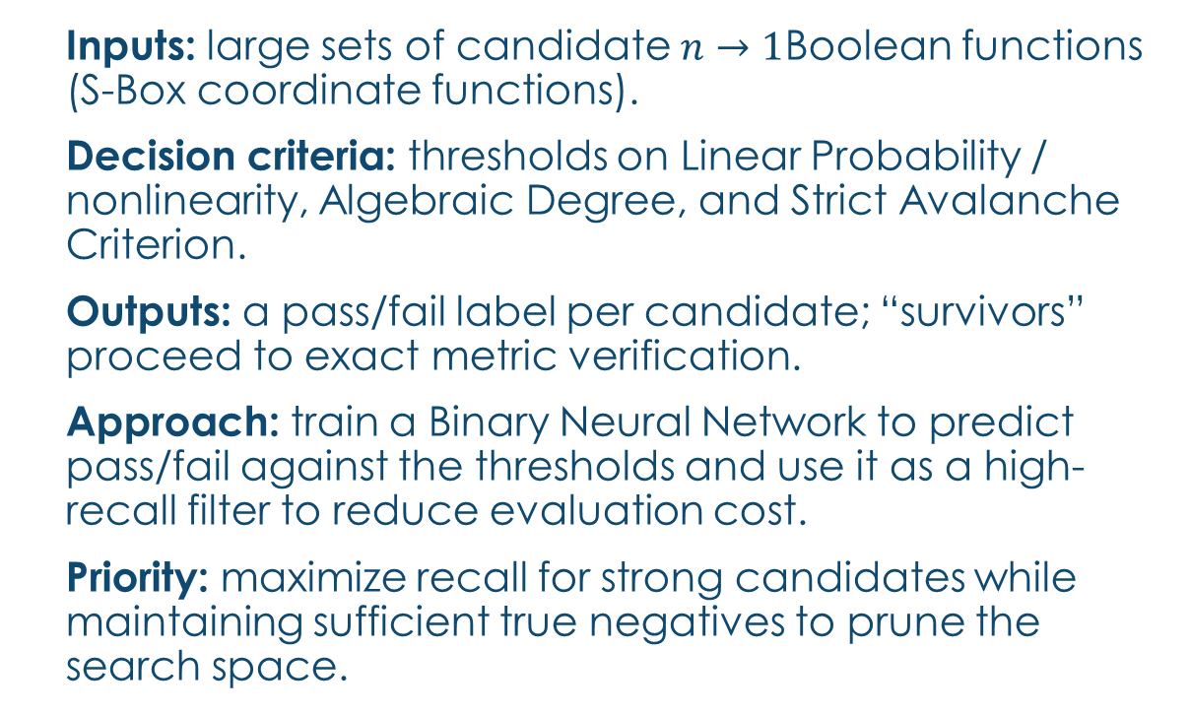
Problem Framing
Inputs: large sets of candidate $n→1$Boolean functions (S-Box coordinate functions).
Decision criteria: thresholds on Linear Probability / nonlinearity, Algebraic Degree, and Strict Avalanche Criterion.
Outputs: a pass/fail label per candidate; “survivors” proceed to exact metric verification.
Approach: train a Binary Neural Network to predict pass/fail against the thresholds and use it as a high-recall filter to reduce evaluation cost.
Priority: maximize recall for strong candidates while maintaining sufficient true negatives to prune the search space.
Notes:
Emphasize that we predict intervals/thresholds, not exact values.

Slide 6
Approach Overview
Inputs: coordinate boolean function outputs (n→1)
Labels: 9-bit vector encodes thresholds for LP and AD, plus SAC
Two encodings: threshold-cumulative vs interval-exclusive
Train BNNs to predict label bits; prioritize high Recall on 'good' classes

Slide 7
Background: SPNs & S-Boxes
SPN (Substitution–Permutation Network): repeated rounds of (1) parallel S-Boxes (nonlinear substitution), (2) a linear diffusion layer (permutation/mixing), and (3) round-key XOR.
Roles: S-Boxes provide confusion (nonlinearity); the linear layer spreads it across the state (diffusion).
S-Box: an n→m Boolean mapping; each output bit is a coordinate function (n→1). SPN strength depends heavily on these per-bit properties plus the diffusion layer.
In this work we focus only on three per-coordinate metrics: Linear Probability (LP) / nonlinearity, Algebraic Degree (AD), and the Strict Avalanche Criterion (SAC).
Objective context: decide if a coordinate meets LP/AD/SAC thresholds to support fast S-Box screening within SPN design.

Slide 8
Key Metrics (Quick View)
Linear Probability (LP) / Nonlinearity — LP measures the best linear approximation bias; lower LP (i.e., higher nonlinearity) reduces susceptibility to linear cryptanalysis.
Algebraic Degree (AD) — Degree of the Boolean ANF; higher degree generally hardens against higher-order differential and algebraic attacks but also increases implementation cost.
Strict Avalanche Criterion (SAC) — Flipping any single input bit should flip the output bit with probability ≈ 0.5; we track deviation from this ideal.
How we use them — Define per-metric thresholds and train a BNN to predict pass/fail; compute exact metrics only for predicted positives.

Slide 9
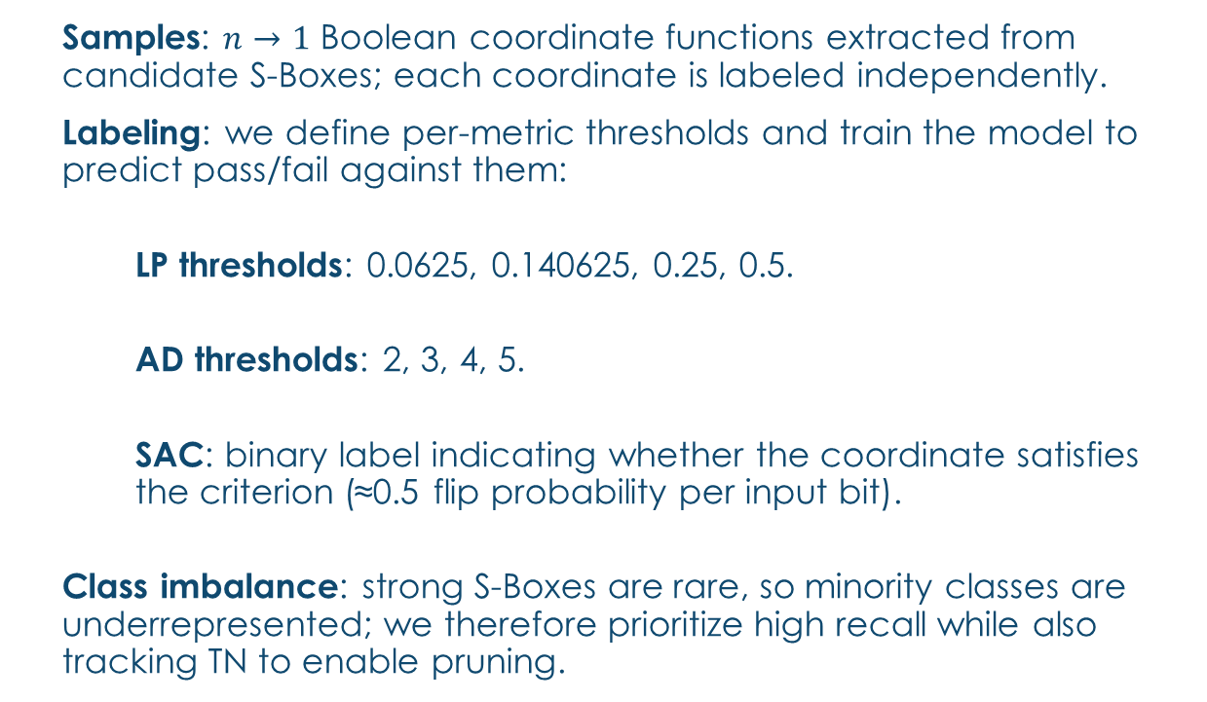
Dataset Design
Samples: $n→1$ Boolean coordinate functions extracted from candidate S-Boxes; each coordinate is labeled independently.
Labeling: we define per-metric thresholds and train the model to predict pass/fail against them:
LP thresholds: 0.0625, 0.140625, 0.25, 0.5.
AD thresholds: 2, 3, 4, 5.
SAC: binary label indicating whether the coordinate satisfies the criterion (≈0.5 flip probability per input bit).
Class imbalance: strong S-Boxes are rare, so minority classes are underrepresented; we therefore prioritize high recall while also tracking TN to enable pruning.
Notes:
We tested removal of rare bit(s) (e.g., AD≤2) and scaling up dataset to mitigate skew.

Slide 10
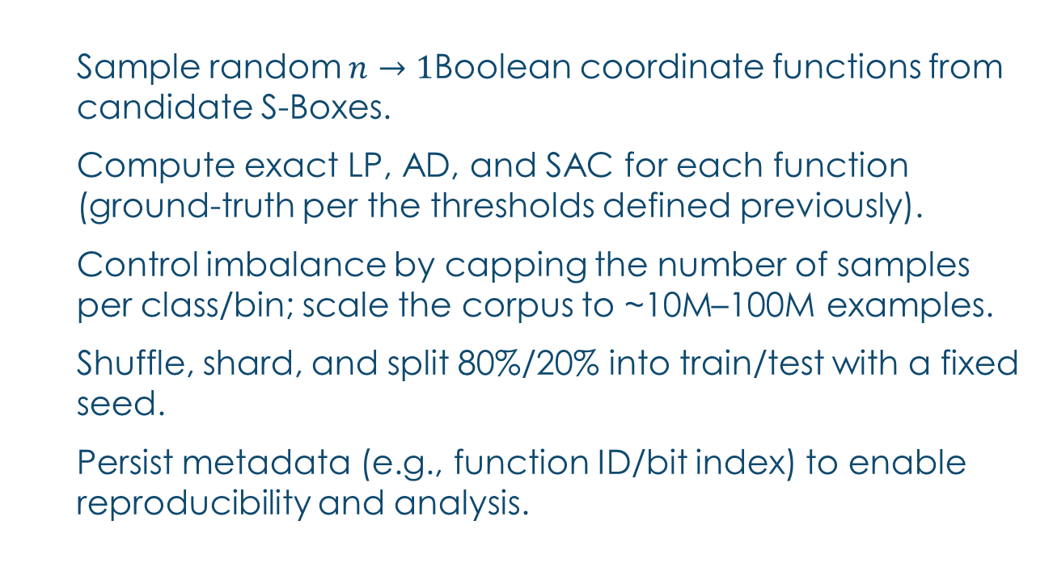
Dataset Generation (Sketch)
Sample random $n→1$Boolean coordinate functions from candidate S-Boxes.
Compute exact LP, AD, and SAC for each function (ground-truth per the thresholds defined previously).
Control imbalance by capping the number of samples per class/bin; scale the corpus to ~10M–100M examples.
Shuffle, shard, and split 80%/20% into train/test with a fixed seed.
Persist metadata (e.g., function ID/bit index) to enable reproducibility and analysis.
Notes:
See full pseudocode in paper; practical caps per label control extreme skew.

Slide 11
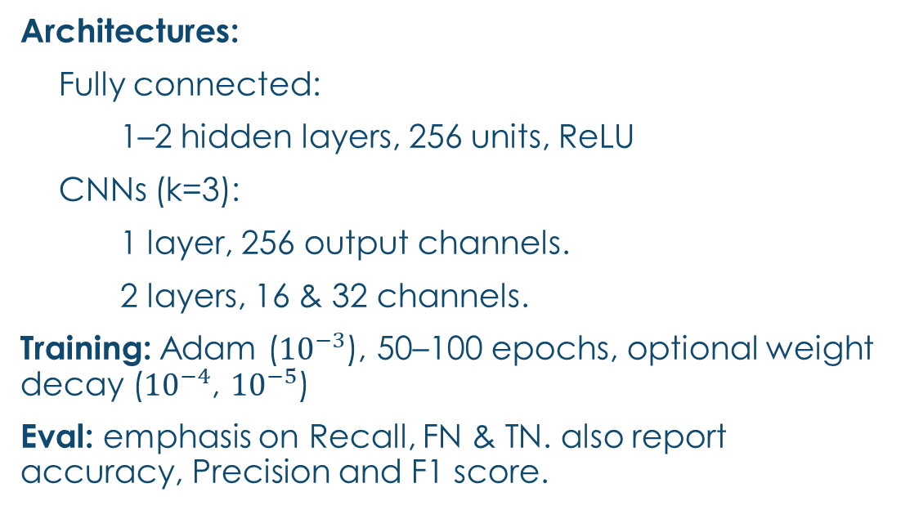
Models & Training
Architectures:
Fully connected:
1–2 hidden layers, 256 units, ReLU
CNNs (k=3):
1 layer, 256 output channels.
2 layers, 16 & 32 channels.
Training: Adam (${10}^{−3}$), 50–100 epochs, optional weight decay (${10}^{−4}$, ${10}^{−5}$)
Eval: emphasis on Recall, FN & TN. also report accuracy, Precision and F1 score.

Slide 12
Results — Highlights
Best performers (bit 0 = optimal LP):
(ii) 2-layer CNN: FN 0.48%, Recall 96.40% but TN only 8.76%
(iii) 2-layer CNN (w/o bits 4–7): FN 1.17%, Recall 91.43%, TN 38.40%
(i) 1-layer Linear (no WD): FN 1.89%, Recall 86.23%, TN 36.62%
Trade-off: CNNs recall more positives but prune fewer negatives → less speedup

Slide 13
Best Models (Bit 0 = Optimal LP)
Model | TN % | FN % | Recall %
(i) 1-layer Linear (no WD) | 36.62% | 1.89% | 86.23%
(ii) 2-layer CNN | 8.76% | 0.48% | 96.40%
(iii) 2-layer CNN (no bits 4–7) | 38.40% | 1.17% | 91.43%
Notes:
Low TN on (ii) means little pruning—hurts acceleration objective despite stellar recall.

Slide 14
Result analysis
Aggregate accuracy and loss are weak proxies for Bit-0 performance; use task-aligned objectives (e.g., Bit-0–focused or recall-weighted losses).
Removing label bits generally degraded performance, suggesting the model benefits from cross-metric correlations in the labels.
Convolutional models achieve stronger metrics but are slower and heavier, raising compute and hardware costs relative to linear baselines.
For acceleration, favor models/operating points that combine high Recall with sufficient true negatives to meaningfully prune the search space.

Slide 15
Conclusions & Takeaways
BNNs are effective high-recall prefilters for S-Box screening.
Acceleration hinges on TN: tune thresholds/loss to maximize “pruned-per-second,” then verify survivors with exact metrics.
A lightweight linear model with a task-aligned loss gives the best recall–TN trade-off per unit compute/memory.
CNNs capture more structure but add latency and hardware cost—use for offline triage or when compute budget allows.

Slide 16
Future Work
Design loss focused on Bit 0 Recall–TN Pareto
Multi-task heads for LP/AD/SAC with calibrated thresholds
Active learning / class-balanced sampling
Hardware evaluation: end-to-end time/energy vs exhaustive baselines

Slide 17
Acknowledgments
Advanced Computer Architectures — Bar-Ilan University
Thanks to Dr. L. Yavitz and Mr. Z. Jahshan
Notes:
Close with application potential and collaboration invites.

