Slide 1

Employee Attrition Analysis
Tommy Mai

Slide 2


Our Role and Client
DDSAnalytics: Talent Management Company
Client: Frito Lays Executives

Slide 3
Goal
Our goal is to explore the top 3 factors of employees that correlate with attrition.
Important to our client:
Cost Savings
Retention of Top Talent
Implement Preventative Strategies

Slide 4
Exploring the Data
The data file provides information on all employees.
Rows: 870
Columns: 36
Missing Data: 0
Important Qualities: Imbalanced data - 140 Employees Leaving vs. 730 Employees Staying

Slide 5
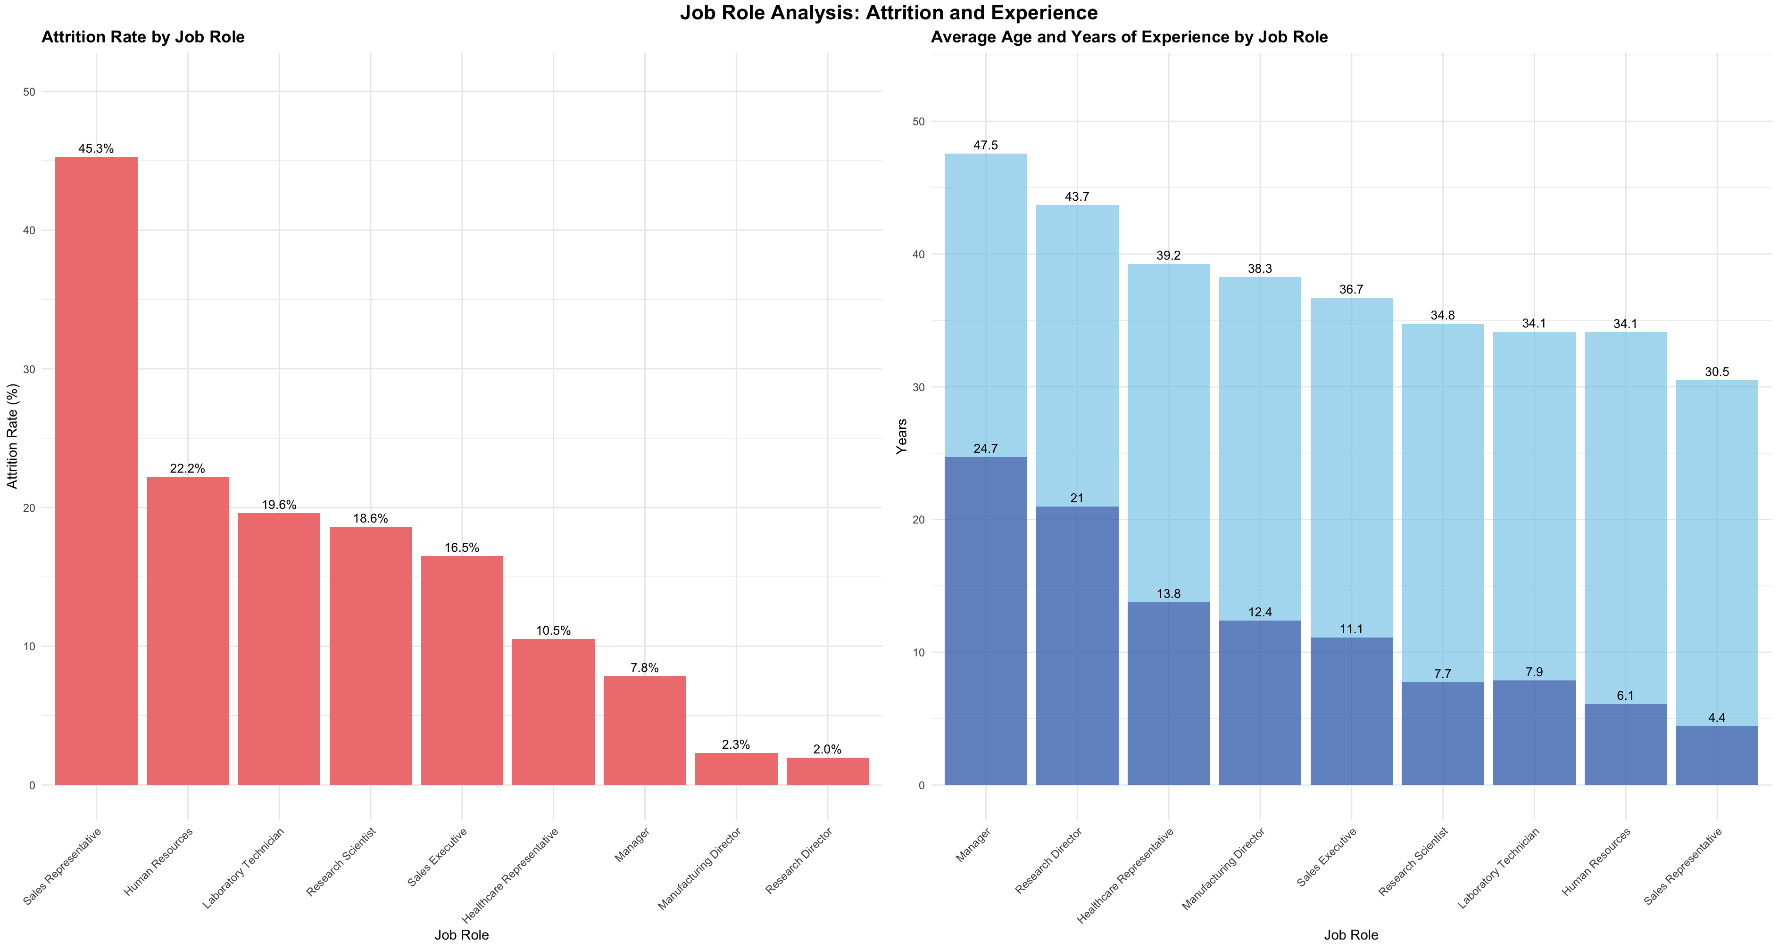

Slide 6


Statistical Analysis
Overtime
Strongest Statistical Predictor (p-value: 2.33e-15)
Total Working Years
Highest Numerical Correlation: (0.167)
Decision Tree Importance: (5.03)
Monthly Income
Second Highest Correlation of (0.154)
Decision Tree Importance: (6.71)

Slide 7
Visualizing The Data

Slide 8
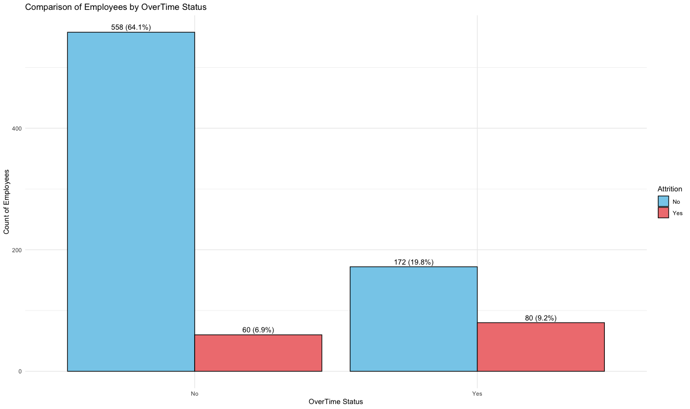
Overtime

Slide 9
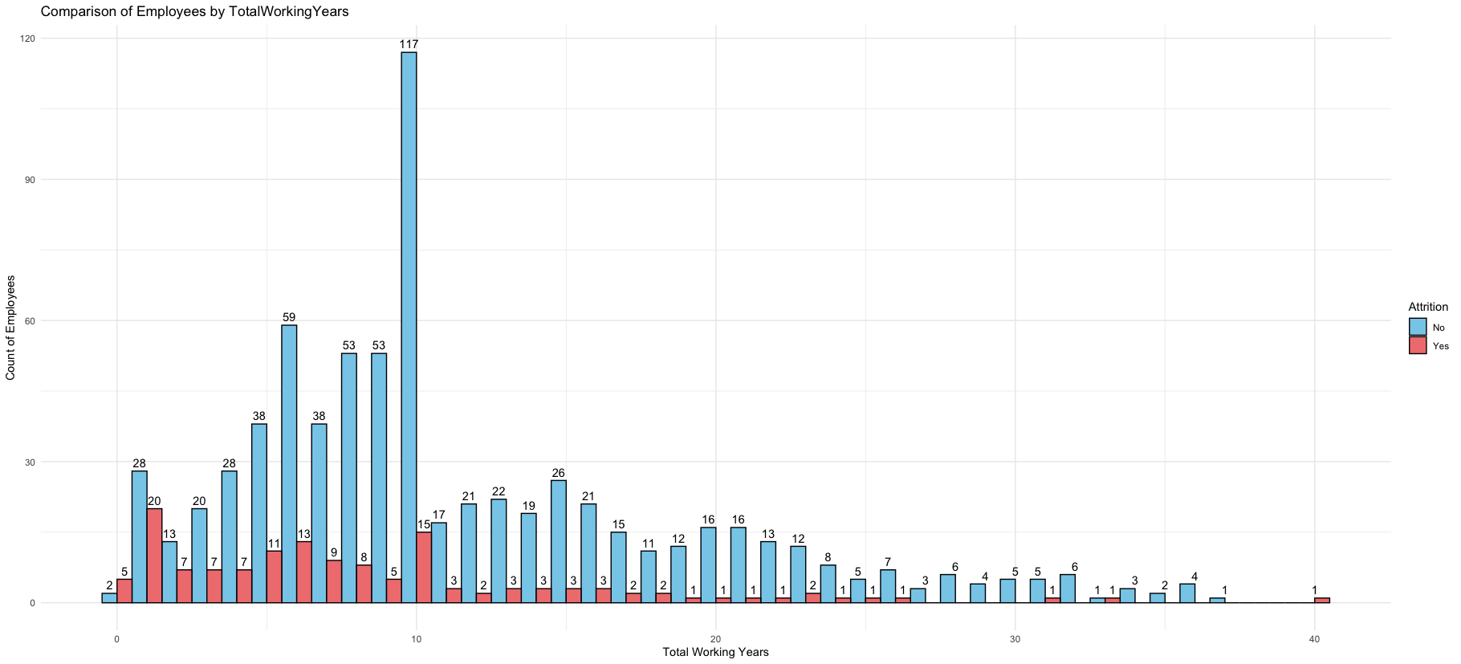
Total Working Years

Slide 10
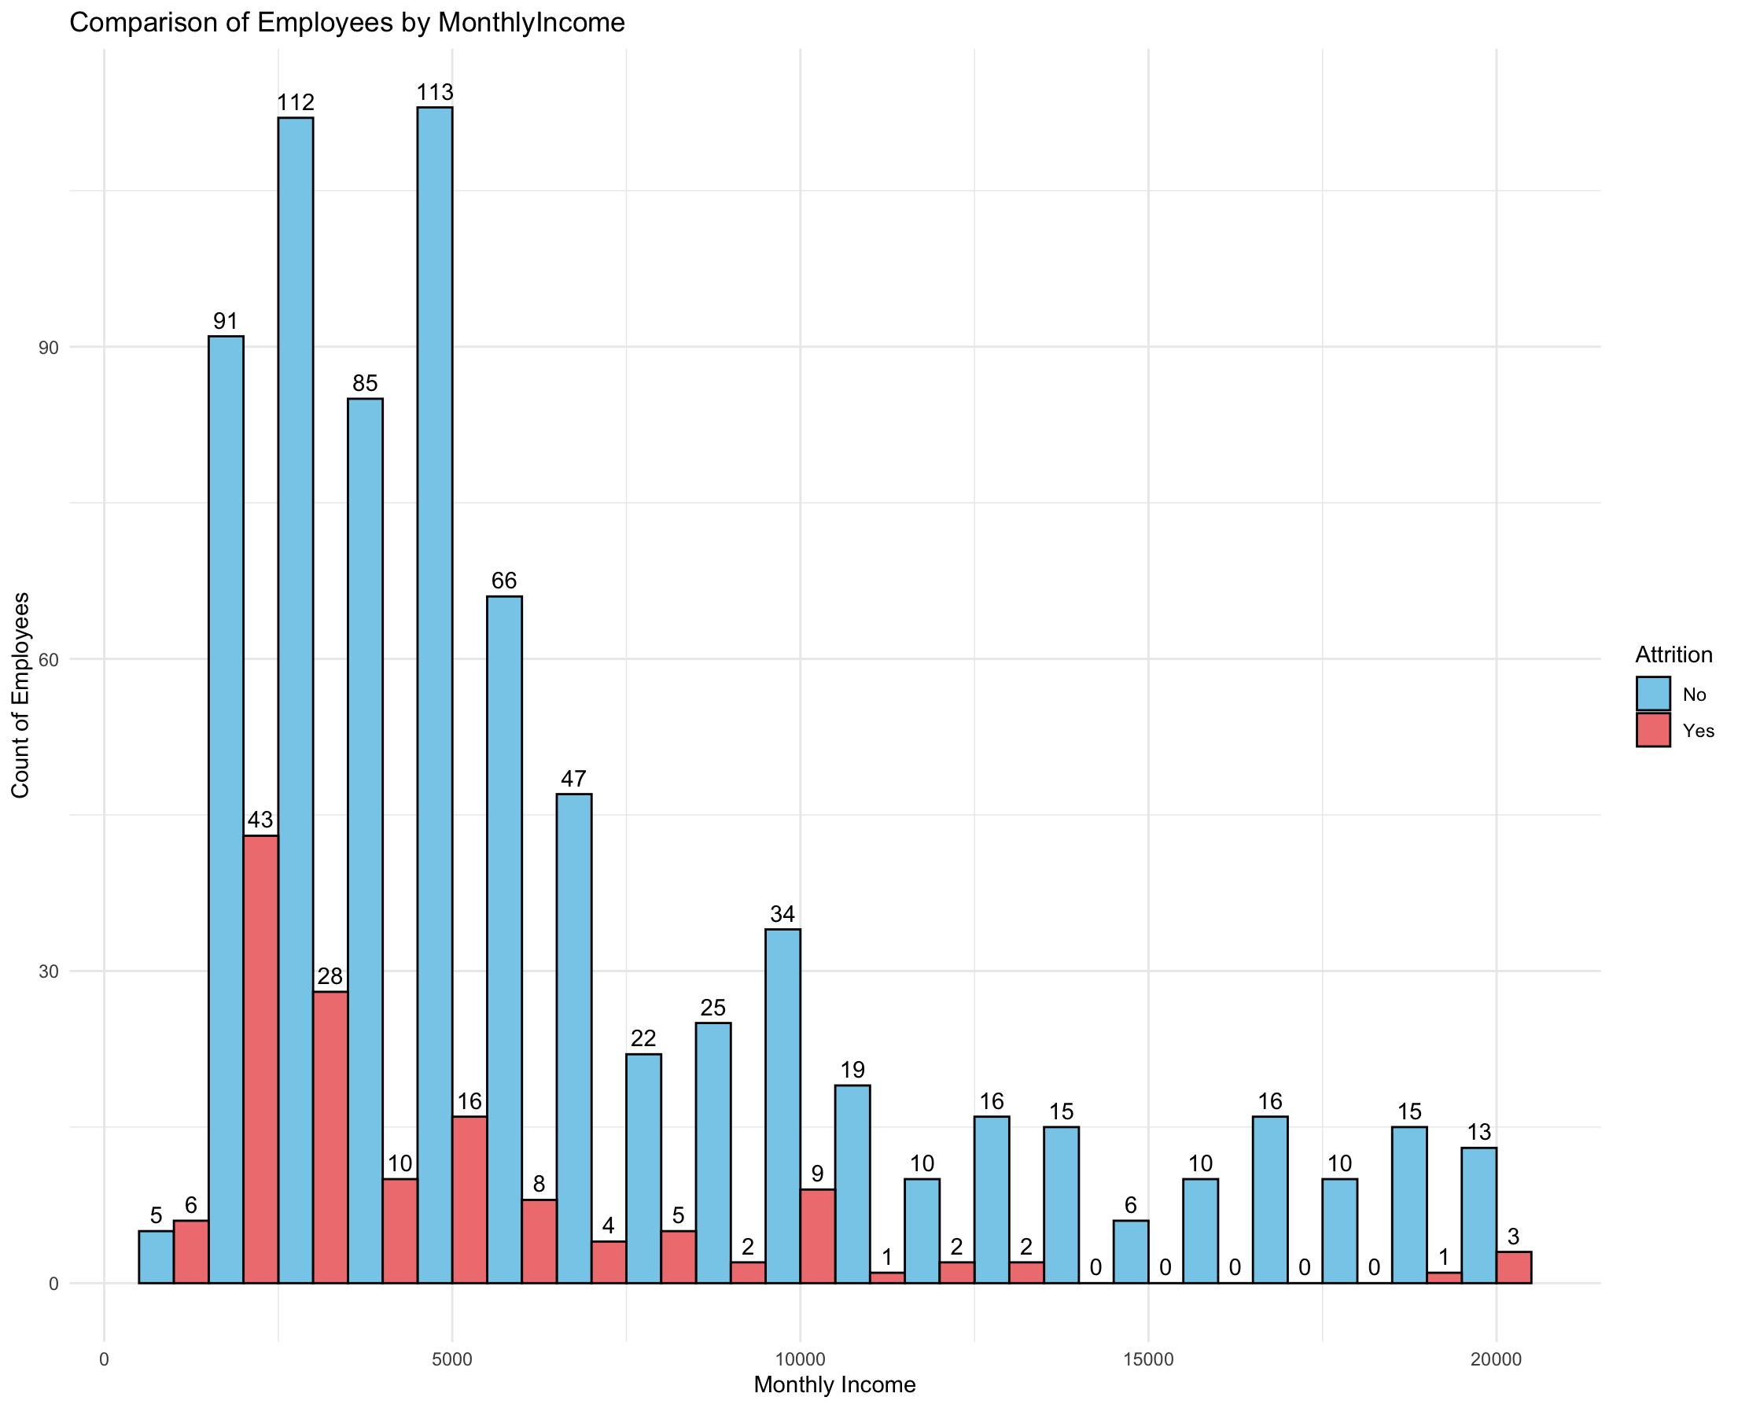
Monthly Income

Slide 11
Classification Models: Naive Bayes

Slide 12
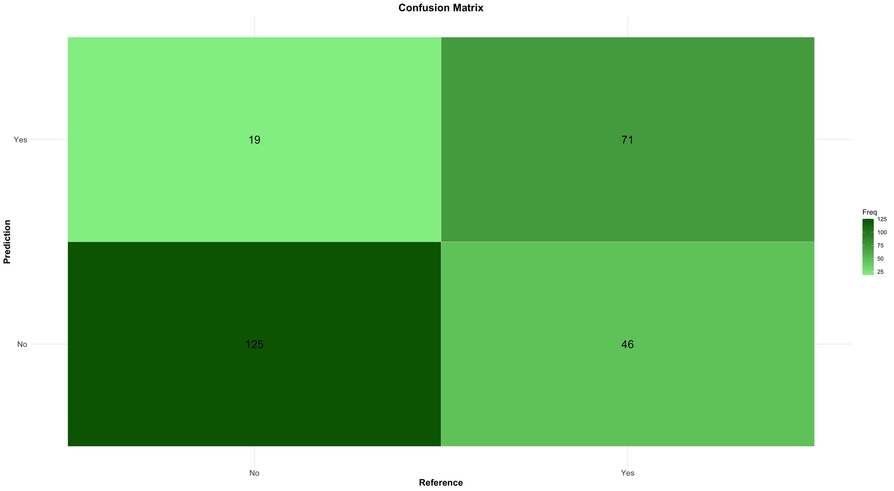
Confusion Matrix

Slide 13
Factors: Overtime, Monthly Income, and Total Working Years
Naive Bayes Model
Accuracy: 0.751
Sensitivity: 0.731
Specificity: 0.789
F1: 0.686

Slide 14
Contact Information
Name: Tommy Mai
Company Email: Tommymai@DDSAnalytics.com

