Slide 1

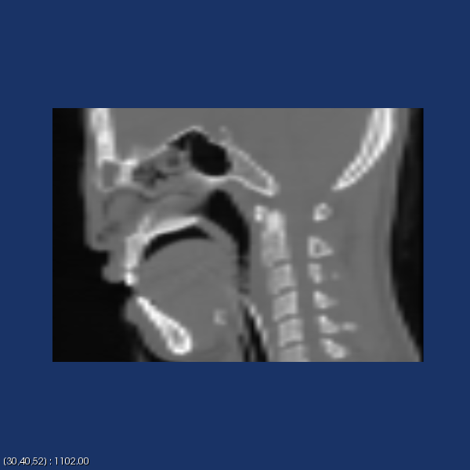

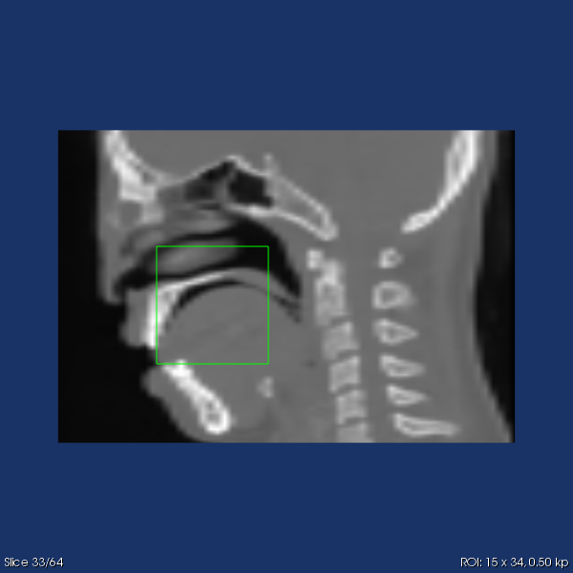
Slice Z and Adjust Window/Level
Slice X and Pick
Zoom
ROI

