Slide 1
三角形状FD

Slide 2
Flow (vehicle/hour/lane)
Density (vehicle/km/lane)

Slide 3
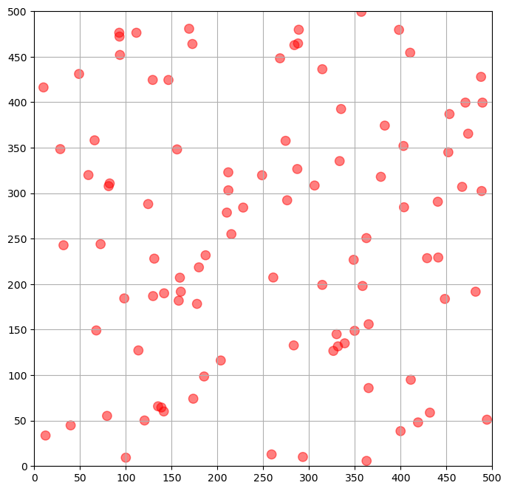
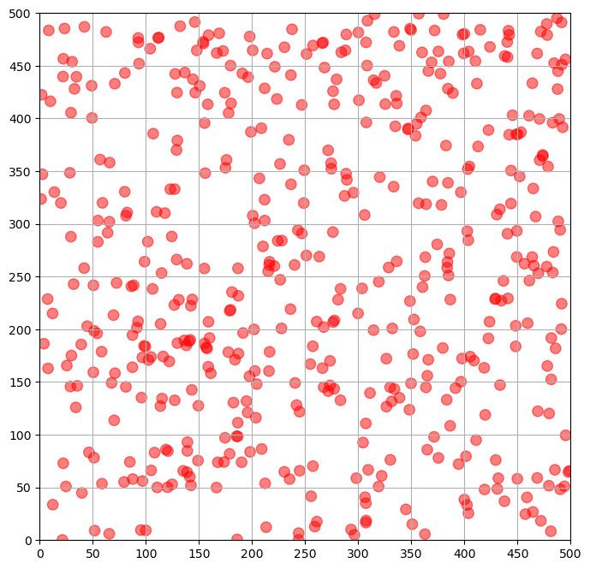
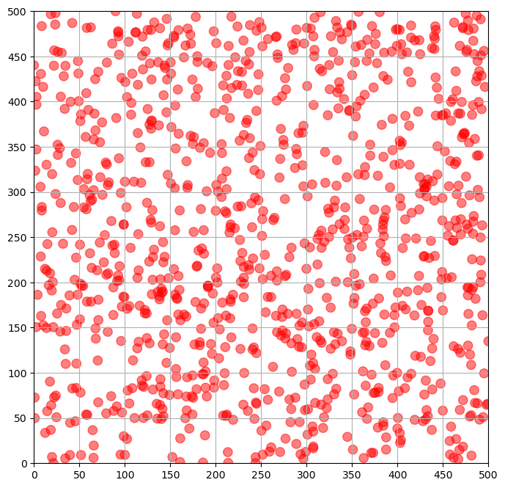
100 agents
500 agents
1000 agents
Pixel
Pixel

