Slide 1
Which Airport to build a new restaurant?
Capstone Project - The Battle of the Neighborhoods (Week 2)

Slide 2
Table of contents
Introduction: Business Problem
Data
Methodology
Analysis
Results
Discussion
Conclusion

Slide 3
Introduction: Business Problem
[Business Problem]
Which Airport to build a new restaurant?
[Background]
I am a manager to plan the new Japanese authentic restaurant. These days, I am instructed by the boss to plan the restaurant for 'inbound tourist'. Because they're increasing year by year, in 2018 inbound tourist is over 40 million a year. So at first I will plan a new restaurant at the airport which is the first and last touch point in their trip. I have to choose the airport on the basis of several data about tourist and airport.

Slide 4
DATA source
Immigration and Emigration number Source: Immigration Statics by Minister of Justice http://www.moj.go.jp/housei/toukei/toukei_ichiran_nyukan.html
Total tour unit cost in Japan Source:Consumption Trends of International Visitors to Japan Survey http://www.mlit.go.jp/kankocho/siryou/toukei/shouhidoukou.html
Airport location(longitude and latitude) Source: Airport GIS data by Ministry of Land, Infrastructure and Transport http://nlftp.mlit.go.jp/ksj/gml/datalist/KsjTmplt-N08.html

Slide 5
Methodology
Comparison of "Emmigraion" figure by each airport and Year-on-year difference(2018vs.2017).
Comparison of "Travel Unit Cost" by each airport and Year-on-year difference(2018vs.2017).
Catch the regional specifics and candidate cities by mapping score noted above.

Slide 6
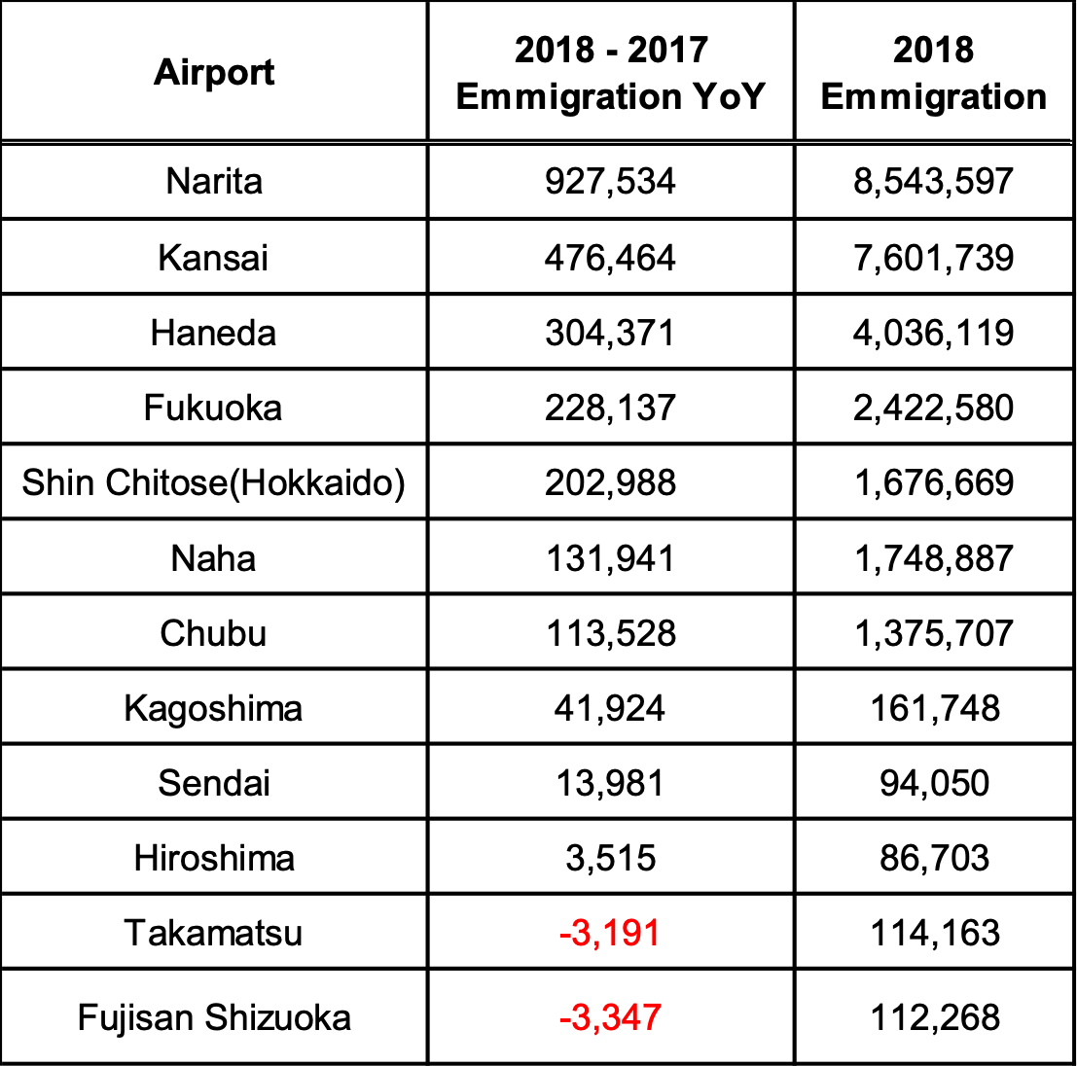
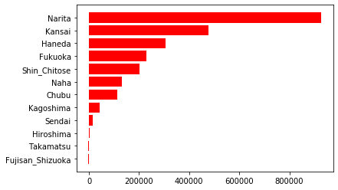
Analysis 1 Comparison of "Emmigraion" figure by each airport and Year-on-year difference(2018vs.2017)
Bar graph sortrd year on year changes Emmigraion by Airport in Japan 2017-2018

Slide 7
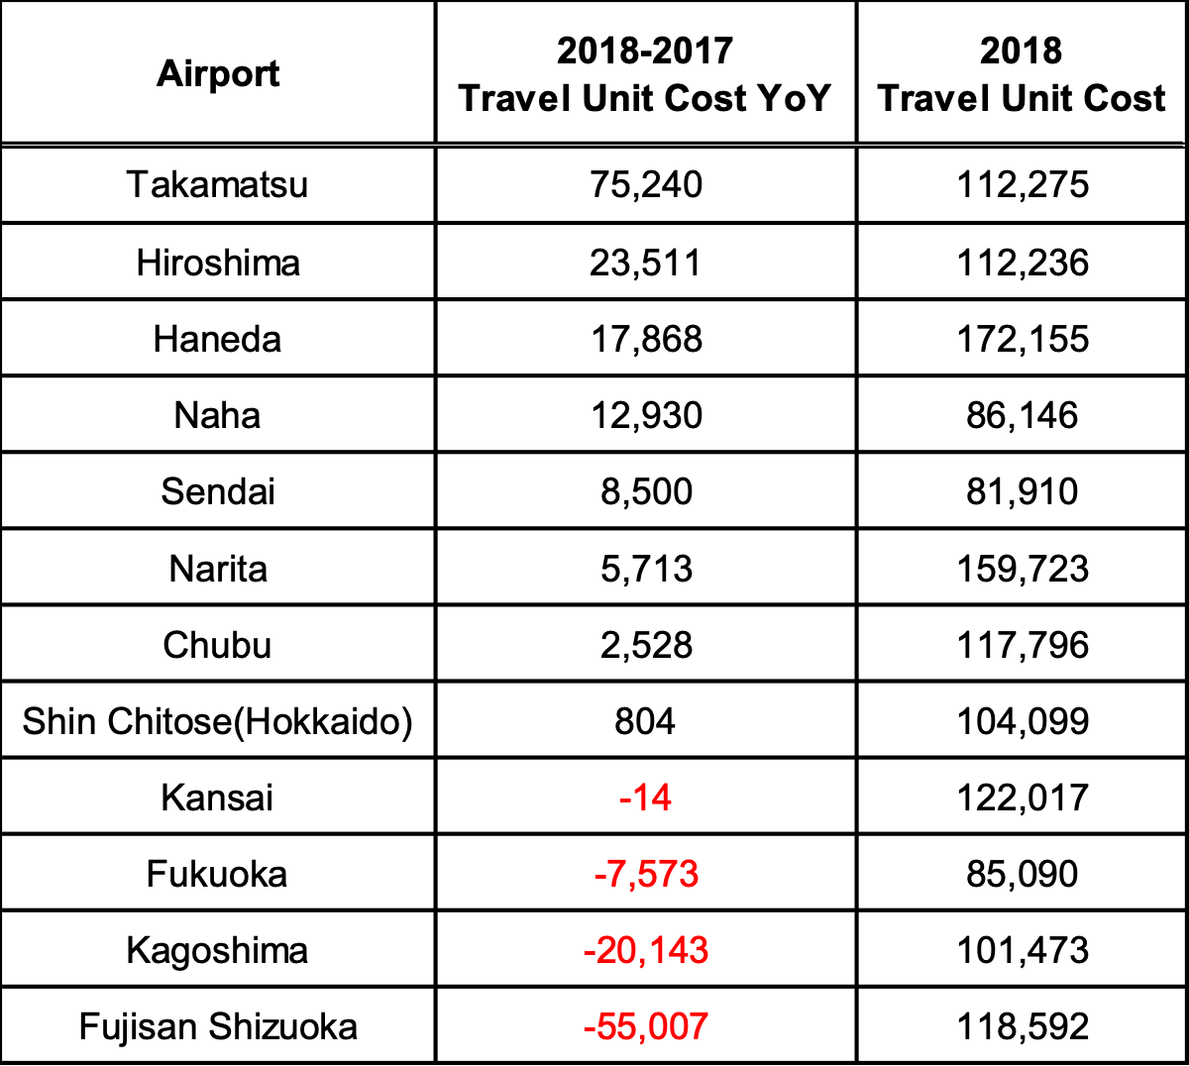
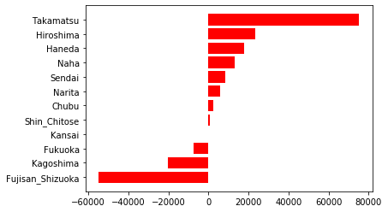
Analysis 2 Comparison of "Travel Unit Cost" by each airport and Year-on-year difference(2018vs.2017).
Bar graph sortrd year on year changes Travel Unit Cost by Airport in Japan 2017-2018

Slide 8
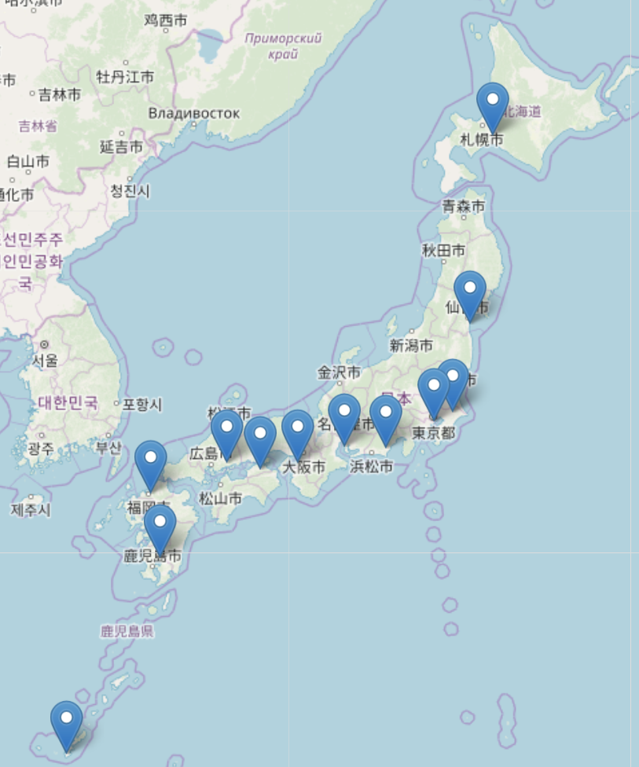
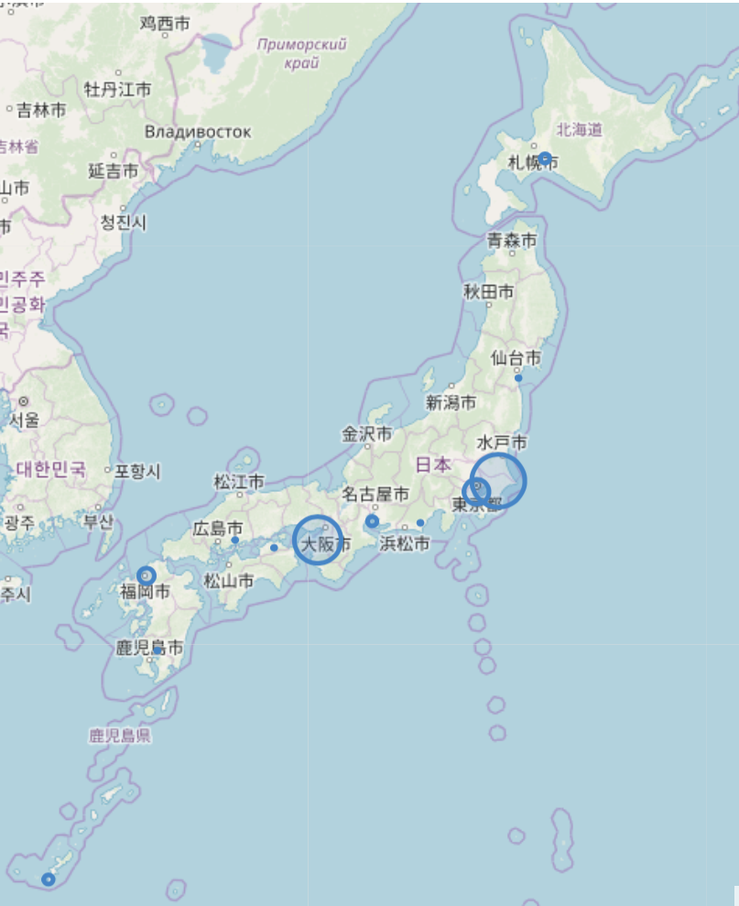
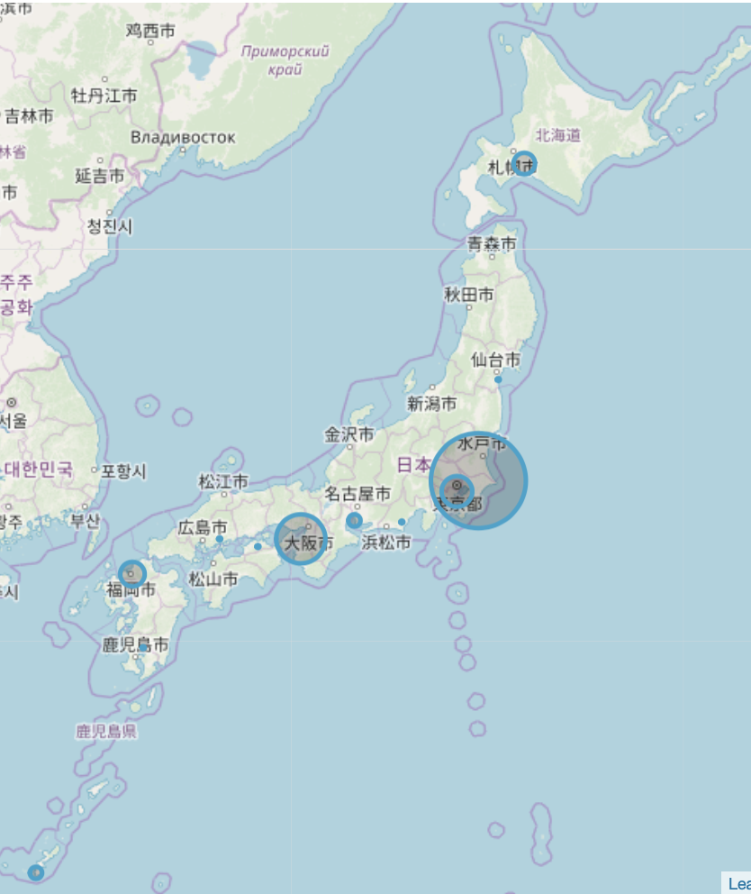
Analysis 3 Catch the regional specifics and candidate cities by mapping score ~Emigration Figure~
Airport Location
Emigration figure
YoY

Slide 9
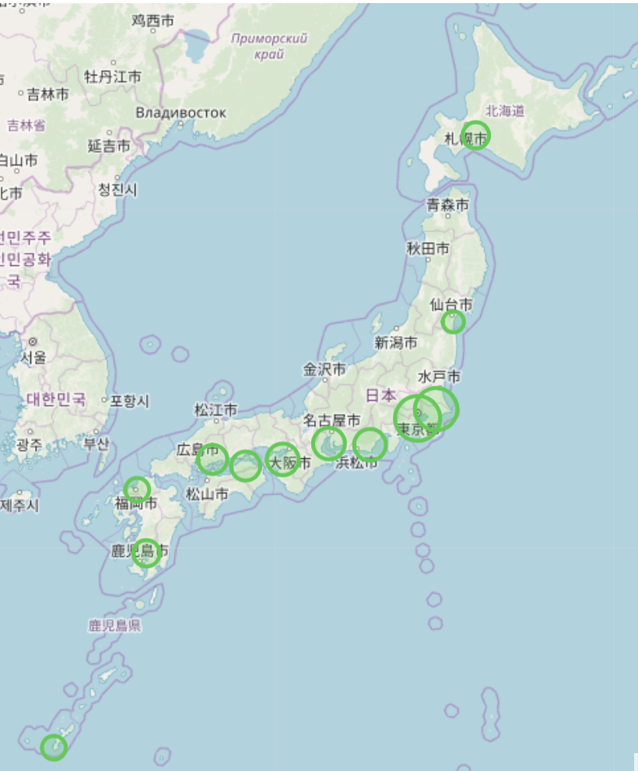
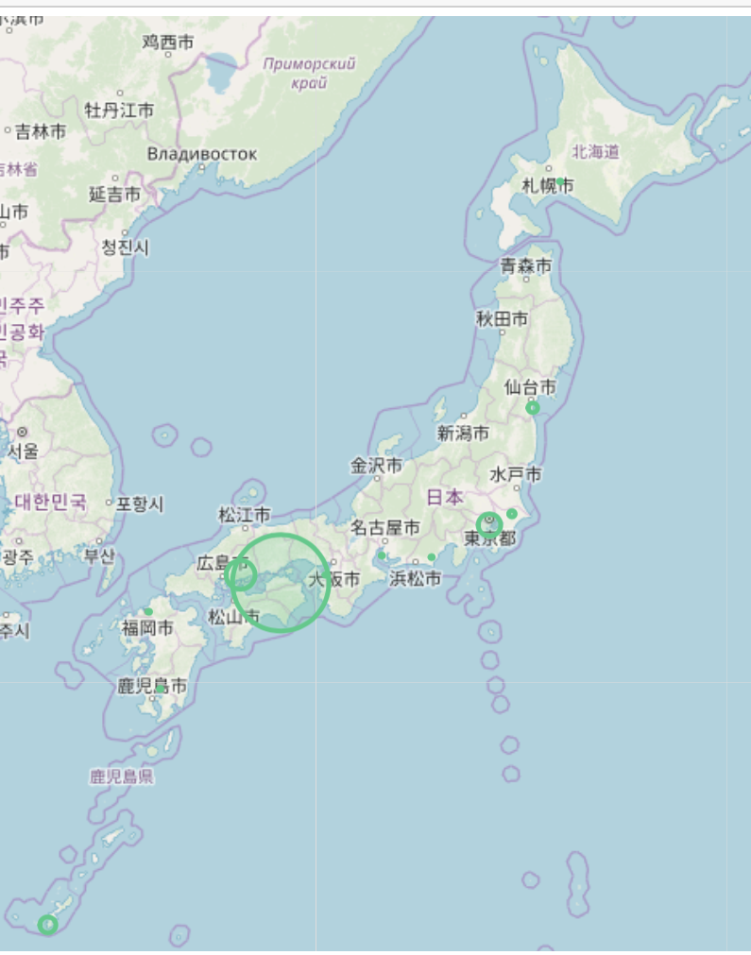
Analysis 3 Catch the regional specifics and candidate cities by mapping score ~TraVEL Unit Cost~
Airport Location
Travel Unit Cost figure
YoY

Slide 10
Results
Emigration
Figure Narita, Haneda, Kansai where are international airport for world is top3.
Year on year changes Same as above, Narita, Haneda, Kansai are top3.
Travel Unit Cost
Figure Same as Figure Narita, Haneda, Kansai where are top3. Unlike a Emigration, Fujisan_Shzuoka and Takamatsu are top rank.
Year on year changes Takamatsu, Hiroshima, Haneda are top3.

Slide 11
Discussion
Haneda, Narita, Kansai are famous for world.
→Those three airport are so competitive.
Takamatsu and Fujisan_Shizuoka have potential for new reastrant,
FYI, From year on year changes Travel Unit Cost mapping, Westside airport are bigger circle than other airport.We may pre-empt the changing for inbound travelers, by moving Takamatsu Airport.

Slide 12
ConCLUsion
I will recomend Takamatsu Airport for candidate airport.
[FYI] Takamatsu-city https://en.wikipedia.org/wiki/Takamatsu,_Kagawa

