Slide 1
Status report #2
2019/10/25 (Fri)
B4 Fujiwara Tomomasa

Slide 2
My Progress
Set up my PC
Login lambda server
Using root
Practice root using MPPC data

Slide 3
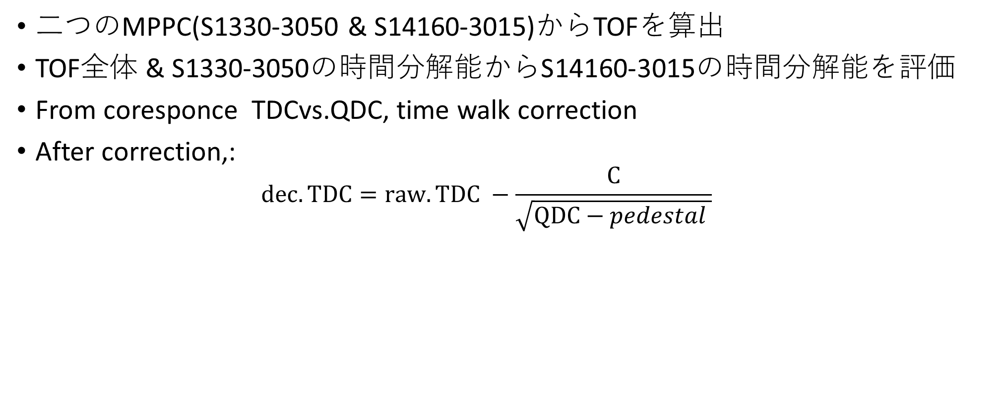
My Progress
二つのMPPC(S1330-3050 & S14160-3015)からTOFを算出
TOF全体 & S1330-3050の時間分解能からS14160-3015の時間分解能を評価
From coresponce TDCvs.QDC, time walk correction
After correction,:
$$dec.TDC=raw.TDC −\frac{C}{\sqrt{QDC−pedestal }}$$

Slide 4
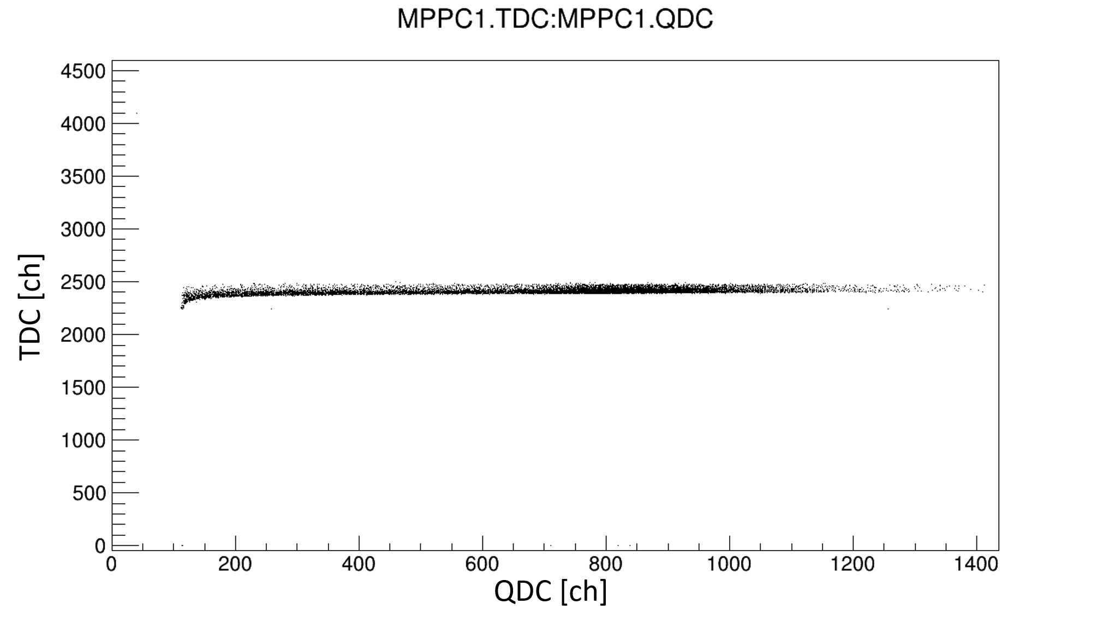
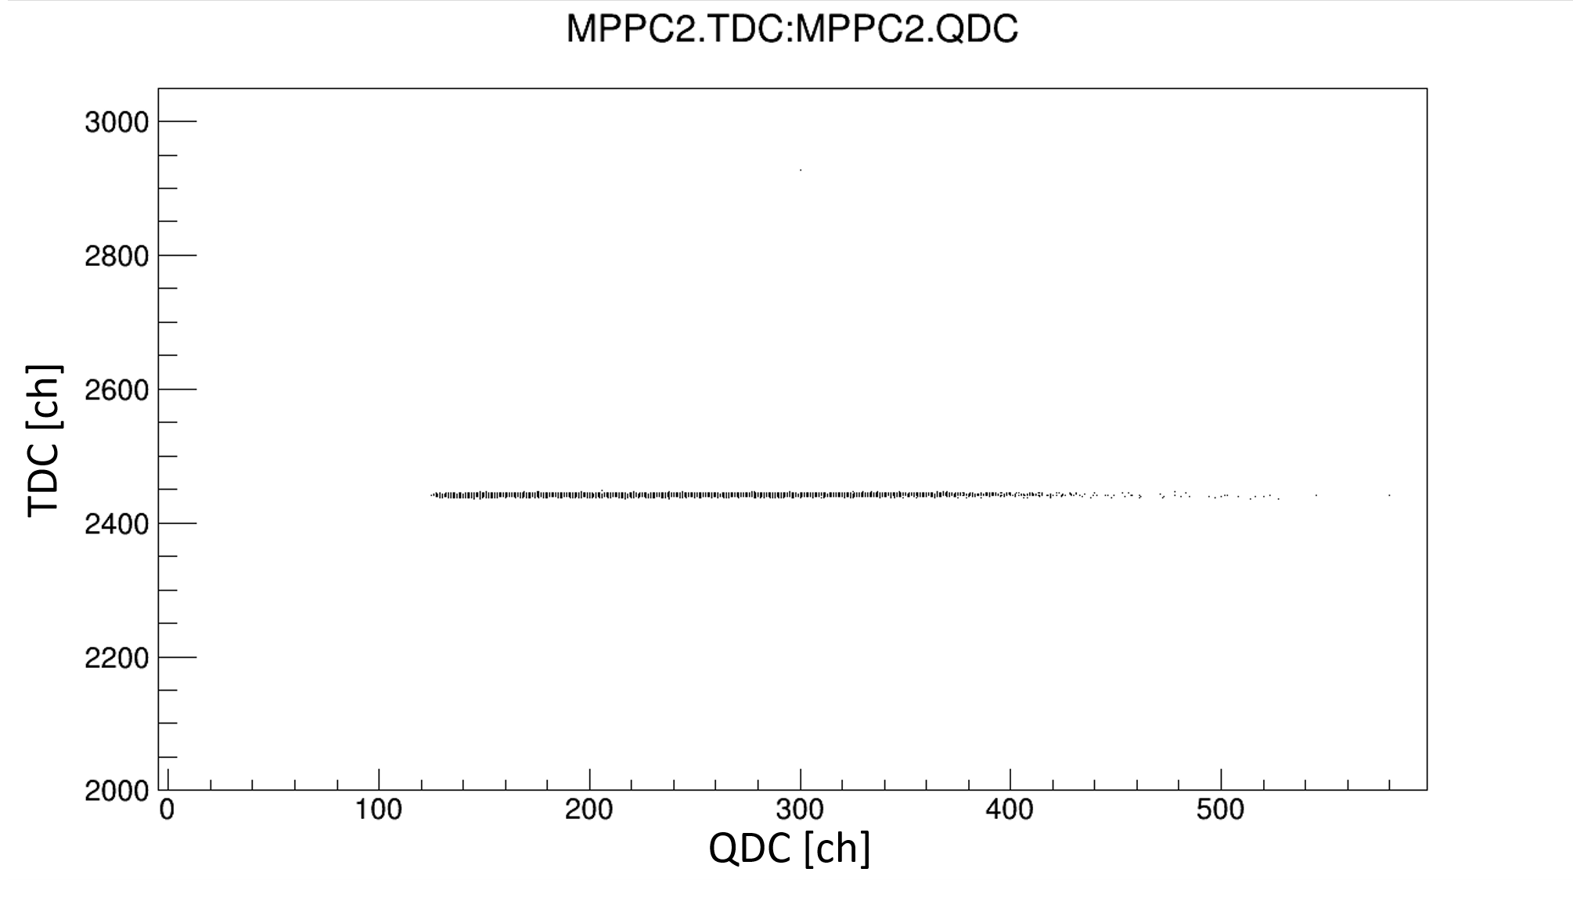
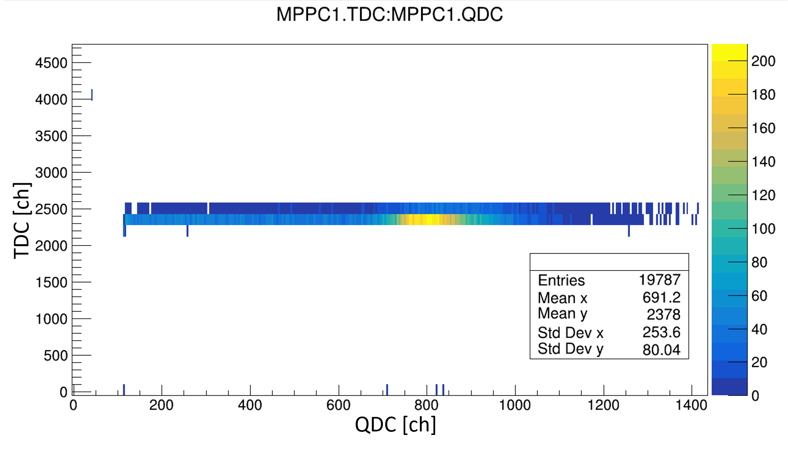
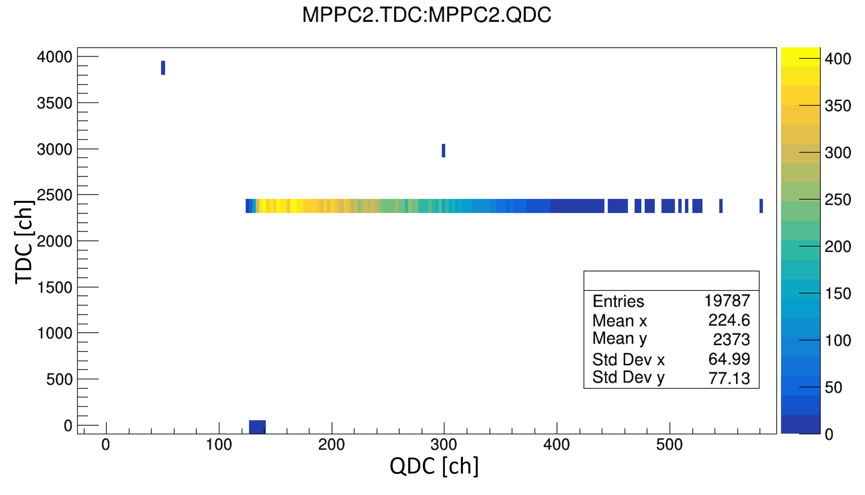
My Progress

Slide 5
To do next
Practice root & analysis MPPC data
Entry for scholarship
電子光再教育

