Slide 1
Status Report #3
2019.11.1 Fri
B4 Fujiwara Tomomasa

Slide 2
What I have done
Entry for Scholarship
ROOT study

Slide 3
ROOT
Leaning analysis procedure using ROOT
Goal: Evaluate time resolution of MPPC S14400-3015
〈Setup of measurement〉
β-ray source
QDC
MPPC1(S14400-3015)
Discriminator
TDC
MPPC2(S14400-3015)
AND
Trigger
TDC
QDC

Slide 4

ROOT
Calculate TOF from MPPC1.TDC & MPPC2.TDC:
TOF = MPPC1.TDC – MPPC2.TDC
$σ_{T}=\sqrt{σ_{1}^{2}+σ_{2}^{2}}$
$σ_{T}$: Time resolution of TOF, $σ_{1,2}$: Time resolution of MPPC1 & 2
Assuming $σ_{1}=σ_{2}=σ_{MPPC}$,
$σ_{MPPC}=\frac{1}{\sqrt{2}}σ_{T}$

Slide 5

ROOT
TDC: output only when $V_{sig}>V_{th}=25mV$
TDC: depend on shape pulse → necessary of correction: Time walk correction
Raw sig.
Raw sig.
time
time
V_{th}
V_{th}
TDC
TDC
time
time

Slide 6
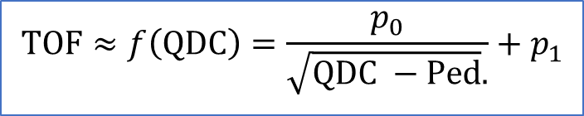


ROOT
Time walk correction
After correction, $TOF=dec.TOF_{1} −dec.TOF_{2}$
TOF
TOF
$$dec.TOF=TOF −f\left(QDC\right)$$
$$TOF≈f\left(QDC\right)=\frac{p_{0}}{\sqrt{QDC −Ped}.}+p_{1}$$
QDC
QDC

Slide 7
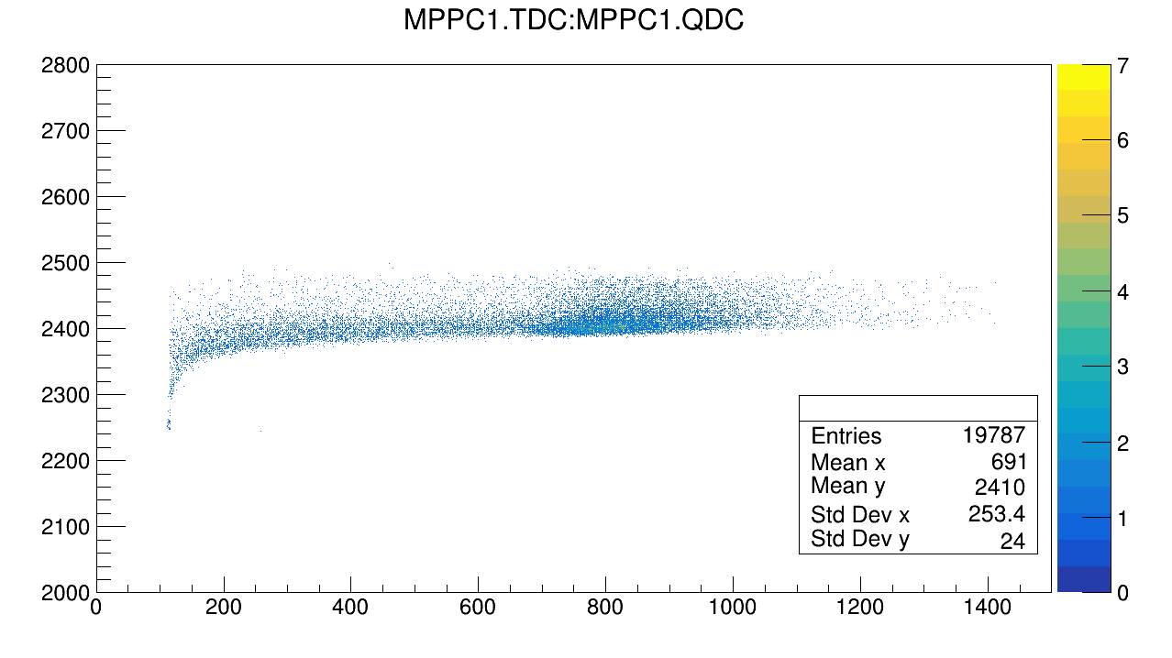
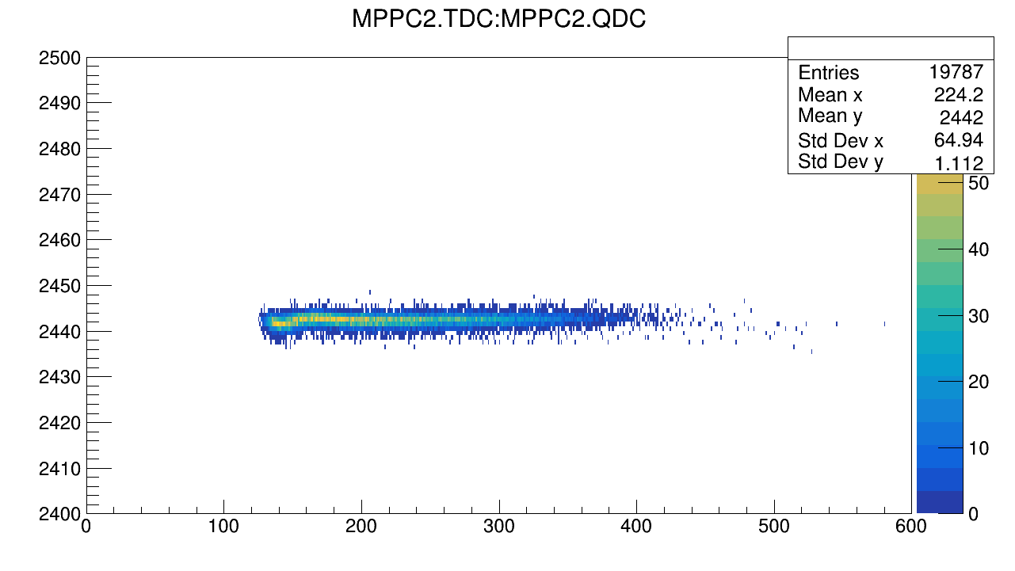
In Progress
Before
Plot TDC vs. QDC1&QDC2
TDC1 [ch]
TDC2 [ch]
QDC1 [ch]
QDC2 [ch]

Slide 8
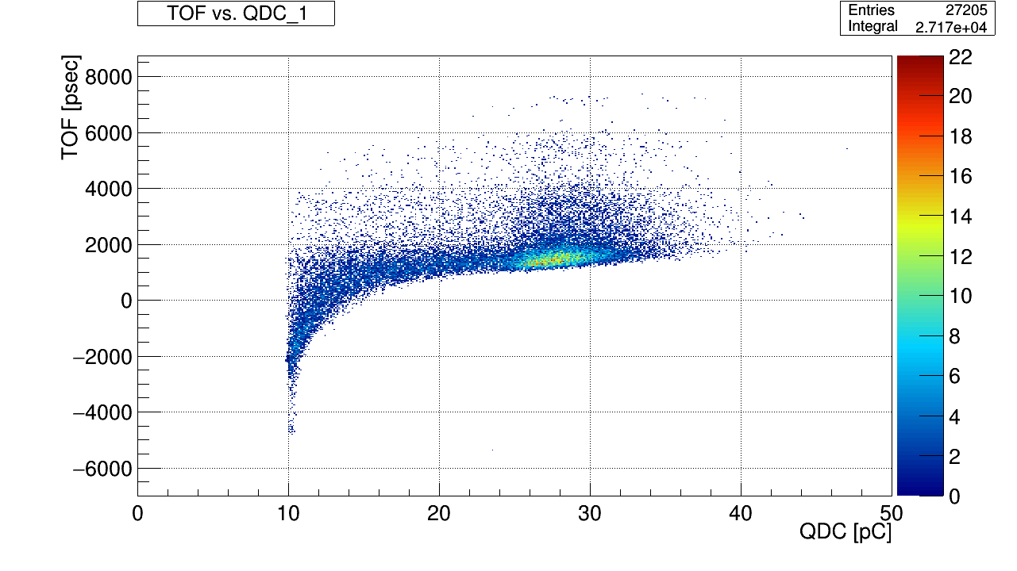
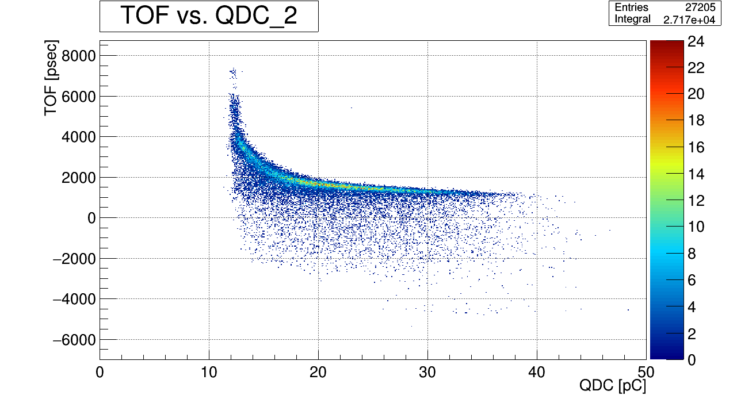
In Progress
Plot TOF vs. QDC1, QDC2

Slide 9
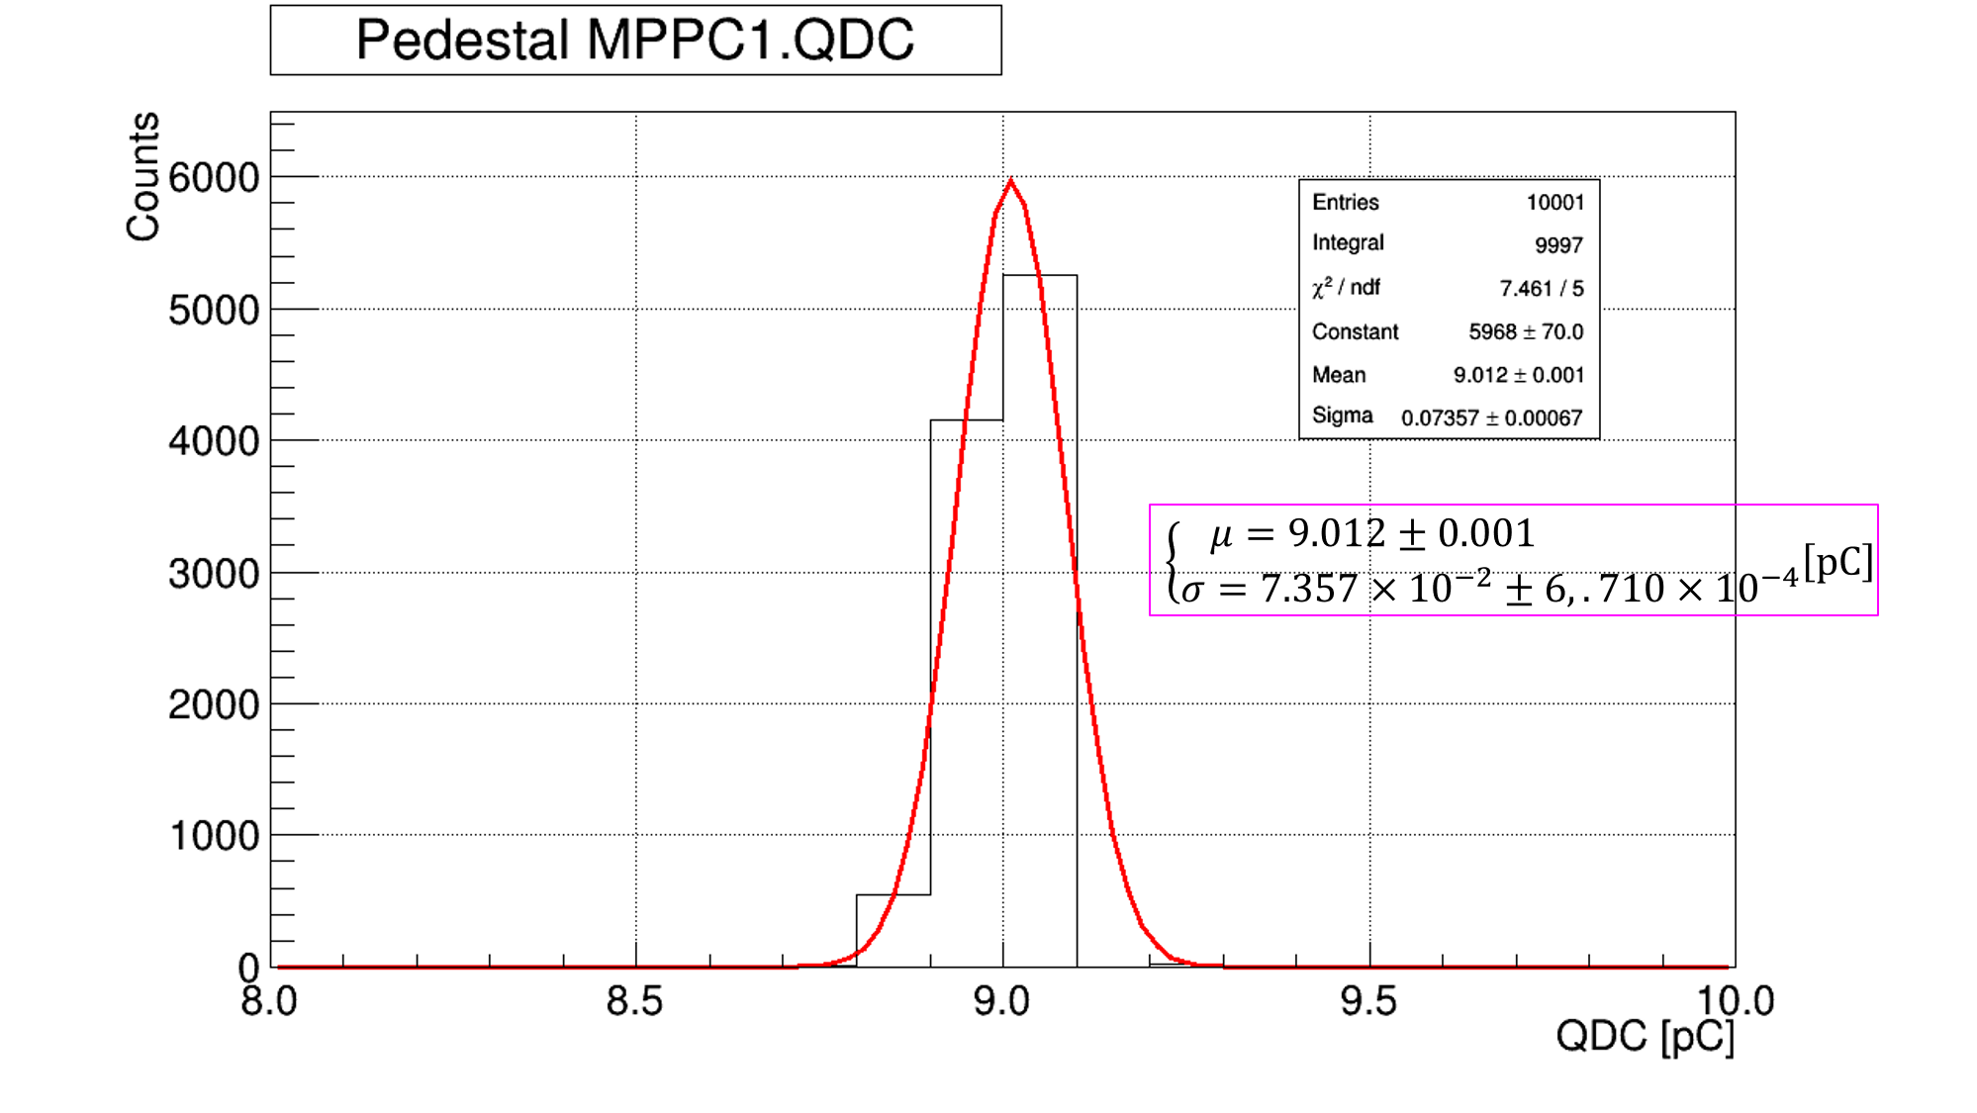
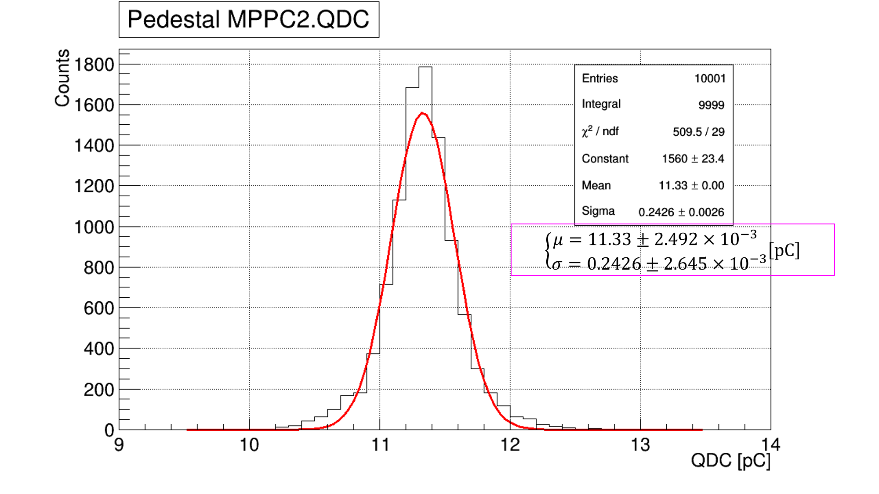
In Progress
Pedestal(run No.0047)
Fit using gassian

Slide 10
In Progress
For time walk correction, focus on TOF vs QDC1 & 2 dist.
Pick up bins with large entry
16<QDC2<26 [pC]
Under this condition,
Calibrate TOF vs. QDC1

Slide 11
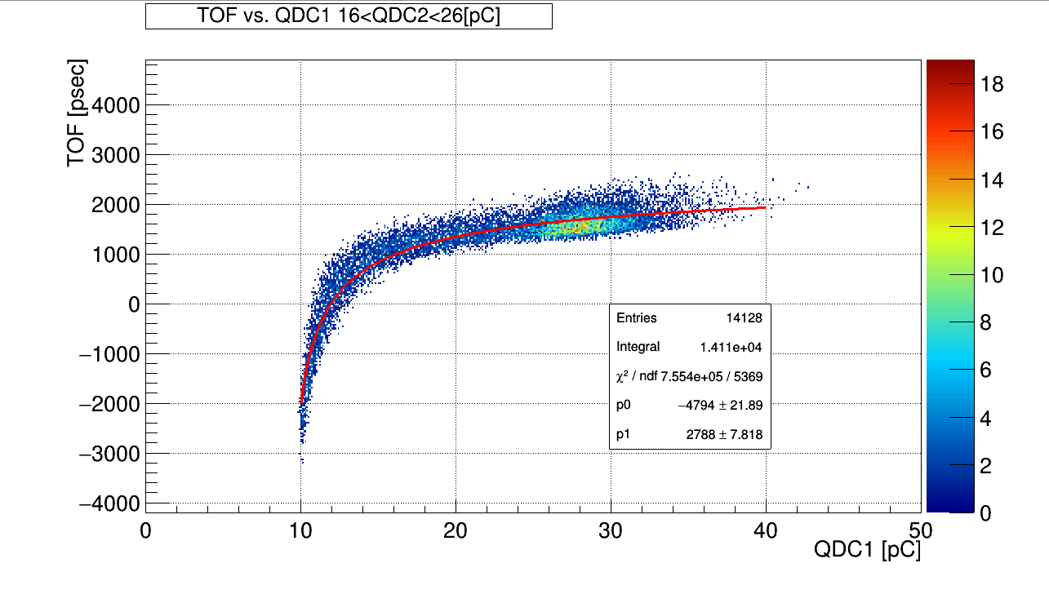
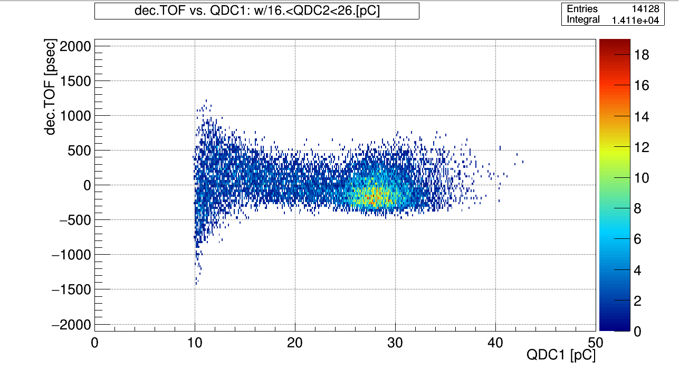
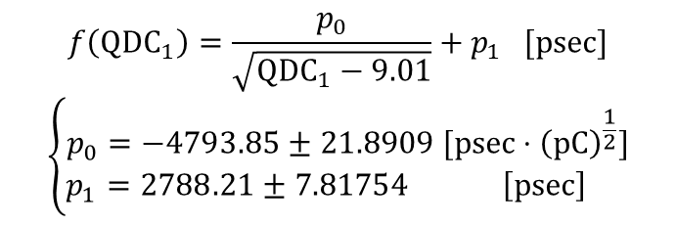
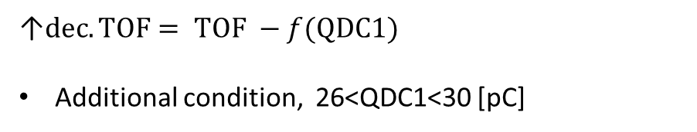
In Progress
$$f\left(QDC_{1}\right)=\frac{p_{0}}{\sqrt{QDC_{1}−9.01}}+p_{1} [psec]$$
$$\left\{\begin{aligned}p_{0}=−4793.85±21.8909 [psec⋅{\left(pC\right)}^{\frac{1}{2}}] \\ p_{1}=2788.21±7.81754 \left[psec\right] \end{aligned}\right.$$
↑$dec.TOF= TOF −f(QDC1)$
Additional condition, 26<QDC1<30 [pC]

Slide 12
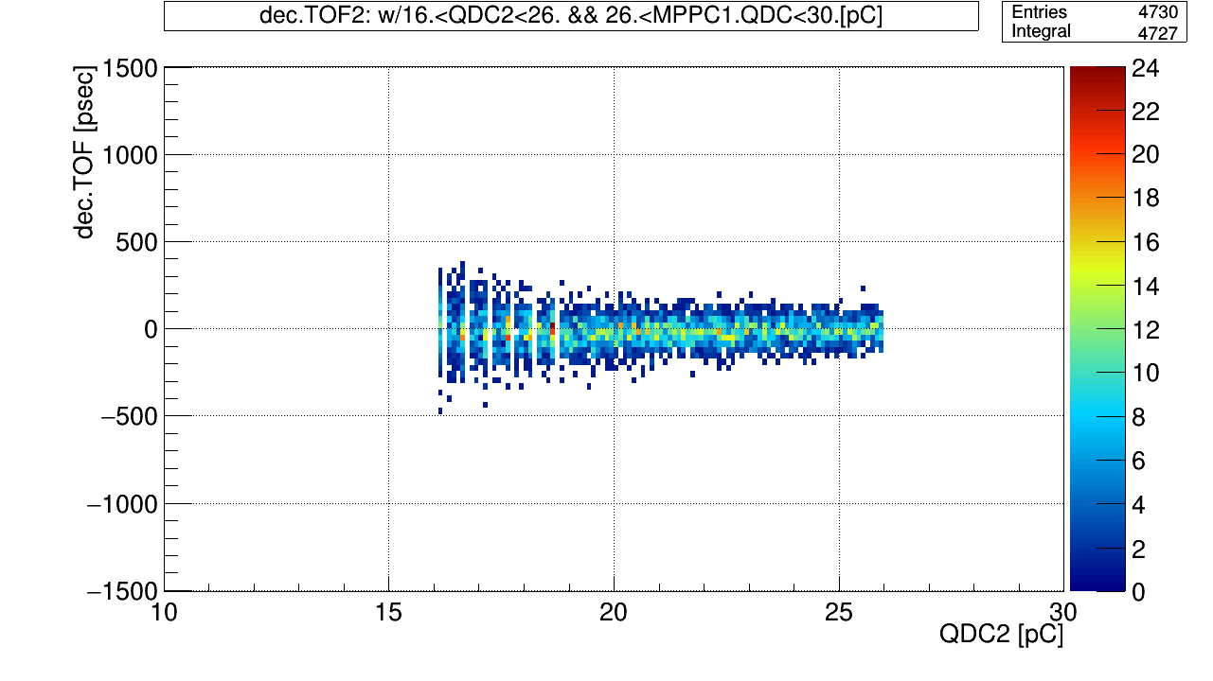
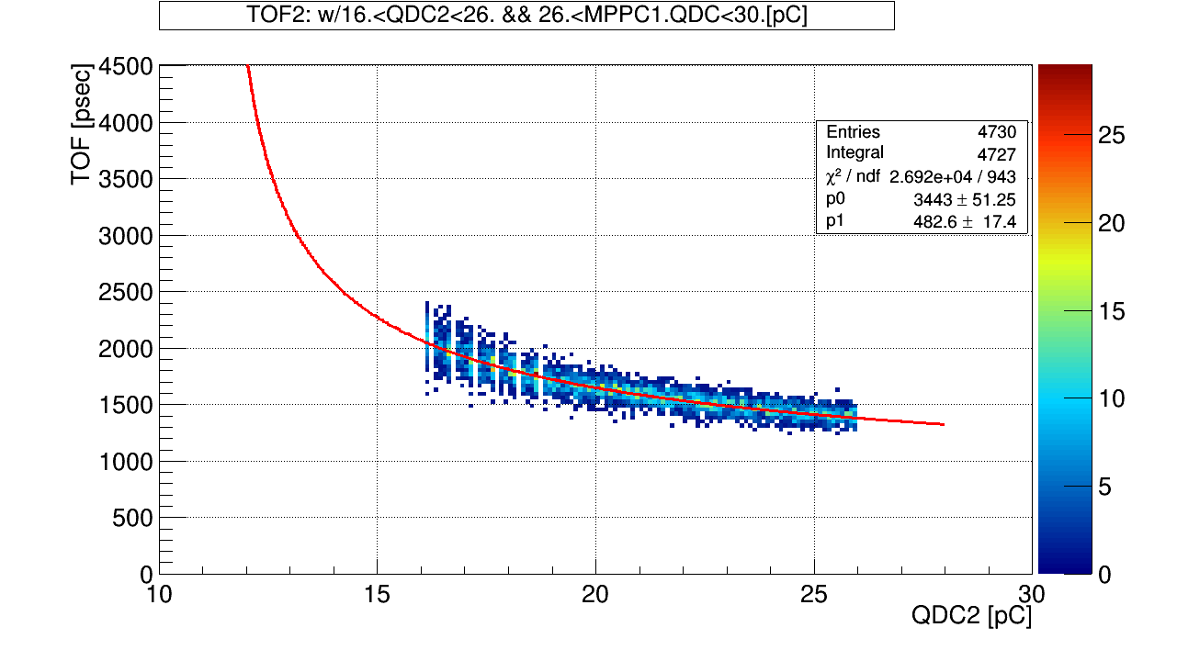
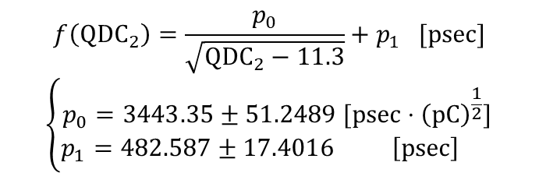
In Progress
TOF vs. QDC2 under gate conditions
↑$dec.TOF= TOF −f\left(QDC2\right)$ vs. QDC2
$$f\left(QDC_{2}\right)=\frac{p_{0}}{\sqrt{{QDC}_{2}−11.3}}+p_{1} [psec]$$
$$\left\{\begin{aligned}p_{0}=3443.35±51.2489 [psec⋅{\left(pC\right)}^{\frac{1}{2}}] \\ p_{1}=482.587±17.4016 \left[psec\right] \end{aligned}\right.$$

Slide 13
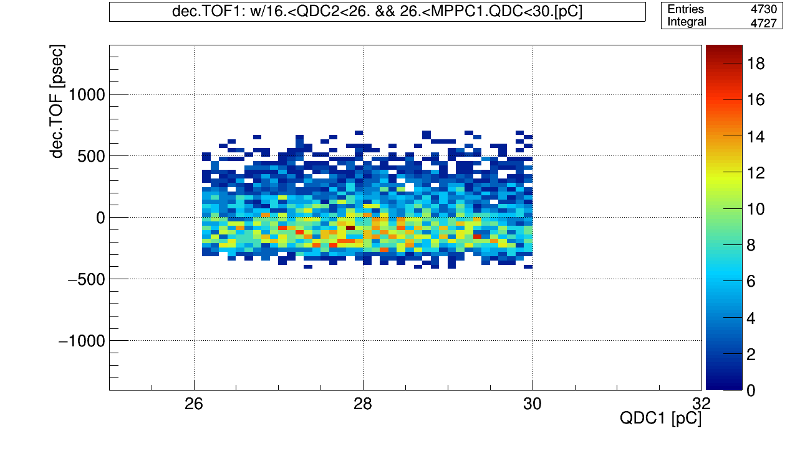
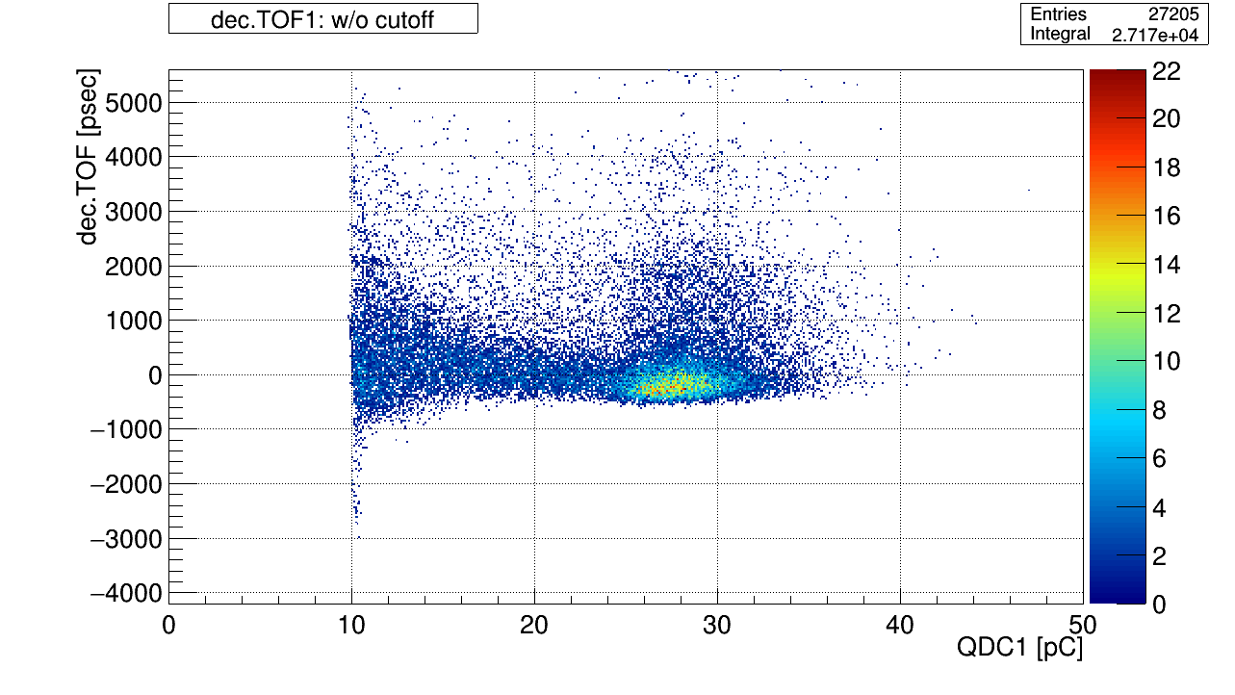
In Progress
↑修正したTOF(dec.TOF)をカットオフを外し、すべてプロット

Slide 14
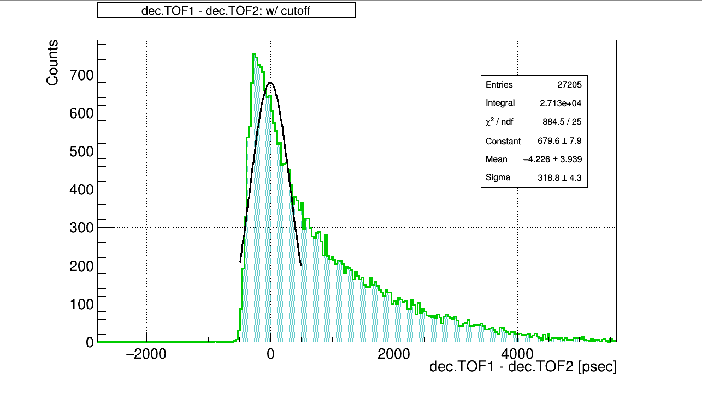
In Progress
←Dist. TOF = dec.TOF1 - dec.TOF2
Really, want to make macro file
I couldn’t solve error…
→ to do next!

Slide 15
To do
Work hard time resolution analyze
Learn macro
FPGA Seminar (11.7～8)

