Slide 1
Status Report #4
2019.11.14 Thu
B4 Fujiwara Tomomasa
FPGA Seminar
evaluate time resolution MPPC

Slide 2
Time resolution of MPPC: setup
Leaning analysis procedure using ROOT
Goal: Evaluate time resolution of MPPC S14400-3015
〈Setup of measurement〉
β-ray source
QDC
MPPC1
Discriminator
TDC
MPPC2
AND
Trigger
TDC
QDC

Slide 3

Time resolution of MPPC
Calculate ToF from MPPC1.TDC & MPPC2.TDC:
ToF = MPPC1.TDC – MPPC2.TDC
$σ_{T}=\sqrt{σ_{1}^{2}+σ_{2}^{2}}$
$σ_{T}$: Time resolution of ToF, $σ_{1,2}$: Time resolution of MPPC1 & 2
Assuming $σ_{1}=σ_{2}=σ_{MPPC}$,
$σ_{MPPC}=\frac{1}{\sqrt{2}}σ_{T}$

Slide 4
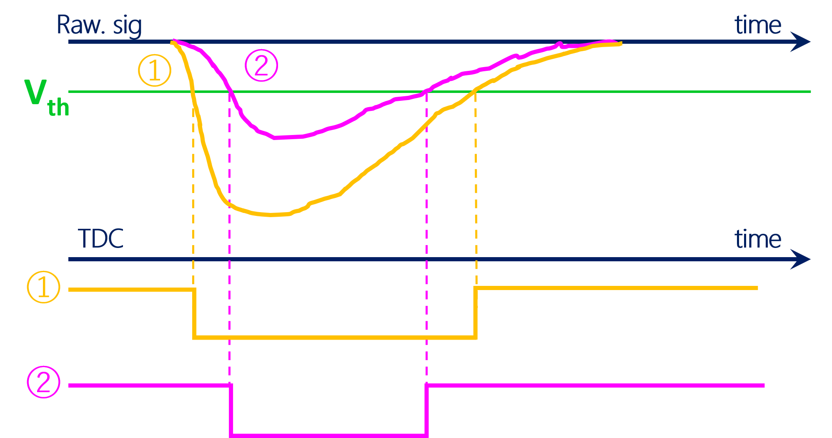
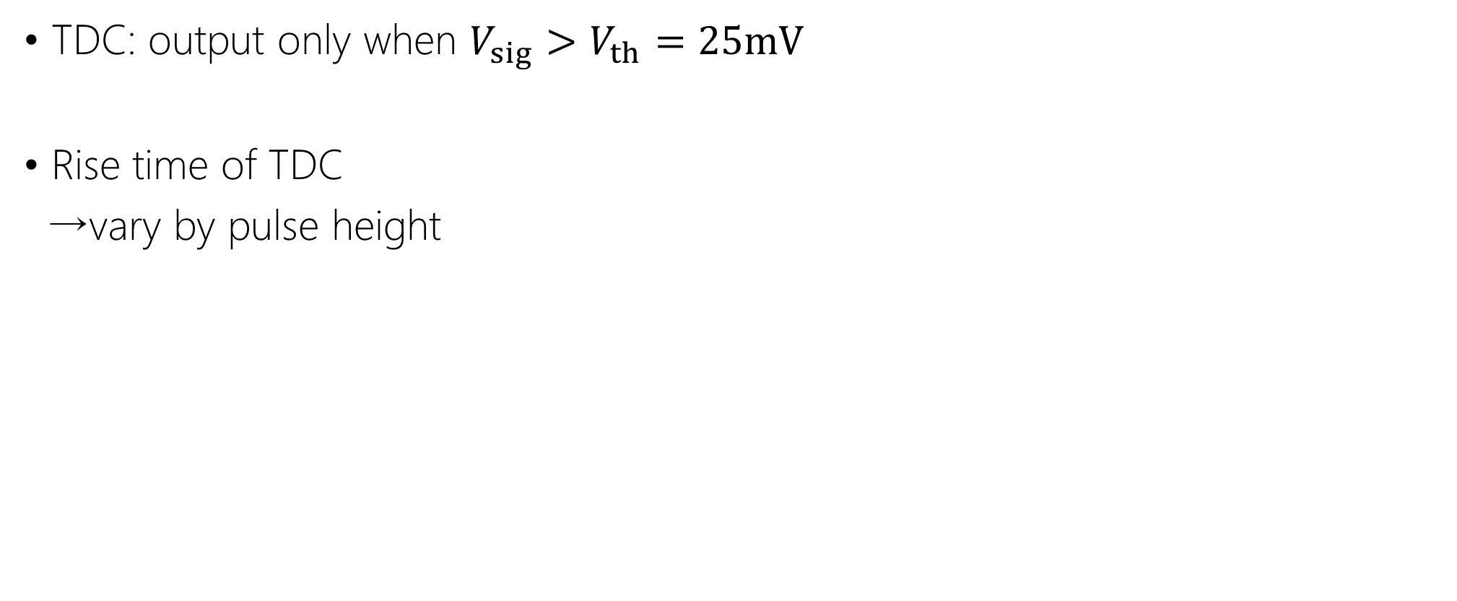
Time walk correction
TDC: output only when $V_{sig}>V_{th}=25mV$
Rise time of TDC
→vary by pulse height

Slide 5




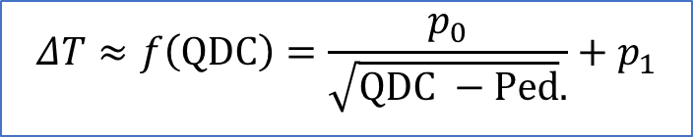
Time walk correction
Time walk correction
$ΔT≡TDC1 −TDC2$
After correction, $TOF=\left(TDC1 −\frac{{p_{1}}_{0}}{\sqrt{QDC1 −ped_{1}}}\right) −\left(TDC2−\frac{{p_{2}}_{0}}{\sqrt{QDC2 −ped_{2}}}\right)$
$$ΔT≈f\left(QDC\right)=\frac{p_{0}}{\sqrt{QDC −Ped}.}+p_{1}$$
$$\left(TDC1 −TDC2\right) −f\left(QDC\right)$$
$TDC1 −TDC2$
$$\left(TDC1 −TDC2\right)−f\left(QDC\right)$$
QDC1
QDC

Slide 6
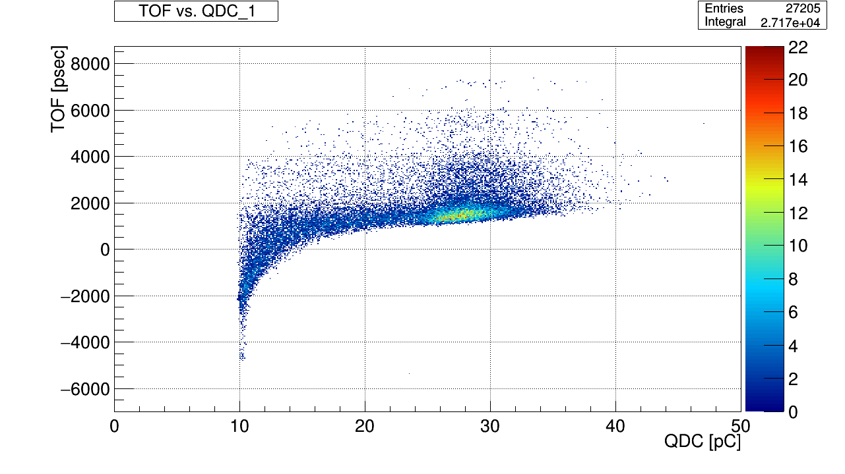
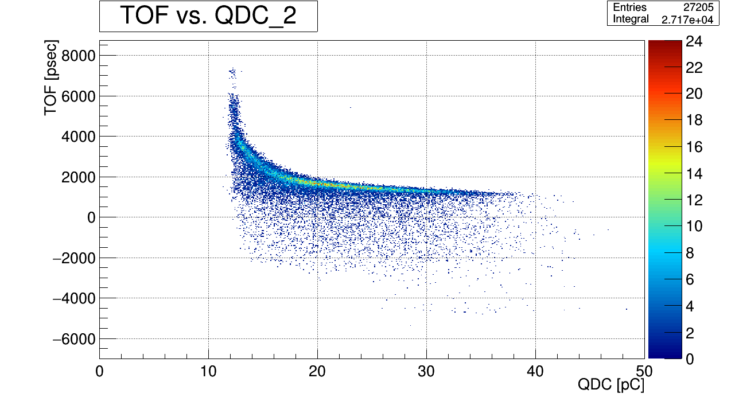





In progress: Constraints for data
$ΔT$ vs. QDC_1
$ΔT$ vs. QDC_2
Before → constrain with MPPC2.QDC
New → constrain with MPPC1.QDC
→ cutoff;$25.0<MPPC1.QDC<30.5 \left[ch\right]$
$$ΔT$$
$$ΔT$$

Slide 7
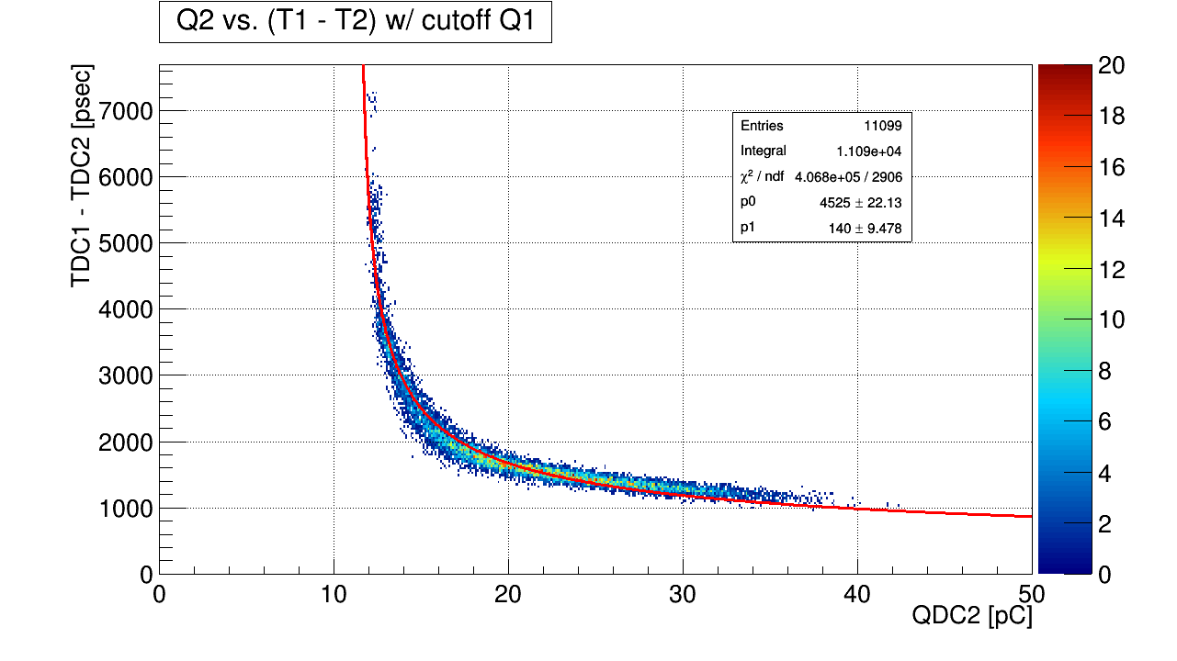
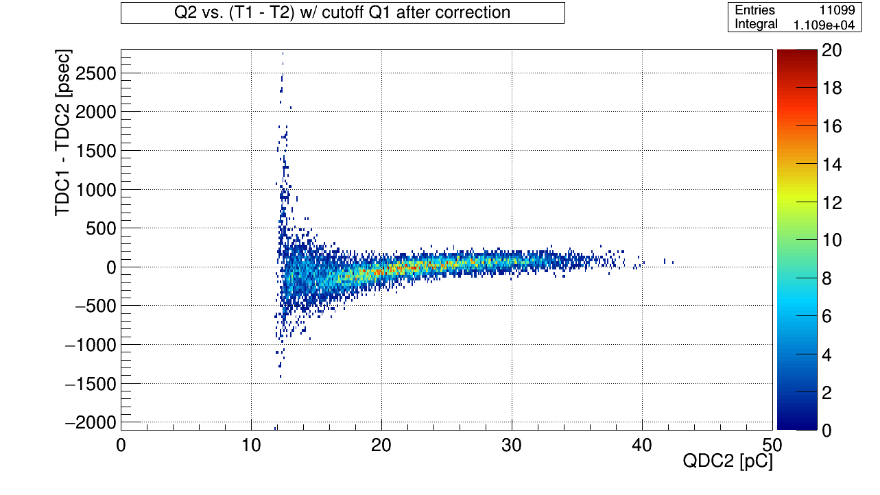
In progress
w/ cutoff
QDC2 vs. (TDC1 – TDC2), after correction
Over correction…
fit parameter x0.9 ➡ Work out? (by 永尾さん)

Slide 8
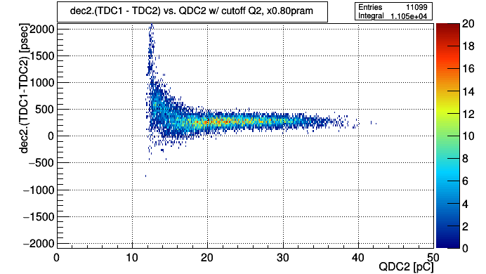

In progress
Result of fitting:
$$f\left(QDC2\right)=\frac{{p_{2}}_{0}}{\sqrt{QDC2\left[pC\right]−Ped[pC]}}+{p_{2}}_{1}$$
$$\left\{\begin{aligned}p_{2_{0}}=4524.74±22.1292 \left[psec∕{\left(pC\right)}^{1/2}\right] \\ p_{2_{1}}=140.049±9.47814 \left[psec\right] \end{aligned}\right.$$
0.80*p₂₀
next cutoff: 17.< QDC2 < 36. [pC]

Slide 9
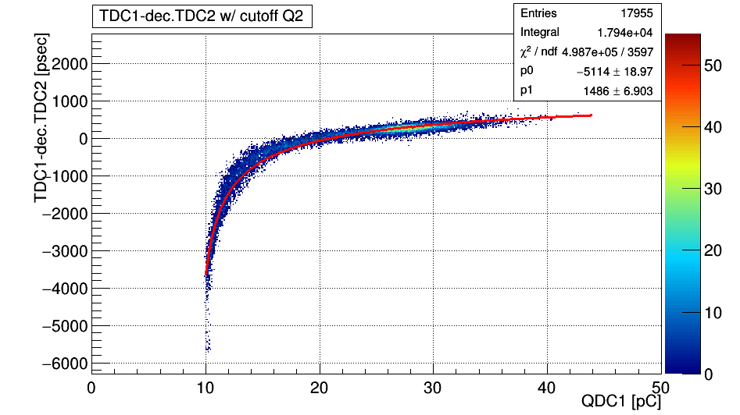
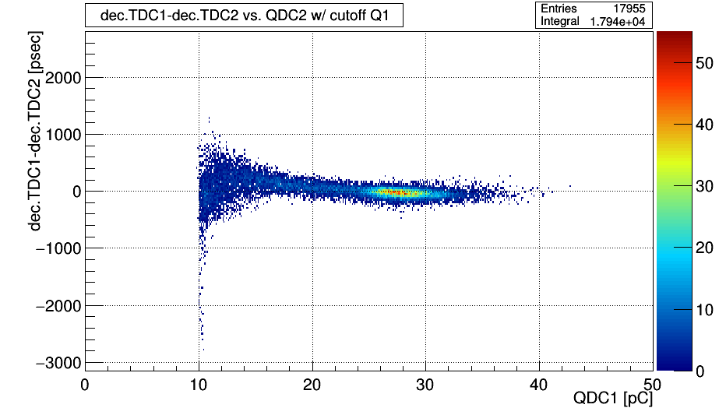
In progress
(TDC1 – TDC2) vs. QDC1 w/cutoff Q2
After correction

Slide 10
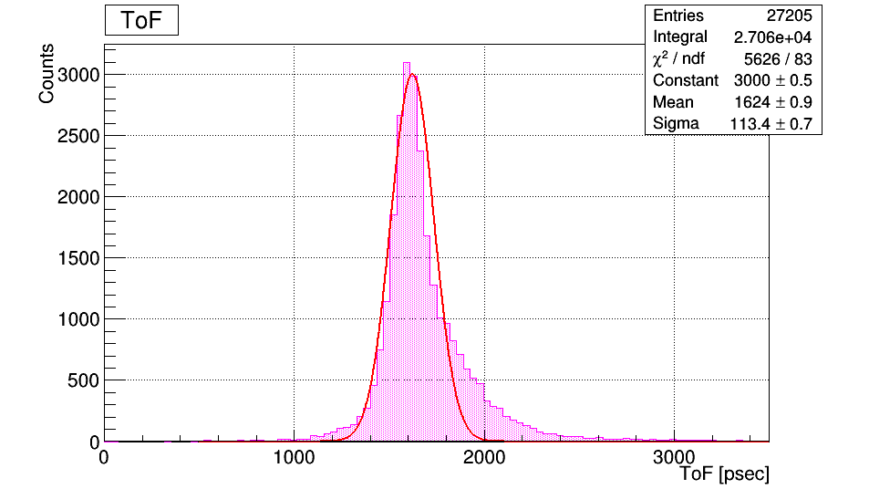
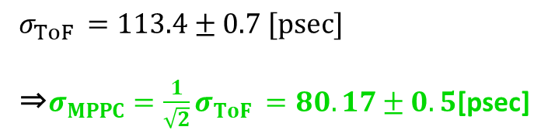
In progress
Result
$σ_{ToF }=113.4±0.7 [psec]$
⇒$σ_{MPPC}=\frac{1}{\sqrt{2}}σ_{ToF }=80.17±0.5$[psec]

Slide 11
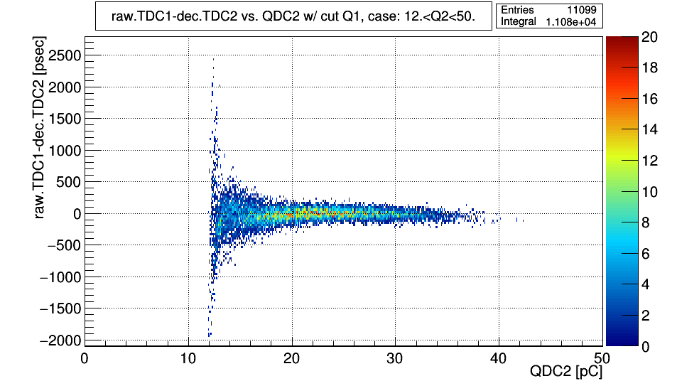
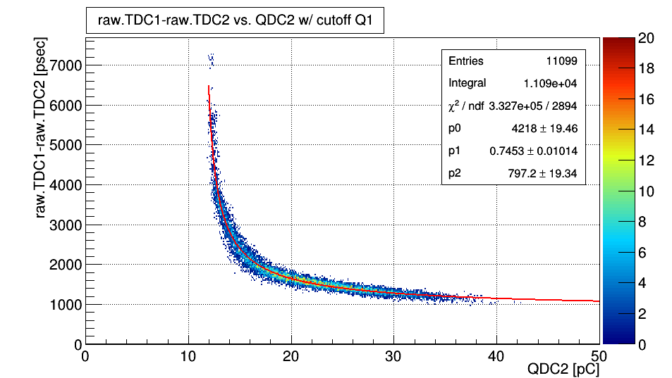

In progress
assume another functional type:
$g\left(QDC\right)=\frac{p_{0}}{{\left(QDC −Ped\right)}^{p_{1}}}+p_{2}$
after correction

Slide 12
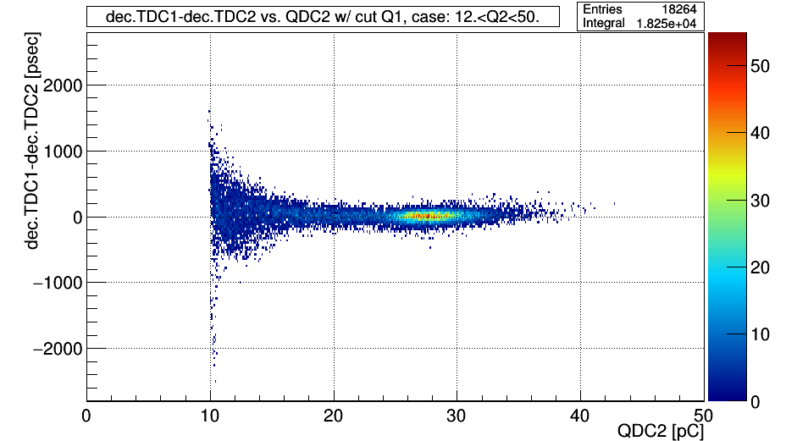
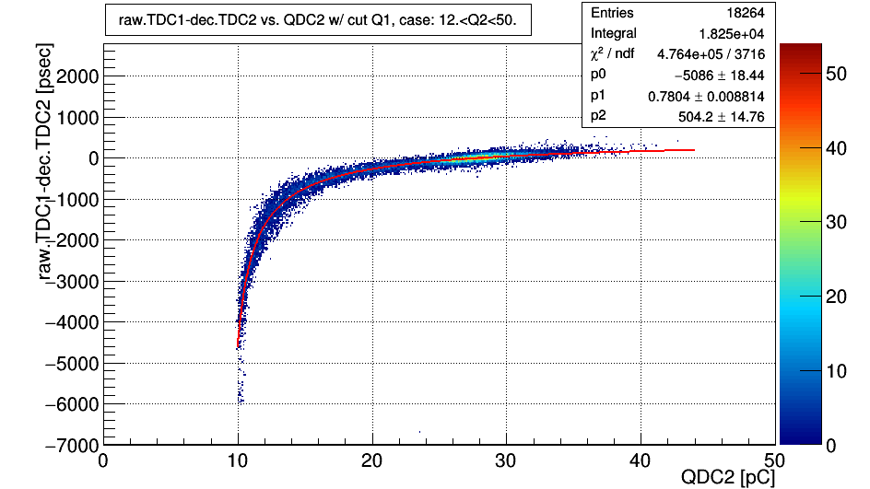
In progress
QDC1
QDC1

Slide 13
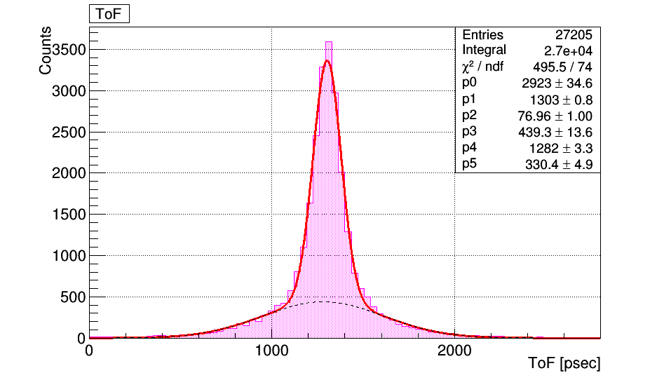
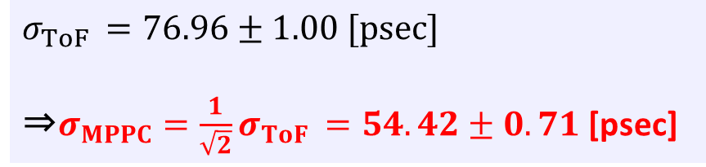
In progress
Reslut: fitting w/ 2gaussian
$σ_{ToF }=76.96±1.00 [psec]$
⇒$σ_{MPPC}=\frac{1}{\sqrt{2}}σ_{ToF }=54.42±0.71$[psec]

Slide 14
To do next
evaluate time resolution of other run data
⇒compare among different condition
日本物理学会会員登録・物理学会申し込み

