Slide 1
Status Report #5
What I have done
2019.11.22 (Fri)
B4 FUJIWARA Tomomasa
ROOT&G4 Seminar
Evaluate timing resolution MPPC

Slide 2
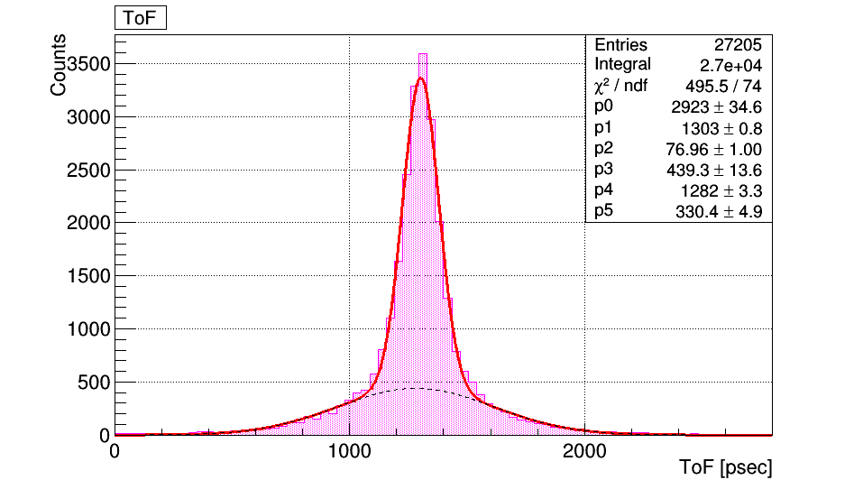


Evaluate timing resolution MPPC
analyze timing resolution of MPPC under different conditions
Focus on value of “V_{b}”
Before: beta0046(data) & 0047(Pedestal) ⇒ $V_{b} =47.7 \left[V\right]$
This time :
V_{b} =41.7V (0042 & 0043)
V_{b} =44.7V (0044 & 0045)
V_{b} =50.7V (0049 & 0048)
V_{b} =53.7V (0050 & 0051)
$σ_{MPPC}$= 54 psec

Slide 3
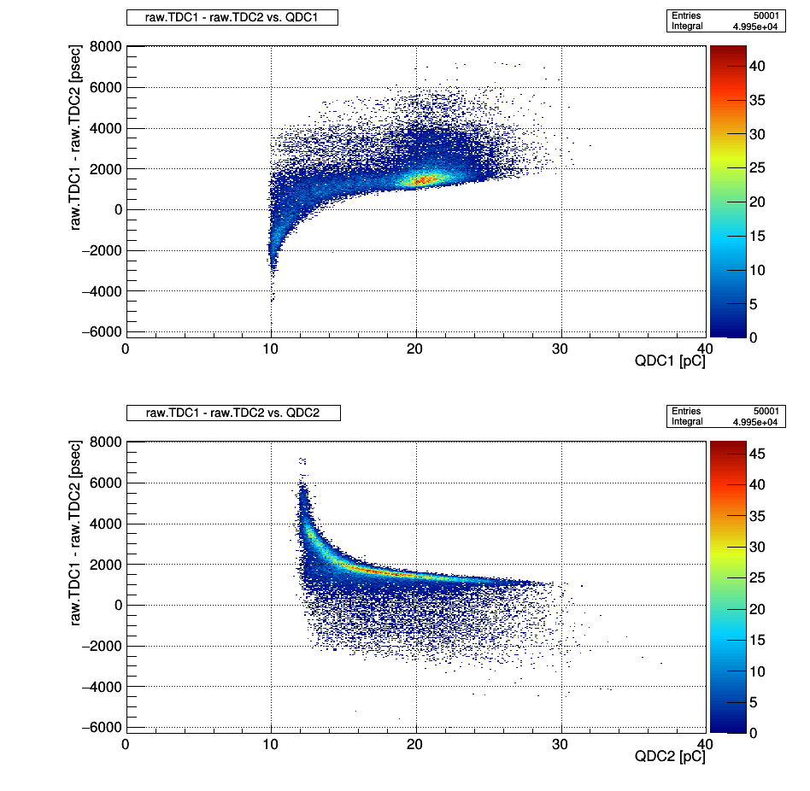
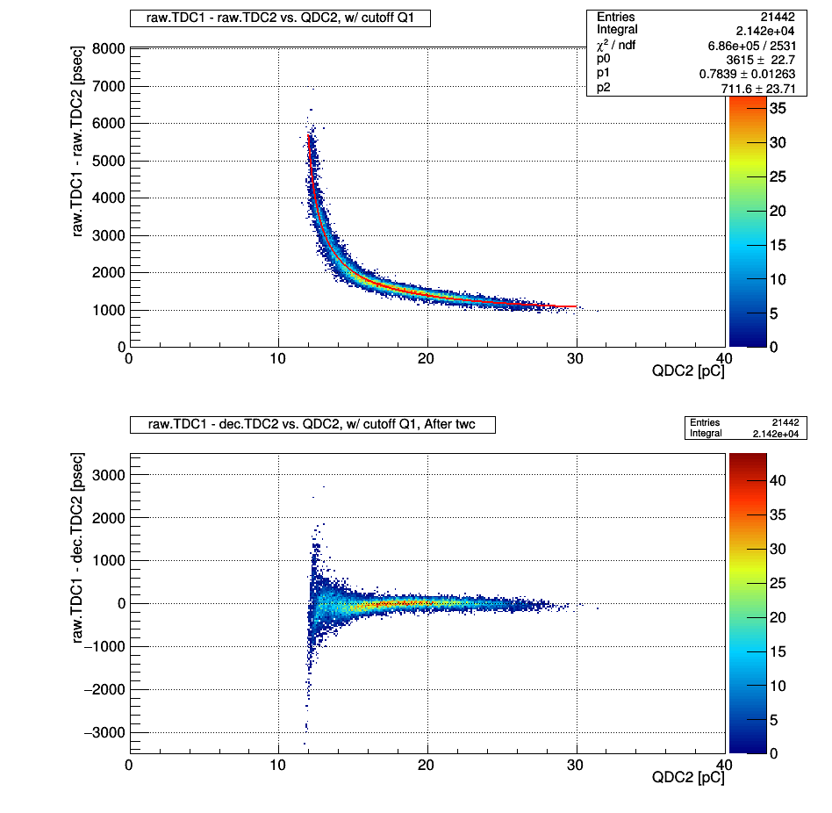
Evaluate timing resolution MPPC: case of V_{b} =44.7V
↓ (r.T1 – r.T2)vs.Q1&Q2
Cutoff: 18.7<Q1 [pC]<22.4, after twc

Slide 4
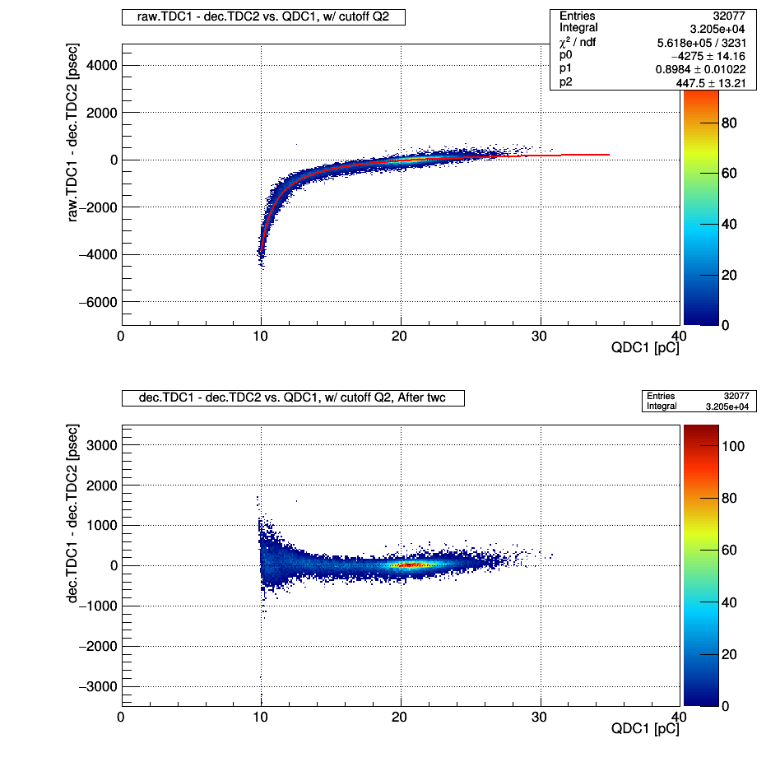
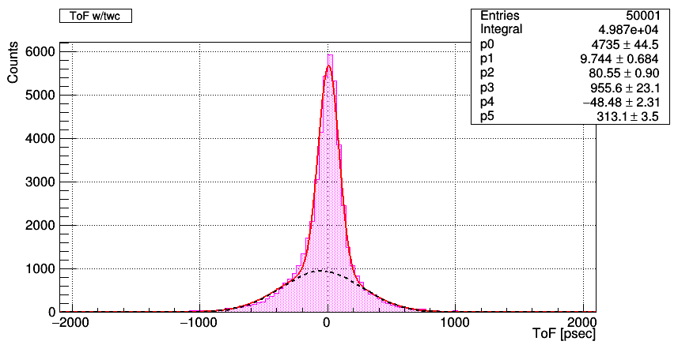
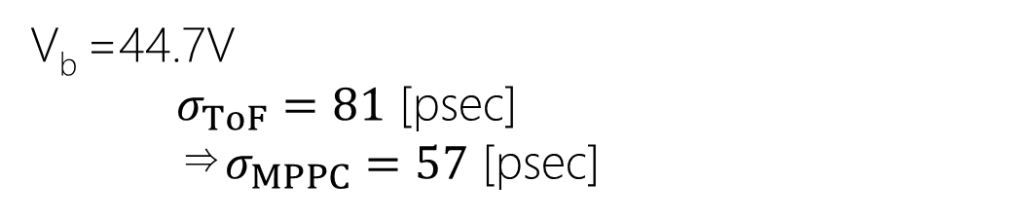
Evaluate timing resolution MPPC: case of V_{b} =44.7V
Result: ToF dist.
Cutoff: 14.0<Q2 [pC]<22.7
V_{b} =44.7V
$σ_{ToF}=81$ [psec]
⇒$σ_{MPPC}=57$ [psec]

Slide 5
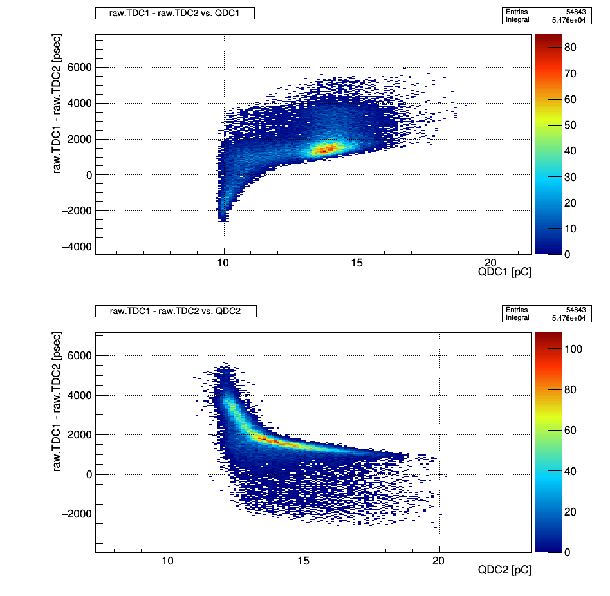
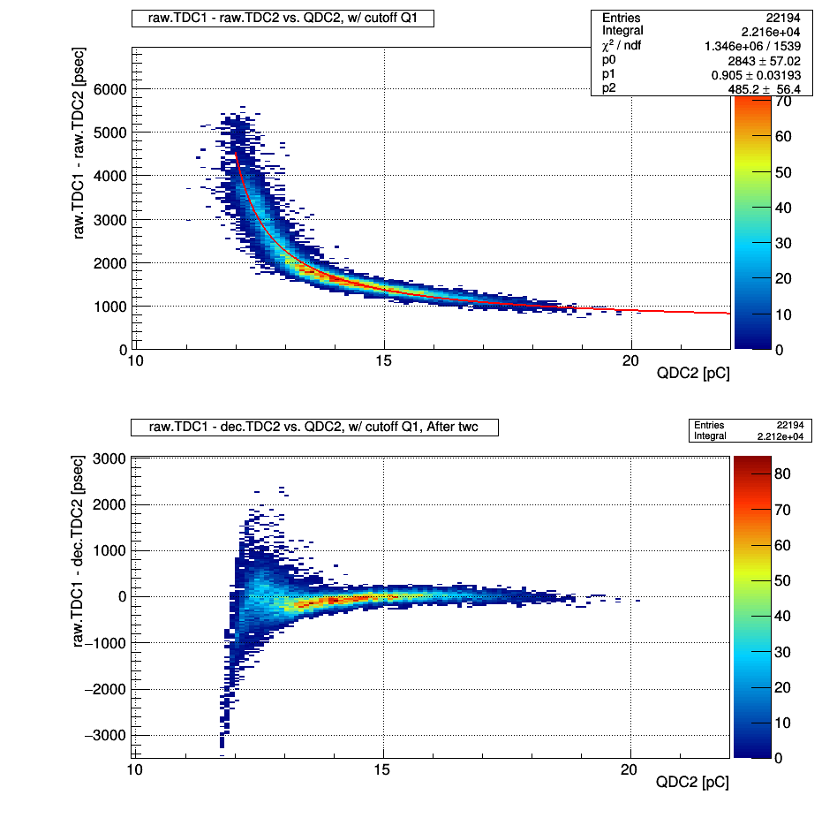
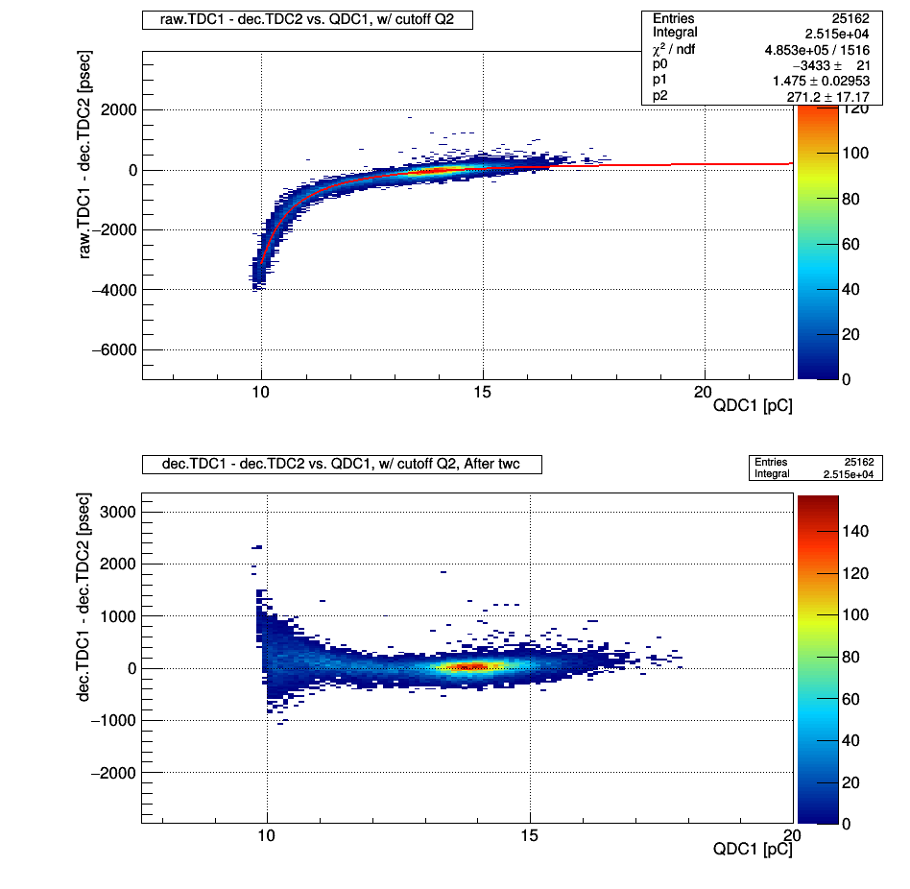
Evaluate timing resolution MPPC: case of V_{b} =41.7V
↓ (r.T1 – r.T2)vs.Q1&Q2
After Q1 selection

Slide 6
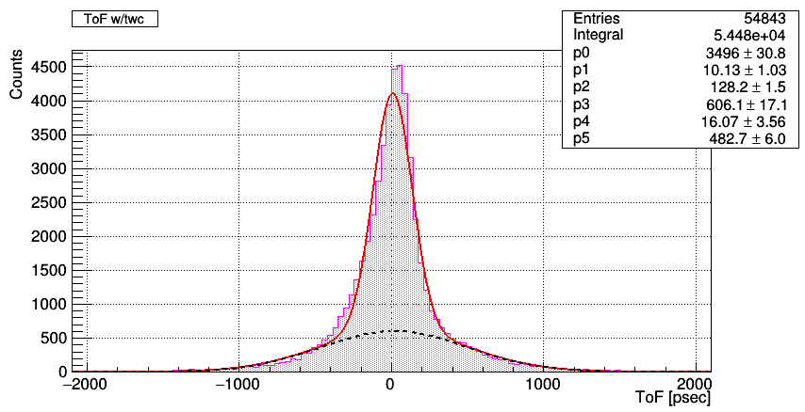
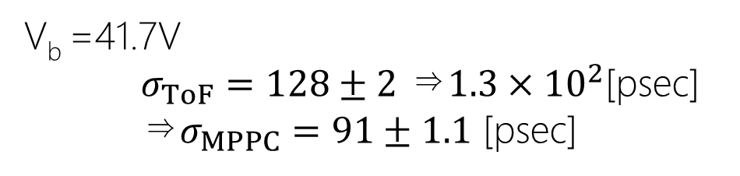
Evaluate timing resolution MPPC: case of V_{b} =41.7V
Result: ToF dist.
Over
V_{b} =41.7V
$σ_{ToF}=128±2$ ⇒$1.3×{10}^{2}$[psec]
⇒$σ_{MPPC}=91±1.1$ [psec]
Bad resolution… Really??

Slide 7
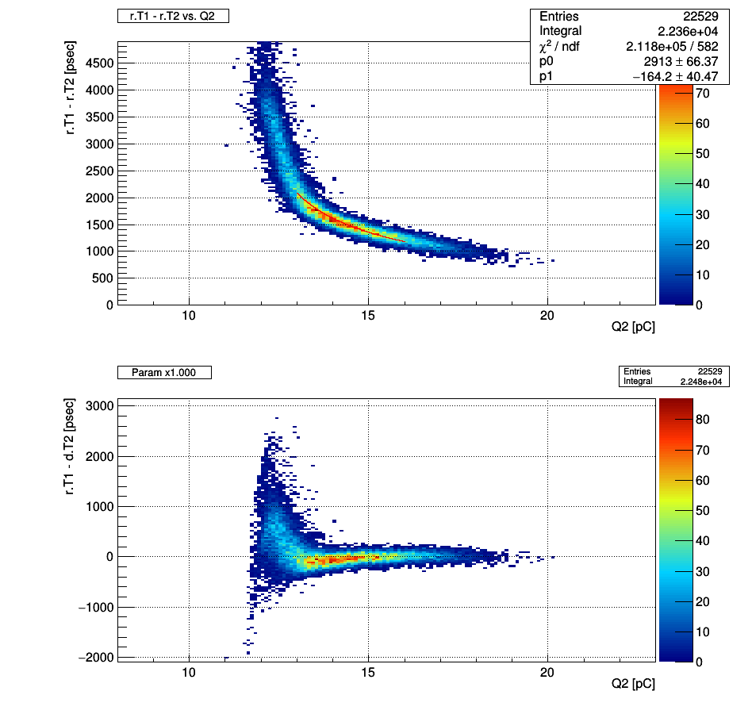

Evaluate timing resolution MPPC: case of V_{b} =41.7V
Modify twc functional type:
$f\left(QDC\right)=\frac{p_{0}}{\sqrt{QDC−Ped}}+p_{1}$
Constrain fit range:
13.0<Q2 [pC]< 16.0
Still over …

Slide 8
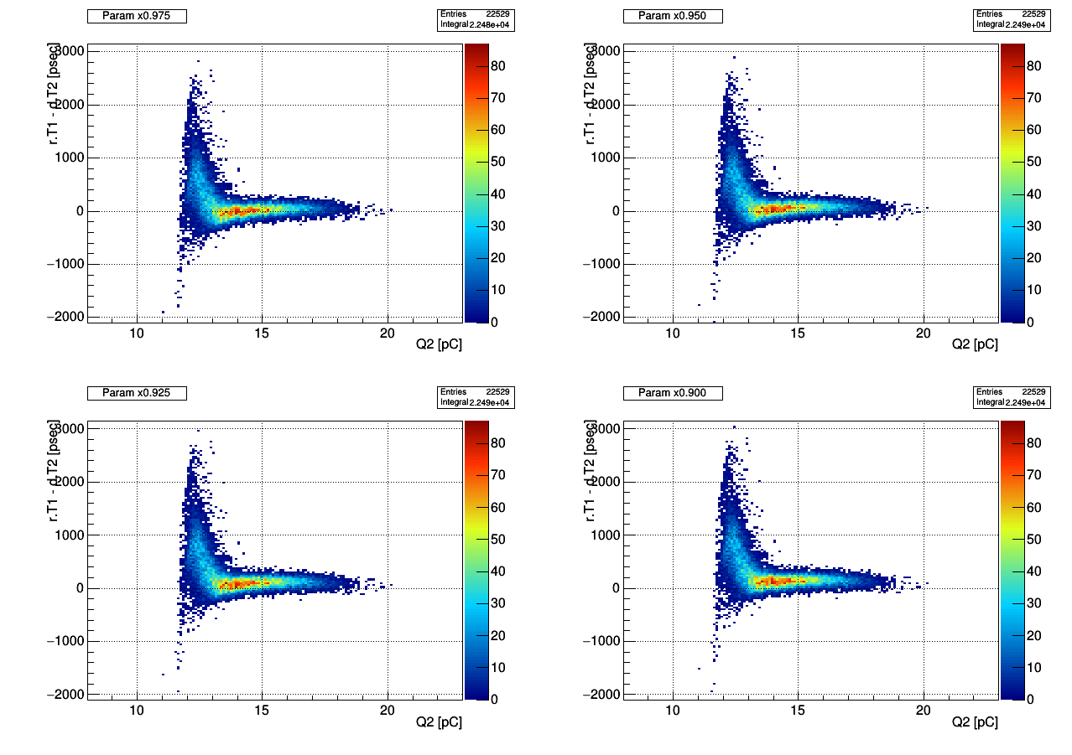
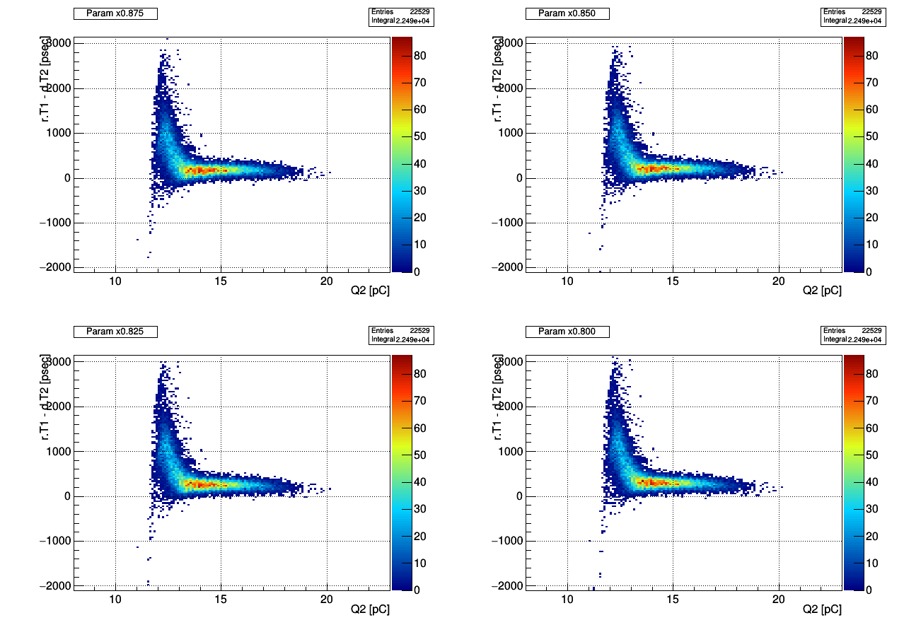
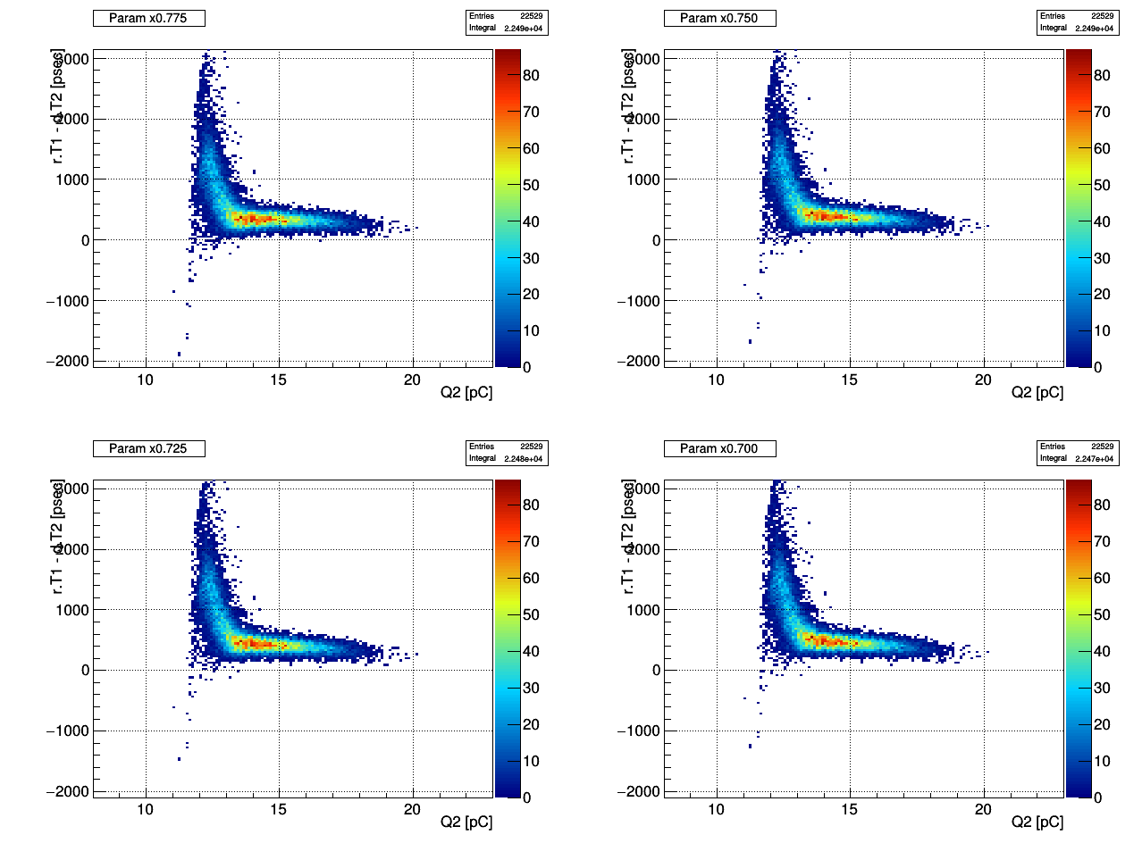
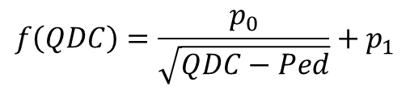
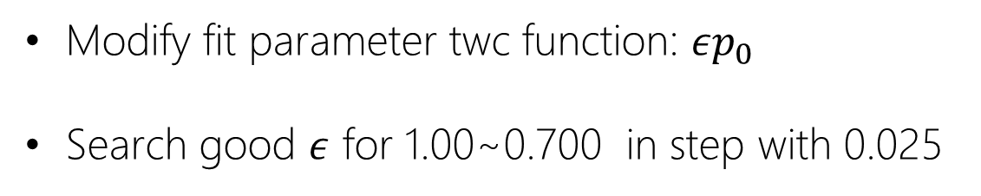
Evaluate timing resolution MPPC: case of V_{b} =41.7V
Modify fit parameter twc function: $εp_{0}$
Search good $ε$ for 1.00~0.700 in step with 0.025
$$f\left(QDC\right)=\frac{p_{0}}{\sqrt{QDC−Ped}}+p_{1}$$
⇒ x0.825 is good?

Slide 9
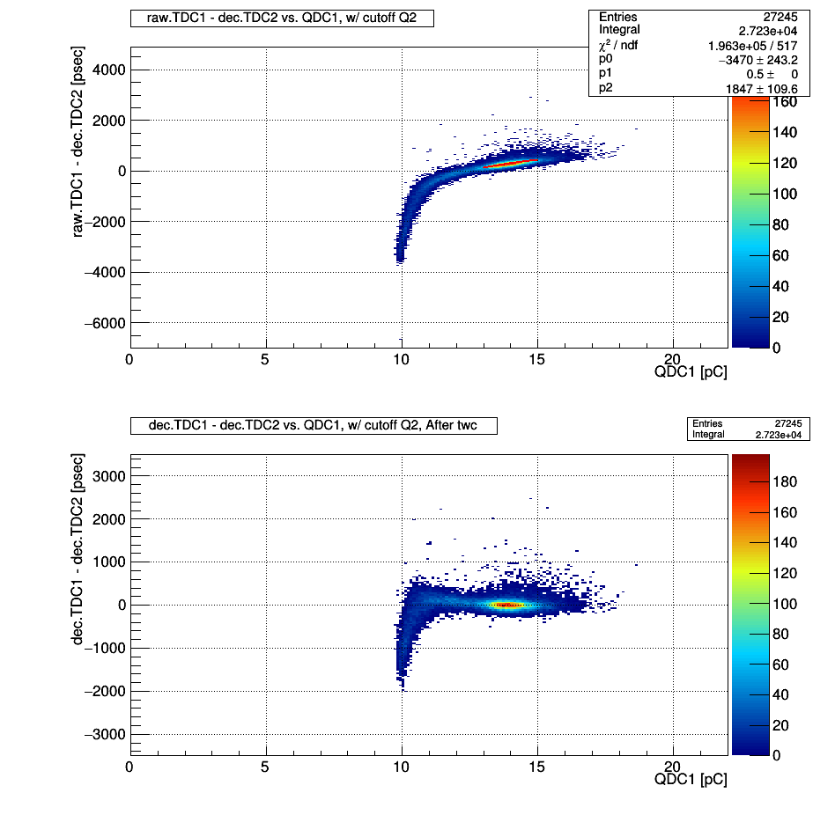
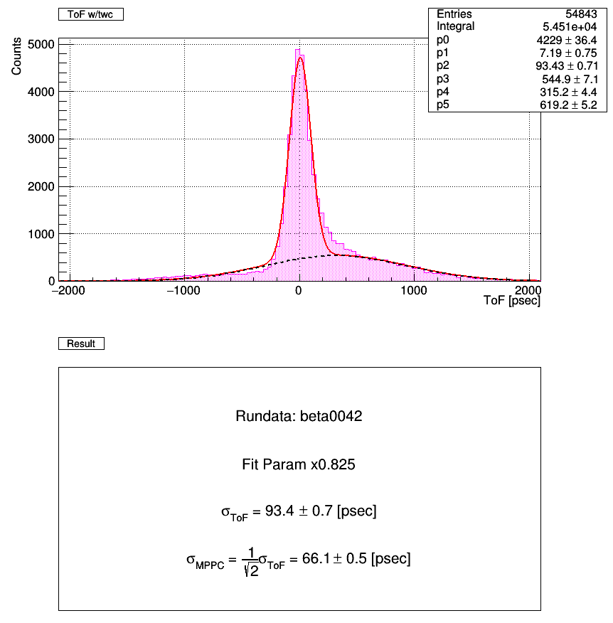
Evaluate timing resolution MPPC: case of V_{b} =41.7V

Slide 10
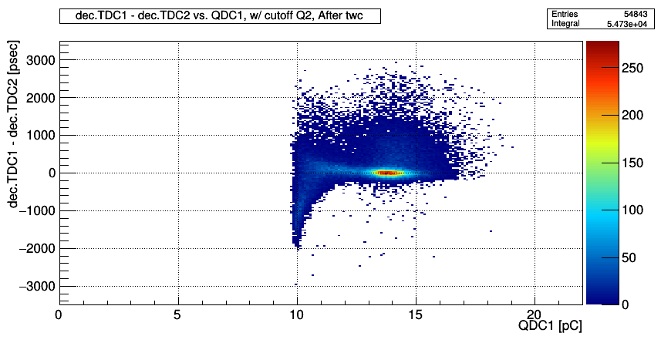
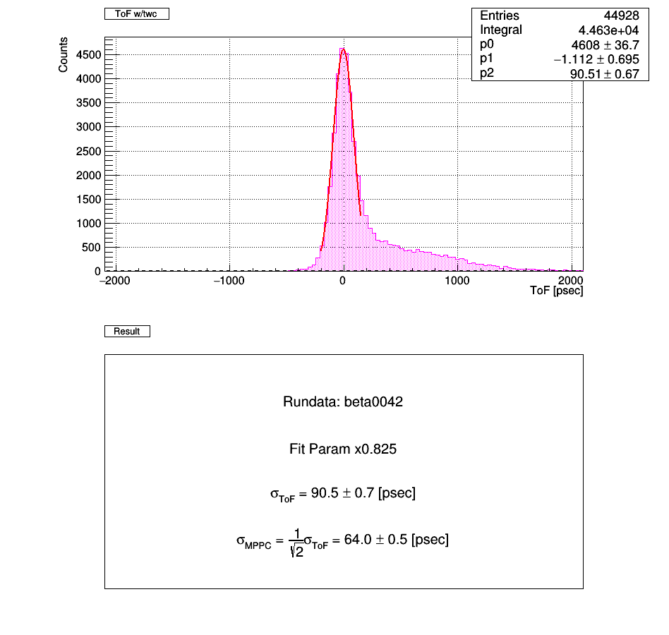
Evaluate timing resolution MPPC: case of V_{b} =41.7V
Cut: Q1 > 11.0pC

Slide 11
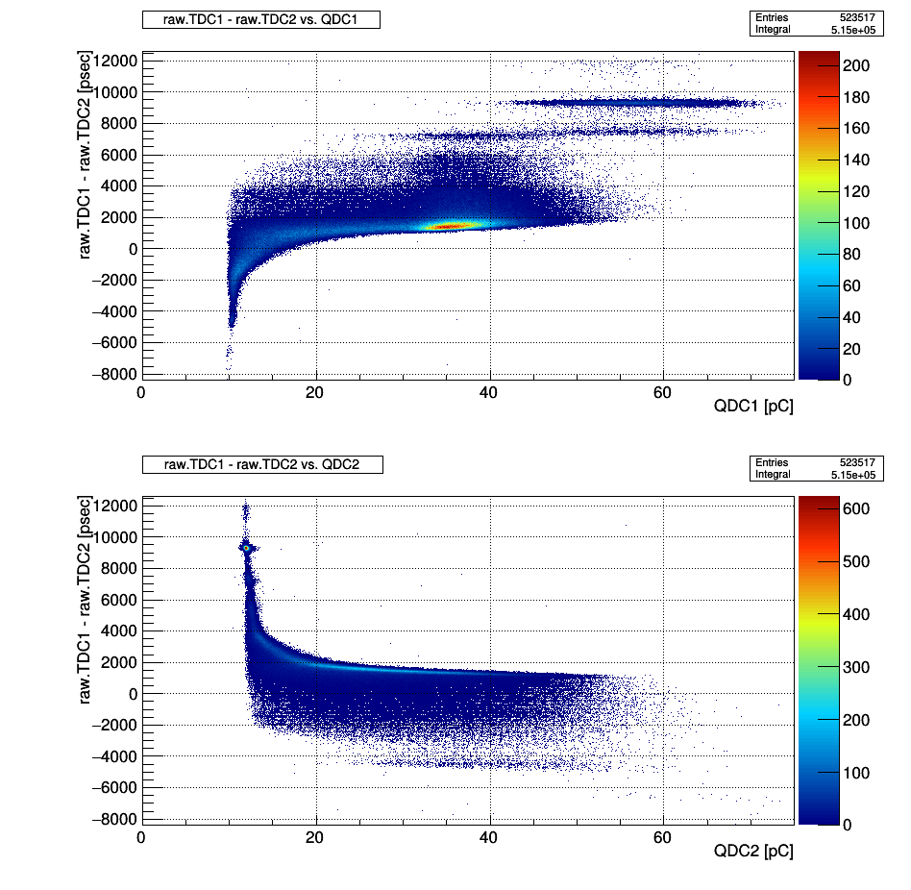
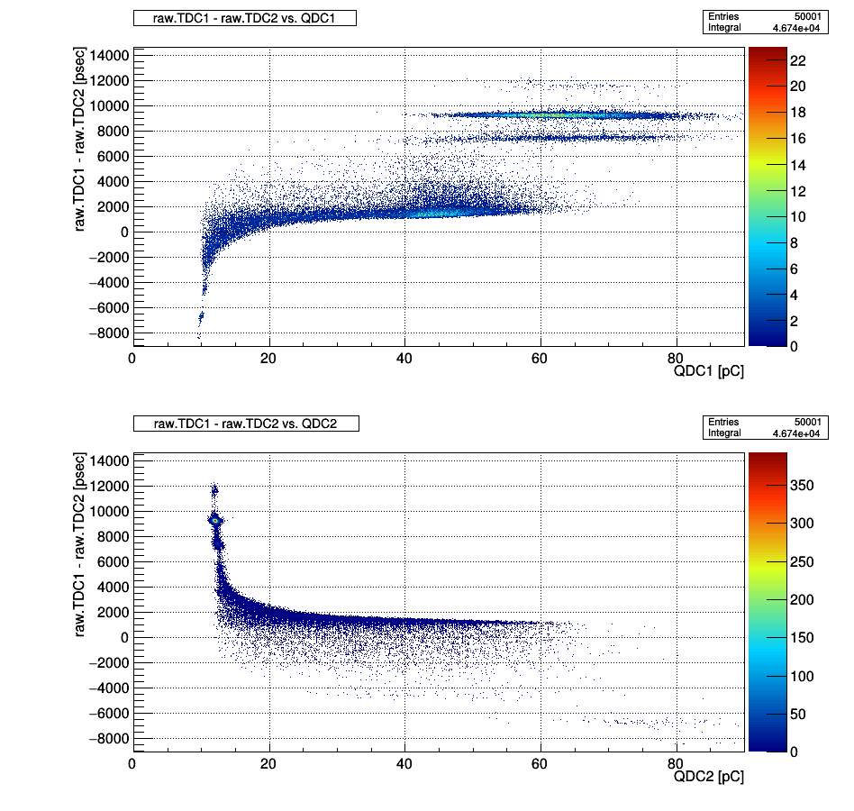
Case of high V_{b} region
Strange structure
???

Slide 12
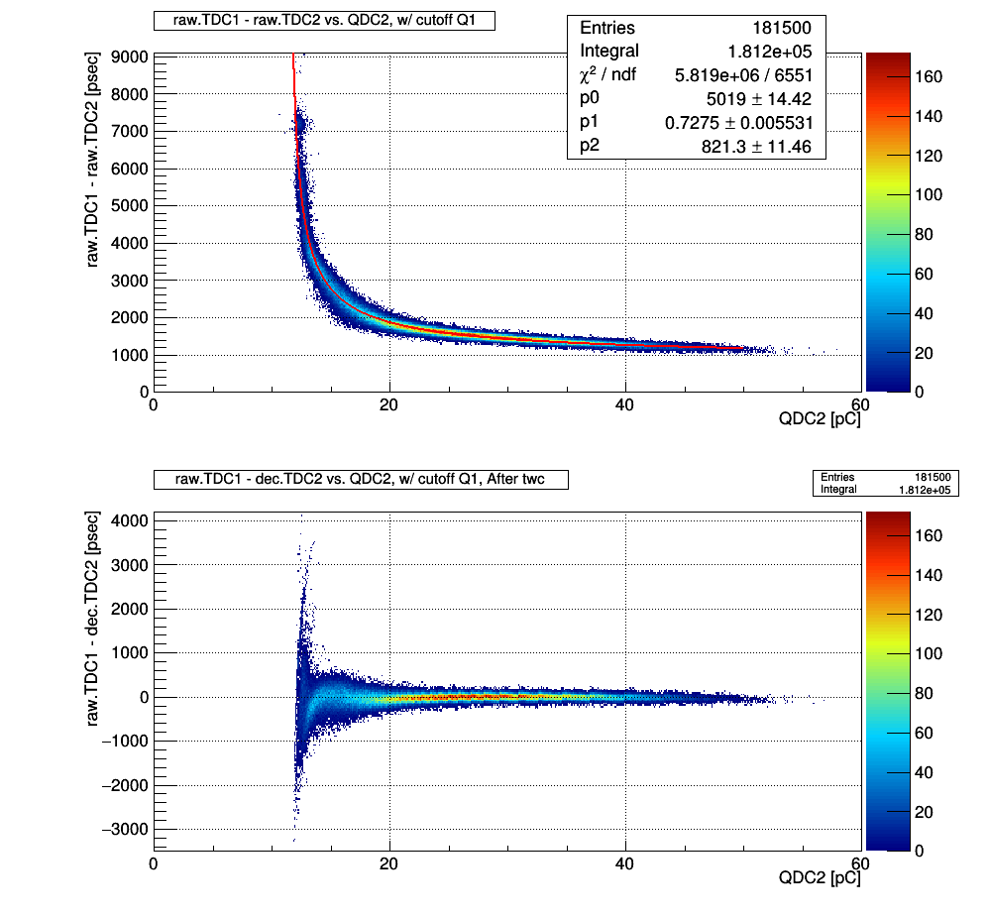
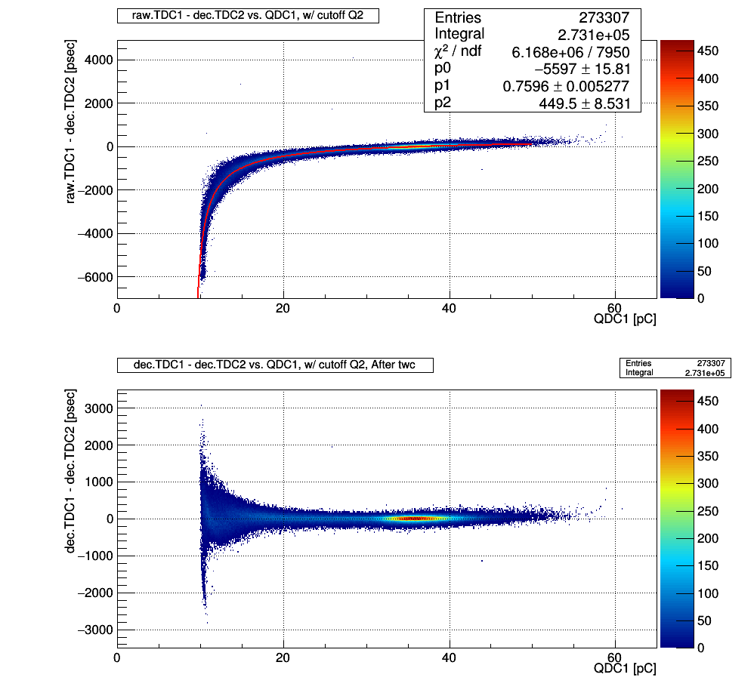
Evaluate timing resolution MPPC: case of V_{b} =50.7V

Slide 13
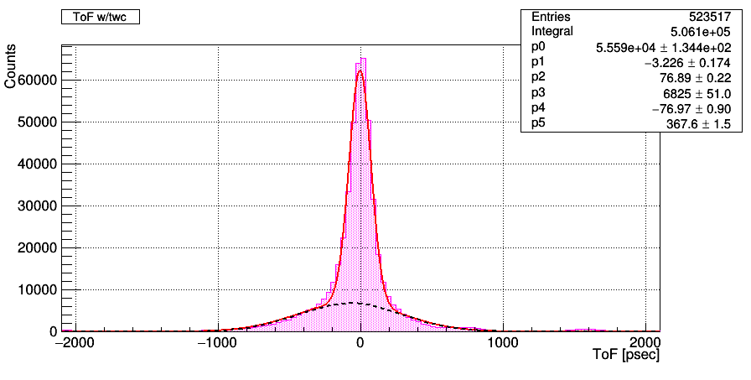
Evaluate timing resolution MPPC: case of V_{b} =50.7V
σ_{ToF} = 76.9 psec
σ _{MPPC}= 54.4 psec

Slide 14
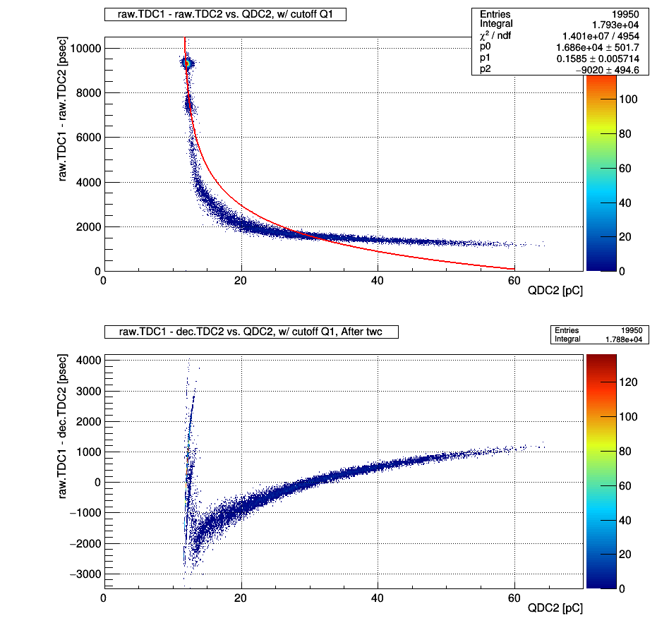
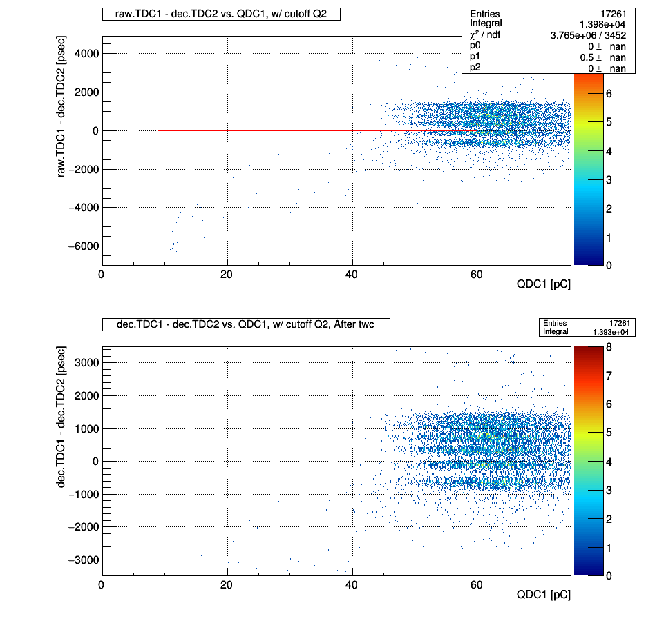
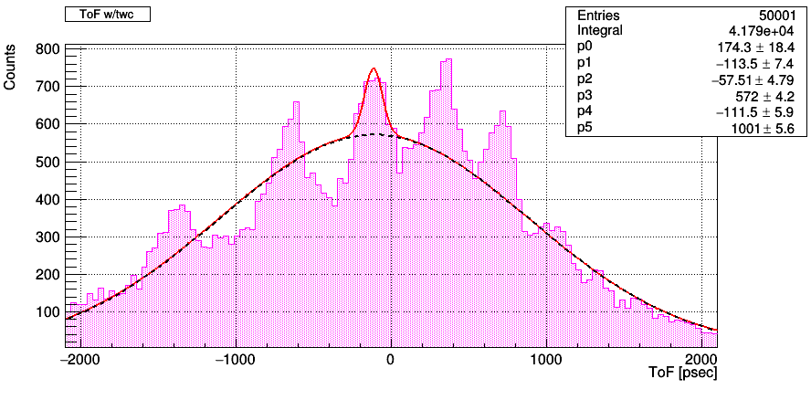
Evaluate timing resolution MPPC: case of V_{b} =53.7V

Slide 15
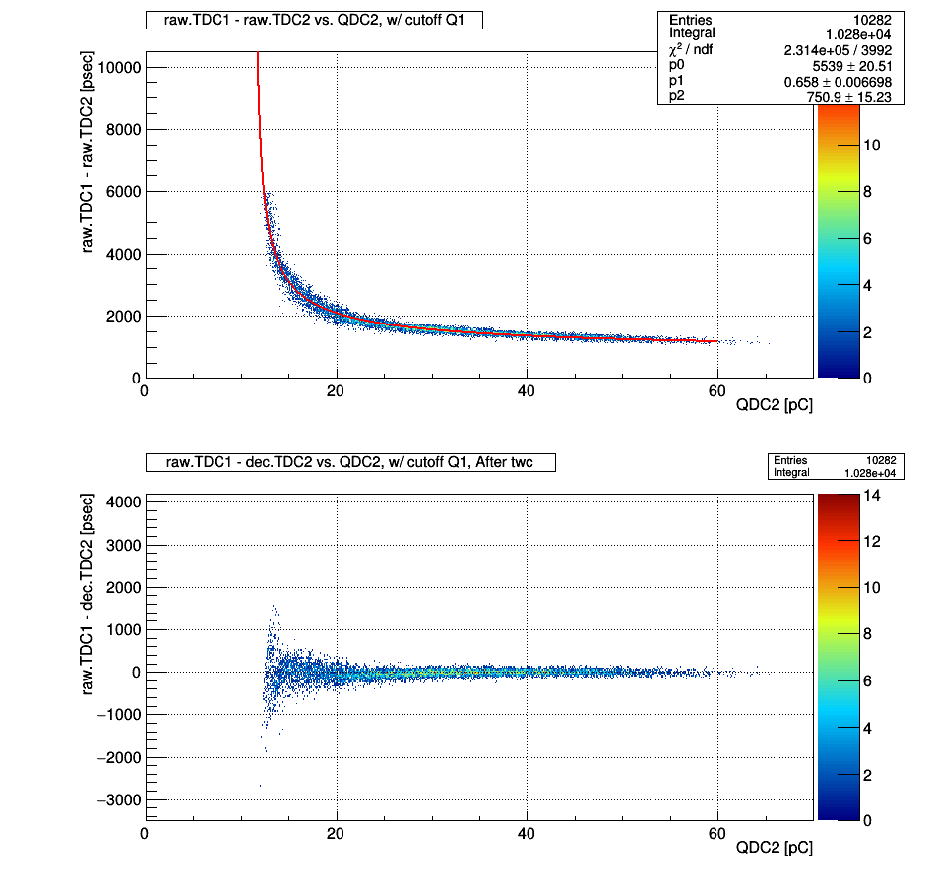
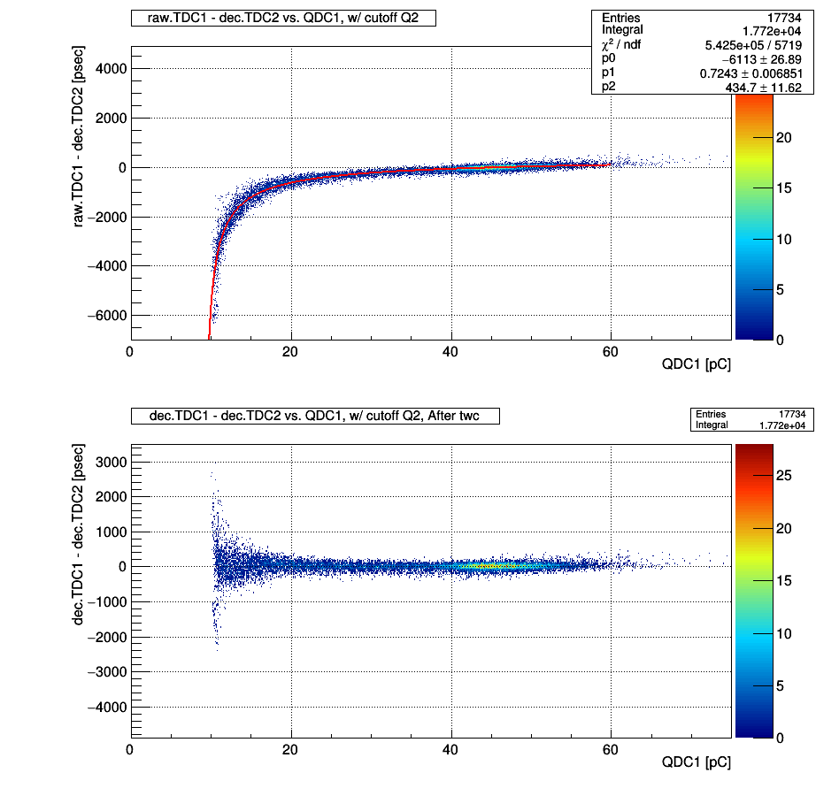
Evaluate timing resolution MPPC: case of V_{b} =53.7V

Slide 16
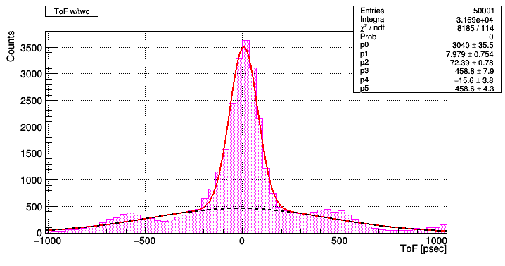
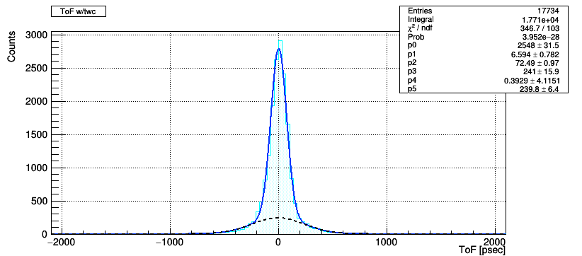
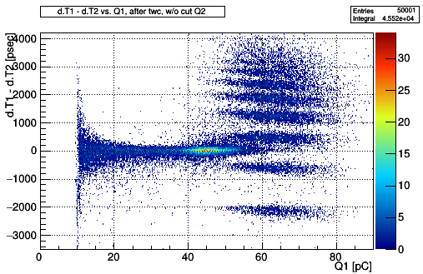
Evaluate timing resolution MPPC: case of V_{b} =53.7V
σ_{ToF} = 72 psec
σ _{MPPC}= 51 psec

Slide 17
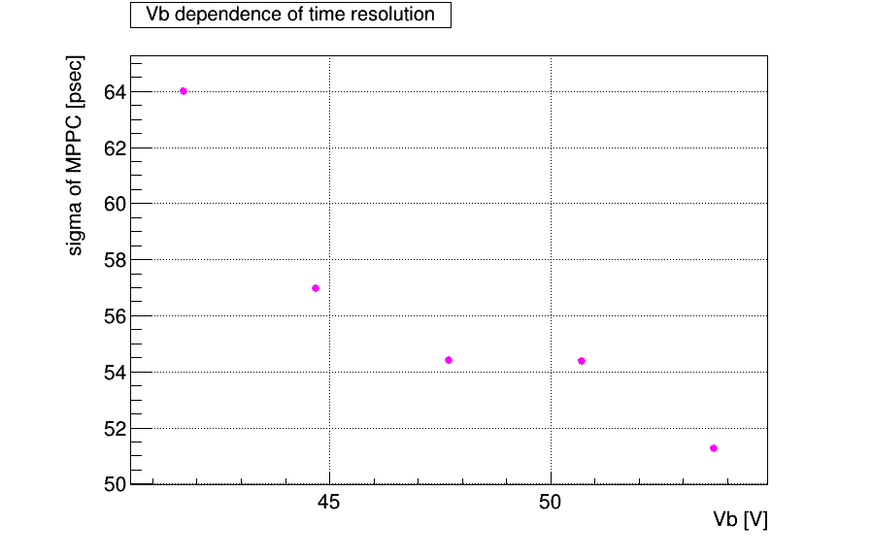
Result

Slide 18
Next to do
Continue analyzing time resolution of MPPC
ROOT & G4 seminar
Report of lecture(deadline: 12.6)
Prepare for detector seminar

