Slide 1
Status report #10
Contents
2020. 01. 09 (Thu)
B4 T. Fujiwara
status of beam time data analysis
Hyper nuclear seminar
Happy new year!

Slide 2
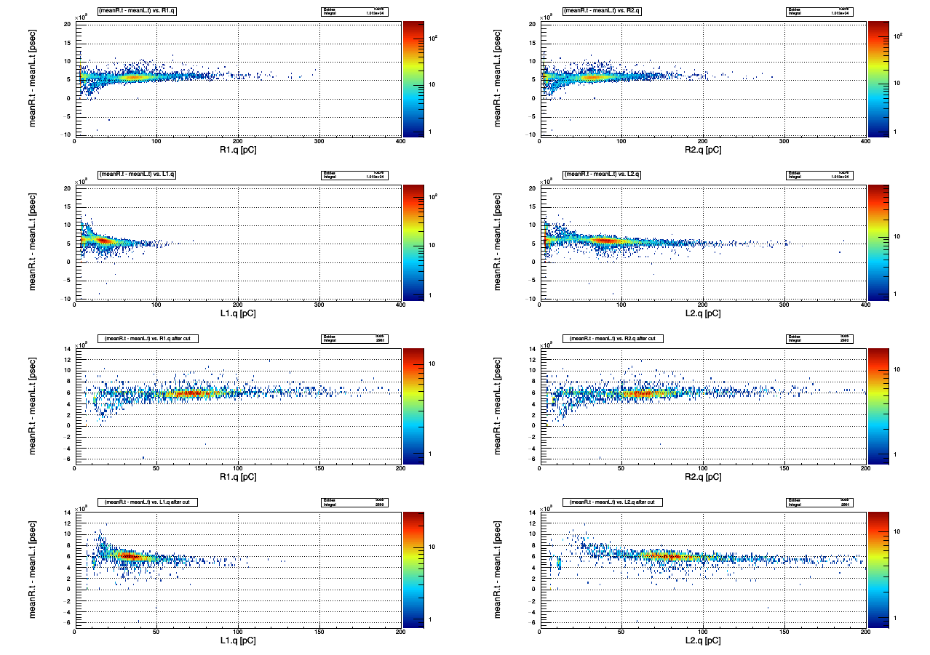
Consideration for cutoff conditions -i-
R2
L2
Case of run0123 data (V_{b} = 44.7V)
What I want to do: remove QDC ~ 0 region
Total entry: ~ 18000, these region ~ 4000-5000 ⇒ accidental ?
Beam direction
R1
L1

Slide 3
Consideration for cutoff conditions -ii-
Apply ToF(BLT – T1) cut: (tdc of T1-1, 2, 3 & BLT1t, b > 0) ⊕ -23 [nsec]<(tdc mean of BLT1t, b – T1-1, 2, 3)<5[nsec]
Still left...

Slide 4
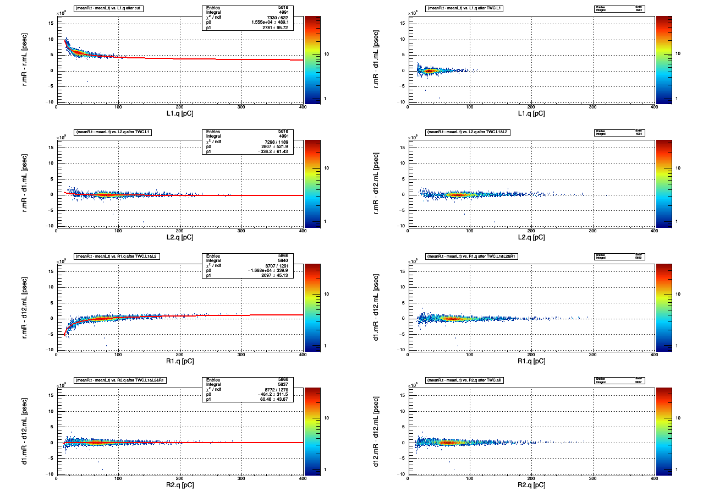
Time walk correction -i-
L1
For now, twc with R1.qdc:
500[ch] < qdc2[10] (R1.qdc)< 1000
From the result of correction for L2,
690[ch] < qdc2[13] < 4095
L2
R2
L2
R1
Beam direction
R1
L1
R2

Slide 5
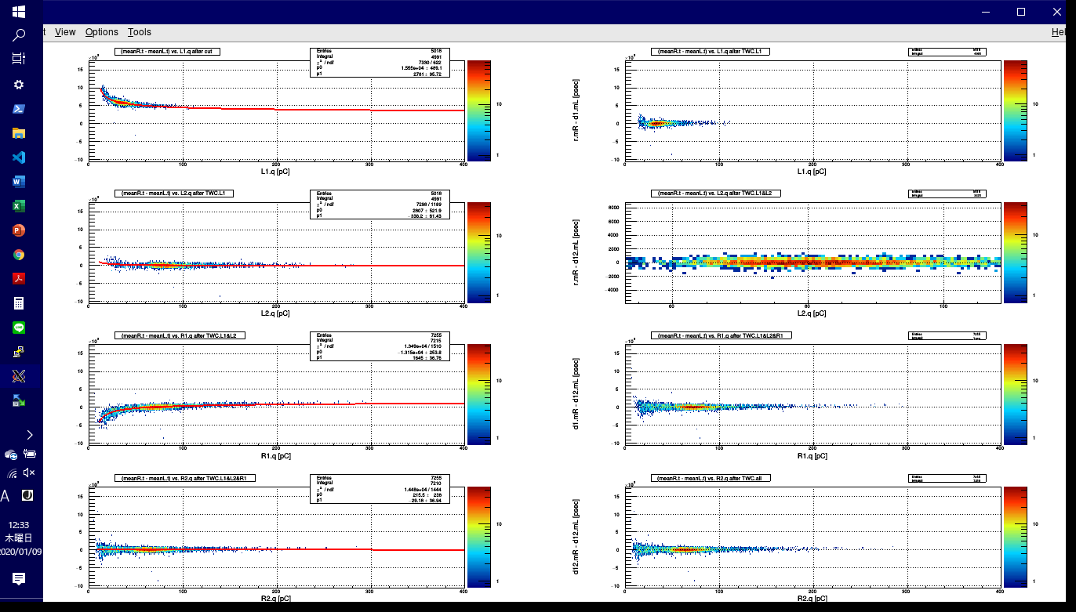
Time walk correction -ii-
About decision of cutoff condition of L2.qdc
What I wanted to do
→ get position (x, y) of bin with maximum entry
→ return “69” but...
double max = h_twc[3] -> GetBinContent(h_twc[3] -> GetMaximumBin());
double M_X = h_twc[3] -> GetXaxis() -> FindFixBin(max);

Slide 6
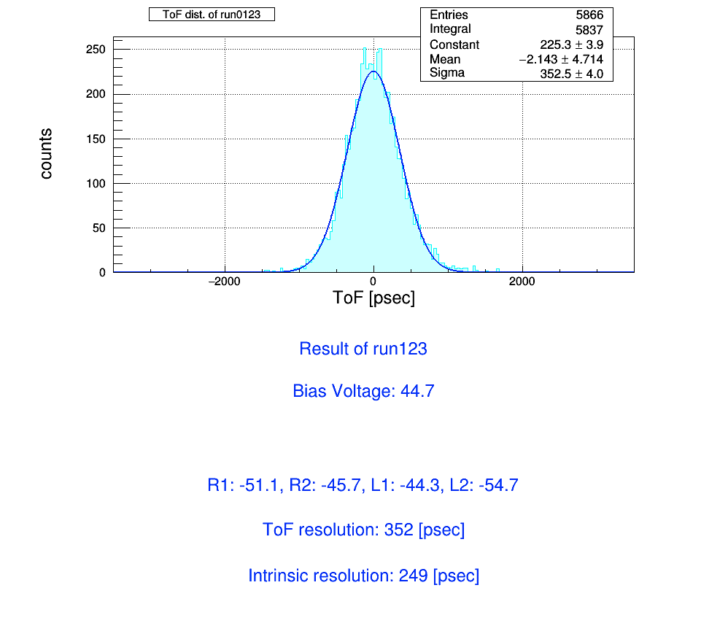
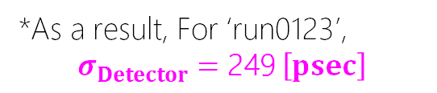
Time walk correction -iii-
*As a result, For ‘run0123’,
$$σ_{Detector}=\text{249} \left[psec\right]$$
年末休み（とゼミの準備等）にかまけて解析に全然手を付けてませんでした...
申し訳ありません．
今日から頑張ります...

Slide 7
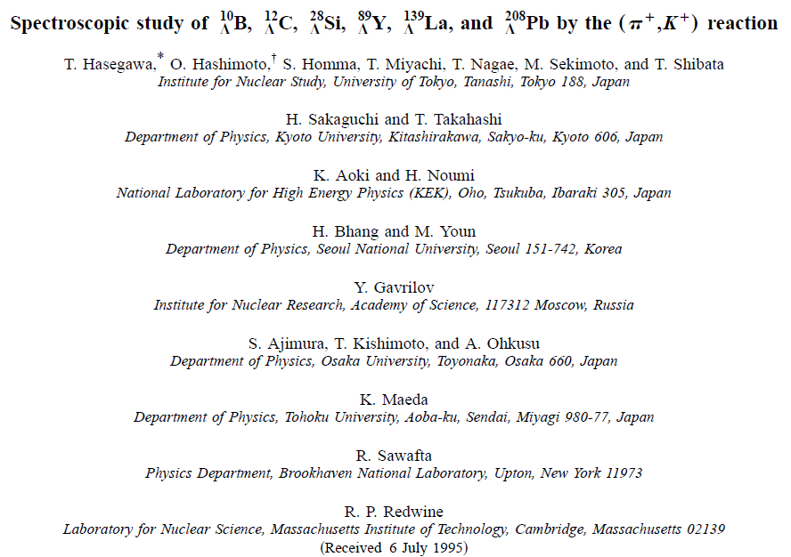
To do next
To continue analysis: V_{b}, V_{th}T1 dependence
“ToF counter” test at testbench using cosmic ray and β-ray source
Hypernuclear physics seminar
JPS abstract

