Slide 1
Status Report #11
2020. Jan. 17 (Fri)
B4 Tomomasa FUJIWARA
Progress of ToF data analysis
Bias dependence
Consideration new(?) method w/ TDC cut
JPS abstract
Hypernuclear physics seminar

Slide 2
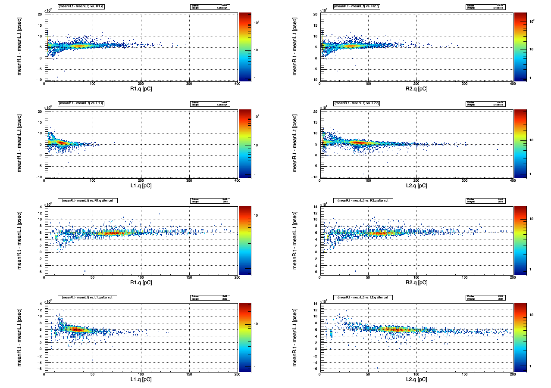
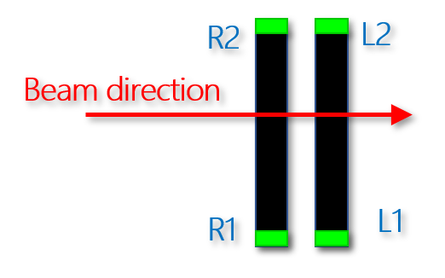
Progress of ToF data analysis
run0123
Previous result
*Ignored strange region
* Time walk correction

Slide 3
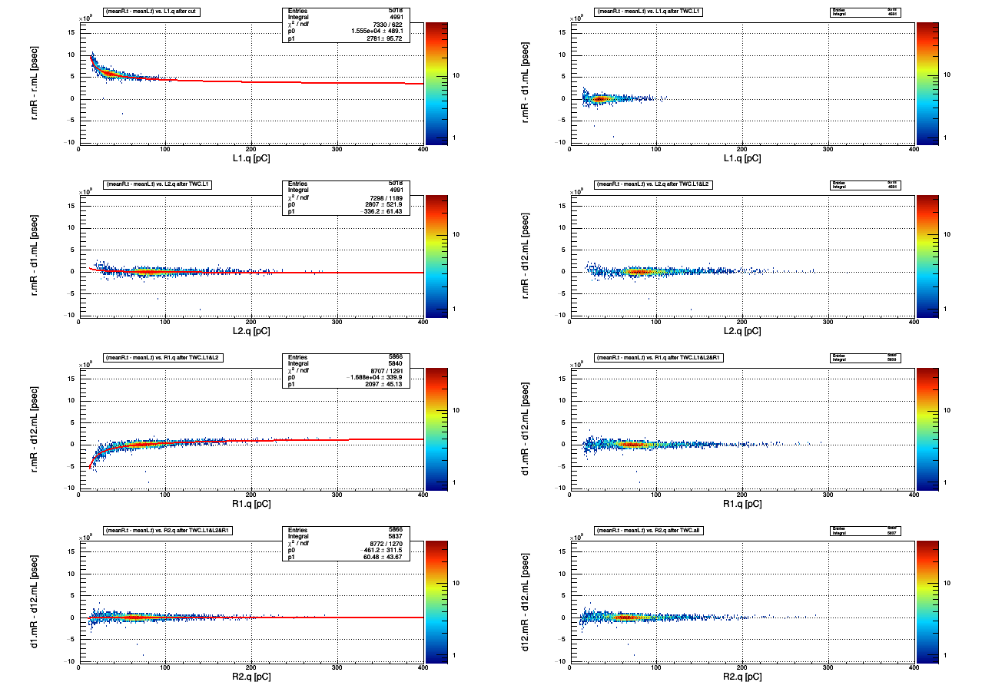
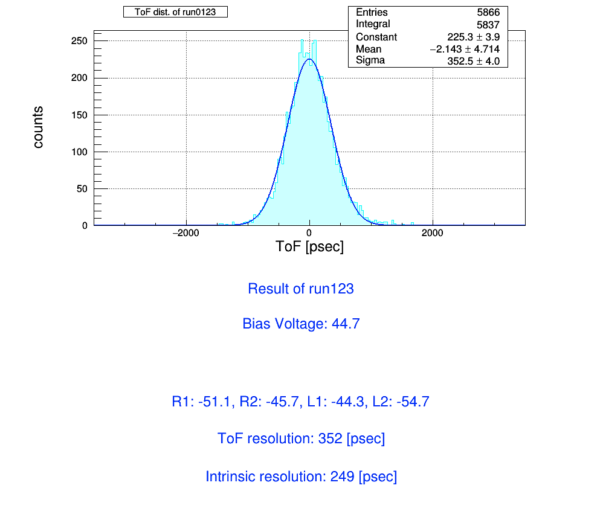
Progress of ToF data analysis
L1
*Ignored strange region
* Time walk correction
a
L2
R1
R2

Slide 4
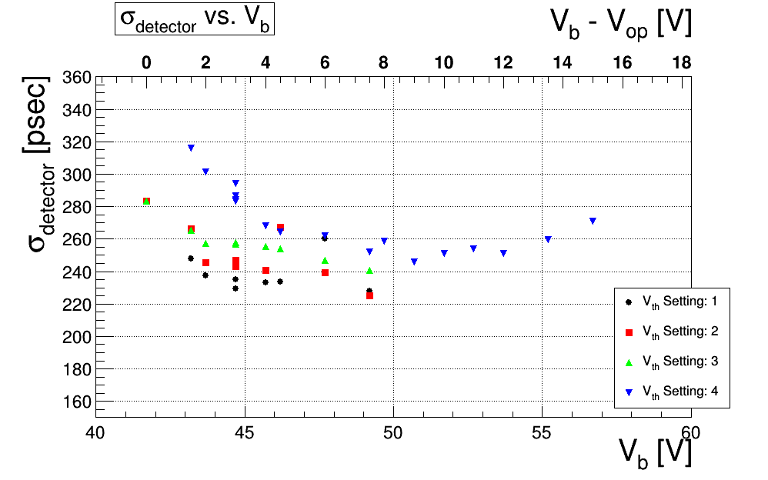
Progress of ToF data analysis
V_{b} dependence
Ignored the strange region.
V_{th} Setting [mV]→ R1, R2, L1, L2
Settting1
-31.1, -25.0, -24.4, -34.7 [mV]
Settting2
value of ‘setting1’ -20mV
Settting3
value of ‘setting2’ -50mV
Settting4
value of ‘setting3’-50mV

Slide 5
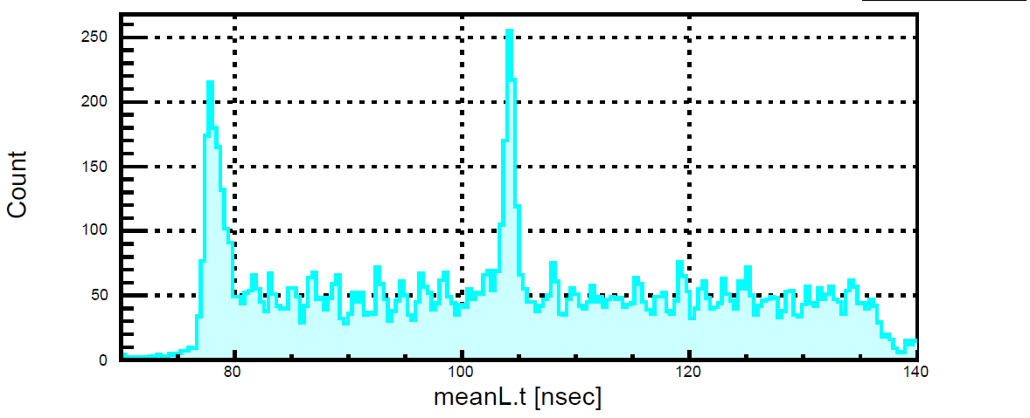
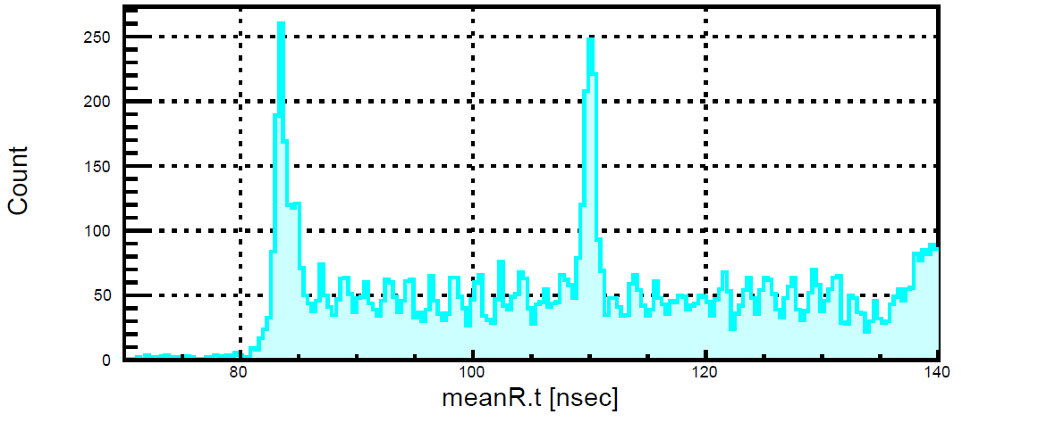

Consideration of new(?) method
Consideration for TDCcut
After last ELS meeting,
“To apply for TDC-cut, we could select good event.”
(by 外山さん)
Check the distribution of mean TDC
“meanTDC”: defined following,
$meanR.t≡0.5\left(R1.tdc+R2.tdc\right)$
There are 2 peak for each distribution

Slide 6
Progress of ToF data analysis
Consideration for TDCcut
Checked the correspond between R and L
②
①

Slide 7
Progress of ToF data analysis
Consideration for TDCcut
Focused on ①(left fig.) and ② (right fig.)
Each regions have ~ 2000 events for total ~10000 events (in case run0123)

Slide 8
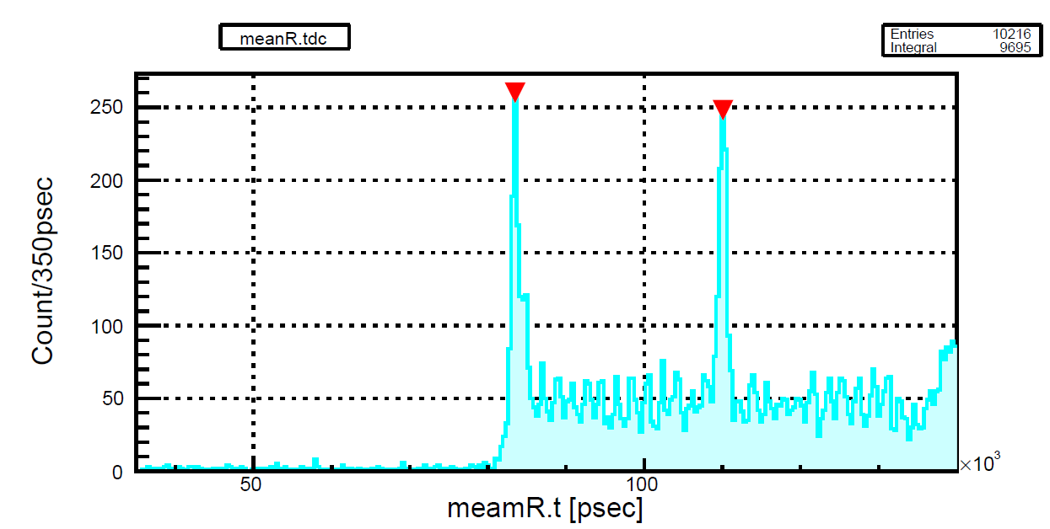
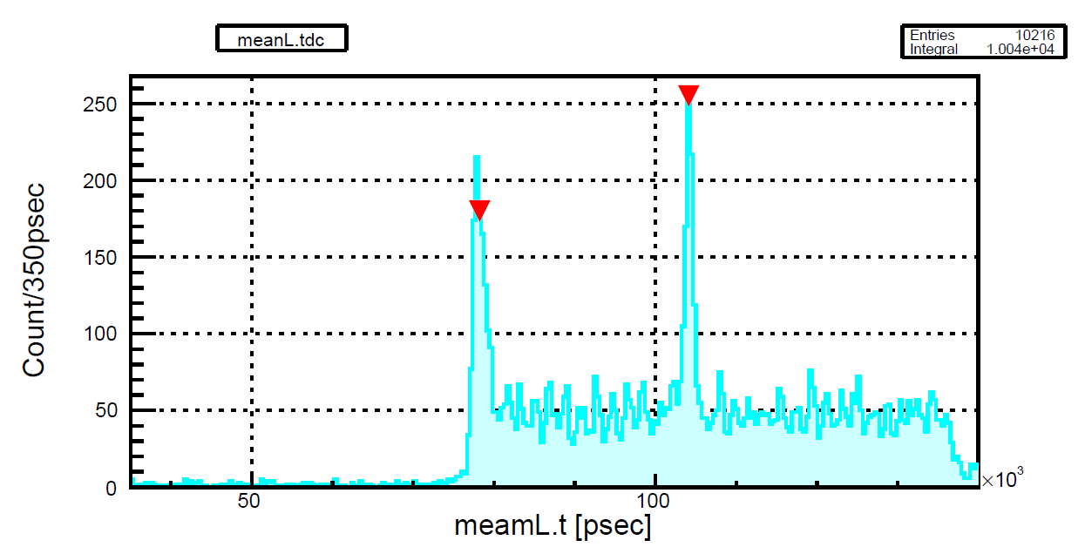
Progress of ToF analysis
83475.0
110075.0
TDC cut constraint
Getting positions of peak
Set tdc-cutoff to chose peak±5nsec region
test for 3 types tdc-cut
78475.0<Right [psec]<88475.0 && 73225.0<Left [psec]<83225.0
105075.0 < Right [psec] <115075.0 && 99125.0 < Left[ psec] <109125.0
1 or 2
78225.0
104125.0

Slide 9
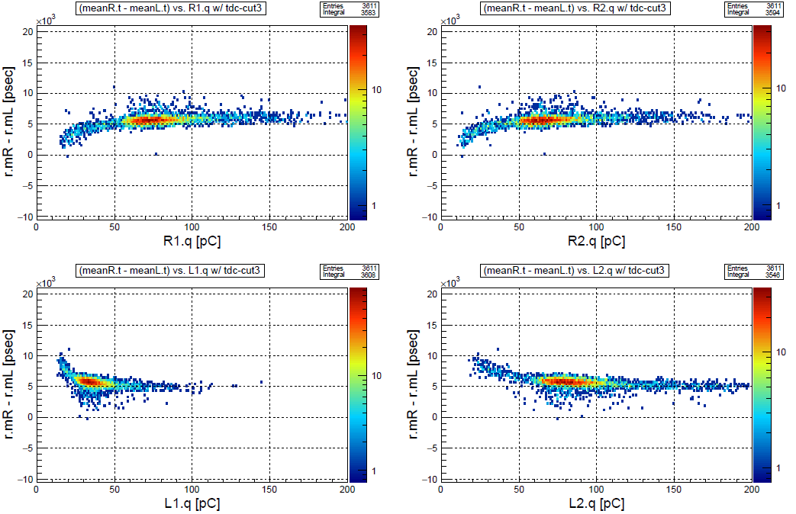
Progress of ToF analysis
Apply for ‘3’
remove the strange region!

Slide 10

Progress of ToF analysis
change the cutoff region form ±5nsec
to ±10 nsec

Slide 11
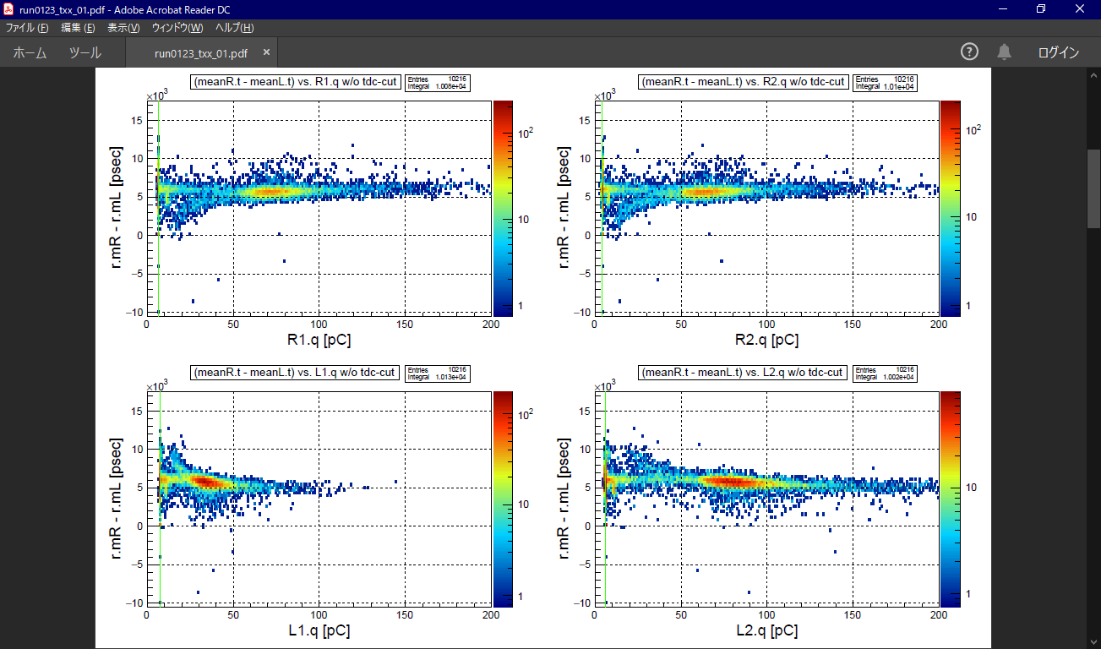
Comparison before and after TDC-cut
Before
After

Slide 12
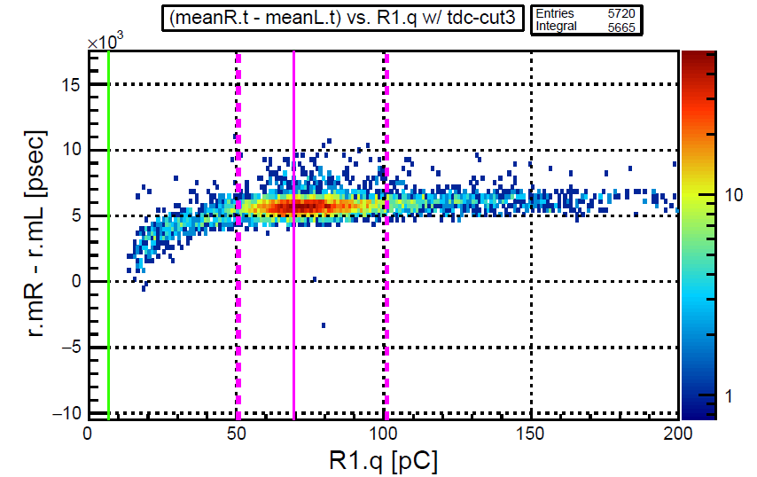
Progress of ToF analysis
Time walk correction
QDC-cut:
Min = 0.7×(Peak - Pedestal) + Pedestal
Max= 0.5×(Peak - Pedestal) + Peak
Min < R1.QDC < Max

Slide 13
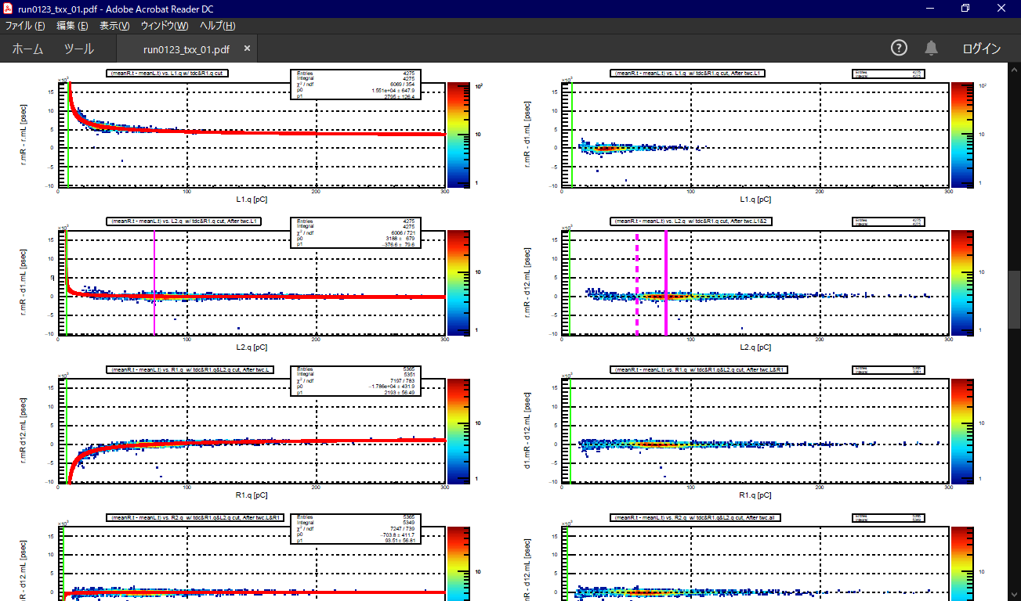
Time walk correction
For L1 & L2

Slide 14
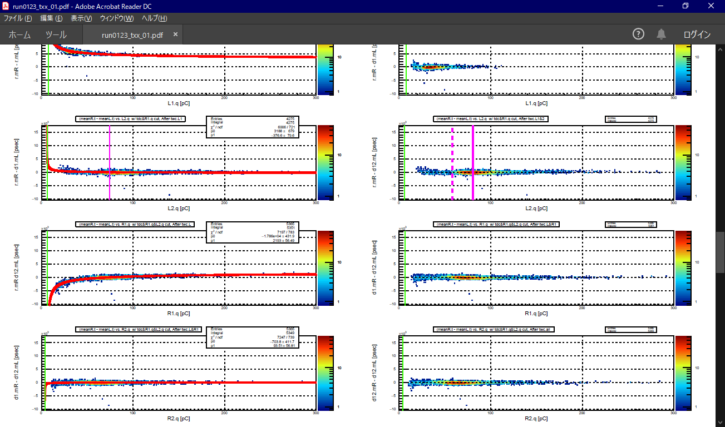
Time walk correction
For R1 & R2

Slide 15
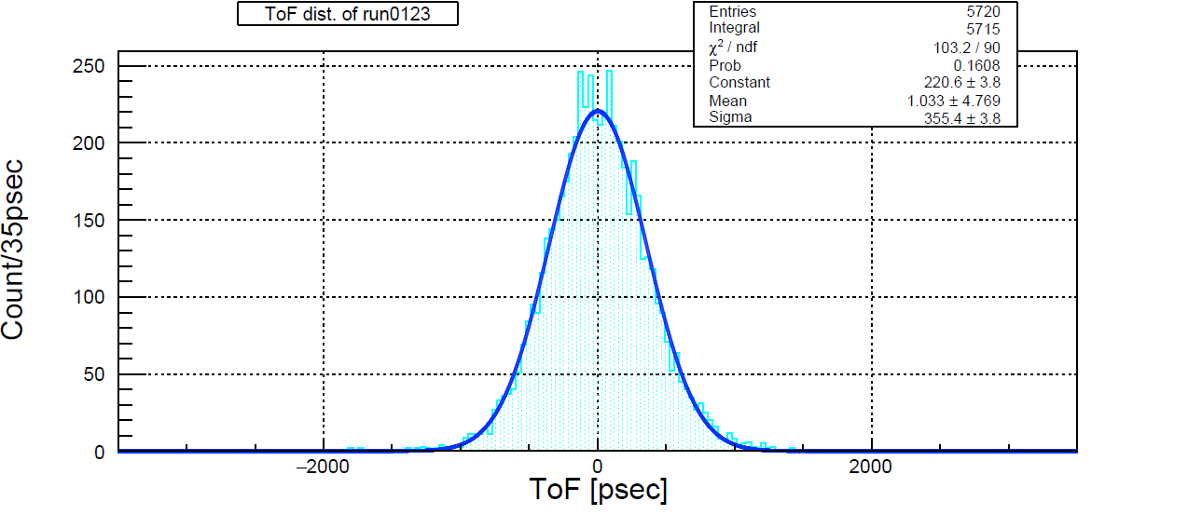
Time walk correction
Final ToF distribution and timing resolution
ToF resolution: 355 psec
Intrinsic resolution: 251 psec
Previous result (w/o tdc-cut)

Slide 16
To do next
Put together results → check Bias dependence
JPS abstract → submit by next Monday

