Slide 1
Status Report #20
2020. 03. 25 (Wed)
B4 FUJIWARA Tomomasa
ToF: consideration for size dependence

Slide 2
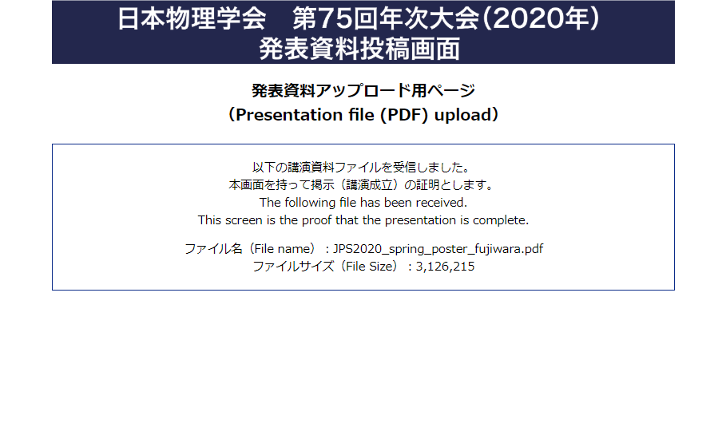
Report
B4 presentation: done
JPS poster: submission]
完成版: wikiにあげました. (http://lambda.phys.tohoku.ac.jp/~db/mediawiki/images/6/60/JPS2020_spring_poster_fujiwara.pdf)
コメント等本当にありがとうございました.

Slide 3
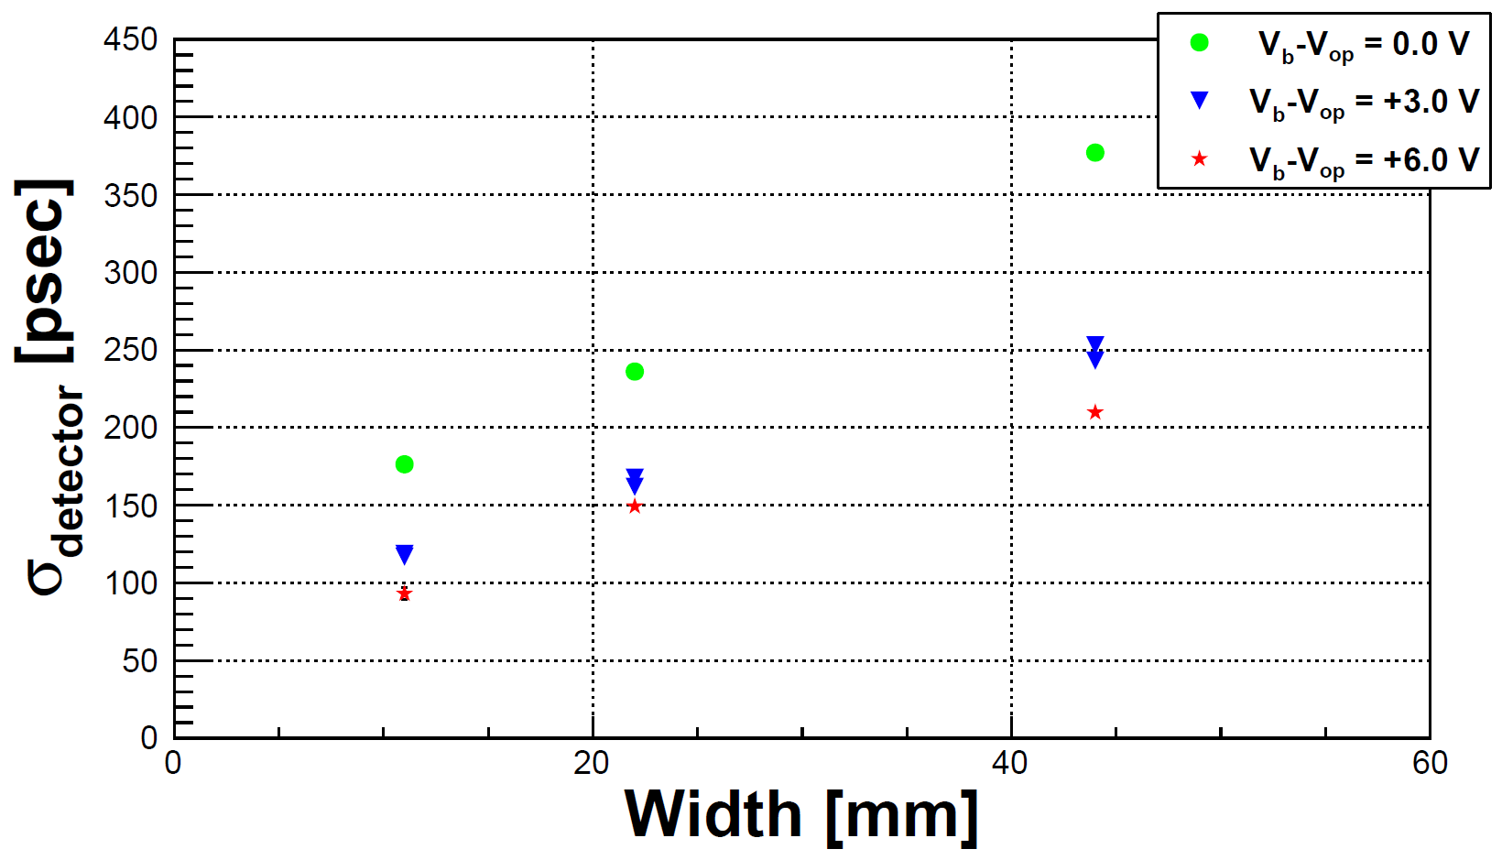
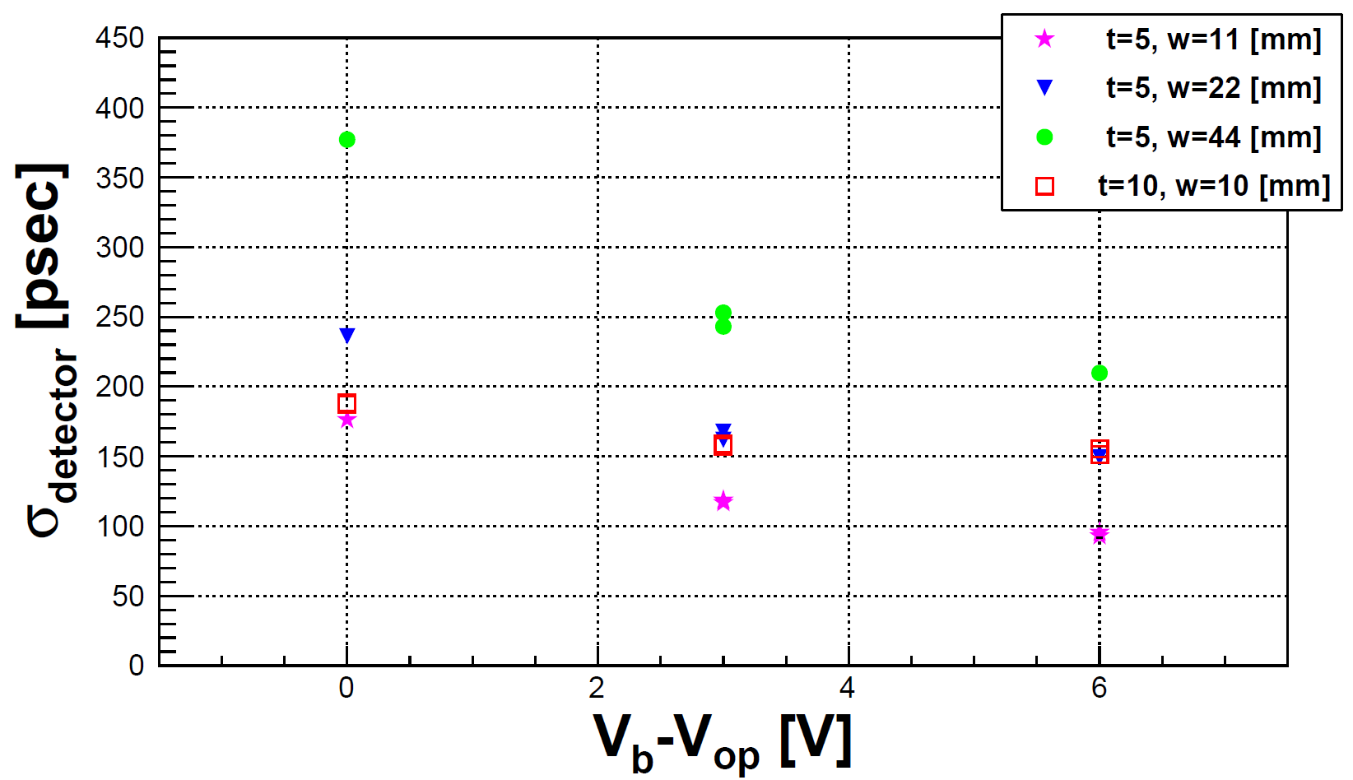
ToF: Consideration for size dependence
What I want to do: Evaluate the effects for σ_{detector}
Width dependence (t=5 mm)
Bias dependence (for various width)

Slide 4
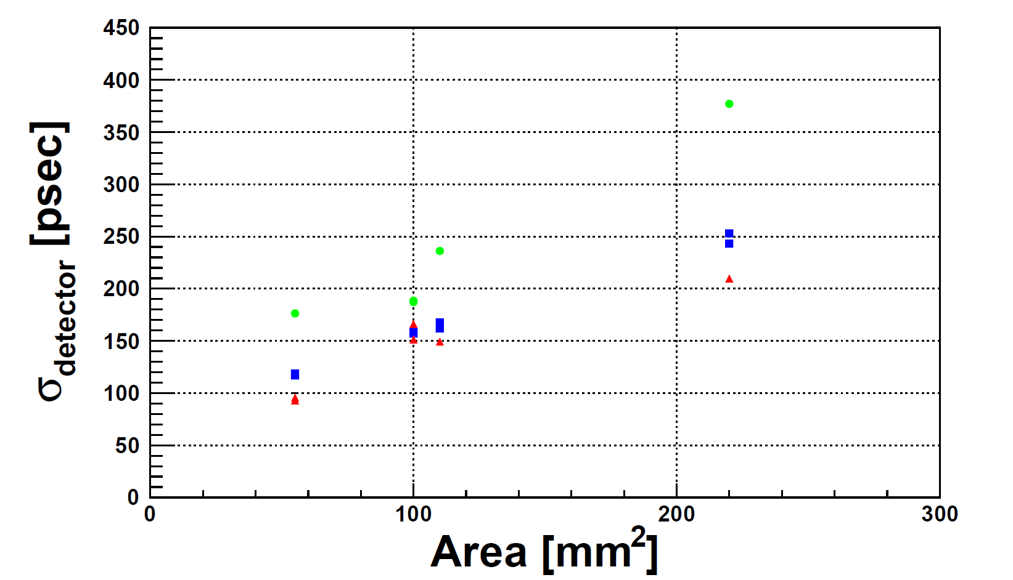
ToF: Consideration for size dependence
Only the case of 10^{t} × 10^{w} × mm²
They indicate difference tendency.
V_{b}-V_{op} = 41.7 V
Area (端面の面積) dependence
端面の面積よりも
厚さや幅の方が支配的といえる
V_{b}-V_{op} = 44.7 V
10^{t} × 10^{w} × mm²
V_{b}-V_{op} = 47.7 V

Slide 5
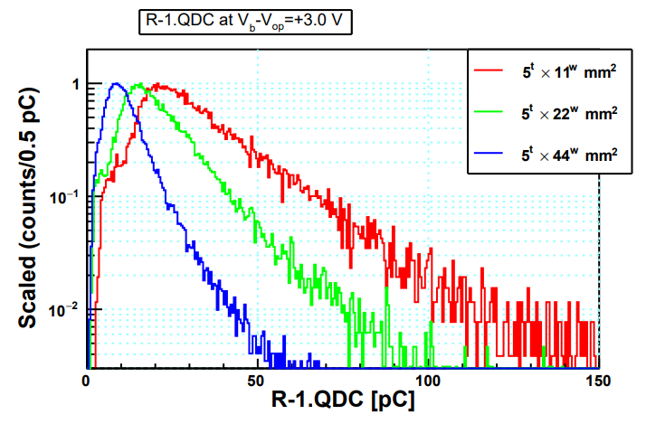
ToF: Consideration for size dependence
Comparison QDC distribution for various width (11 ― 44 mm )
Slightly decrease gain.
⇒ To evaluate MIP(gain) vs. σ_{detector}
⇒ How to define gain of each MPPC ?
⇒ Set standard value, evaluate the ratio (not yet)

Slide 6
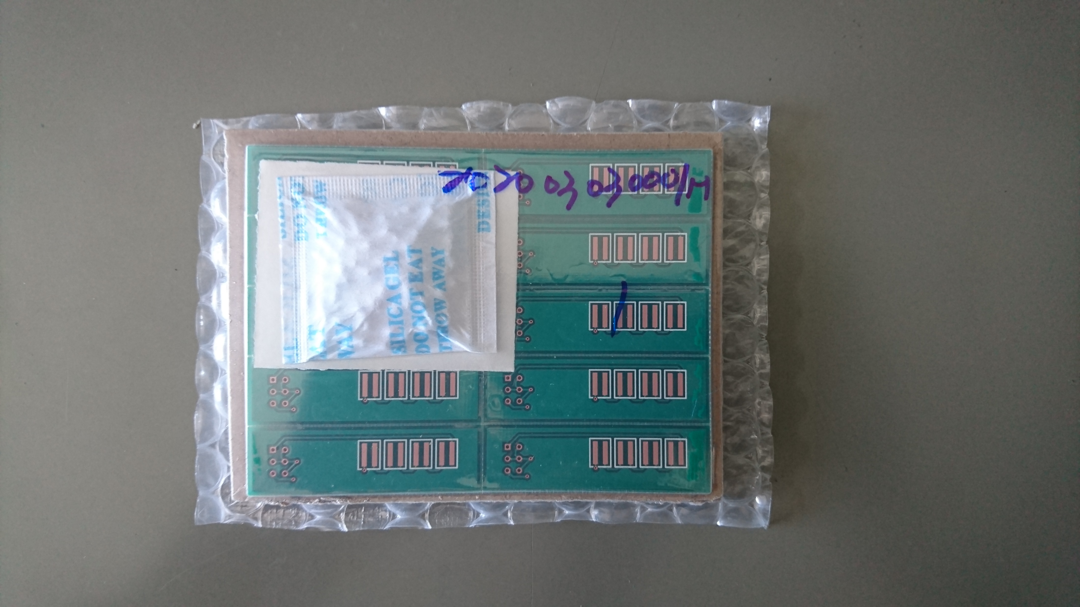
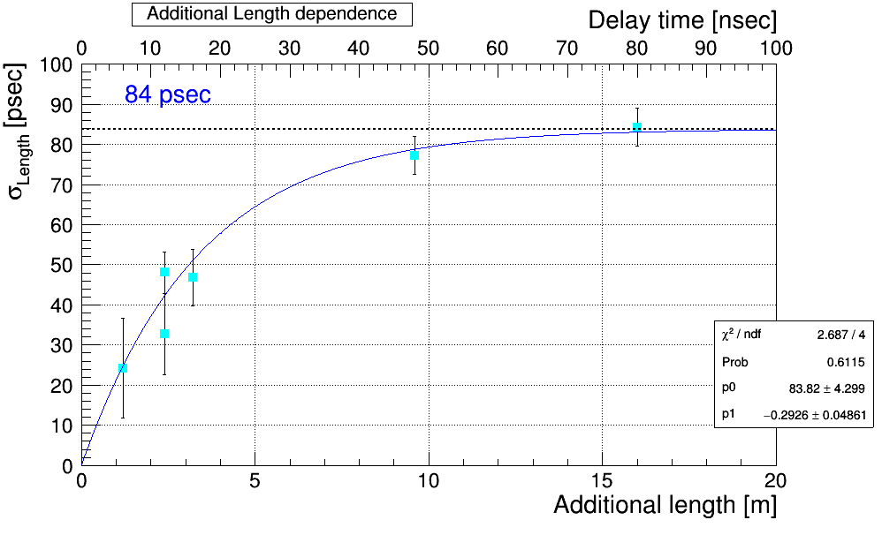
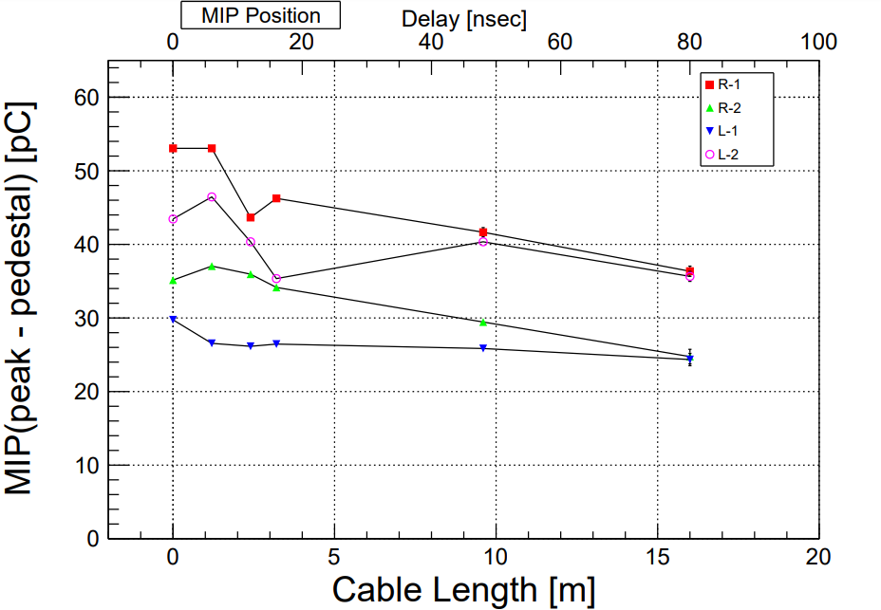
To do next
Evaluate gain vs, σ_{detector} (width & cable length)
Test readout method. (Series or parallel)
⇒ soldering MPPC, resister & capacitors

Slide 7
Back up

