Slide 1
Status Report #26
2020. 05. 08 (Thu)
M1 FUJIWARA Tomomasa

Slide 2
Weekly report
Research
Cosmic ray: check consistency at fix bias (V_{b}=178.8 V)
Simulation: No progress (making mass square)
Seminar
Detector seminar (B4 & M1): Done (yesterday)
ELS seminar: 来週月曜10:00~です. 只今準備中. 大炎上不可避
Others
Registration in this term
TA (物理学実験II 計算機基礎実習, オンラインTA)

Slide 3
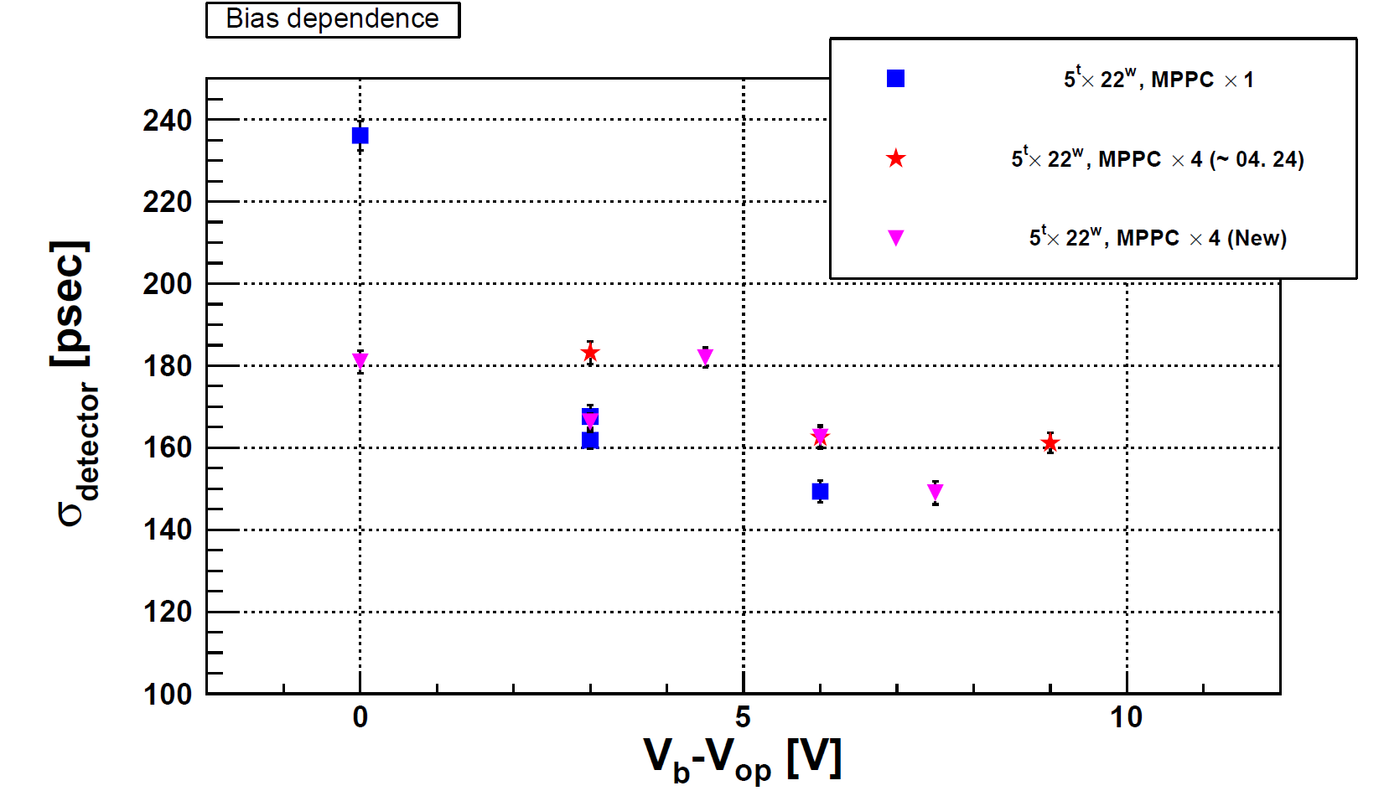
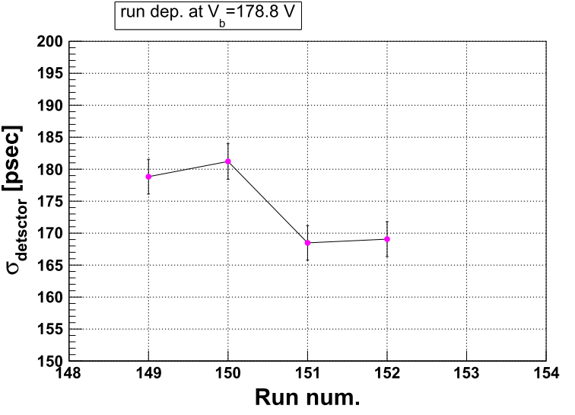
Cosmic ray
電圧をある値(今回はV_{b} = 178.8 V) に固定
~1日でデータを区切り変化を見る
Data taking now
Fluctuate ~±10 ps even same bias

Slide 4
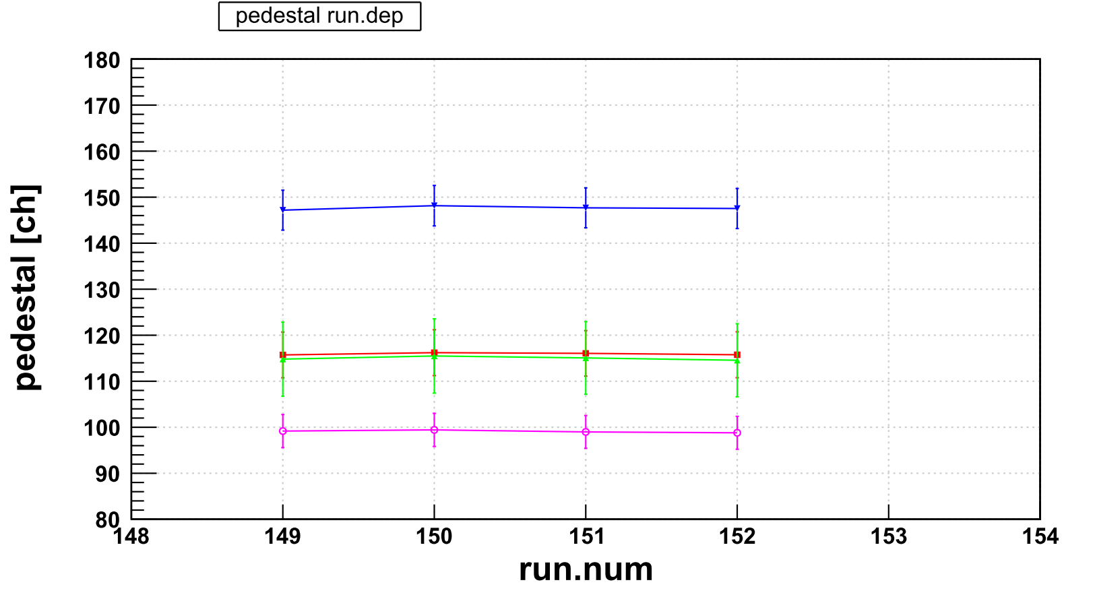
Cosmic ray: evaluate timing dependence
■: R-1 (11 mm)
▲: R-2 (11 mm)
▼: L-1 (22mm)
〇 : L-2 (22 mm)
Fluctuation of Pedestal
change: ~ 1 ch or less

Slide 5
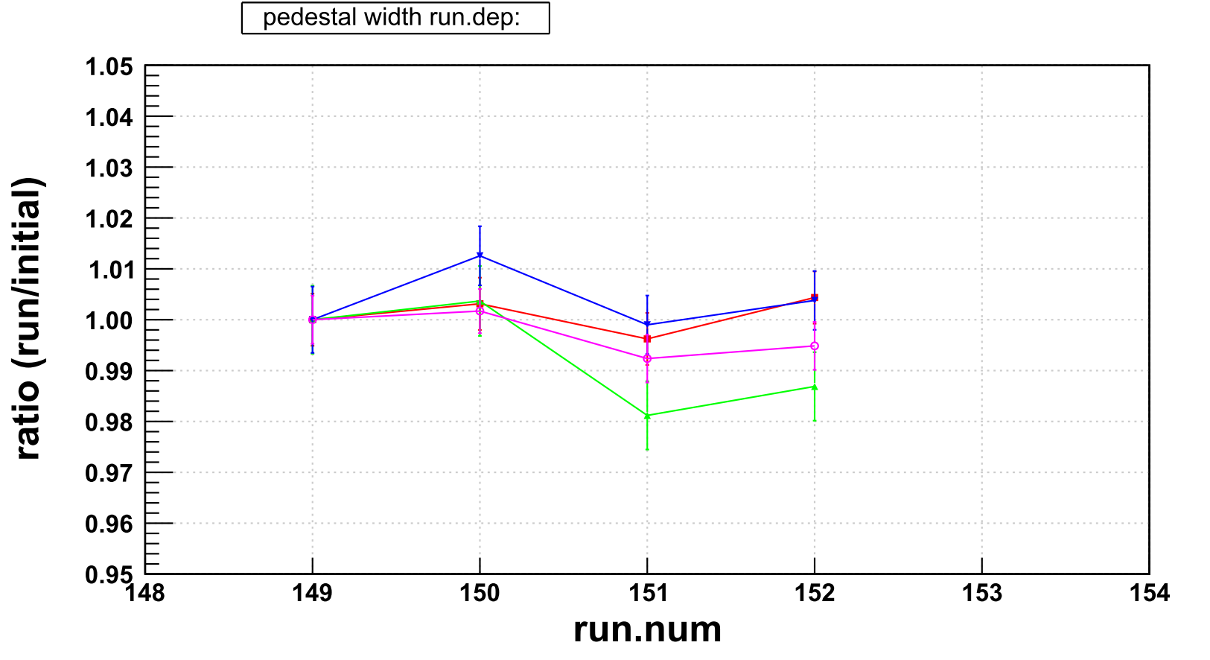
Cosmic ray: evaluate timing dependence
■: R-1 (11 mm)
▲: R-2 (11 mm)
▼: L-1 (22mm)
〇 : L-2 (22 mm)
Width of pedestal
Evaluate the ratio between
the run and initial value (at run149)
~ 2 % change

Slide 6
Cosmic ray: evaluate timing dependence
■: R-1 (11 mm)
▲: R-2 (11 mm)
▼: L-1 (22mm)
〇 : L-2 (22 mm)
一見すると同じ傾向があるように見える
が, ペデスタルの幅の変化は1-2%程度
そこまで大きく影響するとは考えにくい

Slide 7
Next to do
G4 Simulation
Setting Target material
Making mass square distribution → How to evaluate path length
Cosmic ray
Taking more data at the same bias (~10run)
Test higher bias voltage (202.8 V)
卒論
Write down ~ 25 – 30 %

Slide 9
■: R-1 (11 mm)
▲: R-2 (11 mm)
▼: L-1 (22mm)
〇 : L-2 (22 mm)

Slide 10
■: R-1 (11 mm)
▲: R-2 (11 mm)
▼: L-1 (22mm)
〇: L-2 (22 mm)

