Slide 1
Status Report #27
2020. 05. 15 (Fri)
Tohoku Univ.
M1 Tomomasa FUJIWARA

Slide 2
Report (weekly)
Presentation ELS seminar (Monday)
Data taking cosmic ⇒ 178.8 V & 202.8 V
Writing B4 thesis (~60-70%)

Slide 3
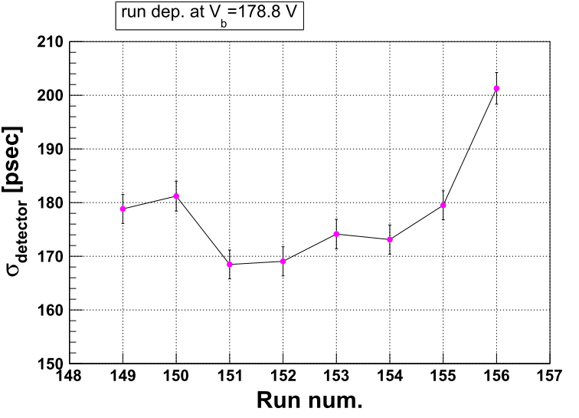
Stablity check at the same bias
Differ ~ 10 psec between run.
⇒ ~170 – 180 psec
Result of run156 is strange.
⇒ ~ 200 psec

Slide 4
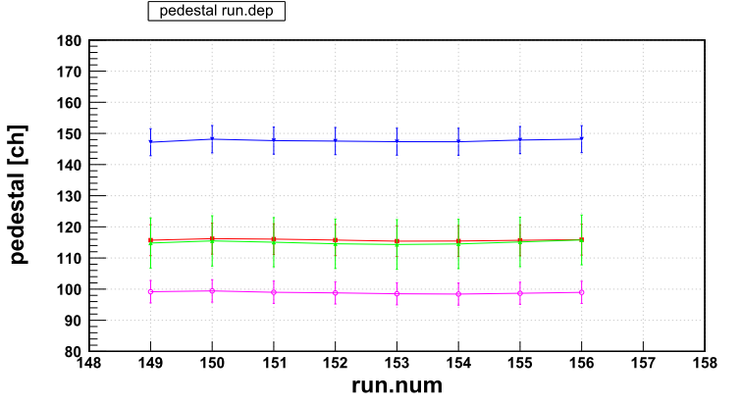
Stablity check at the same bias
Pedestal: not changed between run.

Slide 5
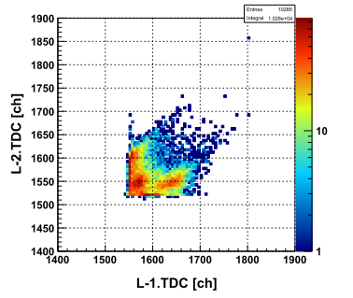
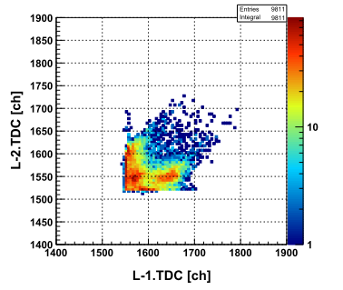
Compare TDC correlation.
Run 151
Run 156

Slide 6
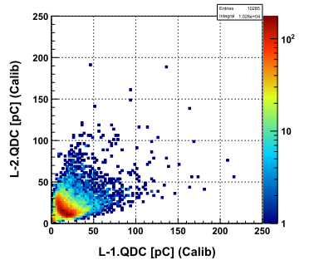
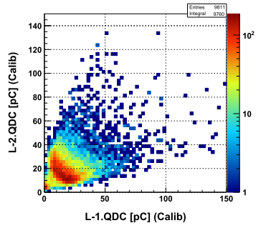
Compare QDC correlation.
Run 151
Run 156

Slide 7
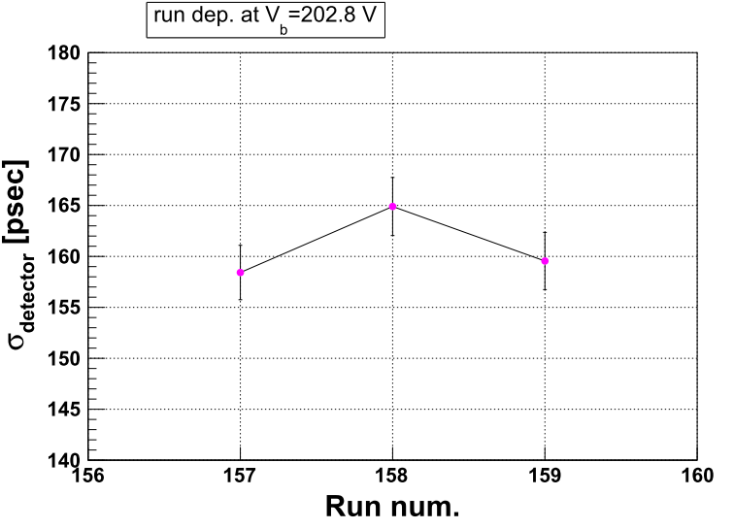

Slide 8
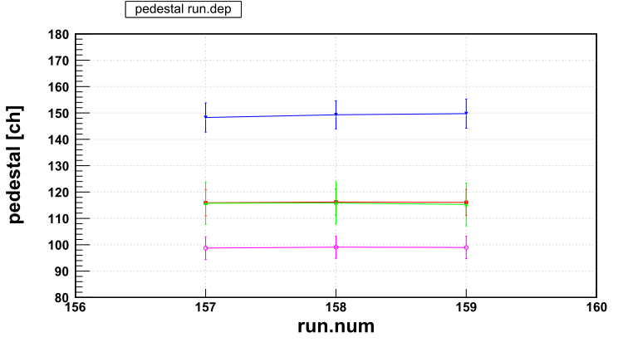

Slide 9
今後の計画 (仮)
Sun | Mon | Tue | Wed | Thu | Fri | Sat
10 | 11 | 12 | 13 | 14 | 15 | 16
17 | 18 | 19 | 20 | 21 | 22 | 23
24 | 25 | 26 | 27 | 28 | 29 | 30
31
5^{t}×11^{w}(x1) & 5^{t}×22^{w} (x4s), Vb=202.8 V
卒論目標 (仮)
5^{t}×11^{w}(x1) & 5^{t}×22^{w}(x4s), Vb=202.8 V & 178.8 V
セットアップ変更
(基板交換)
5^{t}×11^{w} (x2s) & 5^{t}×22^{w} (x4s), Bias scan

