Slide 1
Status report #30
月が変わって
6月よ
2020. 06. 05 (Fri)
Tohoku Univ. M1
Tomomasa FUJIWARA
ToF: new setup
Tuning amp circuit for MPPC

Slide 2
Consistency check for MPPCx4s board
Checked again.
Setup:
ToFR(upstream): 5×11×300 [mm3], mppcx1s
ToFL(downstream): 5×22×300 [mm3], mppcx4s
※ Both of them used new board (designed Fujiwara)
V_{b}-V_{op} [V/mppc]: +9.0(Lside), +3.0(Rside)
Taking 3-runs (~1run/day)
Analysis: assuming Rside has the same resolusion with Mar. data (~ 115 ps)
Run num. | σ_{detector} [psec]
177 | 146.21 ± 2.44
178 | 147.33 ± 2.95
179 | 141.29 ± 2.94
Ave. | ~145

Slide 3
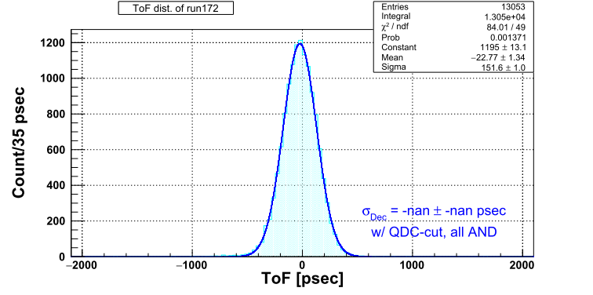
Comparison to the data
The run that has problem
⇒ σ of TOF(not intrinsic) = 151.6 ps
Using only these 3 points
⇒ Intrinsic resolusion ~ 44 psec @ 44.7 V
aaaaa
Run num. | σ_{detector} [psec]
177 | 146.21 ± 2.44
178 | 147.33 ± 2.95
179 | 141.29 ± 2.94
Ave. | ~145

Slide 4
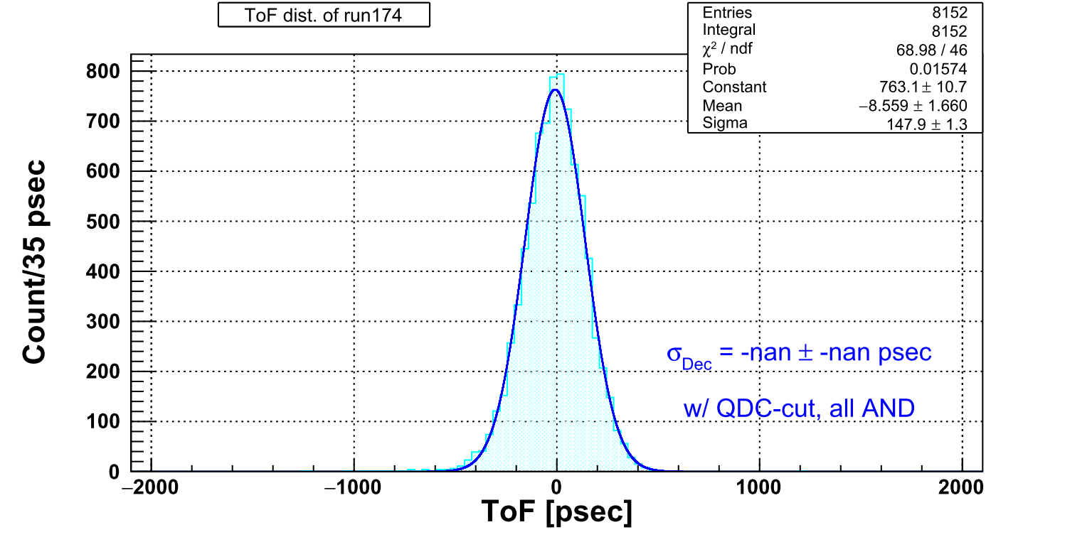
Comparison to the data
For higher bias run (+9.0 V/MPPC)
⇒ σ of TOF(not intrinsic) = 147.6 ps
ギリギリ計算できるかどうかの値
改めて5×11×300 [mm3], MPPCx1s
での測定を行う必要有と判断した
Run num. | σ_{detector} [psec]
177 | 146.21 ± 2.44
178 | 147.33 ± 2.95
179 | 141.29 ± 2.94
Ave. | ~145

Slide 5
New setup for ToF measurement
Conventional setup: 2-scintillators ⇒ analysis: assuming that we know already resolusion one of them.
New setup: 3-scintillators ⇒ calculation mathematical.
Conbination: Target of test + reference×2
reference: 10×10×300 [mm³], MPPCx1s on old board
Setup for measurement: underconstructing
5×11×300 [mm³], MPPCx1s on new board
ToF-T
Between scintillators:
~58 mm
ToF-C
10×10×300 [mm³],
MPPCx1s on old board
ToF-B

Slide 6
New setup for ToF measurement
Trigger logic
Coincidence of 4-CHs of reference ⊕ clock. (carryout from scaler 0.5 Hz)
First plan: All coin. of 6-CHs ⊕ clock.
But too low event rate (1147 events for ~ 14 hours run ⇒ ~1.4counts/min.)
Now testing for data taking.
5×11×300 [mm³],
MPPCx1s on new board
ToF-T
ToF-C
10×10×300 [mm³],
MPPCx1s on old board
ToF-B

Slide 7
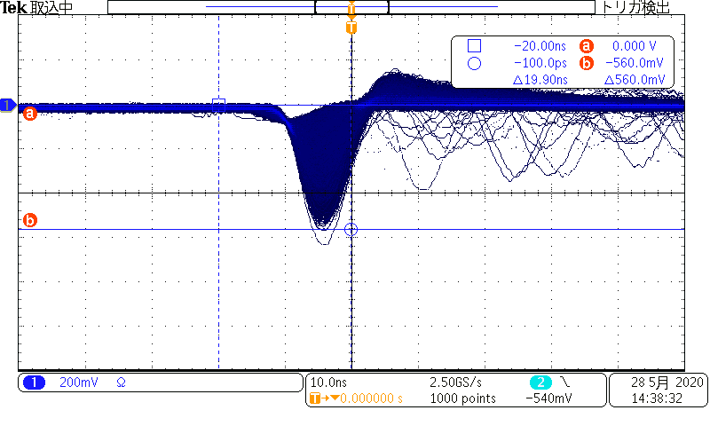
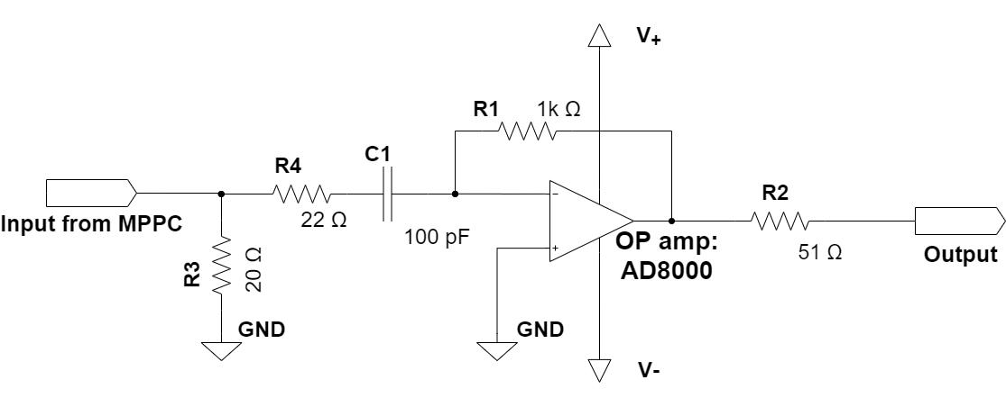
Tuning for amp circuit for MPPC
Problem of MPPC amp circuit: Large over shoot
Adding variable resistance ⇒ pole zero correction
VR

Slide 8
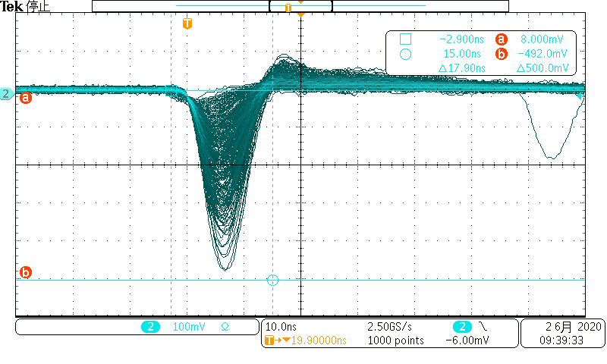
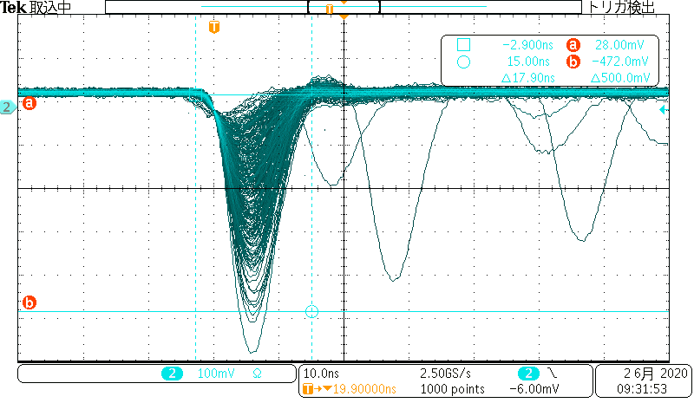
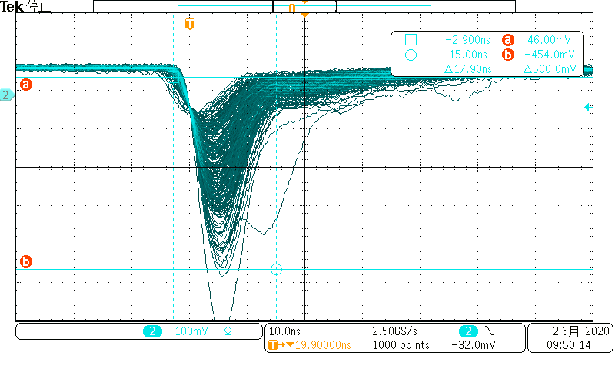
Tuning for amp circuit for MPPC
Comparison for various value
407Ω
203 Ω
96 Ω

Slide 9
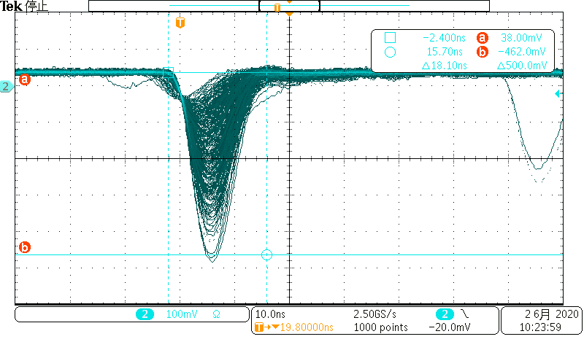
Tuning for amp circuit for MPPC
Comparison for various value
203 Ω
177 Ω
⇒ Employed 170-177 Ω

Slide 10
Others
JPS application:
Title
Japanese: 「ELPHにおけるΛハイパー核実験のためのMPPCを用いた新ToF測定器の開発」
English: “Development of a new ToF counter with MPPC for Λ hypernuclear experiments at ELPH”
Hypernuclear physics seminar (today)

Slide 11
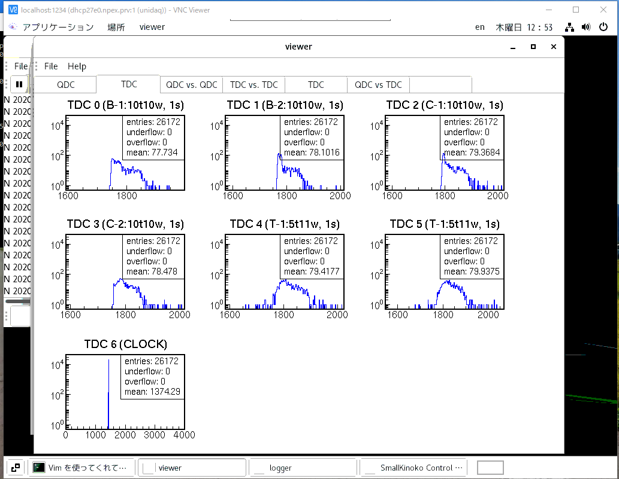

Slide 12
