Slide 1
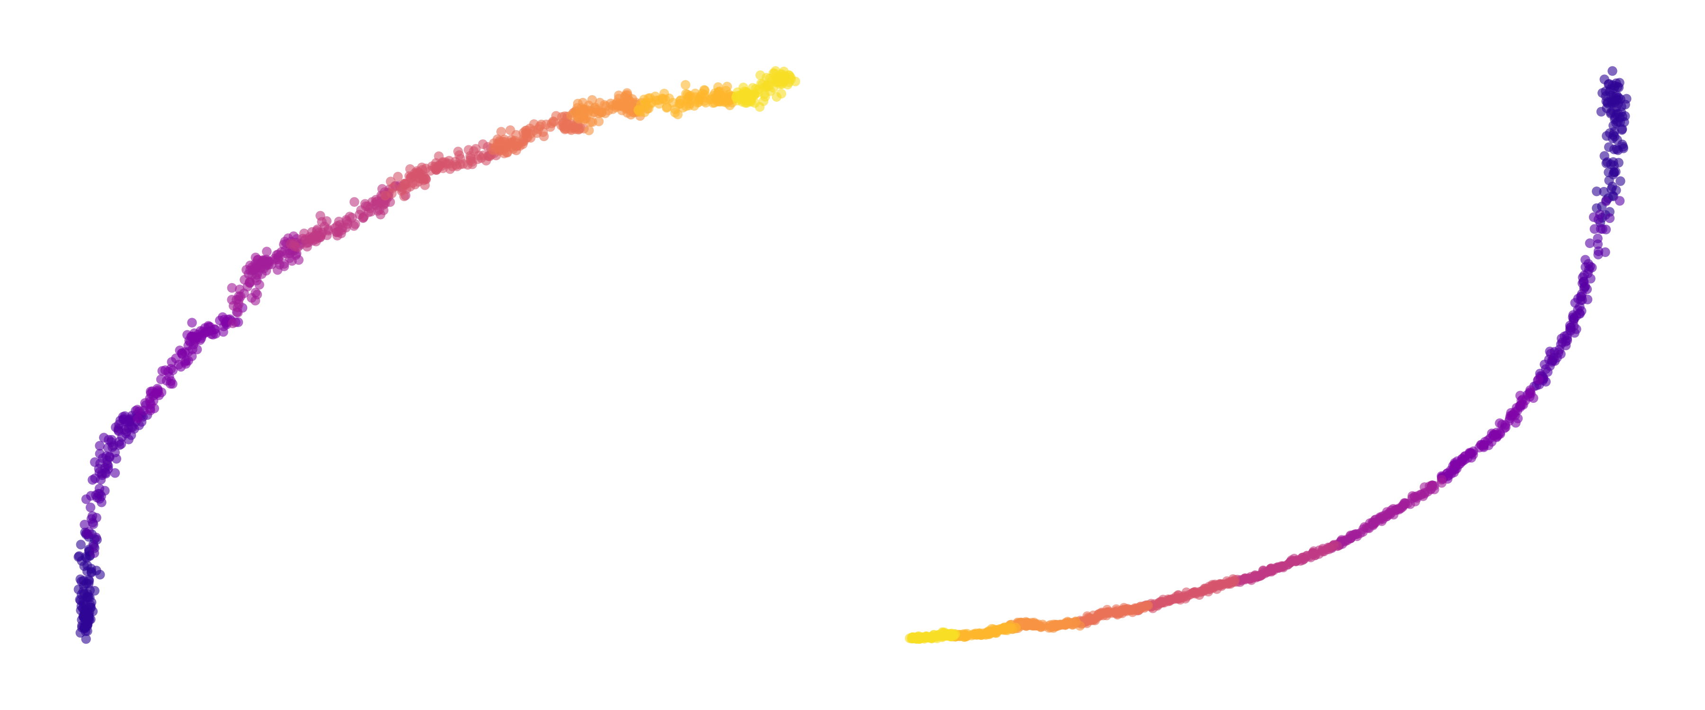
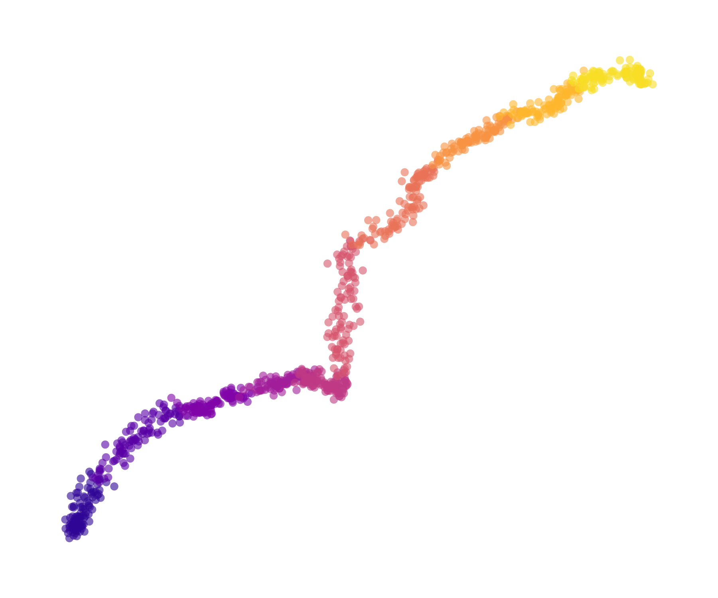
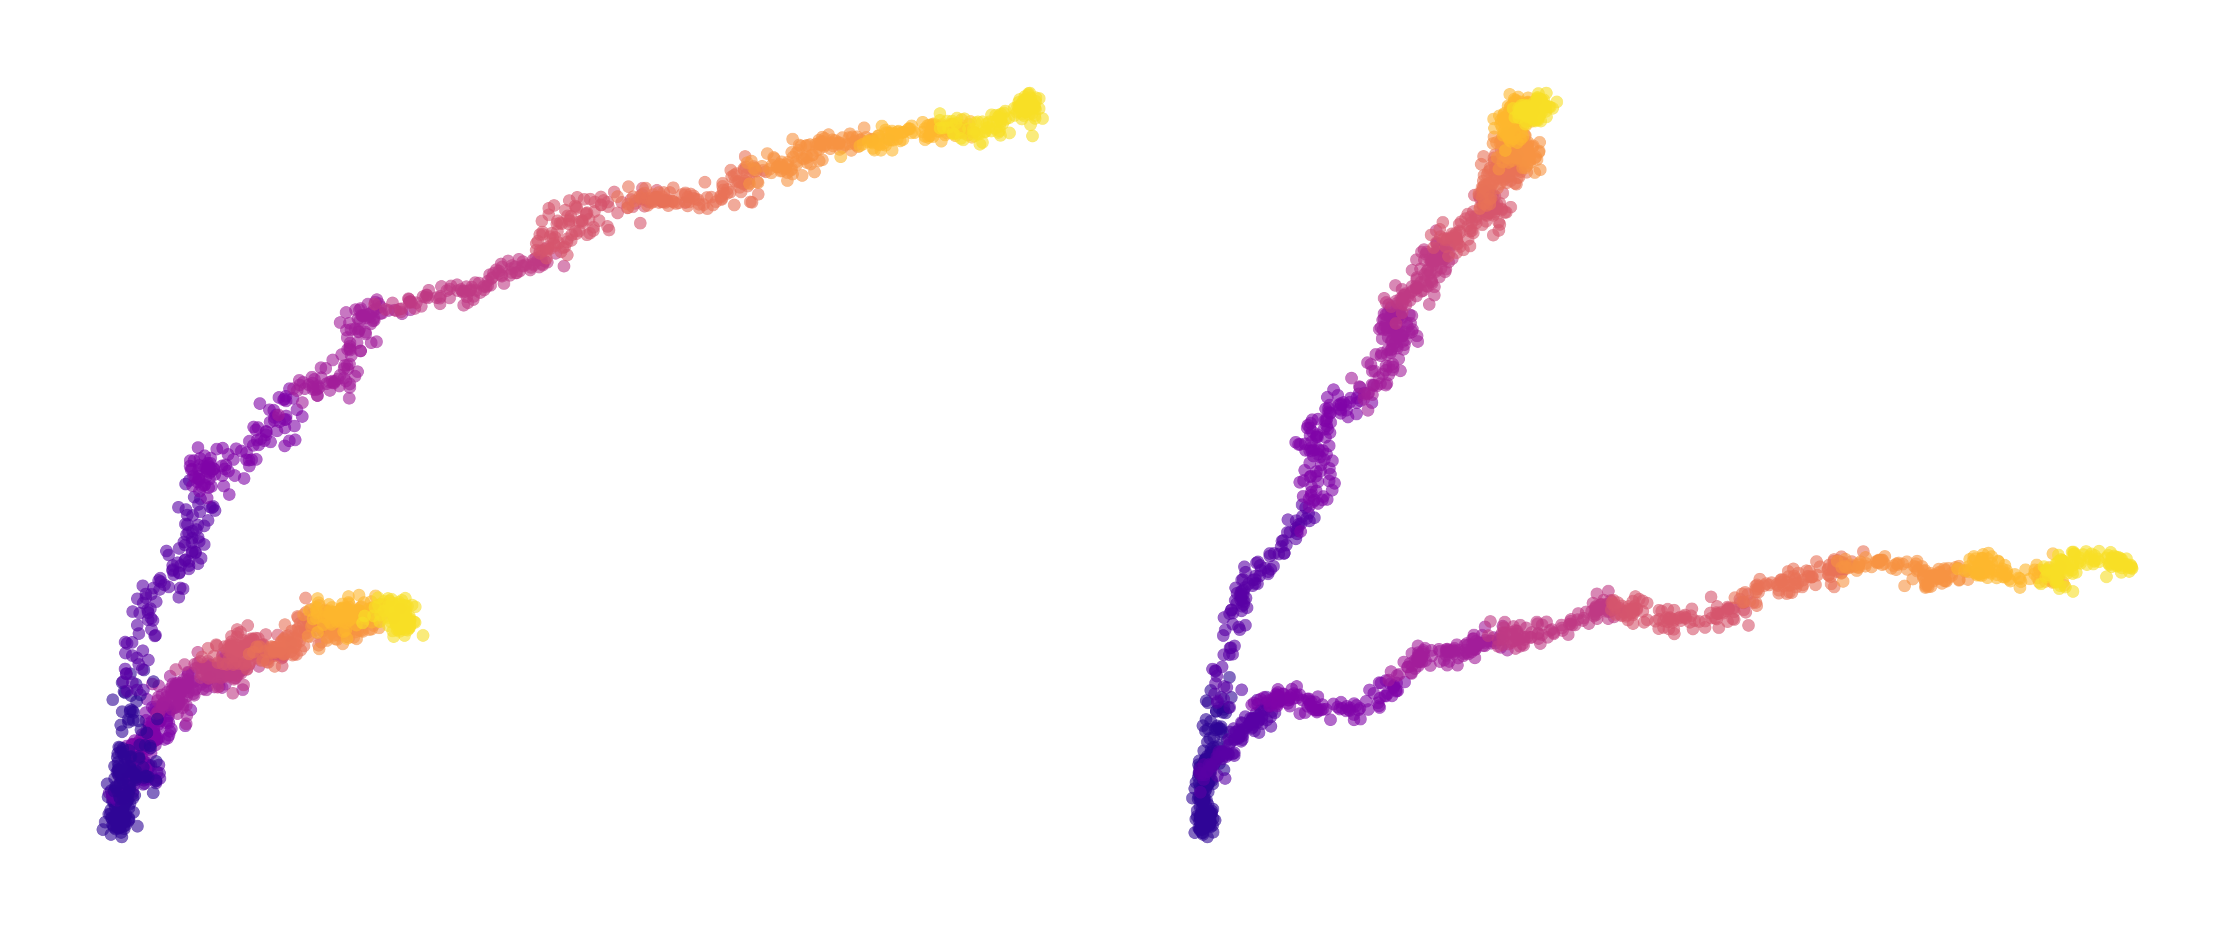
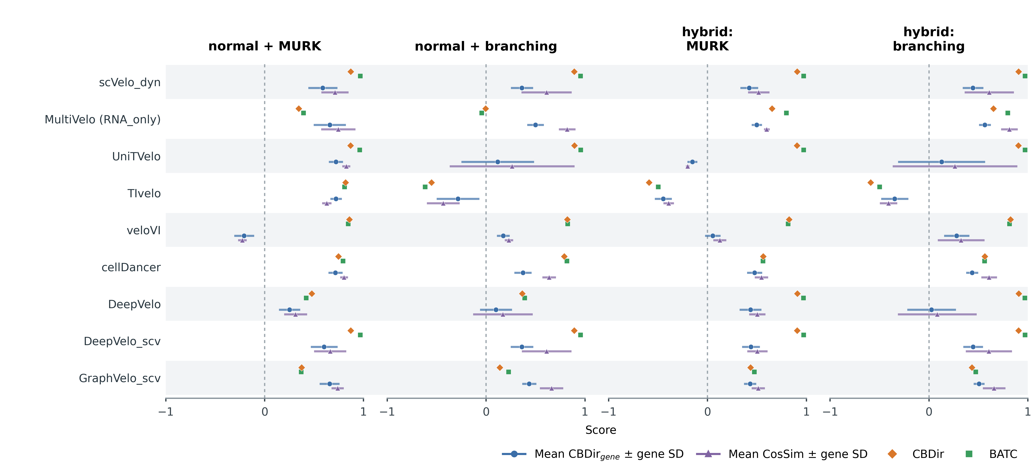
a
3 simulated datasets：
normal genes+MURK genes
normal genes+branching genes
normal genes+MURK genes+branching genes
Early Late
unspliced
+
+
spliced
normal genes
MURK genes
branching genes
b
Gene A
MURK
c
Gene B
branching
Gene C
branching
d

