Slide 1
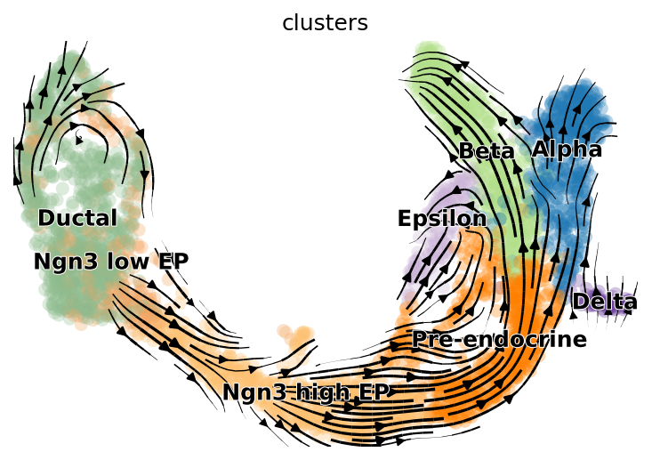

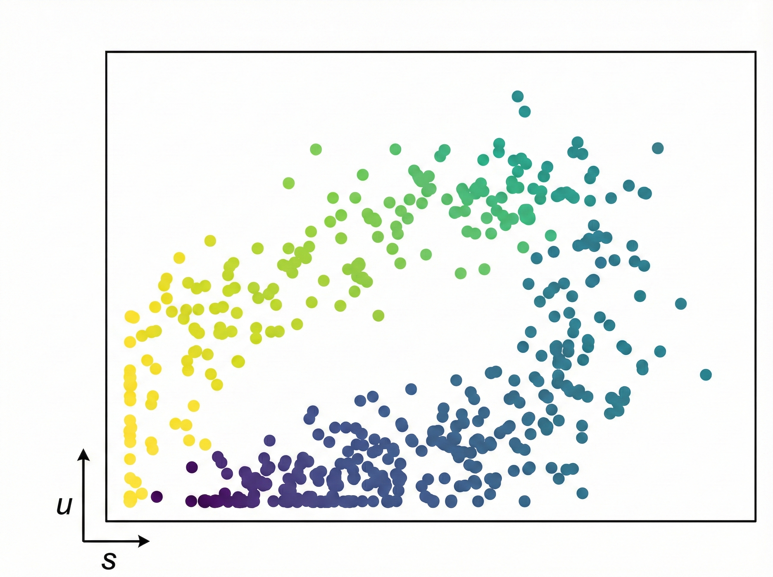
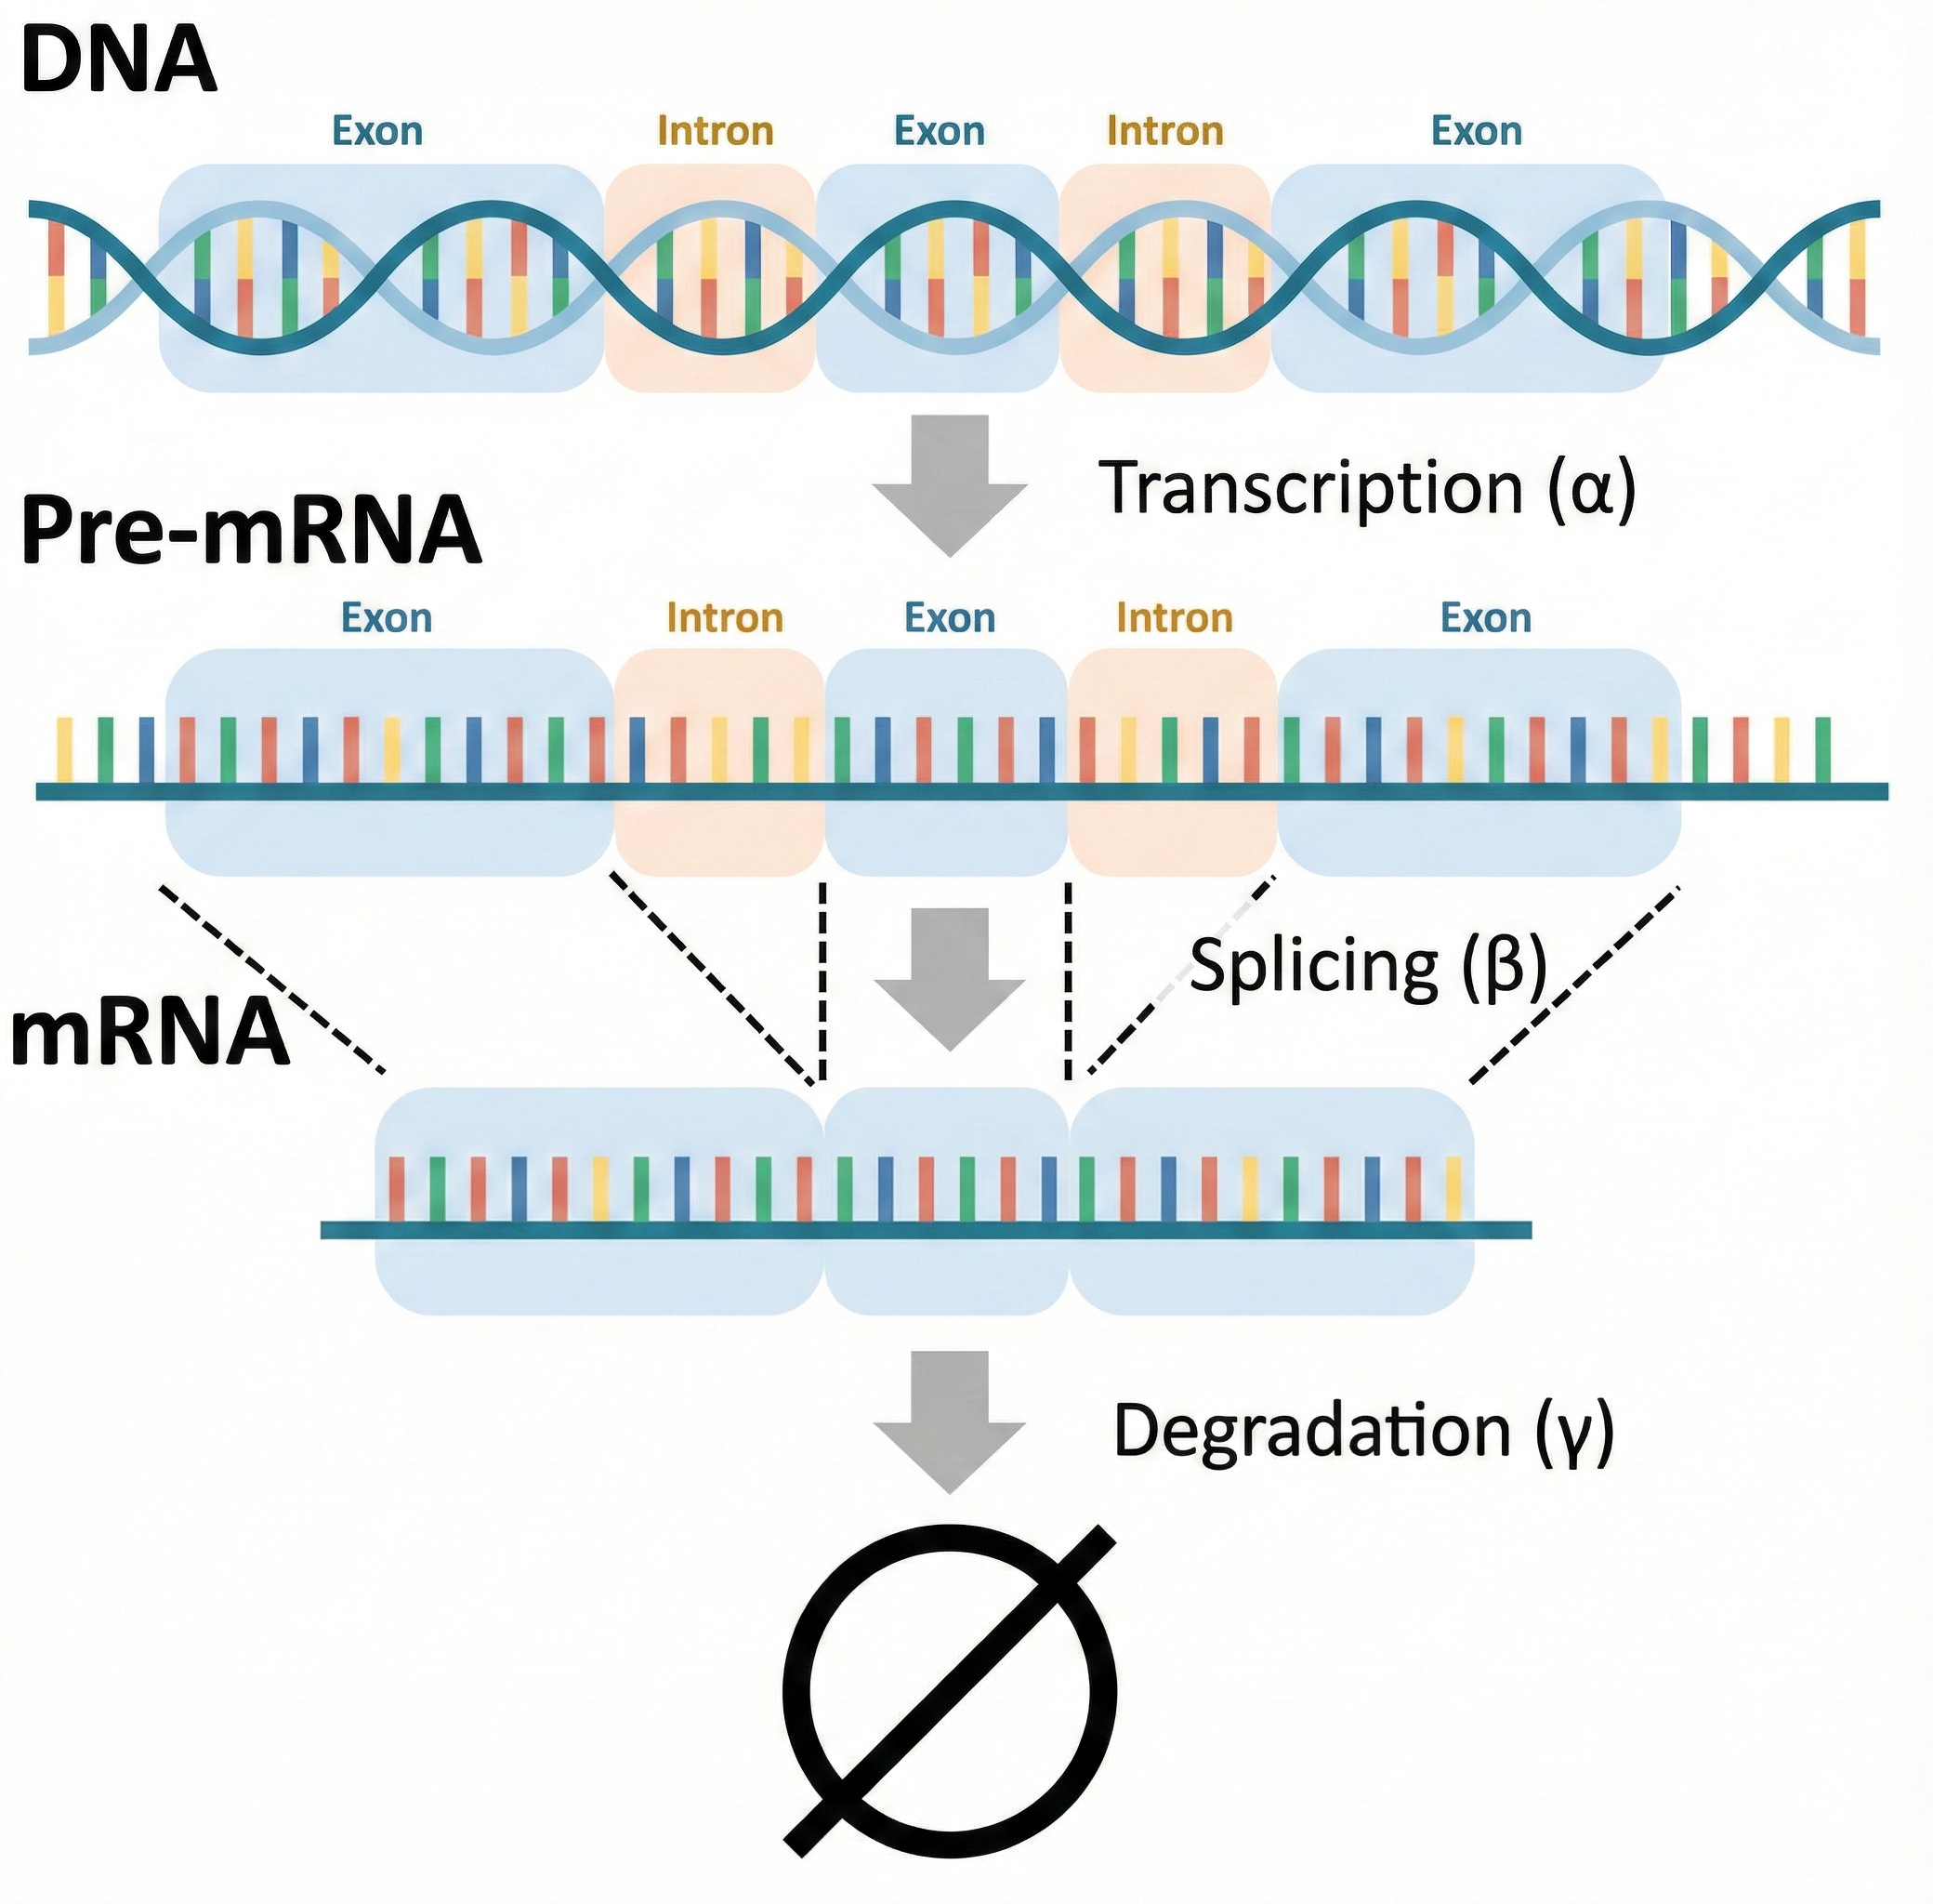
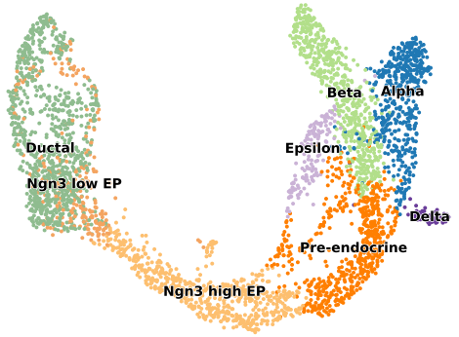
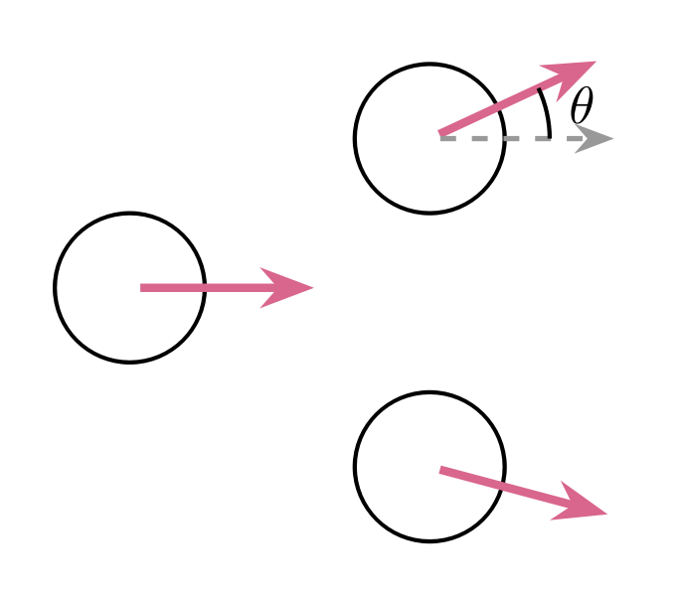
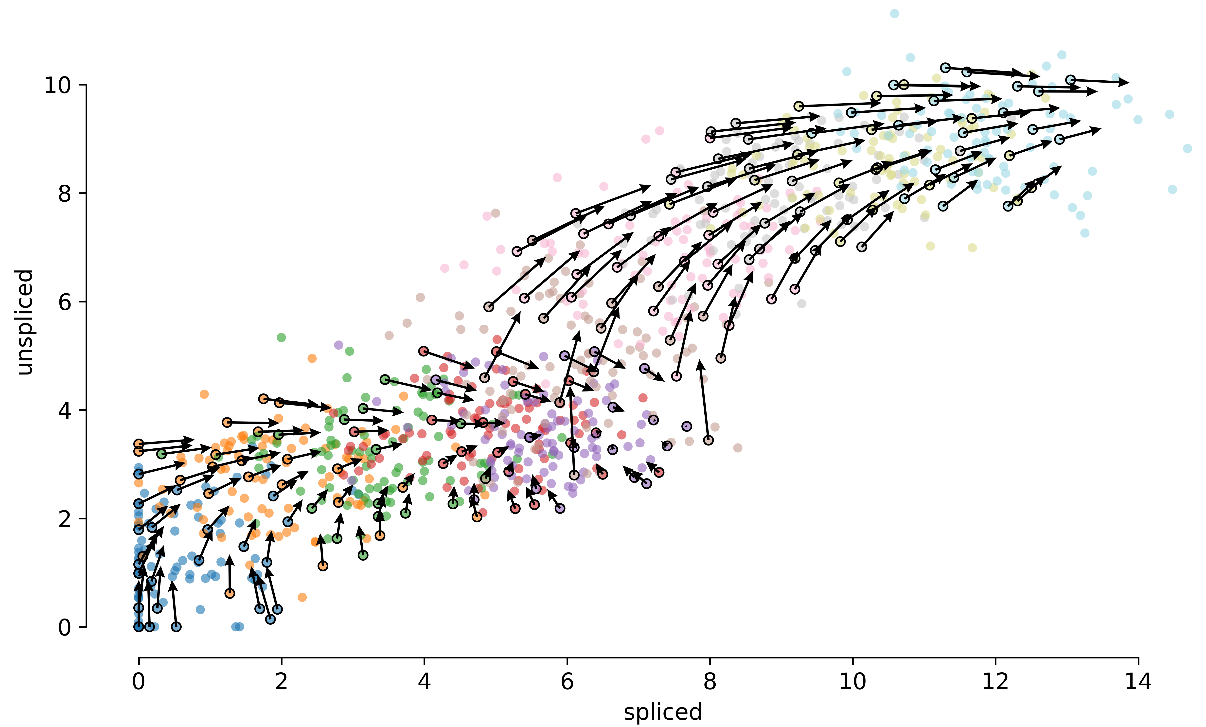


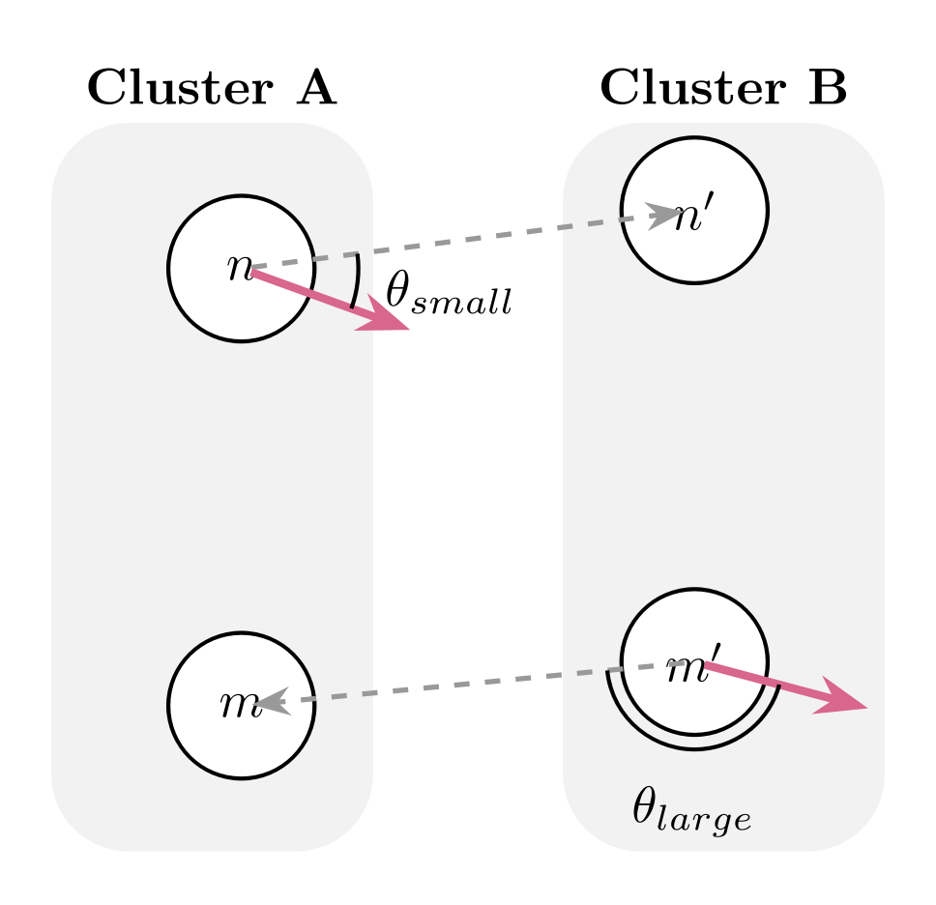
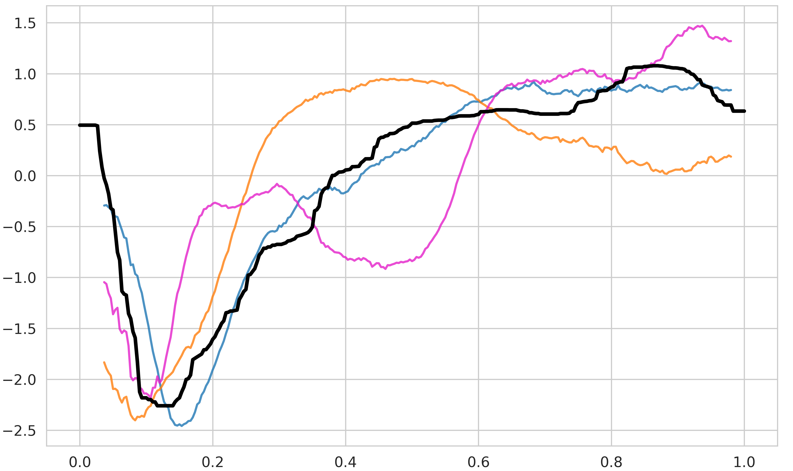


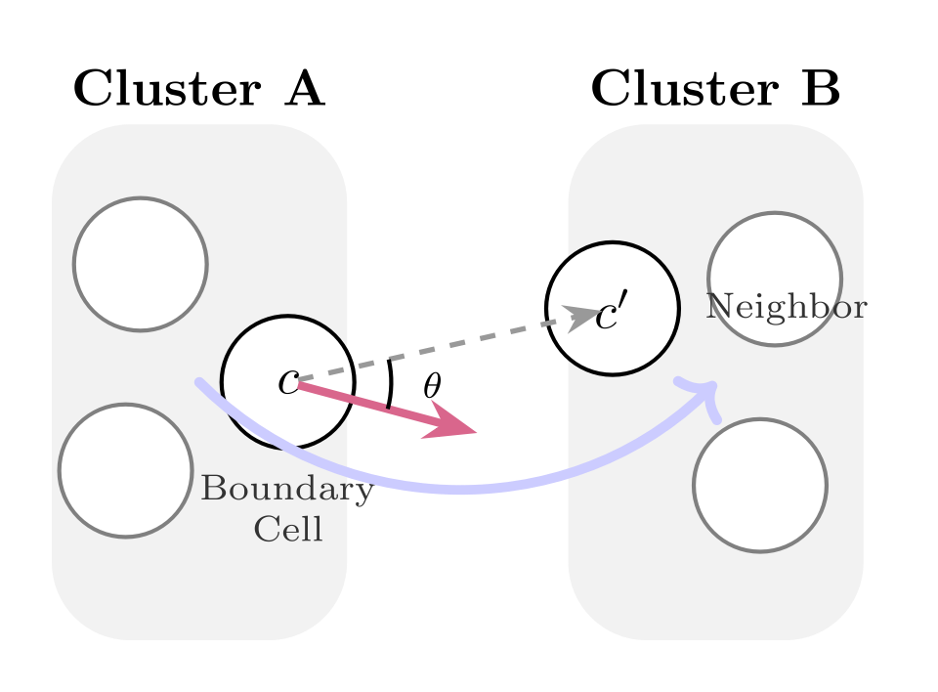
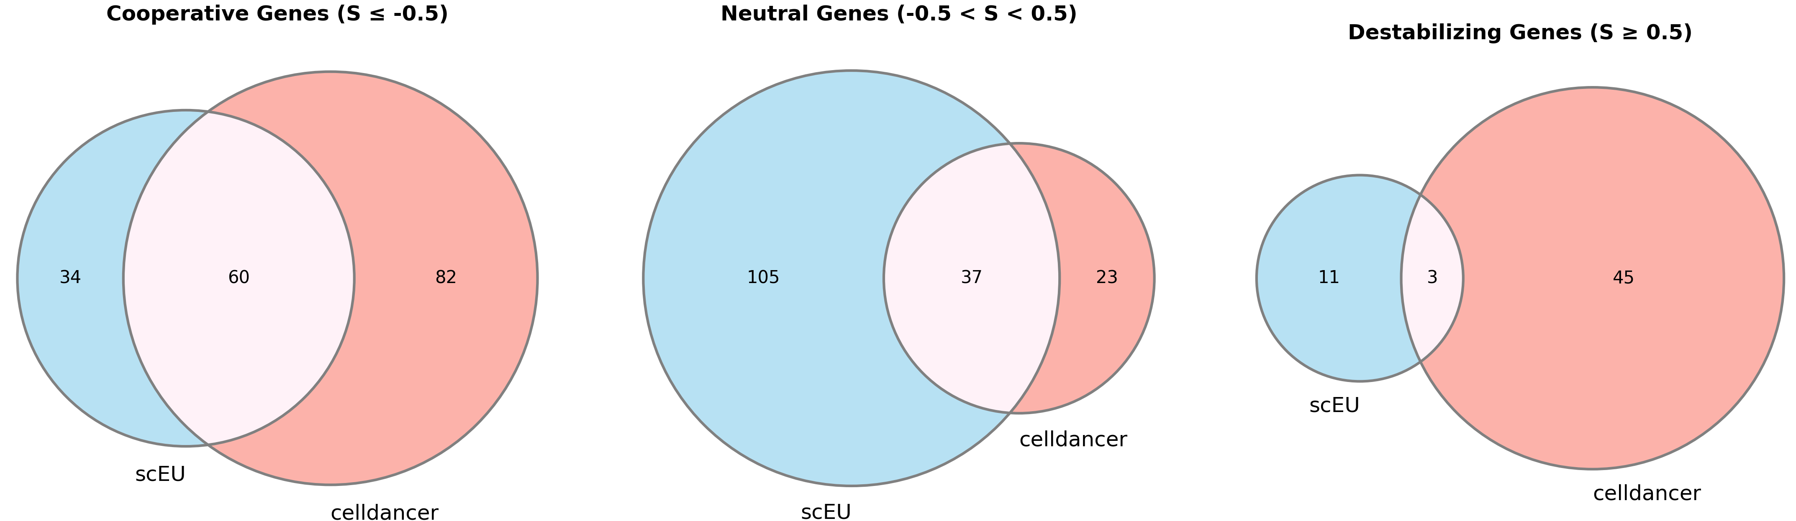
a
Genes
Cells α/β/γ/latent time
Cell Filtering
Gene Selection
Normalization
PCA
k-NN smoothing
Genes
Cells
+
spliced/unspliced count matrix
RNA Velocity Methods
velocity matrix and other parameters
Streamline Plot
Kinetics and Velocity Inference
Cells
Cells
+
u-s Phase map of each gene
Transition probability matrix
Cell embedding(PCA,UMAP,TSNE)
b
20 methods
scVelo(3),Multivelo
cell2fate,Dynamo
veloAE,cellDancer
DeepVelo,veloVI
UnitVelo(2),TSvelo
DeepKINET,SDEvelo
TFvelo,TIvelo
Deepvelo(scVelo),Graphvelo(2)
Performance at Cell level
Performance at Gene level
On velocity matrix
On Gene u-s Phase map
Good？
Consistency score:all cells
ICCoh:In-Cluster Coherence
+
center cell
17 Datasets
14 real datasets
3 simulated datasets
On velocity graph
On Kinetic parameters
TransCosine:Validates trajectory direction via
velocity graph
Comparison of predicted kinetic parameters and kinetic models of genes with ground truth
Nervous System(6)
Hematopoietic System(3)
On velocity embedding
CBDir:Cross-Boundary Direction Correctness
BATC:Branching-aware Trajectory Consistency
Epithelial Tissues(4)
Connective Tissue(1)

