Slide 1
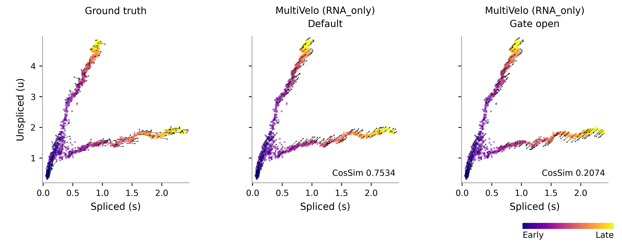
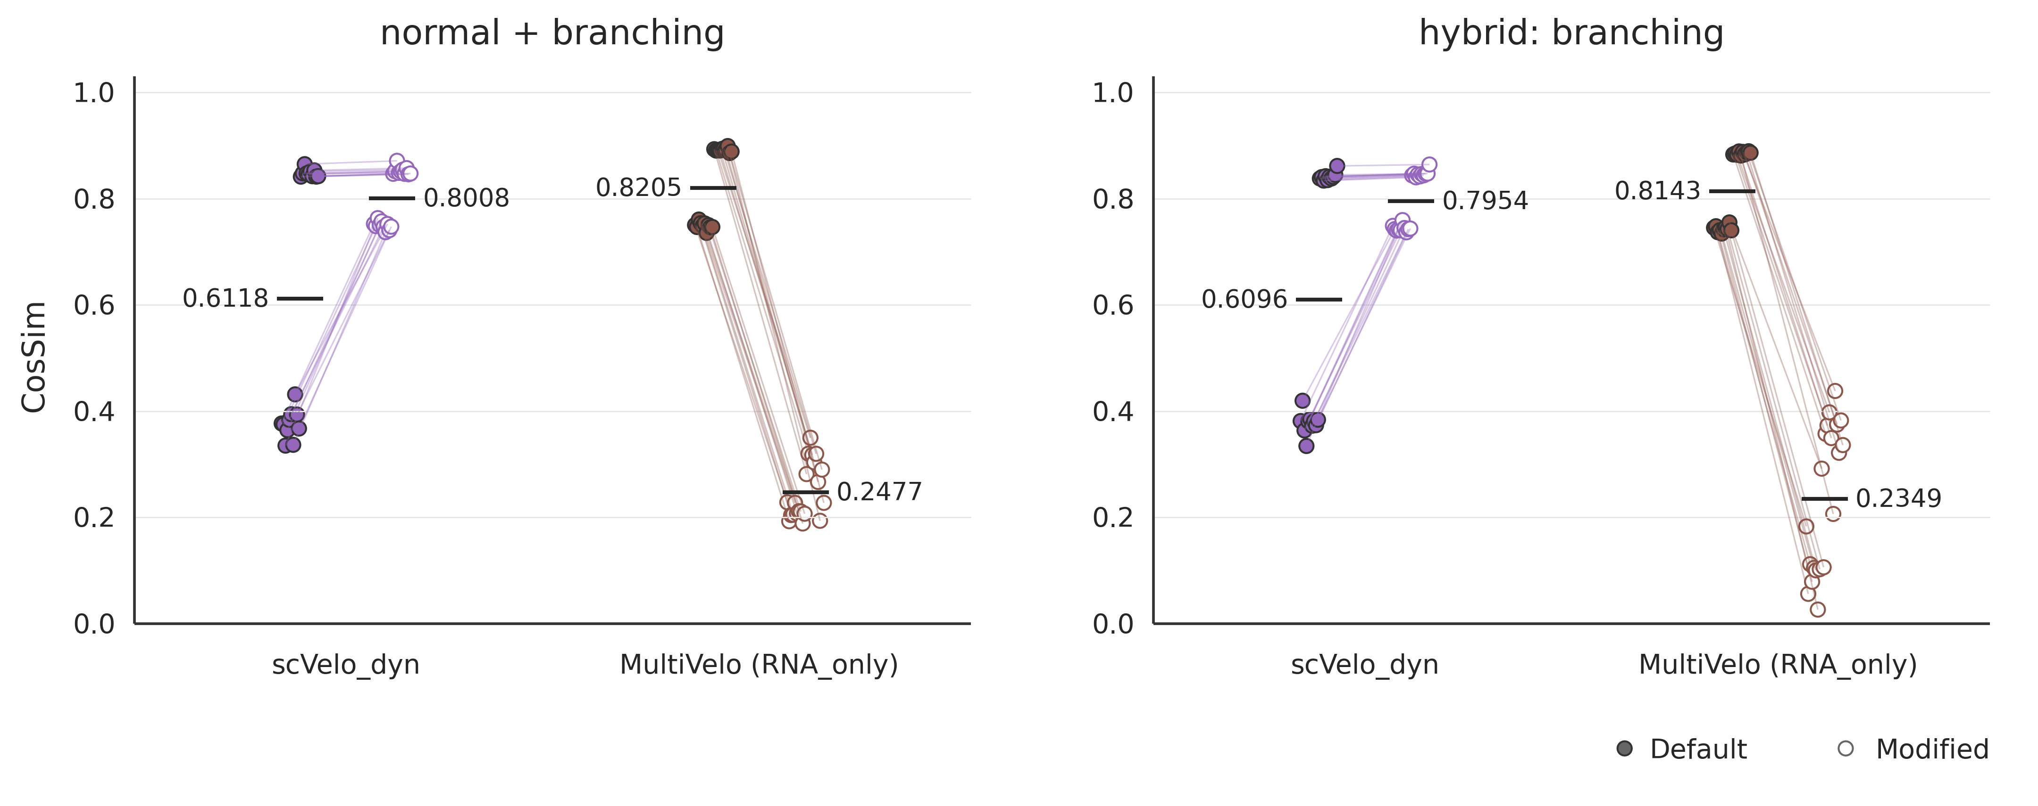
a
b
Notes:
Supplemental Figure 13: TIvelo root-dependent trajectory orientation.
Template: /Users/tomorin/Desktop/pdf_new/supfig12.pptx; original slide canvas and Arial panel labels retained.
A/B: frozen stage-tracing simulation materials. C: separate original-root vs known-early-root paired refits.
D: actual native full-data DPT, not Palantir pseudotime; identical bone-marrow t-SNE coordinates; three paired optimizer seeds.
Simulation root states: /Users/tomorin/Desktop/tivelo_gene_ABC_selected_20260930/assembly_preview_20261001/redesign_v3/ab_assets/state_selection_material.png
Known bins and path-wise DPT: /Users/tomorin/Desktop/tivelo_gene_ABC_selected_20260930/assembly_preview_20261001/redesign_v3/ab_assets/order_comparison_material.png
Paired simulation gene metrics: /Users/tomorin/Desktop/tivelo_gene_ABC_selected_20260930/assembly_preview_20261001/redesign_v3/tivelo_root_control_gene_metrics.png
Bone marrow global DPT and paired cell metrics: /Users/tomorin/Desktop/tivelo_gene_ABC_selected_20260930/assembly_preview_20261001/redesign_v3/bonemarrow_root_control_row.png
Existing plot assets embedded without regenerating data or adding a figure caption.
A/B updated from approved compact material: one unlabeled shared 0--1 colorbar at bottom right. Top row normal + branching; bottom row hybrid. Known bins divided by 9; path-wise DPT unchanged. All a/b/c/d labels are independent native text boxes. C/D source images and placements unchanged.

