Slide 1
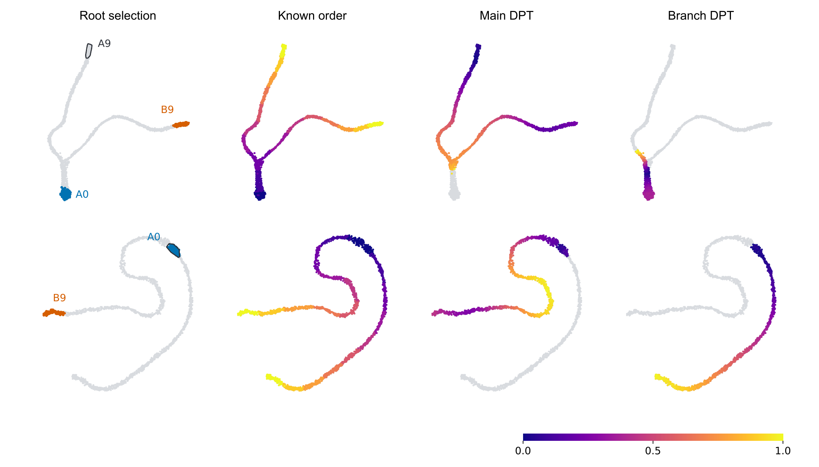

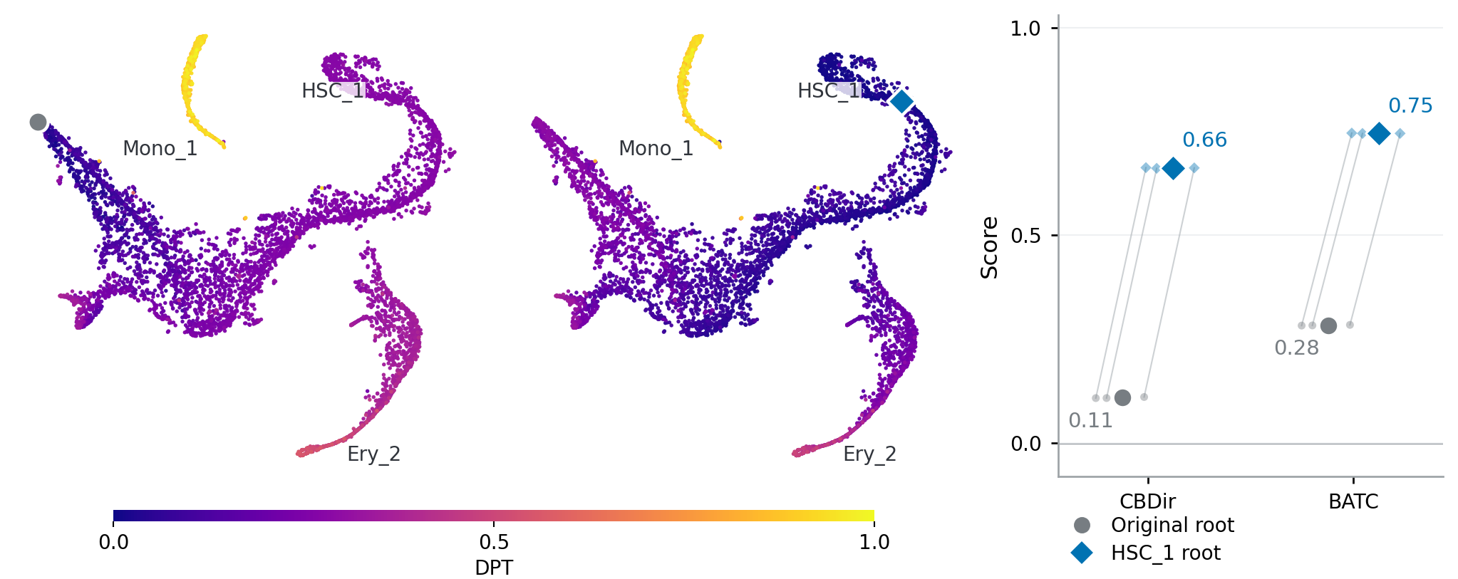
a
b
c
d
Original root (Mono_1)
HSC_1 root
Cell-level scores

